Slide 1
R&T : Accelerators & high field magnets
September 10th, 2021
J. SCHWINDLING on behalf of IN2P3 and IRFU

Slide 2

Accelerators and Magnets (A&M) at IRFU and IN2P3
CNRS / IN2P3 - Institute for Nuclear and Particle Physics
9 laboratories implied in accelerators (main one IJCLab @ Orsay)
9 platforms (including Ganil)
~ 300 FTE
CEA / IRFU - Institute of Research into the Fundamental laws of the Universe
Saclay and Ganil
~ 270 FTE
Using and developing large technological infrastructures
Synergium @ CEA
~ 25000 m²

Slide 3
Other main operating accelerators in France
Light sources:
ESRF at Grenoble (French civil company), since 1994
SOLEIL at Saclay (French civil company), since 2006
Cancer therapy:
« Centre de Protonthérapie » at Orsay
« Centre de Protonthérapie de Normandie » at Caen
« Institut méditérranéen de protonthérapie » at Nice
Currently only occasional contributions of IN2P3 and IRFU to these accelerators → not addressed in this presentation

Slide 4
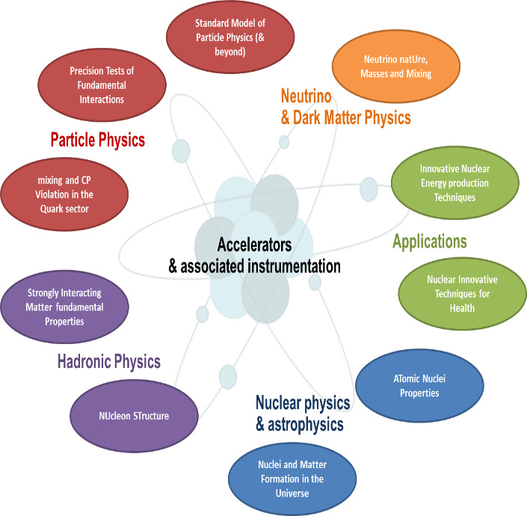
Missions of IN2P3 and IRFU on A&M
Actively participate to the design & construction of particle accelerators and magnets able to address the IN2P3 and IRFU research programs
Strongly develop associated accelerator and magnet R&D
Make accelerator and magnet technologies available to other scientific users and to specific industrial & societal needs (when appropriate)

Slide 5
Main challenges of A&M R&D
Higher beam intensities & luminosities
to be able to track rare events more efficiently, like at ISOL factories for nuclear physics, at high-precision frontier colliders for particle physics or at long baseline facilities for neutrino physics
Higher beam energies and magnetic fields
to address the issues of the next generation high-energy colliders and beyond
Higher efficiency & reliability
to increase the general performance of accelerator-based research infrastructures
Cost reduction
to contribute to financial feasibility
Courtesy F. Zimmermann

Slide 6
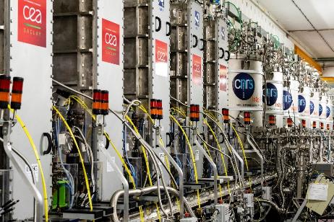
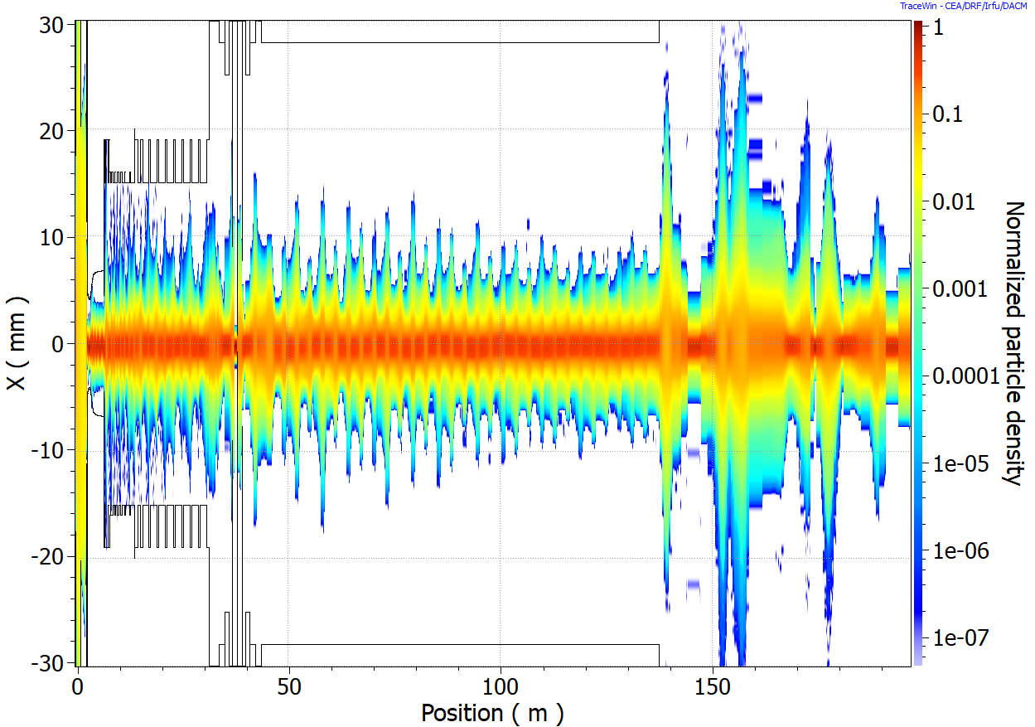
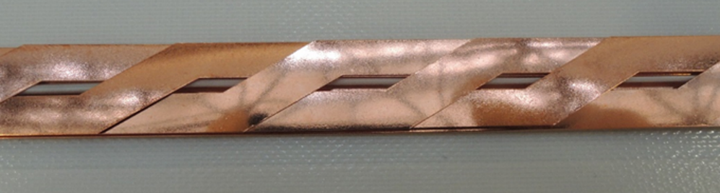
Challenges addressed by…
Operation and upgrade of the national facilities:
For example Spiral2 @ Ganil, Iseult @ Neurospin
Participation to international projects:
Nuclear physics (FAIR)
High Energy Physics (HL-LHC, FCC, ILC / CLIC, μ collider, PIP-2)
Neutron and photon production (XFEL, IFMIF, ESS, SARAF 2, CANS)
ADS (MYRRHA)
Dedicated R&D:
Local, French or European programs
Research topics defined by IN2P3 and IRFU

Slide 7
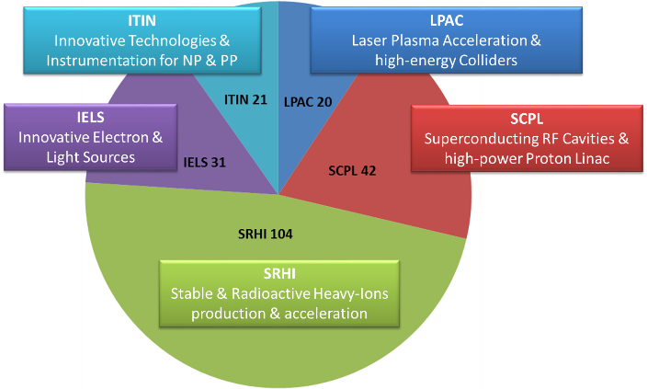
R&D topics
IN2P3
IRFU
SC technologies for high field magnets
Modelisation/ beam dyn. / num. methods
Innovative cryogenic
systems
Superconducting cavities / materials
Understanding high intensity ion beams
RF systems for high power beams
Develop competences on:
Ion production and acceleration
SC cavities and high power p and d linacs
Electron and light sources
High energy colliders
High field magnets
Plasma wakefield acceleration
In the following, some highlights of recent results and ongoing activies

Slide 8
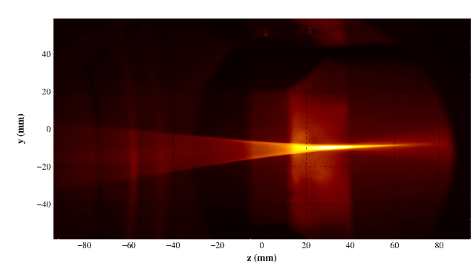
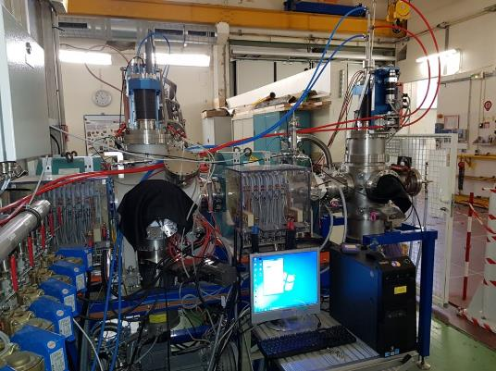
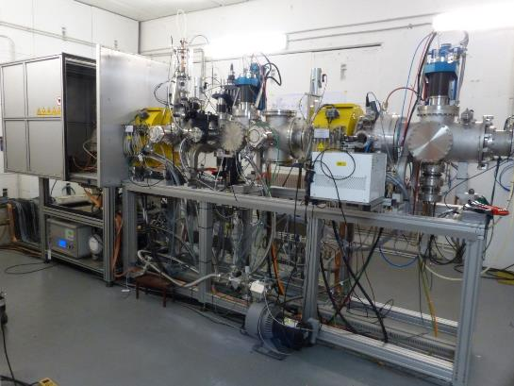
Light ion production
Record current from the IFMIF ECR deuteron source:
140 mA @ 5% duty cycle, emittance < 0.3 π mm.mrad, 90% transmission in RFQ
FAIR source + LEBT and MYRRHA LEBT delivered to GSI and SCK/CEN
120 mA 100 keV D beam @ IFMIF
FAIR source + LEBT @ IRFU
MYRRHA LEBT @ SCK/CEN

Slide 9
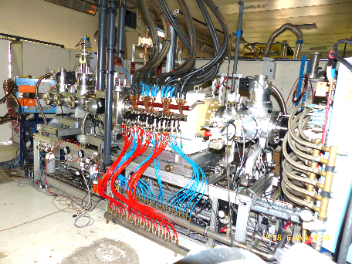
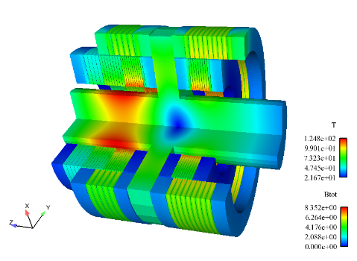
R&D on heavy ion sources
R&D on heavy/ multicharged ions production
Study of ion beam formation from an ECR multicharged ion source (simulation of plasma, extraction and transport, comparisons to experiments)
R&D on charge breeding from 1+ to N+ ions
PHOENIX design with multiple optimizations (materials, confinement, volume)
R&D on ECR source operating at extremely high frequency to pursue extreme ion intensities
Prototype operating at 60 GHz, experimental campaign underway, world record current density of 0.9 A/cm²
To be upgraded with superconducting magnets
ECR charge breeder @ LPSC Grenoble
4.9T
3,5T
6.9T
ions
2.1T ECR
Magnetic configuration of a 60 GHz ion source

Slide 10
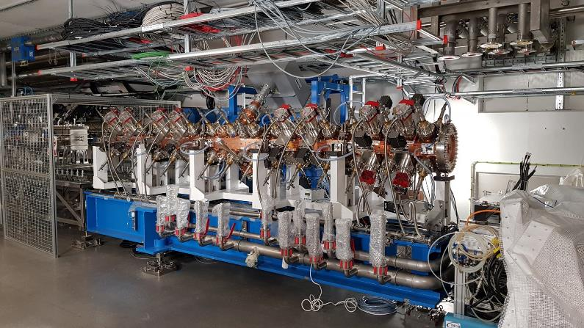
Radio-Frequency Quadrupoles
In the past years, IRFU has designed / built / tuned / conditioned / commissioned several high power RFQs
RFQ | Freq. (MHz) | Cont. / pulsed | Current | Energy | First beam
LINAC4 | 352.2 | Pulsed 7.5% | 80 mA H⁺ | 3 MeV | 2013 at CERN
SPIRAL2 | 88.05 | Continuous | 5 mA H+, D⁺ 1 mA q/A = 1/3 | 0.75 MeV / n | 2015 at Ganil
IPHI | 352.2 | Continuous | 100 mA H⁺ | 3 MeV | 2016 at Saclay
ESS | 352.2 | Pulsed 4% | 70 mA H⁺ | 3.62 MeV | RF cond. July 2021
ESS RFQ conditioned to nominal RF power in July 2021
The ESS RFQ delivered at Lund in August 2019

Slide 11
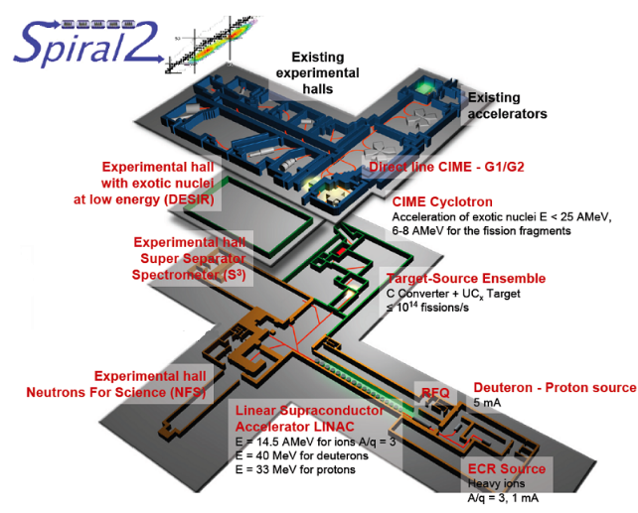
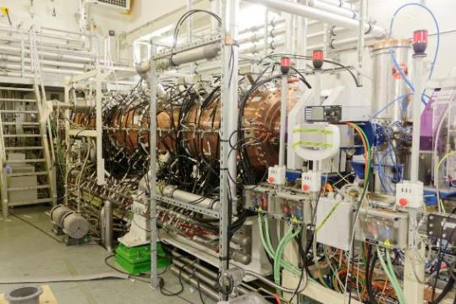
Construction and installation of SPIRAL2 @ GANIL
IN2P3 and IRFU have designed, constructed and installed the SPIRAL2 (A/q = 3 ions) accelerator at GANIL
SPIRAL2 heavy ion source and LEBT
SPIRAL2 Radio-Frequency Quadrupole

Slide 12
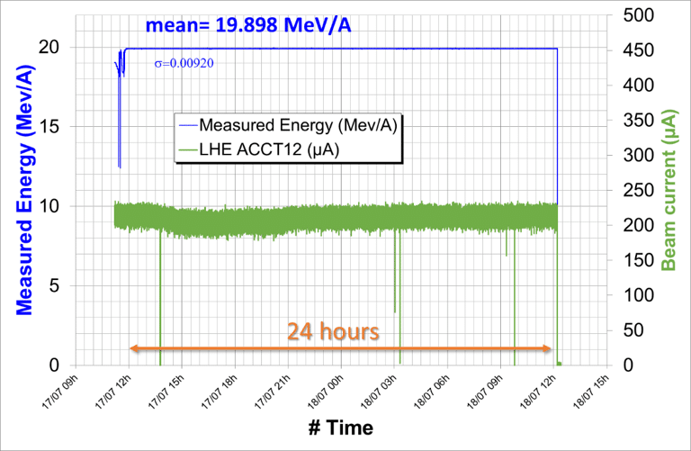
Commissioning of SPIRAL2
Dec. 3rd 2015: First beams accelerated by the RFQ
July 8th, 2019: Authorization by French ASN
Oct 28th 2019: First beam in the Linac
Nov 26th 2019: Proton beam accelerated at 33 MeV
Nov. 18th 2020: 16 kW on beam dump
Jul. 17th 2021: 20 MeV / A for ⁴He ions
RFQ transmission, Dec. 2015
In addition, IN2P3 and IRFU involved in the design (TDR) of a A/q = 7 injector (NEWGAIN EQUIPEX), in particular:
A source for ion production up to Uranium
  Superconducting magnets (3.5 T), two RF frequencies (18 and 28 GHz) heating
  First of its kind in Europe
A new RFQ
Acceleration of ⁴He ions, July 2021

Slide 13
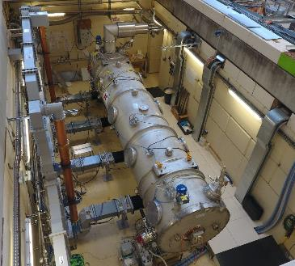
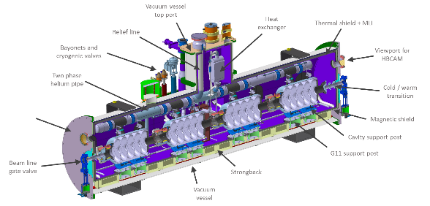
SC cavities and high power proton linacs
Competences and infrastructures for the design, procurement, assembly, test of SC cavities, ancillary equipments (power couplers, tuners, cryogenics…) and cryomodules assembly
Major contributions to several projects:
ESS : 13 spoke cryomodules + cryogenics distribution (IN2P3), 30 medium / high beta CM (IRFU)
SARAF2: IRFU in charge of the delivery of the MEBT + SC LINAC
MYRRHA: Prototype CM + involvement in the series (under discussion)
PIP-II Linac: 7 « SSR2 » (IN2P3), 9 « LB650 » (IRFU) cryomodules
ESS spoke CM assembly at IJCLab
Power test of ESS CM @ IRFU
PIP-II LB650 CM

Slide 14
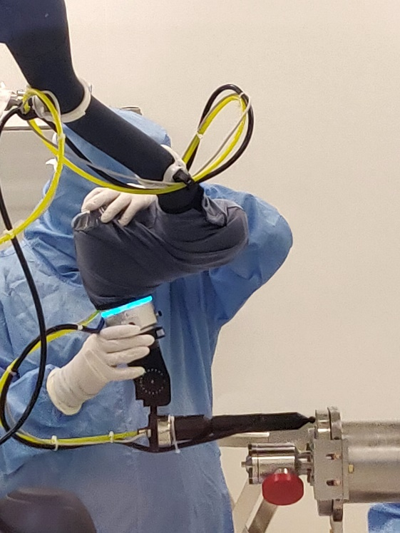
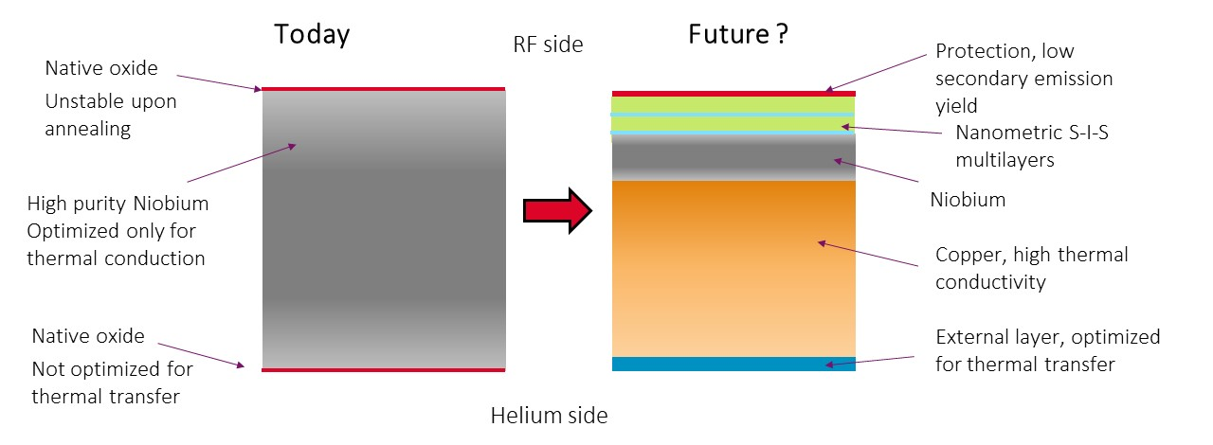
R&D on SC cavities
Objectives: improve gradient and quality factor, reduce construction and operation costs
Improve SC cavities performances:
Improve polishing or electropolishing techniques
Doping and diffusion
Multilayers using Atomic Layer Deposition
Reduce production and operation cost, increase reliability:
Improve cooling (3D metal printing, cryocoolers)
Cobotization
Operator – robot collaboration

Slide 15
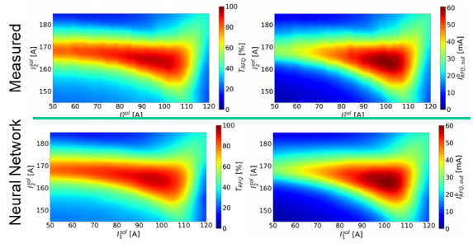
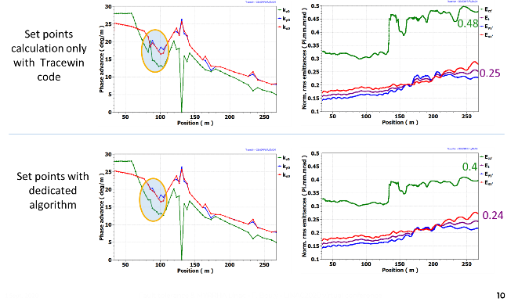
Reliability
Objectives: improvement of accelerator reliability, especially for the MYRRHA ADS project
Study of linac design for optimum beam transport
Artificial intelligence applied to proton injector beam tuning
  Model of with a neural network, trained on experimental and/or simulated data
  Development of on-line beam tuning method (Particle Swarm Optimization)
Algorithms for fast cavity recovery in case of failure (less than 3 s)
  Dedicated algorithms for fault recovery
  Algorithms to be improved with AI
  Cryomodule prototype under construction to test fast retuning
  Study to be coupled with reliability models → estimation of number of expected failures
IPHI injector : measurements and model
Failure compensation of a spoke cavity

Slide 16
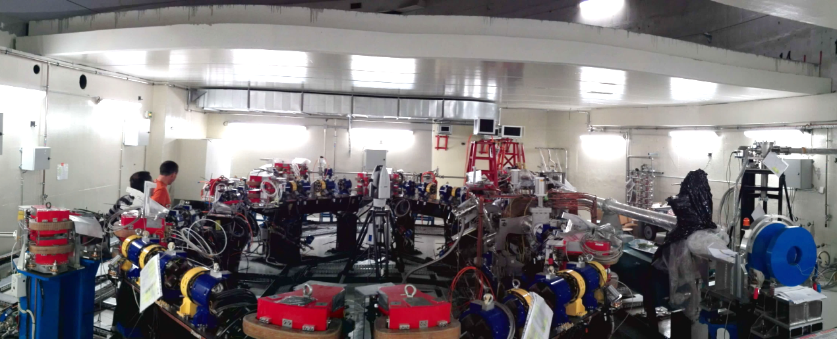

Electrons and light sources
Objectives: develop innovative accelerator concepts for the efficient production of intense electron or photon beams
Compton backscattering:
Thom-X @ IJCLab installed:
Waiting for ASN authorization
First X beams exp. summer 2022
LoI towards a Gamma-Factory PoP @SPS (Sept 2019)

Slide 17
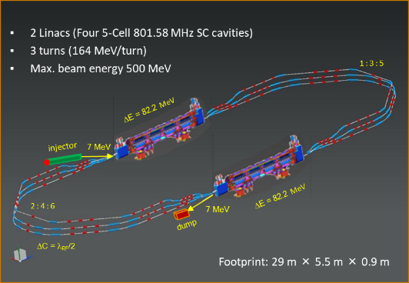






Energy Recovery Linac PERLE
PERLE: A proposed 3 turns 10 MW ERL, based on SRF technology, to serve as testbed for studying, testing and validating a broad range of accelerator phenomena & technical choices for future ERL projects.
Preliminary studies performed → CDR published
Collaboration agreement signed with international partners → work towards a TDR
In agreement with the European Strategy update
National context: could be used as a testbed for electron-Radioactive Ions collision R&D in view of a future facility at GANIL
Target Parameter | Unit | Value
Injection energy | MeV | 7
Electron beam energy | MeV | 500
Normalised Emittance γε_{x,y} | mm mrad | 6
Average beam current | mA | 20
Bunch charge | pC | 500
Bunch length | mm | 3
Bunch spacing | ns | 25
RF frequency | MHz | 801.58
Duty factor |  | CW

Slide 18
High energy colliders
Objectives:
To better understand and master the accelerator and beam physics of high-energy colliders and to identify and develop the most appropriate technologies
To strongly support the development of the CERN colliders complex
Activities:
R&D for a Higgs factory:
  @ SuperKEKB (increase in luminosity)
  R&D on nano-beams for ILC/CLIC @ATF2
  Participation to WG2 of the International Development Team for ILC
  Muon collider studies
Contributions to FCC:
  Lattice optimisation for FCC-hh within EuroCirCol
  Participation to the design study for FCC-ee (booster)
  R&D high intensity positron source
  R&D beam stabilisation @IP (FCC-IS Design Study)
  R&D dynamic vacuum (secondary emission yield, ion stimulated desorption…)

Slide 19
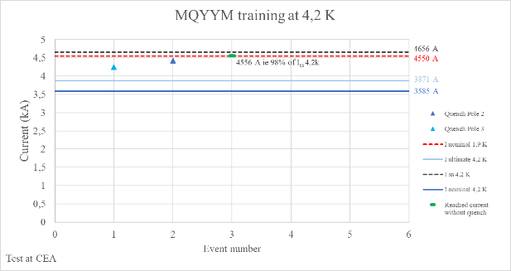
High field magnets
Development of magnets for:
Accelerators (ex. MQYY for HL-LHC, design of dipoles and quadrupoles for FCC)
Particle detectors (ex. MADMAX for MPI)
MRI (ISEULT, nominal field 11.7 T reached in 2019)
R&D objectives:
Magnetic forces and stresses management on large magnets (specially large bores)
Quench detection and magnet protection (development of specific software)
Innovative techniques for magnet cooling to reduce the magnet operation cost (passive systems, closed cooling loops, “Pulsed Heat Pipes” technique)
Higher magnetic field using Nb₃Sn or HTS
Operating Gradient | 120 T/m
Operating current | 4550 A
Bpeak at operation | 6.42 T
MQYY for HL-LHC: nominal field in short model in April 2021
MADMAX (9 T in 1.35 m)

Slide 20
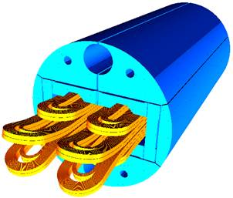
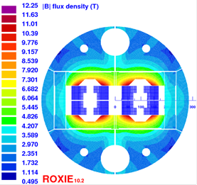
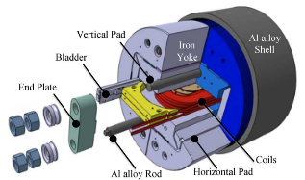
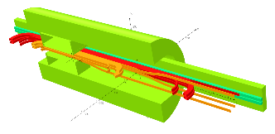
Nb₃Sn Magnets
CERN/CEA COLLABORATION AGREEMENT
R&D activities:
Thermomechanical behaviour of Nb₃Sn conductors during heat treatment
Mechanical tests of Nb₃Sn cables
FCC dipole demonstrator:
SMC 11T (Short Model Coil): Racetrack coils, 11T-dipole cable, 13 T, 15 kA, no aperture
  → Demonstrate fabrication technology
R2D2 (=Research Racetrack Dipole Demonstrator): Racetrack + 2 Graded cables, 11 T, 15 kA, no aperture
  → Demonstrate grading
FCC quadrupole
SMC 11T
R2D2

Slide 21
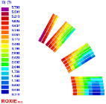
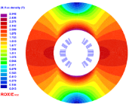
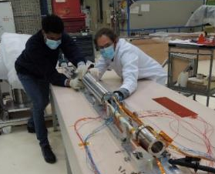
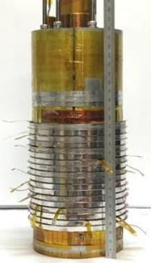
High Temperature Superconductor Magnets
CERN/CEA COLLABO. AGREEMENT – ANR and EU FUNDINGS
R&D activities:
mechanical study of rebco hts metal-as-insulation coils
understand the redistribution of radial and azimuthal currents during transient operation in non-insulated hts coils
study of cryogenic fluid cooling disturbances due to magneto- gravitational volume forces in superconducting magnets
EUCARD 2 – Cos theta HTS dipole
NOUGAT insert:
Insert made of 9 double pancake (ReBCO) (inner diameter of 50 mm) using an MI insulation
32.5 T obtained (14,5 T created by the HTS insert with a background field of 18T @ LNCMI Grenoble)
EUCARD2 dipole
NOUGAT

Slide 22
Plasma Wakefield Acceleration
Challenges: final energy (multi-stage acceleration), low transverse emittance / energy spread, charge, repetition rate, reliability / repeatability, energy efficiency
Activities in France (CEA IRFU + IRAMIS, CNRS IN2P3 + INP, SOLEIL) :
Development of the PIC code
Participation to EuPRAXIA
  Start-to-end optimisation for the CDR
Experiments at UHI 100
Experiments at APOLLON (multi-PW)
  ASN authorization obtained on Sep. 3rd, 2020
  First experiments ongoing
PALLAS (aim = 150 MeV electrons at 10 Hz, setup for second acceleration stage)
LAPLACE (repetition rate kHz)
Ion acceleration experimental program
Optimisation studies for Eupraxia
E bunch example @ APOLLON

Slide 23



European and French fundings
IN2P3 and IRFU involved in ~10 ongoing European programs
+ coordination and strong participation in TIARA (Test Infrastructure and Accelerator Research Area)
A&M activities also supported by French fundings:
Example: PACIFICS (Particle Accelerators Initiative for Future Innovative and Challenging Systems) is aiming at developing the existing French technological infrastructures for accelerator R&D with new high-tech mutualized equipments.
Important funding obtained end 2020: program over 6 years, 9.7 M€
Equipments for fabrication, characterization and tests in 4 accelerator R&D axes:
Axis #1: High-performing magnet science and technology
Axis #2: Innovative materials science for accelerators
Axis #3: Advanced compact laser-plasma accelerators
Axis #4: Next-generation high-performing ion sources

Slide 24
Conclusions
The IN2P3 and IRFU laboratories involved in A&M research cover a large panel of technologies which allow:
to operate the national platforms
to participate strongly to European (and beyond) international projects
Need to keep a high level of R&D on A&M:
by defining and organising the research topics
maintaining and developing the research infrastructures
Importance of the national and European fundings
IN2P3 & IRFU very active in the preparation of the European R&D roadmap (CERN/LDG process), with 13 researchers involved (2+11) in the 5 expert panels

Slide 25
Thank you for your attention

Slide 26
European R&D programs
Ongoing and recent European A&M programs at IN2P3 + IRFU:
+ coordination and strong participation in TIARA (Test Infrastructure and Accelerator Research Area)

Slide 27
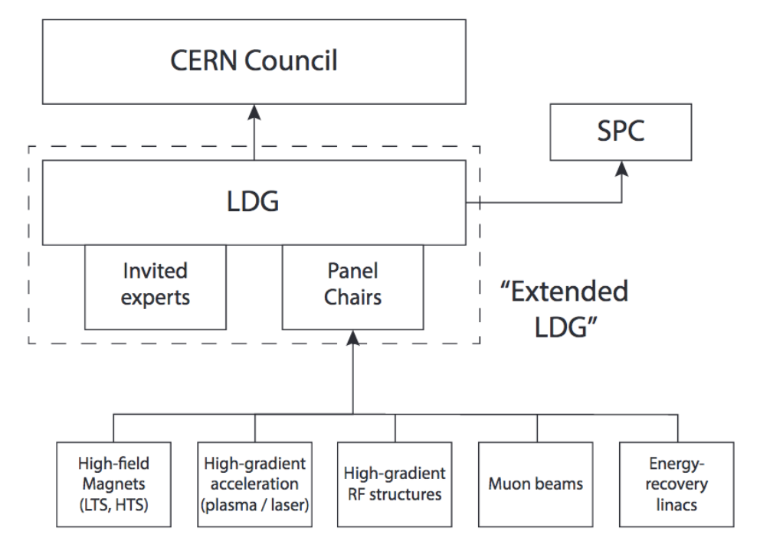
IRFU and IN2P3 in the LDG expert panels
Preparation of the R&D roadmap for the next European Strategy update
IN2P3 and IRFU very active in the 5 expert panels (2 chairs + 11 / 58 participants)

