Slide 2
Beam phase detection
H. Damerau, N. Pittet
Meeting on PS LLRF developments
17/12/2019

Slide 3






Overview
10 MHz cavity controller (11)
RF sources for injection trains, etc.
PSB, kickers Tomoscope, BSM, BI, etc.
10 MHz ret. $Σ\vec{V}$
$$Σ\vec{V}$$
20/40/80 MHz cavity controller (7)
f_{rev}
Freq. program
B, dB/dt, White Rabbit
open loop
To and from10/20/40/80/200 MHz RF cavities
Master clock
f_{rev}
2^{n} f_{rev} clocks and SYNC
20/40/80 MHz ret. $Σ\vec{V}$
$$Σ\vec{V}$$
closed loop
Beam loops
200 MHz cavity controller (6)
$$Σ\vec{V}$$
Synchronous reference dividers
f_{rev,SPS} f_{RF,SPS}
Kickers, ref. processing, RF cavities
WCM and DR PUs
PU proc. ΔR
f_{beam}, DR
PU proc. Δφ
Coupled bunch feedback
Reference dividers
Ref. signal processing
f_{ref}
Finemet cavity
RF
2^{n} f_{rev} clocks and SYNC
Other digital signals

Slide 4
Introduction
Beam phase measurement
  Part of beam phase loop
  Measure (simulated) beam phase versus phase
  of (simulated) cavity returns at configurable harmonic(s)
  Multiple inputs
    Injection oscillator: • Beam replacement before injection
    Beam: • Sensitive pick-ups
    • Wall current monitor
    • 80 MHz (2nd Nyquist zone) receiver
    Cavity return sums: • 10 MHz, 20 MHz, 40 MHz, 80 MHz
    • Single 10 MHz cavity
    • Finemet cavity
  20 RF signals in total
Digital down-conversion to baseband I/Q
Detailed synoptic (6 modules VXS + mezzanines): link

Slide 5
Introduction
Double-harmonic receiver with pre-selection
Data concentrator/selector matrix
Phase detection as part of beam loops
Double harmonic
receiver
Data concentrator/
selector matrix
Phase detection as part of
beam loops
RF1 in
Double harmonic
receiver
Data concentrator/
selector matrix
RF2 in
…
…
RFn in

Slide 6
Phase loop: double phase detection
Combined I/Q
streams: beam
Selector
matrix
Δφ
h₁ (GSHL1)
Selector
matrix
Timings
Functions
Smooth
switch
Phase
loop
amp.
To f_{rev} correction sum
Selector
matrix
Δφ
h₂ (GSHL2)
Combined I/Q
streams: cavity
Selector
matrix
Set ‘present’ and ‘next’ configuration of signals
Smooth switch after only after phase detection

Slide 7
Introduction
Choice of hardware platform
  VXS-based plat-form developed for PSB, LEIR, ELENA, …
  Backplane: only clock and synchronization distribution
  Data exchange by Gigabit links (SFP)
    1 MHz update rate
    32 bit each for I and Q
    2 harmonic, 2 signals
    Net data rate: 256 Mbit/s

Slide 8
Beam synchronous double-harmonic receiver
Convert RF signals to baseband I/Q data
  Beam synchronous down-conversion
  Two harmonics simultaneously: previous/present and next
Configuration: VXS carrier (PSB), FMC-ADC (PSB), FMC-SFP (COTS)
In: 4 RF signals
Out: 2 data streams containing baseband information of 2 signals at
2 harmonics, or 4 signals
FMC
ADC
VXS Carrier
(PSB)
Data stream selection matrix
Internal functions:
HPL1/2, PLOFFSET1/2
FMC
SFP
RF in 1
Baseband I/Q,
h₁ and h₂, 2 signals
RF in 2
RF in 3
Baseband I/Q,
h₁ and h₂, 2 signals
RF in 4

Slide 9
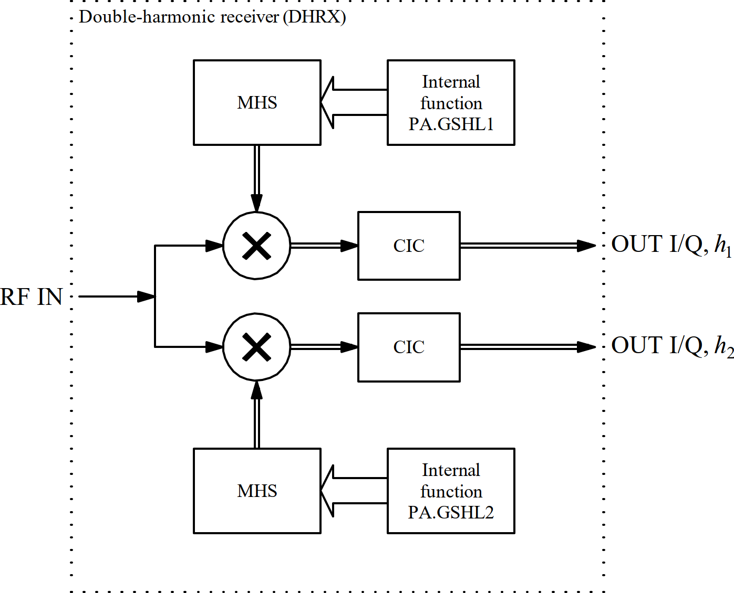
Double-harmonic receiver block
Conversion of direct sampled RF to I/Q baseband

Slide 10
Double-harmonic receiver block
Synchronous receiver:
  VXS motherboard with ADC and SFP mezzanines
2 baseband I/Q data outputs: Operational and MD beam ctr.
(2 × 2 harmonics × 32 bit I/Q)
4 double-harmonic receivers: 2 × 4 I/Q streams
(per output)
Preselection matrix to route I/Q signals from receivers to outputs:
  8 I/Q streams in → 4 I/Q streams out
  Dynamic selection of signals during cycle
    Control function per output data stream
  Static selection
    Fixed registers for configuration
  Simple selection, no smooth switching

Slide 11
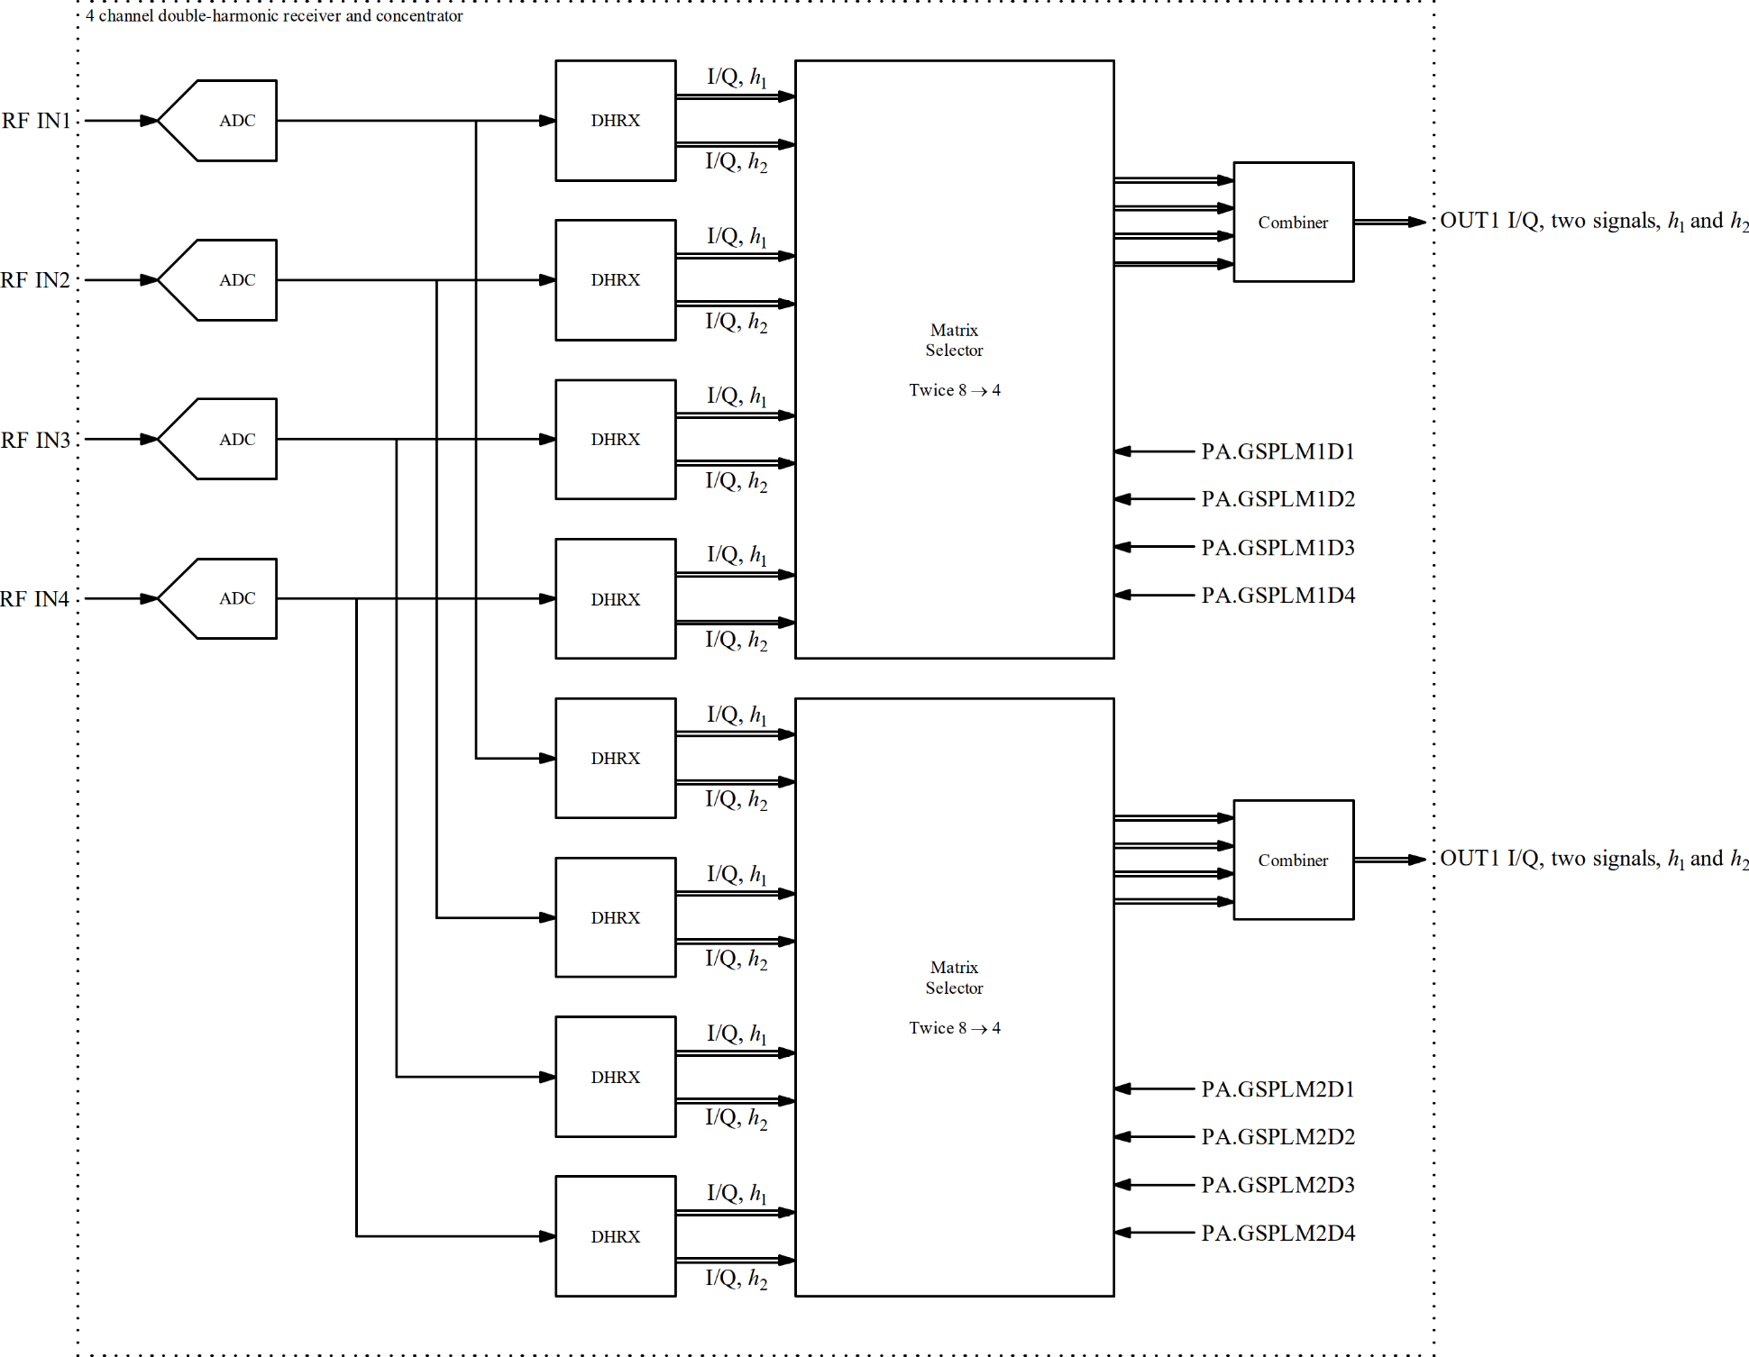
Double-harmonic receiver block
256 MBit/s
Matrix selection
functions
256 MBit/s
Matrix selection
functions

Slide 12
Beam control – non-synchronous concentration
Data concentration of baseband I/Q data streams
  Reduce number of physical SFP connections
  Pack up to 4 baseband I/Q streams into single physical connection (SFP)
Configuration: VXS carrier (PSB), 2 × FMC-SFP (COTS)
Detailed synoptic on DFS (3 modules): link
Baseband I/Q,
4 streams
FMC
SFP
VXS Carrier
(PSB)
Data stream selection
Concentration of data streams
Internal functions:
HPL1/2
FMC
SFP
Baseband I/Q, up to 4 streams
Baseband I/Q, 4 streams
Baseband I/Q, 4 streams
Baseband I/Q, 4 streams
Baseband I/Q, 4 streams
Baseband I/Q, 4 streams
Baseband I/Q, 4 streams

Slide 13
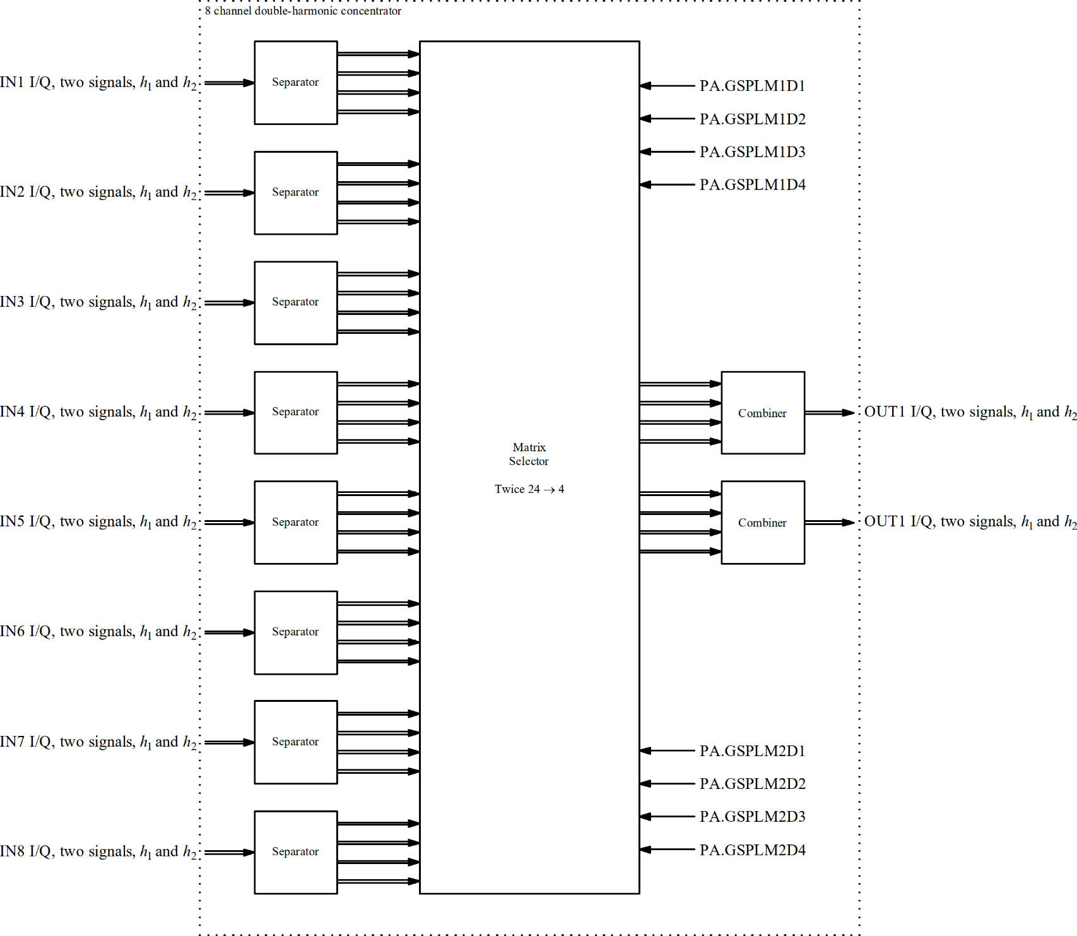
Beam control – non-synchronous concentration
Matrix selection
functions
256 MBit/s
256 MBit/s
Matrix selection
functions

Slide 14
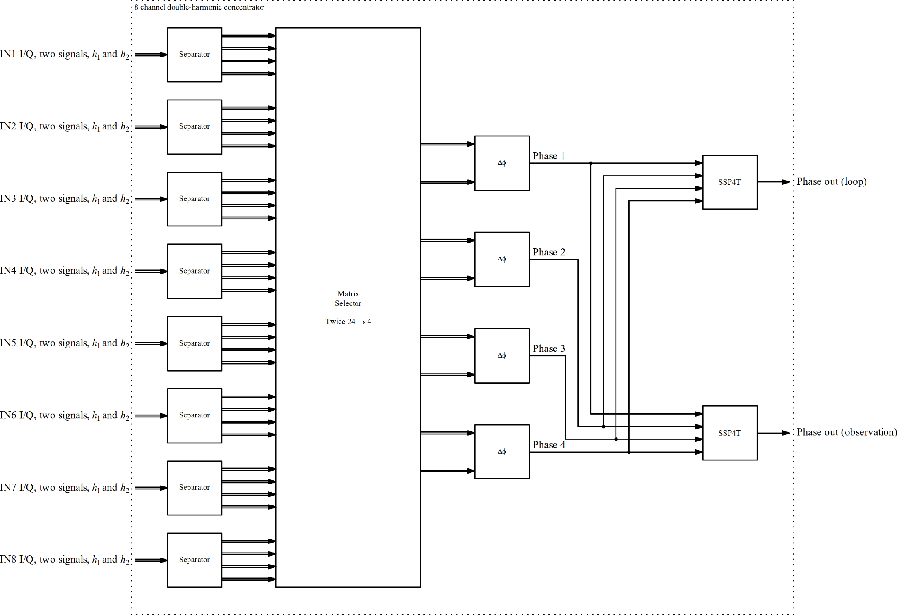
Beam control – non-synchronous concentration

Slide 15
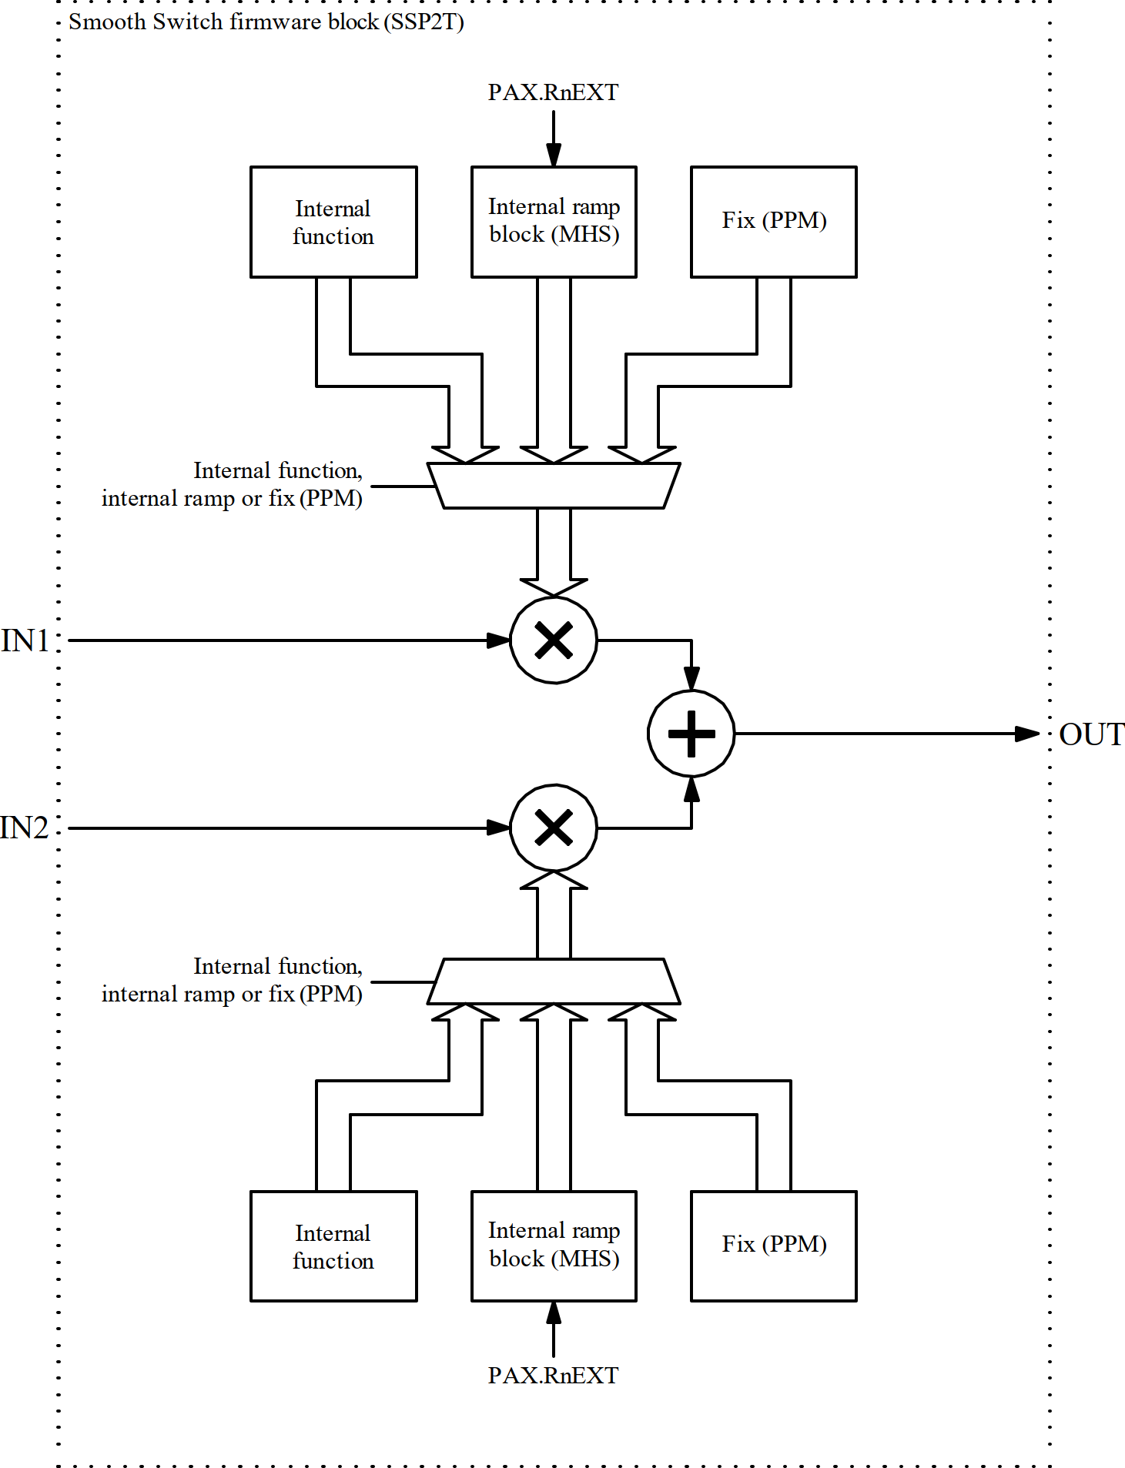
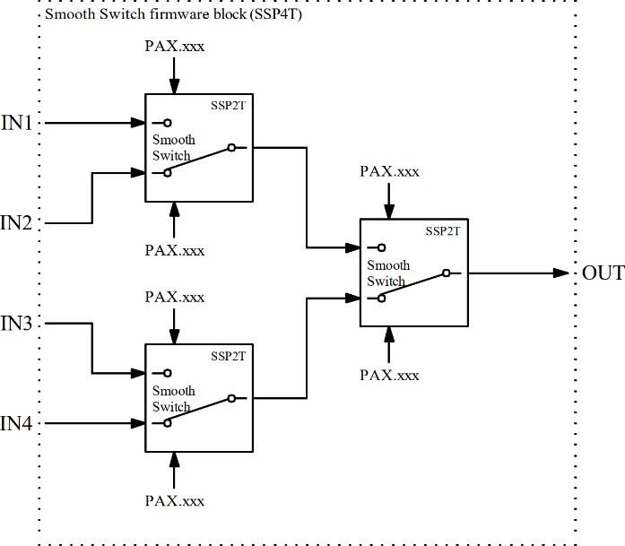
Smooth switch
Control through
  Internal function
  Internal ramp block
  Register (PPM)
Control configuration static per cycle
Potential issues
  Fast (inj.) and slow switching (manipulations)
  Switch between all inputs?
4 input configuration?

Slide 16
Phase loop switching sequence
LHC-type multi-bunch beam (triple splitting or BCMS)
Signal 1 | Signal 2
Injection synthesizer, h₁ = h_{inj} | Cavity return 10 MHz, h₁ = h_{inj} | Beam replaced by injection synthesizer before 1st injection Constant harmonic
Beam, h₁ = h_{inj} | Cavity return 10 MHz, h₁ = h_{inj} | Fast switch-over, timing linked to injection
Beam, h₂ | Cavity return 10 MHz, h₂ | RF manipulation
… | … | …
Beam, h = 21 | Cavity return 10 MHz, h = 21 | RF manipulation
Beam, h = 42 | Cavity return 20 MHz, h = 42 | 1st splitting at flat-top
Beam, h = 84 | Cavity return 20 MHz, h = 84 | 2nd splitting at flat-top

Slide 17
Phase loop switching sequence
Lead ion beam for LHC (example of 100 ns)
Signal 1 | Signal 2
Injection synthesizer, h₁ = h_{inj} | Cavity return 10 MHz, h₁ = h_{inj} | Beam replaced by injection synthesizer before 1st injection Constant harmonic
Beam, h₁ = 16 | Cavity return 10 MHz, h₁ = 16 | Fast switch-over, timing linked to injection
Beam, h₂ | Cavity return 10 MHz, h₂ | RF manipulation
… | … | …
Beam, h = 21 | Cavity return 10 MHz, h = 21 | RF manipulation
Beam, h = 169 | Cavity return 80 MHz, h = 169 | Re-bucketing, h = 21 → 169 Separate beam receiver channel, 80 MHz (2nd Nyquist zone)

Slide 18
Summary and outlook
Multi-input, multi-harmonic beam phase detection
Main firmware blocks
  Double-harmonic receiver (DHRX)
  Dynamic matrix, set by functions (IQFM)
  Smooth switch (SSP4T)
  Data separator and combiner for Gigabit links
Next steps
Finalize layout and overview diagram
Integrate ejection synchronization loops
Define functions and timings
Define firmware framework

Slide 19
Spare slides

Slide 20
Beam control – beam loops
Beam loops calculation
  To be implemented in single VXS carrier board
  I/Q baseband streams of all relevant signals
  Generates digital closed-loop revolution frequency for distribution
f_{rev}, open loop
from frequency program
From beam phase loop amplifier
Σ
±Δf
Σ
From radial loop amplifier
From coarse and fine synchronization
loop amplifiers
f_{rev}, closed loop
to distribution

