Slide 1
PS 200 MHz cavity controller
Matteo P.

Slide 2
PS 200MHz Cavity Controller
Additional regulator

Slide 3
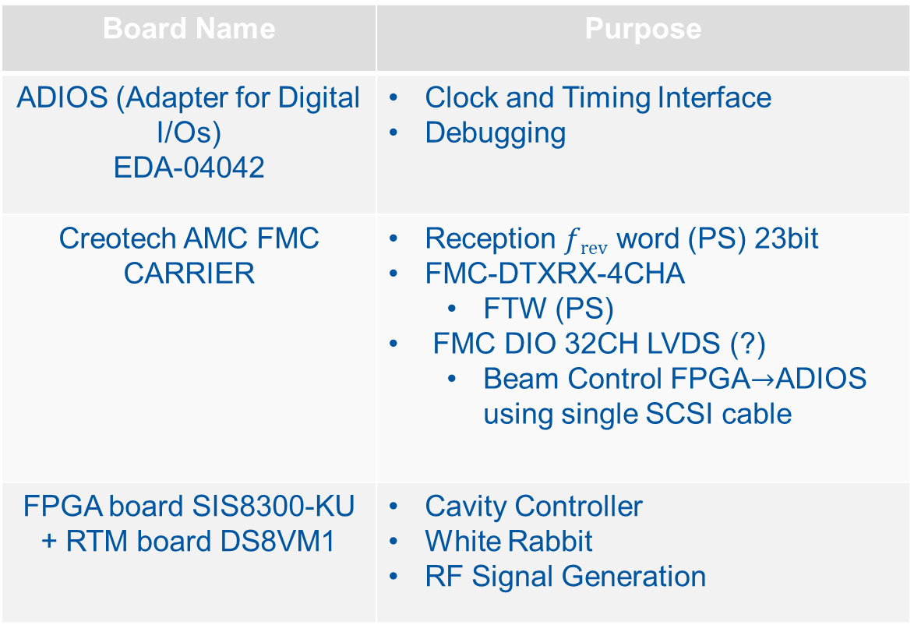
List of Hardware(1/2)
Board Name | Purpose
ADIOS (Adapter for Digital I/Os) EDA-04042 | Clock and Timing Interface Debugging
Creotech AMC FMC CARRIER | Reception $frev$ word (PS) 23bit FMC-DTXRX-4CHA FTW (PS) FMC DIO 32CH LVDS (?) Beam Control FPGA$→$ADIOS using single SCSI cable
FPGA board SIS8300-KU + RTM board DS8VM1 | Cavity Controller White Rabbit RF Signal Generation

Slide 4
List of Hardware(2/2)
Board Name | Purpose
FTCI module EDA-04141 | Interlock veto interface Provide Interlock signal to RTM board DS8VM1
eRTM White Rabbit receiver | Low jitter clock source
RPM NAT-PM-AC600D | Extra power supply for eRTM?
NAT-MCH-PHYS80 NAT-MCH-RTM-E3 NAMC-PMC | Crate Handling Clock gen PCI Mezzanine Card(?)
https://edms.cern.ch/project/CERN-0000192693

Slide 5
ADIOS Diagram
https://edms.cern.ch/document/2061203/0.1

