Slide 1
Neutron Beam Run and LANL
Christopher Mauger for the Neutron Team
University of Pennsylvania
22 January 2020
Also see Wilf’s and Guang’s talks:
https://indico.cern.ch/event/878487/
from which some slides are stolen
Thank you to all who participated both in person and remotely.
Strong participation from all three continents!

Slide 2
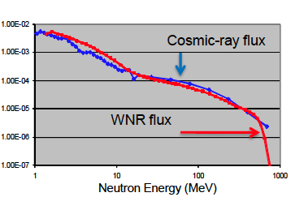
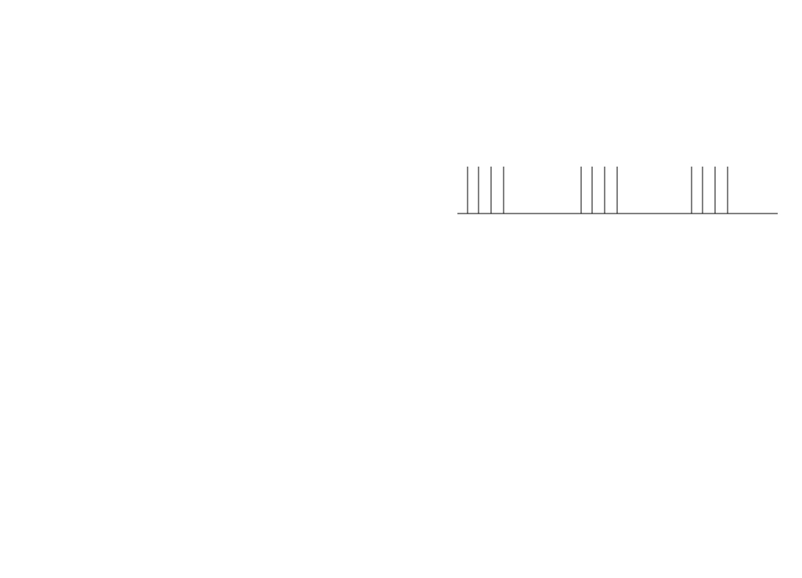
Neutron Beam at LANL
High flux neutron beam, broad energy
spectrum similar to high altitude
cosmic-ray spectrum
Neutrons up to energy of 800 MeV produced by protons impinging on a bare (un-moderated) tungsten target
Time structure of the beam
sub-nanosecond proton bunches 1.8 microseconds apart within a 625 μs long macro pulse
Repetition rate: 100 Hz
Measurements as a function of neutron kinetic energy can be made via time-of-flight techniques.
8.3 ms
625 μs
1.8 μs

Slide 3
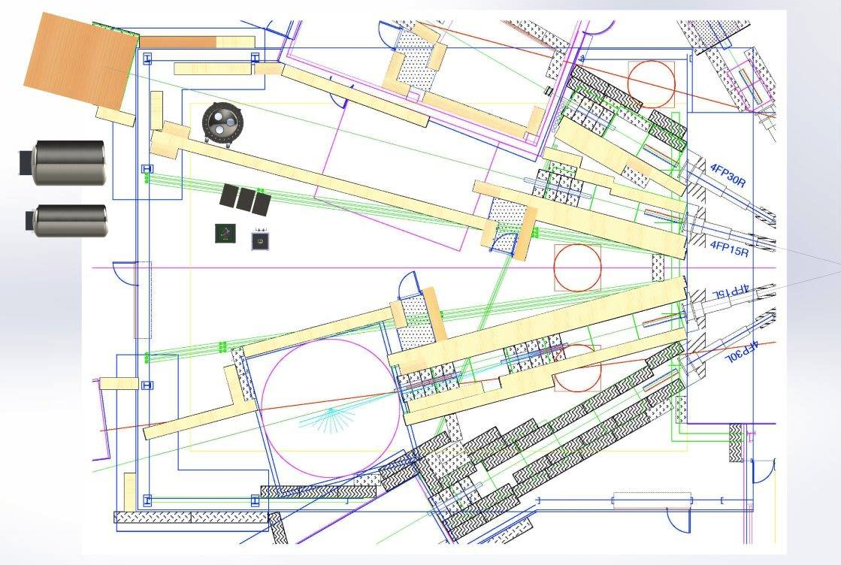
800 MeV protons impinge on an unmoderated tungsten target. Neutrons, protons, pions and gammas produced.
Charged particles swept by a magnet.
Photons and neutrons emerge through beamlines penetrating shielding
20 m location in Flight Path 15R
90 m location in Flight Path 15L
(external hall to left of diagram )
Target upstream of this diagram
Inductive coil upstream of target provides trigger signal for our detectors

Slide 4
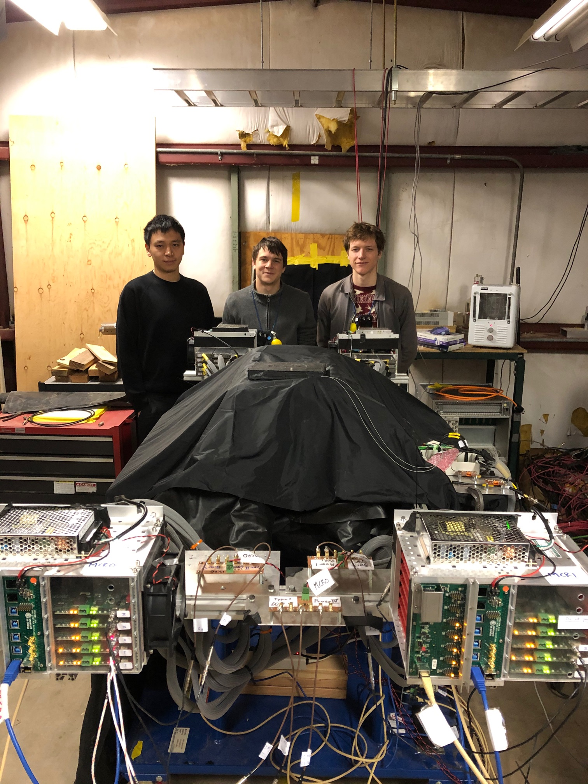
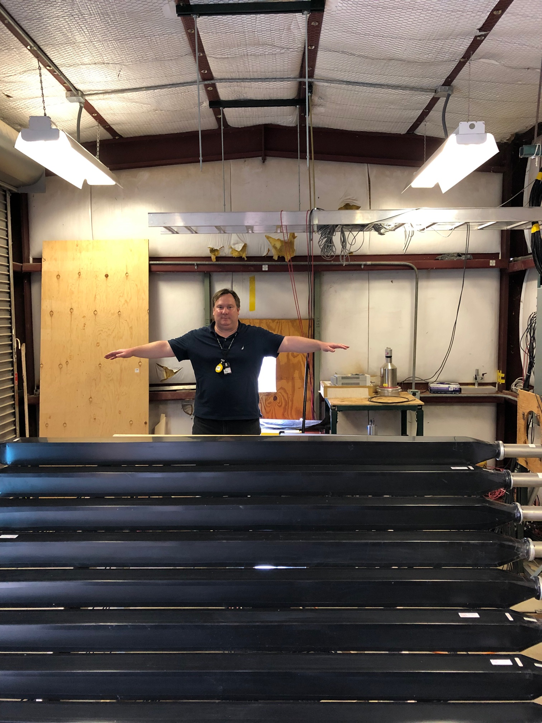
15L 90m location looking downstream
left: before, right: SFGD prototype

Slide 5
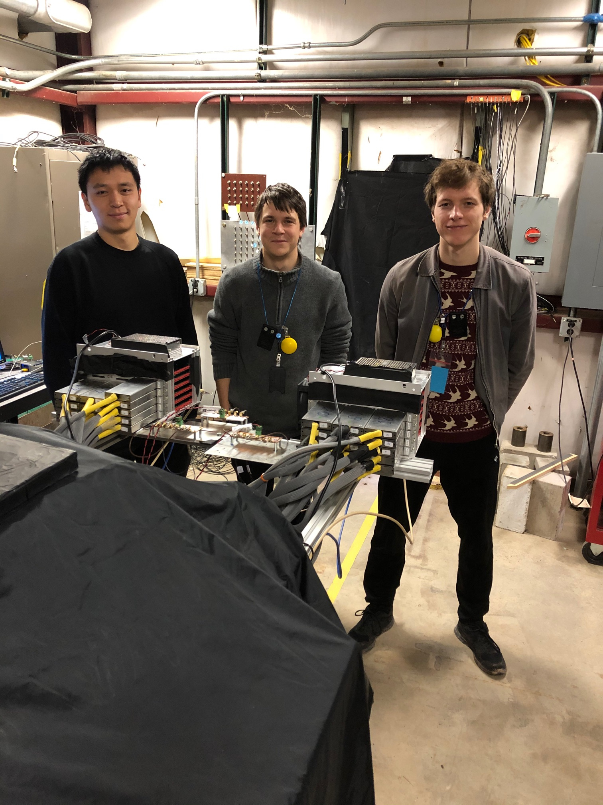
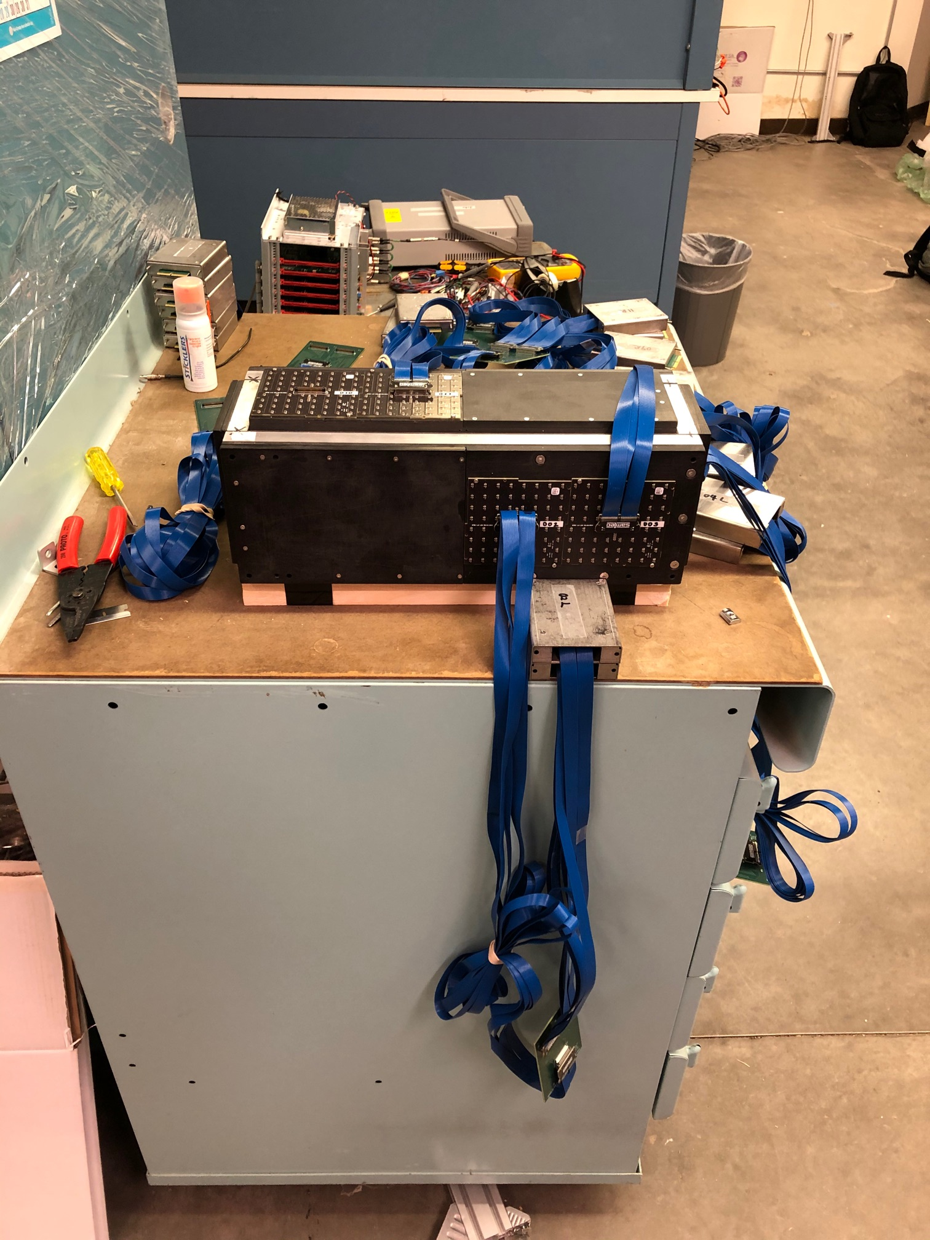
Left: looking upstream SFGD prototype
Right: US-Japan prototype in assembly hall

Slide 6
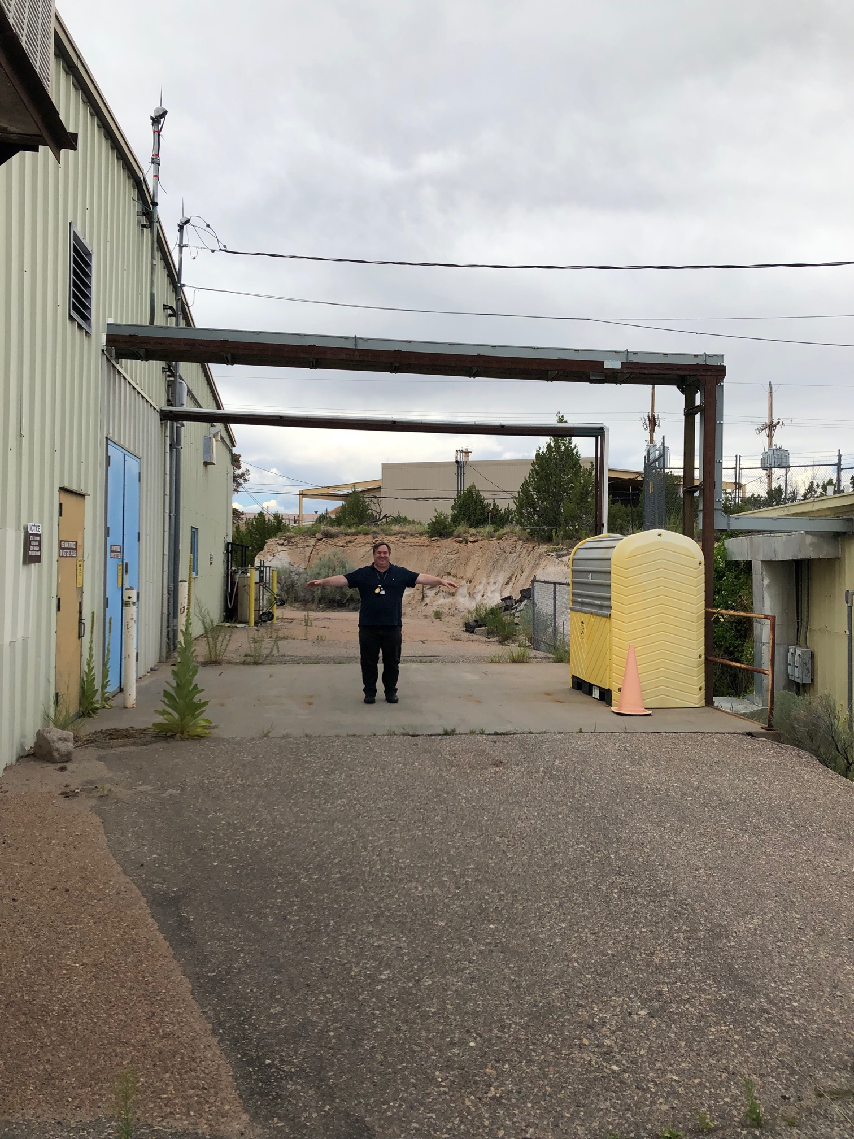
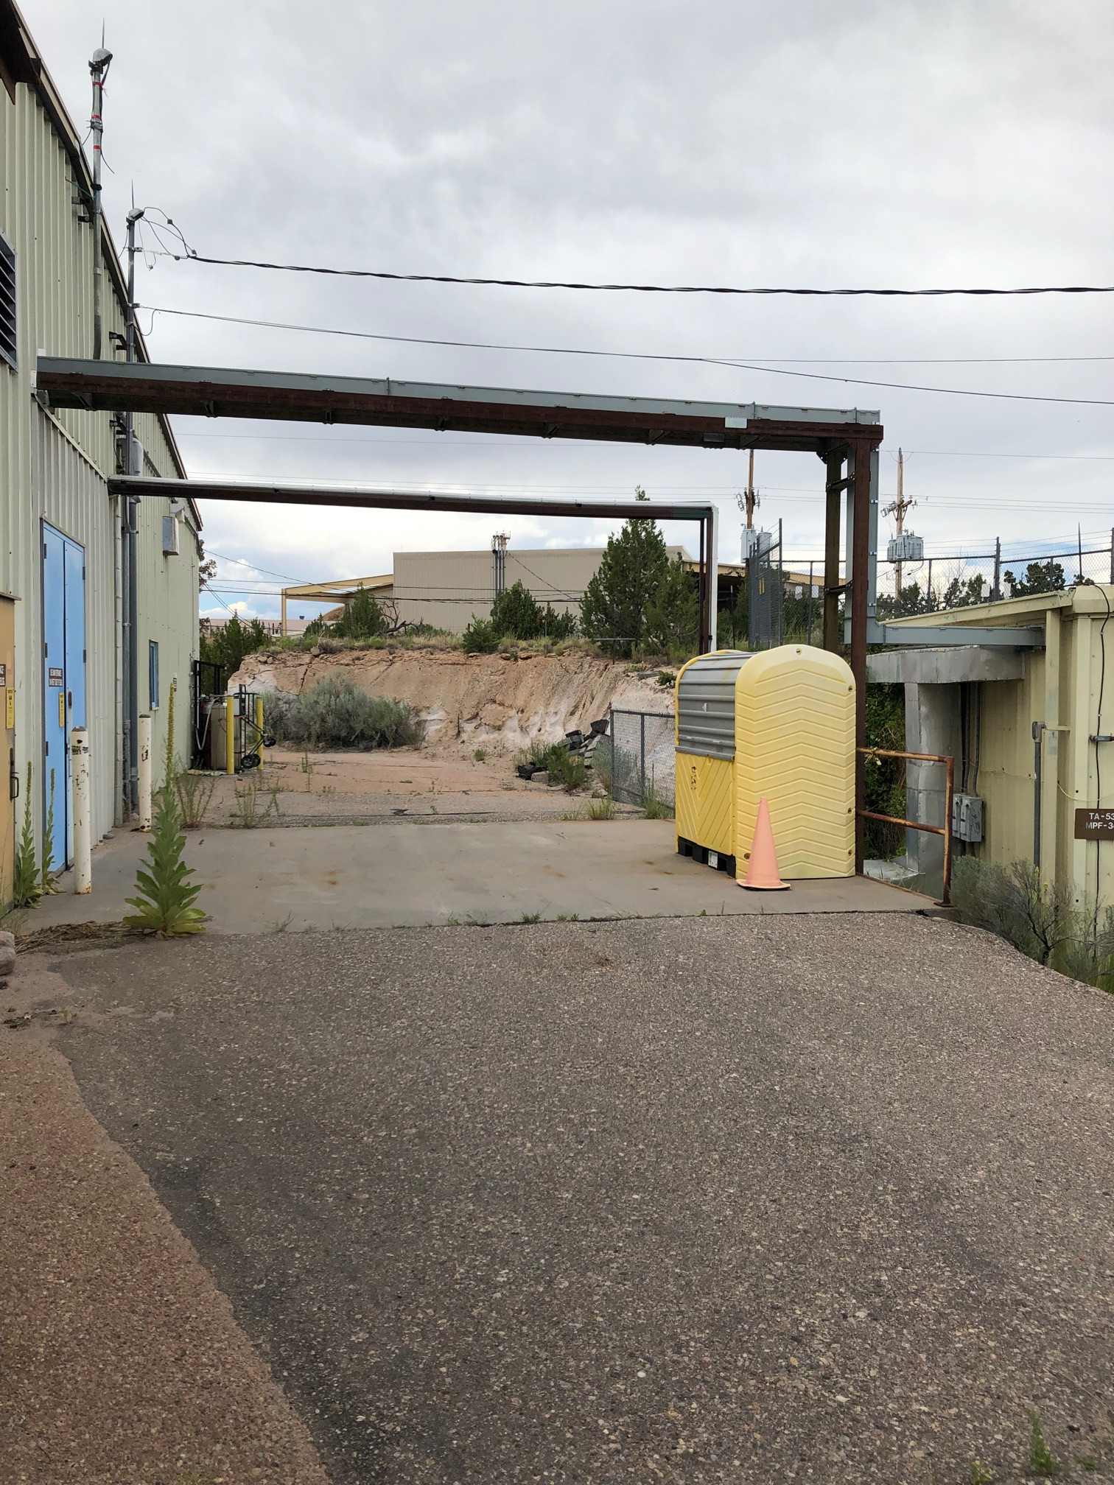
Span between beamline building (right) and lab (left)
Our DAQ cables pass across
the space between the
beamline (no access when
beam is on) and the assembly
hall (access OK)

Slide 7
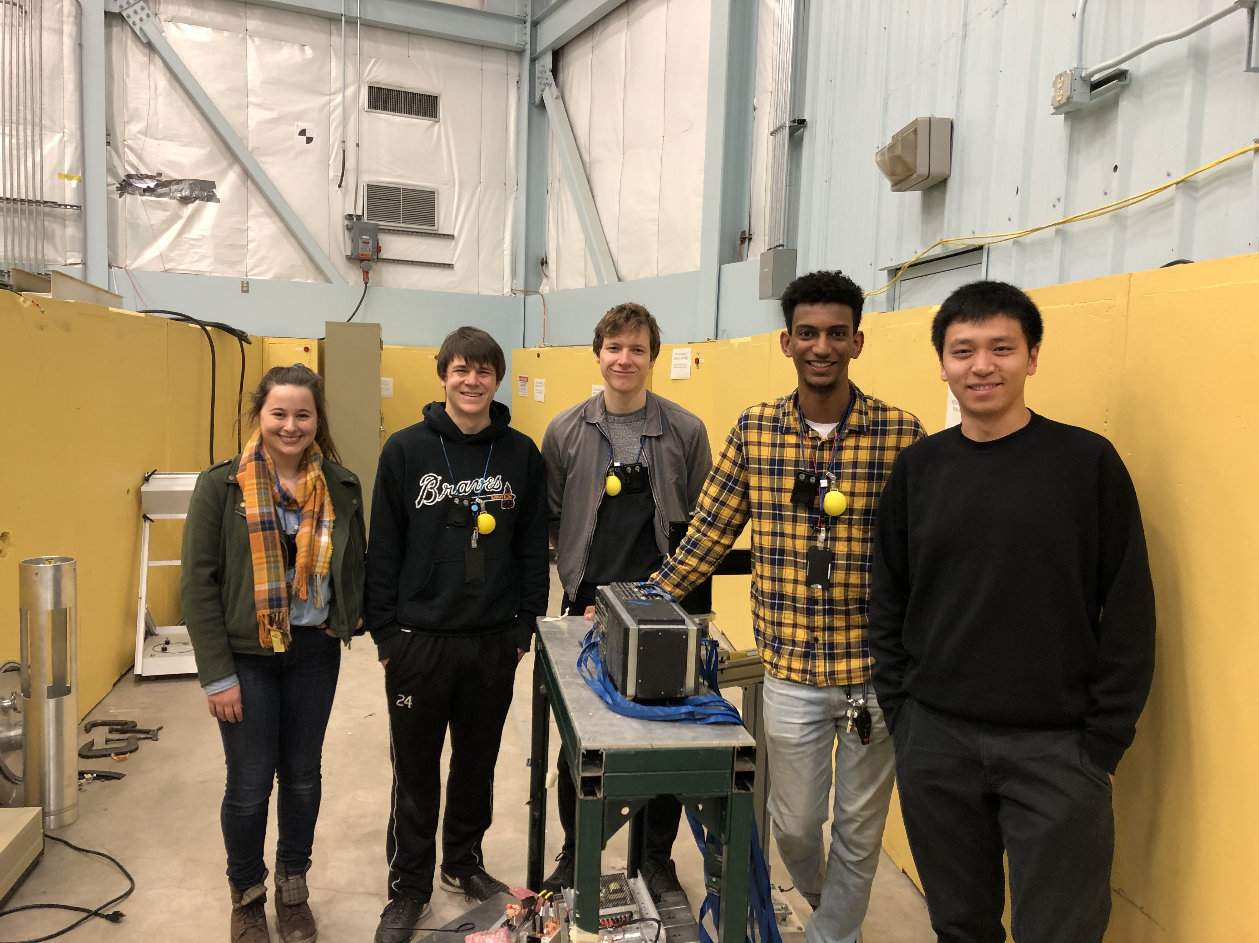
US-Japan Prototype in the 15R flight path – 20m location (looking downstream)
Successfully deployed on
the last day of the run

Slide 8
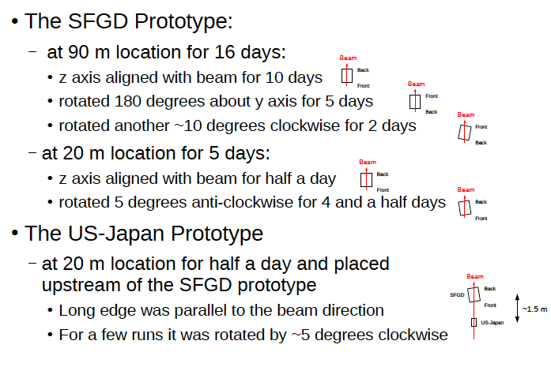
Detector Configurations
From Shorrock

Slide 9
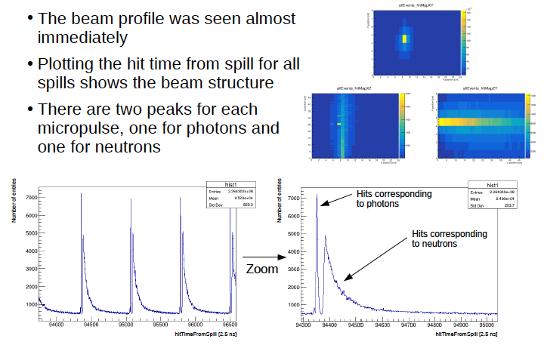
SFGD Prototype at 90m
From Shorrock

Slide 10
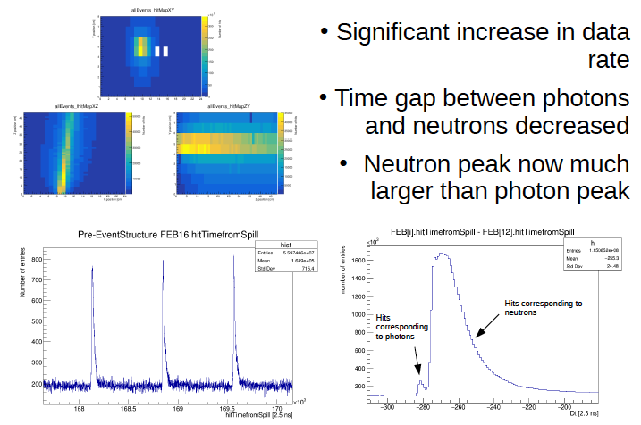
SFGD Prototype at 20m
From Shorrock

Slide 11
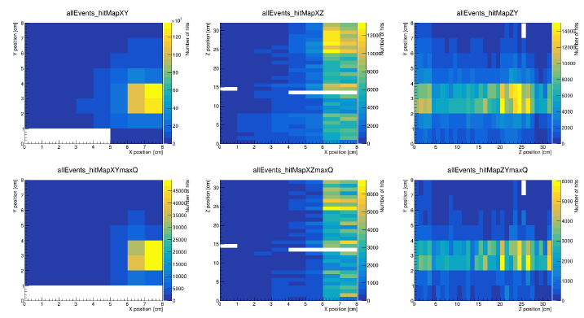
US-Japan Prototype at 20m
From Yang

Slide 12
Current Status, Near-term Issues
Analysis underway – discussion tomorrow
basic detector understanding
physics: total and partial cross sections as a function of neutron energy
All equipment currently at LANL
Need a decision soon on the following:
Do we want to run either of our detectors during the upcoming run cycle?
If yes, proposal is due on 2 March, we must start planning soon
If no, we should ship the detectors to appropriate locations

Slide 13
Do we want to run during the next beam cycle (June-Dec, 2020)
Running means one or two weeks of data
Proposals due on 2 March (call is out) – ask for one
Is there something interesting we could learn with more data?
Pro 1: Collecting more data is always good
Pro 2: Could try advanced configurations
Pro 3: Detectors already at LANL – small effort compared with last year, could pursue improvements useful for SFGD that lower personnel requirements
Con 1: No resources currently to do this
Con 2: Personnel are busy with analysis of current data and preparation/development of the SFGD
Response to Con 2, physicists always oversubscribe themselves – why should 2020 be any different?
What do we need to know to make this decision?
data analysis?
do we know enough already (that we do not want to make the effort)?

