Slide 1
EOCHL Simulation and Implementation
Vladimir Zivkovic, Jan David Schipper
National Institute for Subatomic Physics (Nikhef), Amsterdam, The Netherlands

Slide 2
Simulation Conditions
Simulator: QuestaSim 6.5b
EOCHL Physical description
Timing EOCHL sdf file typical used.
DOB Physical description
Timing DOB.pt.tt.sdf file used.

Slide 3
Trigger System
Trigger system inputs are:
1) L1_Trig_In, pulse signal,
2) Trigger_Count, 4 bit number.
The logic generates for every L1_Trig_In pulse a Trigger_Count number of output pulses.
The L1Trig_Out pulses are ‘1’ during the low phase of the clock.
Every L1Trig_Out pulse increases the L1In output.

Slide 4
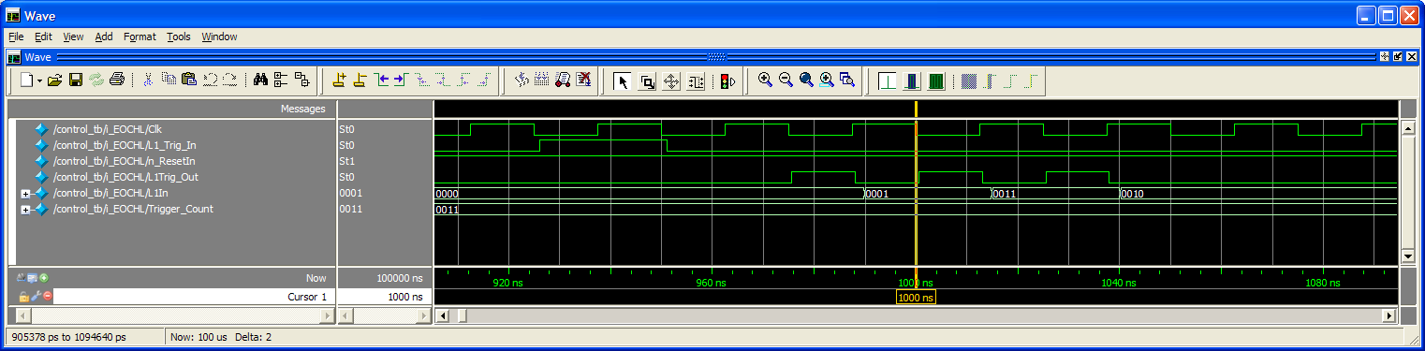
Simulation Result
After a L1_Trig_In pulse, in this case 3 pulses are generated
at the L1Trig_Out output during the low phase of the Clock.

Slide 5
Column Read Out
Read Out sequence:
1) L1Trig_Out pulse is registered.
2) L1Req value offered to the Columns.
3) Wait for and detect Token signal.
4) If Token is ‘1’ send Read signal
5) Wait for and store Data, and detect Token again.
6) If Token is ‘0’ end of event detected, else go to 4.
7) Increase L1Req and go to point 1.

Slide 6
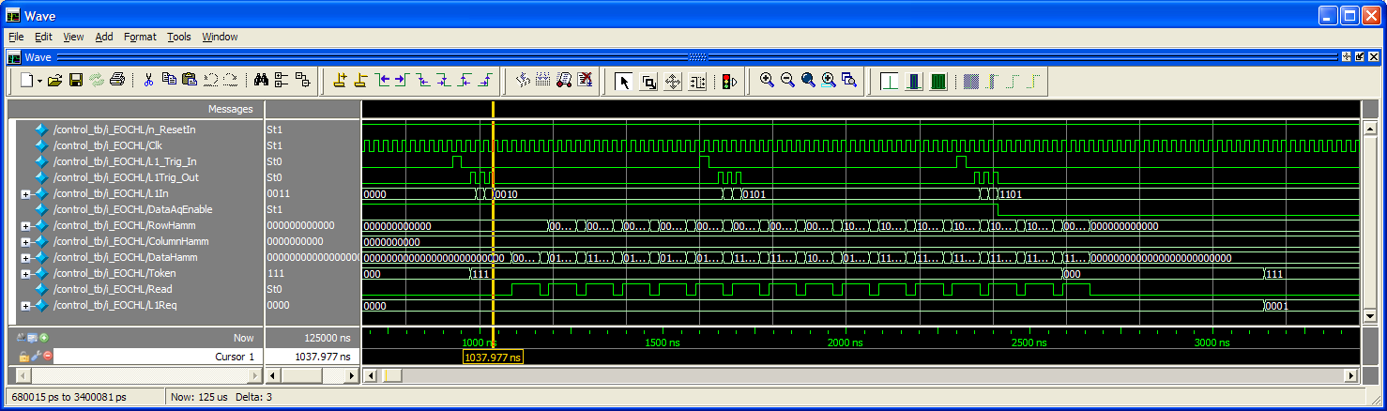
Simulation Results.
After the L1_Trig_In pulse 3 triggers are sent to the columns.
This gives Event data in the columns. Immediately after storing the first
trigger the readout cycle starts. The Token from the columns is ‘1’ and the
Read signal is toggled until is get ‘0’.
During this Read out cycle the DataAqEnable is disabled. The Event in progress
is finished before the Readout stops.
After the Readout cycle the L1Req number is increased by 1.

Slide 7
Interface with the DOB
The interface has 3 control signals and 3 data words.
Control signals: Read_Fifo
Read_Clk_Fifo
Empty
Data signals: Data_Word0
Data_Word1
Data_Word2
On the output of the EOCHL is a full dual port Fifo.

Slide 8
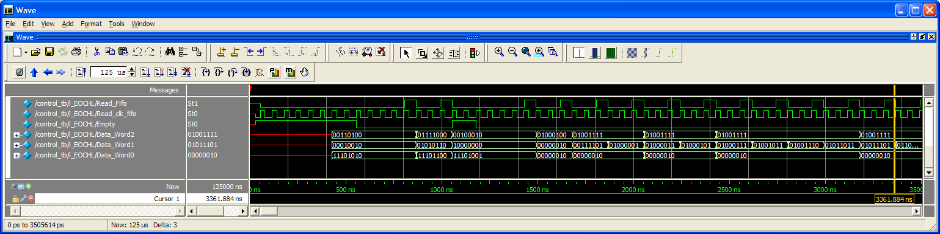
Simulation Results

Slide 9
Output Data.
# FIFO : Header - BC=[34] LV1Id=[ 0] Serv_Word=[1]
# FIFO : Data - col=[ 1] row=[ 2] Tot=[ 4, 4] (pix=[ 1, 2])
# FIFO : Data - col=[ 1] row=[ 61] Tot=[ 4,15] (pix=[ 60, 61])
# FIFO : Data - col=[ 1] row=[ 65] Tot=[ 4,15] (pix=[ 64, 65])
# FIFO : Data - col=[ 1] row=[ 67] Tot=[ 4,15] (pix=[ 66, 67])
# FIFO : Data - col=[ 1] row=[ 69] Tot=[ 4,15] (pix=[ 68, 69])
# FIFO : Data - col=[ 1] row=[ 71] Tot=[ 4,15] (pix=[ 70, 71])
# FIFO : Data - col=[ 1] row=[ 75] Tot=[ 4,15] (pix=[ 74, 75])
# FIFO : Data - col=[ 1] row=[ 78] Tot=[ 4,15] (pix=[ 77, 78])
# FIFO : Data - col=[ 1] row=[ 91] Tot=[ 4,15] (pix=[ 90, 91])
# FIFO : Data - col=[ 1] row=[ 93] Tot=[ 4,15] (pix=[ 92, 93])
# FIFO : Data - col=[ 1] row=[ 97] Tot=[ 4,15] (pix=[ 96, 97])
# FIFO : Data - col=[ 1] row=[101] Tot=[ 4,15] (pix=[ 100, 101])
# FIFO : Data - col=[ 1] row=[105] Tot=[ 4,15] (pix=[ 104, 105])
# FIFO : Data - col=[ 1] row=[111] Tot=[ 4,15] (pix=[ 110, 111])
# FIFO : Data - col=[ 1] row=[121] Tot=[ 4,15] (pix=[ 120, 121])
# FIFO : Service Address = [0a] Service Count = [001]

Slide 10
Error Registration
32 Error Registration blocks included.
Inputs are rising edge sensitive.
All counters are stop counting when maximum value is reacted.
The Error inputs are toggled 2x or 3x in the simulation from outside the EOCHL.
Then an Error Request is done

Slide 11
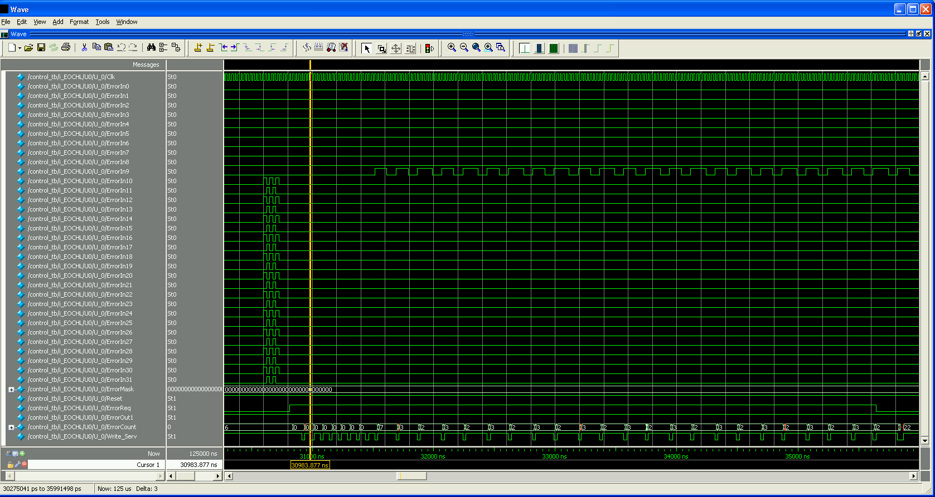
Simulation Results

Slide 12
# FIFO : Service Address = [00] Service Count = [000]
# FIFO : Service Address = [01] Service Count = [000]
# FIFO : Service Address = [02] Service Count = [000]
# FIFO : Service Address = [03] Service Count = [000]
# FIFO : Service Address = [04] Service Count = [000]
# FIFO : Service Address = [05] Service Count = [000]
# FIFO : Service Address = [06] Service Count = [000]
# FIFO : Service Address = [07] Service Count = [000]
# FIFO : Service Address = [08] Service Count = [000]
# FIFO : Service Address = [09] Service Count = [007]
# FIFO : Service Address = [0a] Service Count = [003]
# FIFO : Service Address = [0b] Service Count = [002]
# FIFO : Service Address = [0c] Service Count = [003]
# FIFO : Service Address = [0d] Service Count = [002]
# FIFO : Service Address = [0e] Service Count = [003]
# FIFO : Service Address = [0f] Service Count = [002]
# FIFO : Service Address = [10] Service Count = [003]
# FIFO : Service Address = [11] Service Count = [002]
# FIFO : Service Address = [12] Service Count = [003]
# FIFO : Service Address = [13] Service Count = [002]
# FIFO : Service Address = [14] Service Count = [003]
# FIFO : Service Address = [15] Service Count = [002]
# FIFO : Service Address = [16] Service Count = [003]
# FIFO : Service Address = [17] Service Count = [002]
# FIFO : Service Address = [18] Service Count = [003]
# FIFO : Service Address = [19] Service Count = [002]
# FIFO : Service Address = [1a] Service Count = [003]
# FIFO : Service Address = [1b] Service Count = [002]
# FIFO : Service Address = [1c] Service Count = [003]
# FIFO : Service Address = [1d] Service Count = [002]
# FIFO : Service Address = [1e] Service Count = [003]
# FIFO : Service Address = [1f] Service Count = [002]
All Service Addresses are now send out in one block.
Address 09 is the Fifo Full registration.
On the start or the Error Readout Sequence it was filled with 7
At the end of the simulation the Fifo full has occurred 22 times, because
The readout of the errors just needs two clock cycles.

Slide 13
Scan Chain
Simulation is started with a Reset.
Normal Clk is disabled, also the 160 MHz.
Shift in register is set to 11101000
Si Input shift register is 8 bits and repeating the start pattern.

Slide 14
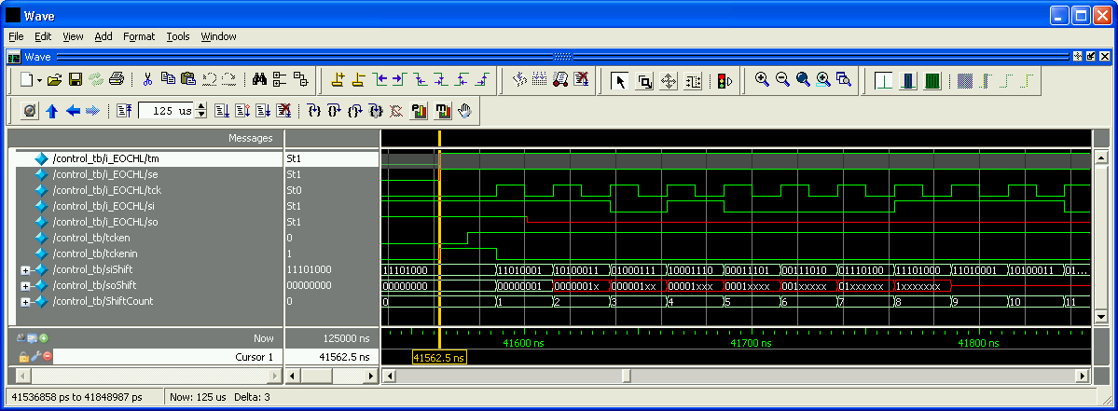
Simulation
Beginning of the scan chain shift in

Slide 15
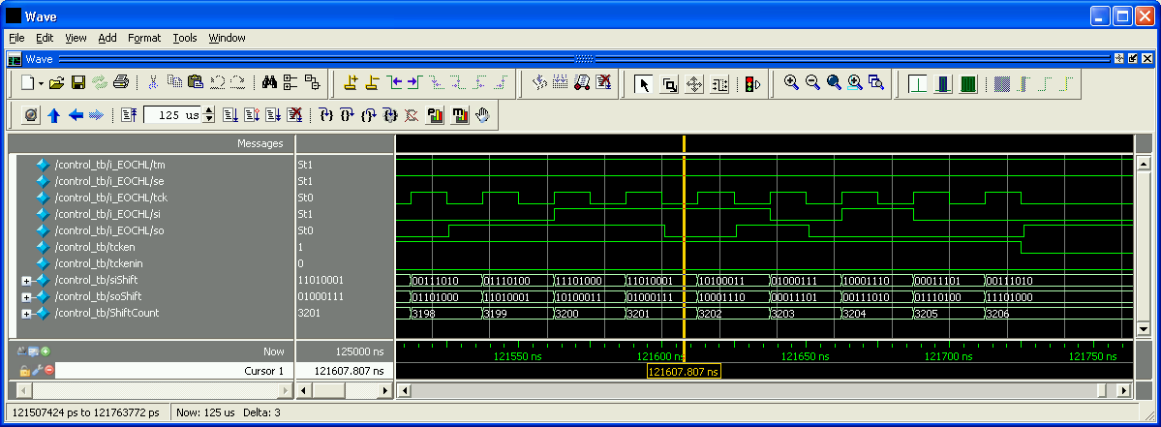
End of the scan chain shift cycle. On the end 8 extra clock cycles has
been added to shift the start pattern into the soshift register.
The Chain length is 3191 element. During Scan chain insertion 7 LOCKUP
Cells are added to the chain on the borders of clock domains.
Because some of these cells connect positive clock and negative clock edges
as well as clock domains, 7 additional cycles are present at soshift.

Slide 16
Implementation
Two-pass mapped flow for synthesis and DfT
  Synopsys Design and DfT Compiler, Version B-2008.09-SP2 for linux
Placement and Routing
  Cadence SoC Encounter v07.10-s219_1
Physical Netlist Verification and Sign-off
  Statistical Timing Analysis (STA), Synopys PrimeTime, Version B-2008.09-SP2 for linux
  Simulation with back-annotated netlist with Mentor Graphics QuestaSim 6.5b
Physical Verification
  DRC, LVS, netlist extraction with parasytics with Calibre 2009.3_32.2
ATPG
  Synopsys TetraMAX ATPG, Version B-2008.09-SP2 for linux
Note: An OpenAccess 2.2 from Cadence used to create the “Analog on Top” flow

Slide 17
Synthesis
Control Script
(.tcl)
Design Constraints
(.tcl)
Input, output delay =5ns,
Clock(s) timing and uncertainty (500p)
False path on reset, scan, wire_load_model
scx3_cmos8rf_lpvt_ff_1p32v_m55c.db scx3_cmos8rf_rvt_tt_1p2v_25c.db scx3_cmos8rf_rvt_ss_1p08v_70c.db
Library
Synopsys Design Compiler
Design database
RTL Netlist
(.v) (.sv)
Synopsys Internal
database
Listings
Mapped Netlist
(.v)

Slide 18
DfT Insertion
Control Script
(.tcl)
Test Constraints
(.tcl)
Library
Synopsys DfT Compiler
Clock gating, multiple clock domains
Mapped Netlist
(.v)
STIL/CTL
test
protocol
Synopsys Internal
database
Listings
Constraints
after scan (.sdc)
Scannable Netlist
(.v)

Slide 19
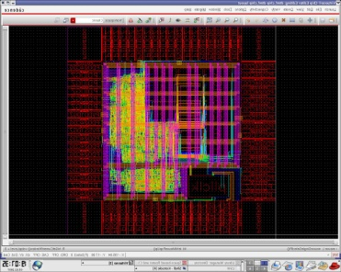
Placement and Routing
Scanable
netlist (.v)
Library
Constraints
after scan (.sdc)
Control,
configuration, fp
Floorplan (Power bars, blockings)
    Placement
O
P
E
N
A
C
C
E
S
S
2.2
Scan Chain Reordering
V
I
R
T
U
O
S
O
Clock tree synthesis
Timing Analysis
Chip finishing in Virtuoso
Optimization postCTS
Routing/optimization
Add filler cells
Verification, DfM
Backannotation
(MMMC, .SDF, .SPEF,)
Physical netlist (.v)

Slide 20
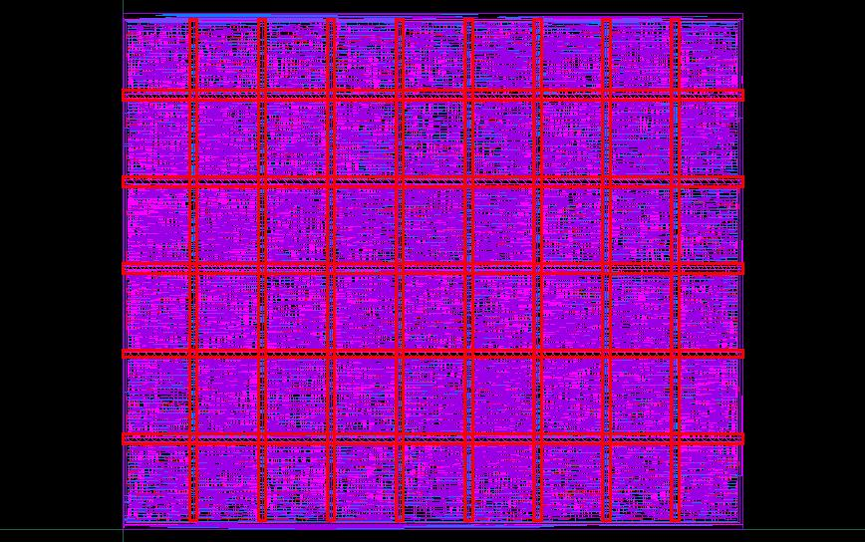
Block Layout
Size: 720µ x 600µ
Nr of cells > 32000, gate count ≈ 200 000
Power bars placed every 80µ in vertical direction in both M2 and M3
10µ thick placement blocking layers every 100µ, enclosing 4µ routing blockages
Placement and routing blockages underneath vertical bars to help with the congestion

Slide 21
Netlist Verification with simulation and sign-off
All simulations performed with the back-annotated netlist from the layout, SDF reflecting delays in the three corners and in communication with DOB (refer to Jan David sim charts).

Slide 22
Physical Verification
Calibre DRC, LVS
  Manual intervention within the layout: label placement on VDD! and VSS! bars
  Inherited Connections due to the library mismatch
  T3-isolated pwell?
  Netlist extraction together with layout parasitics done, but full analog simulation does not appear feasible

Slide 23
ATPG
x
x
x
x
Tmax Control Script
(.tcl)
Test Constraints
(.tcl)
x
x
x
x
Library,
primitives
Synopsys TetraMAX
Clock gating, multiple clock domains
Physical Netlist
(.v)
STIL/CTL
test
protocol
Synopsys Internal
database
write/run DRC
Patterns
Test setup verification ongoing, preliminary results:
Scan chain length 3191
Fault coverage: 91.23%
Number of test patterns: 245

