Slide 1
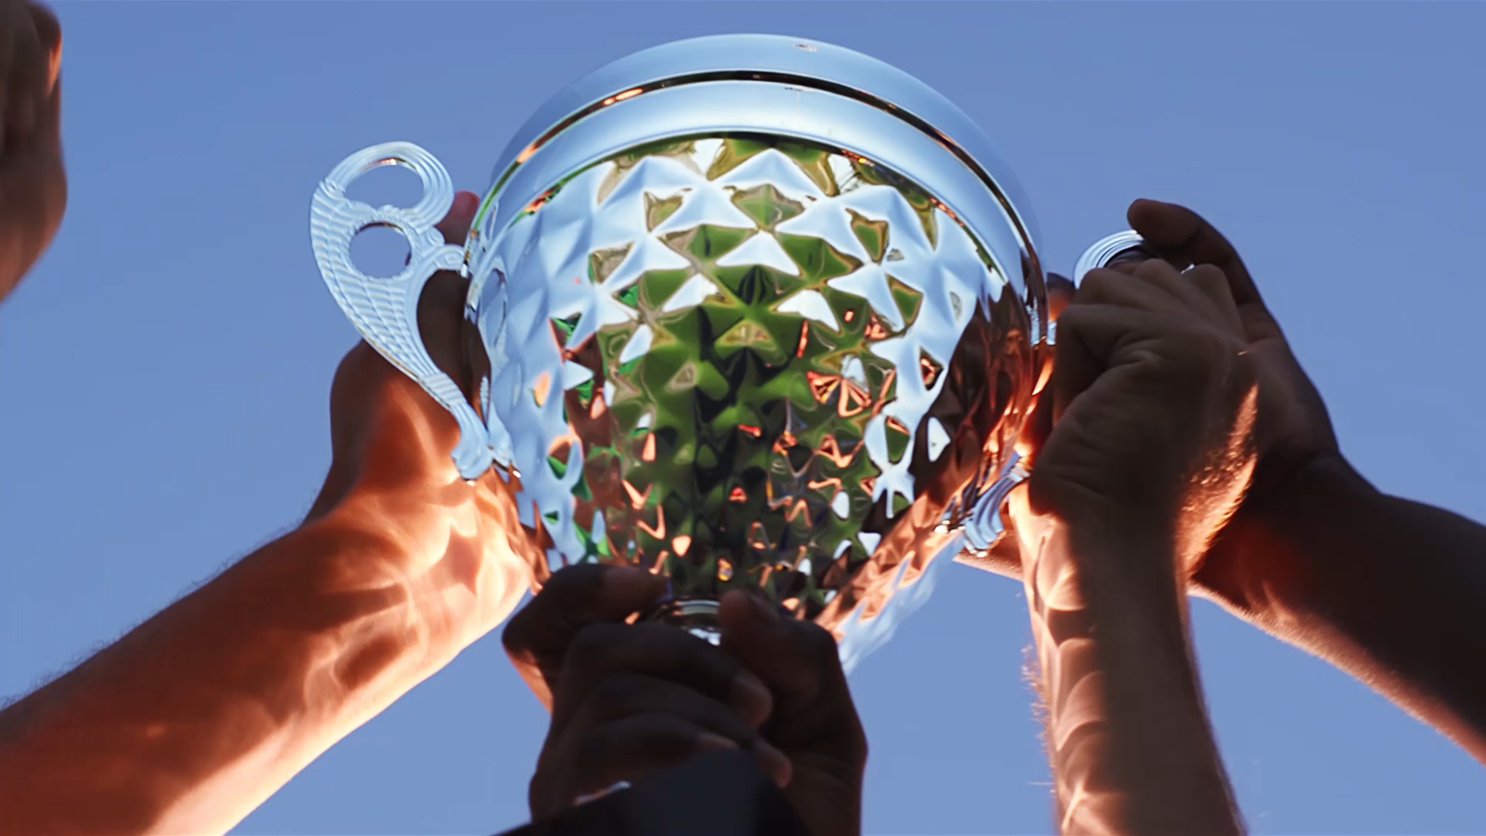
Awards for the best poster
Nina Burlac, searching for neutrinoless double beta decay with LEGEND experiment
Giulia Pieramico, geant4 simulation of the ABALONE photosensor
Maxime Pierre, neutrinoless double beta decay search in XENON1t/nt

Slide 2
Awards for the most active students asking questions and making comments
Robert Hammann
Francesco Poppi
Giovanni Volta

