Slide 1
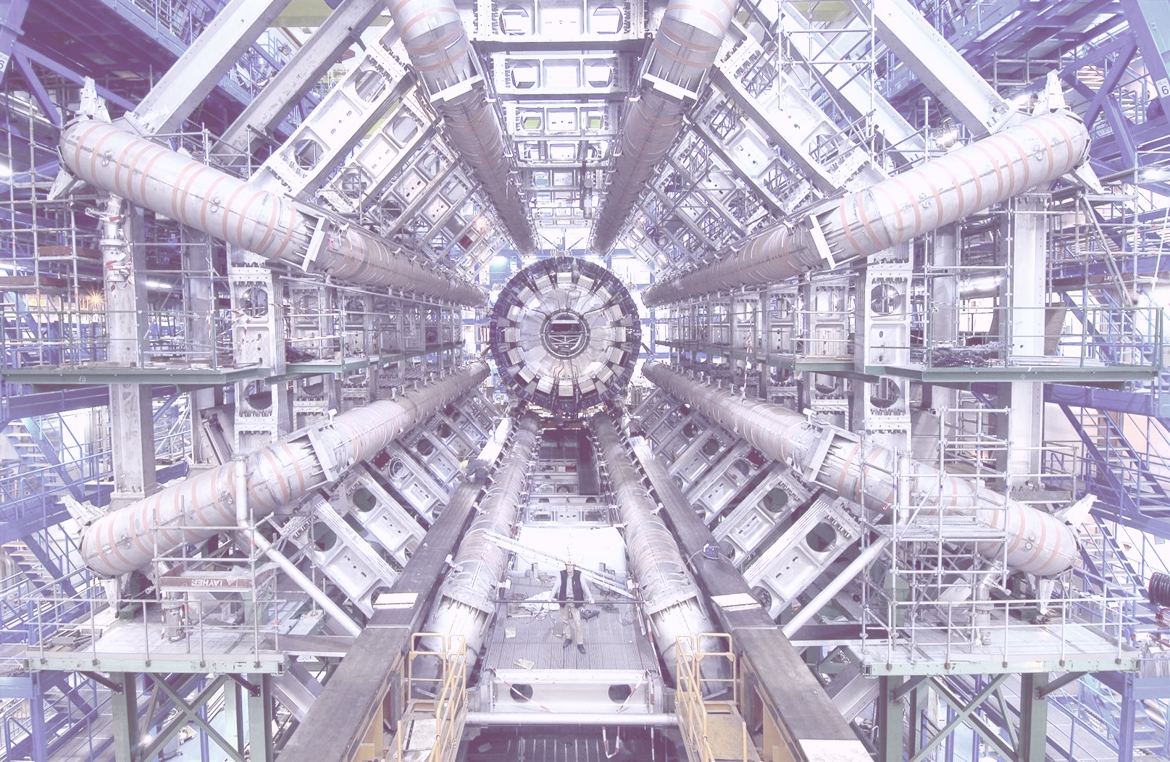



TU/e - FairSHiP
Integration and Performance Analysis
of the SHiP Conditions Database
FairSHiP | ST2019 | 2020.09.04

Slide 2

Agenda
Team Charter
Introduction
Executive Summary
Risks
Architecture
Methodologies
Results
Conclusion
pg. 4
pg. 5
pg. 6
pg. 9
pg. 12
pg. 20
pg. 23
pg. 30
FairSHiP - Agenda | ST2019 | 2020.09.04

Slide 3
Agenda
Team Charter
Introduction
Executive Summary
Risks
Architecture
Methodologies
Results
Conclusion
pg. 4
pg. 5
pg. 6
pg. 9
pg. 12
pg. 20
pg. 23
pg. 30
FairSHiP - Agenda | ST2019 | 2020.09.04

Slide 4
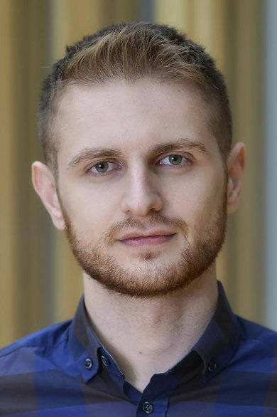
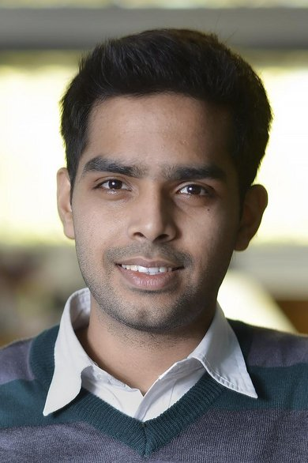


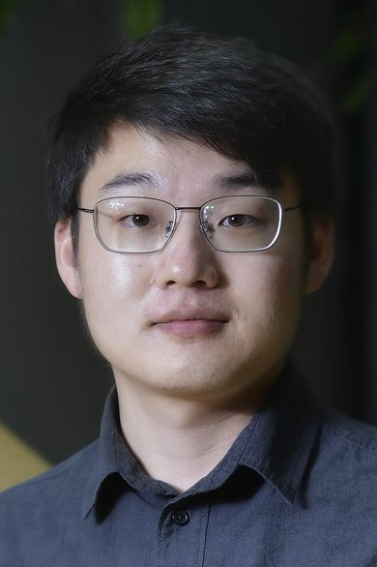


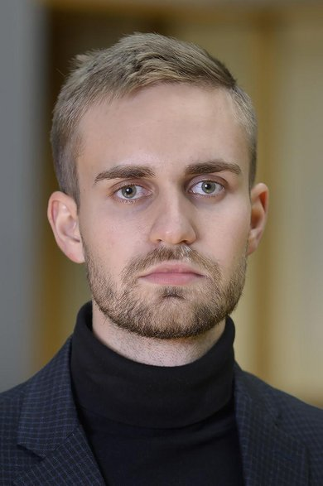
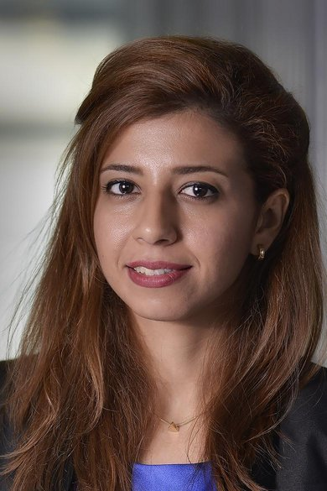
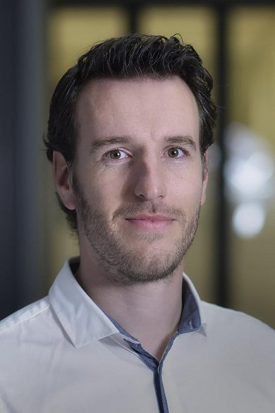
Team Charter
George Azis
Developer
Nathan D’Penha
Developer
Han Gao
Developer
J.J.M.J. van der Heijden
Developer
Yitian Kong
Configuration Manager
Christopher O’Hara
Project Manager
Yusril Raji
Scrum Master
Vladimir Romashov
Quality Manager
Raha Sadeghi
Test Manager
T.J.G.M. Vrancken
Architect
FairSHiP - Team Charter | ST2019 | 2020.09.04

Slide 5
Introduction - What is FairSHiP?
Experiment
FairSHiP is the simulation & reconstruction framework based on FairROOT and ROOT
Search for Hidden Particles (SHiP): Particle physics-based experiments for Hidden Sector
Hopes to find evidence of Dark Matter and Lepton-Flavor Violations
Location
Physical: Onsite at CERN SPS Facility in Switzerland (and part of France)
Virtual (LHC@home): Research groups around the world (over 600 institutes and universities)
Atlas@home led to discovery of Higgs-Boson and 300 publications
Mission
“Unite people from all over the world to push the frontiers of science and technology, for the benefit of all” (CERN)
FairSHiP - Introduction | ST2019 | 2020.09.04

Slide 6
Executive Summary
POP
D&A
NFR
Purpose of Project
POP1 Integrate the SHiP Conditions Database into FairSHiP via aliBuild
POP2 Integrate the final product into an existing script (alignment data from testbeam)
POP3 Merge final product into the official FairSHiP repository
Design & Analysis
D&A1 Read & Write Conditions data into a database
D&A2 Analyze performance of the Conditions DB API (MongoDB)
D&A3 Check for edge cases during testing to ensure the API is problem-free
Non-Functional Requirements
NFR1 Ensure that the Conditions DB API is performant
NFR2 Create intelligible code and documentation for future useability
NFR3 Develop an extensible framework that is easily adaptable for new technologies
FairSHiP - Executive Summary (1/2) | ST2019 | 2020.09.04

Slide 7
POP
STEPS TO SUCCESS
FIRST STEP
Conduct a detailed inspection of related works and consult directly with industry experts.
FOURTH STEP
Receive approval from CERN team. Merge Request to official repository.
SECOND STEP
Setup up environments, databases, and containers. Derive requirements, functions, and implement continuously.
THIRD STEP
Test and benchmark API. Update architectures and merge results.
FairSHiP - Executive Summary (2/2) | ST2019 | 2020.09.04

Slide 8
TIMELINE
POP
Our Brief Journey with Particle Physics
TBD 2026
SHiP Experiment at SPS
04 FEB 2020
Project Kick-Off
Extract (non)-functional requirements
Ideate and prototype interface solution
EARLY APR 2020
Finalize Testing, Integration, and Benchmarking
Conduct Analysis and Write Documentation
Final Presentation and Merge
04 MAR 2020
Design Freeze!
Final Architecture
TBD 202X
Simulations for muon flux
Possible extension for other experiments and data
FairSHiP - Timeline | ST2019 | 2020.09.04

Slide 9
RISK MITIGATION
POP
Risk Avoidance and Mitigation Strategy
Risk (rk) | Details | Impact x Probability
I - Knowledge Deficiencies | Concerns: Lack of Technical Knowledge Plan: Consult industry experts and conduct research | Impact: Medium Probability: Medium
II - Deliver Wrong Product | Concerns: Mismatch in requirements Plan: Regular communication with CERN | Impact: High Probability: Low-Medium
III - COVID-19 | Concerns: University shutdown, illness Plan: Create remote environments and contingencies | Impact: Medium Probability: High
FairSHiP - Risk (1/2) | ST2019 | 2020.09.04

Slide 10
Risk: Impact vs Probability
POP
rk I
Knowledge Deficiencies
rk II
Deliver Wrong Product
rk II
rk III
COVID-19
Key criteria assessed
Scope
Deadline
Quality
Future Adjustments
Technical Limitations
rk III
Impact
rk I
Probability
FairSHiP - Risk (2/2) | ST2019 | 2020.09.04

Slide 11
Agenda
Team Charter
Introduction
Executive Summary
Risks
Architecture
Methodologies
Results
Conclusion
pg. 4
pg. 5
pg. 6
pg. 9
pg. 12
pg. 21
pg. 24
pg. 31
FairSHiP - Agenda | ST2019 | 2020.09.04

Slide 12

Architecture
From Requirements to Model

Slide 13
Architecture - Requirements
D&A
NFR
The system shall be integrated into FairSHiP via aliBuild
The system shall be able to access SHiP Conditions data (r/w)
The system shall support MongoDB as DBMS
The system shall be performant when running a local MongoDB-server instance
FairSHiP - Architecture (1/8) | ST2019 | 2020.09.04

Slide 14
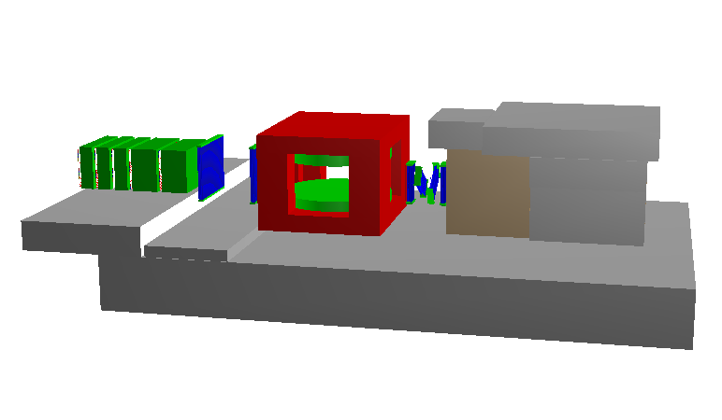





Architecture - High-Level
D&A
NFR
experiment
researcher
simulation/analysis
user
+ tag
? tag
? validity
conditions
conditions
application
data
DBMS
(mongoDB)
storage adapter
FairSHiP - Architecture (2/8) | ST2019 | 2020.09.04

Slide 15

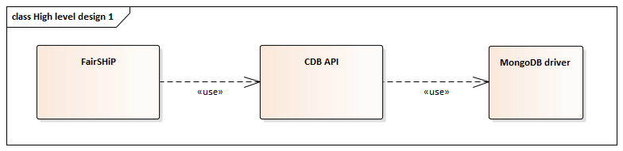
Architecture - Design 1
D&A
FairSHiP - Architecture (3/8) | ST2019 | 2020.09.04

Slide 16
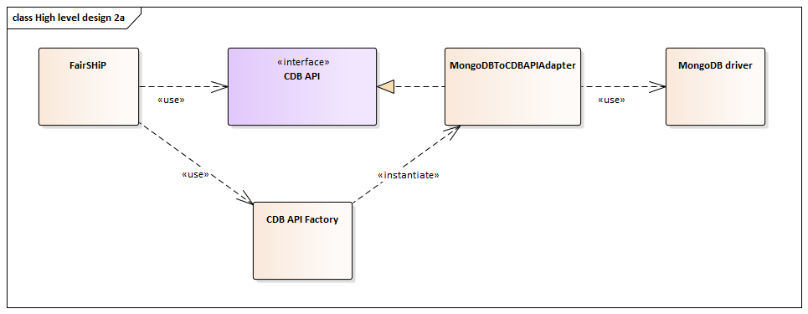
Architecture - Design 2a
D&A
NFR
FairSHiP - Architecture (4/8) | ST2019 | 2020.09.04

Slide 17
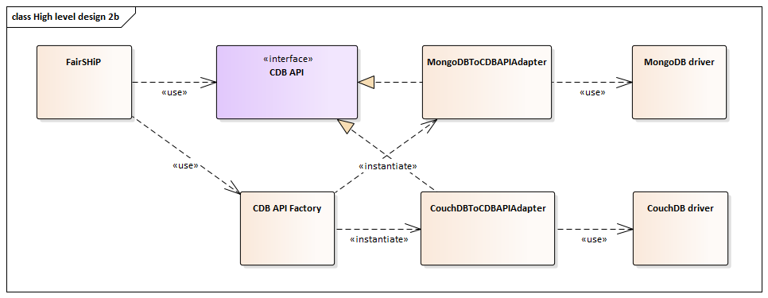
Architecture - Design 2b
D&A
NFR
FairSHiP - Architecture (5/8) | ST2019 | 2020.09.04

Slide 18
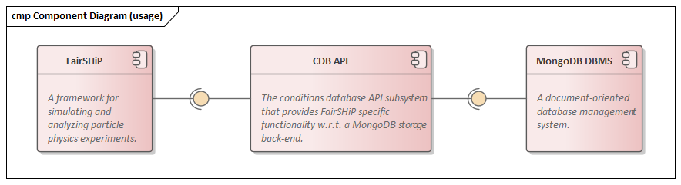
Architecture - Components
D&A
FairSHiP - Architecture (6/8) | ST2019 | 2020.09.04

Slide 19
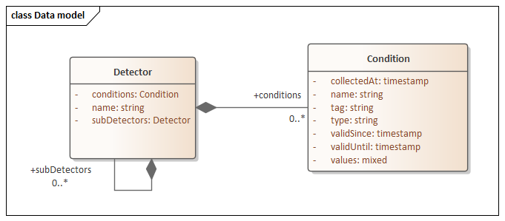
Architecture - Data Model
D&A
NFR
FairSHiP - Architecture (8/8) | ST2019 | 2020.09.04

Slide 20
Methodologies - Technologies
D&A
NFR
Python Interpreted, high-level programming language
MongoDB Cross-platform document-oriented database
MongoEngine Python object data mapper (structure)
PyTest (Unit) Test framework for Python
PyLint Source-code conformity checker for Python
Docker Distributed runtime containers
GitLab CI Continuous Integration Environment
aliBuild Compiler/Build Tool for ALICE Experiments
Doxygen Documentation Generator
FairSHiP - Methodologies (1/2) | ST2019 | 2020.09.04

Slide 21
Examples of Functions
D&A
NFR
After any database has been constructed via a configuration file:
list_detectors( )
add_detector( ) ; remove_detector( )
get_conditions( )
get_conditions_by_tag( )
get_conditions_by_name_and_validity( )
get_condition_by_name_and_tag( )
get_condition_by_name_and_collection_date( )
update_condition_by_name_and_tag( )
FairSHiP - Methodologies (2/2) | ST2019 | 2020.09.04

Slide 22
Agenda
Team Charter
Introduction
Executive Summary
Risks
Architecture
Methodologies
Results
Conclusion
pg. 4
pg. 5
pg. 6
pg. 9
pg. 12
pg. 20
pg. 23
pg. 30
FairSHiP - Agenda | ST2019 | 2020.09.04

Slide 23
Results
Testing & Analysis

Slide 24
Results - Testing/Benchmarking
D&A
NFR
Test cases derived from Business Requirements (Traceability)
Automated testing for most cases using GitLab CI
  Some items were manually tested
Compared features and steps for wall time and CPU time (baseline vs implementation)
Conducted Stress Test to evaluate use cases
147 Unit Tests (All Passed)
FairSHiP - Results (1/5) | ST2019 | 2020.09.04

Slide 25
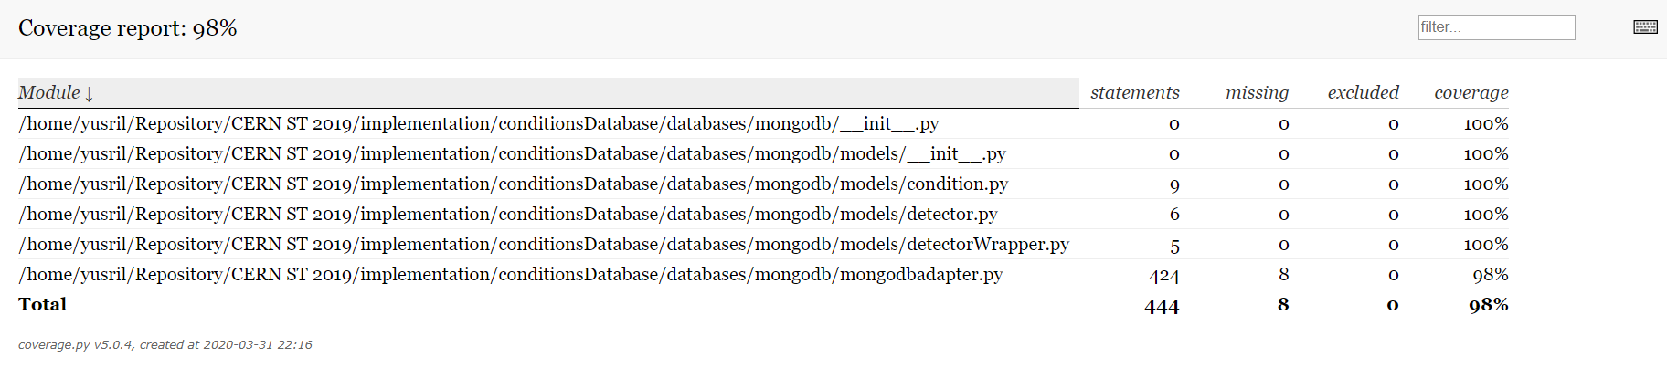
Results - Testing
D&A
NFR
FairSHiP - Results (2/5) | ST2019 | 2020.09.04

Slide 26
Results - Benchmarking (Features)
D&A
NFR
 | original [ms] |  | integrated [ms] |  | original - integrated [ms]
features | wall time | cpu time | wall time | cpu time | wall time | cpu time
Daniel Retrieval | 0.09 | 0.01 | 22.23 | 17.86 | - 22.14 | - 17.86
Persistent Alignment Constants | 82.43 | 73.08 | 125.99 | 118.33 | - 43.46 | - 45.25
Import Alignment Constants | 34.78 | 31.05 | 110.17 | 105.00 | - 75.39 | - 73.95
FairSHiP - Results (3/5) | ST2019 | 2020.09.04

Slide 27
Results - Benchmarking (Steps)
D&A
NFR
 | original [s] |  | integrated [s] |  | original - integrated [s]
step | wall time | cpu time | wall time | cpu time | wall time | cpu time
recoStep1 | 2359.26 | 2354.74 | 2433.88 | 2412.40 | - 74.62 | - 57.46
recoStep2 | 654.91 | 628.35 | 695.26 | 681.77 | - 40.35 | - 53.42
FairSHiP - Results (4/5) | ST2019 | 2020.09.04

Slide 28
Results - Benchmarking (Stress)
D&A
NFR
API Performance and reliability | wall time [s] | CPU time [s]
Add one detector | 0.012 | 0.005
Add 100 detectors | 0.190 | 0.170
Create Complex Structure | 392.212 | 378.264
List Detectors ( > 100 detectors) | 0.389 | 0.370
Add one massive condition | 0.372 | 0.355
Get Condition by name and tag | 0.185 | 0.180
Update condition by name and tag | 0.273 | 0.265
FairSHiP - Results (5/5) | ST2019 | 2020.09.04

Slide 29
Agenda
Team Charter
Introduction
Executive Summary
Risks
Architecture
Methodologies
Results
Conclusion
pg. 4
pg. 5
pg. 6
pg. 9
pg. 12
pg. 20
pg. 23
pg. 30
FairSHiP - Agenda | ST2019 | 2020.09.04

Slide 30
Conclusion
Delivering the Product

Slide 31
Quality Assurance
NFR
Strict review process
Doxygen used for standardized code comments
PEP8 style guide
Traceability Matrix (Requirements to Test Case)
FairSHiP - Quality | ST2019 | 2020.09.04

Slide 32
POP
D&A
NFR
Conclusion
A production-level API was developed and integrated
98% coverage in testing
Benchmarking revealed minimal additional overhead
A demo video was created for knowledge transfer
“Keeping it simple” can be challenging
Communication is key
FairSHiP - Conclusion | ST2019 | 2020.09.04

Slide 33
Acknowledgements
Eric Van Herwijnen & Oliver Lantwin
Yanja Dajsuren & Désirée van Oorschot
Lecturers/Coaches
Ad Aerts
FairSHiP - Acknowledgements | ST2019 | 2020.09.04

Slide 34
Questions?
Thank you for your time!
FairSHiP - Questions? | ST2019 | 2020.09.04

Slide 35
References
https://www.slac.stanford.edu/econf/C06092511/presents/TU002_PPT.PDF
https://cds.cern.ch/
ST-2017 Documentation
https://ship.web.cern.ch/ship/FairShip/default.html
https://github.com/ShipSoft/FairShip
https://indico.cern.ch/event/482695/contributions/1159356/attachments/1226973/1796779/FairShip-Tutorial_Intro-Feb2016.pdf
FairSHiP - References | ST2019 | 2020.09.04

Slide 36
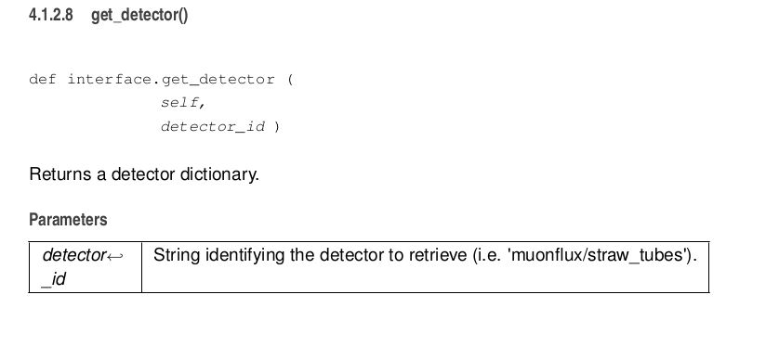
Technologies - Doxygen
FairSHiP - Technologies | ST2019 | 2020.09.04

Slide 37
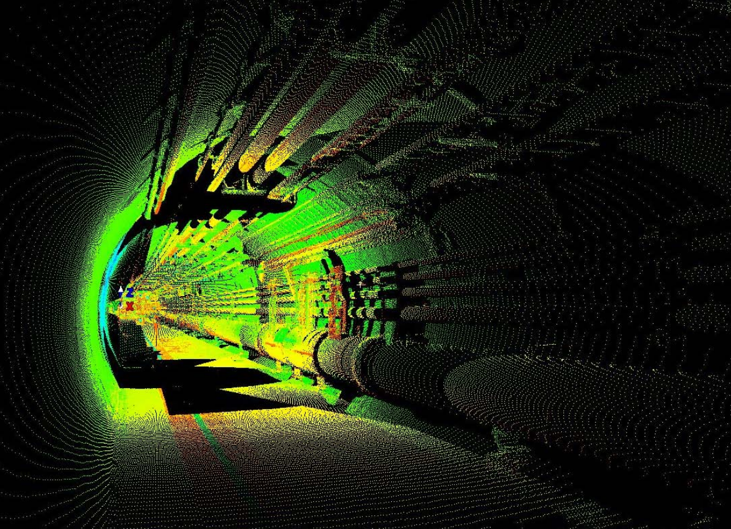
www.slac.stanford.edu
FairSHiP - Simulation | ST2019 | 2020.09.04

Slide 38
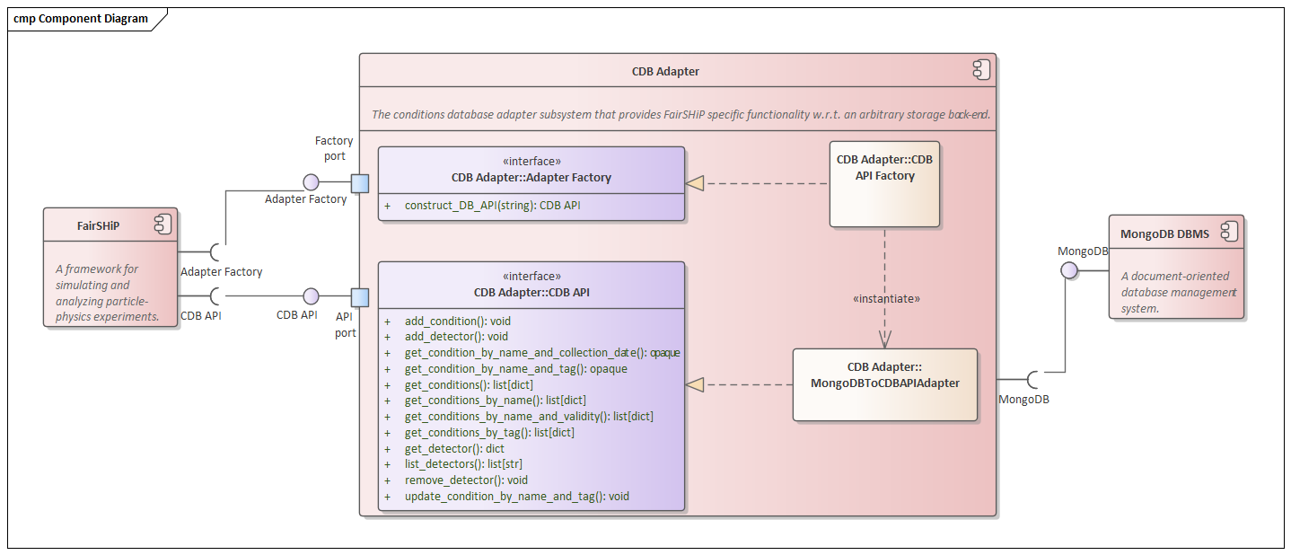
Architecture - Components
D&A
FairSHiP - Architecture | ST2019 | 2020.09.04

Slide 39
Requirements
Number | Feature
1 | The system shall store SHiP experiments’ conditions data.
1-1 | The system shall add a (sub)detector model.
1-2 | The system shall add a condition model to a (sub)detector model.
2 | The system shall retrieve SHiP experiments’ conditions data.
2-1 | The system shall retrieve a list with (sub)detector model names.
2-2 | The system shall retrieve all condition models with a specific name for a given detector.
2-3 | The system shall retrieve the condition model with a specific name and tag for a given detector.
2-4 | The system shall retrieve the condition model with a specific name and collection date for a given detector.
2-5 | The system shall retrieve all condition models with a specific tag.
FairSHiP - Backup | ST2019 | 2020.09.04

Slide 40
Requirements
Number | Feature
3 | The system shall remove a (sub)detector model and all associated conditions.
4 | The system shall update a condition model validity interval and type.
4-1 | The system shall update a condition model’s validity interval.
4-2 | The system shall update a condition model’s type.
5 | The system shall be integrated into FairSHiP such that it can be built with Alibuild.
6 | When running a local MongoDB-server instance, the system shall return any set of condition models specified by a tag within 5s.
7 | The system shall be extensible such that it can support multiple storage back-ends.
8 | The performance deviation of the integrated system and the original one shall not be more than 20 percent.
FairSHiP - Backup | ST2019 | 2020.09.04

Slide 41
Traceability
Req. | Prio. | Description | Related Test(s)
1 | Must | The system shall store SHiP experiments’ conditions data. | 1, 5
1.1 | Must | The system shall add a detector model. | 1
1.2 | Must | The system shall add a (sub)detector model to a detector model. | 1
1.3 | Should | The system shall remove a detector model and all associated conditions. | 4
1.4 | Should | The system shall remove a (sub)detector model and all associated conditions from a (sub)detector model. | 4
1.5 | Must | The system shall add a condition model to a (sub)detector model. | 5
1.6 | Must | The system shall update a condition model’s validity interval. | 11
FairSHiP - Backup | ST2019 | 2020.09.04

Slide 42
Traceability
2 | Must | The system shall retrieve SHiP experiments’ conditions data. | 3, 6, 7, 8, 9, 10, 12
2.1 | Must | The system shall retrieve a list with (sub)detector model names. | 2
2.2 | Should | The system shall retrieve a (sub)detector model. | 2
2.3 | Must | The system shall retrieve all condition models for a given detector model. | 12
2.4 | Must | The system shall retrieve all condition models with a specific name for a given detector. | 7
2.5 | Must | The system shall retrieve all condition models with a specific name and validity for a given detector. | 8
2.6 | Must | The system shall retrieve the condition model with a specific name and tag for a given detector. | 11
2.7 | Must | The system shall retrieve the condition model with a specific name and collection date for a given detector. | 10
2.8 | Must | The system shall retrieve all condition models with a specific tag. | 12
FairSHiP - Backup | ST2019 | 2020.09.04

Slide 43
Traceability
3 | Must | The system shall support MongoDB as DBMS. | 19
4 | Must | The system shall be integrated in FairSHiP such that it can be built with Alibuild. | 15
5 | Must | Integration of drifttubesmonitoring.py with the API | 16
6 | Should | When running a local MongoDB-server instance, the system shall return any set of condition models specified by a tag within 5s. | 14, 17, 18
7 | Could | The system shall be extensible such that it can support multiple storage back-ends. | 19
FairSHiP - Backup | ST2019 | 2020.09.04

