Slide 1

Instrumentation cryogenic Requirements for WP6a
V. Gahier
28/01/20

Slide 2
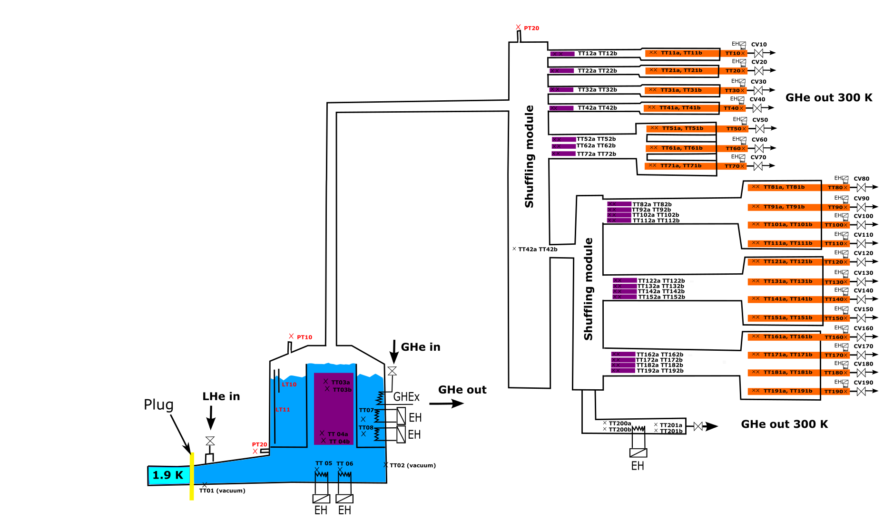
Cryogenic instrumentation of DFX/DFH
DFHx
SC link
DFx
From DFHx Conceptual Design Review
Instrumentation J Fleiter

Slide 3
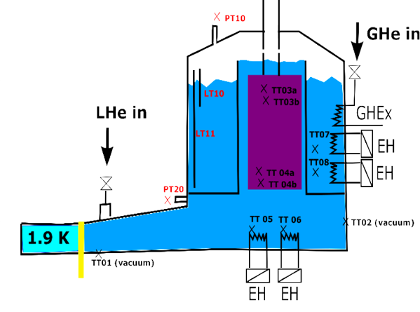
Zoom on DFx
Located in the tunnel in a zone with radiation up to 625 kGy (based on QXL data)
Number | Instrumentation | Normal Operating Range | Range | accuracy
4 | Process Temperature transmitter* | 4.4-5.5 K | 3-325 K | +/- 0.1 K
2 | Vaccum Temperature transmitter | 4.4-300 K | 3-325 K | +/- 0.5-1 K
4 | Electric Heater | 0-100 W | 0-300 W | 1 W
2 | Flexible Level transmitter | 365-515 mm | 0-615 mm | 10 mm
2 | Pressure transmitter | 1.05-2 bara | 0-4 bar | 0.01 bar
1 | Pressure switch (line D) | NA | NA | NA
1 | Temp switch (SV) | NA | NA | NA
Requirement for P,T measurement in QRL for virtual flow calculation of line C and line E (already provided)
Requirement for T measurement in QRL for duty calculation of gas heater (to be the nearest of the DFx)
* TT for heater protection not included

Slide 4
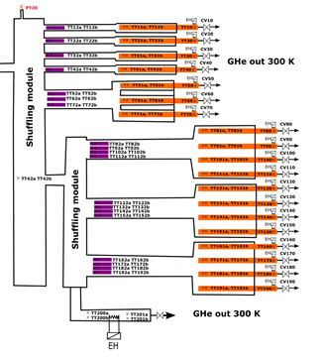
Zoom on DFHx
Located in Service Gallery- No radiation expected
Instrumentation to be provided In purple zone
WP6a will provide temperature probes in current leads
Number | Instrumentation | Normal Operating Range | Range | accuracy
42 | Temperature transmitter | 10-20 K | 3-325 K | +/- 0.5 K (TBC)
1 | Electric Heater | 0-1500 W | 0-15000 W | 1 W
2 | Temperature transmitter | ambient | 3-325 K | +/- 5 K
1 | Pressure transmitter | 1.05-2 bara | 0-4 bar | 0.01 bar
1 | Differential Pressure transmitter (TBC) | 0-100 mbar | 0-300 mbar | 1 mbar
1 | Temp switch (SV) | NA | NA | NA

Slide 5
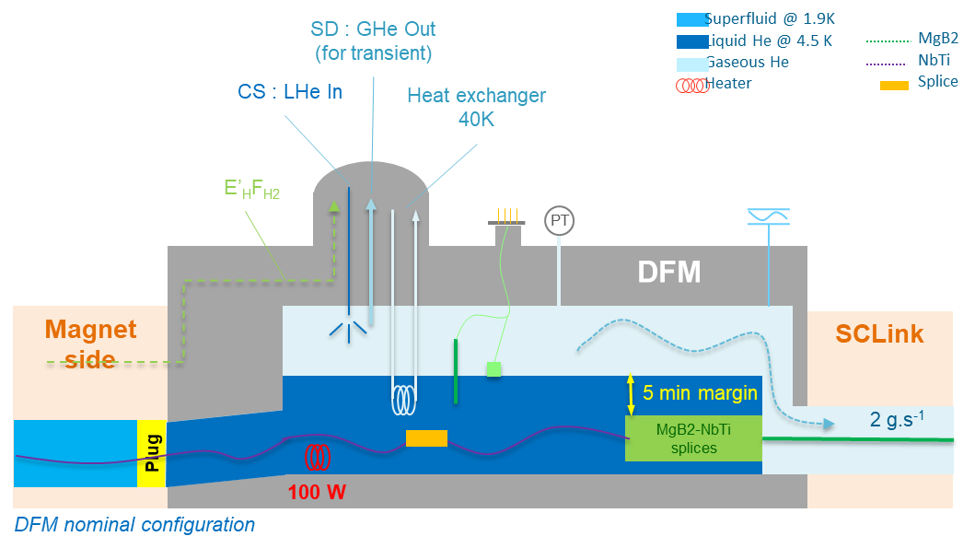
Zoom on DFm
PRELIMINARY
Located in the tunnel in a zone with radiation over 1000 kGy (TBC, based on QXL data)
Number | Instrumentation | Normal Operating Range | Range | accuracy
4* | Process Temperature transmitter | 4.4-5.5 K | 3-325 K | +/- 0.1 K
2 | Vaccum Temperature transmitter | 4.4-300 K | 3-325 K | +/- 0.5-1 K
2 | Electric Heater | 0-100 W | 0-300 W | 1 W
2 | Level transmitter | TBC | TBC | 10 mm
2 | Pressure transmitter | 1.05-2 bara | 0-10 bar | 0.01 bar
1 | Temp switch (SV) | NA | NA | NA
Requirement for P,T measurement in QRL for virtual flow calculation of line C and line E
Requirement for T measurement in QRL for duty calculation of gas heater
* TT for heater protection not included

Slide 6
Zoom on DFHm
PRELIMINARY
Located in Service Gallery- No radiation expected
(number of cold TT to be confirmed according to the final number of current leads)
Number | Instrumentation | Normal Operating Range | Range | accuracy
20 (TBC) | Temperature transmitter | 10-20 K | 3-325 K | +/- 0.5 K (TBC)
1 | Electric Heater | 0-325 W | 0-7500 W | 1 W
2 | Temperature transmitter | ambient | 3-325 K | +/- 0.1 K
1 | Pressure transmitter | 1.05-2 bara | 0- 4 bar | 0.01 bar
1 | Differential Pressure transmitter | 0-100 mbar | 0-300 mbar | 1 mbar

Slide 7
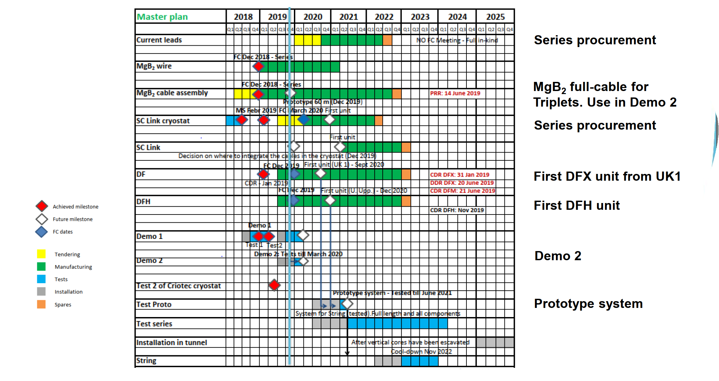
Planning
Instrumentation to be available:
for the test proto in SM18 – Q4 2020
DFx/m – Q2 2021
DFHx/m - Q2 2022

Slide 8
Total for installation in the tunnel
Cold powering of Inner Triplets
 | Number | Instrumentation | Normal Operating Range | Range | Total (x4)
DFx | 4 | Process Temperature transmitter | 4.4-5.5 K | 3-325 K | 16
 | 2 | Vacuum Temperature transmitter | 4.4-300 K | 3-325 K | 8
 | 4 | Electric Heater | 0-100 W | 0-300 W | 16
 | 2 | Level transmitter | 365-515 mm | 0-615 mm | 8
 | 2 | Pressure transmitter | 1.05-2 bara | 0-4 bar | 8
DFHx | 42 | Temperature transmitter | 10-20 K | 3-325 K | 168
 | 1 | Electric Heater | 0-1500 W | 0-15000 W | 4
 | 2 | Temperature transmitter | ambient | 3-325 K | 8
 | 1 | Pressure transmitter | 1.05-2 bara | 0-4 bar | 4

Slide 9
Total for installation in the tunnel
Cold powering of matching section
 | Number | Instrumentation | Normal Operating Range | Range | Total (x4)
DFm | 4 | Temperature transmitter | 4.4-5.5 K | 3-325 K | 16
 | 2 | Vacuum Temperature transmitter | 4.4-300 K | 3-325 K | 8
 | 2 | Electric Heater | 0-100 W | 0-300 W | 8
 | 2 | Level transmitter | TBC | TBC | 8
 | 2 | Pressure transmitter | 1.05-2 bara | 0-4 bar | 8
DFHm | 20 (TBC) | Temperature transmitter | 10-20 K | 3-325 K | 80
 | 1 | Electric Heater | 0-325 W | 0-700 W | 4
 | 2 | Temperature transmitter | ambient | 3-325 K | 8
 | 1 | Pressure transmitter | 1.05-2 bara | 0-4 bar | 4

Slide 10
Grand Total
Instrumentation in tunnel | Grand Total
Temperature transmitter | 312
Electric Heater | 32
Level transmitter | 16
Pressure transmitter | 24
Differential Pressure transmitter | 8
Instrumentation to be available:
DFx/m – Q2 2021
DFHx/m - Q2 2022
Instrumentation for prototype | Grand Total
Temperature transmitter | 52
Electric Heater | 4
Level transmitter | 2
Pressure transmitter | 4
Differential Pressure transmitter | 1
Instrumentation to be available:
for the test proto in SM18 – Q4 2020

