Slide 1
Resistive MPGD
Processes and problems
Rui de Oliveira 12/02/2020
CERN RD51 mini-week

Slide 2
Goal of resistive protections
Make Sparks invisible
Simplify the detector structure
Reduce the cost
Be large size compatible
Aim to use only industrial processes
Achieve performances competitive with best existing MPGDs
  Rate
  Space resolution
  Time resolution
  Energy resolution
  Low mass

Slide 3
Type of resistive MPGDs
Resistive Micro-Megas
  Single resistive layer
  2 resistive layer
Micro-Resistive-Well
  Single resistive layer
  2 resistive layer protection
Resistive GEM
Resistive THGEM

Slide 4
DOCA
(Distance Of Closest Approach)
Breakdown of the resistive layer
No effect on the resistive layer
0V
HV
R layer
Polyimide
DOCA
No possibility to create a voltage breakdown
Dielectric
DOCA
A breakdown of the resistive layer means creating a low Ohmic channel in the layer

Slide 5
DOCA
(Distance Of Closest Approach)
Breakdown voltage
PI 420MV/m
DLC theory 650MV/m
our measurement 10MV/m
Perfect SiO2 1000MV/m
PVD SiO2 1MV/m
spark
HV
Dielectric
Of course, dielectric strength are greatly impacted by impurities, dopants, structure, interconnected porosity, flaws and micro-cracks from thermal expansion mismatches
0V
DOCA
The most critical damage in this protection system is the resistive material breakdown due to the voltage set by the spark.
-This BV is an intrinsic parameter of resistive material.
-Setting a good DOCA can prevent any breakdown of the resistive layer.
-This is first barrier , if it fails there is no control on the spark current .
If DOCA is set correctly, the next damage (current instabilities) will come from electron/ion bombardment→
- temperature rising (joule effect) →material evaporation →material deposition
This effect can be reduced:
-firstly by far, avoiding local repetitive sparks → get rid of contaminants like dust.
-by increasing the melting point of materials → higher the better for protection
-by increasing the thermal conductivity of materials → good thermal conductors & thicker layers
-by reducing the amount of charges induced by the spark→ by increasing the resistive value
Material | Thermal conductivity W/mK
Glass epoxy | 0.2
PI | 0.18
Aluminium | 235
Copper | 384
Natural diamond | 895–1350

Slide 6
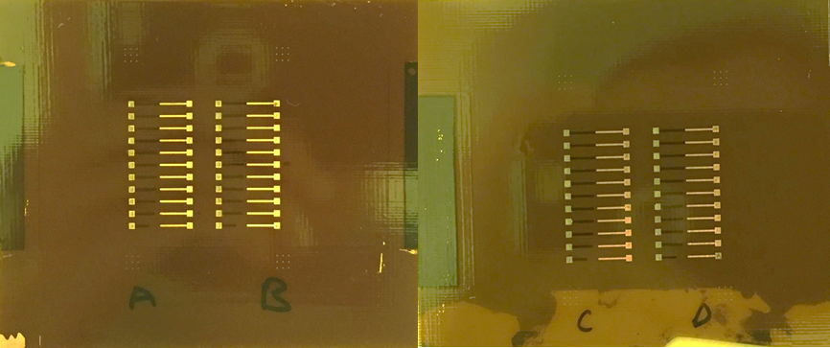
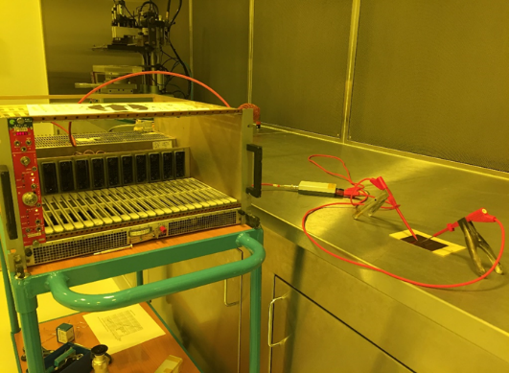
DOCA test
0V
HV
0V
spark
HV
DOCA
-11 patterns → DOCA ranging from 1.0mm down to 0.1 mm
-Single hole test
–DLC 60M/Sqr
-4 sets have been tested (A,B,C,D)

Slide 7
Discussion on DOCA
First observation, the voltage to see current is close to 800V in air!
  We were expecting 650V for a 50um gap (like GEMs)
Second ,the current shape during overvoltage depends on DOCA distance
  Smooth current increase with long DOCA
  sudden increase to uA with small DOCA
After 30 sec with 30nA in one hole we can observe a voltage drop
  After several session of 30s , it stabilize in between 550V to 650V (0 current voltage)
  No voltage breakdown , no visible damages on any structures.
We want to look now at the “sparks” nature when operating in overvoltage mode.
  We would like to study the single hole spark current shape and rate with a fast oscilloscope .
  This is possible with DLC since we do not damage the device
Preliminary results : with 60Mohms/Sqr DLC , the DOCA can be as low as 0.1mm without visible damages

Slide 8
DLC naming
DLC
“DLC+”
“DLC++”
Cu
Cr
DLC
Apical
Apical
Apical
or
or
Apical
Apical

Slide 9
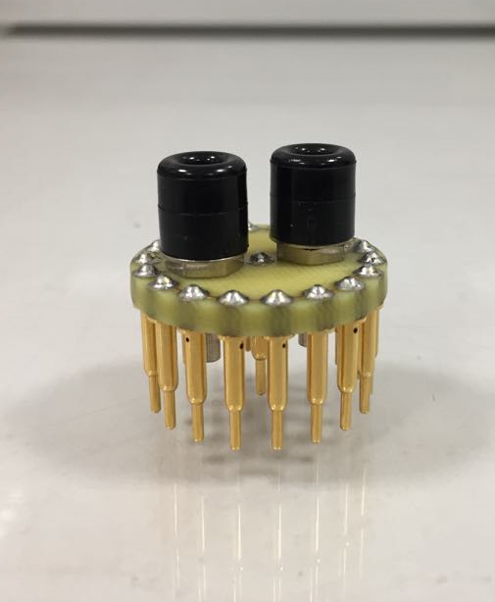
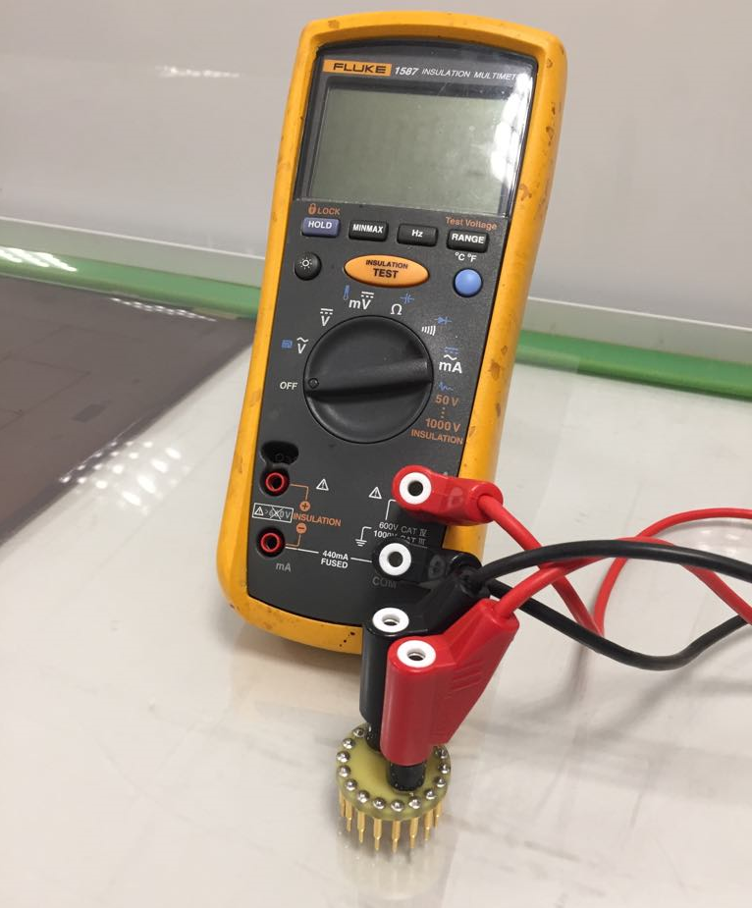
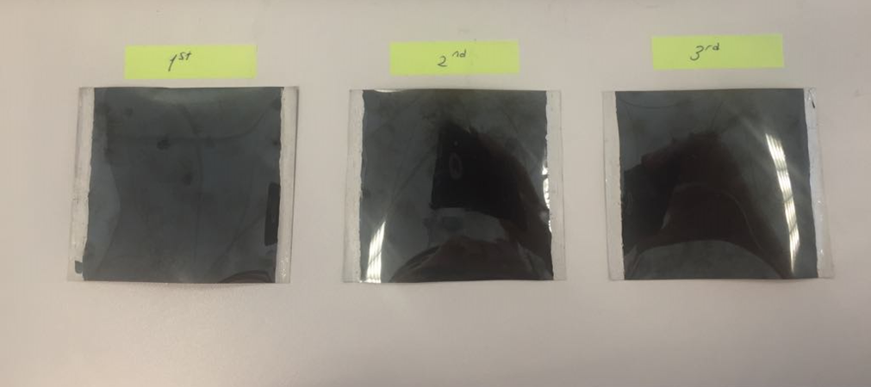
Resistive measurements
Probe calibration
7cm x 7cm square of DLC
  lateral silver connection to create 1 Square
Connect probe to Ohm-meter
Compare probe measurement to silver connections measurement
Error in the range of 5%
We can directly read the value from the Ohm-meter
7 cm
7 cm
DLC Film | Surface Resistivity (kΩ/□) | Surface Resistance From The Probe (kΩ) | Coefficient Factor | Error (%)
1 | 359 | 345 | 1.041 | 4
2 | 386 | 364 | 1.060 | 6
3 | 403 | 380 | 1.061 | 5

Slide 10
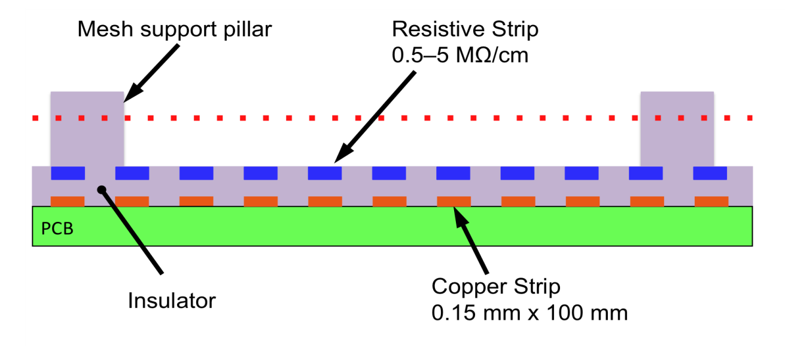
Different Resistive protection approach with Micro-Megas
Medium rate detectors
High rate detectors
Printed
2 layers screen printed resistors
Single layer screen printed
SBU
2 “DLC+” layers → SBU
1 DLC
Mix
MIX DLC and screen printed

Slide 11
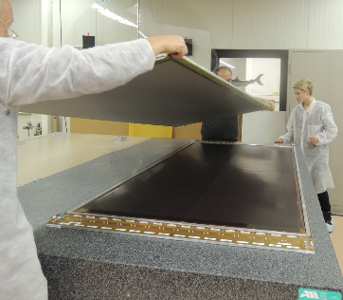
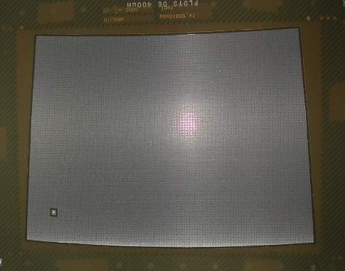
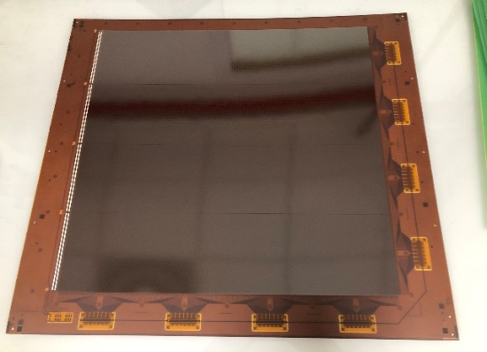
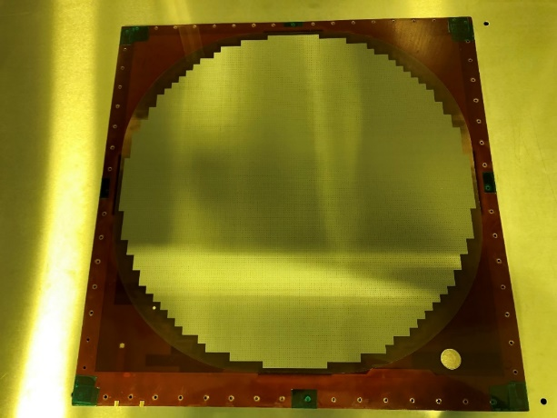
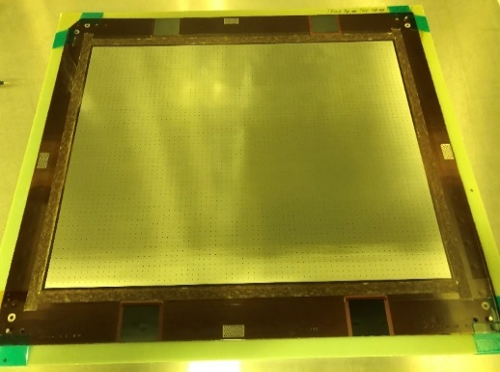
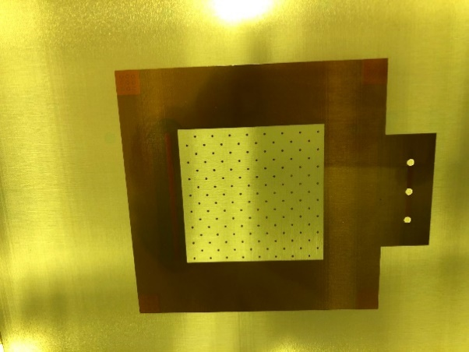
Resistive Micromegas:
1 printed layer
1 DLC
1 DLC
2 printed layers
ILC TPC
30cm x 15cm
3mm x 8mm pads
2M/Sqr sharing layer
20 LSBB
50cm x 50cm
X/Y 1mm/1mm
30M/Sqr sharing layer
5 ILC DHCAL
50cm diameter
pads 1cm x 1cm
5M/Pad
ATLAS NSW
Strips 100k/Sqr
2m x 1m
1 DLC
2”DLC+” SBU
MIX DLC/Printed
32 T2K upgrade
40cm x40cm
1cm x 1cm pads
500K/Sqr sharing layer
1 Demonstrator
5cm x 5cm
1mm x 3mm pads
2R layers 30M/sqr
2 Demonstrators
5cm x 5cm
pads 1mm x 3mm
5 and 20M/pad

Slide 12
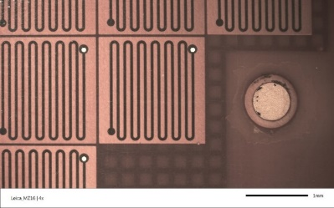
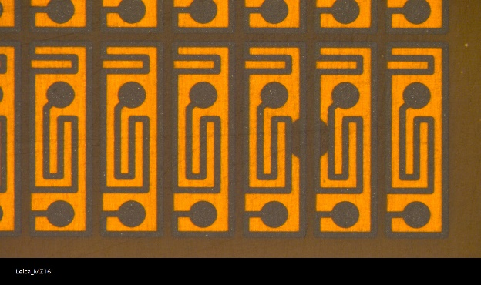
2 Printed layers
-Extra Large DOCA
-Embedded Res should be less than 10KOhms/square
-Large pads
-Accurate layers registration even in large size
-No DLC needed
-High rate detectors
PCB
Coverlay gluing + drilling + via fill
1cm x 1cm pad→ Ok
There is space to create
2 to 20 Mohms Resistor
with 10K/sqr paste
Resistive paste resistors
(10KOhms/square max)
Coverlay gluing + via fill
+ top resistive printing (100K max)
1mm x 3mm pad→ Bad result
There is no space to create
2 to 20 Mohms Resistor
with 10k paste
‘BULKage’
DOCA: 10mm

Slide 13
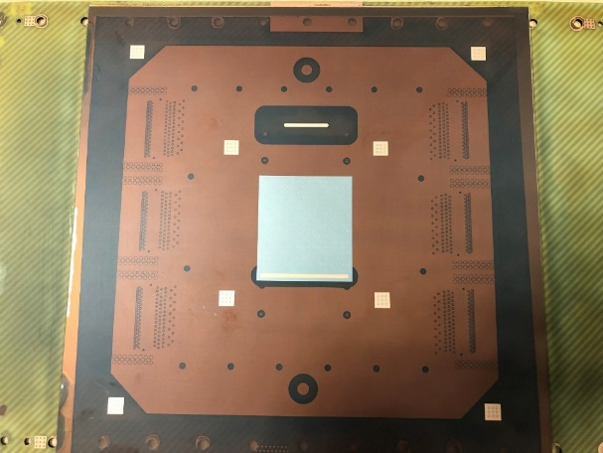

2 “DLC+” structure with SBU process
Sequential Build Up
-Extra Large DOCA
-any resistive value
-Adjustable evacuation point density VS rate
-No major resistive change during production
-Needs “DLC+”
-delamination
-resistive value
-DLC value hidden during processing
-no problem with layers registration
-good energy resolution
-100% compatible with STD PCB processes
PCB
Glue “DLC+”
drill
Plate
Pattern Cu
Glue “DLC+”
drill
Plate
Pattern Cu
‘BULKage’
DOCA: 3mm

Slide 14
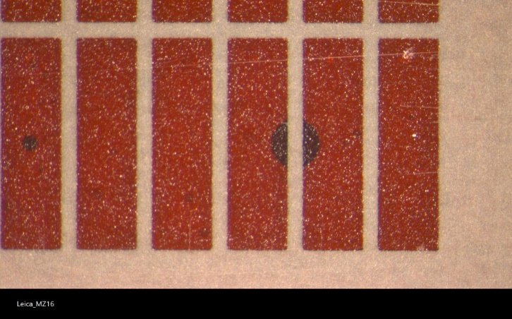
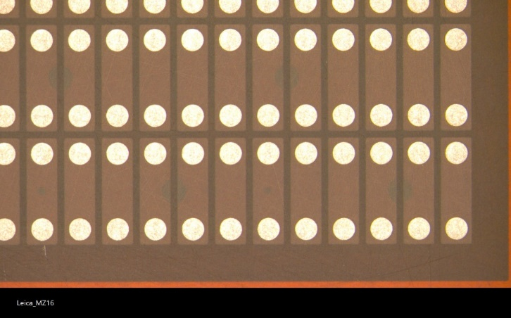
MIX method
-Large DOCA
-Any resistive value
-Maximized evacuation point location
-No major resistive change during production
-Needs simple DLC foils
-no problem with large size layers registration
-the filling technic is not STD in PCB world
-Ultra high rate detectors
PCB
DLC Gluing
DLC pattern
Drilling
Coverlay
Silver paste fill
Coverlay
Res paste fill
‘BULKage’
DOCA: 2mm

Slide 15
Summary on R-MM
We have now solutions for :
  Large signal spreading
  High rate
  Small pads
  Large size
We need to improve the DLC/Cr/Cu deposit to propose a solution 100% compatible with industry (out of the BULK process).
We need also to work on the DLC resistive value prediction with “DLC+” materials
Resistive detectors need better cleanliness during production than STD ones
DLC can be patterned

Slide 16
Different Resistive protection in µRwell
High rate detectors
SG
µRwell
1”DLC+” with Silver or Cu evacuation Grid
DF
Single DLC layer
1 DLC with Drill and fill method
SBU
2 “DLC+” Sequential Build Up

Slide 17
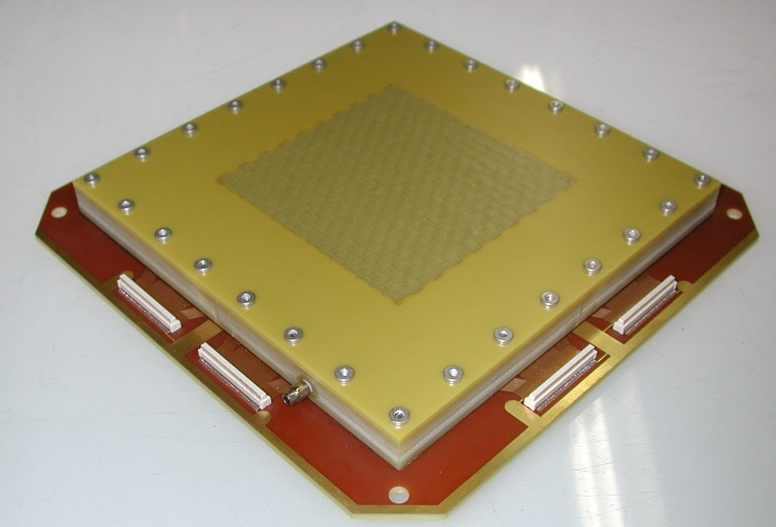
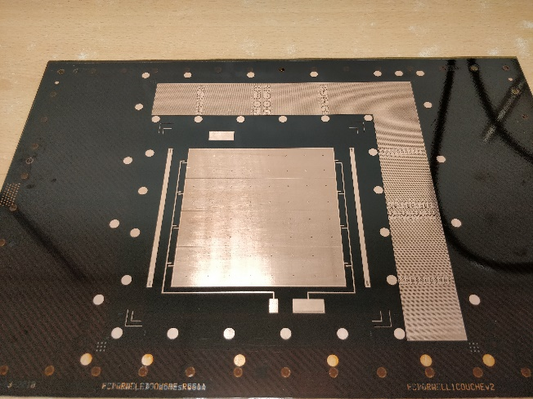
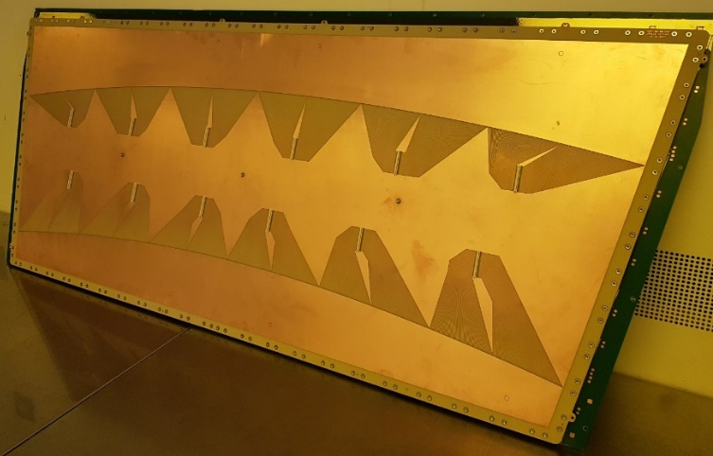
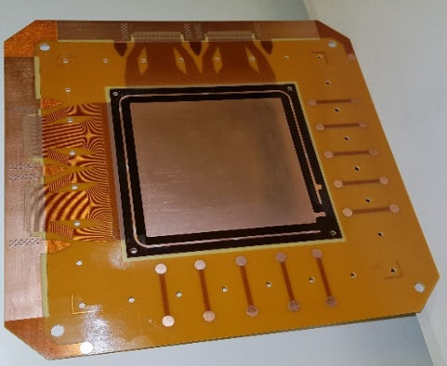
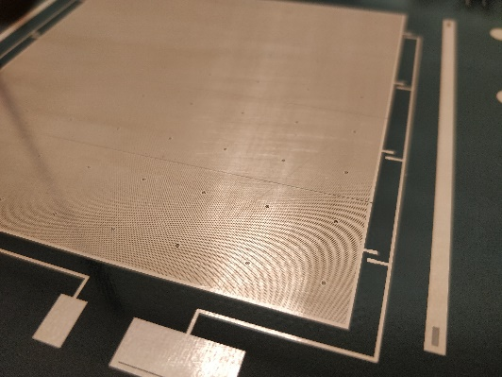
µRwells examples :
Large µRwell detector
Like CMS GE21 module M4
120cm x 55cm
10cm x 10cm
µRwell detector
“study kit”
10cm x 10cm
µRwell detector
drill and fill
And SBU

Slide 18
Classical µRwell
Copper Mesh 5um
Polyimide 50um
DLC 0.1um
Pick up pads/lines
+
1 gluing/1 patterning/1 etching
Probably the simplest MPGD
Single piece
Flexible
-
Lateral current evacuation
Delivered to : Stony Brook , Novosibirsk, Virginia ,China, Frascati
Sizes from 10cm x 10cm up to 1.2m x 0.5m

Slide 19
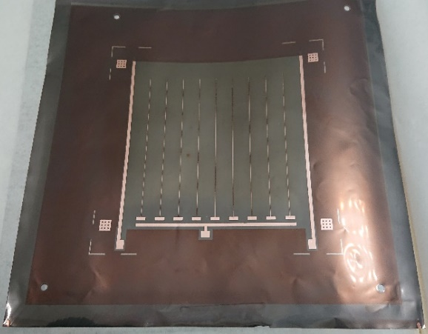
SG type:
Silver or Cu Grid
1 DLC drill and fill
“DLC+”
-Really simple construction
-Low cost
-Any resistive value can be proposed
-Adjustable evacuation line density VS rate
-Efficiency is design dependent
-No major resistive change during production
-Needs copper plated “DLC+”
-DOCA accuracy depends on mesh to line registration
-Subject to 0.5mm line to mesh miss-registration in 1m size
-Mesh to line miss-registration critical above 100um
-Needs an distortion scaling system to pattern the mesh
R/O
Make Grid
R/O
Cu strips
GLUE
DLC area
0.6mm
“DLC+” foil
‘Wellize’
DOCA: 0.25mm for 80M
0.1mm Cu line , 12mm pitch
0.6mm blind zone → efficiency above 97%

Slide 20


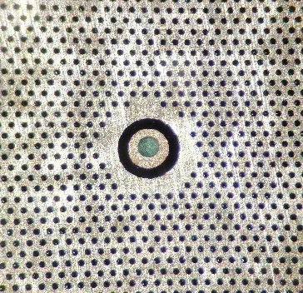
DF Type
Drill and Fill
R/O
DLC
gluing
-DOCA under better control
-simple construction
-any resistive value
-Adjustable evacuation point density VS rate
-No major resistive change during production
-Needs simple DLC foils
-no problem for large size registration
-Silver filling is not STD in PCB world
-DLC to silver contact need to be improved
A solution is in progress to address
these 2 last points
Drill
12mm
Fill
‘Wellize’
DOCA : 0.25mm
0.2mm hole
0.7mm dead zone
0.7mm

Slide 21
SBU type
Sequential Build Up
R/O
DLC+
Pattern Pads
& Glue
-Extra Large DOCA
-Any resistive value can be used
-Adjustable evacuation point density VS rate
-No major resistive change during production
-Needs copper plated DLC+
-possible layers miss-registration up to 0.5mm in large size
-Miss-registration critical above 0.5mm
-100% compatible with STD PCB processes
Drill
Plate
& Etch
DLC+
Pattern Pads
& Glue
Drill
Plate
& Etch
‘Wellize’
DOCA : 6mm
0.7mm

Slide 22
Summary on uRwell
We have now solutions for :
  Large spreading
  High rate
  Small pads
  Large size
We need to improve the “DLC+” material to propose a solution 100% compatible with industry.
We need also to work on the DLC resistive value prediction with “DLC+” materials
DLC can be patterned

Slide 23

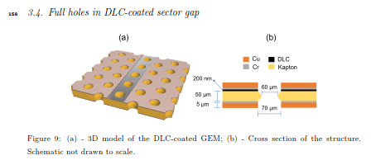
DLC Resistive GEM
“DLC+”
“DLC+”
“DLC++”
Cu/Cr
pattern
+ sand blasting
+ sand blasting
Kapton
etch
Cu/Cr
etch
FTM process
In progress
Waiting for good base material

Slide 24
Resistive THGEM
Kapton with DLC
PCB
Kapton with DLC
Glue the 3 parts with prepreg
Drilling like a THGEM

Slide 25
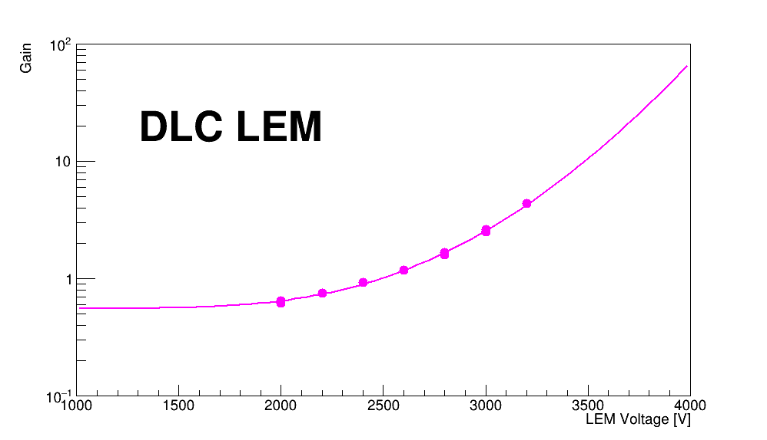
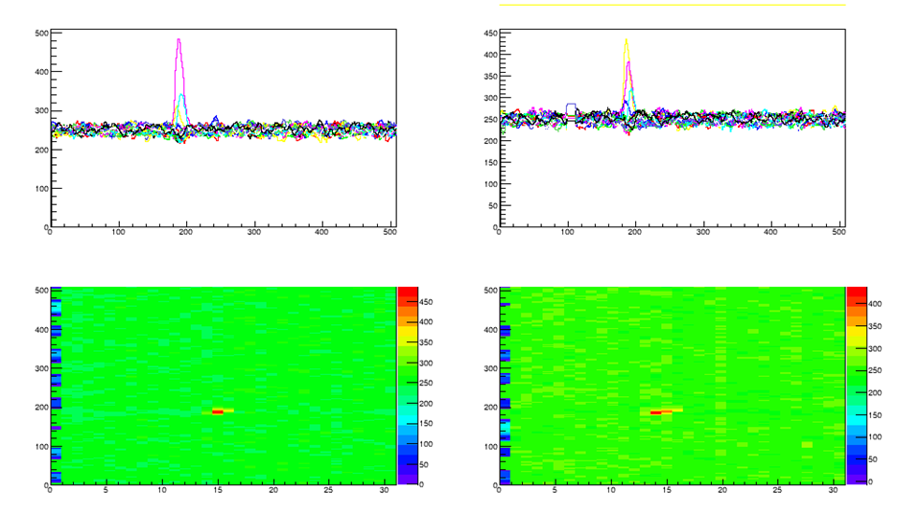
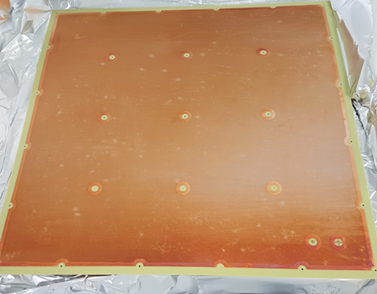
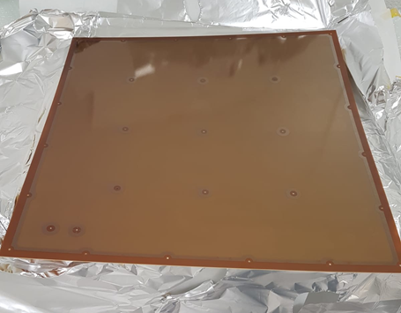
Resistive LEM
Tests @ CEA/Irfu
Quenching of discharges with resistive 50×50 cm² LEM :
Made at CERN EP-DT-EF :
- copper side facing readout anode
- DLC on 50 µm APICAL polyimide film (250 MΩ/)
- same geometry as CFR-35 (ProtoDUNE-DP)
- no rims, no gold plating on copper face.
Tests in progress at CEA/Irfu.
R&D will continue in collaboration with CERN.
Signal from 5.5 MeV alpha
Time bin
Time bin
Copper face
DLC face
Channel no
Channel no

Slide 26
Problems with
-DLC
-DLC+

Slide 27
DLC uniformity
1m x 0.6m foils 500Kohms/square target

Slide 28
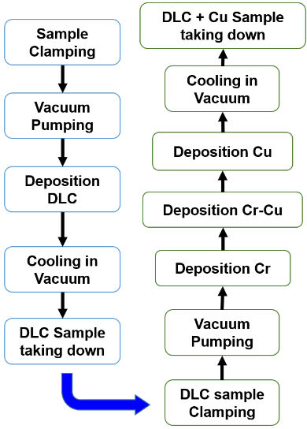
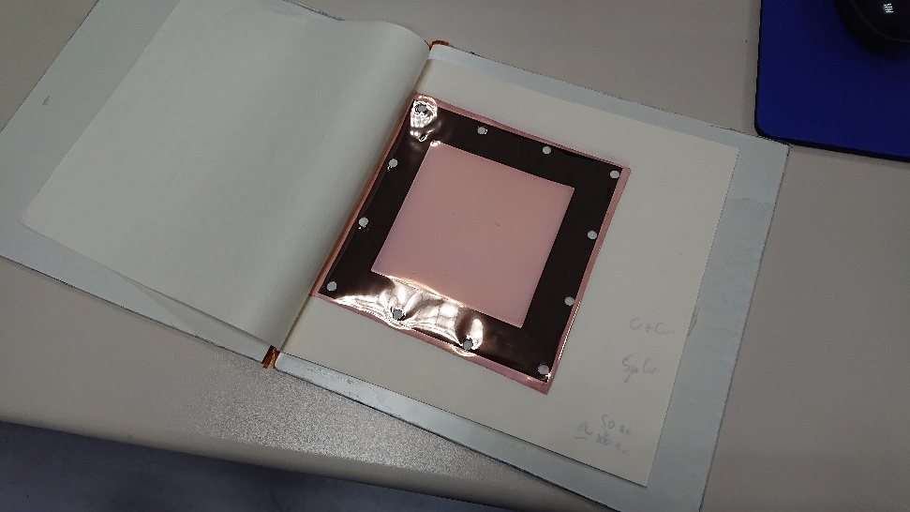
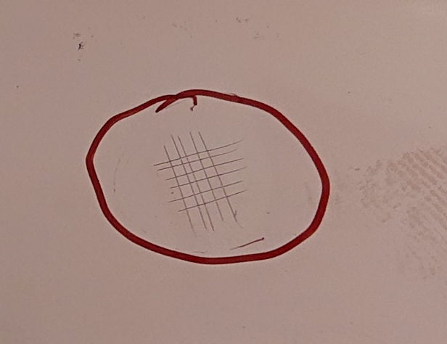
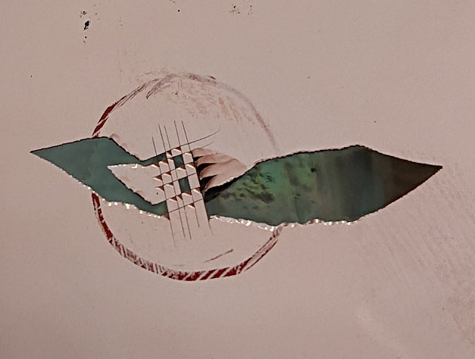
“DLC+” adhesion
Cu
Cr
DLC
Apical
Adhesion force estimation
100% Base material
50% HEIFEI 300 deg deposition
40% ESS
30% HEIFEI center of the foil
10% HEIFEI outer Part
The DLC Value is always much lower after copper
removal (HEIFEI but also ESS) by a factor of 4 to 10
Scalpel cut
After tape peeling

Slide 29

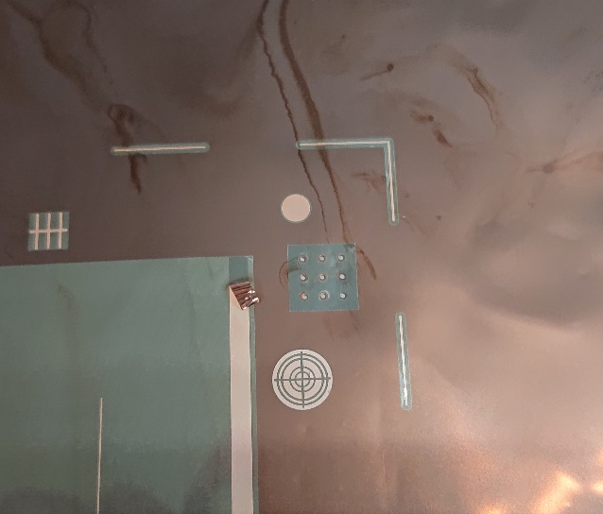
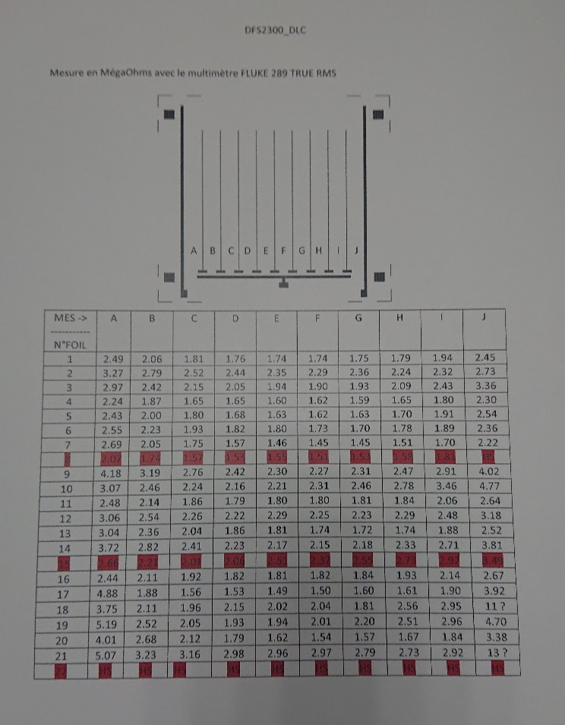
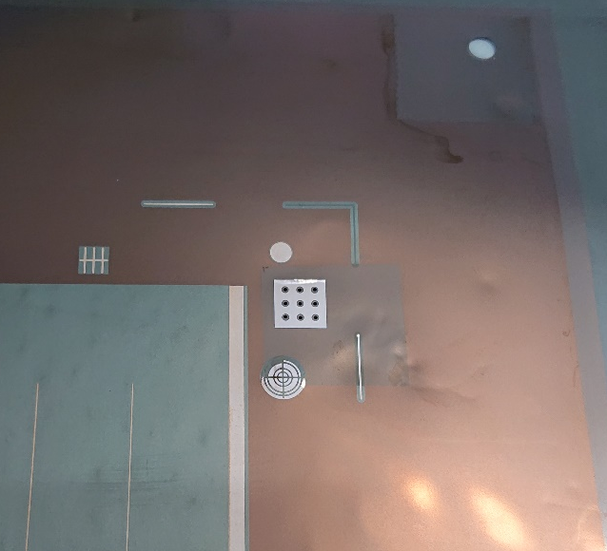
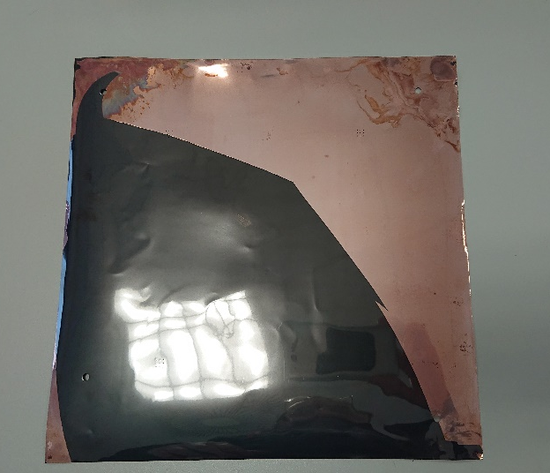
“DLC+” : present adhesion is just at the acceptable level
20 foils produced → SG detectors
Resistor shape factor of 10
20 Mohms/sqr instead of 80 expected
Lower values at the center
Good repeatability
Signs of weak Cu/Cr to DLC interface
on 3 foils
25cm
25cm

Slide 30
conclusion
We need to Improve the DLC+ and DLC++ materials
  But robust solutions with simple DLC already exist
We need to work on DLC uniformity
  But the present uniformity is ok for a lot of applications
DOCA study should be continued
  Find the parameter to adjust material evaporation (design and materials)

Slide 31
Thank you
Questions?

Slide 32
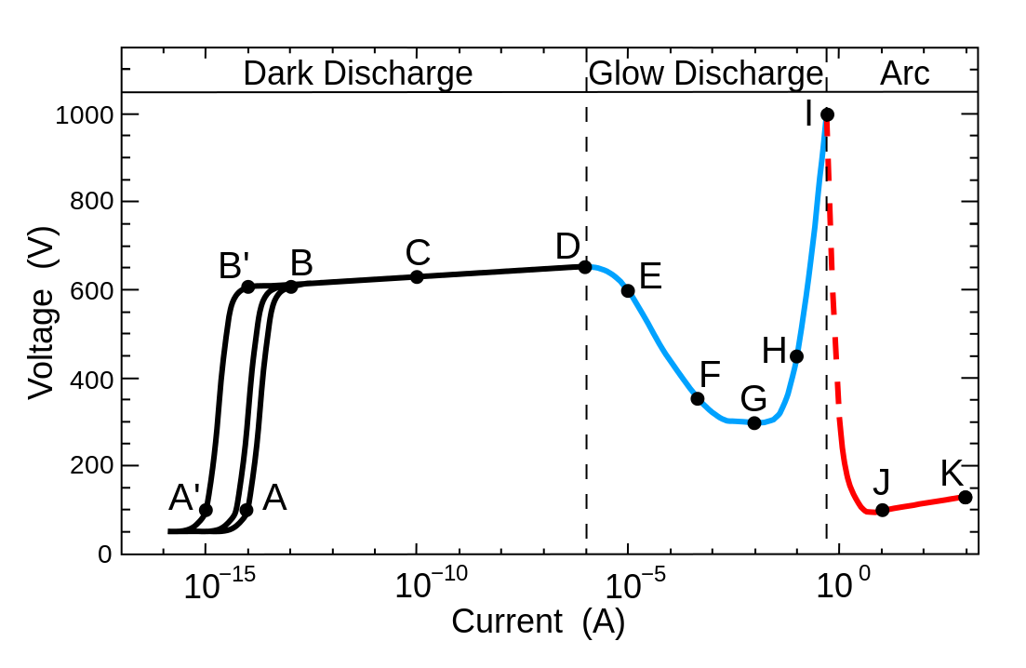
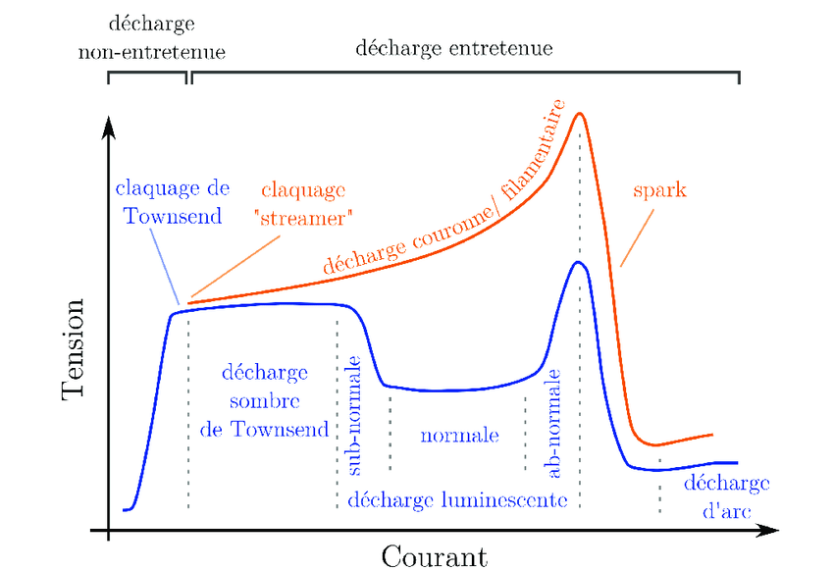
Voltage versus current characteristics for neon gas at 1 Torr pressure between flat electrodes spaced 50 cm.
A-D dark discharge
A-B: non-self-sustaining discharge and collection of spontaneously-generated ions.
B-D: the Townsend region, where the cascade multiplication of carriers takes place.
D-I glow discharge
D-E: transition to a glow discharge, breakdown of the gas.
E-G: transition to a normal glow; in the regions around G, voltage is nearly constant for varying current.
G-I: represents abnormal glow, as current density rises
I-K arc discharge

Slide 33
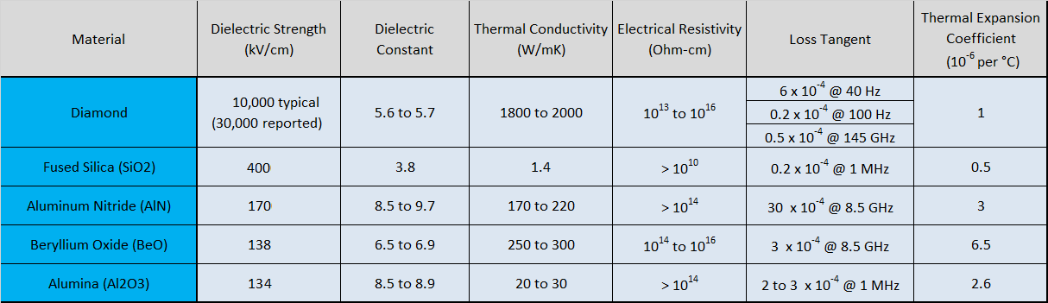
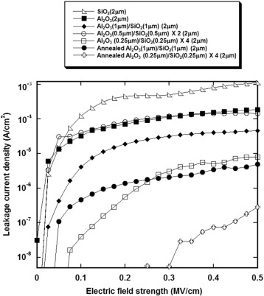
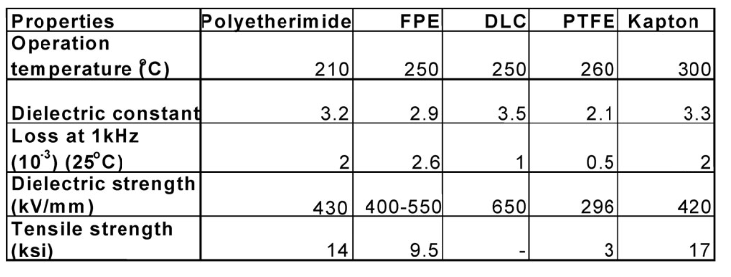
Thin Solid Films
Volume 595, Part A, 30 November 2015, Pages 171-175
Electrical insulation and breakdown properties of SiO₂ and Al₂O₃ thin multilayer films deposited on stainless steel by physical vapor deposition
Author links open overlay panelJosuMartinez-Perdiguero^{ab}LuciaMendizabal^{b}Maria C.Morant-Miñana^{ac}IreneCastro-Hurtado^{ac}AritzJuarros^{ab}RocíoOrtiz^{ad}AinaraRodriguez^{ac}
figure 5. Dielectric, resistivity and thermal properties of diamond and other electrically
insulating material. Source: NIST, Manufacturers and R&D Literature
figure 6. Capacitors dielectric materials comparison.
Source: IEEJ Dielectric Materials for Capacitors

