Slide 1

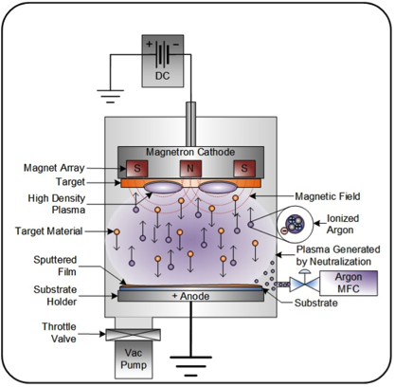
Coating Machine Project
Theory
PVD = PHYSICAL VAPOR DEPOSITION
HPCVD= Hybrid Physical-Chemical Vapor Deposition or Reactive PVD

Slide 2
Coating Machine Project
In our Workshop, we have experienced in :
-PVD coating for Low Mass circuit in LHC detector
Aluminium bus circuit (Alice) 12microns to 35microns thickness
-PVD coating for tribological caracteristics
TiN, TiCN, TiAlN, CrN, BN in machining application, molded plastic application
-PVD coating for decorative application
TiO2, Cr, Au, Ni
-PECVD coating like DLC in automotive application
-Surface activation of polymer by Reactive Plasma RF
-Etching and reactive etching on polymer and metal
-Preparation by plasma
Grafting molecule Polyvinyl-pyrolidone on implant medical

Slide 3
Coating Machine Project
Expected capabilities
- Deposition by HPCVD DC magnetron
-DLC , Cu, Cr , Al, B4C
-Backing
-Cleaning
-reverse sputtering of the substrate (RF plasma for dielectrics)
- Sputtering / Co-sputtering
-adjustable gradient of material or layer by layer coating
-Reactive sputtering
-adding H2, N2, CH4, C4H10, Ne to Argon
-Large coating area
-with a good homogeneity of thickness to garanty resistance homogeneity
-due to Cost restriction we have selected an existing machine

Slide 4
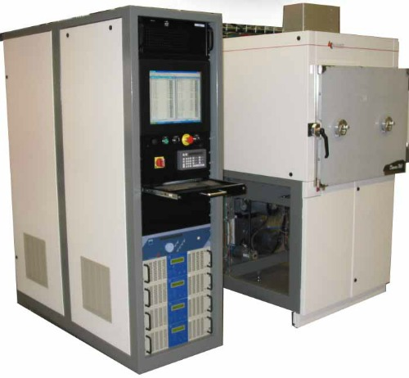
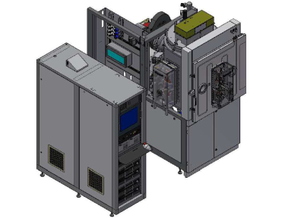
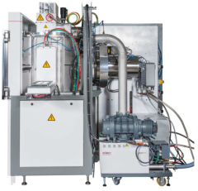
DECORA 760+
Upgrade configuration
Standard configuration
2376mm
2911mm
2147mm
Pumping system :
-1 dry pump
-2 turbomolecular pump
Pressure limit 5.10-7mbar
Getter effect if necessary by metal emission
Chamber treatment:
800mm x diam 760mm

Slide 5
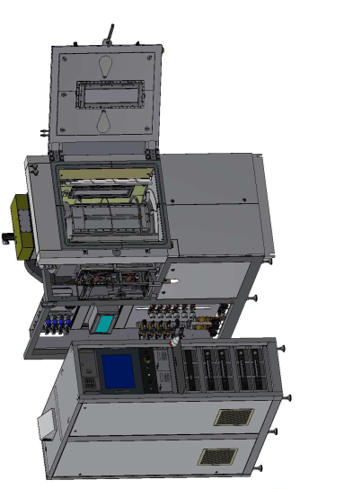
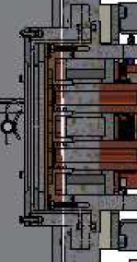
Carbon cathode 1
cathode 2
Cupper cathode 3
Chromium cathode 5
cathode 4
5 Cathodes for SPUTTERING :
usable with all material ,like carbon, metallic, alloy, B4C or segmented cathode…
Different configurations, step by step layer, co-sputtering and without machine output
Heater : 300 deg maximum, degazing material

Slide 6
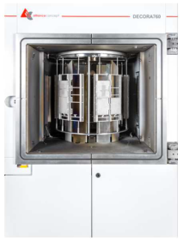
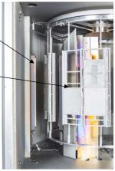
INTERNAL VIEW
760mm
800mm
cathode
Substrate holder
polarised
CATHODE
Gas injector close up of each cathode, mono pur gases or mixed gases (H2, N2, CH4….)
-Surface treatment of foil :
external face = 1,7m x 0,6m
Internal face = 3 segments of 0.5m x 0,6m

Slide 7
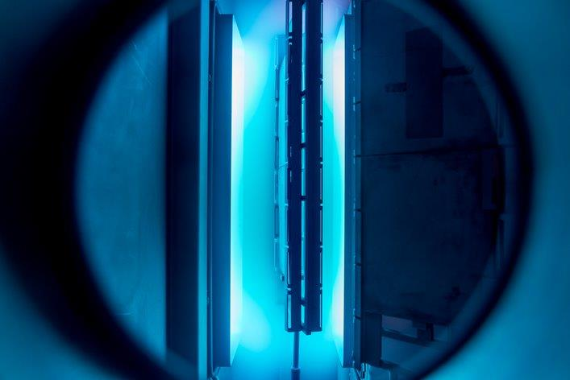
Homogeneity
Homogeneity with cathode 500mm length x 127mm width
+/-4% = 360mm width
+/-30% = 450mm width
+/-50% = 470mm width
Theorical capacity of coating : 1 foil 1.7mx 0.6m per batch
Cost : around 500kEuro

Slide 8
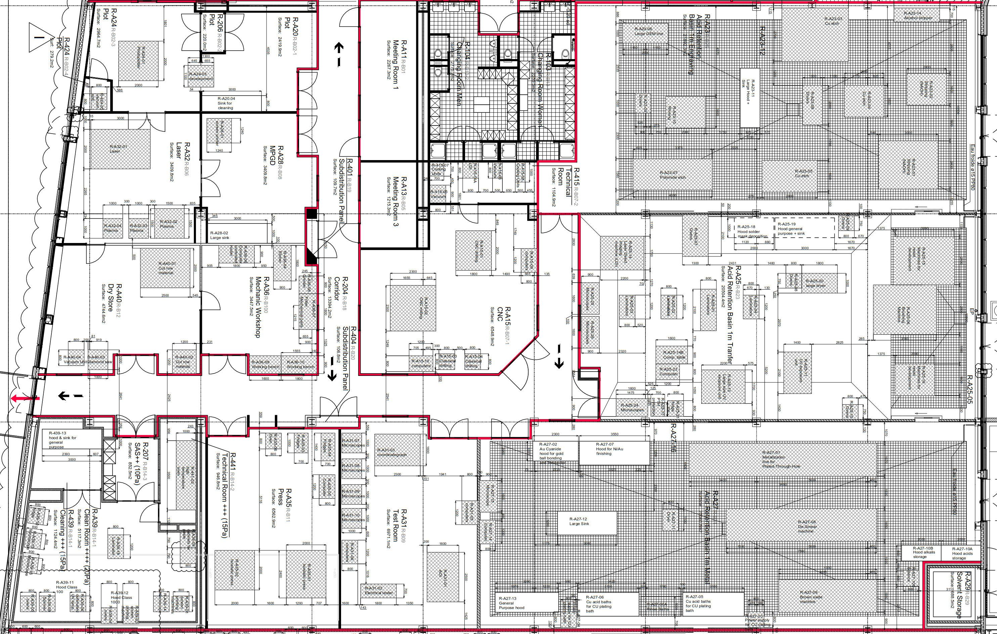
Implementation in 107 Building
UV scanner
DLC machine

Slide 9

Coating Machine Project
Experiences
Machine
Implementation
Funding

