Slide 1
The Timepix4 design parameters
  X. Llopart,
  On behalf of the Medipix4 Collaboration
11th February 2020

Slide 2

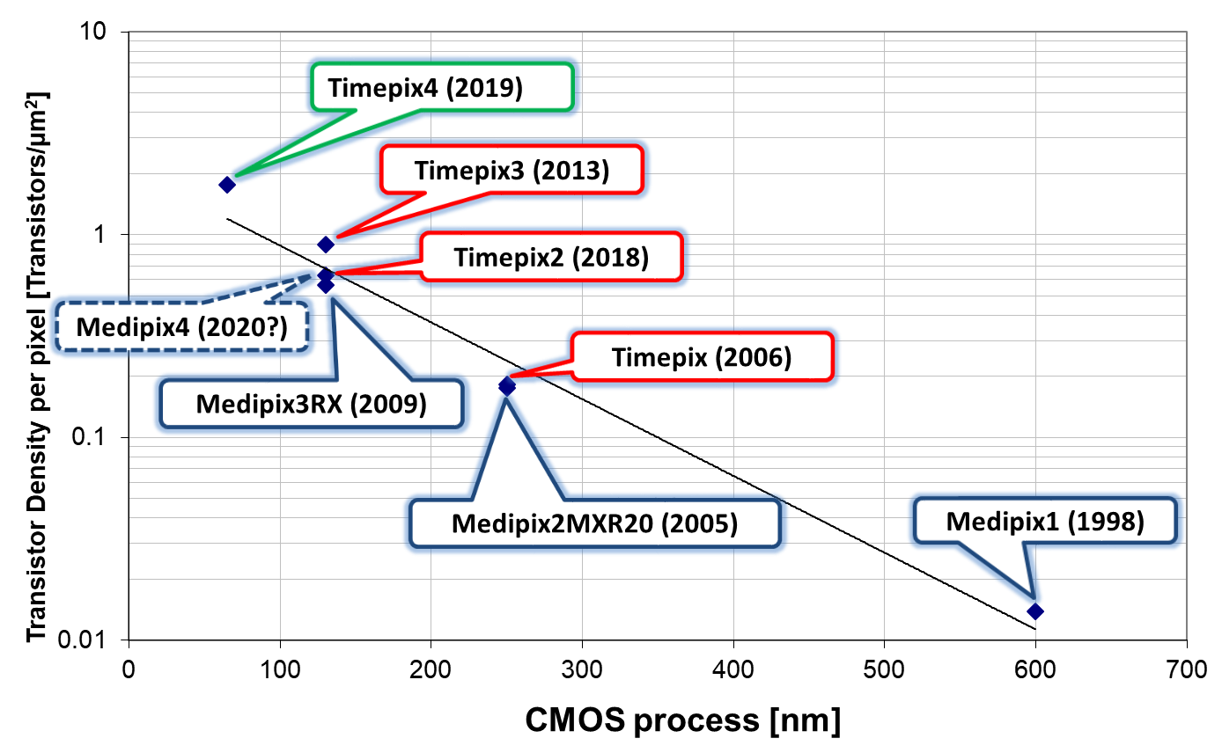
Medipix4 Collaboration (from 2016)
CEA, Paris, France
CERN, Geneva, Switzerland,
DESY-Hamburg, Germany
Diamond Light Source, Oxfordshire, England, UK
IEAP, Czech Technical University, Prague, Czech Republic
JINR, Dubna, Russian Federation
NIKHEF, Amsterdam, The Netherlands
University of California, Berkeley, USA
University of Houston, USA
University of Maastricht, The Netherlands
University of Canterbury, New Zealand
University of Oxford, England, UK
University of Geneva, Switzerland
IFAE, Barcelona, Spain
University of Glasgow, UK
Timepix4: A 4-side tillable large single threshold particle tracking detector chip with improved energy and time resolution and with high-rate imaging capabilities
15 members

Slide 3
Timepix4 applications
Data-Driven applications:
  HEP:
    Very high rate pixel telescope
    Sensor studies (high speed)
    Beam gas interaction (PS SPS/LHC?)
    AeGIS/ASACUSA
    ATLAS background rad monitor and TRD detector
    MOEDAL
    GEMPIX / large area TPC
    Test vehicle for next gen LHCb-VELO with tens of ps time resolution
  Time-of-flight mass spectrometry
  Neutron time-of-flight imaging
  Radiation monitors
  Electron microscopy
  X-ray and powder diffraction
  Compton camera for medical diagnostics
  Sub-pixel resolution imaging
  Gamma and neutron imaging for nuclear industry and Homeland Security
Frame-based imaging applications:
  X-ray imaging in synchrotrons with extreme high rates > 10⁹ particles/mm²/s
20th Anniversary Symposium on Medipix and Timepix
  https://indico.cern.ch/event/782801/

Slide 4
Timepix4 main requirements
Use of a commercial 65nm CMOS process
Build a 4-side buttable “as large as possible” pixel array
Particle identification and tracking (Data-driven and zero suppressed)
  Sub-ns time binning
  Improve the energy resolution
Imaging (frame based with CRW sequential readout)
  Increase particle count rate
Designers:
  CERN: R. Ballabriga, T. Poikela, E. Santin, V. Sriskaran, N. Egidos and X. Llopart
  Nikhef: V. Gromov and A. Vitkovskiy
  IFAE: R. Casanova

Slide 5
Timepix3 → Timepix4
 |  |  | Timepix3 (2013) | Timepix4 (2019)
Technology |  |  | 130nm – 8 metal | 65nm – 10 metal
Pixel Size |  |  | 55 x 55 µm | 55 x 55 µm
Pixel arrangement |  |  | 3-side buttable 256 x 256 | 4-side buttable 512 x 448
Sensitive area |  |  | 1.98 cm² | 6.94 cm²
Readout Modes | Data driven (Tracking) | Mode | TOT and TOA
 |  | Event Packet | 48-bit | 64-bit
 |  | Max rate | 0.43x10⁶ hits/mm²/s | 3.58x10⁶ hits/mm²/s
 |  | Max Pix rate | 1.3 KHz/pixel | 10.8 KHz/pixel
 | Frame based (Imaging) | Mode | PC (10-bit) and iTOT (14-bit) | CRW: PC (8 or 16-bit)
 |  | Frame | Zero-suppressed (with pixel addr) | Full Frame (without pixel addr)
 |  | Max count rate | ~0.82 x 10⁹ hits/mm²/s | ~5 x 10⁹ hits/mm²/s
TOT energy resolution |  |  | < 2KeV | < 1Kev
TOA binning resolution |  |  | 1.56ns | 195ps
TOA dynamic range |  |  | 409.6 µs (14-bits @ 40MHz) | 1.6384 ms (16-bits @ 40MHz)
Readout bandwidth |  |  | ≤5.12Gb (8x SLVS@640 Mbps) | ≤163.84 Gbps (16x @10.24 Gbps)
Target global minimum threshold |  |  | <500 e⁻ | <500 e⁻
3.5x
33%
8x
5x
2x
8x
4x
32x

Slide 6
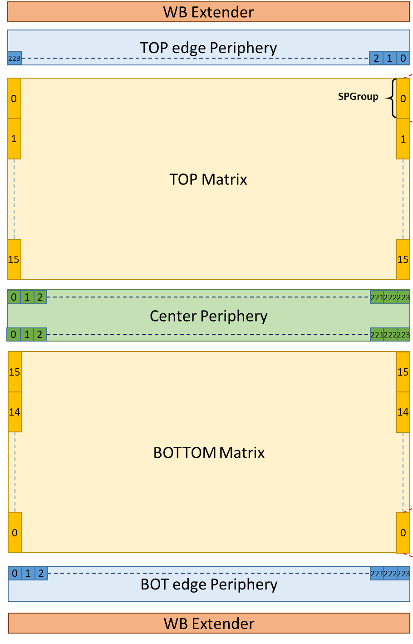

Timepix4 floorplan arrangement
512 x 448 of 55 x 55 µm pixels
3 “hidden” peripheries with TSV (Through-Silicon-Vias):
  TOP Edge: Data Readout & Slow Control
    147 TSVs/WBs: 106 POWER/GND and 41 IO
  BOTTOM Edge: Data Readout & Slow Control:
    147 TSVs/WBs: 106 POWER/GND and 41 IO
  CENTER: Slow Control and Analog Blocks (DACs, ADC, Band-Gaps…)
    147 TSVs: 124 POWER/GND and 23 IO
On-chip bump to pixel redistribution layer (RDL)
Chip size:
  With WB (wirebonds extenders): 29.96 mm x 24.7 mm
    >93.7% active area (28.16mm x 24.64mm)
  Without WB (TSV Only) : 28.22 mm x 24.7 mm
    >99.5% active area (28.16mm x 24.64mm)
Control architecture allows to operated Timepix4 from any of the 3 peripheries:
  i2C protocol
  Custom Slow Control protocol
  Interface to DAQ:
    Through 3xTSVs
    Through 2xWB
Fast readout requires at least 1 serial link enabled in each edge periphery:
  Serial links are highly configurable 40MBps → 10GBps
24.7 mm (448 pixels)
29.96 mm (512 pixels)
28.22 mm (512 pixels)

Slide 7
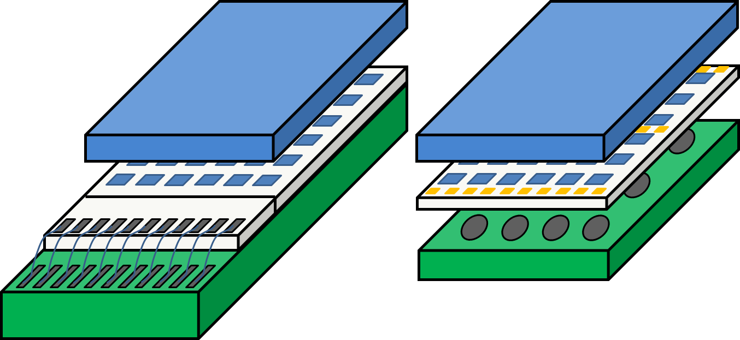
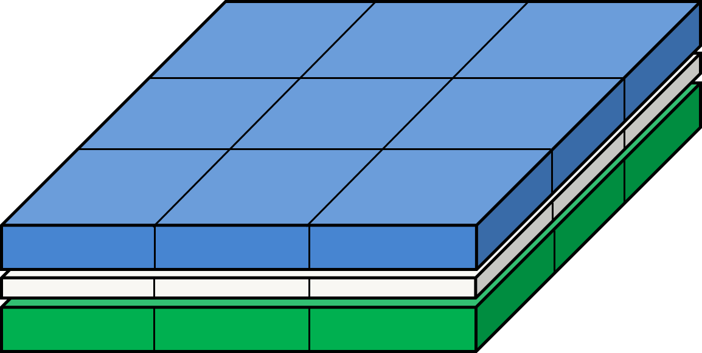
4-side buttable pixel arrangement
FC
FC
Sensor
BGA
ASIC
Wire Bonding
PCB
Target to build large area detectors by combining smaller modules
The through-silicon vias (TSVs) is the key technology for this paradigm shift

Slide 8
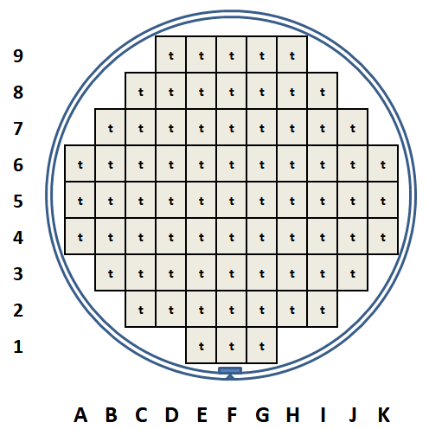
Expected Timepix4 Yield
Timepix3/Medipix3
Yield=73%
Timepix3/Medipix3
192/261 good dies
Timepix4
30/73 good dies
Timepix4
Yield=37%
*Based in the foundry yield model for perfect dies

Slide 9
Timepix4 Pixel Schematic
1 pixel
8 pixels
32 pixels
Front-end
Front-end
Super pixel
SPG
8-bits
Leakage
Current
compensation
Counters
&
Latches
 | bits
ADDR | 9
ToA | 16
ufToA_start | 4
ufToA_stop | 4
fToA_rise | 5
fToA_fall | 5
ToT | 11
Pileup | 1
8-bits
Clock
local
Sync
Readout
ADB
Input
pad
2.5fF
Synchronizer
&
Clock gating
Preamp
TestBit
~50mV/ke⁻
MaskBit
16-bits
VCO
@640MHz
8-bits
8
5-bit Local
Threshold
4
3fF
640MHz
TpA
TpB
Time stamp
OP Mode
Control
voltage
Data out
to EOC
clock
(40MHz)
Global threshold

Slide 10
Pixel Operation in TOA & TOT [DD]
Tpeak < 25ns
Preamp Out
Disc Out
ClkRef (40MHz)
Global TOA (16-bit)
65533
65534
65535
0
1
2
3
4
VCO Clk (640MHz)
FTOA_RISE (4 bits)=7
FTOA_FALL (4 bits)=11
TOA (16-bit)
X
65534
TOA (16 bits)=65534
TOT Clk (40MHz)
TOT (10 bits) =4
UFTOA_Start (4-bits)
X
0
UFTOA_Stop (4-bits)
X
8

Slide 11
Timepix4 FE
R. Ballabriga
The Timepix4 chip front-end has to be versatile in order to be used:
  With different types of sensors:
    Bipolar detection and <10nA leakage currents (high-Z materials)
  In tracking and as well in imaging:
    Imaging at high rates (e.g. synchrotrons) imposes a minimum pulse width. In order to be at the state of the art in terms of rate capability, the dead time of the front-end should be smaller than ~200ns.
    Tracking applications impose an input jitter in the front-end below 50 ps_{rms} (time bin 195 ps)
FE architecture follows the “classic” Medipix approach (Krummenacher FE)
  Gain adjustment (log gain in hole collection)
  Improved for low jitter and fast count-rate when required → power
Q_{in}=2.2ke⁻
I_{KRUM}=20nA

Slide 12
Timepix4 Slow control and Readout
Timepix4 has separated readout and control data paths
Slow control (SC):
  Protocols:
    I2C protocol
    Custom serial slow control protocol (< 40 MHz)
  Slow control operation can be done from any of the 3 available peripheries
  Registers:
    Pixel matrix configuration > 2 Mb (8-bit/pixel + 24-bit/spgroup)
    Peripheral registers (DAC settings, operation modes, e-fuses, ….)
Data readout (DAQ):
  Each half matrix readout through its correspondent edge periphery
    8 serializers in each periphery with < 81.92 Gbps
  Uses a 64/66b standard protocol
  Zero-suppressed and data driven readout → 64-bit data packet/hit
    TOA/TOT mode
    24b data-driven Photon Counting (PC) mode
  Full frame with Continuous-Read-Write (CRW):
    8-bit or 16-bit Photon Counting (PC) mode

Slide 13
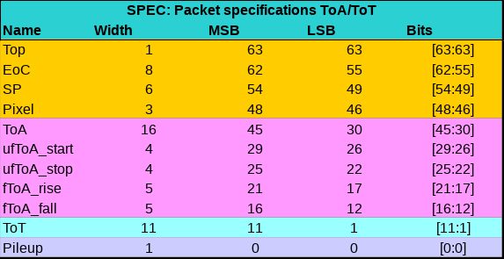
Timepix4 Readout Modes : Data-Driven
Zero-suppressed continuous data-driven
  Output bandwidth from 40 Mbps (2.6 Hz/pixel) to 160 Gbps (10.8 KHz/pixel)
  Uses 64b/66b standard encoding communication protocol
Shutter
Acquisition time
Qin
DataOut
64bit
64bit
64bit
64bit
64bit
64bit
Address: 18 bits
Time: 29 bits
Energy: 21 bits

Slide 14
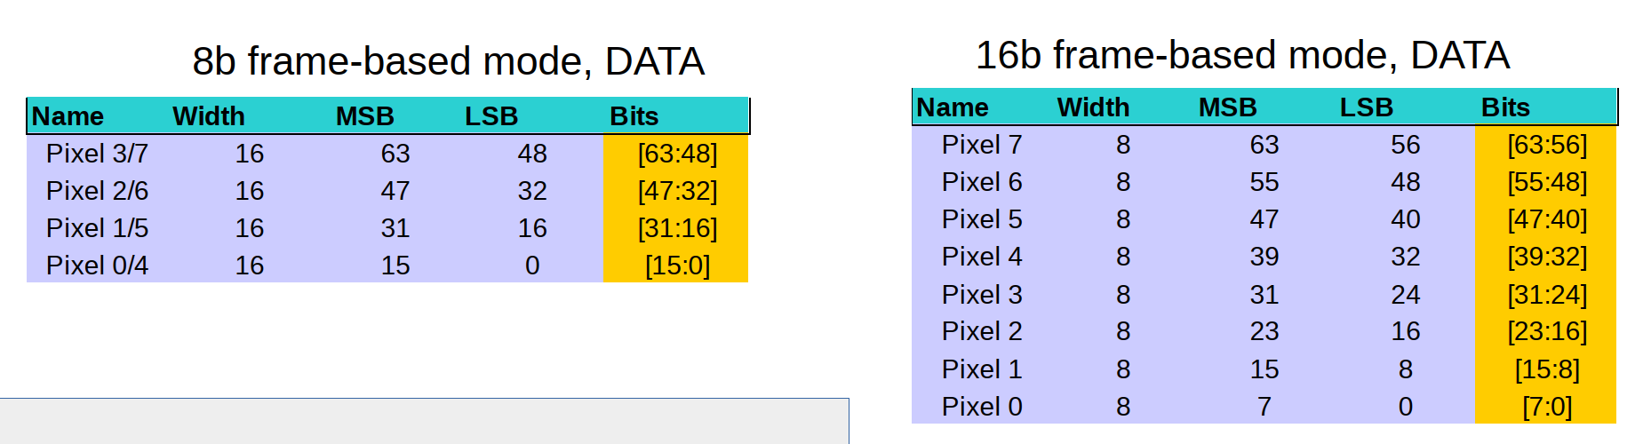
Timepix4 Readout Modes : Frame-based
Full frame readout with continuous read-write (CRW):
  No zero-suppressed → no pixel address sent
  8-bits or 16-bit counter depth
  Uses 64b/66b standard encoding communication protocol
  Frame rate limited by bandwidth:
    16-bit @ 8Ghits/mm²/s > 1.28 Gbps → ~370 fps up to 44.6 Kfps @ 163.84 Gbps
    8-bit @ 1Ghits/mm²/s > 20.48 Gbps → ~11.8 Kfps up to 89.2 Kfps @ 163.84 Gbps
16-bit frame
8-bit frame

Slide 15


On-pixel TDC simulations → TOA resolution
Threshold set at 500 e⁻ and FE with ENC 60 e⁻_{rms}
Timepix3
Timepix4
Timepix4 TOA resolution limited by TDC when Qin > ~10 ke⁻
~451 ps_{rms} ($\frac{25}{16∗\sqrt{12}}$)
~56 ps_{rms} ($\frac{25}{128∗\sqrt{12}}$)

Slide 16
On-pixel TDC simulations → TOT resolution
Qin =1 .2 Ke⁻, RZ=25ns/ Ke⁻ and FE with ENC 60 e⁻_{rms}
Timepix4 TOT measurement dominated by ENC and not by sampling error:
~700 e⁻ FWHM in Si Sensor @ENC 60 e⁻_{rms}

Slide 17
Digital (dynamic) Power Consumption
[data-driven]
Simulated power consumption density to be ~20 % less of Timepix3:
  Digital power consumption 25% less
    Improved pixel matrix clock distribution (DDLL)
    130nm → 65nm
  Analog consumption is ~5% more
    Minimize jitter → < 50ps_{rms}
    Compensate increase in input capacitance
Timepix3
Timepix4

Slide 18

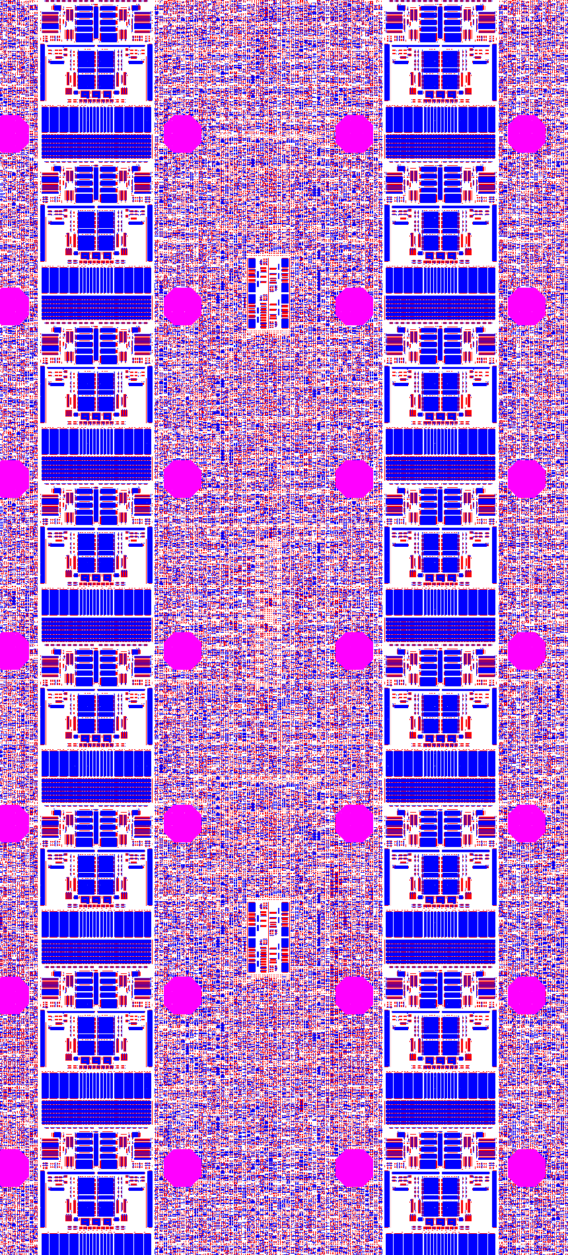
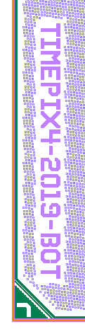
Timepix4 (2019)
24700 µm
Pixel size | 55 x 55 µm
Array | 512 x 448
Pixels | 229376
APLL | 19
ADLL | 16
10 Gbps serializers | 16
On-pixel VCO | 28672
dDLL Columns | 448
Biasing DACs | 13
ADC | 1
Transistors in pixel | ~6000
Transistors in chip | ~1.5 bn
51.4 µm
55 µm
55 µm
VCO
ADB Station
29960 µm
VCO
DIGITAL
ANALOG

Slide 19
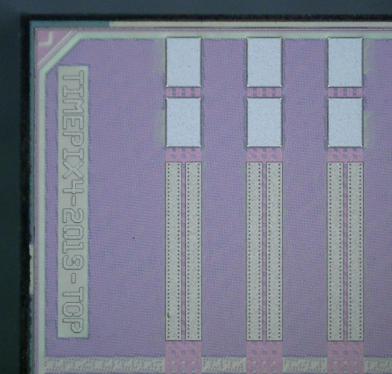
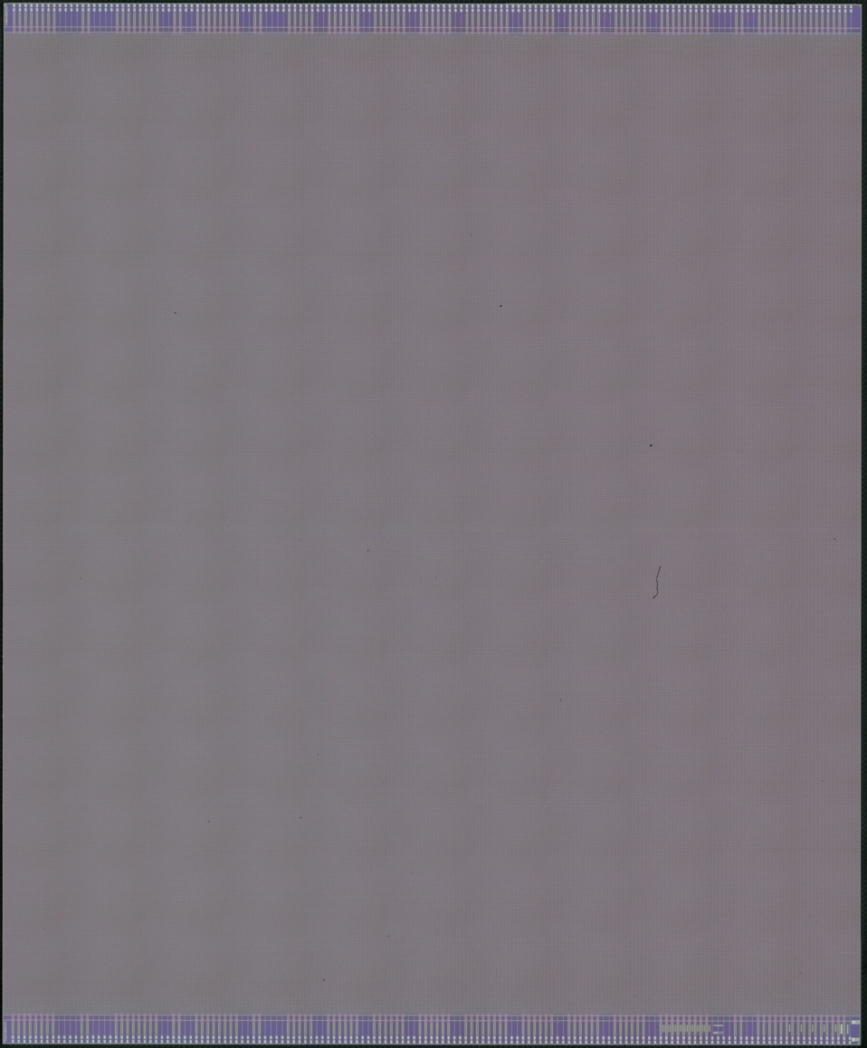
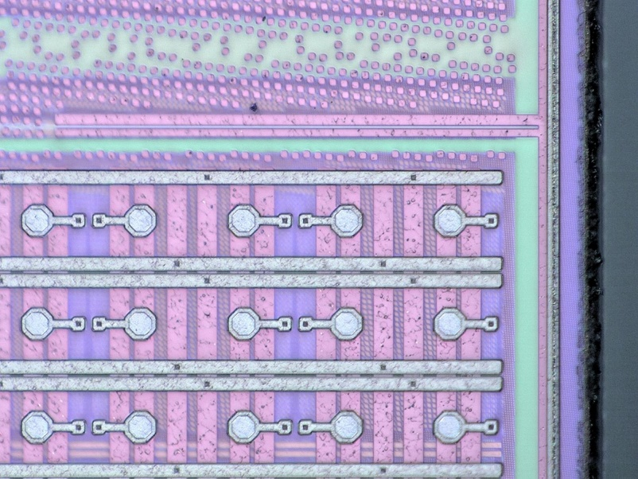
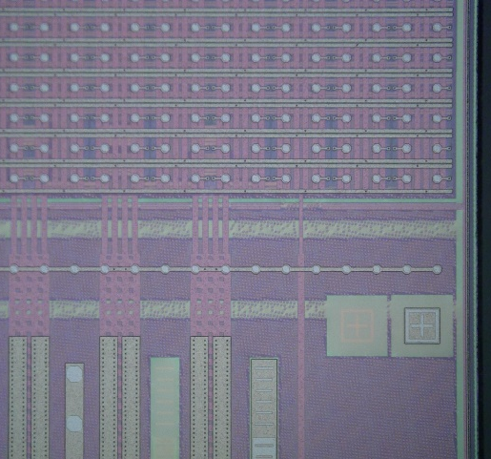
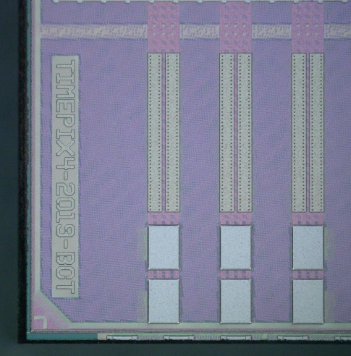
24700 µm
6 wafers received at the end of January
First diced chips available last week
First in the coming days in Nikhef
29960 µm

Slide 20
Conclusions
Timepix4 is the new particle-tracker and photon counting hybrid pixel detector designed with the support of the Medipix4 collaboration:
  Large area hybrid pixel detector with 6.93 cm² sensitive area
  4-side buttable with <0.5% dead area (not sensitive)
  TOA: 23-bit dynamic range (1.6ms) with 195 ps LSB
  TOT: 15-bit dynamic range with 60-100 e- LSB
  PC: 8-bit or 16-bit CRW up to 8*10⁹ hits/mm²/s
  Very configurable architecture to accommodate a large number of different applications
Total design time of ~3 years with 9 engineers → ~13 year FTE
Timepix4 was submitted to fabrication on the 7th of November
First tests in the coming days @ Nikhef

Slide 21
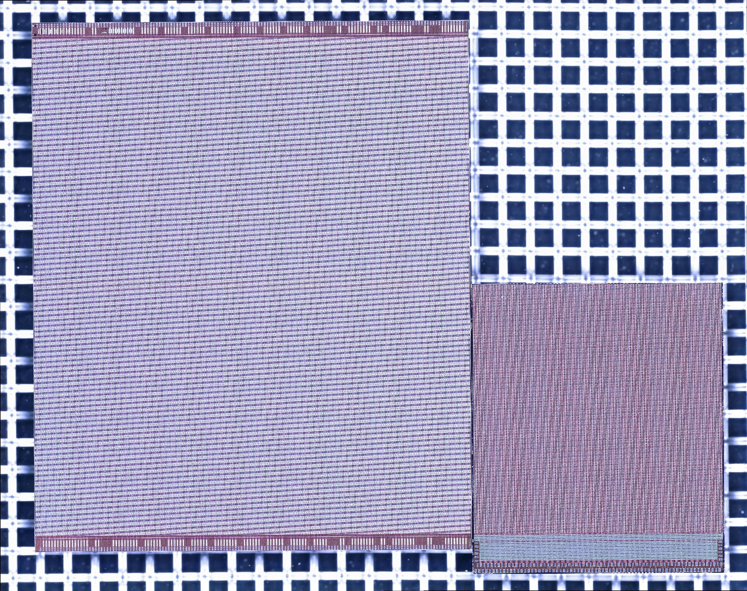
Thank you !
Timepix4
Timepix2
More detailed information in: https://indico.cern.ch/event/788037/
http://medipix.web.cern.ch/

Slide 22
SPARE

Slide 23
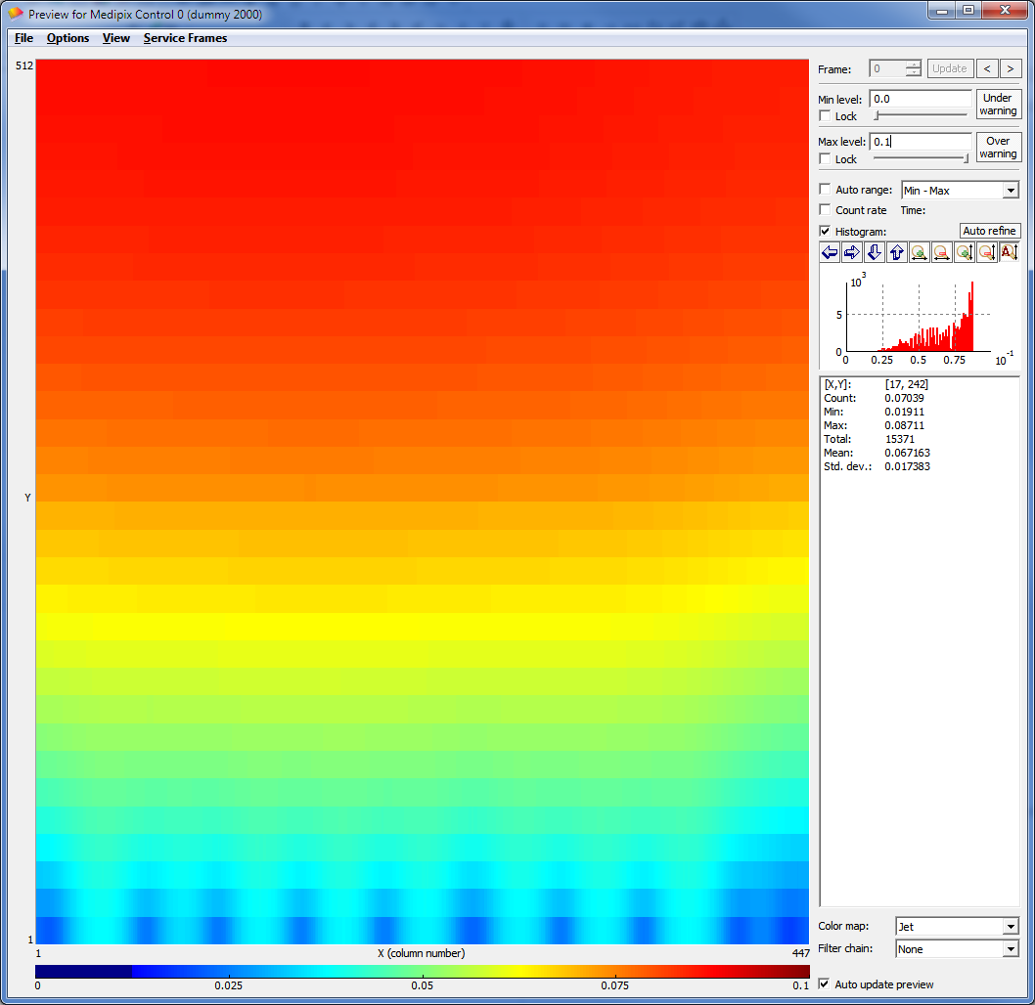
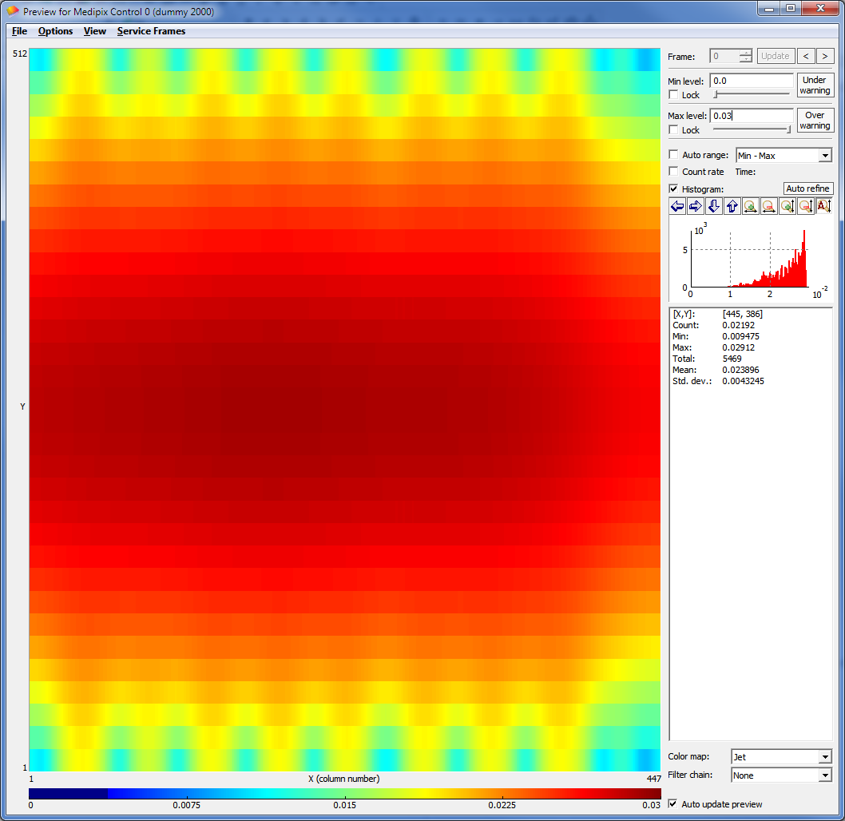
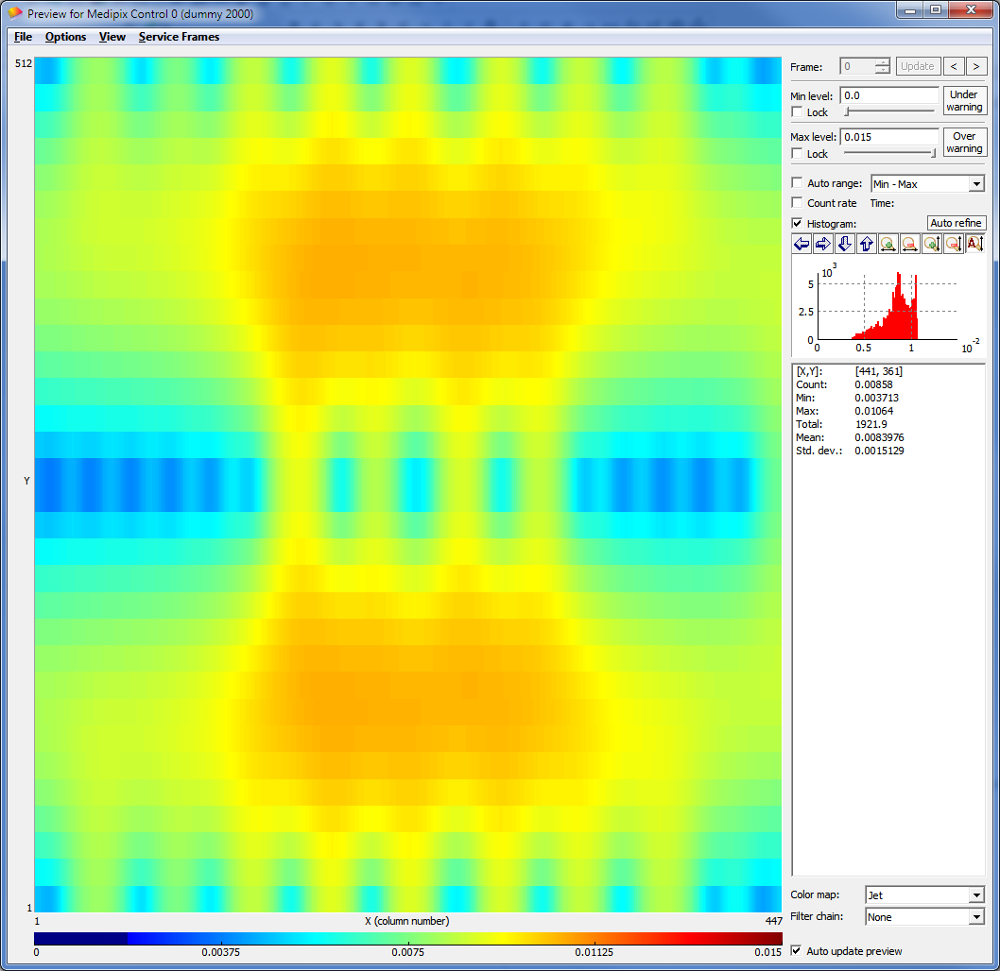
Analog (static) power supply distribution
 | Total I (chip) |  | 1 WB | 2 WB | 3 TSV
Nominal Analog Power [10 µA/pixel] | ~2300 mA | V_{drop} [max-min] | 68 mV | 19.6 mV | 6.9 mV
 |  | Imax pad | 118 mA | 60 mA | 57 mA
Low Analog Power [1 µA/pixel] | ~230 mA | V_{drop} [max-min] | 6.8 mV | 1.96mV | 0.69mV
 |  | Imax pad | 11.8 mA | 6 mA | 5.7 mA
1 WB
2 WB
3 TSV

