Slide 1
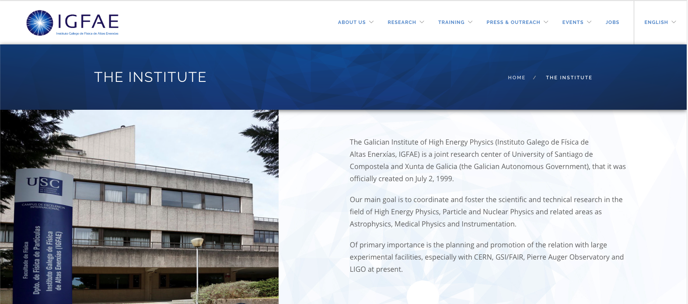
2020 RD51 Collaboration Meeting
D. González-Díaz (on behalf of the organizing committee)

Slide 2
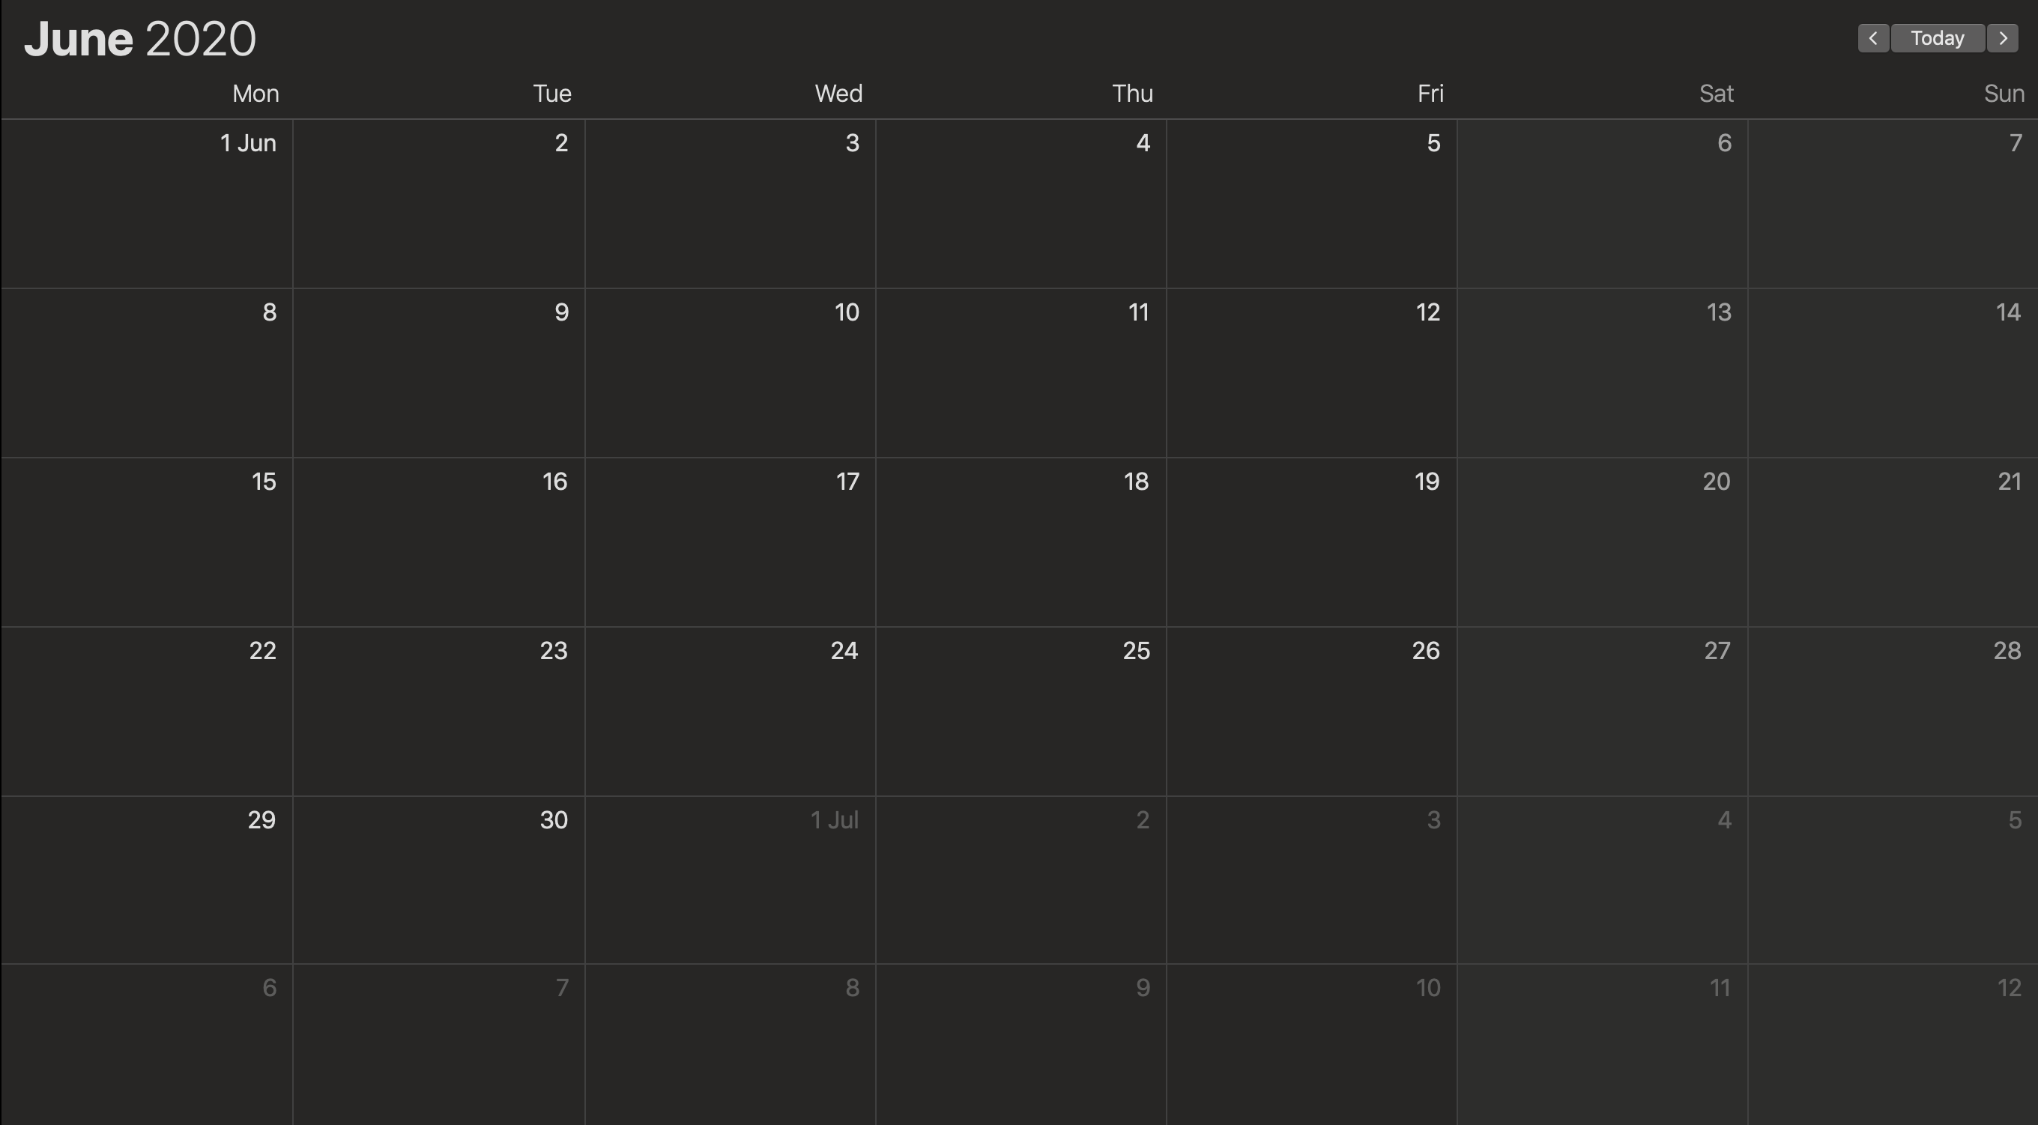
dates and organization
local committee
A. Gallas (LHCb)
J. A. Garzón Heydt (HADES)
A. Saa-Hernández (NEXT/DUNE)
D. González-Díaz (NEXT/DUNE)
J. Benlliure (FAIR/LaserPET)
D. Cortina (FAIR)
M. Seco (technical support)

Slide 3
Monday
Tuesday
Wednesday
Thursday
Friday
registration
RD51-session I
RD51-session III
RD51-session V
WI-session II
WI-session IV
RD51-closing
WI-closing
RD51-session II
RD51-session IV
WI-session I
introductory talks
WI-session III
departure
visit to IGFAE and USC Facilities
old town tour theatrical show
welcome cocktail
collaboration dinner
collaboration
board meeting
WI: topical workshop on instrumentation.
New Horizons for TPCs

Slide 4
fees
- 150€, including 5day-meals, (buffet based on typical products).
+ Conference dinner and social event (45 €).
Tariff per accompanying person:
- 55€, including welcome cocktail.
- 110€, including also 5day-meals.
+ Conference dinner and social event (45 €).
venue
The talks will take place at the premises of IGFAE/USC, inside the campus.
grants and other extras
There will be limited support for students, that will be announced in an upcoming circular.

Slide 5
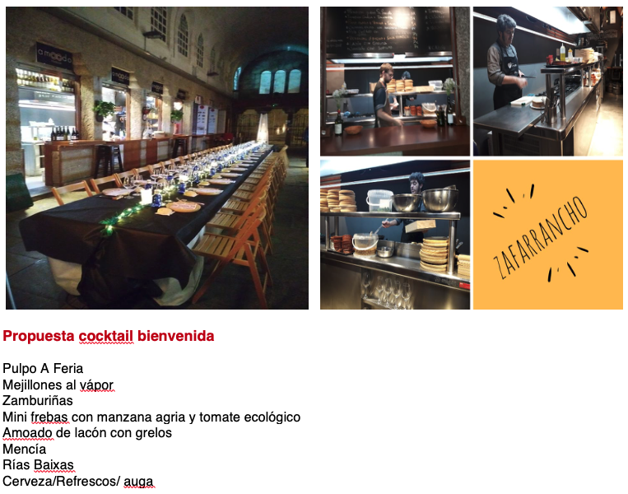
cocktail (on the evening of the first day)
(octopus)
(mussels)
(scallop)
(mini-steaks)
(pork leg with cabbage (traditional style)
(typical wines)

Slide 6
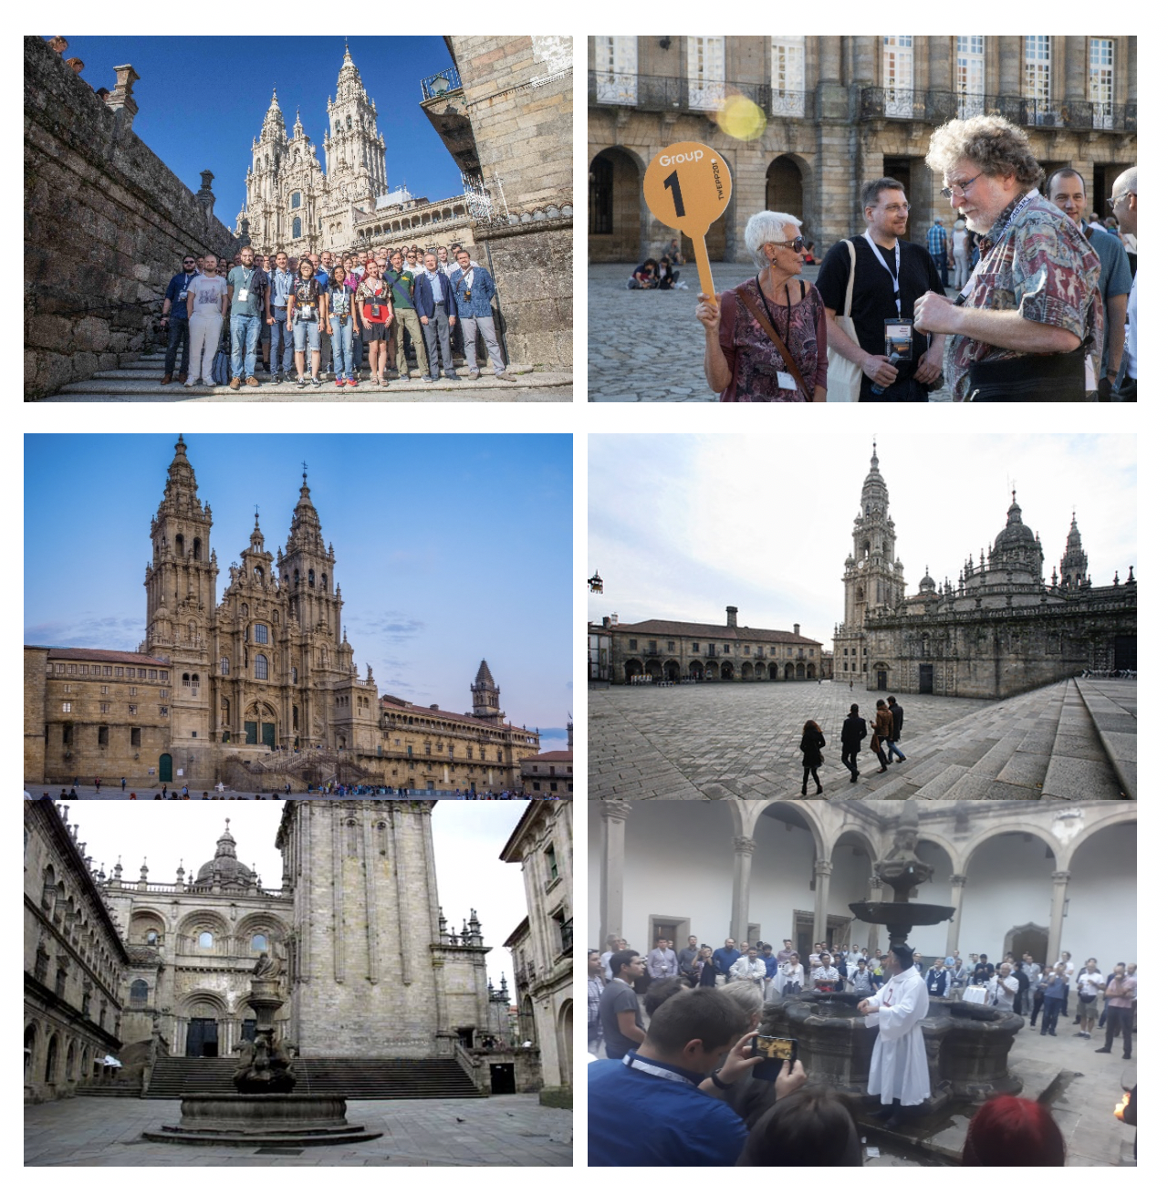
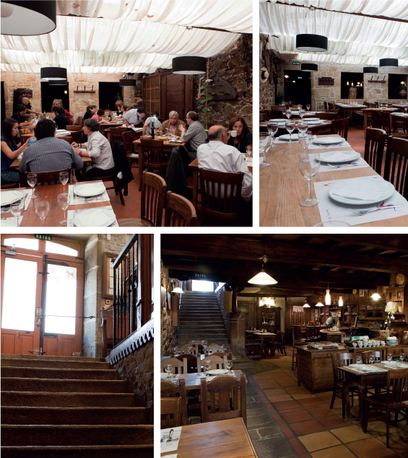
social event & theatrical representation
collaboration dinner

Slide 7
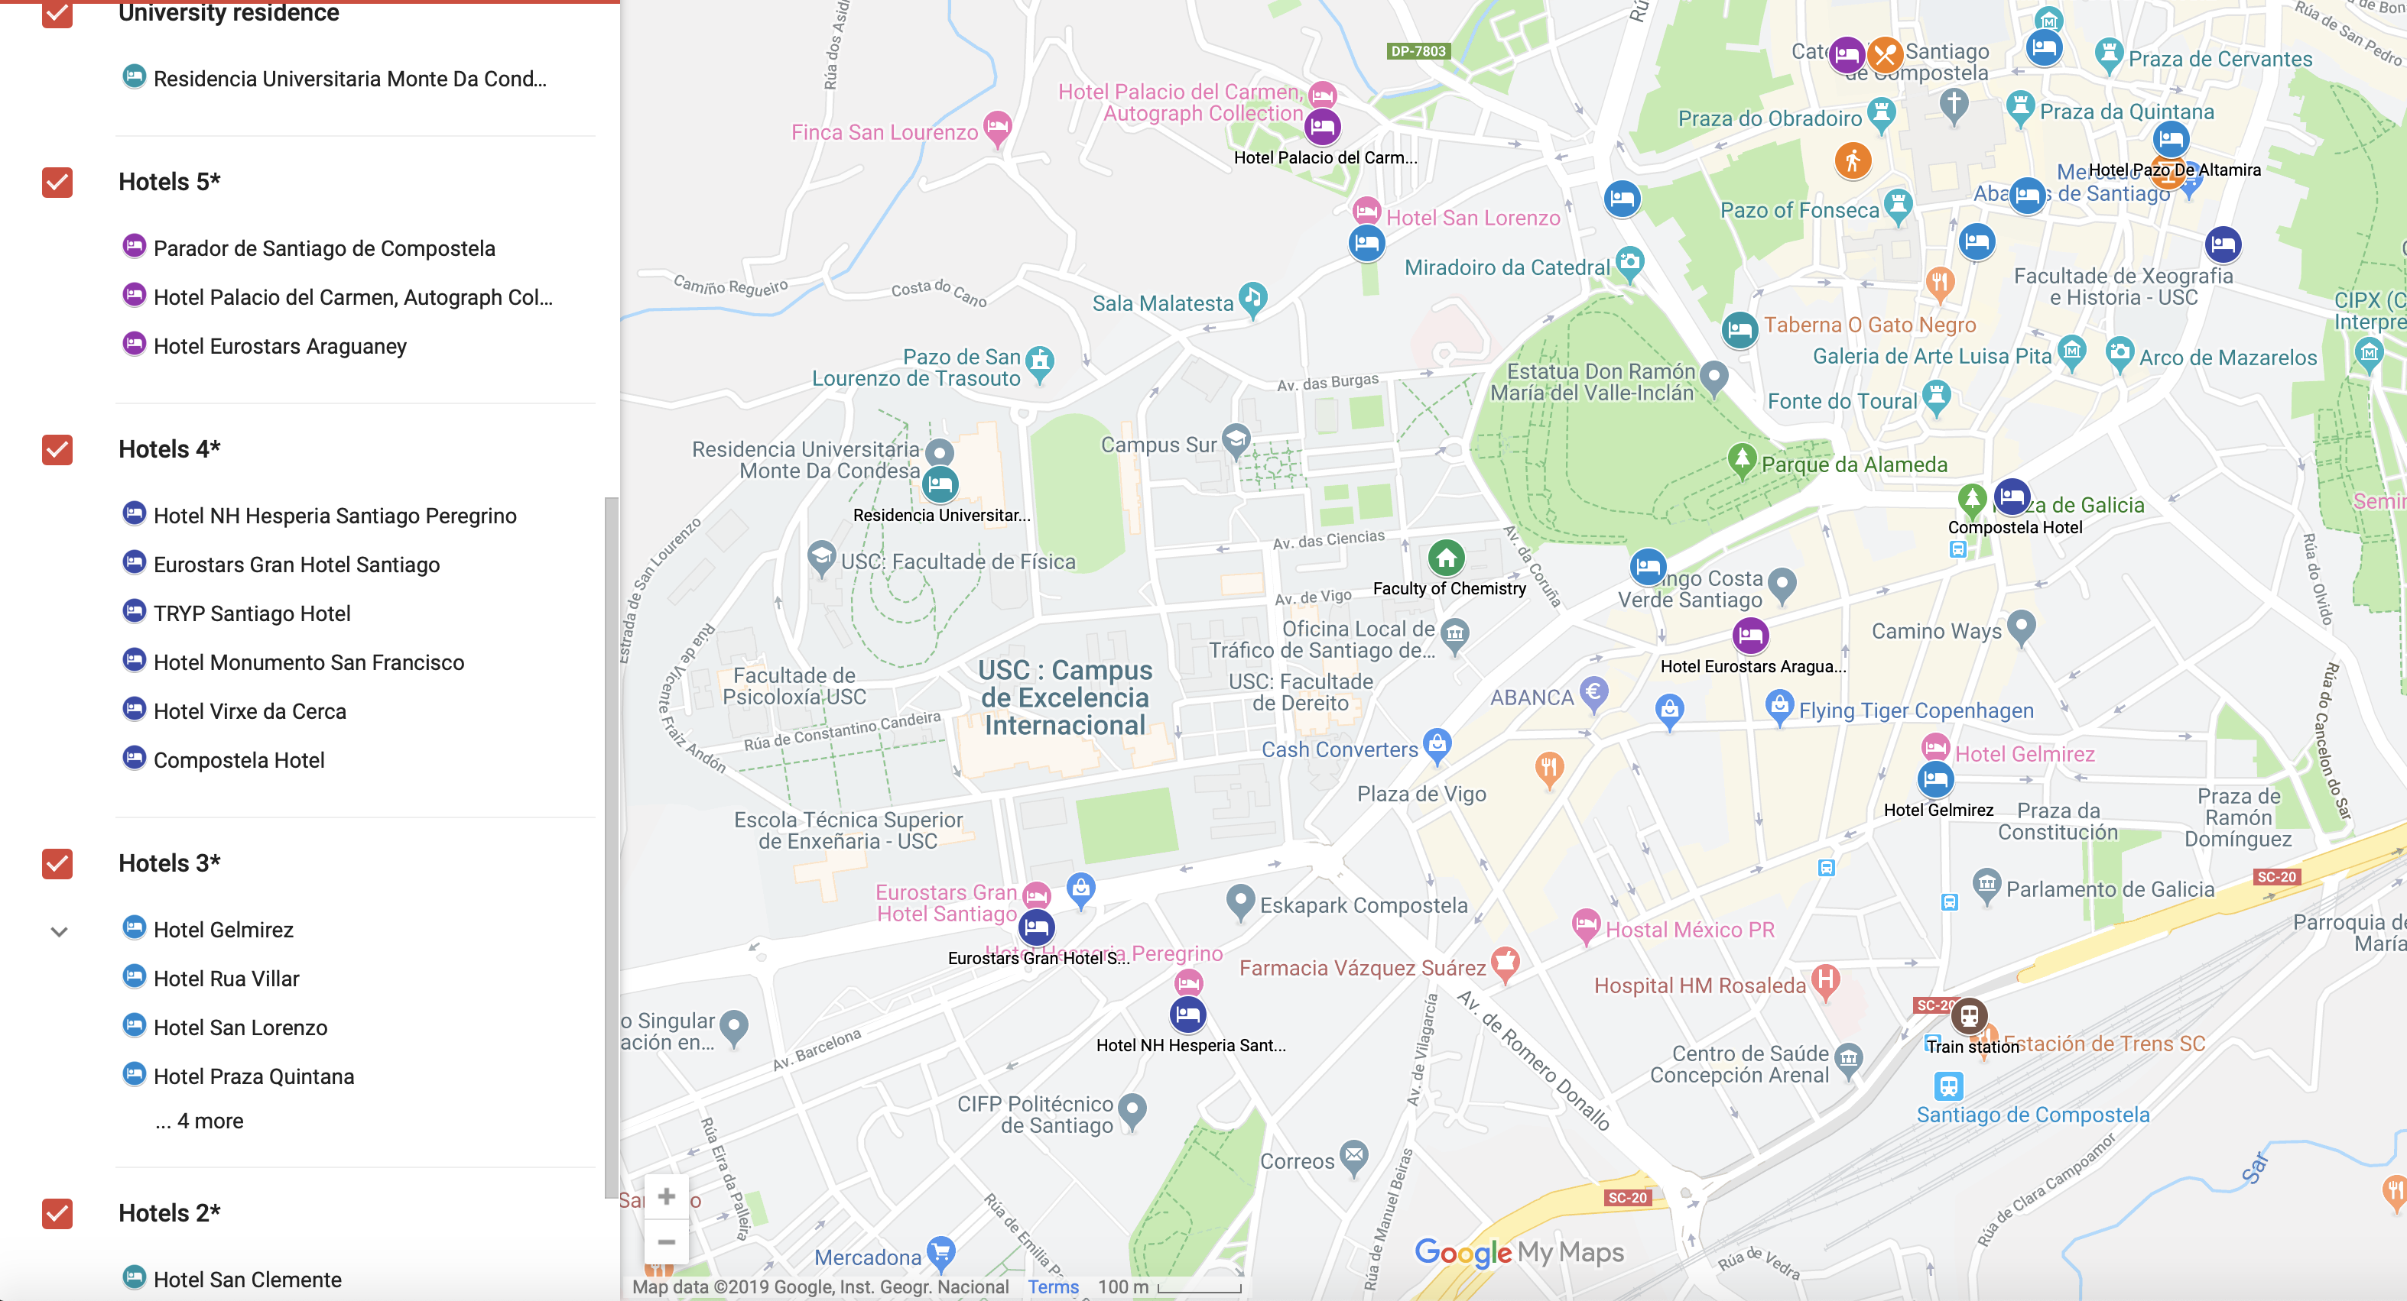
accomodation
there is a broad range of Hotel types, styles and prices:
35-90€/night, typical (maximum is 200€/night in the Hostal de los Reyes Católicos)
- Due to the high Hotel occupancy in June, we recommend and early registration.
- Pre-reservations have been made at Eurostar Gran Hotel Santiago (1 min from campus).

Slide 8
access and information
Santiago has a well-connected international airport with regular direct flights to Geneva, Basel, Amsterdam, Dublin, Frankfurt, London, Rome and Paris.
The connection to Madrid and Barcelona is very good (several flights/day) so access by connecting flights is convenient as well, usually.
There are regular shuttles from the airport to the city (3€, every 30min), and a taxi drive is 21€. Inside the city, most places of interest are within walking distance.
Information will be provided up to the beginning of the collaboration meeting, in the form of timely circulars.

