Slide 1
ALICE GAS SYSTEMS
  2019 Activities
  23/01/2020
  EP/DT/FS – Gas Group
  Louis-Philippe De Menezes

Slide 2
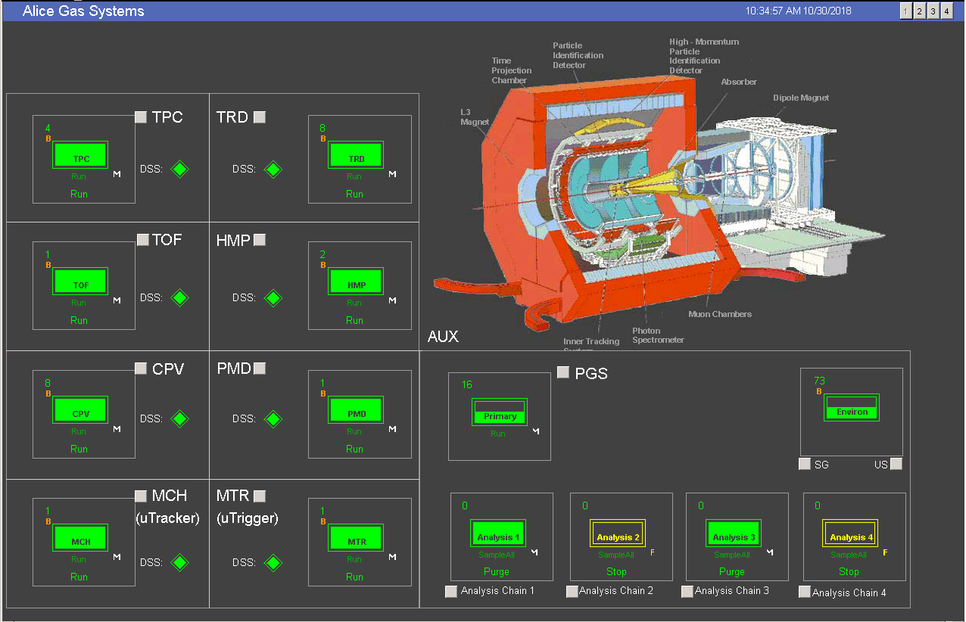
TOPICS
  * Piquet Interventions
  * M&O interventions
  * Activities 2019
  EP/DT/FS – Gas Group
  Louis-Philippe De Menezes

Slide 3
Piquet interventions
45 piquet interventions in 2019
17% / 83%
17h of stop
External reasons:
Supply
Atmospheric phenomenons
Power cuts
  EP/DT/FS – Gas Group
43h30 of direct work
  Louis-Philippe De Menezes

Slide 4
M&O interventions
120 M&O interventions
  EP/DT/FS – Gas Group
  Louis-Philippe De Menezes

Slide 5
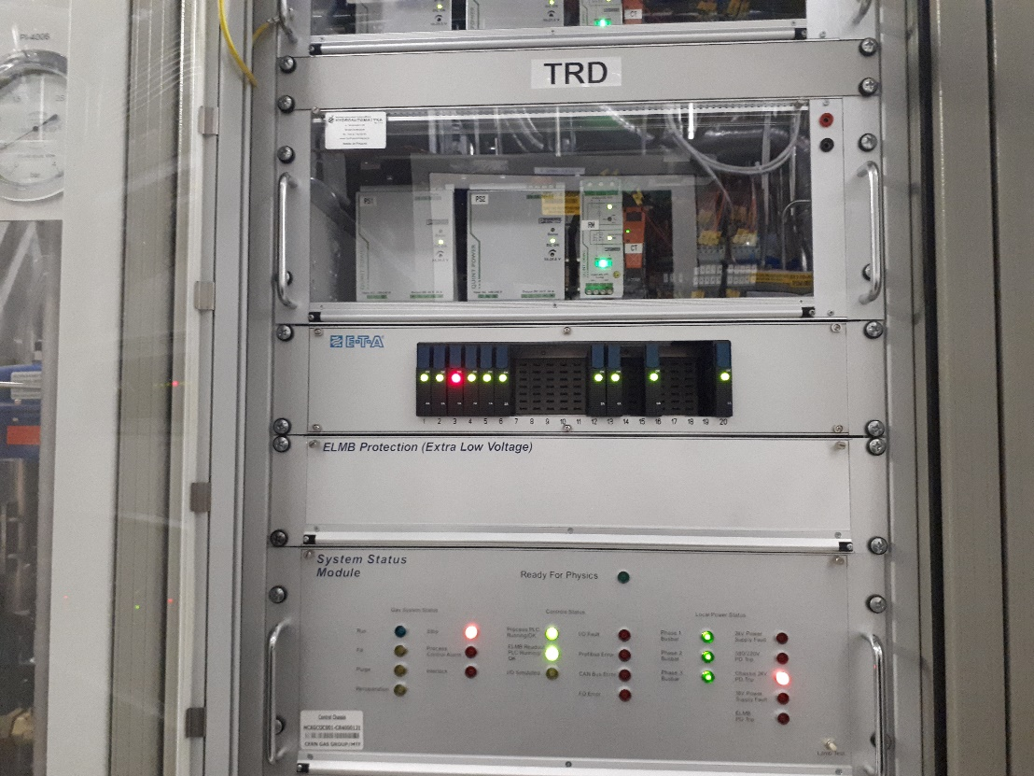
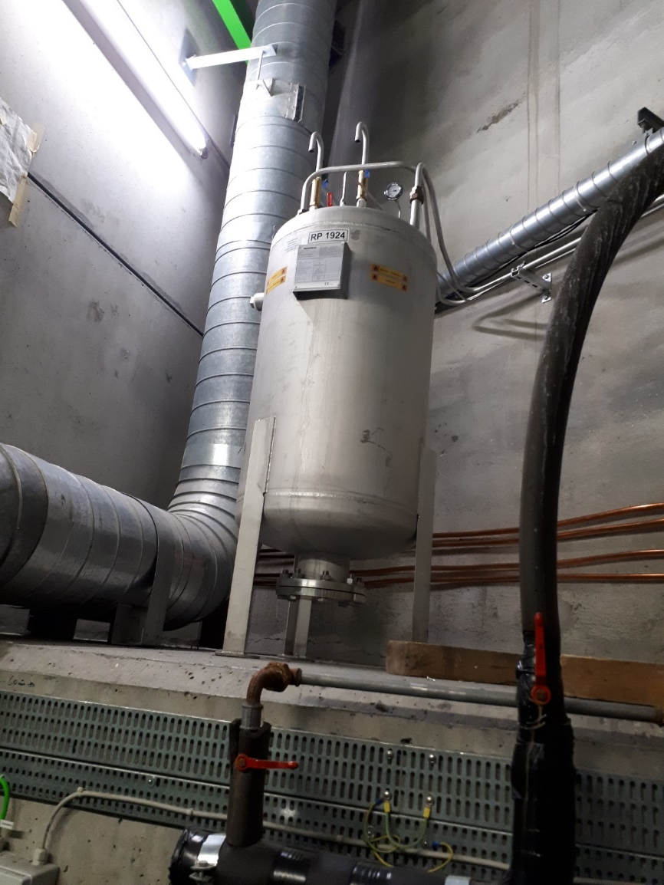
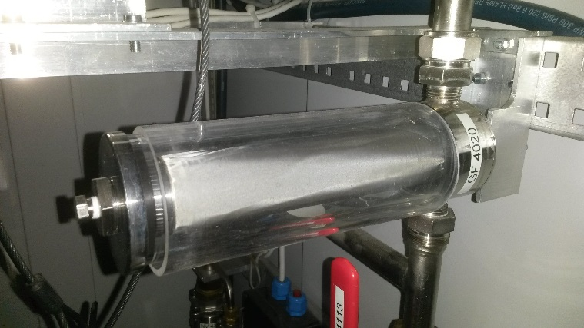
M&O interventions
Example of activities 2019
Software changes
Power supply change in almost all systems
Buffer pressure ( Safety Validation)
Safety valves checks
Filters change / cleaning
TPC pump module
MTR Pump filter
  EP/DT/FS – Gas Group
Buffer pressure tests
  Louis-Philippe De Menezes

Slide 6
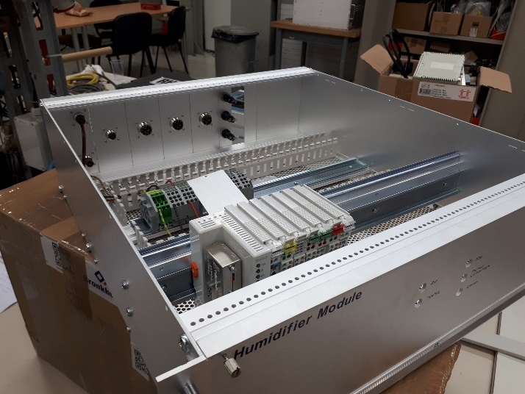
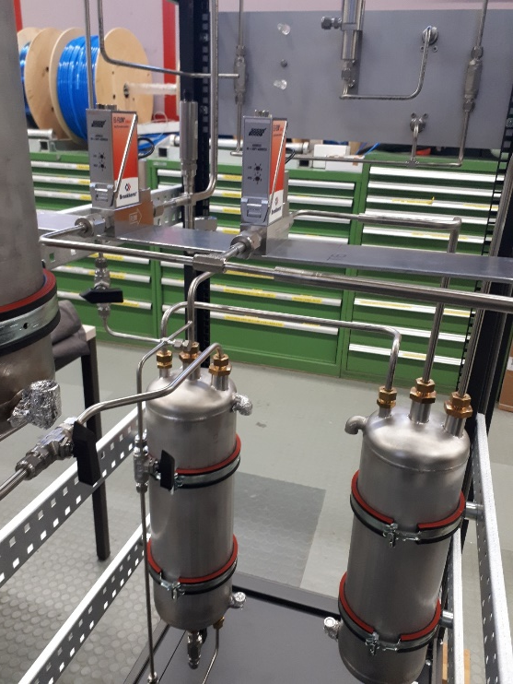
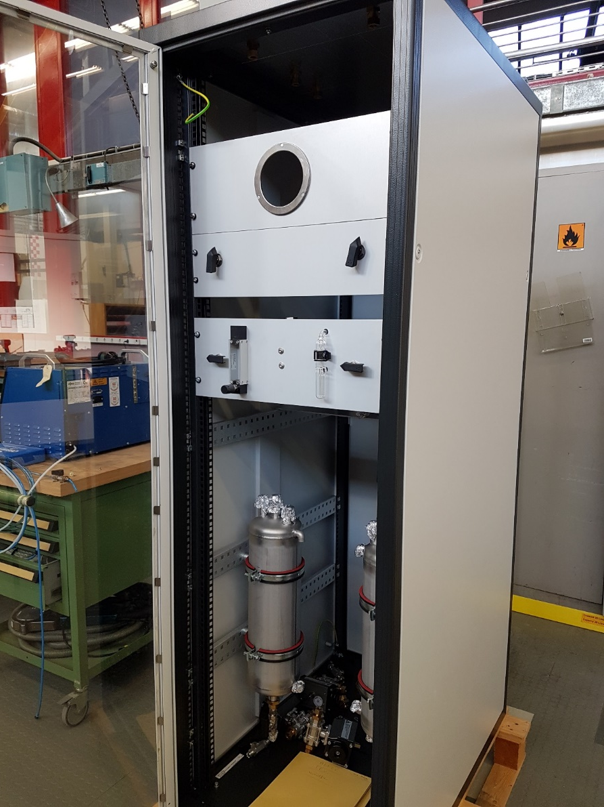
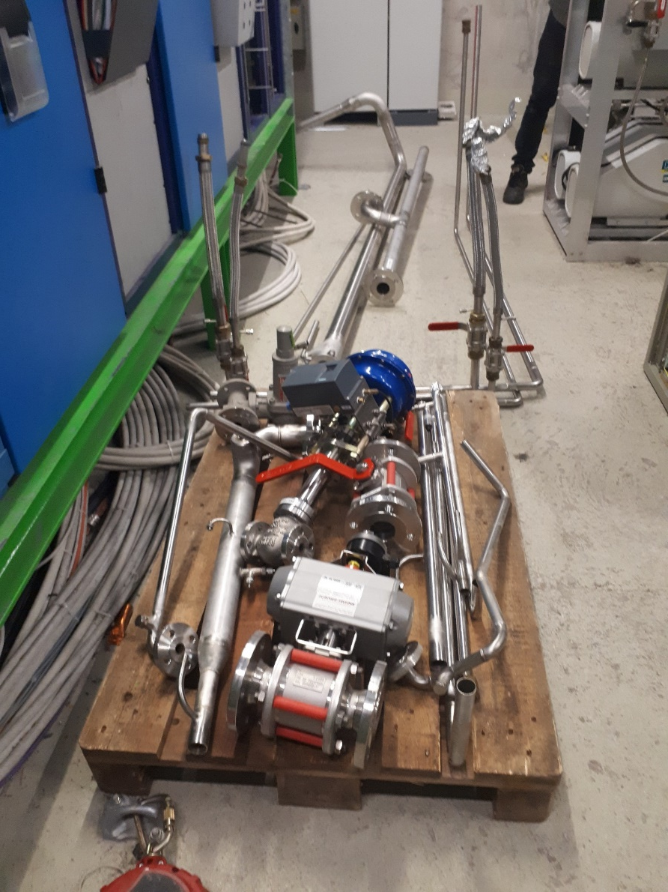
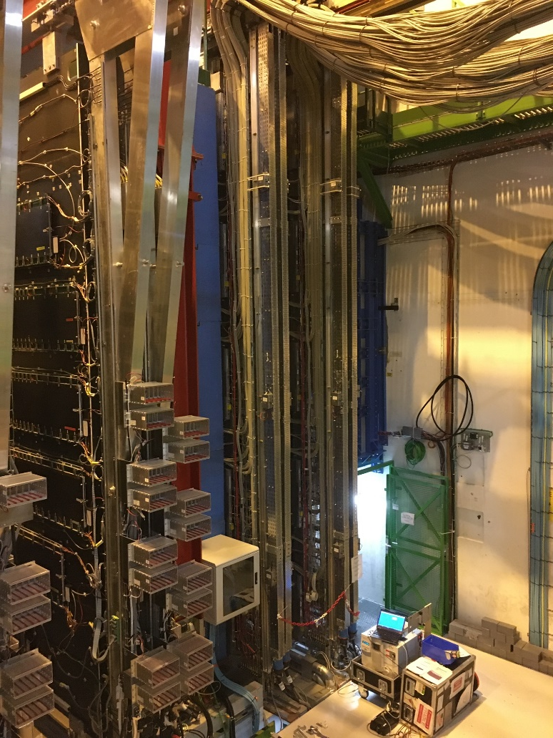
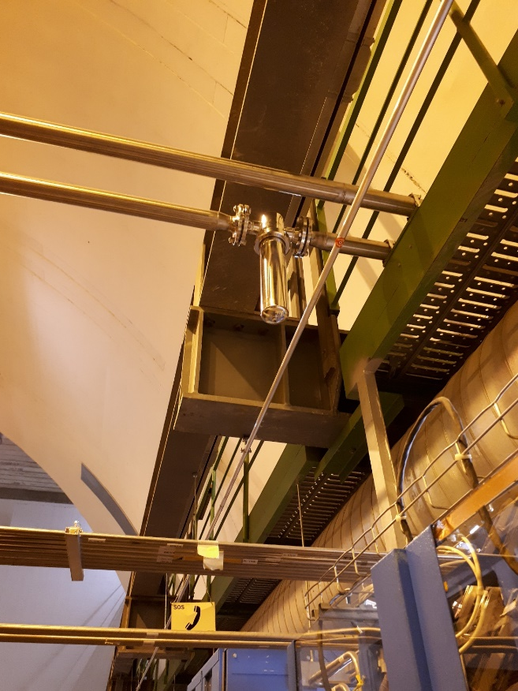
Activitie
NEW CPV Humidifier Rack + electrical chassi construction
Example of activities 2019
New module ( CPV Humidifier)
TPC pump module cleaning
Collaboration for gas analysis (MTR)
Periodic checks
Modification of TPC filter place
TPC pump module
  EP/DT/FS – Gas Group
MTR tests
  Louis-Philippe De Menezes

Slide 7
ThANK you

