Slide 1

Knowledge & Technology Transfer@ CERN
Henning Huuse
Patent Portfolio Manager

Slide 2
Introduction
CERN is a Knowledge Factory.
Leading-edge knowledge is generated at CERN all the time, both in fundamental physics and in areas of direct interest to industry and society at large.

Slide 3
KTT Mission
Identify CERN knowledge which can drive innovation outside the domain of particle physics.
Enable and facilitate the knowledge and technology transfer process.
Protect CERN intellectual property whenever appropriate through adequate means.
Impact-driven approach

Slide 4
KTT in numbers
Staff:
  12 FTE CERN Staff
  2-5 students and young professionals
Portfolio:
  >160 registered cases
  38 patent families, 225 patents
  40% is licensed
Revenue 2009:
  CHF 800k from licensing of CERN IP
  CHF 600k from R&D projects

Slide 5
KTT group
Technology Transfer
  IP management and protection
  Licensing of CERN IP
Hadron Therapy
  Coordinates EU projects
  Training networks
CERN Global Network
  Alumni network
  Partner companies

Slide 6
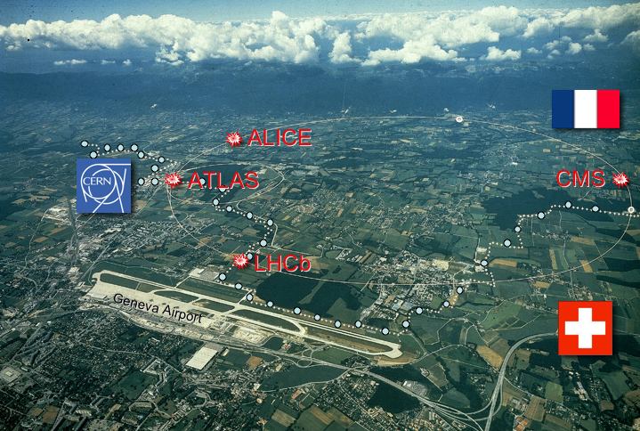

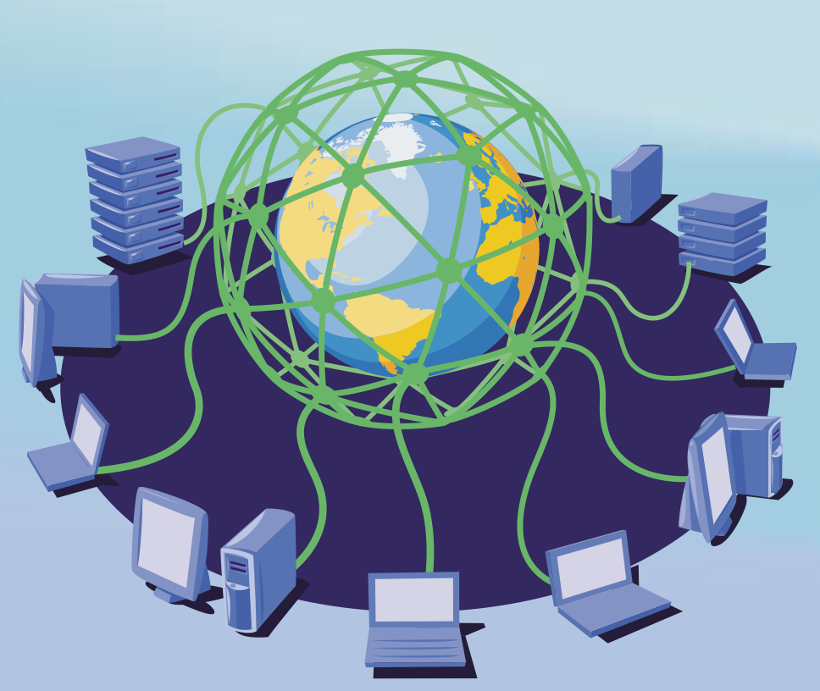
CERN Technologies - Innovation
Three main technology drivers at CERN
Accelerating
particle beams
Detecting particles
Vacuum
Cryogenics
Superconductivity
Large-scale computing (Grid)

Slide 7
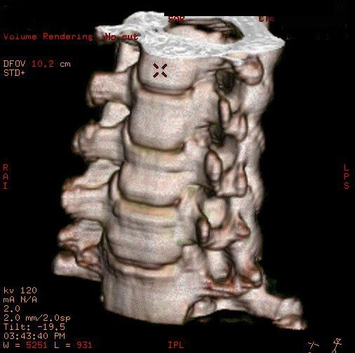
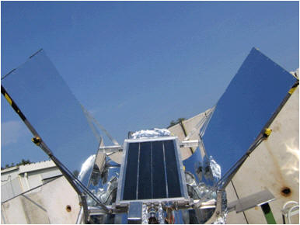


Technology Transfer Paths
CERN has a very diverse and versatile technology portfolio,
stemming from its key technology areas.
Main application domains: medical, energy and environment,
Information and Communication Technologies.
Vacuum
Hadron Therapy
Cryogenics
Medical Imaging
Superconductivity
E-health
Beams
Energy Generation
Detectors
Energy Saving
IT/Grid
Digital libraries

Slide 8
Knowledge Transfer Modes
Licensing of intellectual property and consulting
  Example: license to a Spanish company to use CERN’s patent on non-
  evaporable getter thin films in order to manufacture evacuated flat solar
  panels.
Joint R&D with external partners
  Example: collaboration with a German company active in the field of
  dosimetry.
CERN training programs and personnel mobility
  Example: the Austrian Doctoral Student Program (see C. Fabjan’s talk).

Slide 9
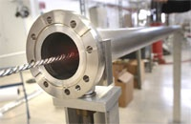
Solar Panels
CERN Ultra-High Vacuum technologies are being used to develop a new generation of evacuated flat panel solar collectors.
These collectors achieve very high operation temperatures thanks to low thermal losses and the collection of diffused light.

Slide 10
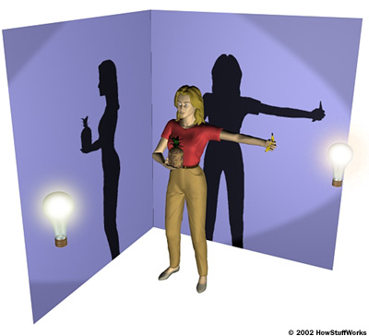




Medical Imaging – Computed Tomography (CT)
Morphological Analysis
The X-ray source and the detector array rotate around the body
  The bed supporting the patient moves through the device
  Whole-body 3-D images constructed from 2-D slices in a given bed position
Features:
  Good spatial resolution
  High doses -> limited number of examinations (DNA damage)
  Cannot be used for screening
  Can operate with other modalities such as PET
X-ray source
Banana detector
Notes:
Ct morphological high resolution
Pet functional medium res metabolism-related
Together is ideal!

Slide 11
CT Breakthrough from Particle Detector Electronics
A paradigm shift: current to counting mode thanks to fast electronics
developed for LHC detectors
Current
  Limited contrast
  High dose
    Restricted use for screening
Counting
  High contrast
  Colour mode possible
  Lower dose (factor of 10)
    Opportunity for screening
Courtesy GE
Courtesy Rabin Medical Center, Israel
Notes:
11
Fast electronics (photon counting chips for silicon strip detectors at the LHC) is instrumental for CT counting mode (colour mode)

Slide 12
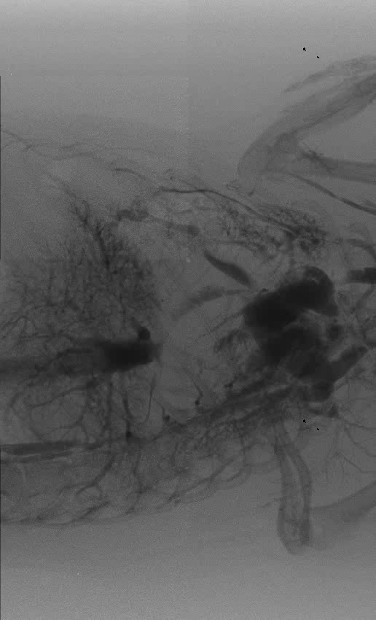
CT Breakthrough from Particle Detector Electronics
Courtesy MBI

Slide 13
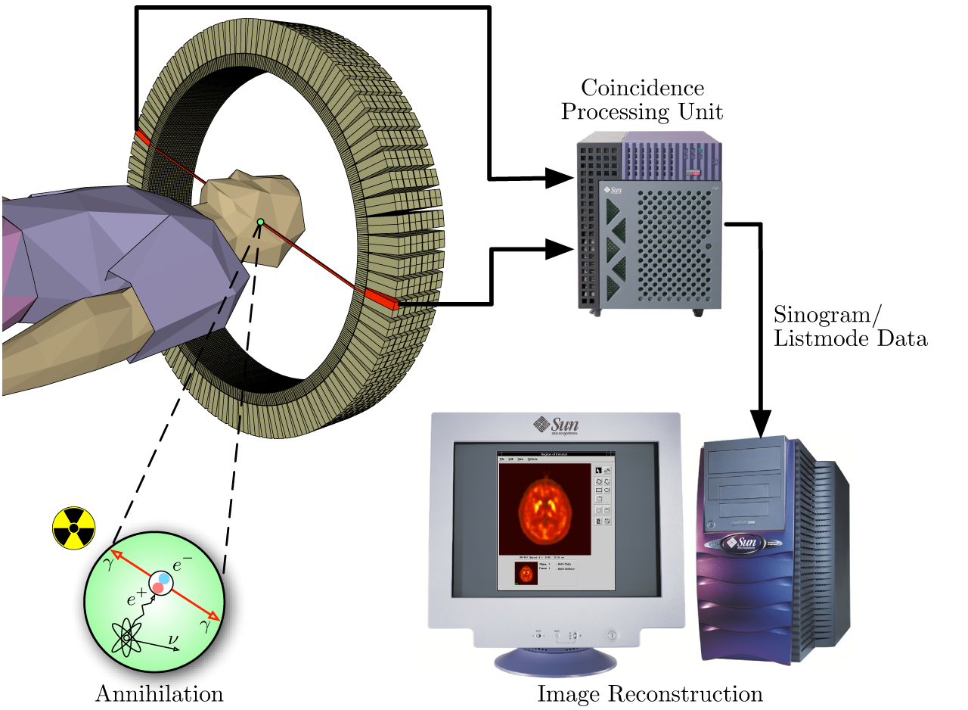
Medical Imaging – Positron Emission Tomography (PET)
Functional Analysis
The system detects pairs of gamma rays emitted indirectly by a positron-emitting radionuclide (tracer), which is introduced into the body on a biologically active molecule.
Images of tracer concentration
in 3-dimensional space within the
body are then reconstructed by
computer analysis.
Crystals developed for LHC
detectors are used in PET
Scanners.

Slide 14
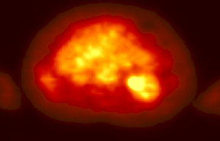
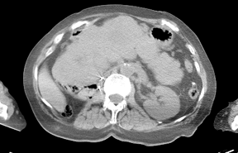
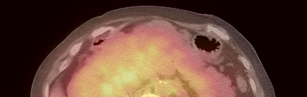
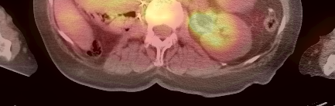
Image fusion: PET + CT
PET - Functional
Structural - CT
PET + CT
from University of Pittsburgh & Siemens
Notes:
Ct morphological high resolution
Pet functional medium res metabolism-related
Together is ideal!

Slide 15
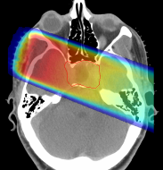
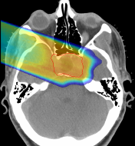

Hadron Therapy
28 cm
tumour
target
200 MeV
protons
480 MeV
carbon ions
charged hadron beam
that loses energy in matter
X rays
protons or
carbon ions
Hadron beams provide new treatment opportunities for
deep-seated tumours.
Hadron beams are more effective than X-rays in destroying tumours
while sparing healthy tissues nearby.
Photons
Protons
GSI
Notes:
Protons, like all charged particles, slow down as they travel through a material as a result of electromagnetic interactions. The slower they move, the more efficient they are at ionizing atoms in their path and the more likely they are to interact with atomic nuclei. This means that the highest radiation dose is delivered at the point in the body at which they stop - the so-called Bragg peak - while the dose elsewhere is low

Slide 16
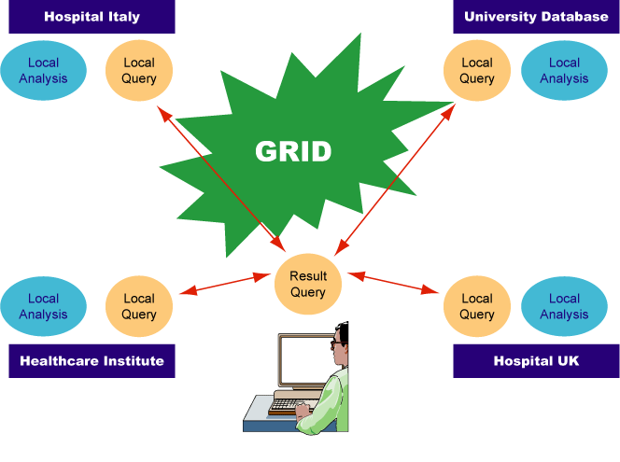
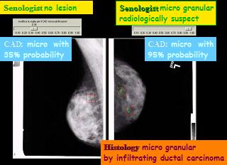
Grid applications: MammoGrid
Breast cancer is a huge societal problem
  1 out of 8 women will develop breast cancer
  Systematic screening needed (mammographies)
  Analysis of images in hospital: small reference
  database, diagnosis based on GP’s experience
Mammogrid project
Grid-based implementation of distributed
mammogram database across Europe
  Give each GP access to thousands of diagnosed images
  Enable remote diagnosis
  Software to extract tissue information for clinical studies (pattern recognition algorithms, etc)
Developed by Italian University
Notes:
Presentation in TT case Mammogrid/presentations (41)..........
1 out of 8 women will develop breast cancer
Systematic screening needed
Analysis of images in hospital – small reference database – pb of false positive → need several comparison to improve analysis
Give each CP access to thousands of diagnosed images across Europe
Mammogrid (2002-2005) implements a distributed mammogram database --- CERN put Grid middleware ---lhs density analysis, rhs pattern recognition for diagnostics
Was transferred to Spanish company

Slide 17
Summary
Through its technical know-how and its leadership, CERN is driving
innovation in key domains such as life sciences, energy&environment
This is a very illustration of the role of fundamental research as a
driver of technical innovation, delivering tangible benefits to mankind!

