Slide 1
WISPR - Web of Intelligent Systems, Products and Processes
ICT-2009.1.3 Internet of Things and Enterprise Environments

Slide 2
Vision
to exploit the potential of the Internet of Things by
enabling a Web of Intelligent Systems, Products and Processes facilitating the responsible production, distribution and
use of safer and sustainable “things” aimed at improving the quality of Life.

Slide 3
Concepts
  Intelligent Systems – the combinations of the networked products and processes providing benefit to all stakeholders in the value-chain, from producer to consumer.
  Intelligent Products – the individual “things” with ID, sensing, information processing and communicating capabilities networked in IoT,
  Intelligent Processes – structured and emergent activities and tasks providing specific services

Slide 4
Research clusters

Slide 5
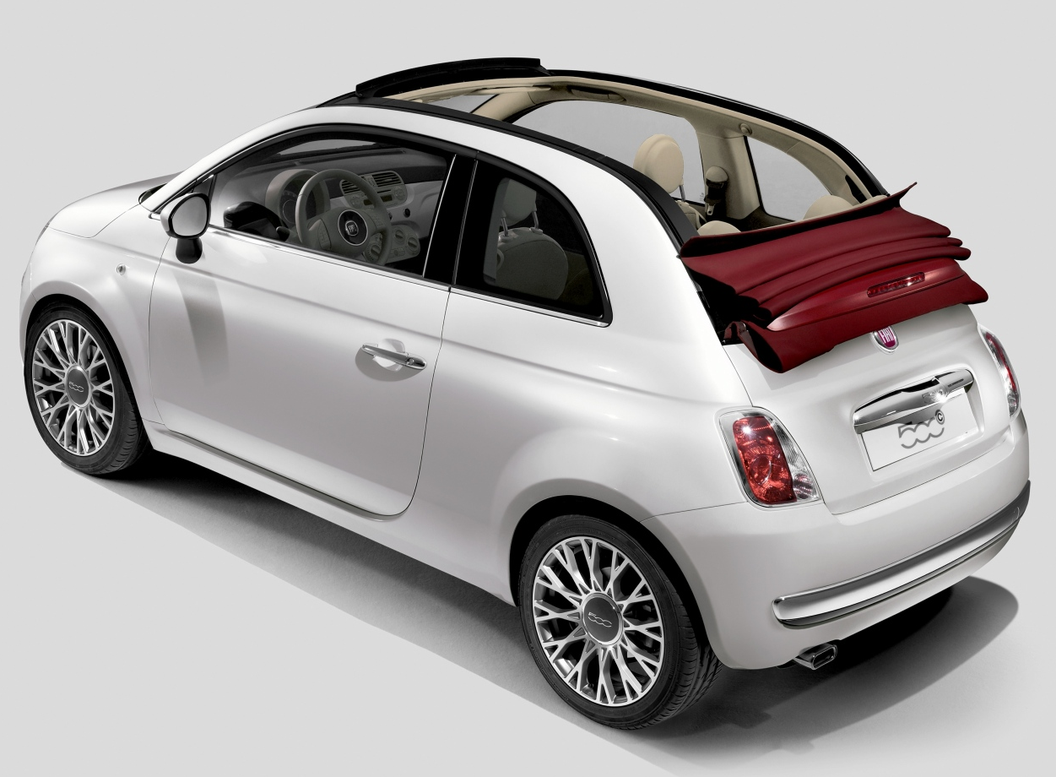
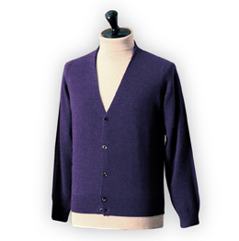
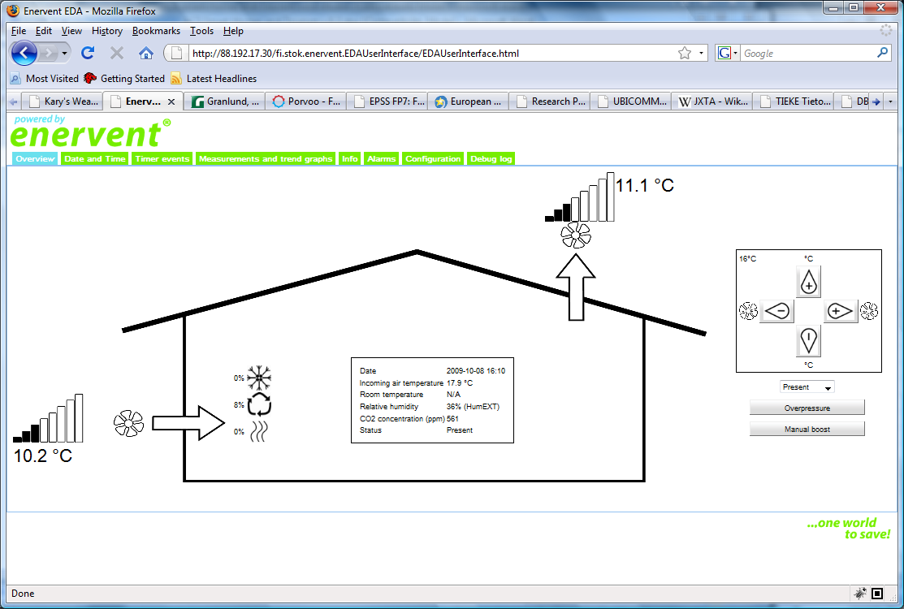
Application Scenarios
Automotive
Clothing
Home and environment

