Slide 1

EU-NMP CSA-CA 233469
1
Notes:
1

Slide 2
Strategic Purpose of Project
  Prepare a roadmap for future (2020) manufacturing research IMS
  Define a list of research topics for IMS cooperation
2
Notes:
2

Slide 3
Roadmap Key Areas
KAT 1 Sustainable Manufacturing
KAT 2
Energy
Efficient Manufacturing
KAT 3
Key
Technologies
KAT 4
Standards
KAT 5
Education
3
Notes:
3

Slide 4
Industrial Roadmap Workplan
On Line
Survey 1
Industrial Workshops
Mapping
Industrial Interviews
Scenarios and Vision
Research
Topics
Research Action Clustering
Finetuning
On Line
Survey 2
Visionary RTs
Research Topics Prioritization
ROADMAP
Notes:
4

Slide 5
Research Topics
1 Sustainable Manufacturing 27
2 Energy efficient Manufacturing 11
3 Key Technologies 23
4 Standards
5 Education 9

Slide 6
How a Research Topic looks like
6
Notes:
6

Slide 7
How a Research Topic looks like
7
Notes:
7

Slide 8
How a Research Topic looks like
8
Notes:
8

Slide 9
How a Research Topic looks like
9
Notes:
9

Slide 10
Sustainable Manufacturing - Research Topics
 | RA 1.1 | RA 1.2 | RA 1.3 | RA 1.4 | RA 1.5
1.02 - Green Controller for Machining |  |  |  | ✓
1.04 - Sustainability Metrics |  |  |  | ✓
1.05 - Sustainability workshops |  |  |  | ✓
1.09 - Sustainable Packaging |  |  |  | ✓
1.10 - Optimization of Electronic Sustainability |  |  |  | ✓
1.11 - Materials re-use optimization |  | ✓ |  | ✓
1.21 - Sustainable Supply Chain Design |  |  |  | ✓
1.25 - Management of hazardous substances in manufacturing |  |  |  | ✓
1.07 - EOL management supporting technologies |  |  |  | ✓
RA 1.4
Sustainable Product and Production
10
Notes:
10

Slide 11
Education - Research Topics
RT5.01 | Teaching Factories
RT5.02 | Cross Sectoral Education
RT5.03 | Communities of Practice
RT5.04 | From tacit to explicit knowledge
RT5.05 | Innovation Agents
RT5.06 | Benchmarking
RT5.07 | Serious Games
RT5.08 | Personalized and ubiquitous Learning
RT5.09 | Accelerated Learning

Slide 12
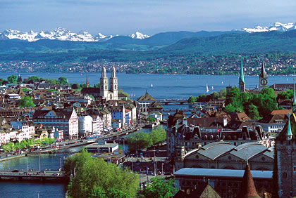
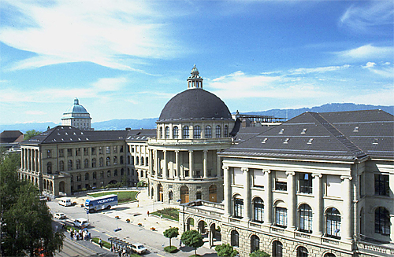
IMS2020 Summer School 2010
IMS2020 Summer School will be held in Zurich on May 26-28 2010
Target audience
  PhD students
  Young professionals from industry
  www.ims2020.net
12

