Slide 1
Commissioning Coordination Committee meeting 10/01/2020
Fernando PEDROSA

Slide 2
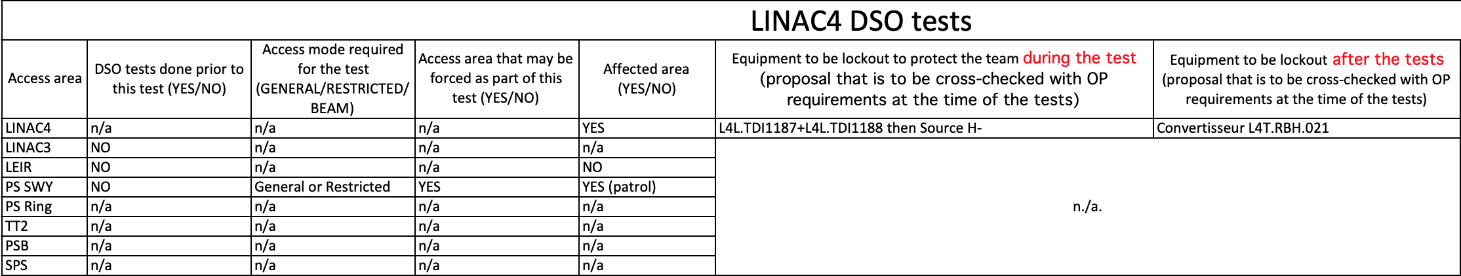
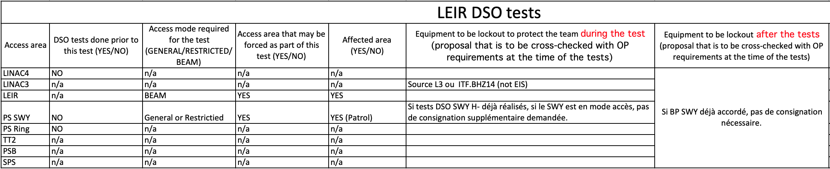
DSO tests

Slide 3
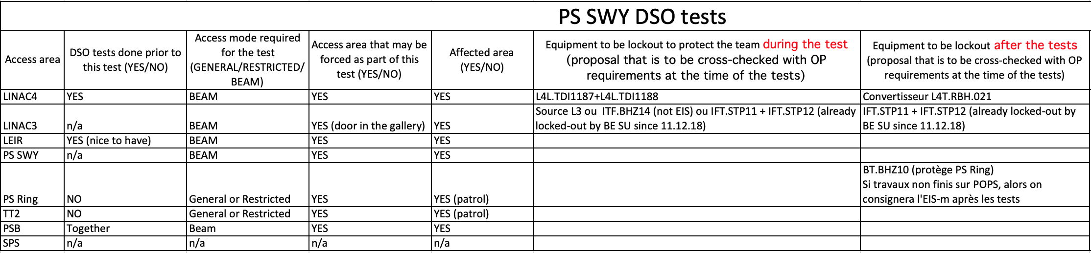
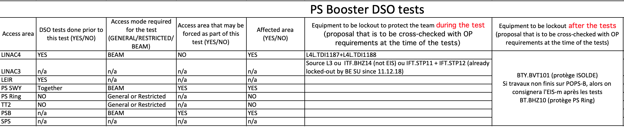
DSO tests

Slide 4
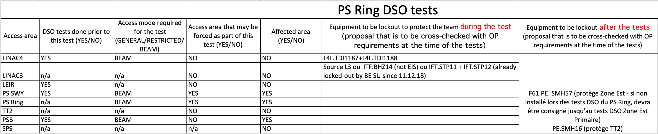
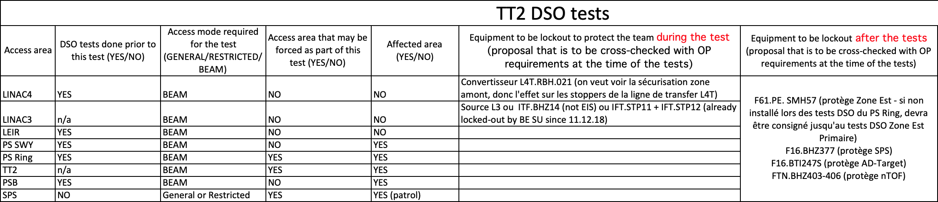
DSO tests

Slide 5
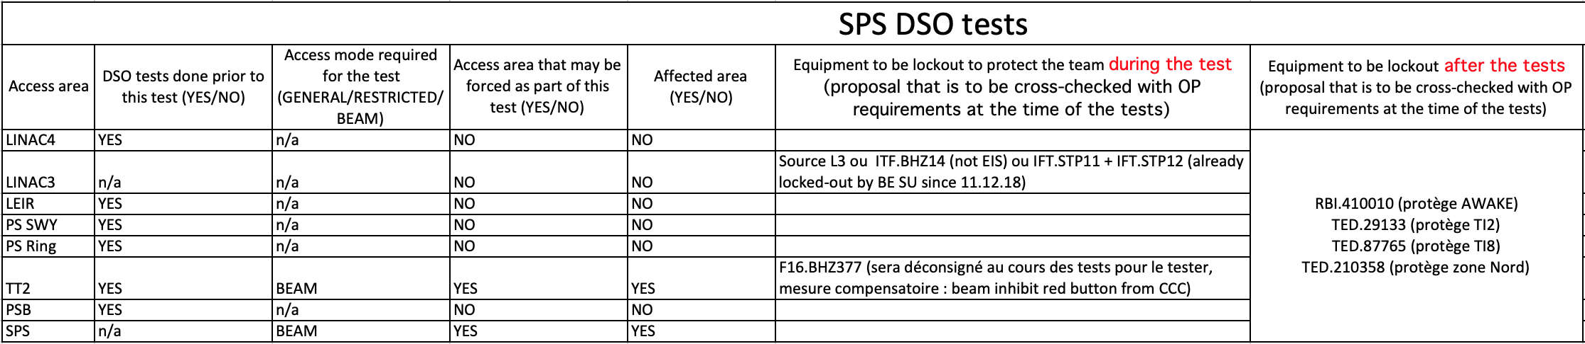
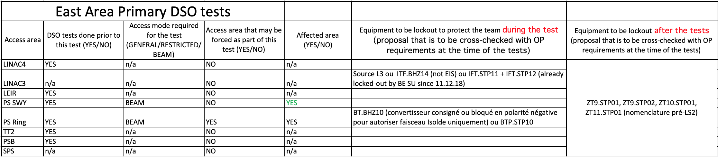
DSO tests

Slide 6
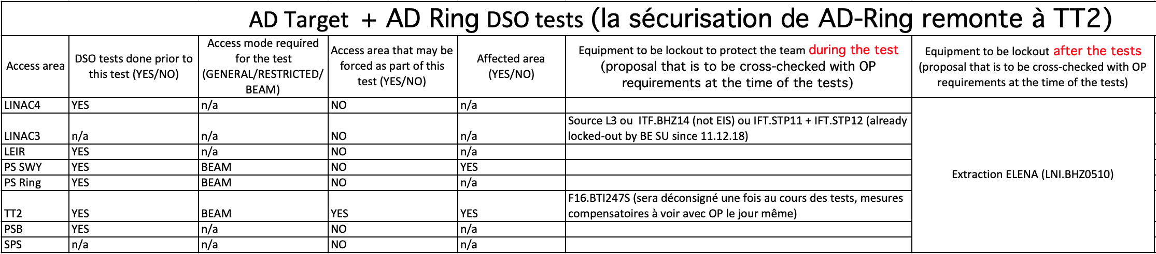
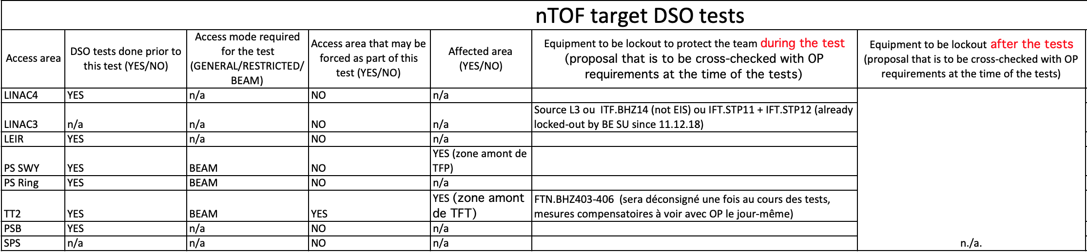
DSO tests

Slide 7
DSO tests
Based on the information collected on these tables the scenario that would minimize the times that an access zone needs to be stopped for the DSO tests is:
LINAC4 DSO test the 23rd of March or the 24th before the PS SWY DSO tests;
LEIR DSO test the 23rd of March or the 24th before the PS SWY DSO tests;
PS SWY, PSB, PS Ring and TT2 DSO tests performed together the 24th and 25th of March
  This DSO tests should validate all the EIS BEAM and as much as possible the EIS Machine
Having all the EIS BEAM validated would allow to perform the DSO test for the EIS machine validation later if needed (PS -> POPS, PSB-> POPS-B + MPS) faster and without affecting the adjacent areas

Slide 8
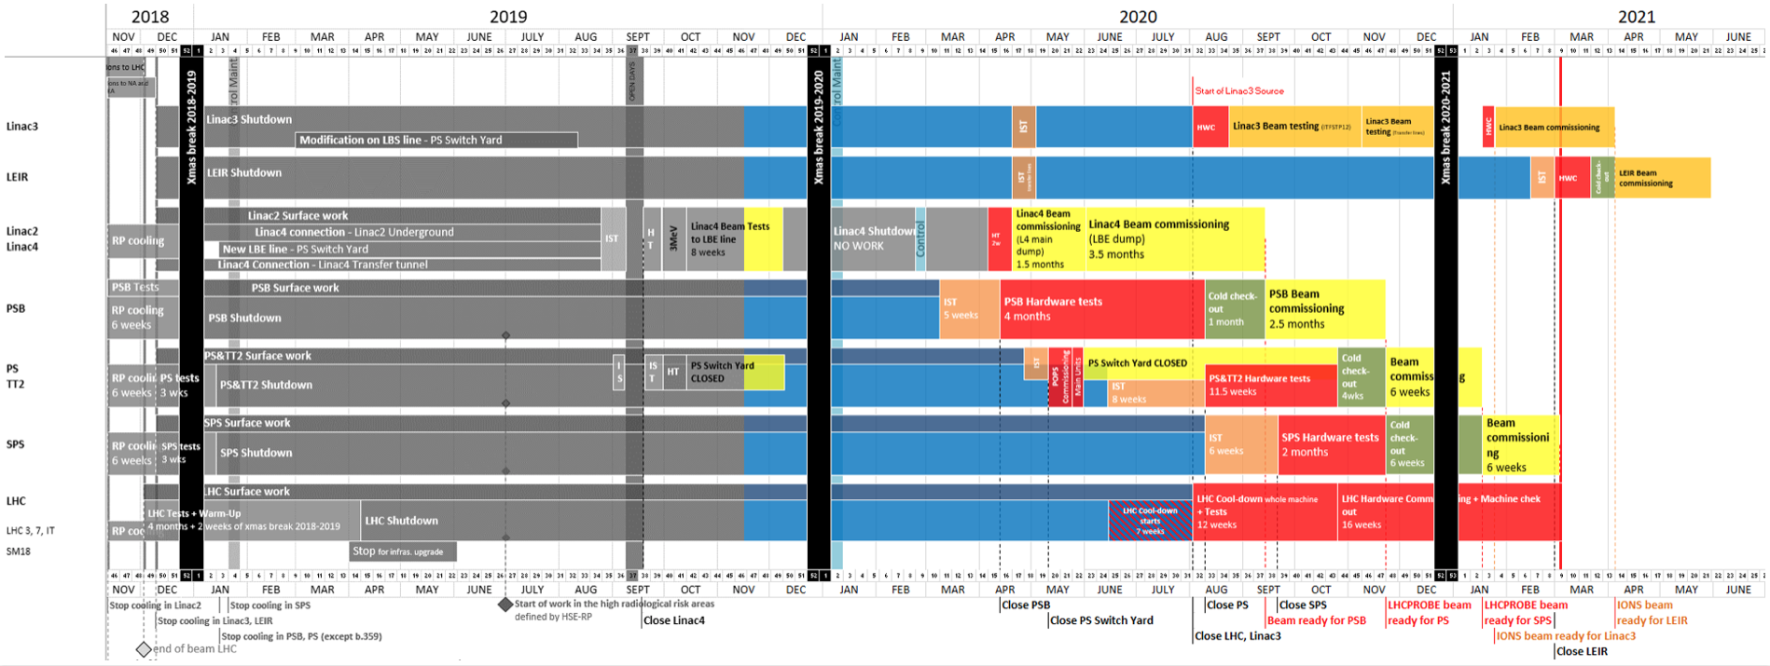
Master Schedule
POPS-B + MPS

Slide 9
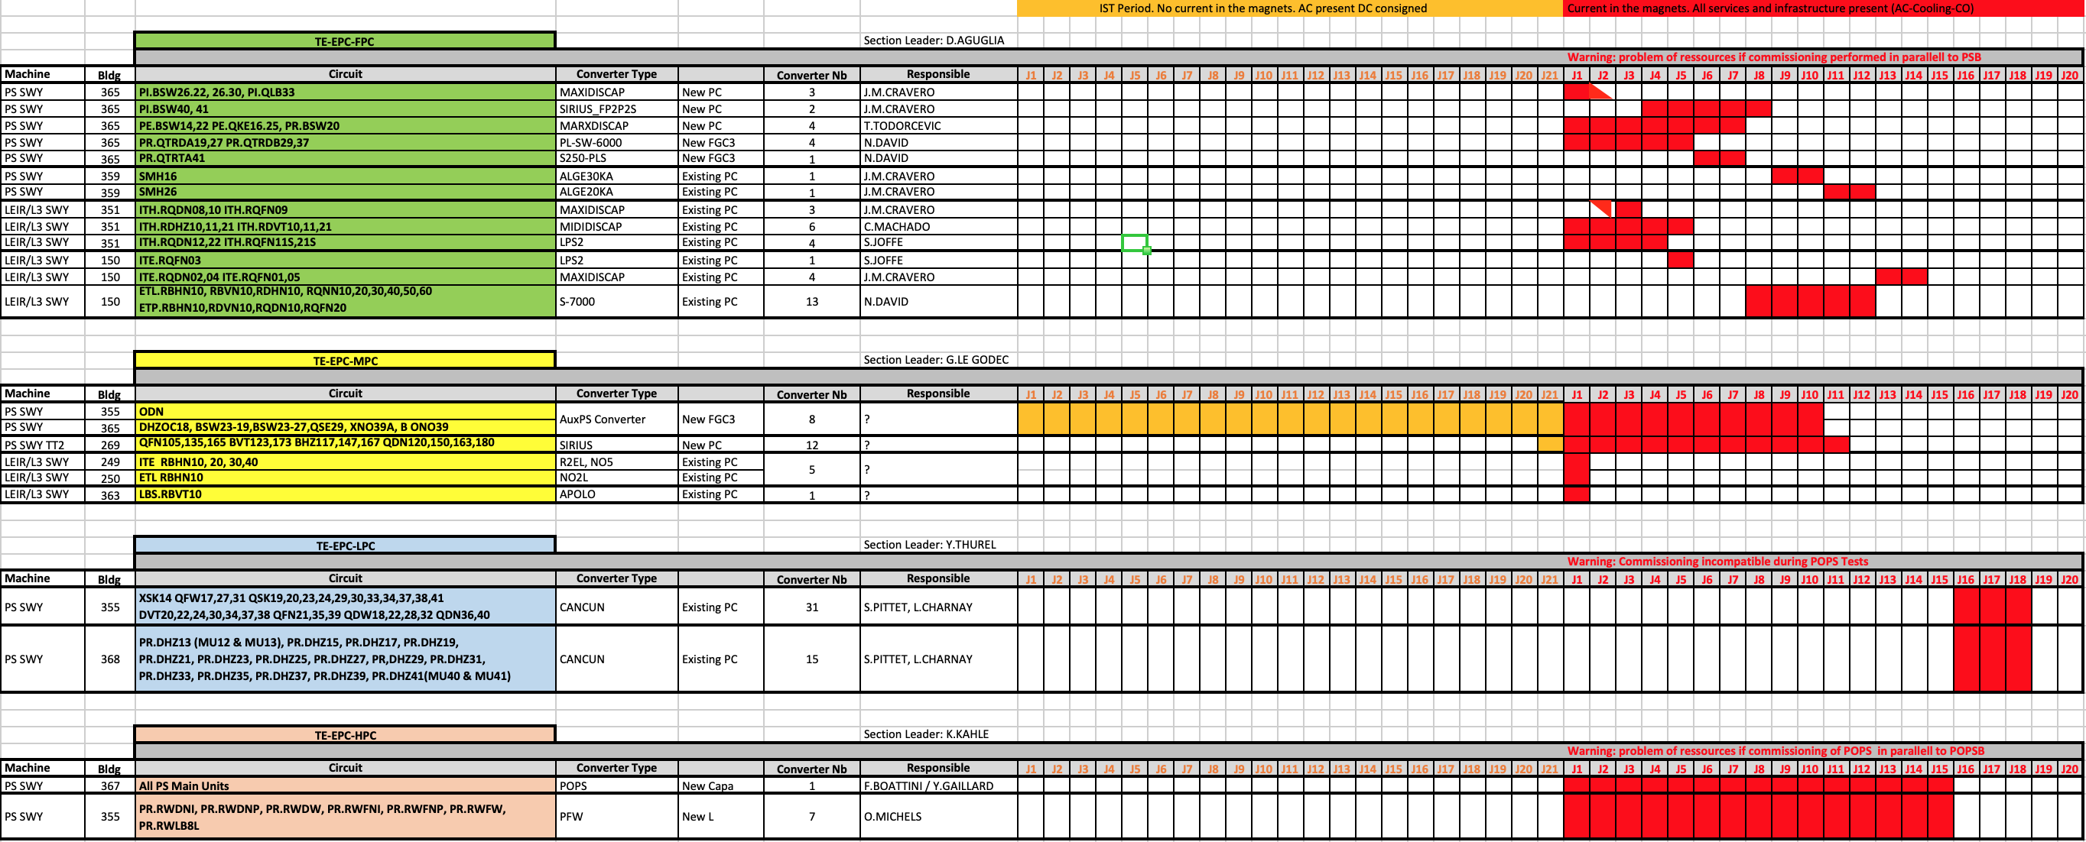
Modifications
Wish expressed from EPC to start the POPS-B tests in April instead of June as foreseen today in the PSB HWC planning and agreed in February 2019
POPS not available before the 6th July 2020 due to the new delivery date at the end of February
New durations (EDMS 2279382)

Slide 10
Actual PSB Hardware commissioning planning before and during POPS-B + MPS
All tests requiring access
POPS-B + MPS
All tests requiring access
  MSC tests – auxiliary magnet tests + transfer lines (BI, BTP, BTM, …)
  ABT tests phase 3 and phase 4
  …

Slide 11
Actual PSB Hardware commissioning planning before and during POPS-B + MPS
All tests requiring access
POPS-B + MPS
POPS-B and MPS
  DSO test with POPS-B for the Hardware Permit
  1 week at the beginning for the magnet patrol
  4 weeks of POPS-B tests
  DSO test with the MPS for the Hardware Permit
  1 week for the MPS test
  DSO test for the for the Beam Permit

Slide 12
PSB Hardware commissioning planning before and during POPS-B + MPS with the new date
POPS-B + MPS + others
Option 1
  The tests that require access are performed together with POPS-B +MPS if compatible, and the POPS-B or MPS tests are stopped to allow access if needed

Slide 13
PSB Hardware commissioning planning before and during POPS-B + MPS with the new date
POPS-B + MPS
All tests requiring access
Option 2
  The tests that require access are performed after POPS-B +MPS, and the LINAC4 LBE dump tests are stopped to allow access

Slide 14
PSB Hardware commissioning planning before and during POPS-B + MPS with the new date
All tests requiring access
POPS-B + MPS
Option 3
  POPS-B +MPS tests are kept as much as possible as planned today without affecting the availability of POPS for the 6th of July 2020

Slide 15
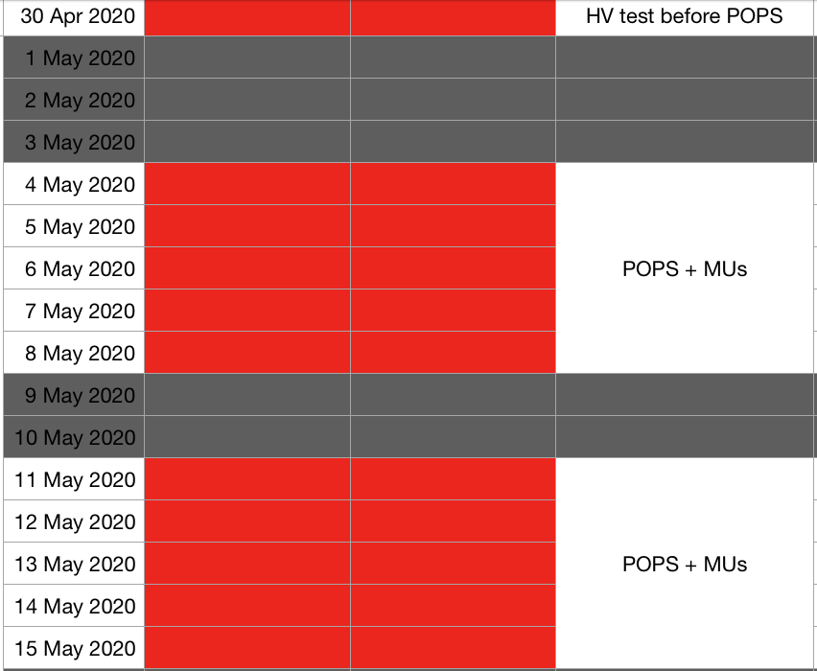
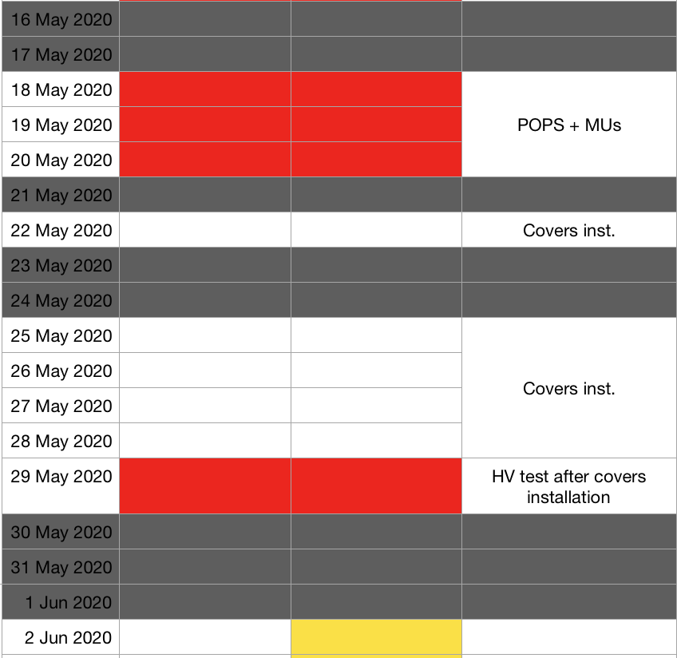
Master Schedule

Slide 16
New POPS commissioning schedule
9 days of full access to TE-MSC
15 days of POPS tests with the MUs (LINAC4 tests stopped for access on a 1 day pre-warning notice)

Slide 17
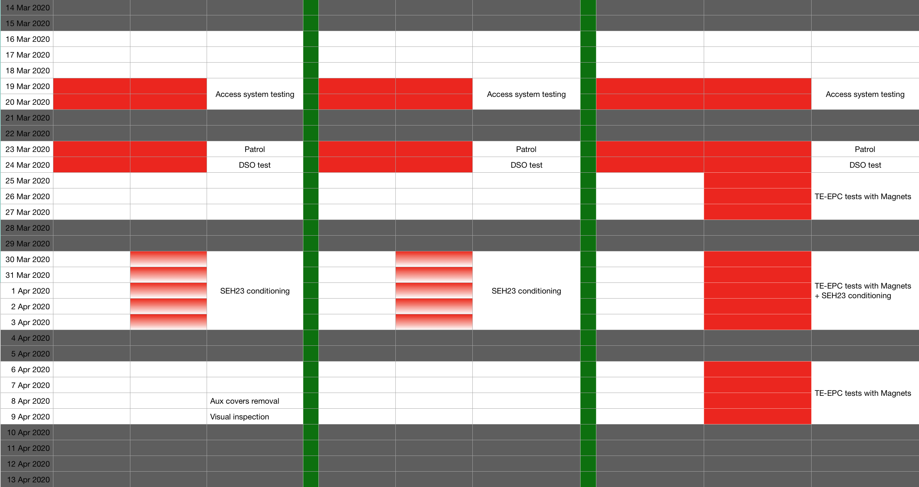
Planning options for the period before PS SWY closure

Slide 18
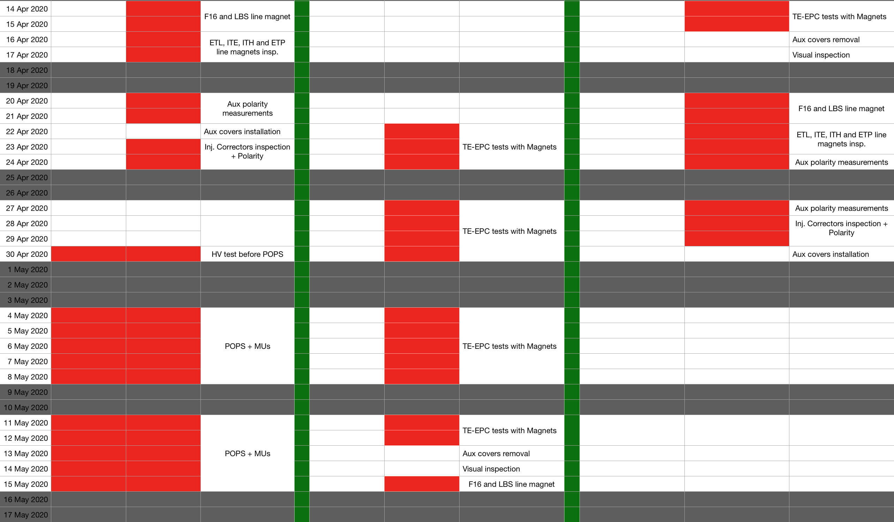
Planning options for the period before PS SWY closure

Slide 19
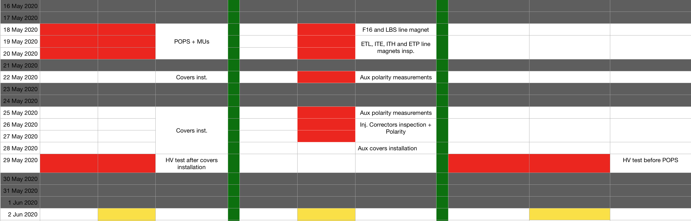
Planning options for the period before PS SWY closure
The two options give more time for the ISTs that require access and that have to be performed before closing the PS SWY
The 5 days removed in August 2020 to the ISTs period is compensated by the additional access time that is now recovered in May 2020 by removing the POPS tests (RF are the may systems affected and they will start their IST period in Feb 2020 already)
The 5 days removed to the LS2 shutdown period will have to be compensated by a tighter schedule, but we had already a limited number of activities in this period because we were already in the IST period

Slide 20
New POPS commissioning schedule
9 days of full access to TE-MSC
15 days of POPS tests with the MUs (LINAC4 tests stopped for access on a 1 day pre-warning notice)

Slide 21
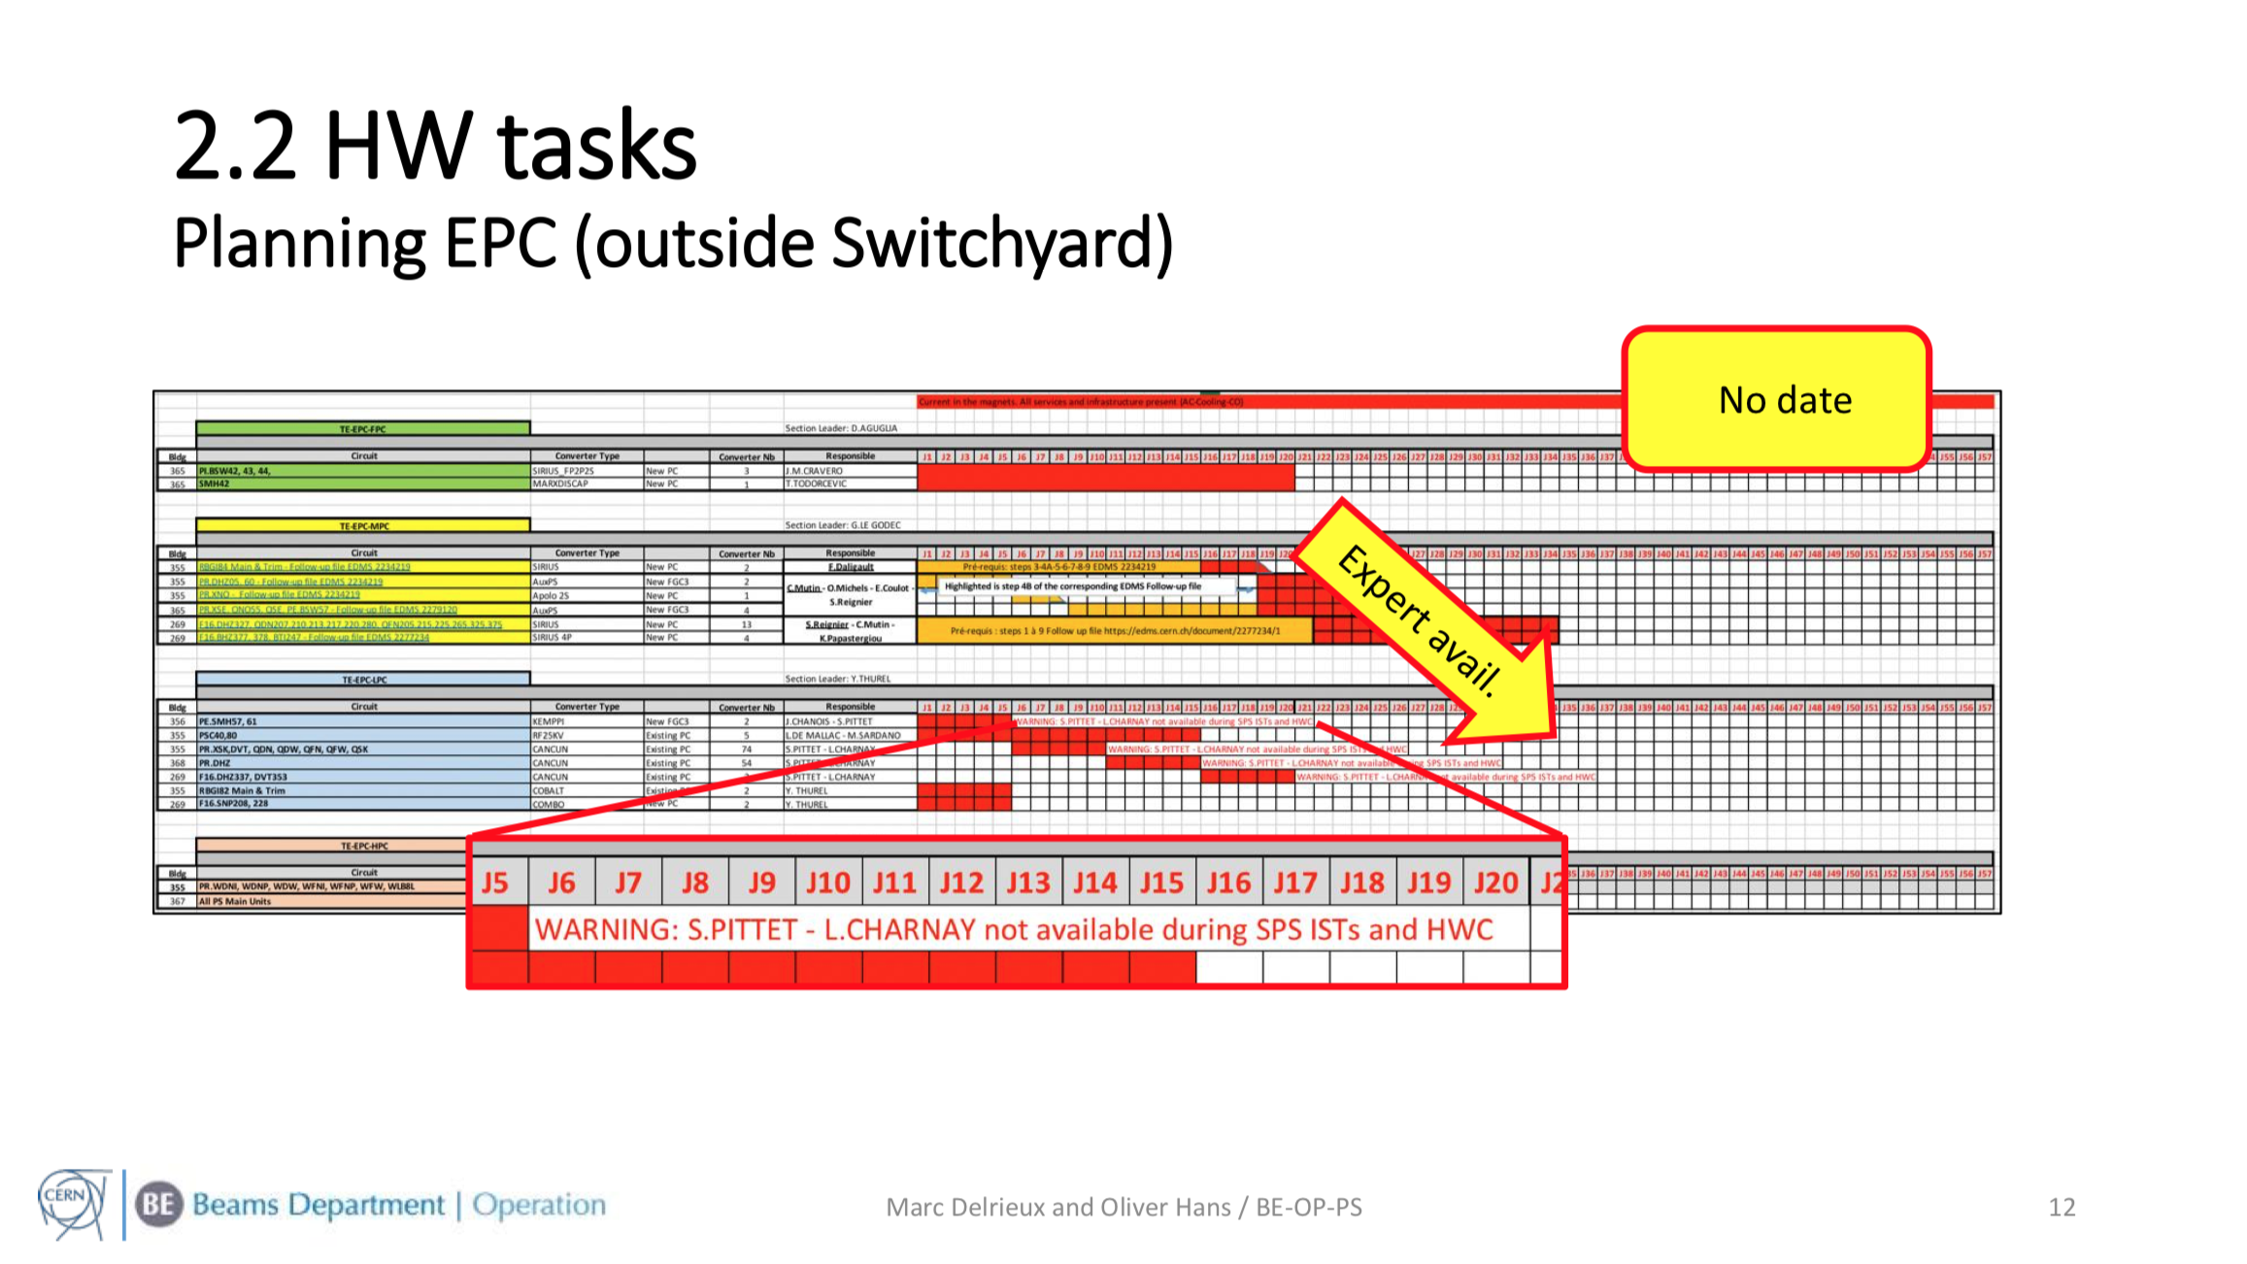
New POPS commissioning schedule – PS HWC
Problem to be addressed

Slide 22
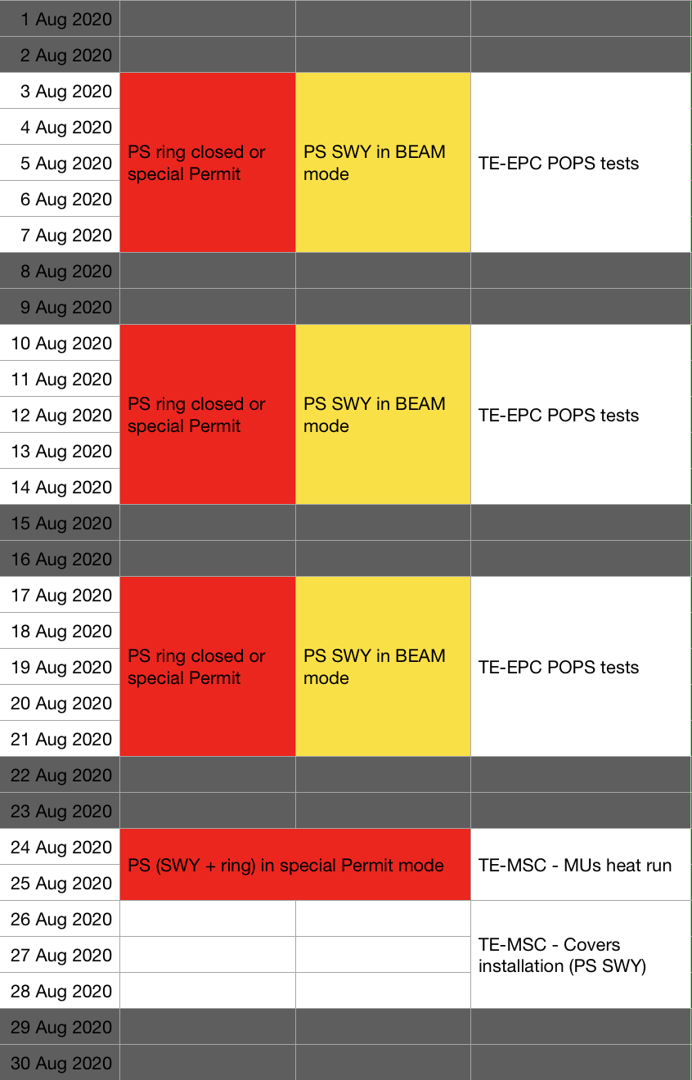
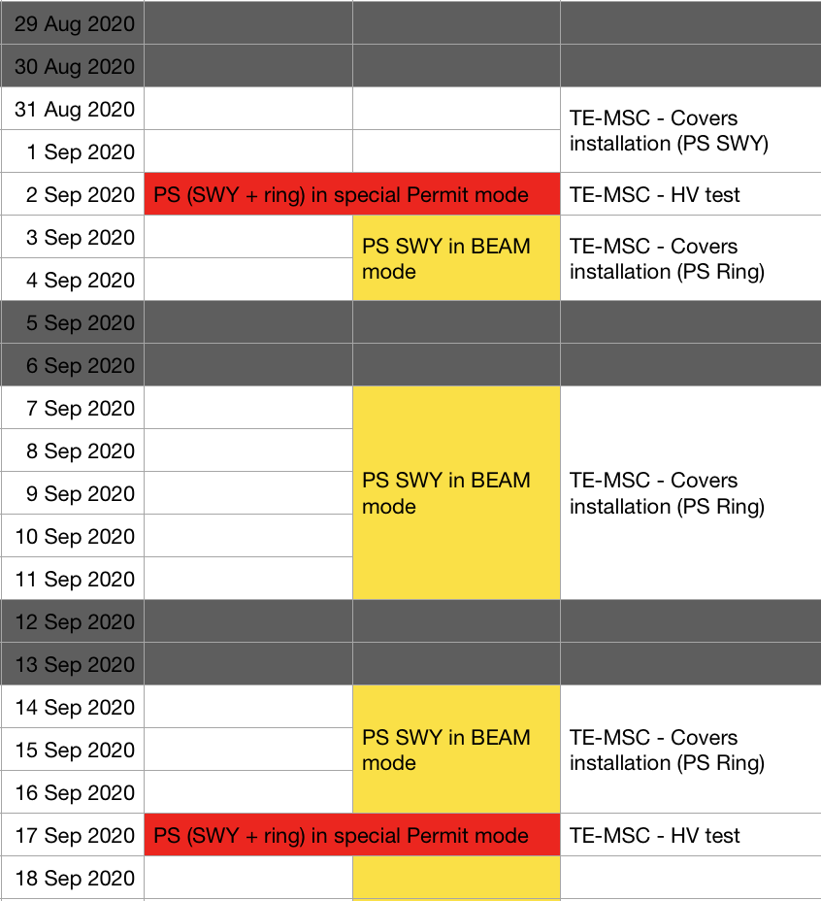
New POPS commissioning schedule – PS HWC

