Slide 1
Planning and Tracking Dry Runs
Online access to planning
Dry runs into check list tool?

Slide 2
What is done when?
IST → equipment groups carry out tests to assert optimal functioning of equipment
  During shutdown or HWC period
Dry run → vertical slice test in collaboration between equipment groups, CO, OP from equipment to control room application/algorithm/setting
  During shutdown or HWC period
HWC/check out: OP runs equipment with control room tools with all interfaces and within operational scenarios. Machine is run as with beam
  During HWC period

Slide 3
Planning
The lists are available for the various machines
Dates to be inserted into MS project
  Extra category: → not according to accelerator zone
  Should be possible to show dry planning in calendar view → possibly all machines
Technical details to be sorted out for end of January
→ should enable equipment groups, CO to be pro-active
Mainly dry runs during shutdown need special attention

Slide 4
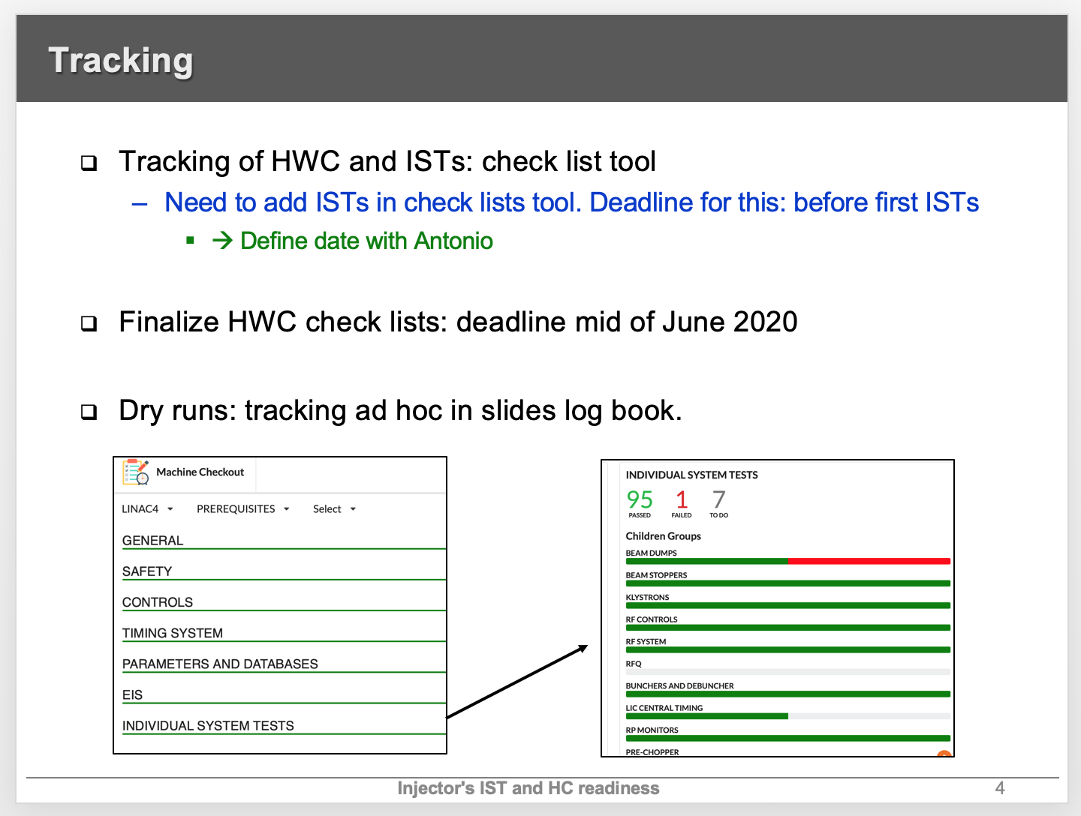
Tracking
From discussion in the SPS commissioning WG
→ Proposed dry run tracking was not satisfactory to everybody

Slide 5
After reflection and discussion: Tracking
2 categories of dry runs (also ISTs)
  Cat1: Dry runs that will have to carried out in that form each LS/YETS
  Cat2: Dry runs that rely on specific test environment that was put in place for staged deployment and early testing given the complexity of system/process
    Part of procedure will used only once
    Systems/processes with Cat2 dry runs will have Cat1 dry runs/HWC tests in the final configuration during HWC.
The check list tool is meant for “eternity”
  Lists that have been prepared for one-off tests will be visible for LS/YETS to come

Slide 6
After reflection and discussion: Tracking
→ Cat1 dry runs will be part described in check list tool
  → tracking automatic
→ recommend to describe check list of Cat2 dry runs in ad hoc format
  Presentation/discussion of results and issues one of the key agenda topics for machine commissioning meetings
  Tracking and re-scheduling within machine commissioning/coordination team in their format
    Re-scheduling → MS project planning update
Example of Cat2 dry runs:
  RF ATIM testing with lab oscilloscope to verify correct timing and applications setting through JAPC directly, not yet through LSA
  SPS BPM electronics testing with ALPS FESA class for one sextant only
  …

Slide 7
Other consideration
Equipment groups to use check list tool for ISTs and/or their commissioning?
Similar considerations
  → describe tests that validate the final configuration of system
Then check lists are an asset during the commissioning
  Procedures kept alive and updated as part of commissioning analysis
  Tracking and statistics automatic
Depending on how equipment groups want to use it, care needs to be taken when defining initial structure
  Across complex in one view for given system? All group equipment per machine?,…

