Slide 1


BSM Higgs searches at ATLAS and CMS
Aruna Kumar Nayak
Institute of Physics
Bhubaneswar, India
The XXVIII International Conference on Supersymmetry and Unification of Fundamental Interactions (SUSY 2021)
23-28 Aug 2021

Slide 2
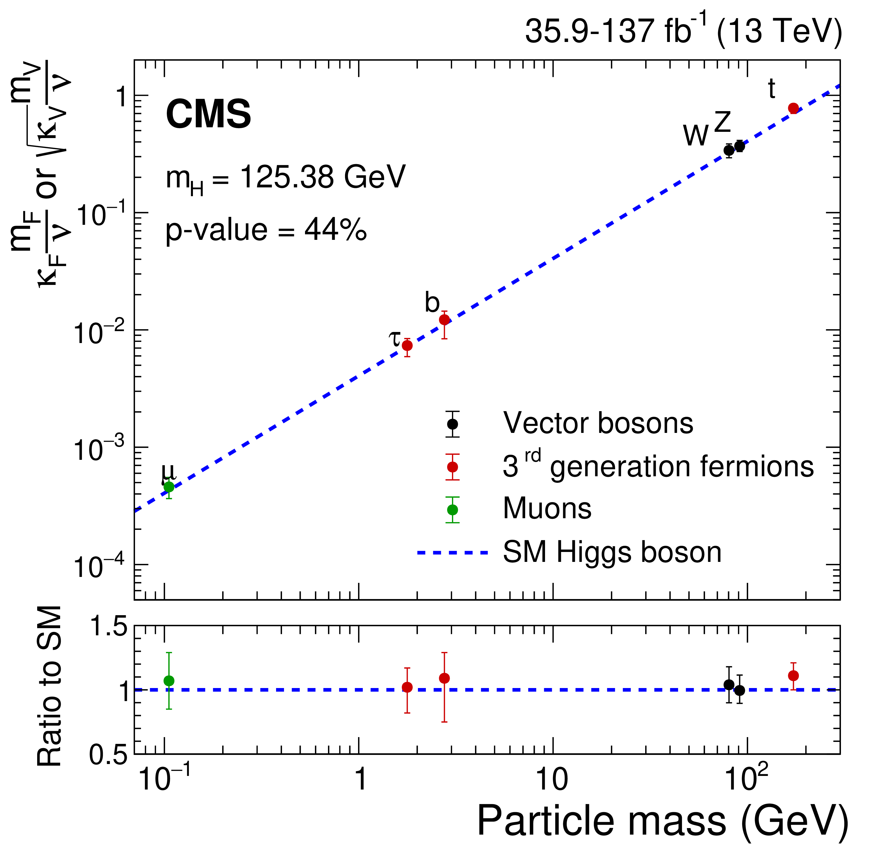
Introduction
Higgs boson searches beyond the SM: Important aspect of Higgs physics program at LHC
Complimentary to the SM interpretations/investigation of properties of the observed 125 GeV scalar particle
BSM searches include:
Searches for more complex Higgs sector
Prediction of additional Higgs bosons from many models beyond SM
Search for exotic decays not expected within the SM.
This talk highlights only a few recent searches

Slide 3
Searches for Extended Higgs sector

Slide 4
Higgs in MSSM
Two Higgs doublets => 5 physical bosons: h, H (CP even), A (CP odd), H±
  Controlled by two parameters at tree level: m_{A} and tanβ
  Other SUSY parameters are important at higher order corrections
Searches in all possible decay channels
bb
ττ
μμ
H → ZZ → 4l/llνν
A → Zh → ll(νν)bb/llττ
H → WW → llνν
H → hh → 4b/bbγγ/bbττ
H / A →
(most sensitive at high tanβ region)
(sensitive at low tanβ region)
H → tt
(sensitive at high m_{A} and low tanβ region)
Charged Higgs (H±) searches

Slide 5
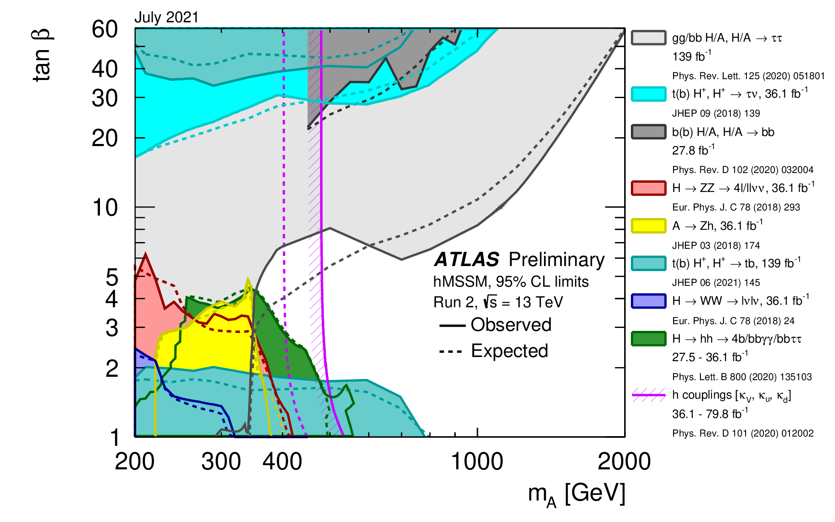
Higgs in MSSM
ATL-PHYS-PUB-2021-030
Interpretation in hMSSM scenario (as proposed in arxiv:1307.5205, 1502.05653)
Exclusion of MSSM parameter space via direct searches for heavy Higgs bosons
Searches in all possible decay channels
(ZZ, WW, Zγ, γγ, hh,
ττ, tt, bb)

Slide 6
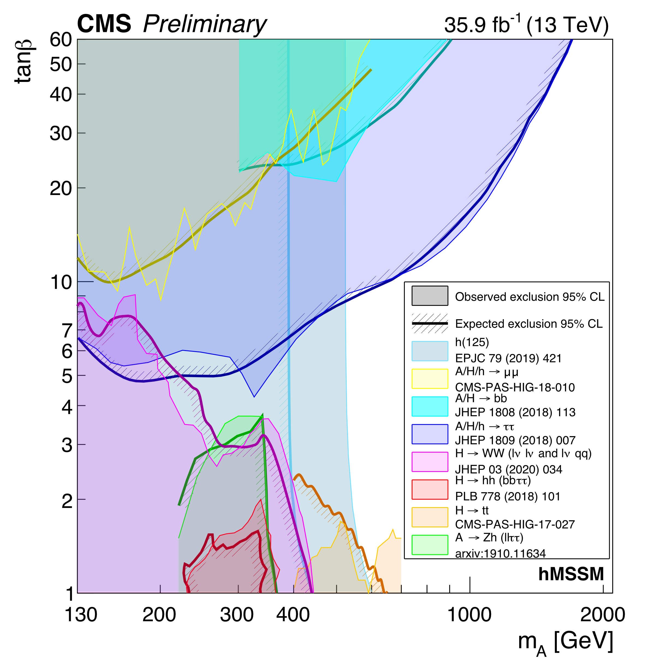
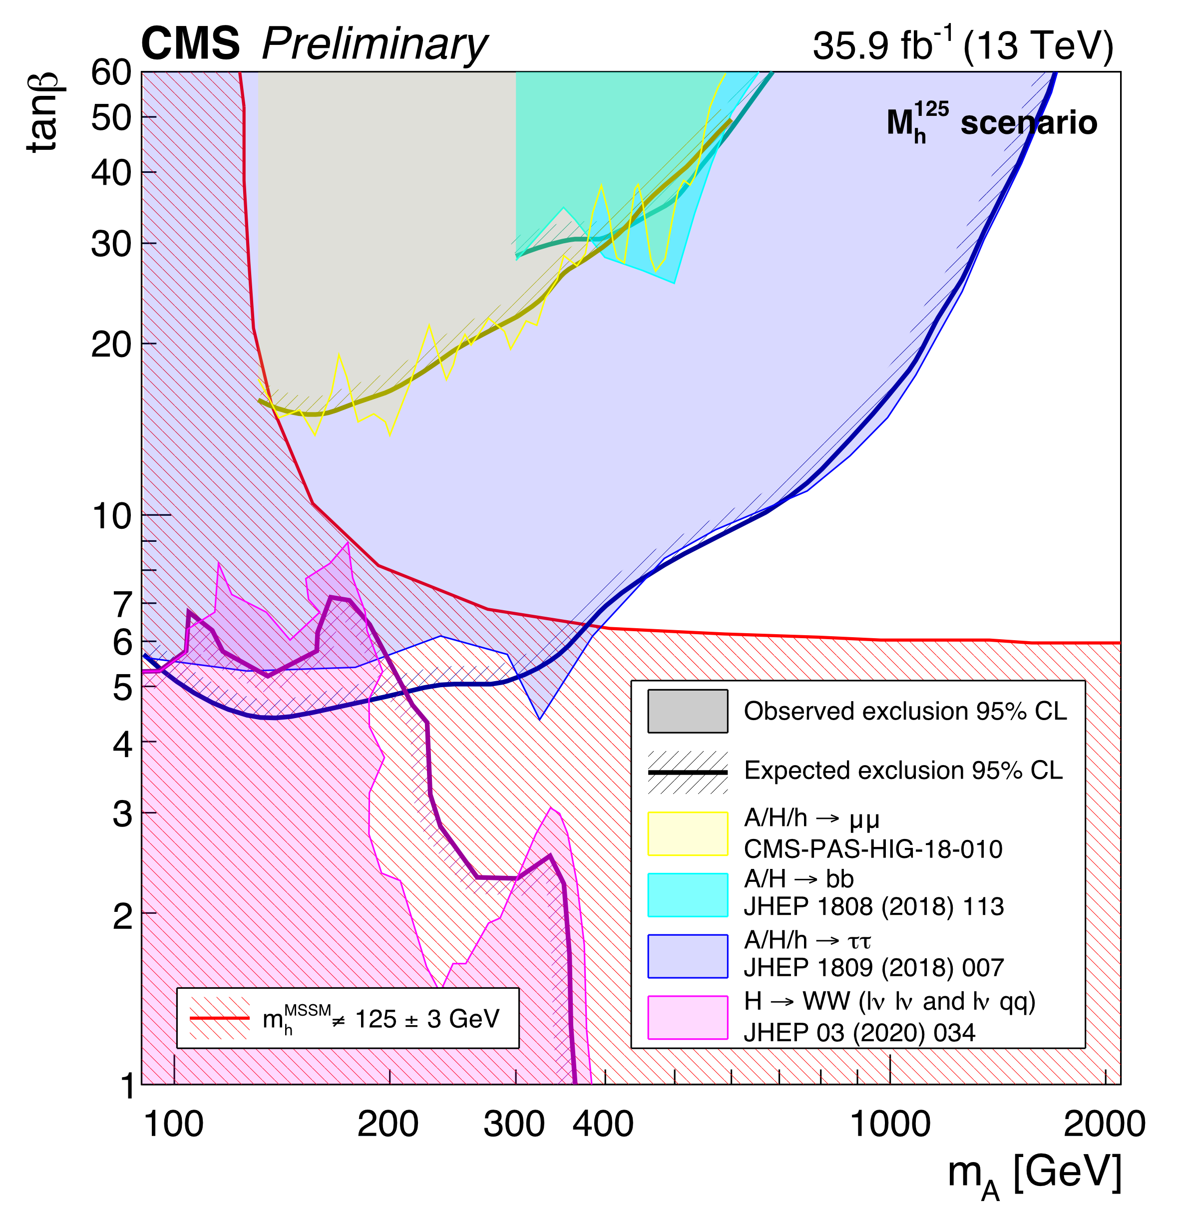
Higgs in MSSM
SummaryResultsHIG
Similar searches at CMS
Interpretations also in m_{h}¹²⁵ scenario (as proposed in arxiv:1808.07542)
Full Run-2 results awaited.

Slide 7
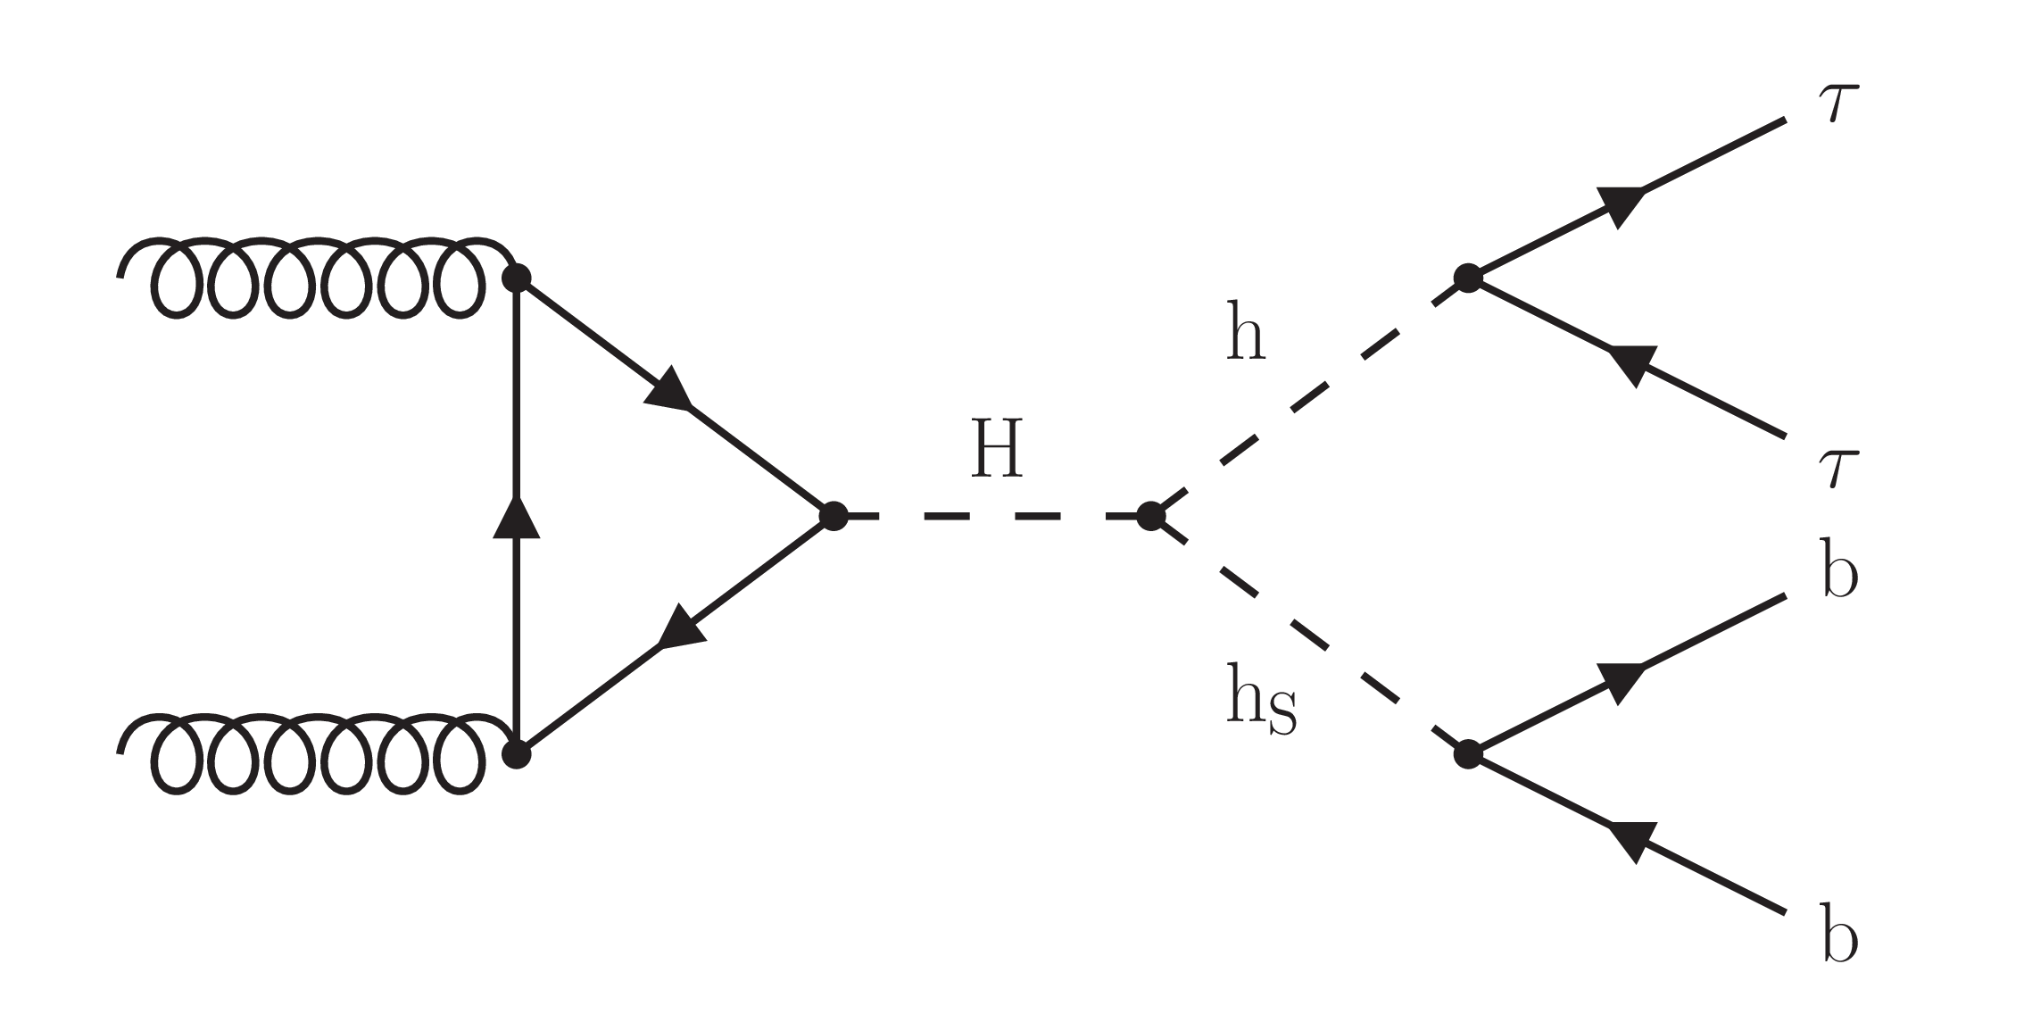
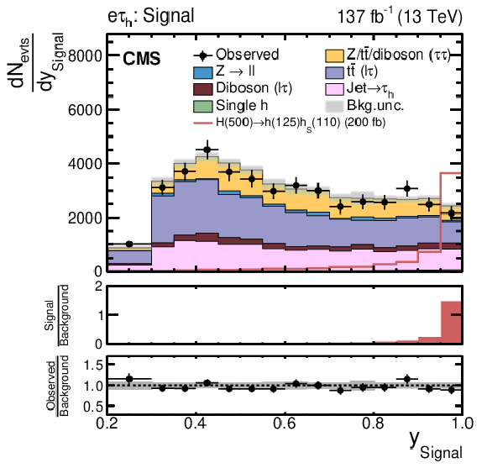
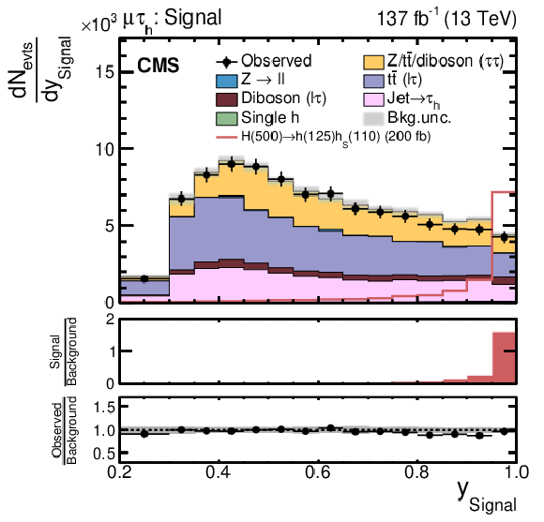
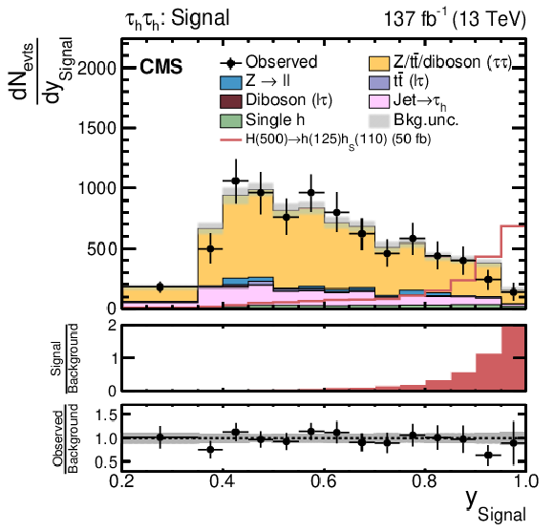
H→bbττ
CMS-HIG-20-014
H_{MSSM}→h_{s}(bb) + h₁₂₅(ττ)
Motivated by models such as Next-to-MSSM: Extend the MSSM Higgs sector by one more singlet field
Events categorized based on tau decay modes: τ_{e}τ_{h}, τ_{μ}τ_{h}, τ_{h}τ_{h}
Neural Network based classifier discriminator
  Used in ML fit to extract signal
Major backgrounds: Z+jets, tt+jets
Events with real τ_{h} using tau embedding method
Events with misidentified τ_{h} using fake probability method
Events with tau decay to leptons from MC

Slide 8
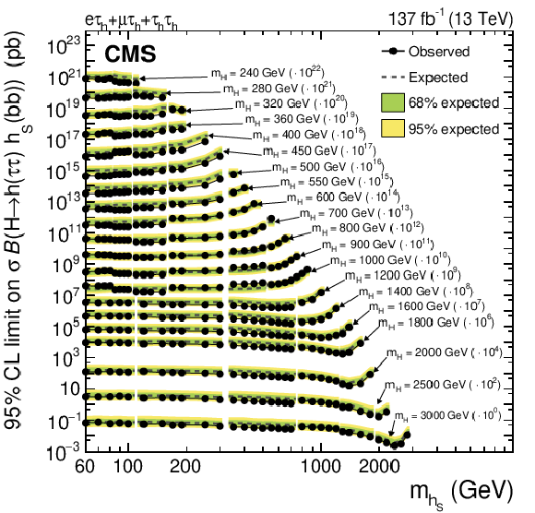
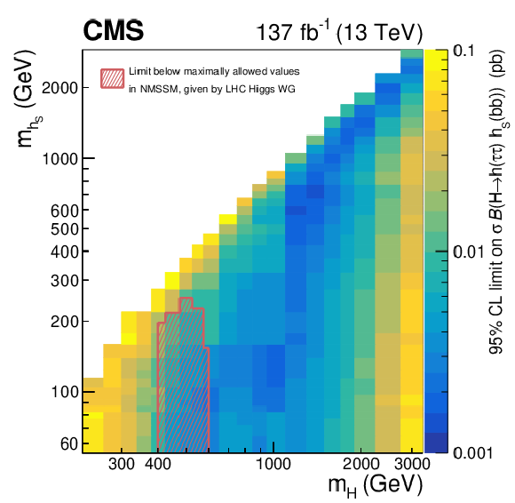
H→bbττ
CMS-HIG-20-014
H_{MSSM}→h_{s}(bb) + h₁₂₅(ττ)
Upper limit on BR, for m_{H} = 240 GeV to 3 TeV

Slide 9
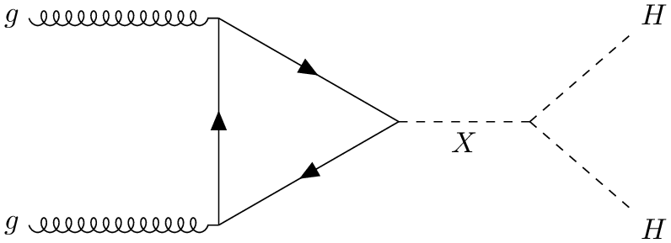
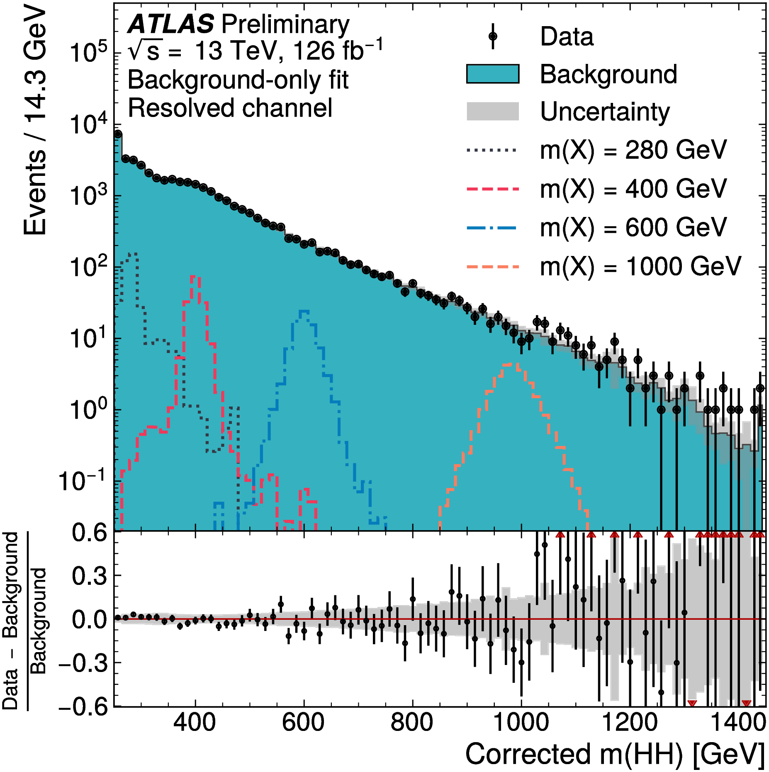
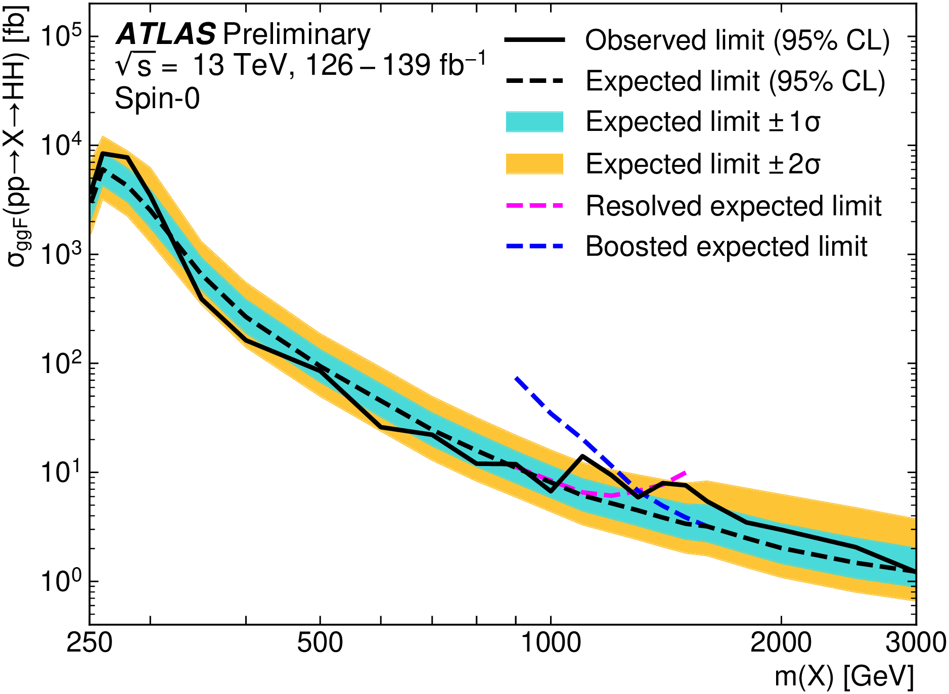
Resonant HH → bbbb
Benchmark signal model:
ATLAS-CONF-2021-035
A generic spin-0 boson (e.g. heavy Higgs in 2HDM),
produced via gluon fusion
Analysis in two complementary channels
Resolved: 4 b-jets reconstructed individually,
Boosted: Higgs reconstructed as large-radius jet
Background (dominated by QCD) is estimated from lower no. of b-tagged events in data

Slide 10
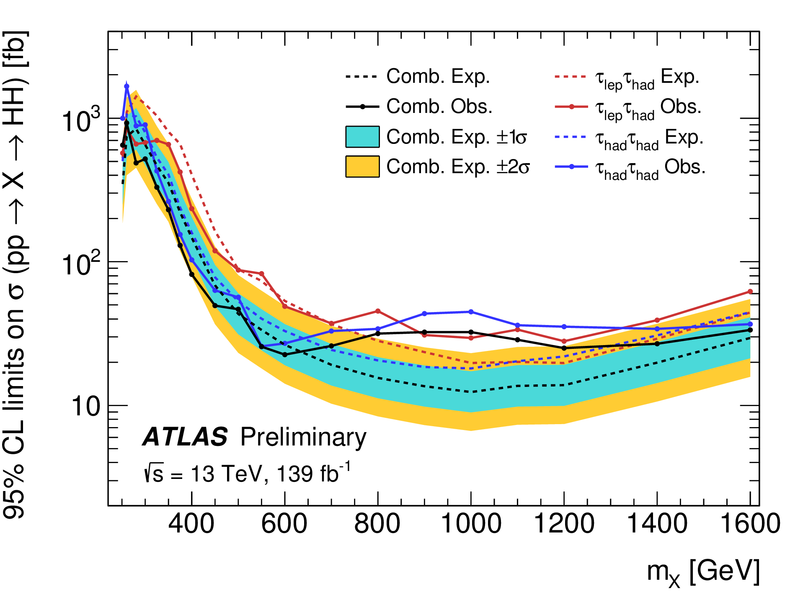
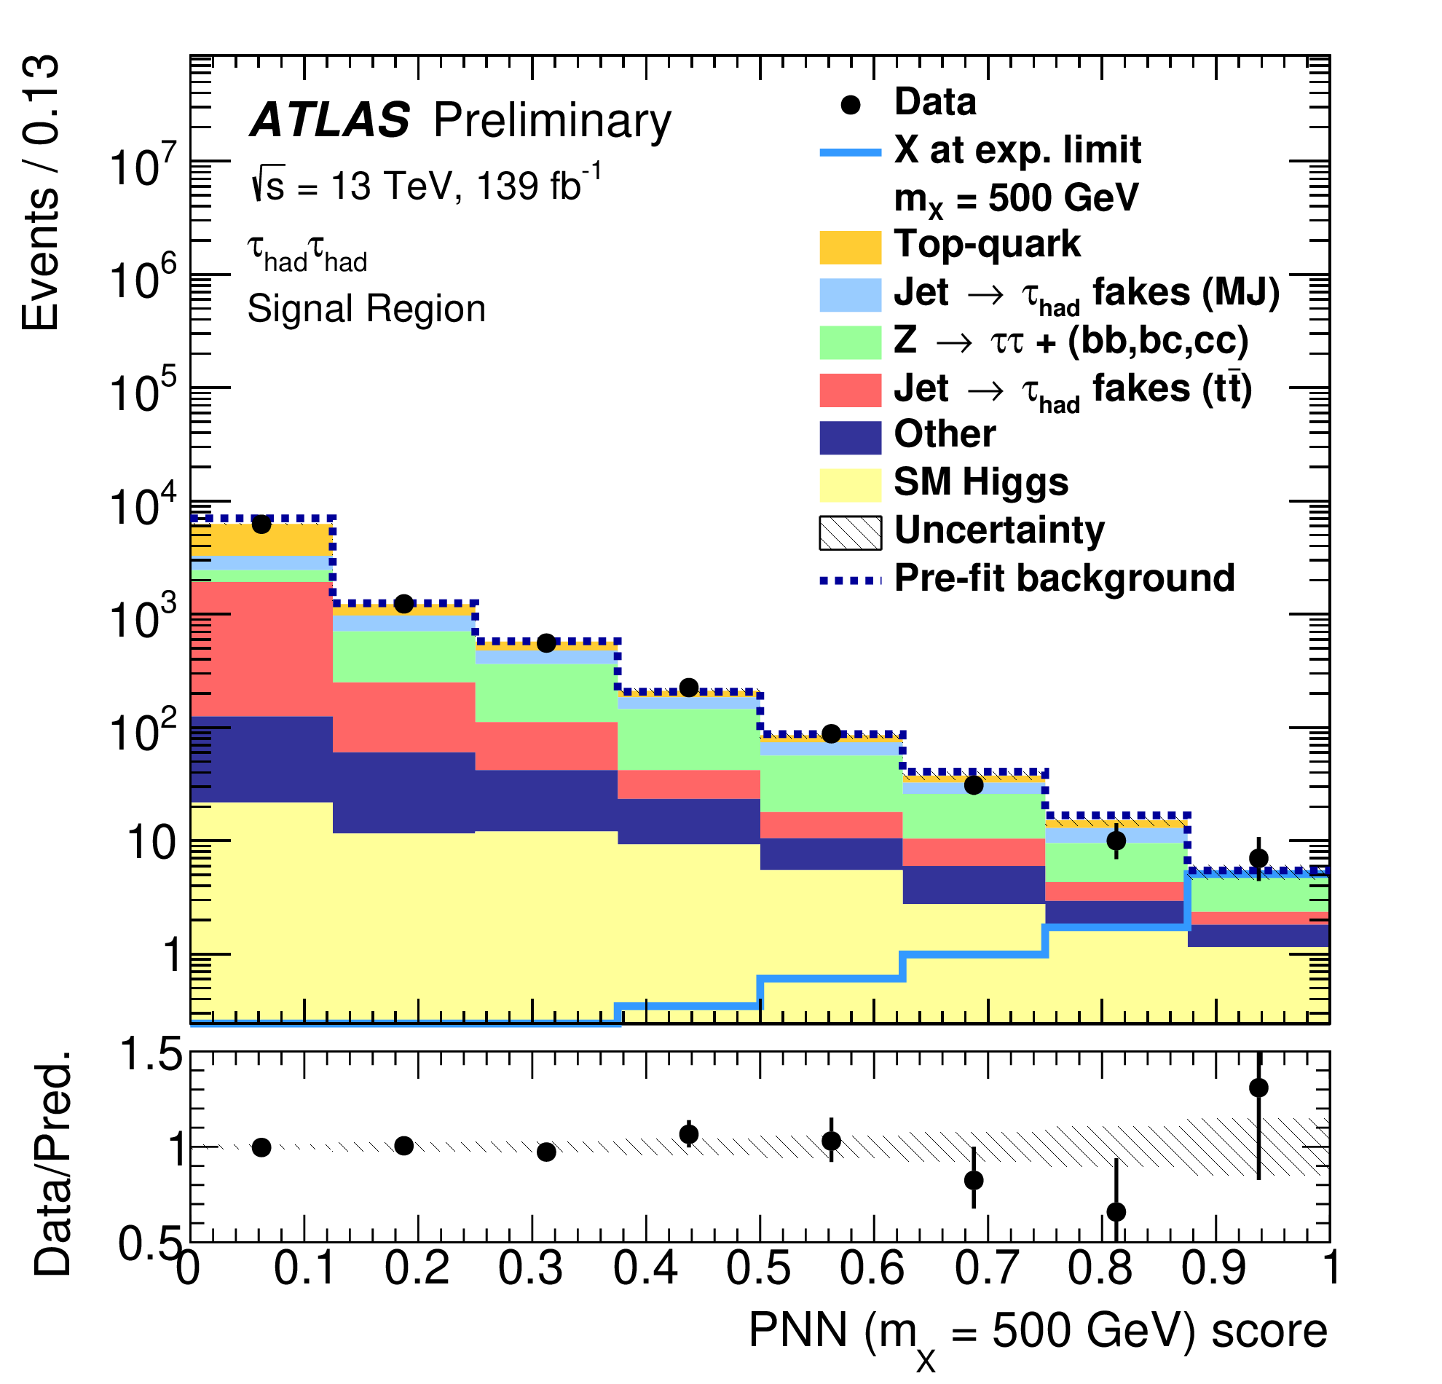
Resonant HH → bbττ
ATLAS-CONF-2021-030
A narrow-width CP-even scalar particle (X)
is used as the benchmark model (e.g. Heavy Higgs in 2HDM)
Both tau decay modes considered: τ_{lep}τ_{had}, τ_{had}τ_{had}
Backgrounds: tt, Z+HF jets, QCD
Events with real τ_{had} are modeled from MC, normalizations taken from control and low score signal regions
Events with fake τ_{had} are estimated from data, using fake/scale factor method.
MVA analysis, using parameterized neural network
Simultaneous binned maximum-likelihood fit to the MVA output distributions in 3 SR and m_{ll} in Z+HF control region
Local (global) significance
at 1 TeV: 3.0σ (2.0σ)

Slide 11
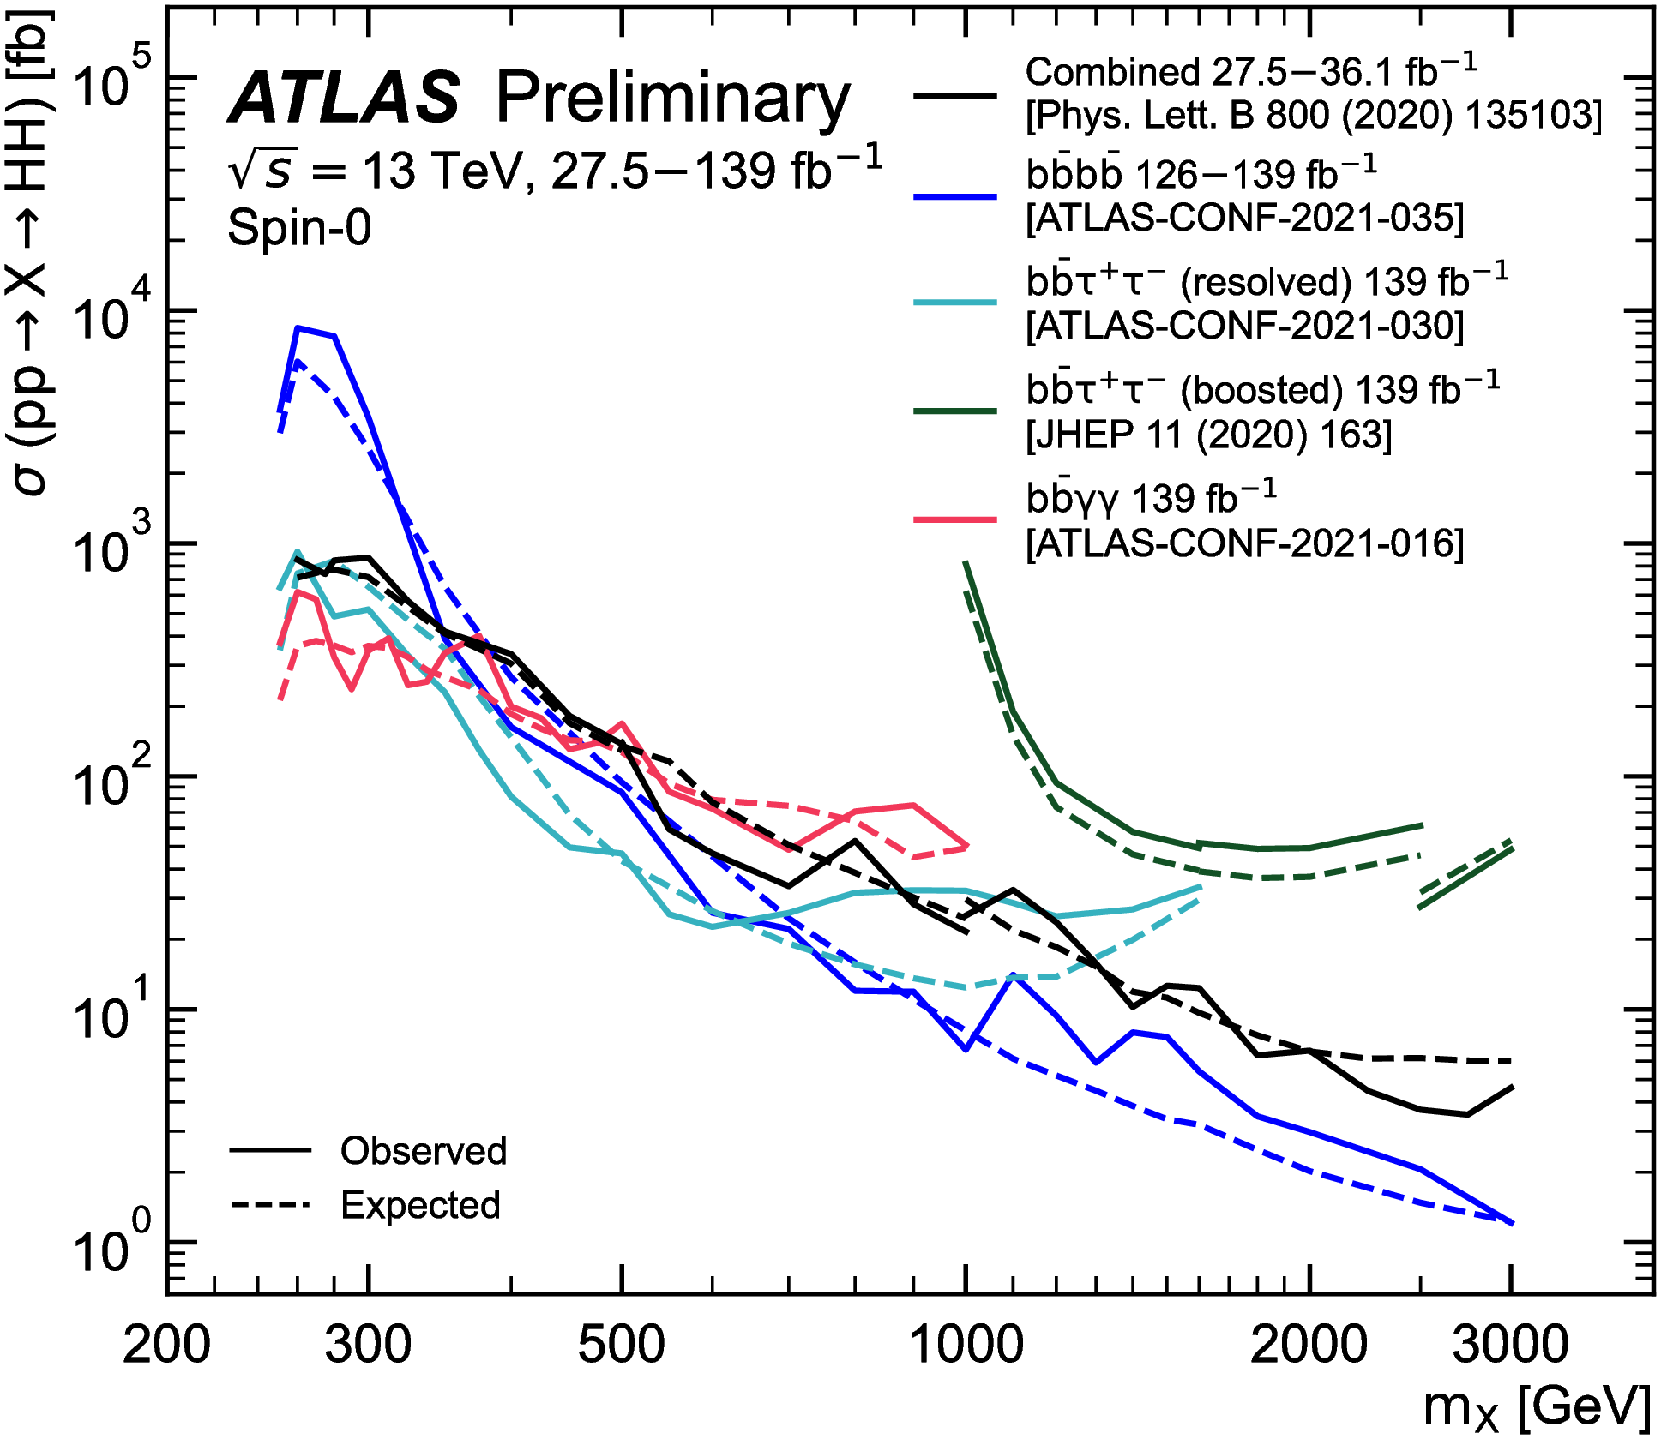
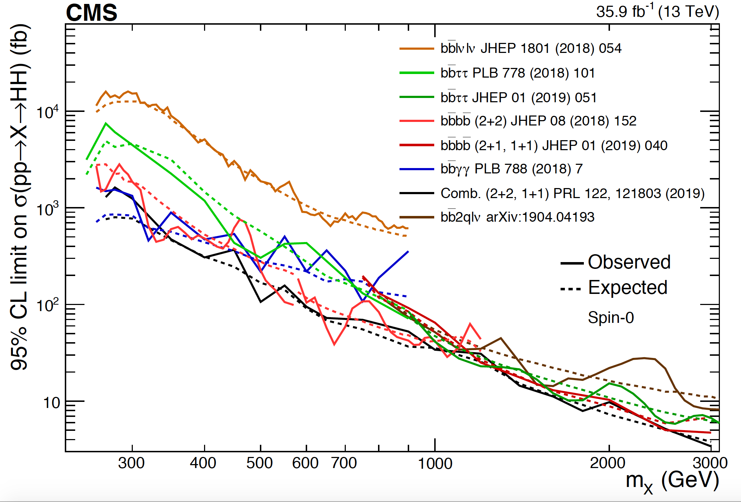
Combination of X → HH searches
ATL-PHYS-PUB-2021-031
SummaryResultsHIG
Upper limits at 95% CL on the resonant HH production cross-section as a function of the mass for a narrow-width scalar resonance

Slide 12
Charged Higgs searches
Singly (H±) and Doubly (H±±) charged Higgs
    Produced in models, such as 2(3)HDM, Higgs triplet models
    (e.g. Type-II Seesaw) etc..
Many Searches at LHC
          H± → tb
          H± → τν
          H± → cb
          H± → cs
          H± → W±Z
          H±± → W±W±
          H±± → l±l±

Slide 13
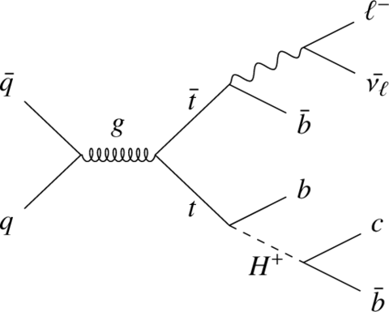
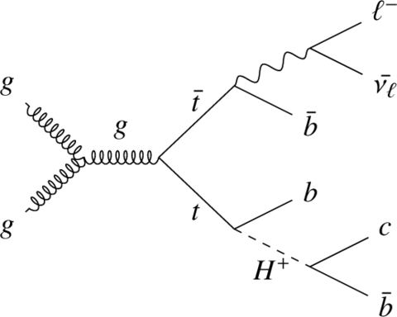
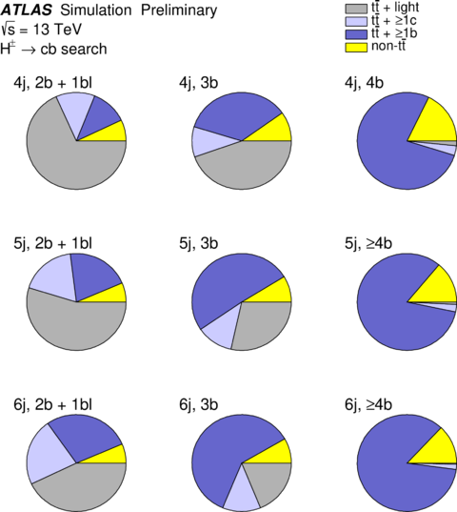
t → H±b, H± → cb
ATLAS-CONF-2021-037
Light charged Higgs boson production in top quark decays, and decaying to cb
60 GeV < m_{H}+ < 160 GeV
Final state: 1l + ≥ 4 jets (3 b-tagged)
  Events categorized according to no. of jets and b-jets
Major background: SM tt+jets
Signal/Background discrimination using NN classifier
Trained against SM tt background
Parameterized as function of m_{H+} and all signal samples are combined for the training.

Slide 14
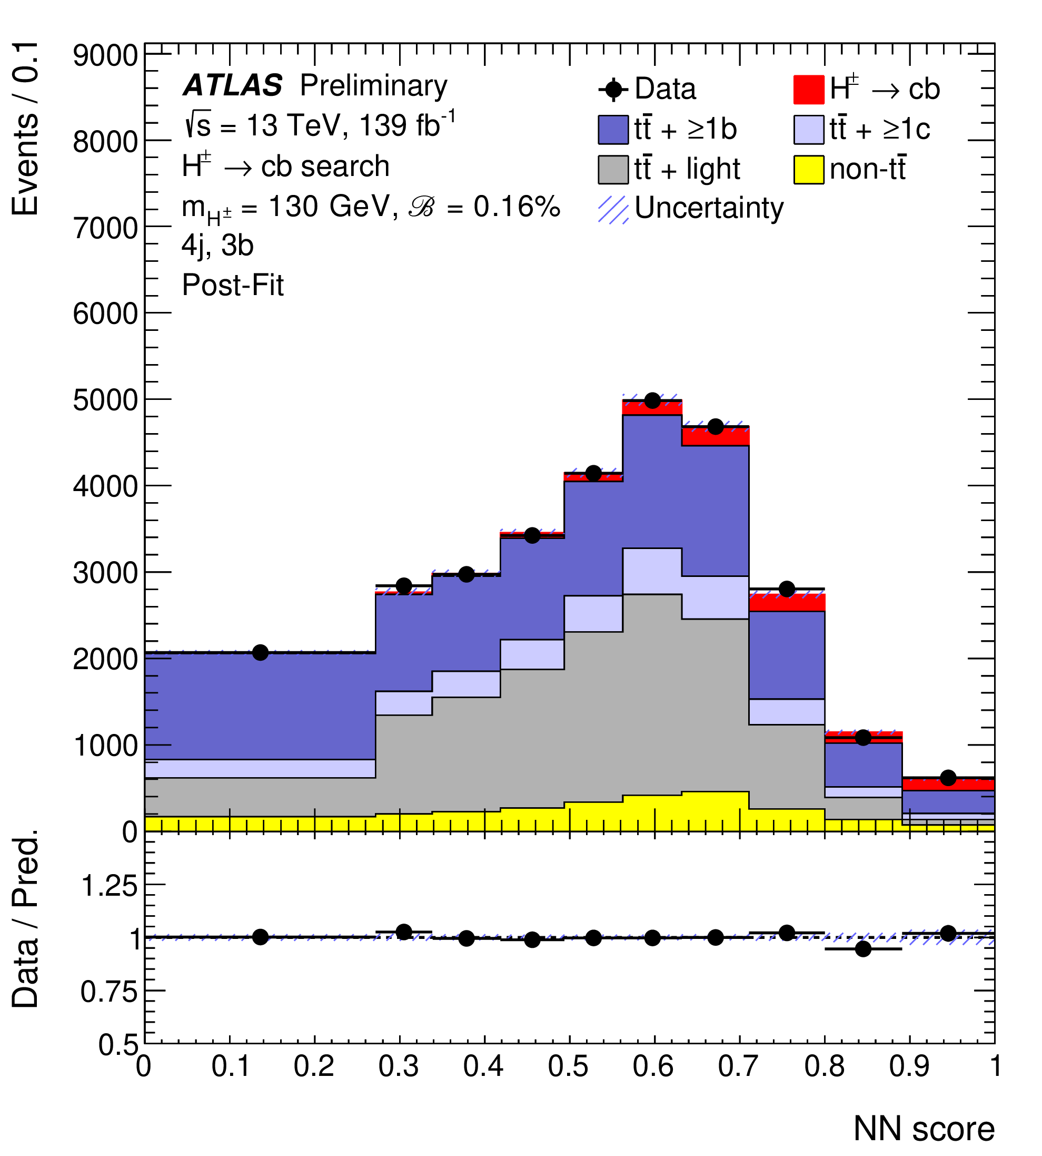
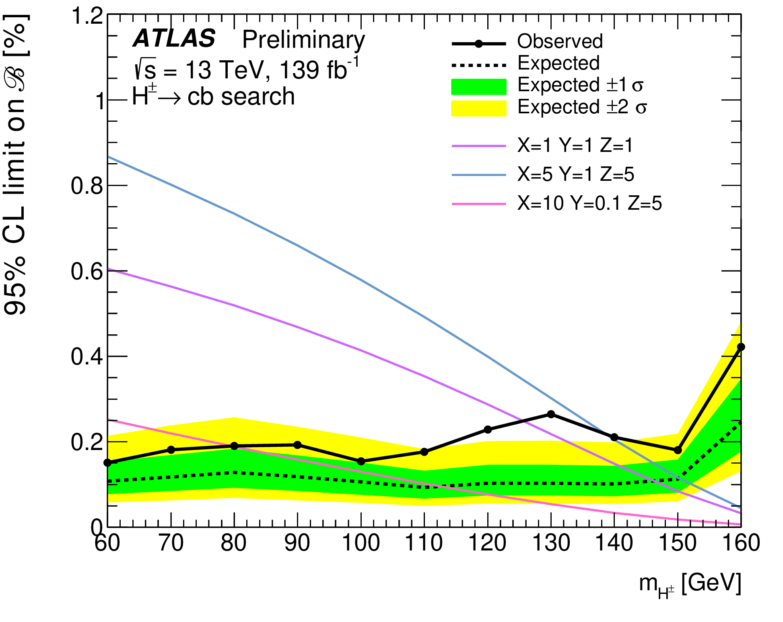
t → H±b, H± → cb
ATLAS-CONF-2021-037
Binned profile likelihood fit of the NN discriminant across 3b and ≥4b regions
Control background and reduce systematic uncertainties
95% CL upper limits on
B = B(t → H±b) × B(H± → cb)
Excess at m_{H+} = 130 GeV, with local (global) significance of 3σ (2σ)
3HDM predictions for 3 benchmark values are shown

Slide 15
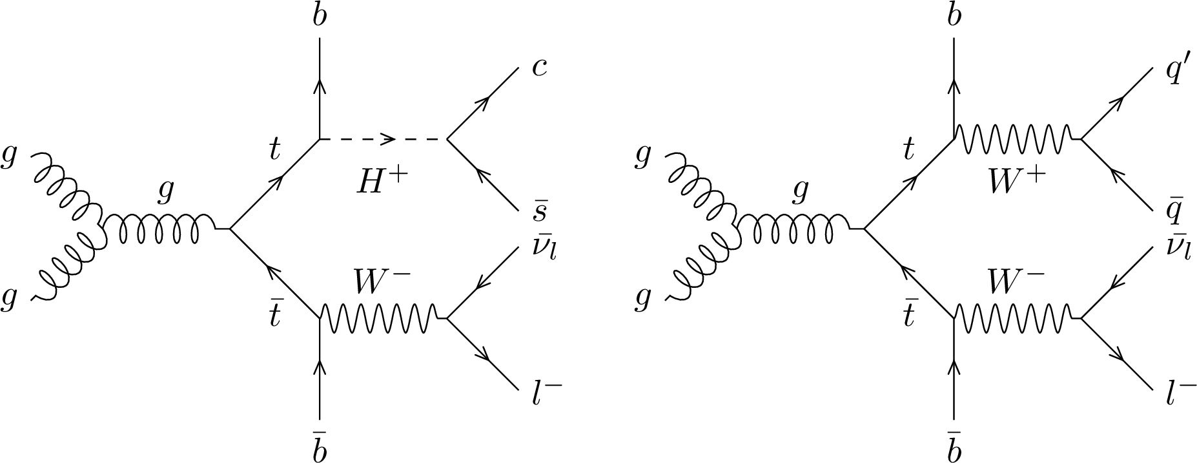
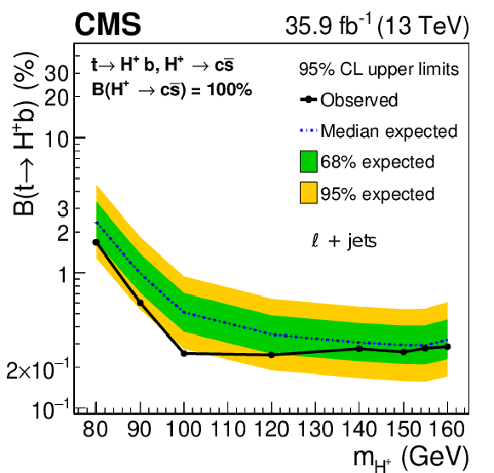
t → H±b, H± → cs
PRD 102 (2020) 072001
Light charged Higgs production in top decays, and decaying to cs
80 GeV < m_{H}+ < 160 GeV
Final state: 1l + >= 4 jets(2 b-tagged)
  Full reconstruction of tt events using kinematic fit
  Improves m_{jj} (m_{H+}) mass resolution significantly
  Signal region categorized based on c-tagging working point
Major background: SM tt
Upper limits on B(t→H⁺b), assuming B(H⁺ → cs) = 1

Slide 16
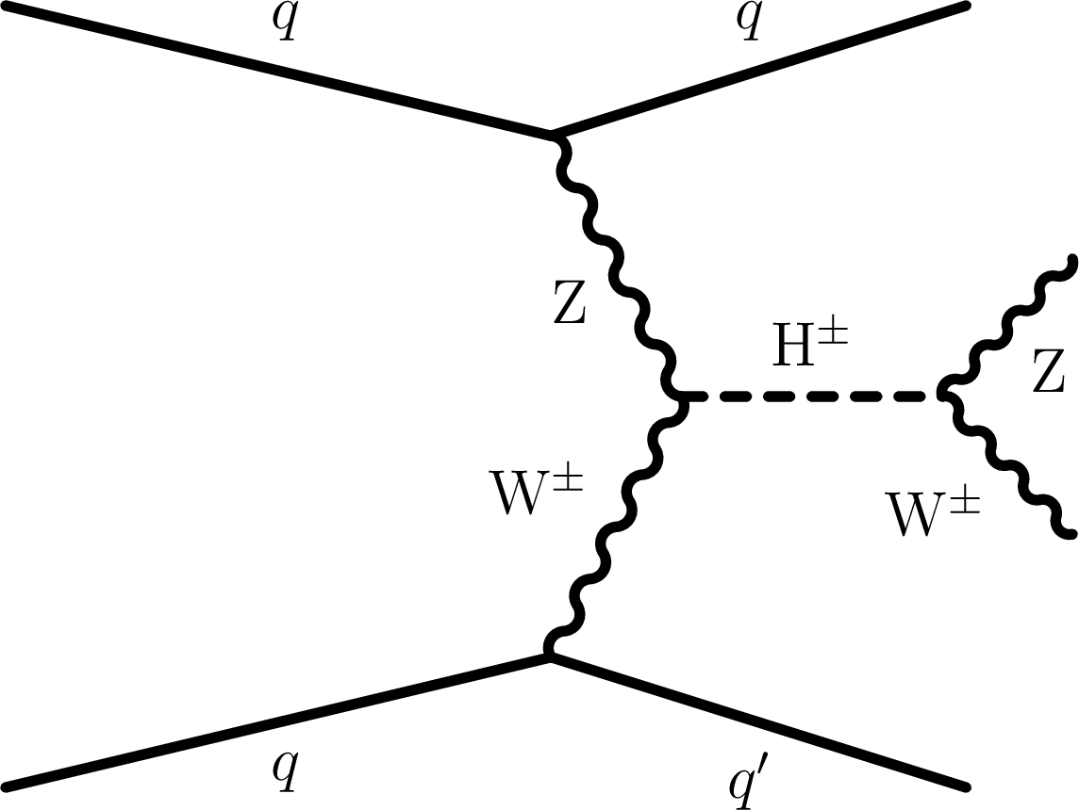
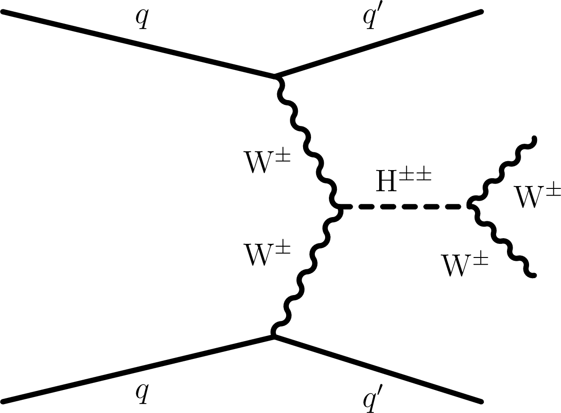
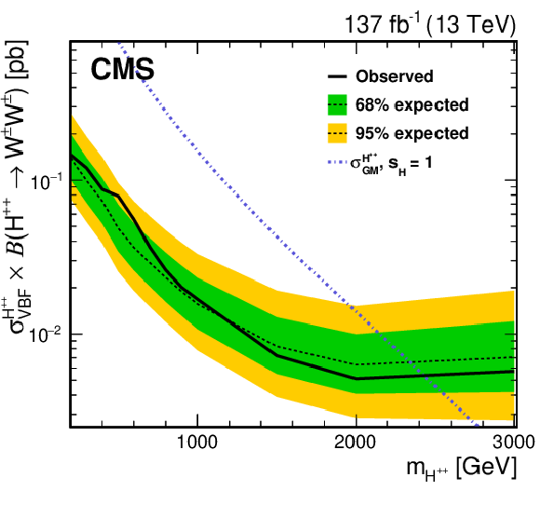
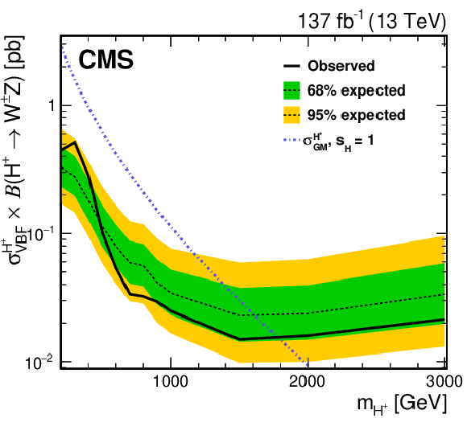
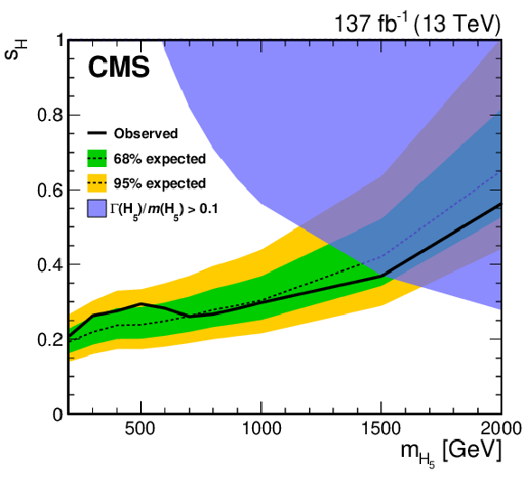
Charged Higgs decay to Vector bosons
VBF production of H±± → W±±W±± / H± → W±Z
EPJC 81 (2021) 723
Searches for VBF production of charged Higgs boson, and decaying to pair of gauge bosons
→ Motivated by the Georgi–Machacek model, with SU(2) scalar triplets
Clean signature: two isolated same-sign lepton (2lss) or three isolated lepton (3l), with two VBF jets
Signal extraction using binned max. likelihood fit of 2D distribution ( M_{T}^{VV} and m_{jj} )

Slide 17
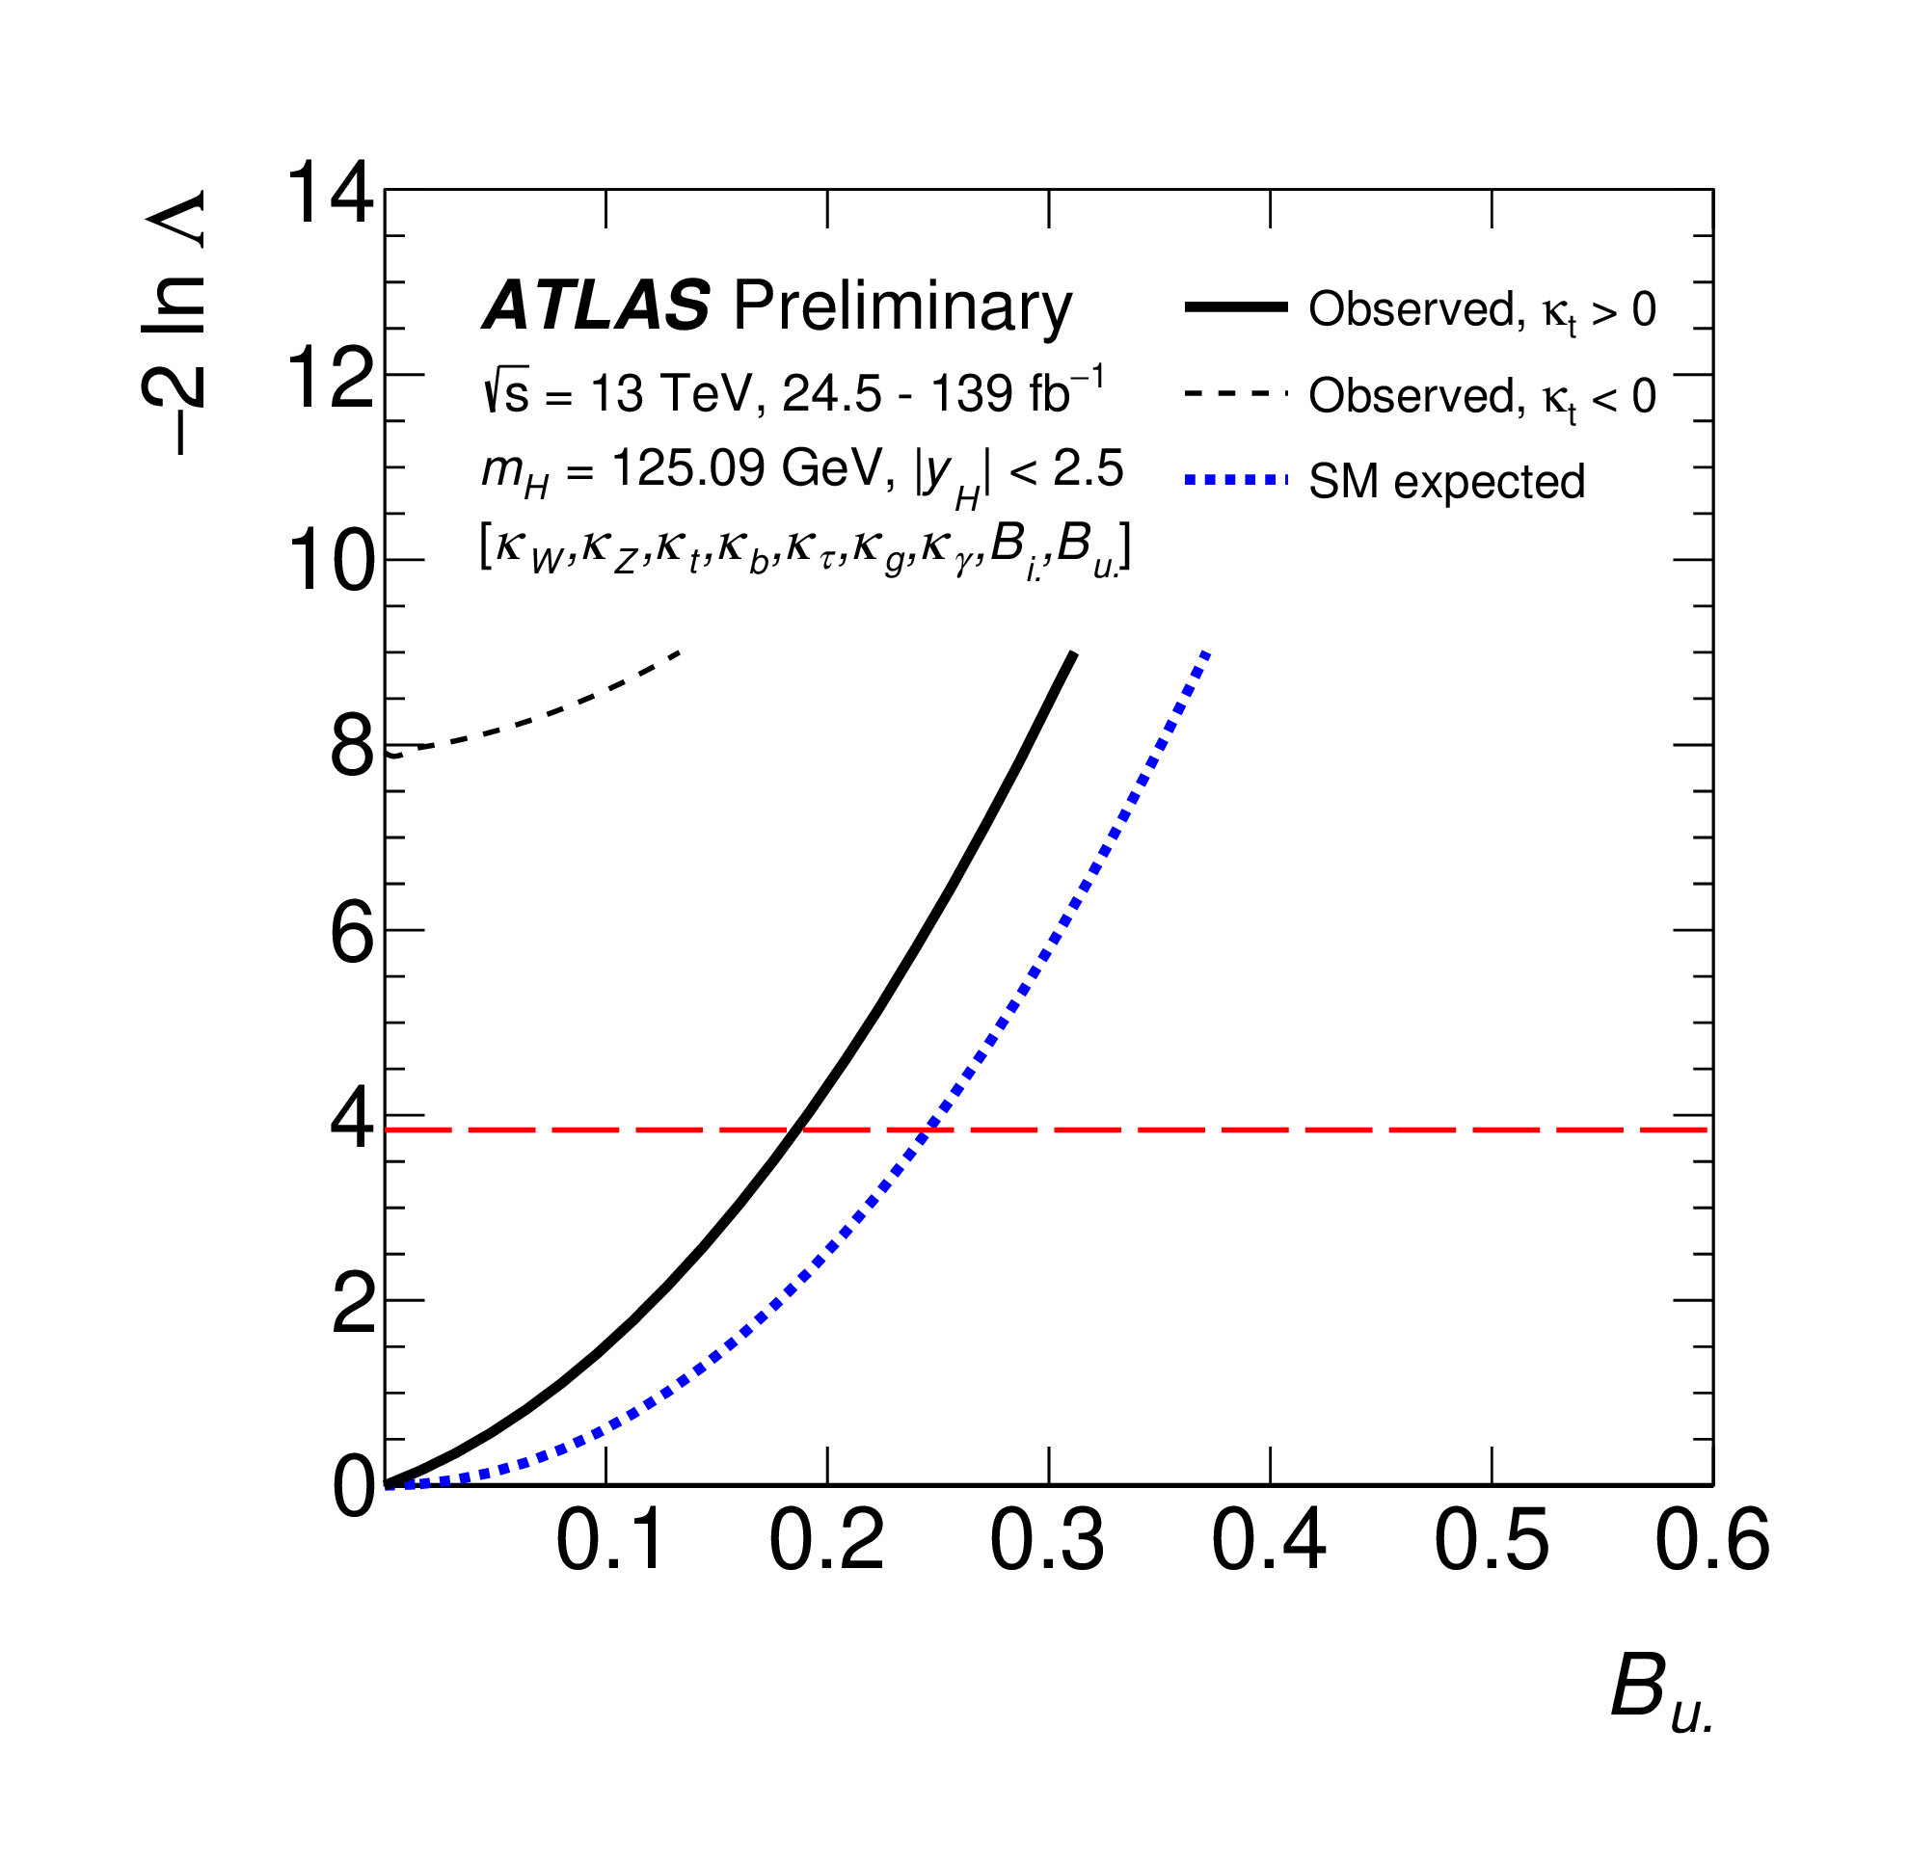
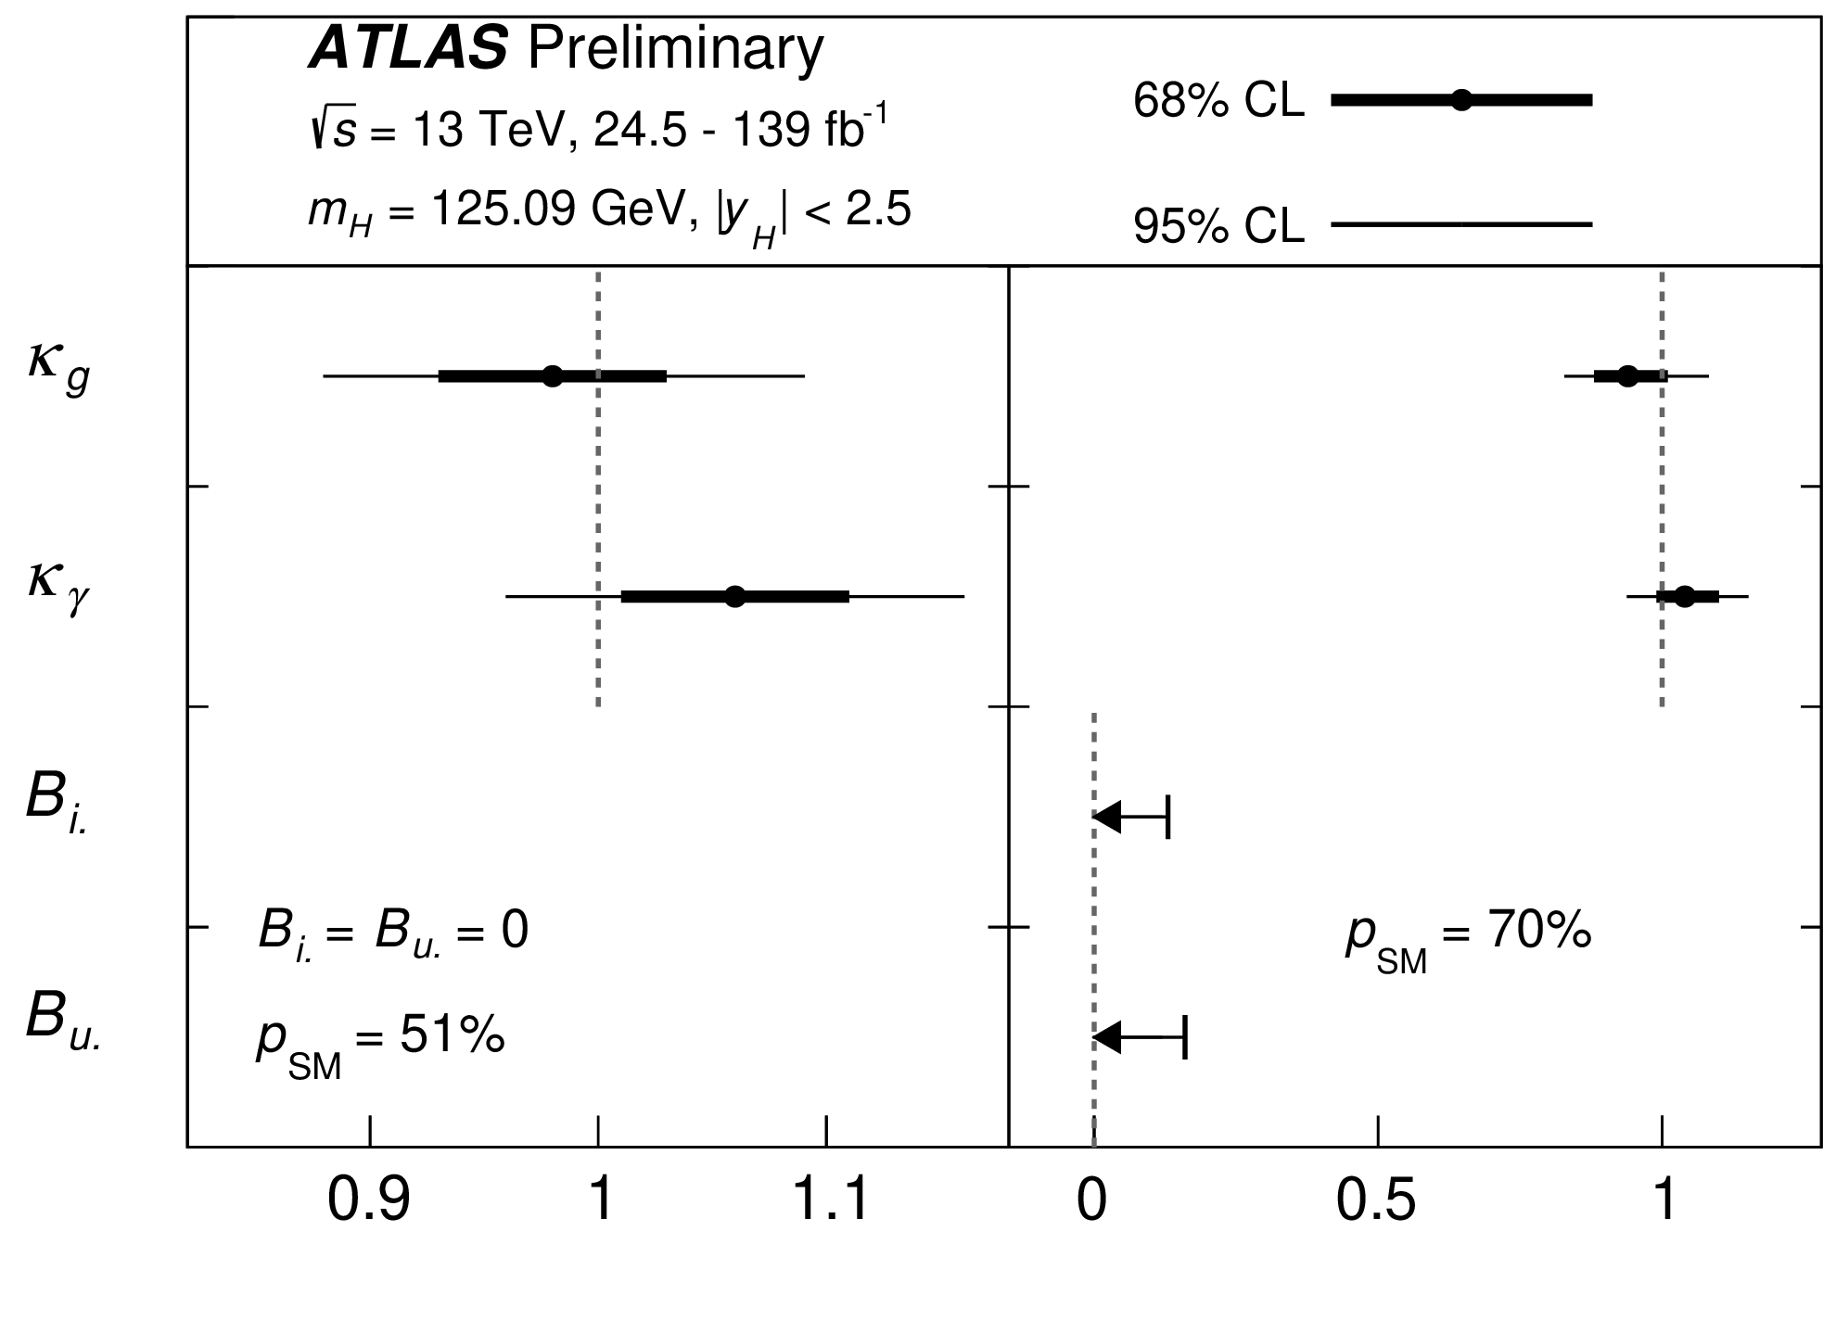
Non-standard Higgs decays
Width of SM Higgs is small ➔ small coupling to BSM can result in detectable branching fractions
Constraint on BR(h → undetected), from combination of Higgs measurements, still allows for O(10%) decays into unobserved particles.
ATLAS-CONF-2020-027

Slide 18
h(125) → aa searches
Motivated by Next-to-MSSM Higgs sector:
Extend the MSSM Higgs sector by one more singlet field
      Adds more degrees of freedom:
7 Higgs bosons: h₁, h₂, H₃, A₂, a₁, H±
h(125) → aa decay mode possible in NMSSM scenarios, where “a” stands for just a Higgs boson that could be scalar or pseudo-scalar
Many final states analyzed for varying m_{a} values, up to m_{a} ≤ m_{h}/2
The decay products of “a” boson boosted for low m_{a} values:
    Challenging final states
    Special care needed to reconstruct and identify leptons
Results are presented in terms of upper limits on cross section times branching fractions
Large number of searches at LHC
(γγ)(γγ)
(γγ)(gg)
(μμ)(μμ)
(μμ)(ττ)
(bb)(μμ)
(bb)(bb)
(bb)(ττ)
(ττ)(ττ)
h → aa →
Only a few recent results are presented in this talk

Slide 19
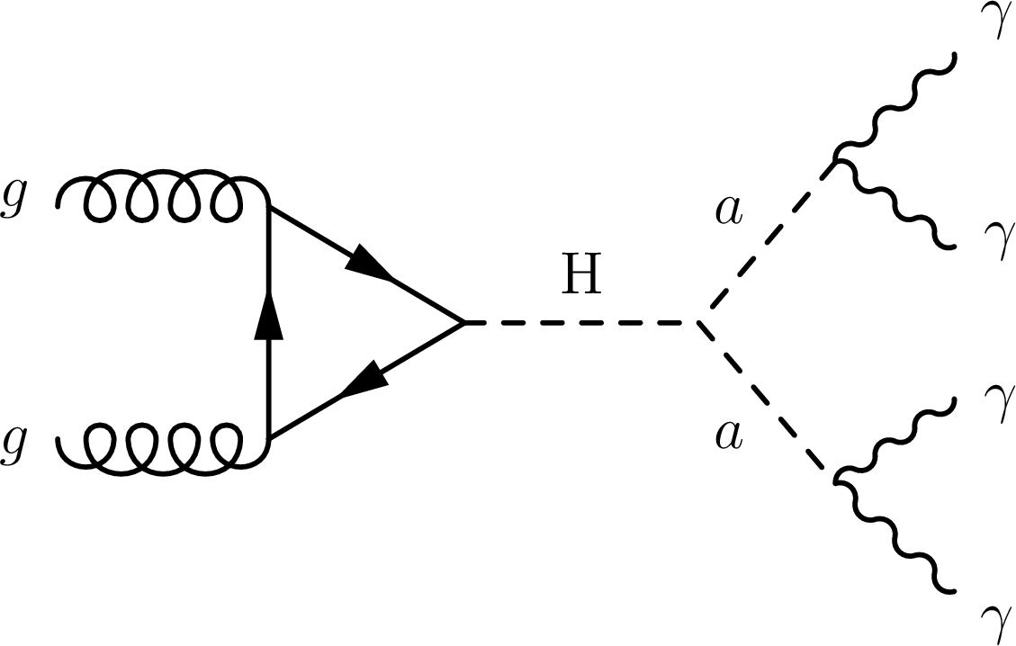
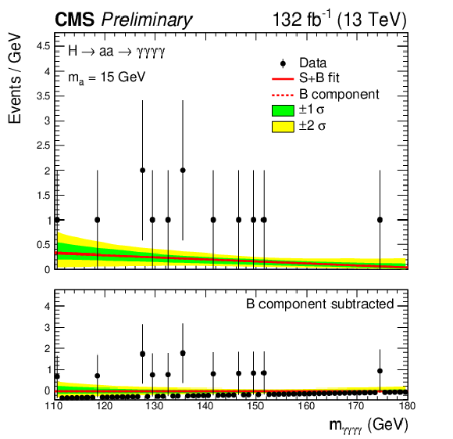
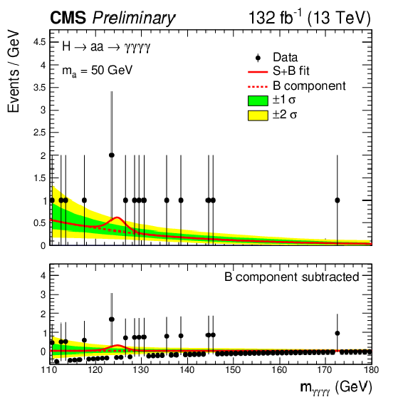
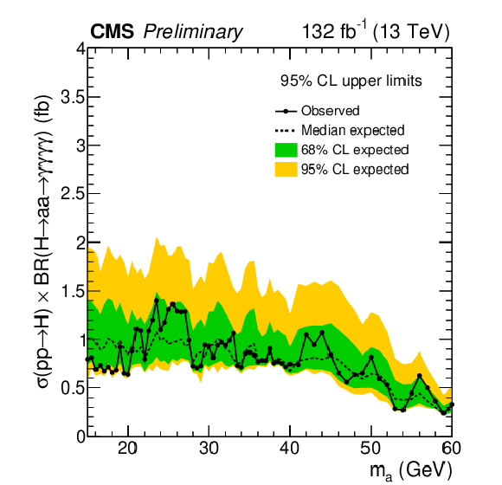
h→ aa →4γ
CMS-PAS-HIG-21-003
Search for 4 isolated photons, in mass range 15 GeV < m_{aa} < 60 GeV
In some models Br(a → γγ) is large
Low background
A BDT classifier is trained to distinguish signal from 4γ background
Parameterized as function of the hypothesized m_{a}.
m_{4γ} mass peak signal plus smooth background fitted to data
Upper limits on
XS × BR
m_{a} = 15 GeV
m_{a} = 50 GeV

Slide 20
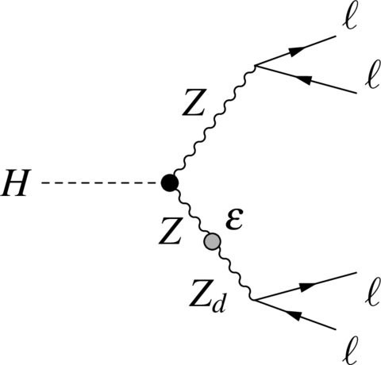
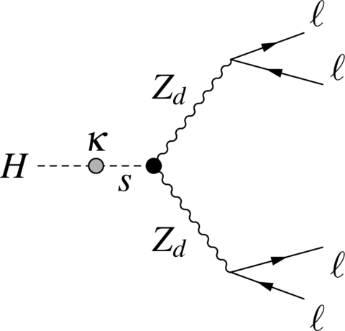
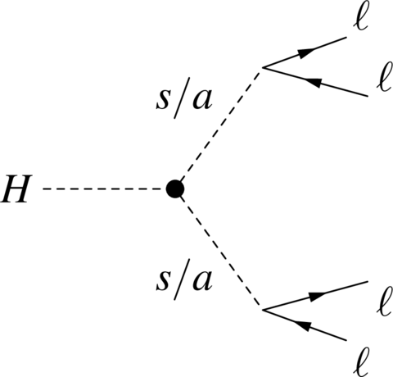
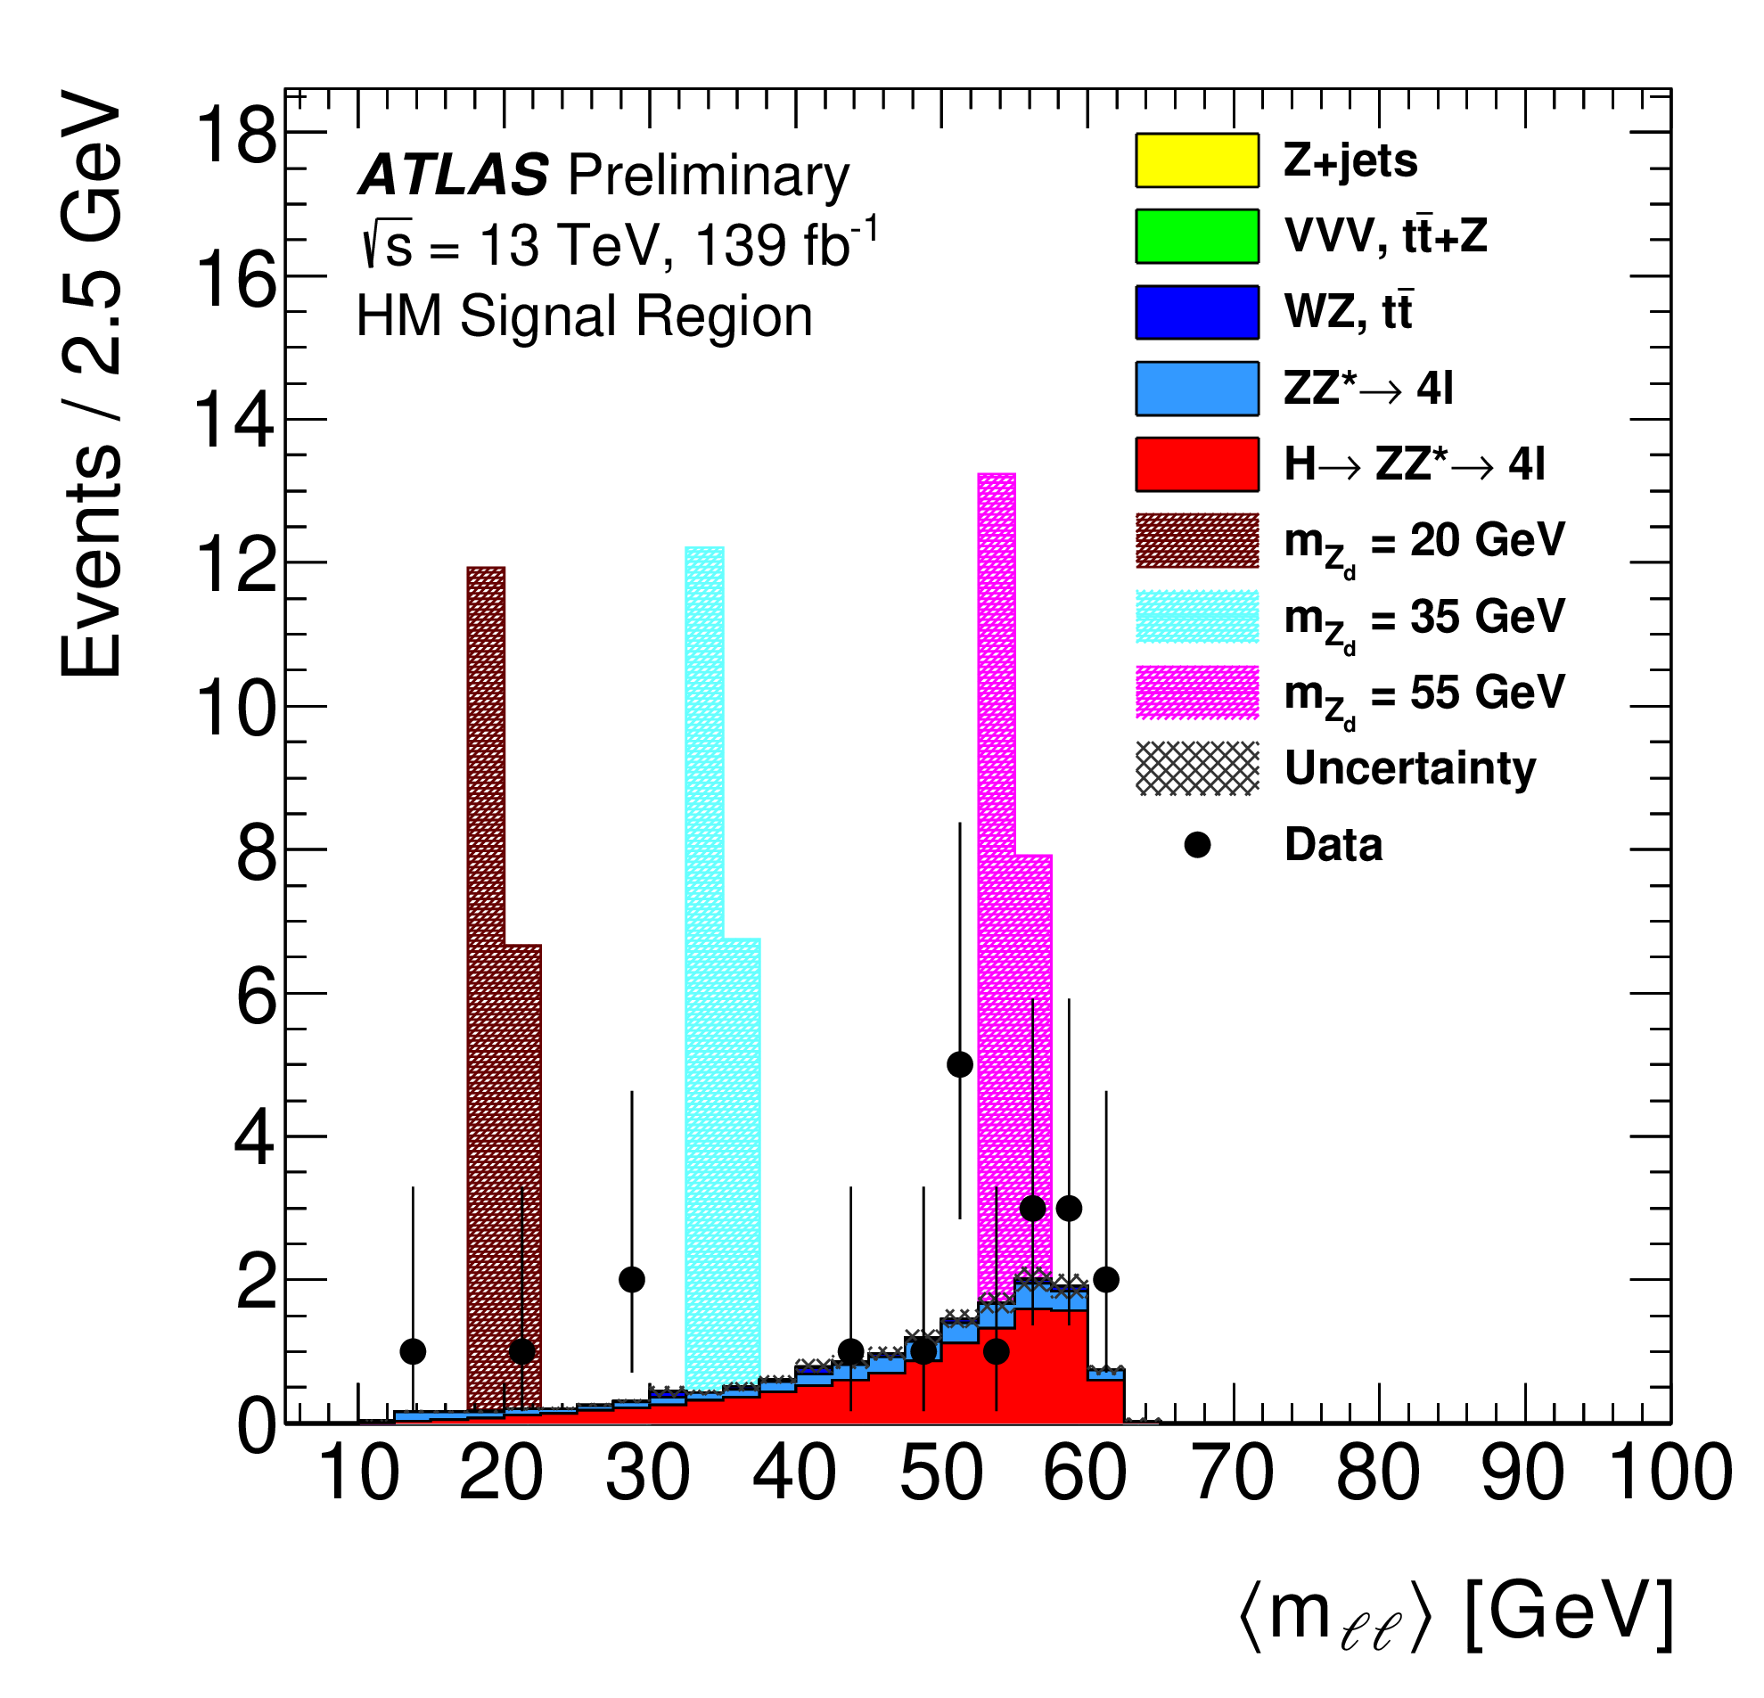
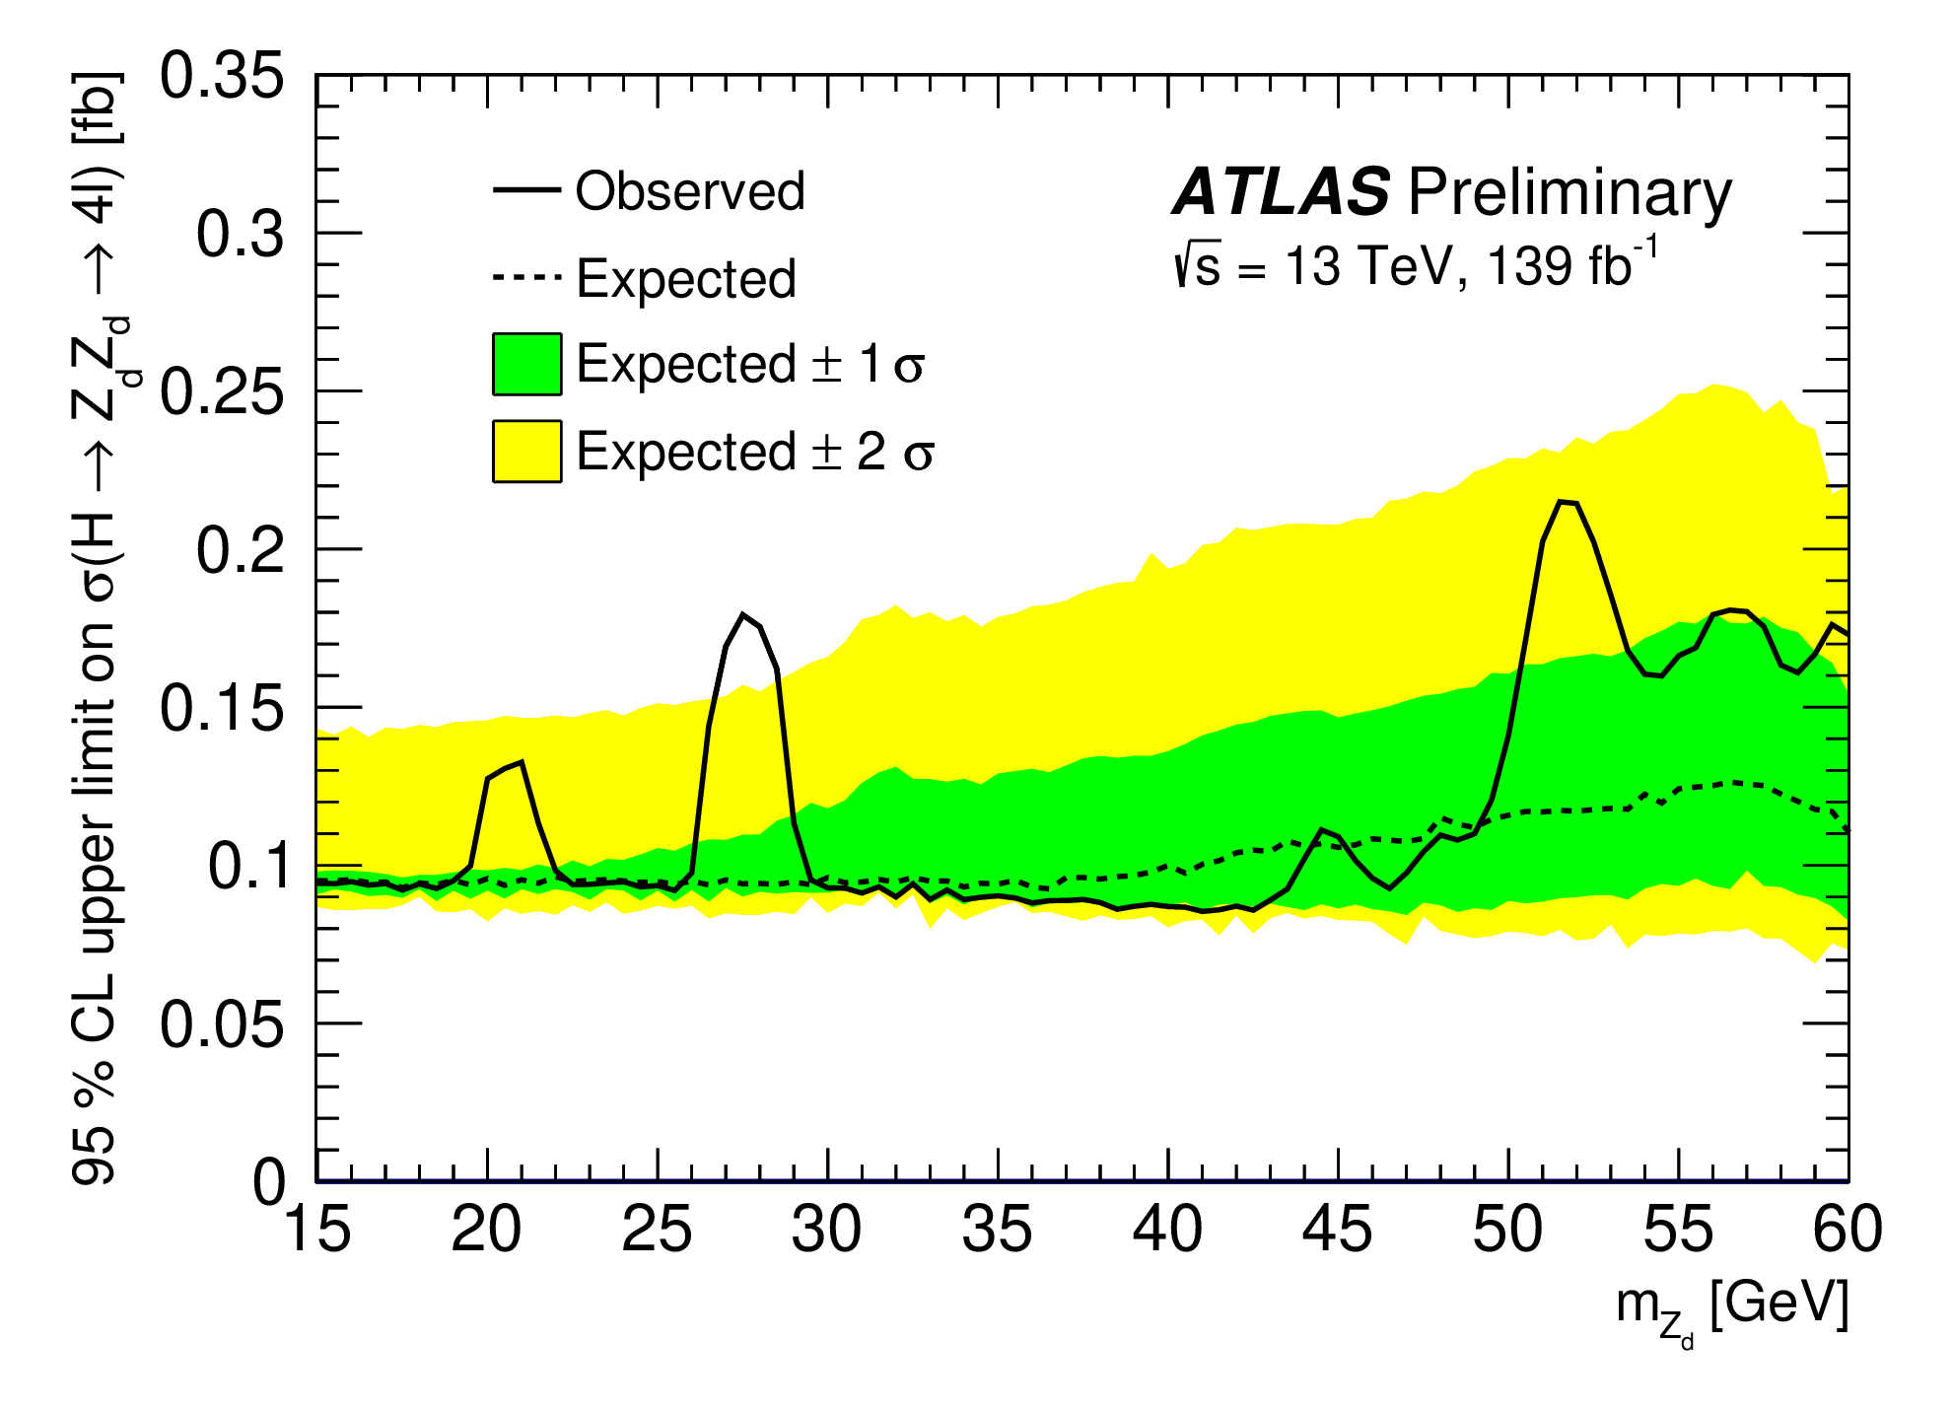
h → 4l
ATLAS-CONF-2021-034
Motivated by DM models with scalar/vector portal, which include mediator X between dark/hidden sector and SM
➔ searches for h → XX / ZX →4l
High mass Z_{d}Z_{d}
High mass (15 - 60 GeV): both e & μ
Low mass (1 – 15 GeV): only μ
Limits set also in other channels

Slide 21
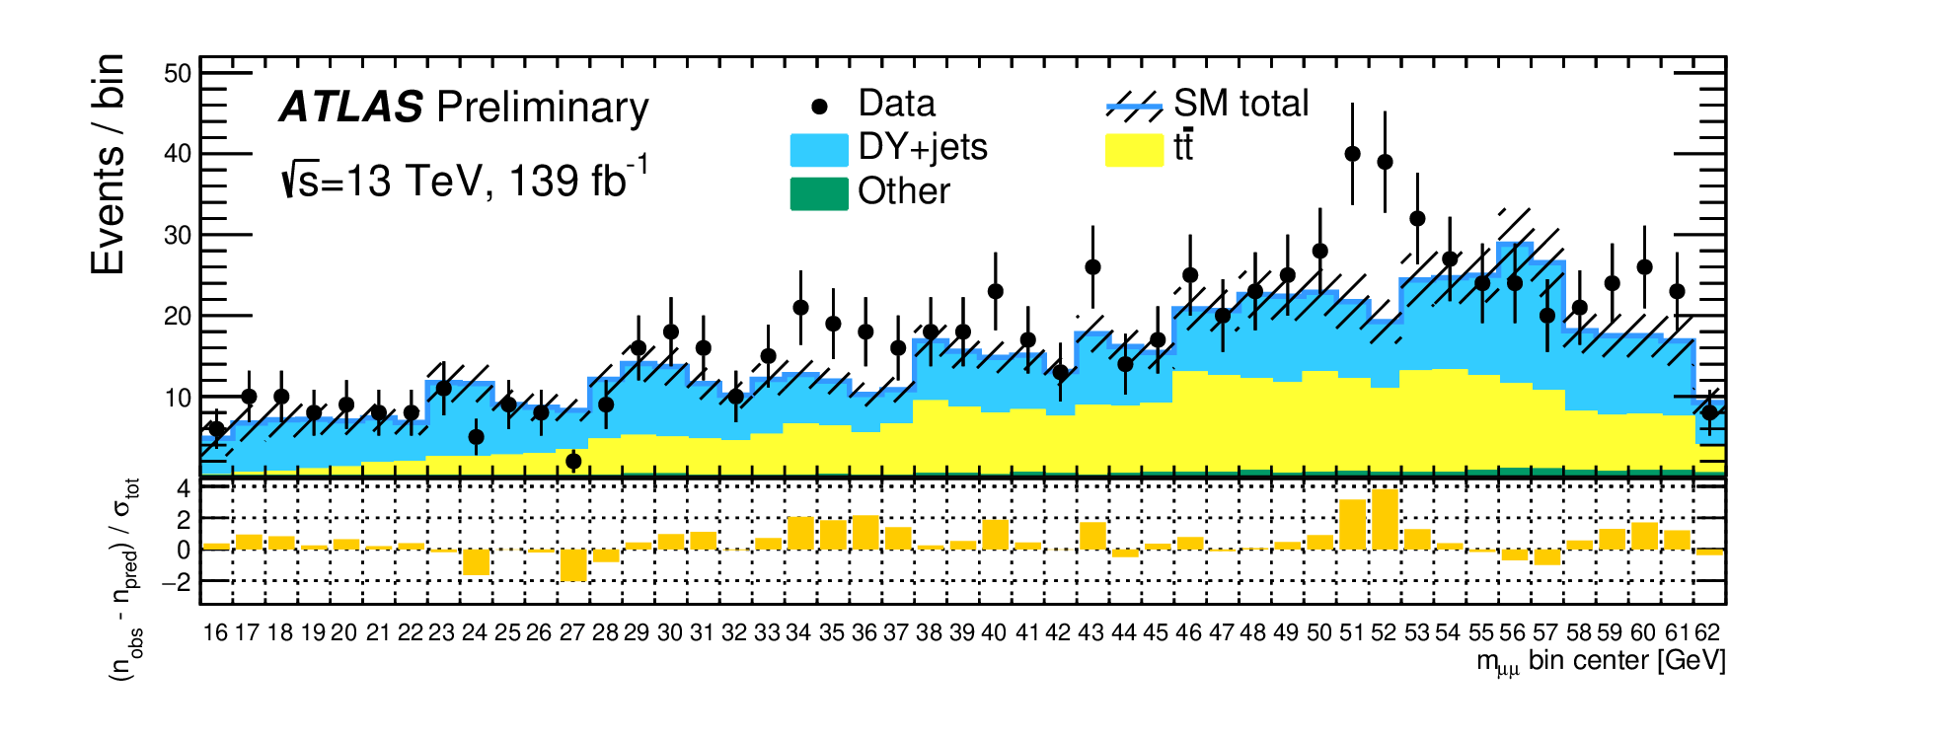
h→aa→bbμμ
ATLAS-CONF-2021-009
BDT based analysis, trained with kinematic variables as input
Separate BDT for each 8 GeV m_{μμ} mass window.
Major backgrounds: tt & DY, estimated from control regions
The DY bkg template in the control region (0-b-tag) is reweighted using a BDT-based reweighting to get the template in the signal region (2-b-tag)

Slide 22
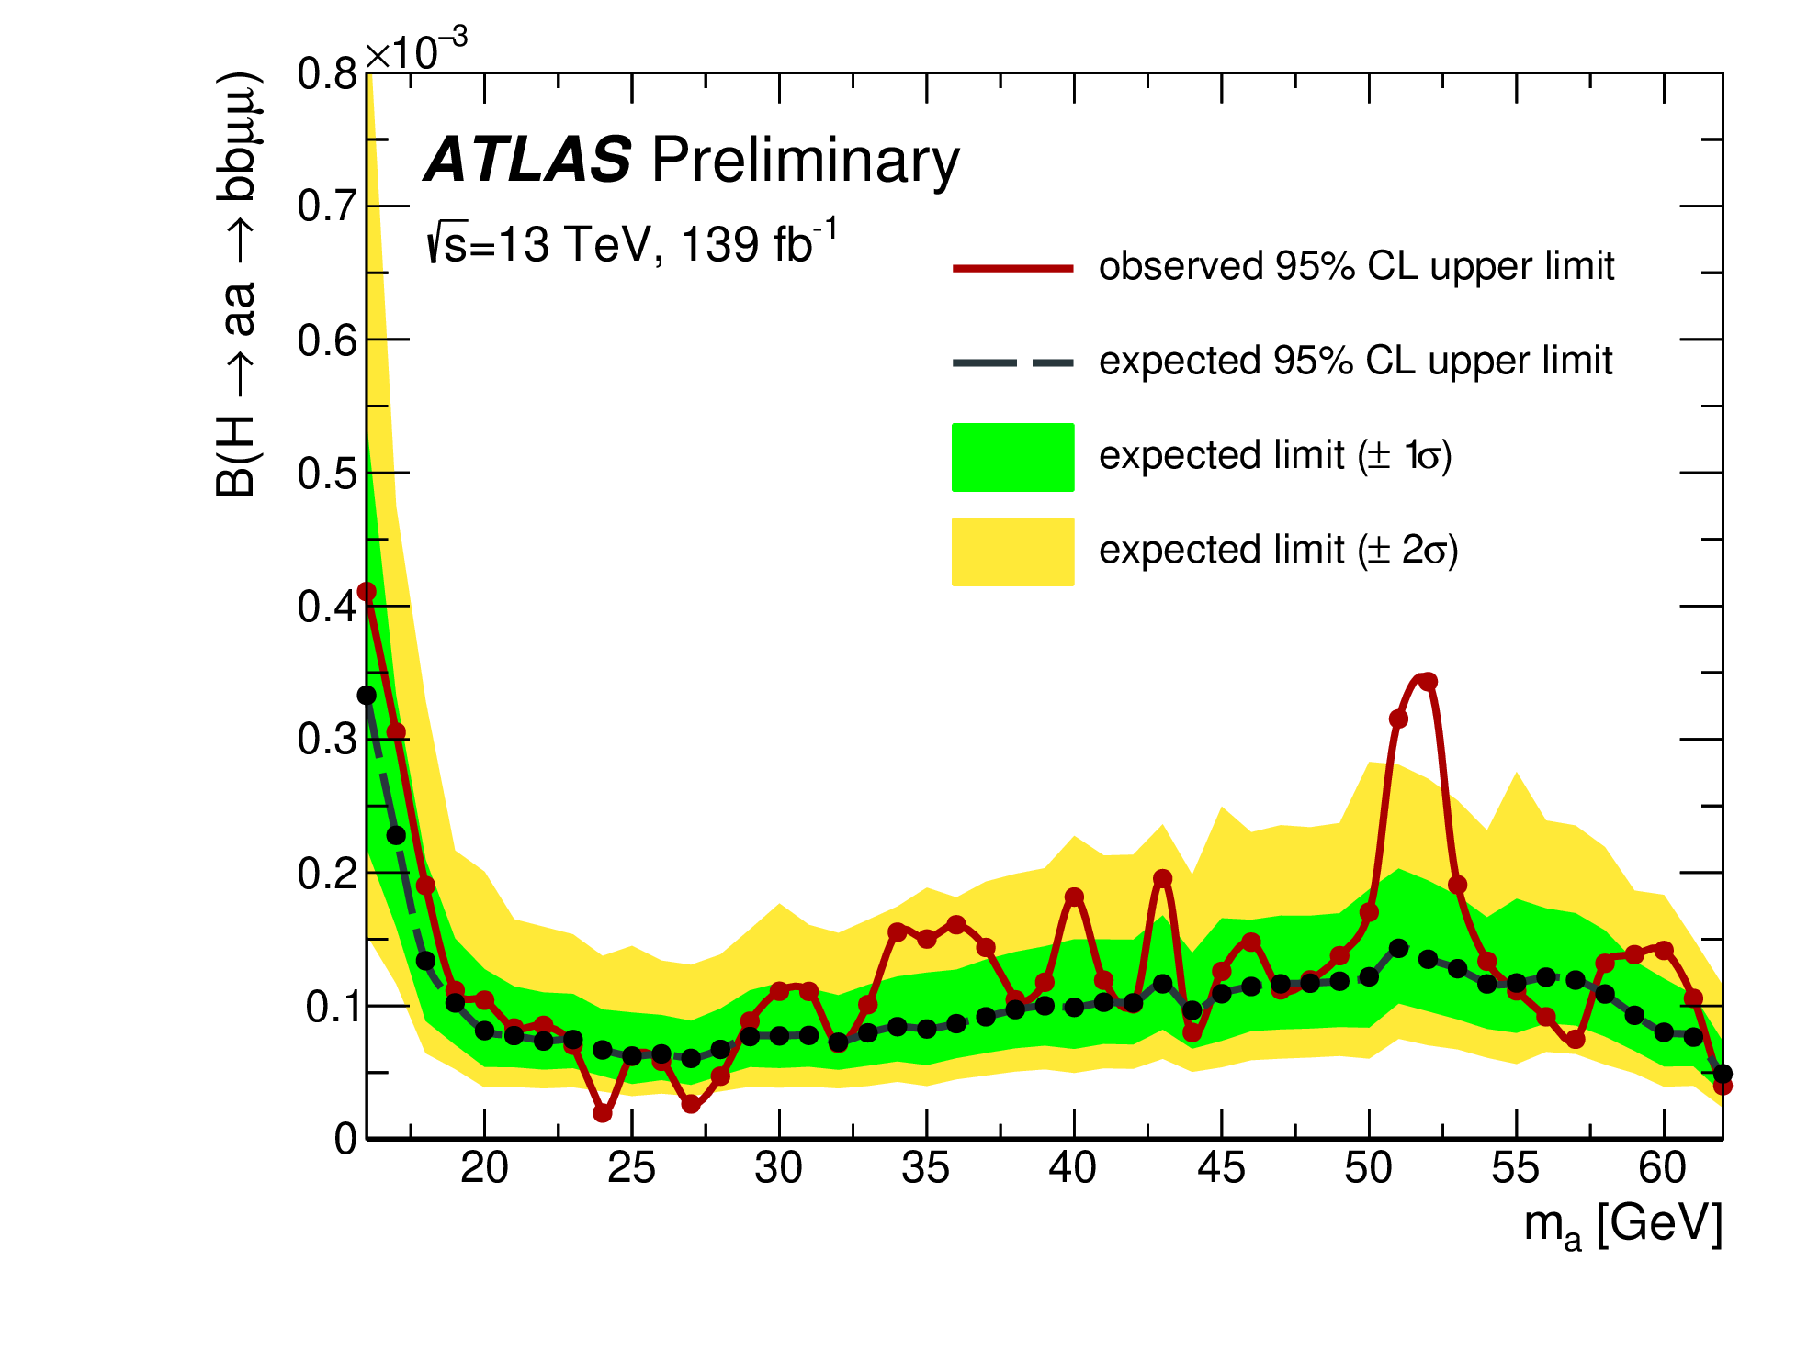
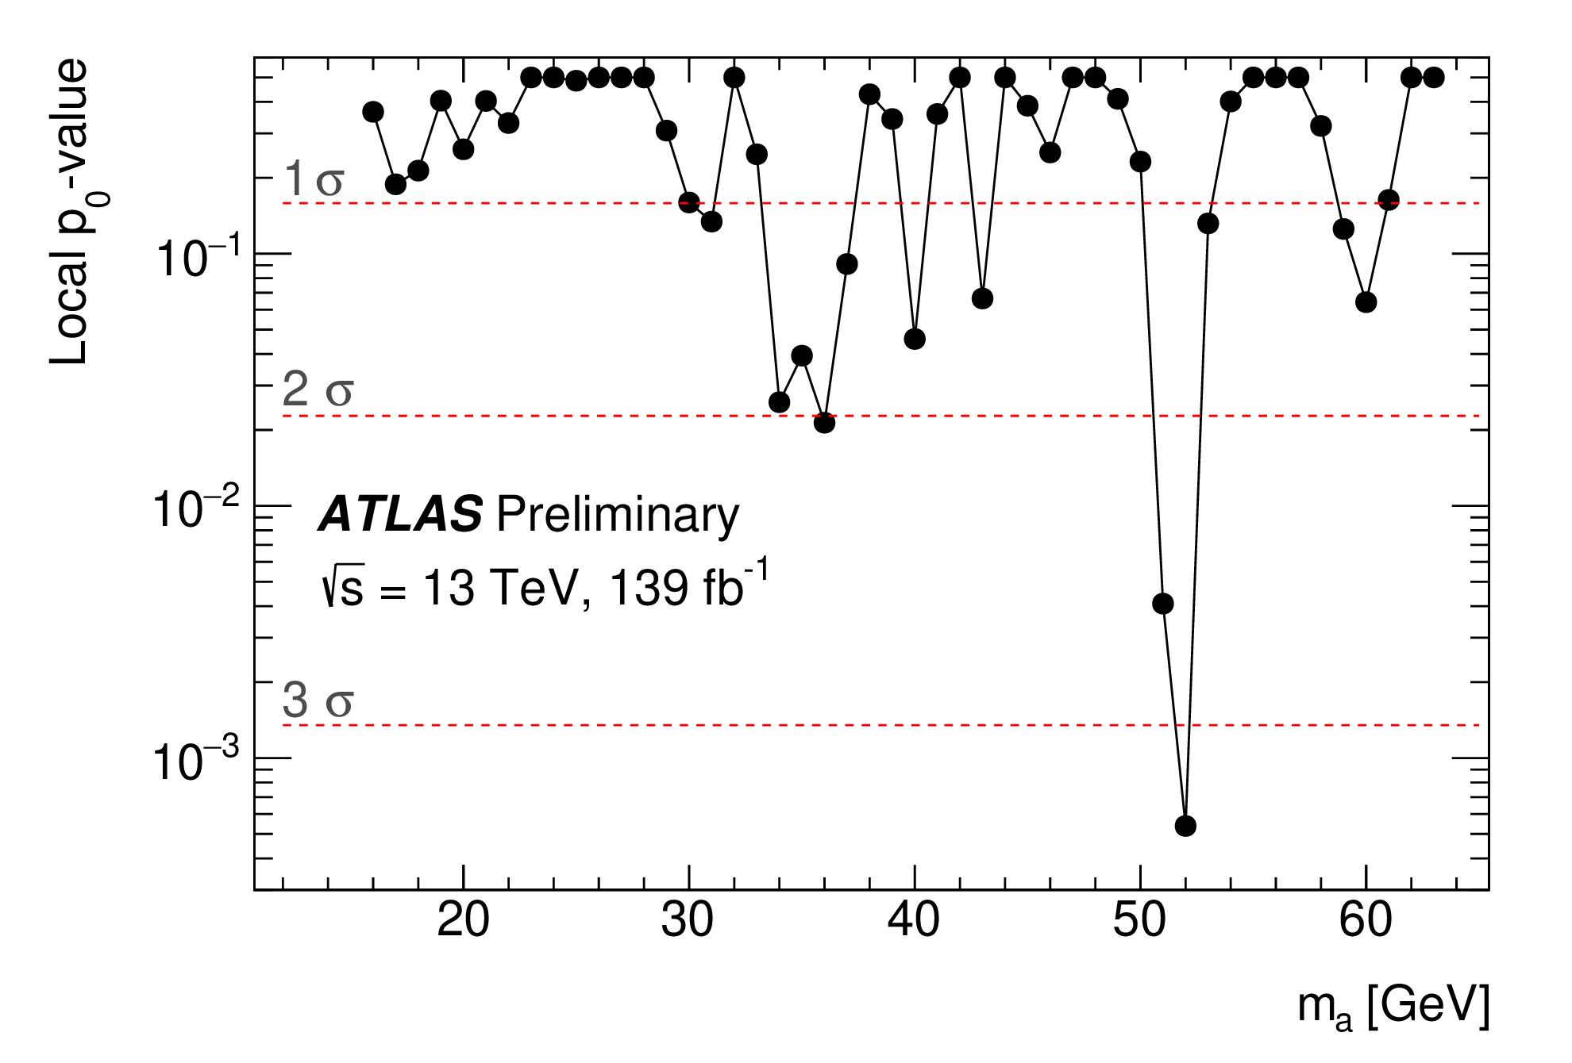
h→aa→bbμμ
ATLAS-CONF-2021-009
BDT based analysis, trained with kinematic variables as input
Separate BDT for each 8 GeV m_{μμ} mass window.
Major backgrounds: tt & DY, estimated from control regions
The DY bkg template in the control region (0-b-tag) is reweighted using a BDT-based reweighting to get the template in the signal region (2-b-tag)
Limits on B(H→aa→bbμμ), in the range (0.22 − 4)×10⁻⁴
local (global) significance of 3.3σ (1.7σ) at 52 GeV

Slide 23
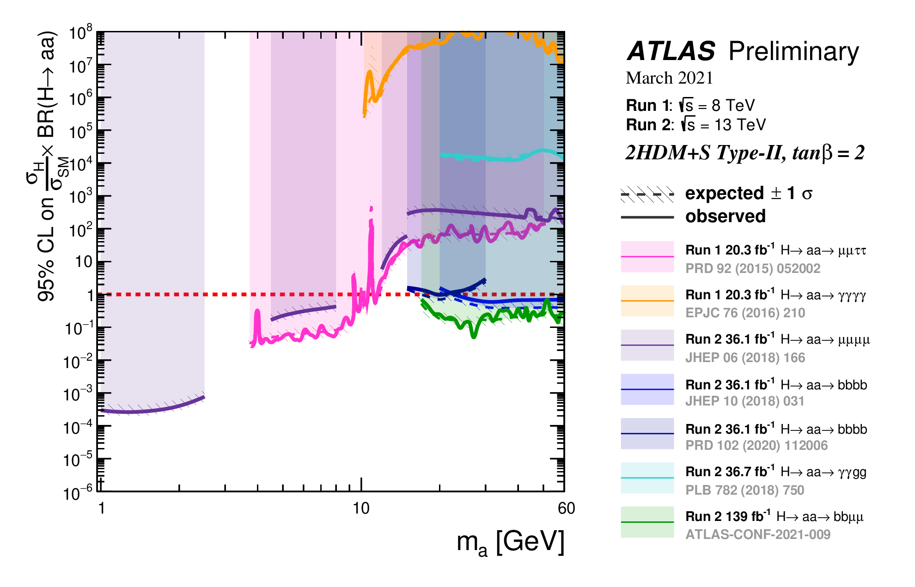
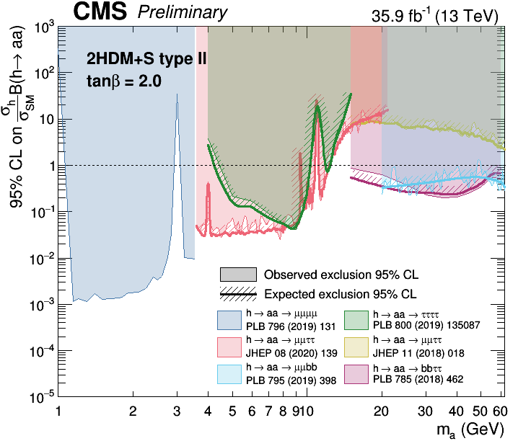
h → aa interpretations
h → aa limits in benchmark scenarios
Interpretations also in other benchmark models
Look at ATL-PHYS-PUB-2021-008 and Summary2HDMSRun2
Updates expected after full Run-2 analyses are completed

Slide 24
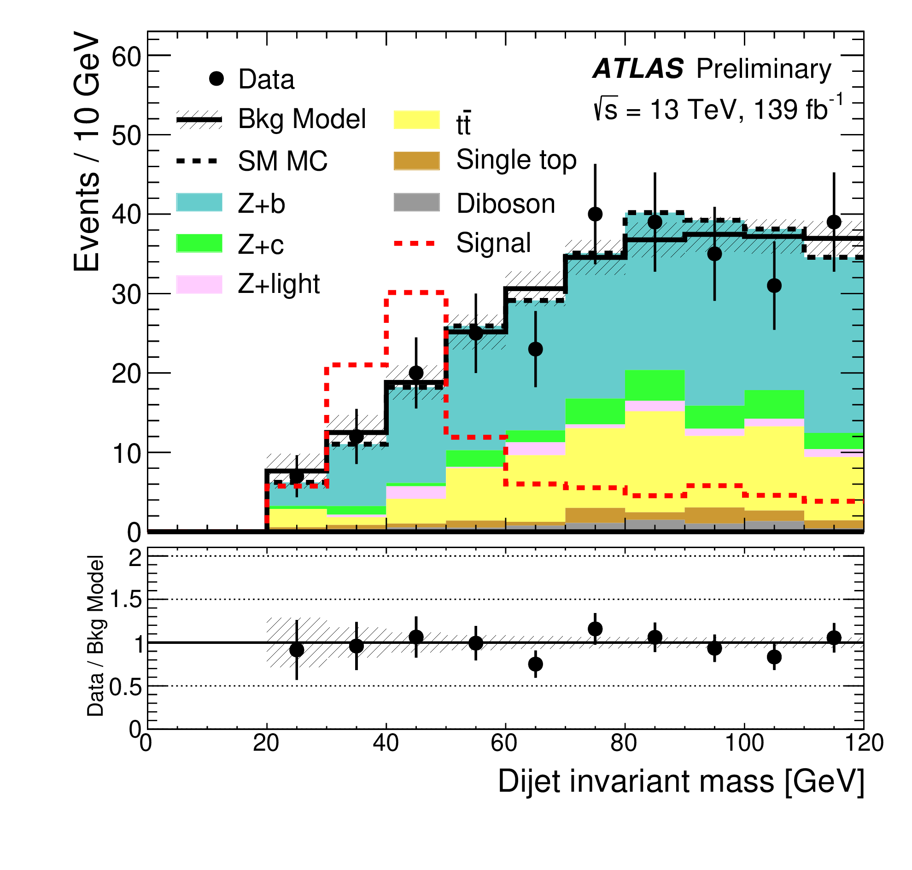
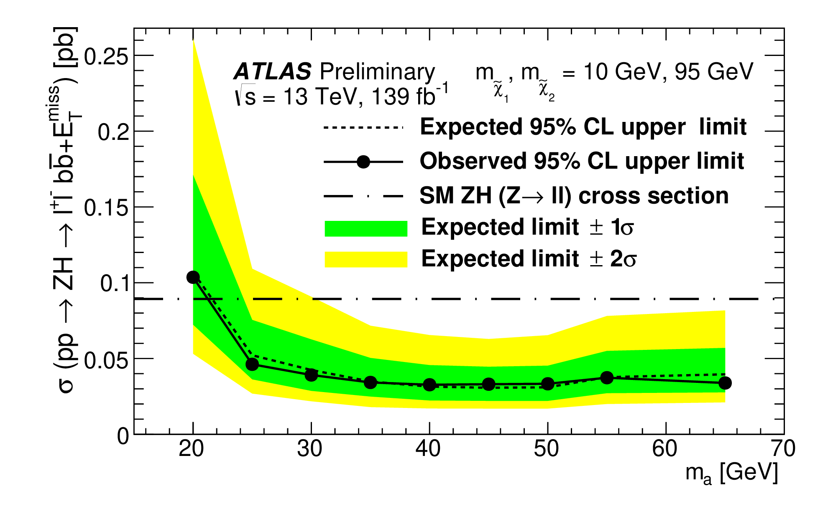
h→bb+invisible
HDBS-2018-07
Zh, with Z→ll and h → χ̃₂⁰χ̃₁⁰ → a χ̃₁⁰χ̃₁⁰ → bb+invisible
Search for dijet mass peak from a decays
Suppression of tt and Z+jets backgrounds:
Require ≥ 1 b-jet
0.8 < (p_{T}^{jj} + p_{T}^{miss})/p_{T}^{ll} < 1.2
Limits on XS × BR for different χ̃₂⁰,χ̃₁⁰ mass

Slide 25
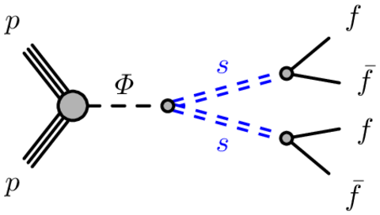
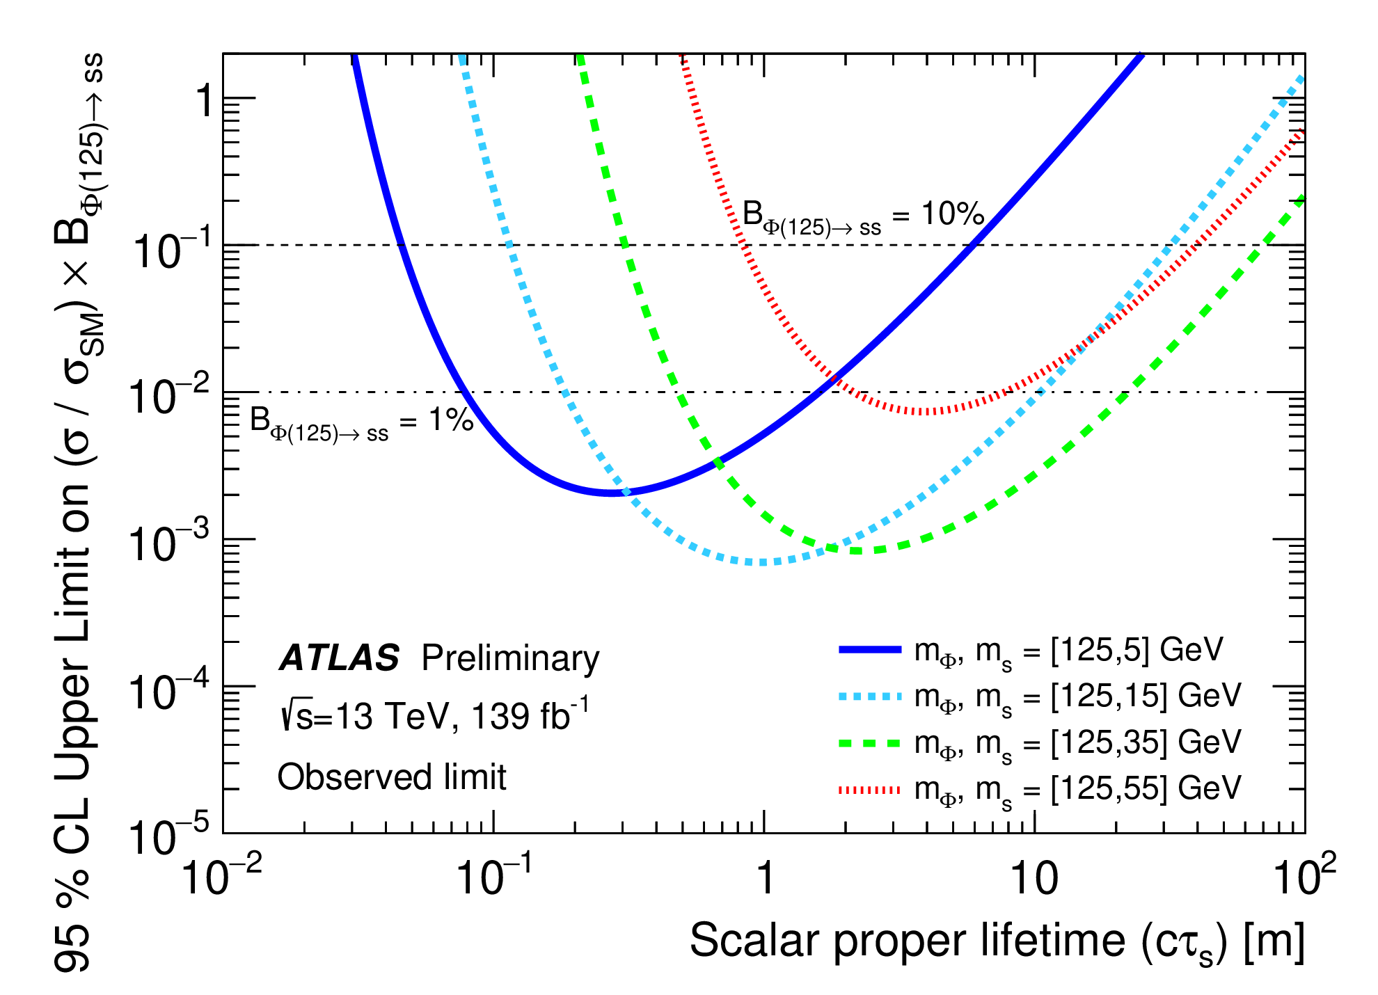
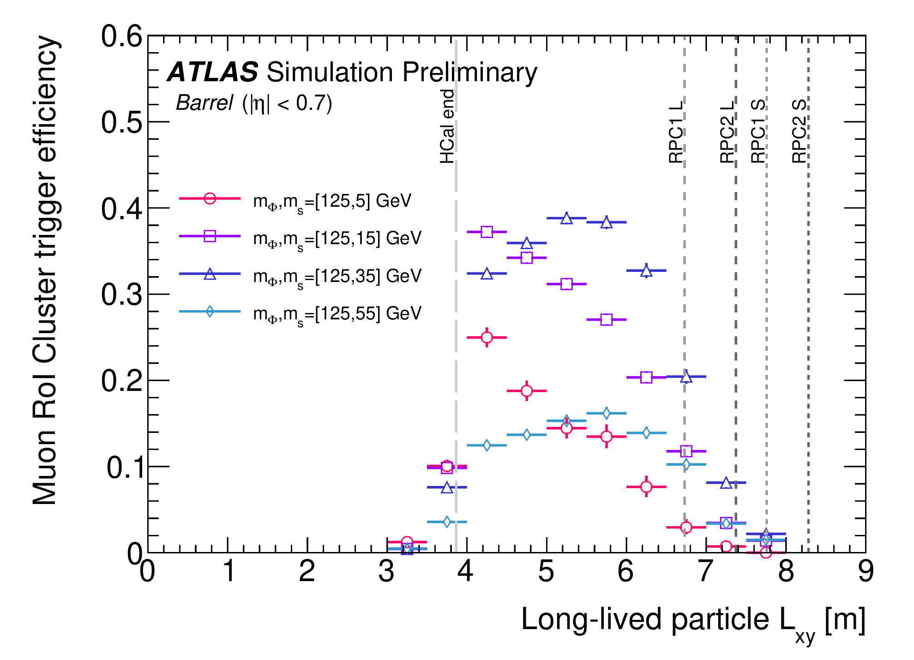

Higgs decay to LLP
ATLAS-CONF-2021-032
Hidden sector models predict exotic Higgs decays to LLP
→ Search for events with two displaced vertices from long-lived particles (LLP) pairs
Requires reconstructing vertices of LLPs decaying to jets in the muon spectrometer, displaced between 3m and 14m with respect to the primary vertex
Dedicated muon spectrometer multi-RoI trigger and track segment and vtx reconstruction in muon spectrometer
Background from punch-through jets suppressed with track & calo isolation
0 events observed with 0.32 ± 0.05 expected bkg
BR(Φ(125)→ss) =10% excluded for cτ(s) in range
4 cm — 7.8 m
for m_{s} = 5 GeV
Also limits for m_{φ} ≠ 125

Slide 26



LFV decays
CMS-HIG-20-009
Search for H→eτ and μτ decays
Forbidden in SM, but allowed in many BSM models
2 tau decay modes: τ_{h} or τ_{μ/e}
Jet based categories designed to enhance the contribution of different Higgs production mechanisms: 0-jet, 1-jet, 2-jets (ggH), and VBF
BDT classifier to extract signal
B(h → μτ) < 0.15 (0.15)%
B(h → eτ) < 0.22 (0.16)%

Slide 27



LFV decays
Phys. Lett. B 801 (2020) 135148
Search for H→eμ decays
Events with b-jets and significant MET are rejected to suppress backgrounds
Events categorized according to p_{T}^{eμ}, η^{eμ}, and VBF

Slide 28
Summary
Rich program to search for new physics in the Higgs sector at LHC
Both ATLAS and CMS experiments search for many non-SM decays of the observed 125 GeV scalar as well as presence of additional Higgs bosons
There are many improvements in analysis techniques
Large parameter space of the MSSM benchmark scenarios are already excluded.
Analyses for many searches with full run-2 data are still in progress
Looking forward to exciting results in future

Slide 29
Thank You

Slide 30




H⁺ → tb
JHEP 06 (2021) 145
Searches for the production of tbH⁺, H⁺→tb, in the mass range 200 GeV – 2 TeV.
Final state: 1l + jets
  Events categorized according to no. of jets and b-jets
  Neural Network to discriminate signal from background
  Background dominated by tt+jets (normalized from control regions)
Limits on production cross section times branching fraction, and interpretations in MSSM scenarios.

Slide 31





Charged Higgs decay to Vector bosons
Pair production of H±±, associated production of H± and H±±.
→ Motivated by Type II seesaw model
Clean signatures: two same-sign leptons (2lss), three leptons (3l) and four leptons (4l).
Strong limits on σ × BR
JHEP 06 (2021) 146

Slide 32


MSSM Higgs interpretations

