Slide 1



XrdEc:
the whole story
Michal Simon
30/03/2023
Michal Simon

Slide 2
Introduction
XrdEc a high performance scalable EC-based file storage module motivated by the ALICE O2 use case.
Originally developed for EOS and afterwards extended to work with any type of XRootD backend storage
30/03/2023
Michal Simon

Slide 3
Writing
Client buffers the data until it has a full block
The block is divided into chunks
The chunks are erasure coded (Intel ISAL Reed-Solomon)
All chunks (data/parity) are checksumed (h/w assisted CRC32C)
30/03/2023
Michal Simon

Slide 4
Writing
Each stripe is stored in a ZIP archive, each chunk is a separate file within the archive
Header: crc32, size, etc.
obj.0.0
Block: 0, Stripe: 0
Header: crc32, size, etc.
obj.1.0
Block: 1, Stripe: 0
Header: crc32, size, etc.
obj.2.0
Block: 2, Stripe: 0
Central Directory
Header: crc32, size, offset, name
Header: crc32, size, offset, name
Header: crc32, size, offset, name
30/03/2023
Michal Simon

Slide 5
Writing
Each stripe is stored in a ZIP archive, each chunk is a separate file within the archive
crc32
crc32
crc32
crc32
obj.0.0
obj.0.1
obj.0.2
obj.0.3
crc32
crc32
crc32
crc32
obj.1.0
obj.1.1
obj.1.2
obj.1.3
crc32
crc32
crc32
crc32
obj.2.0
obj.2.1
obj.2.2
obj.2.3
Central Directory
Central Directory
Central Directory
Central Directory
Header
Header
Header
Header
Header
Header
Header
Header
Header
Header
Header
Header
30/03/2023
Michal Simon

Slide 6
Reading
There is no need to reconstruct a block for every read
  Unless the client needs to do error correction
  While streaming the data user can benefit from full performance boost due to striping
In order to verify the checksum the client at minimum needs to read a whole chunk
  Reads are translated into respective chunks
  Chunks are cached until user is accessing data within same block
offset
length
offset
length
Data
Data
Data
Data
Data
30/03/2023
Michal Simon

Slide 7
Loading the EC plug-in
On demand by the server
  The server can send a special redirect response that will trigger loading the plug-in for given file
          The response contains: number of data and parity chunks, block size, placement group (data servers hosting the stripes), additional cgi to be send to data servers
Standard client plug-in config file
  EC layout, checksum type, etc.
  One think we cannot preconfigure is the placement group, in this case we have to obtain it during runtime using deep locate
30/03/2023
Michal Simon

Slide 8
Operation support
Open modes: Write + New or Read
Natively in the EC module
  Open, Close, Read, VectorRead, Write
In addition in the plug-in
  PgRead, PgWrite, Stat
30/03/2023
Michal Simon

Slide 9
Use Case: Alice O2
500 EPNs (Event Processing Node), each hosting 4 GPUs, each GPU generating a Time Frame every 40 seconds
  2000 data sources in total
  Aggregate throughput of 100GB/s
A Time Frame (TF) corresponds to a single 2GB file in EOS
  TF has to be copied to EOS in less than 40 seconds
Data sources transfer data directly to EOS (CERN CC) in (kind of) round robin fashion at 20 ms intervals
  every 20 ms a new file will be created and 2GB of data transferred
30/03/2023
Michal Simon

Slide 10
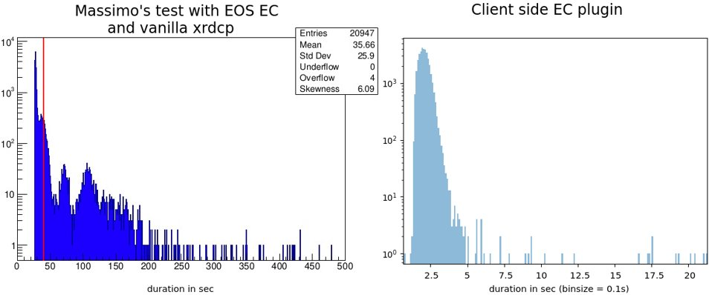
Use Case: Alice O2
Massimo’s test: clients run on the batch farm (20% of the target load), data recorded on EOSALICEO2 cluster (10 servers, ~20% of production system)
Client side EC plugin test: EPN simulator (4 AliceO2 servers) generating ~10% of the target load, data recorded on 6 EOSALICEO2 servers (~10% of production system)
30/03/2023
Michal Simon

Slide 11
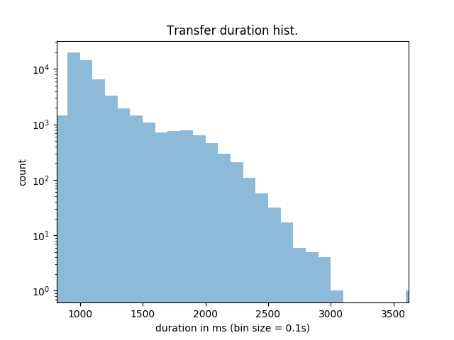
Use Case: Alice O2
~30% of the target production load, ~10% of the cluster capacity
10+2 layout,
30GB/s of aggregate throughput (600 streams),
1 hour run, 6 data servers
Avg duration: 1127msec
Avg transfer rate: 1.84GB/s
Transfer rate stdev: 0.317
Transfer duration stdev: 272
30/03/2023
Michal Simon

Slide 12
Integrating XrdCl+EC with the xrootd storage
Mode 1. Use xrootd storage directly as an EC store
  Xroot protocol and xrootd client (with EC support) only
Mode 2. Use XRootD Proxy as gateway to backend storage
  Enable EC in the proxy’s xrootd client component.
  EC is invisible to the users
    They use existing xrdcp/xrdfs, gfal, curl
  Support all WLCG security, protocols, TPC, etc.
  The backend xrootd storage is plain and simple
This mode is good for local administration
This mode is better for user access
The rest of the slides are about this mode
30/03/2023
Michal Simon

Slide 13
Interface to users
Nothing changed: users will still work with root(s) or http(s) URL:
https://atlas.cern.ch:1094/atlas/rucio/user/jdoe/my.data or
root://atlas.cern.ch:1094//atlas/rucio/user/jdoe/my.data
Think of “atlas/rucio/user/jdoe” as bucket, folder, whatever you like.
  Your access permission may be based on top level buckets/folders.
Three sets of tools for GET/PUT/DEL/LIST/RENAME
xrdcp/xrdfs: work mostly with root(s) URLs
gfal2: works with both root(s) URL and http(s) URLs
curl: works with http(s) URLs
Supports DTN functionality
Authentication, VOMS, access tokens, TPC, etc.
30/03/2023
Michal Simon

Slide 14
Performance test environment
Backend: XRootD storage:
19 nodes of retired Dell R510s, each:
  24GB RAM, 1Gpbs NIC, 12x 3TB HDD (some have 11)
  Each HDD is presented to the OS as its own SCSI device (via LSI RAID controller)
  CentOS 7, XRootD 5.3.4 (later auto-updated to 5.4.0), xrootd “sss” security
312 pre-placed test files (ATLAS data files) ranging from 30MB to 1.1GB, all with known adler32 checksum
Frontend: XRootD EC proxy
64 core, 128GB, 100Gbps NIC
CentOS 7, unreleased XRootD (2021-12-17+patch)
EC configuration: 8+2, chunk size 1MB (so a block has 8+2 MB)
30/03/2023
Michal Simon

Slide 15
Single stream performance with xrdcp
Getting the baseline performance numbers using Mode 1
Run a EC enabled xrdcp, write and read a single ~8GB file.
Memory to memory (between RAM disk in client node and page cache in Dell 510s)
Write: 904MB/s (Actual writing speed: 904 * (8+2)/8 = 1130MB/s ← near the line speed)
Read: 1017MB/s
  EC doesn’t need to read the parity chunks (unless there is an error)
  This is a good indication that EC code isn’t the bottleneck in this environment.
Single stream performance by a client, read from and write to storage via the EC proxy (Mode 2)
Write: 904MB/s ← near the line speed limit (1250MB/s)
  This is a good indication that EC code and EC proxy setup do not present a bottleneck for writing
Read:
  With memory cache in proxy (8MB page size ← to align with EC block size, 1 prefetching): ~505MB/s
30/03/2023
Michal Simon

Slide 16
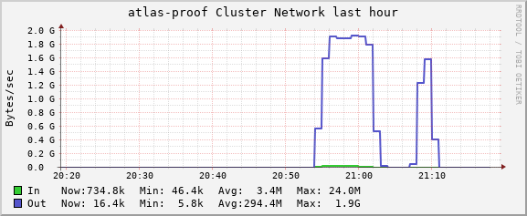
Aggregate read performance by many clients
Network upper limit
19 Gbit/s or
2.375GB/s
Throughput: View from storage
w/o mem cache w/ mem cache
Read the pre-placed 312 data files, repeat 5 times
Spread the read to 150 concurrent clients
Memory cache clearly helped, it both
  cache (reduce read from storage)
  enable large block read (align with EC blocks)
30/03/2023
Michal Simon

Slide 17
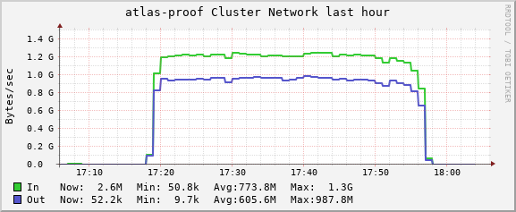
Aggregated Read/Write performance
Backend storage view
In: write
Out: read
Memory cache: off
By 200 concurrent clients
Randomly pick 20 files from the 312 sample files
Read and write back at the same time
  Note: FS prioritizes write over read
30/03/2023
Michal Simon

Slide 18
Summary
XrdEc is a very performant implementation, we run almost at h/w speed (Intel ISAL, h/w assisted CRC32C)
The tests at AliceO2 and SLAC yield very good results
We started work on ops tools this summer (using student workforce), which resulted in a xrdrepair tool
30/03/2023
Michal Simon

