Slide 1
GE2/1 Foils Design, status and avalablity
M. Bianco
Internal Review of the GE21 Foil Production at Mecaro
Jan 22, 2020

Slide 2
Preamble
The very recent observation of the double-polarity signal in GEM chambers equipped with the double segment GEM foils pose a serious question on the validity of the current GEM foils layout for GE2/1.
Current GEM foils are the results of the studies driven by the request to eliminate/reduce the spark propagation toward the RO strips.
Spark propagation is strongly suppressed in chambers equipped with double segmented foils but a new problem, now, have been found.
May the current layout will not be the layout used in the GE2/1 mass production, a fast R&D (see Jeremie slides) is going to be execute do clarify this question.
In this talk the GEM foil layout and the repository of the fails as prepared for the EDR is going to be shown.

Slide 3
Outline
Summary of the double-polarity signal study
  Observation and effects on the trigger/RO data path
Design files availability
  Status
  EDMS Repository
  Access to the files
Summary

Slide 4
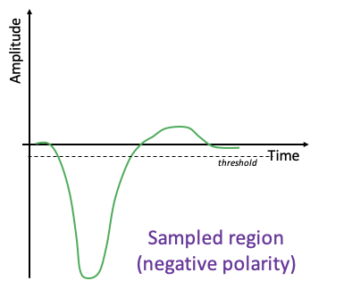
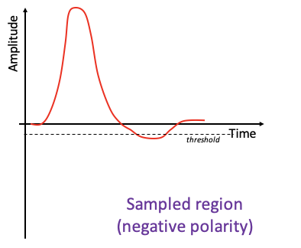
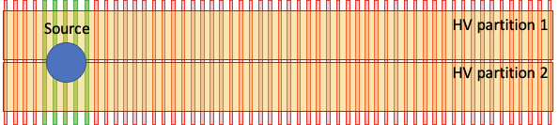
The Double-Polarity issue
Source induced signal
Parasitic
signal
0
8
16
1
9
17
7
15
23
GE1/1 Long chamber with double-segmented GEM foils
readout sector 0 (VFAT 0)
readout sector 8 (VFAT 8)
readout sector 16 (VFAT 16)

Slide 5
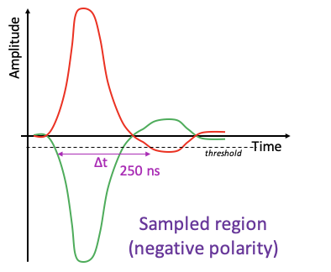
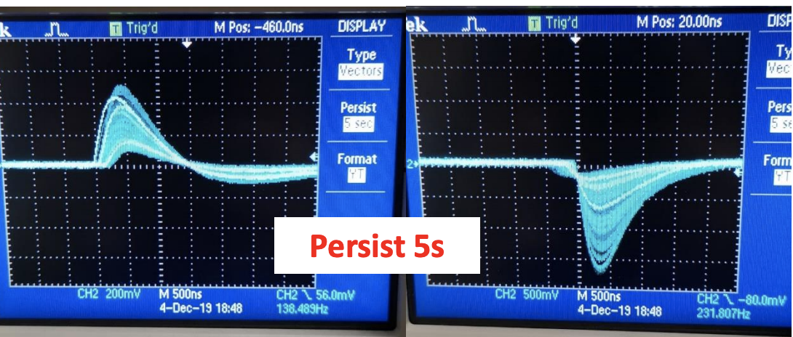
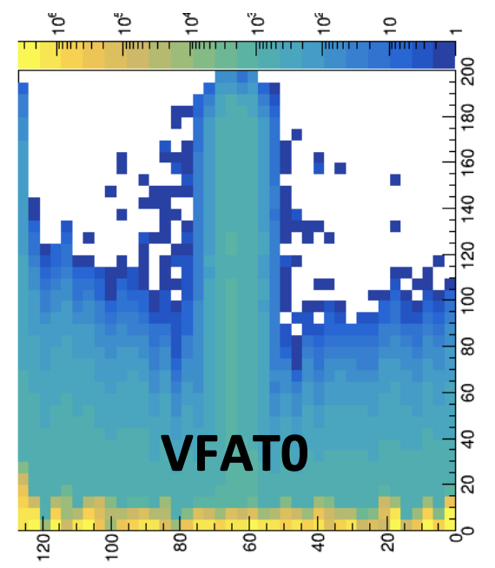
Characteristics of the Parasitic Signal
Origin: mirror image of the source induced signal but the negative overshoot is only visible with HIPs Range: all the non-active strips that are facing the active HV partition (i.e. the full eta partition)
Rate: comparable to the source induced rate
Timing: delayed by about 250 ns with respect to the source induced signal
Source induced signals
Counts
Parasitic signals
Threshold
Data taken with pre-amp ORTEC 142 PC (all 128 strips merged in one channel)
Data taken with VFAT3 (“per-channel” SBIT scan)

Slide 6
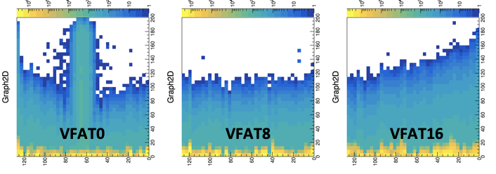
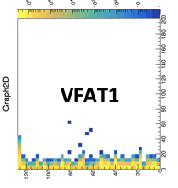
Effect on the RO and Trigger path
Source induced signals
Alpha Source
Parasitic signals
0
8
16
Source induced signals
1
9
17
Parasitic signals
SBIT vs Threshold scan
(strip per strip)
with alpha source
7
15
23
Effect on the RO path: ETA Partition “totally fired ” by HIP
In case of GE2/1 due to the particular routing of the strips toward the RO connectors fired 50% of two eta sectors
Effect on the Trigger path: FPGA get > 8 Sbit for a single HIP event, the chamber (whole module in GE2/1 not able to handle the trigger information)

Slide 7
Design files available
So far two different kind of GE2/1 GEM foils have been designed
  Single side segmented; toward the Drift board
  Double-side segmented; with equivalent size of segmentation (~ 100 cm²) on both sides of GEM foils
Gerber files available for both kind of foils for the 8 GE2/1 module type
Currently in EDMS, under the GE2/1 production folder, are available only gerber files for double-side segmented foils, as approved at the EDR in may 2019

Slide 8
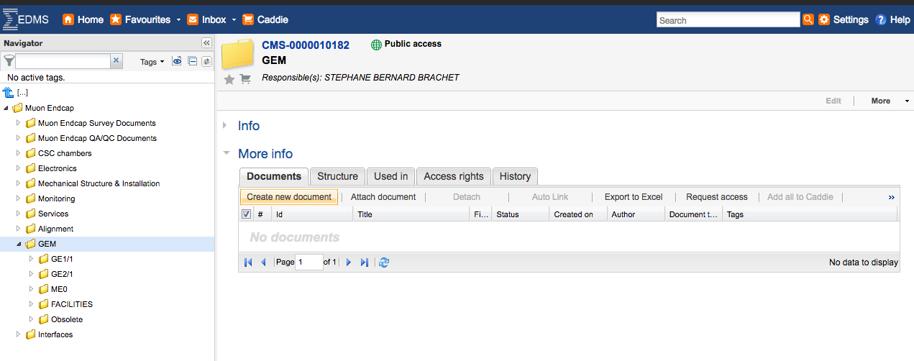
EDMS Repository
https://edms.cern.ch/ui/#!master/navigator/project?P:1617398001:1424611140:subDocs
EDMS is the official repository at CERN for technical documents
Responsible for the GEM area is Stephane Brachet, CERN engineer
Three main folders GE1/1, GE2/1 and ME0 contains the documents produced so far by GEM group

Slide 9
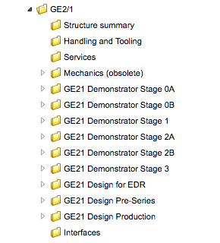
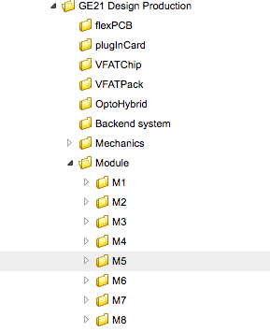
The GE2/1 structure in EDMS
Different subfolders for the different stages of the project, as specified in the GE2/1 R&D twiki:https://twiki.cern.ch/twiki/bin/viewauth/CMS/MuonGEMGE21RnDDevelopment)
GE2/1 files (Modules) as approved during the EDR are stored under the “GE2/1 Design Production” subfolder

Slide 10
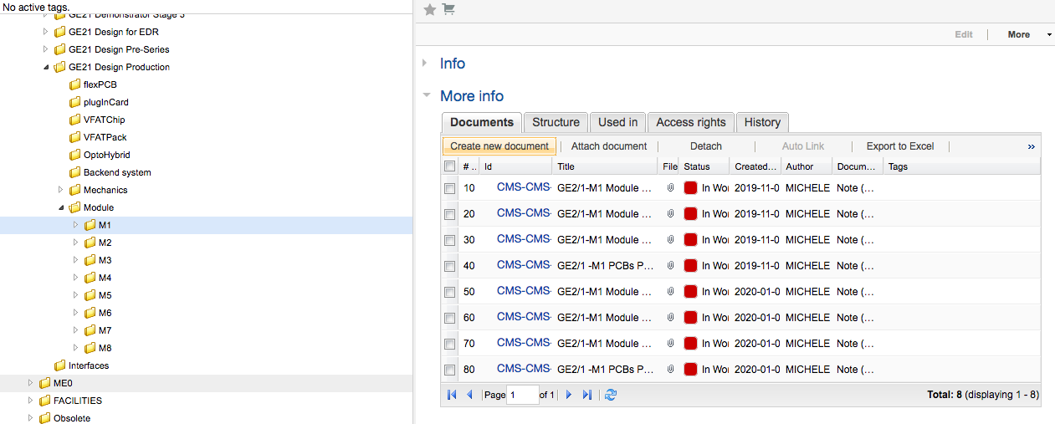
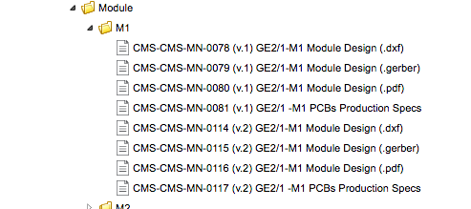
GE2/1 Modules and foils files
Two different way to display same kind of information

Slide 11
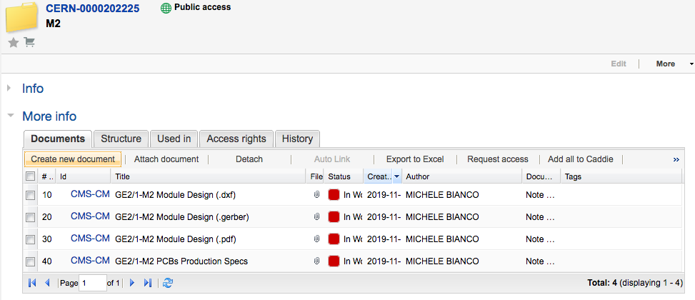
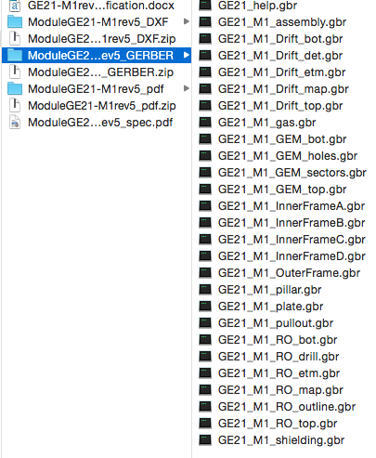
GE2/1 Modules and foils files
Subfolder modules contains both drawings and specs files for the full set of module components
Drawings are given in gerber, dxf and pdf format
Files for GEM foils production are named as GE2/1_MX_GEM_xxx
Access to the file is currently available for all CERN users

Slide 12
Summary
Current GEM foils are the results of the studies driven by the request to eliminate/reduce the spark propagation toward the RO strips as presented at the EDR held in May 2019
Gerber files for the whole set of GE2/1 Modules are currently available in EDMS
Recent observation of double polarity pulse impose a stop to the GE2/1 foils production both in Rui lab (production started in Nov 2019) both in Mecaro till the clarification of the nature and effects of the double polarity pulses on the detector performaces both from trigger and RO point of view

Slide 13
Backup

