Slide 1









Andy Rose, Imperial College, London
awr01@imperial.ac.uk | andrew.william.rose@cern.ch

Slide 2
Overview
Past: Design rationale
Present: Serenity 1.1
Future: Serenity 1.2

Slide 3
Past: design rationale

Slide 4
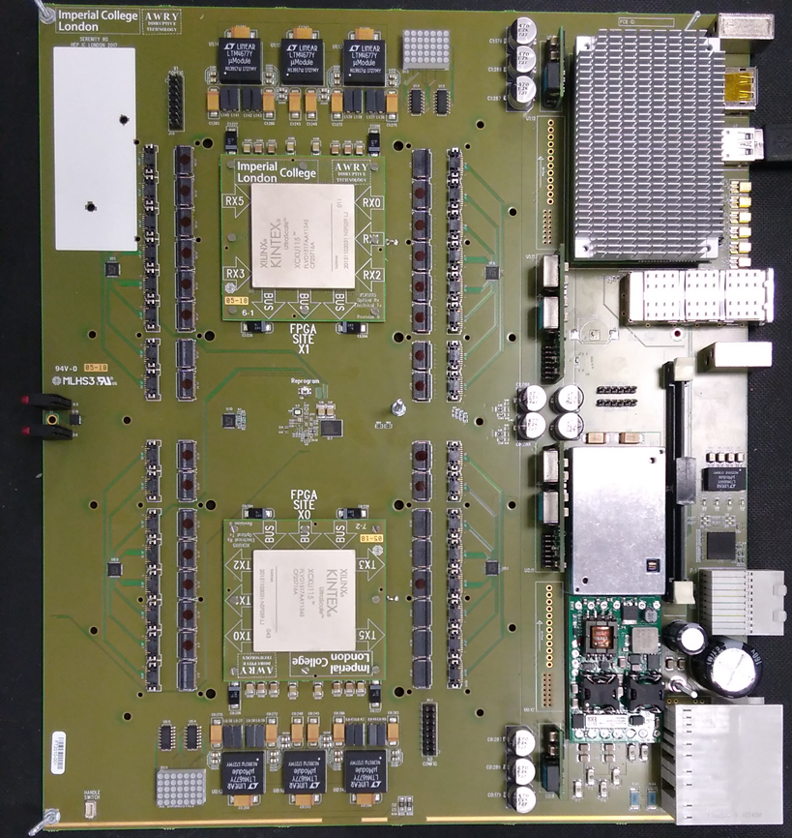
What is Serenity?
Serenity ATCA blade with daughter cards
ATCA Development Platform
Carrier Card
  Services - Power, Clocks, Optics, Interconnects, IPMC & CPU
Daughter Cards
  Data Processing FPGAs
Firmware & Software
  Generic, Flexible Infrastructure

Slide 5
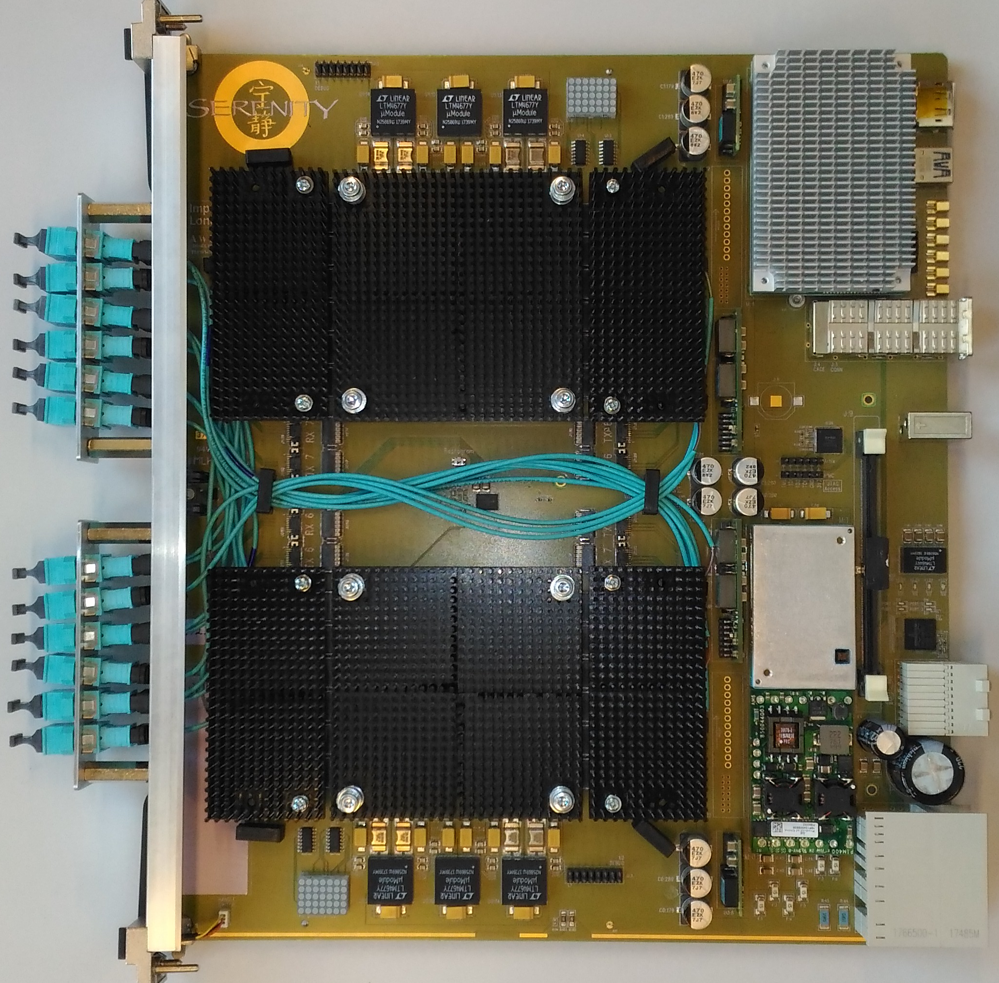
What is Serenity?
ATCA Development Platform
Carrier Card
  Services - Power, Clocks, Optics, Interconnects, IPMC & CPU
Daughter Cards
  Data Processing FPGAs
Firmware & Software
  Generic, Flexible Infrastructure

Slide 6
Which problems was Serenity meant to solve?
UK is involved in many projects: Different projects want different FPGAs, different optical and electrical connectivity
  Can one board make everyone happy?
  If not, can we at least provide a rapid-prototyping platform for ATCA?
Bulk of cost concentrated in FPGAs, bulk of potential failure modes in carrier
  Can we decouple financial risk from production risk?
How do we keep up with a rapidly evolving FPGA landscape?

Slide 7
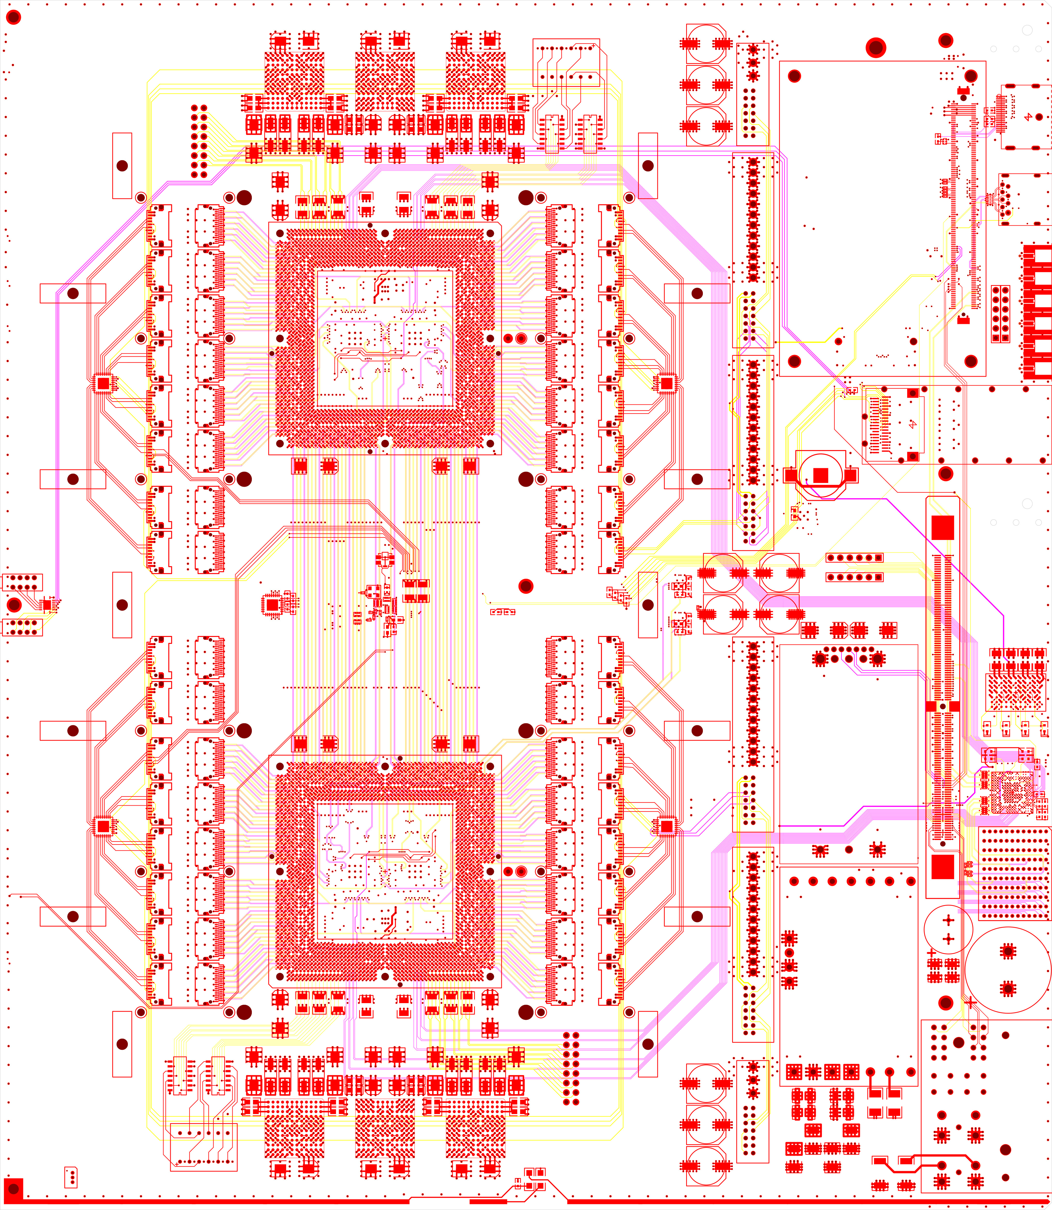
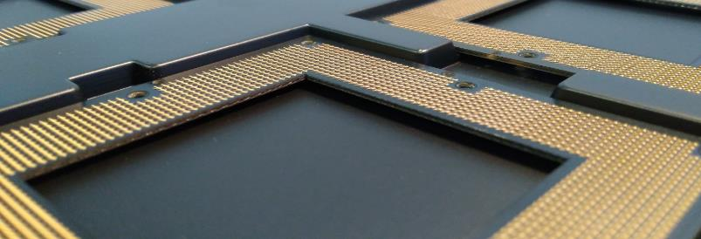
How?
FPGAs on Daughter-cards:
  Freedom to choose your preferred family, package, generation, (vendor?)
Freedom to choose your balance of optical and electrical connectivity
Carrier testing done with FPGAs safely in their static-bags
36+36 firefly
36+36 firefly
North
QSFP
64 pairs, direction unspecified
24+24 “spare”
24+24 “spare”
36+36 firefly
36+36 firefly
South
Samtec Z-RAY produced to custom specification

Slide 8
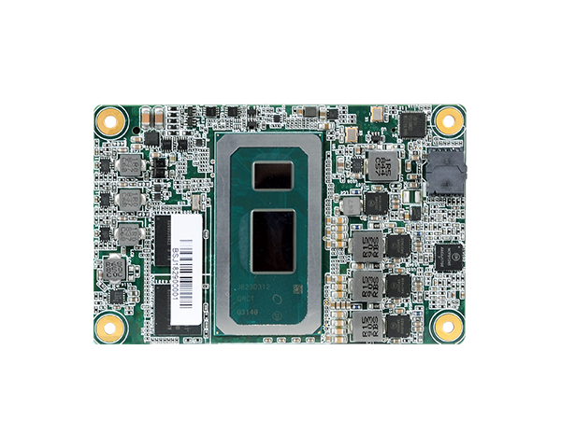
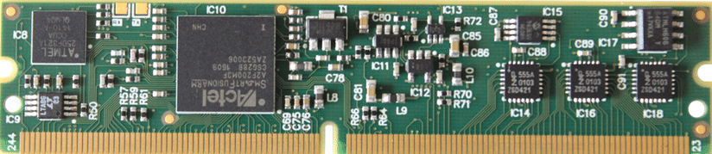
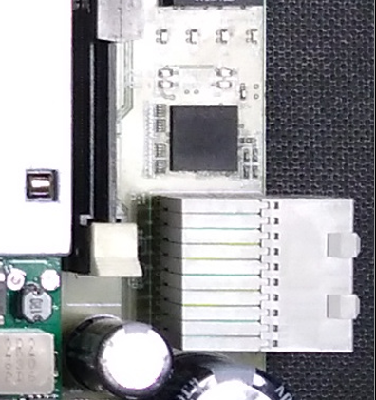
An aside: COTS Components
ATCA low level control – IPMC
Available from CERN
Runs the commercial standard software
Standard Intel x86 COM-Express Type 10 CPU
Running standard Centos Linux
What sys-admins want, not necessarily what hardware engineers want!
PCIe interface to FPGAs
Clean separation of hardware, firmware and software
Ethernet
Switch with integrated Gigabit Ethernet Phys
AC coupled via capacitors
Small form factor 1cm²
VLAN capable
COM-Express with i5 processor now under test at IC!
Up to 16GB RAM, 4 cores + hyperthreading @ 4.1GHz!
A different beast to the Atom we have been using

Slide 9
What were the concerns?
We started the project with serious concerns over choice of ATCA, particularly:
  Thermal management
    Optics must be kept below 50C or longevity drops at shocking rate
  Acoustic noise
Others expressed concern over
  Interposer signal integrity
  Supplying power to FPGAs
  Cooling FPGAs on daughter-cards
  Limited prior experience with 16 or 25G links
  Whether different institutes could really work across subdetector boundaries

Slide 10
Present: Serenity 1.1

Slide 11
Present: Serenity 1.1
Does the thing actually work?

Slide 12
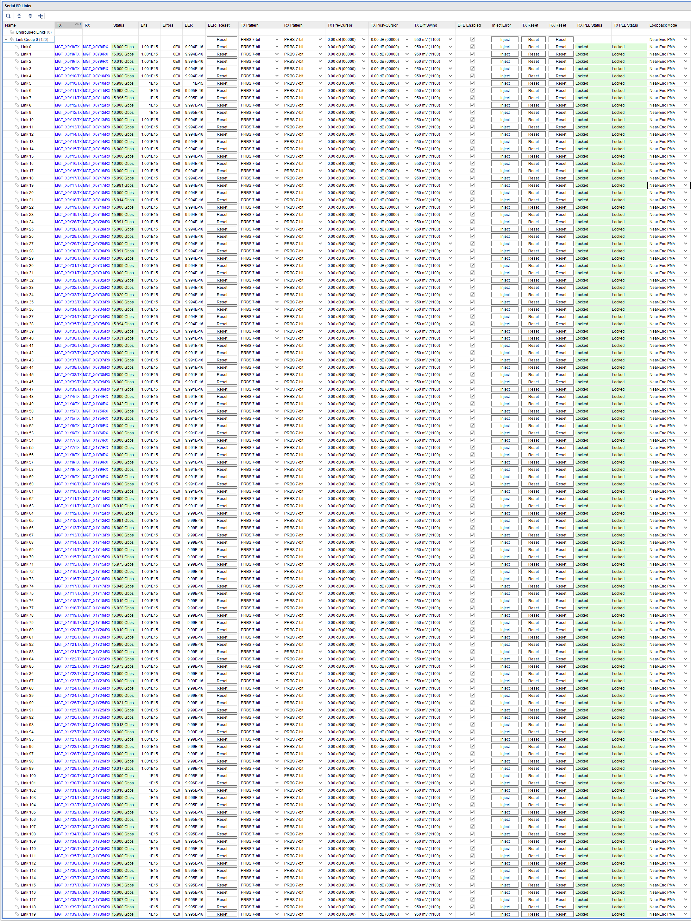
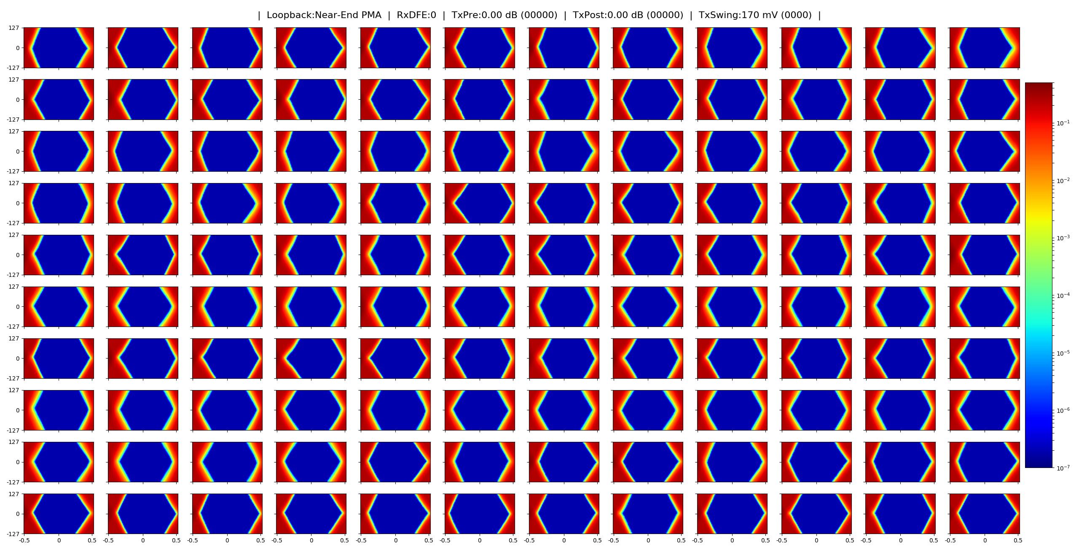
LINKS - Internal LOOP
120 simultaneous IBERTs
  16Gbps, Near-end PMA loopback. Default settings
Each link passed 1e15 bits - No errors
120Pb of data through silicon
Indicated good clock and power stability
DUAL KU115

Slide 13
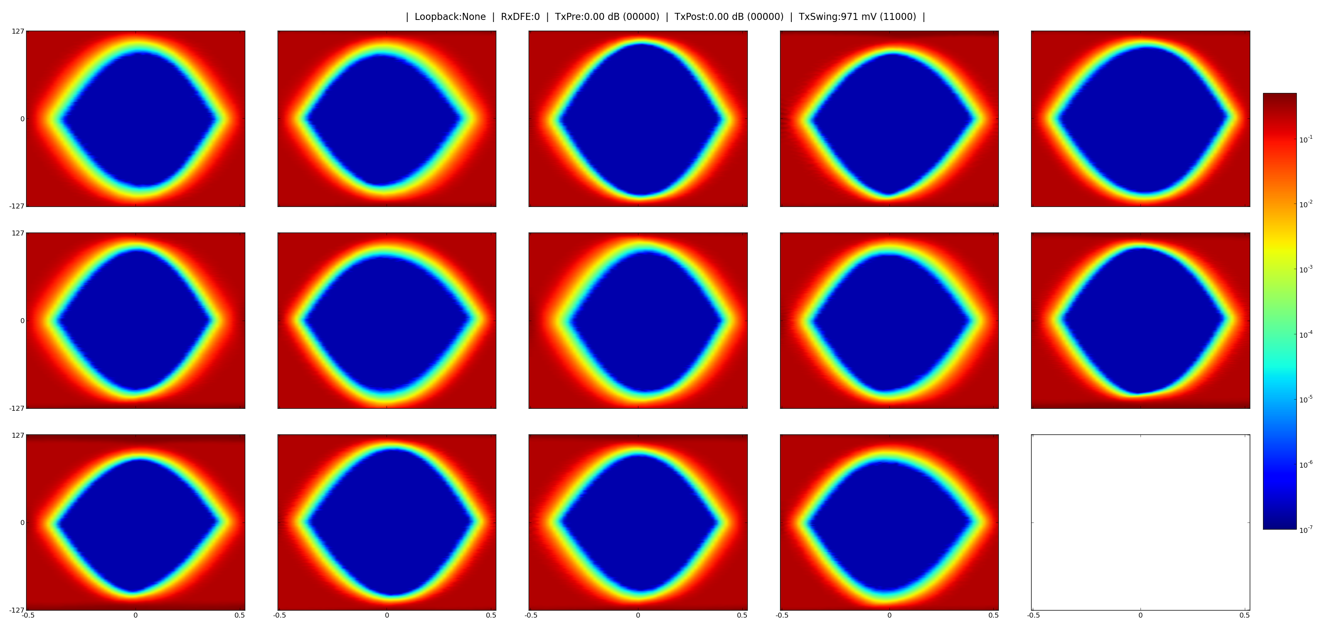
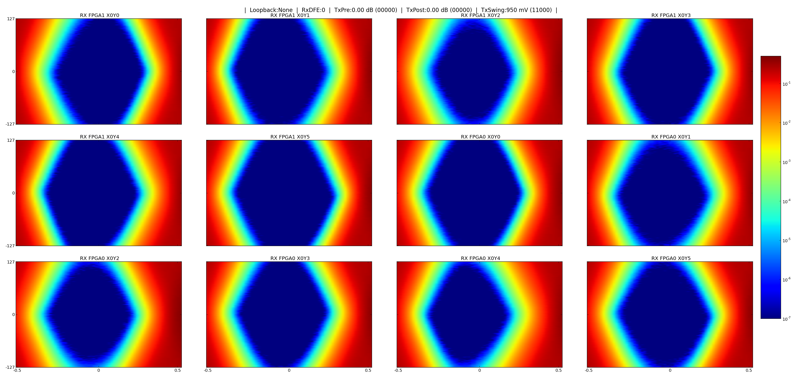
Links – INTERFPGA BUS
DUAL KU15P
Copper links over inter-interposer bus
Two independent FPGAs
  16 Gbps & 25.6 Gbps
  PRBS31, LPM mode, no pre/post-cursor tuning
Each link passed >1e15 bits
  No errors
16 Gbps
25.6 Gbps

Slide 14
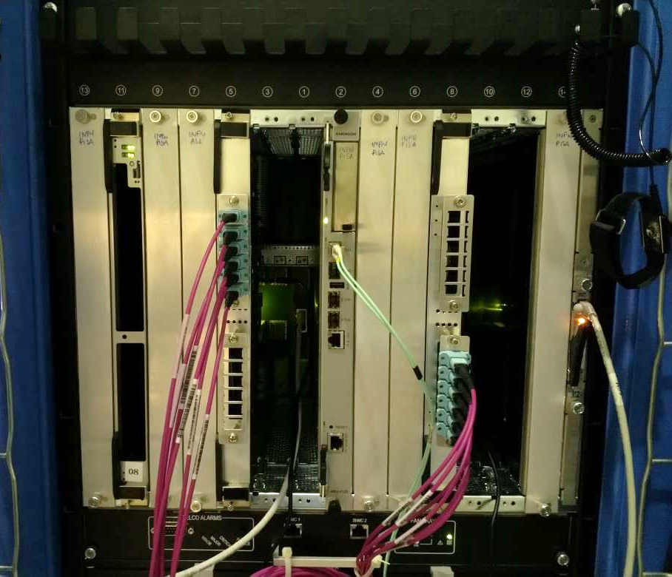
Links – OPTICAL Test STAND
Board-to-board optical data transfer test
  ‘Real-world’ measurement
  Independent clocks, powering, communications
  Hosted in ATCA shelf @CERN
48 optical channels running simultaneously
  12 x 28Gbps (4TX+4RX) Firefly optics
Four independent FPGAs
  25.6 Gbps, with Firefly CDR
  PRBS31, LPM mode, no pre/post-cursor tuning
2m optical fibre
Tracker Integration Facility @CERN

Slide 15
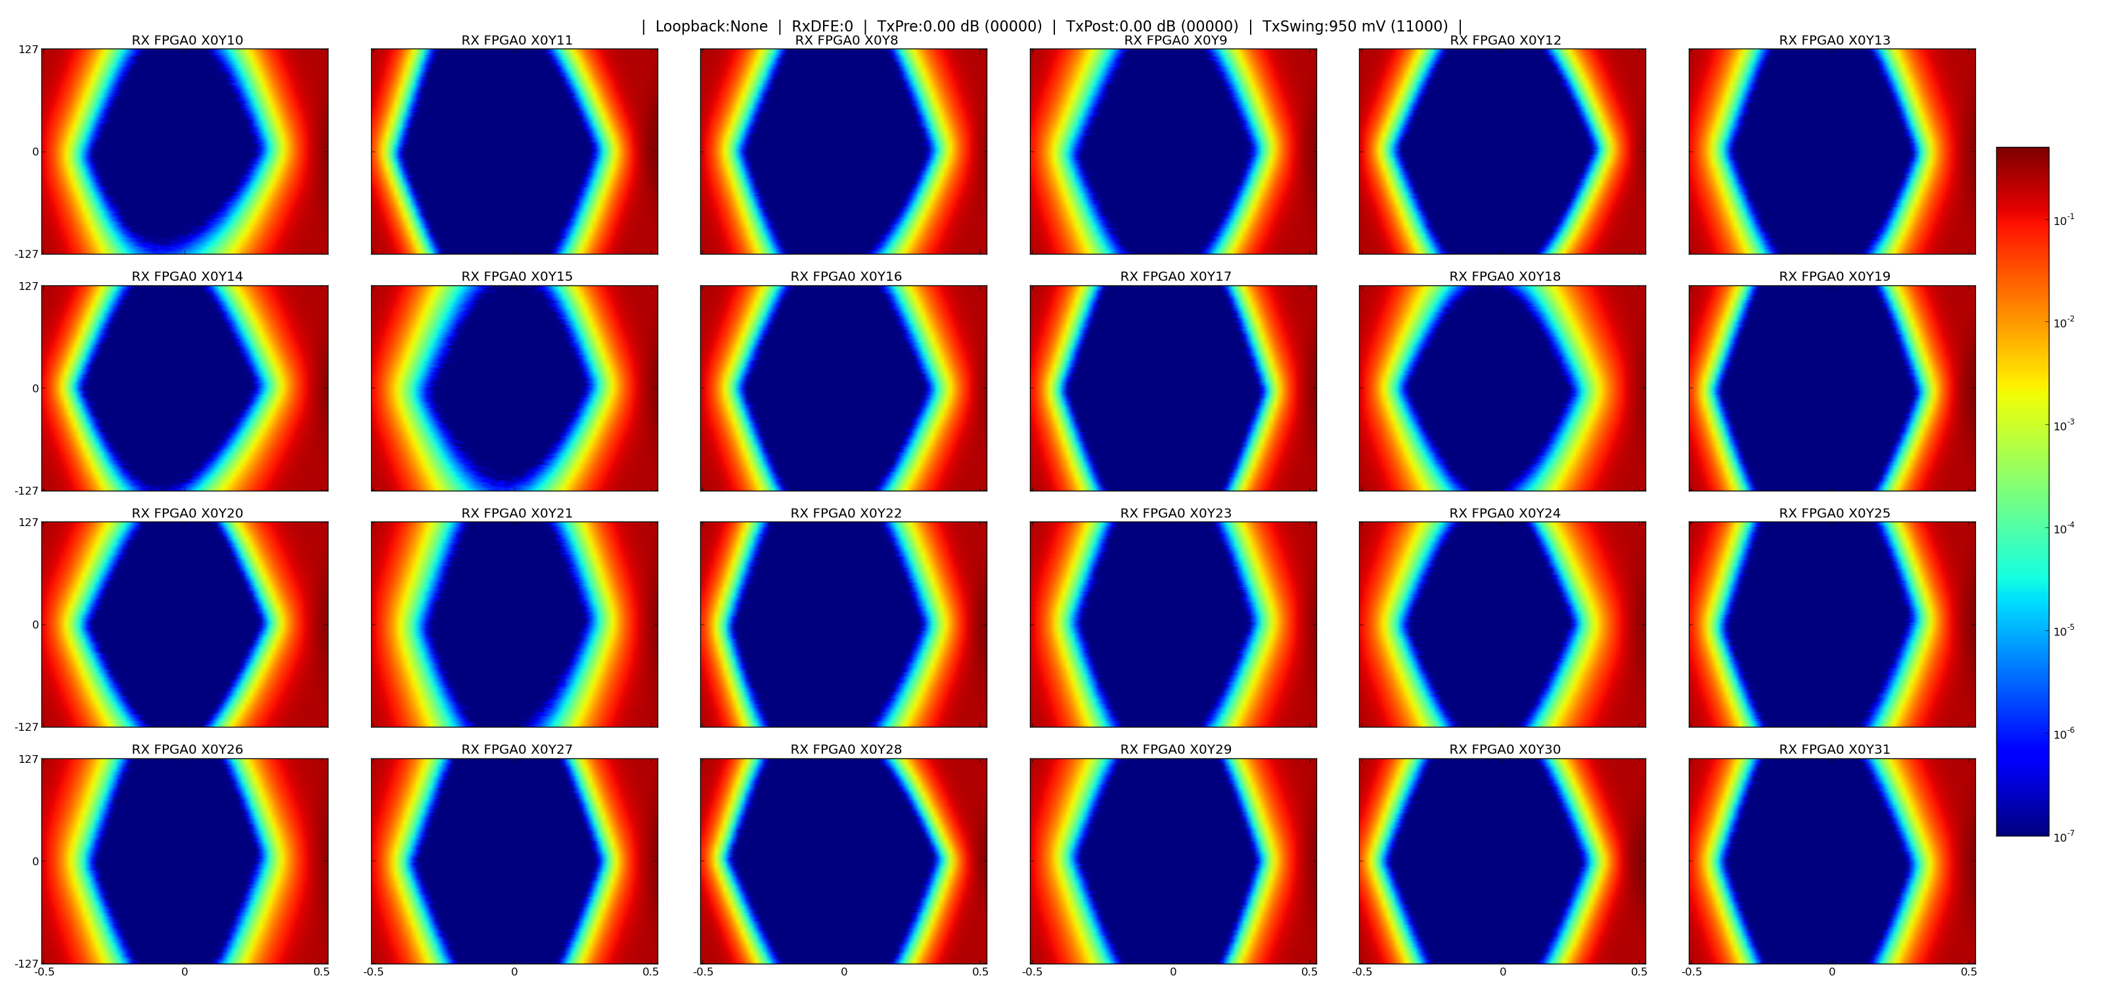
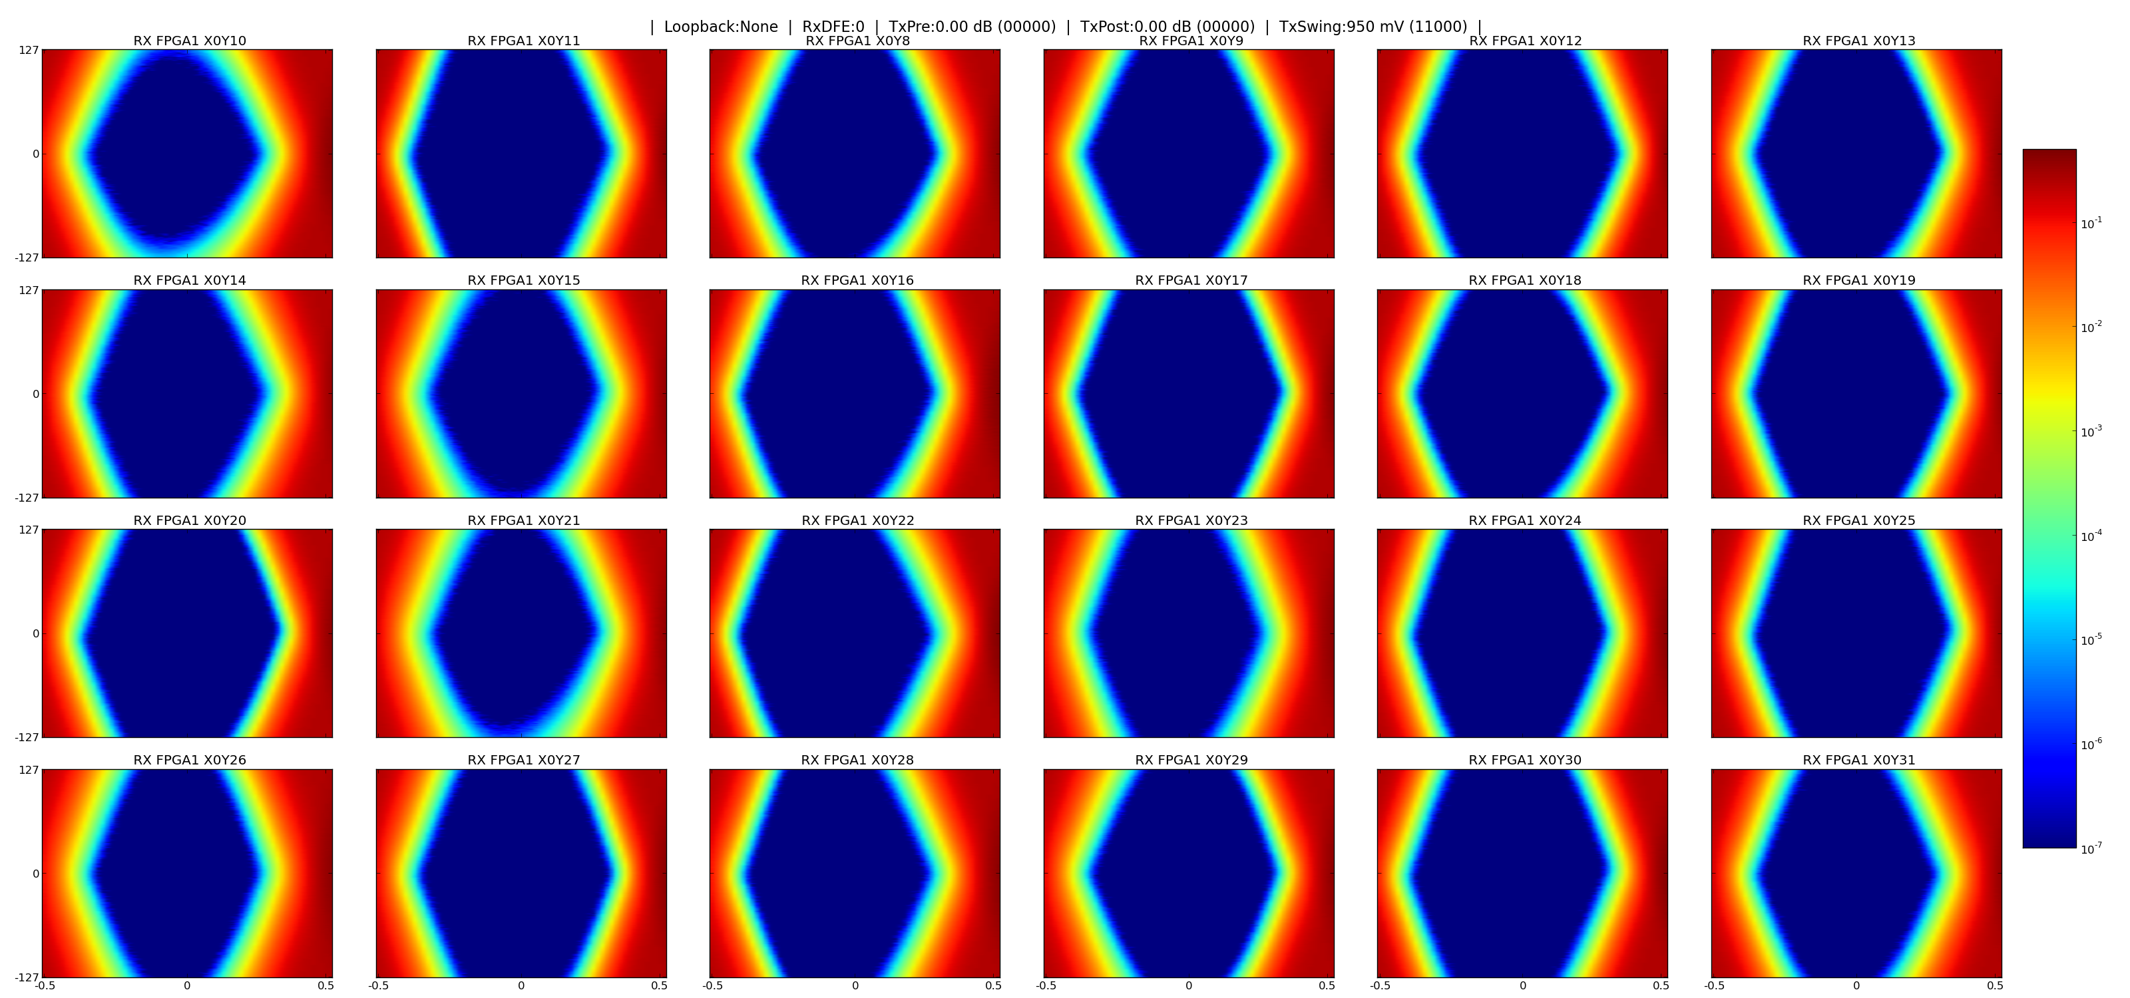
Links – OPTICAL Test STAND
2x DUAL KU15P
>200Pb of data transferred between boards
  Over 2 days
  No errors observed
Eye diagrams suggest significant margin when using Firefly CDR
  Opening 50%-70% UI
  To be confirmed with optical attenuation measurements
25.6 Gbps
25.6 Gbps

Slide 16
Backend protocol
Ioannina
Have moved beyond the “MP7” 8b10b protocol and beyond high-speed eye-diagrams
A full back-end protocol: Hermes
  The communication protocol of the Gods
Based on Aurora (64/66), but with protocol hardening
  Hardening based on Interlaken (64/67) protocol
Fully integrated into the EMP framework
  CRC checking, buffers, header/footer management, etc.

Slide 17
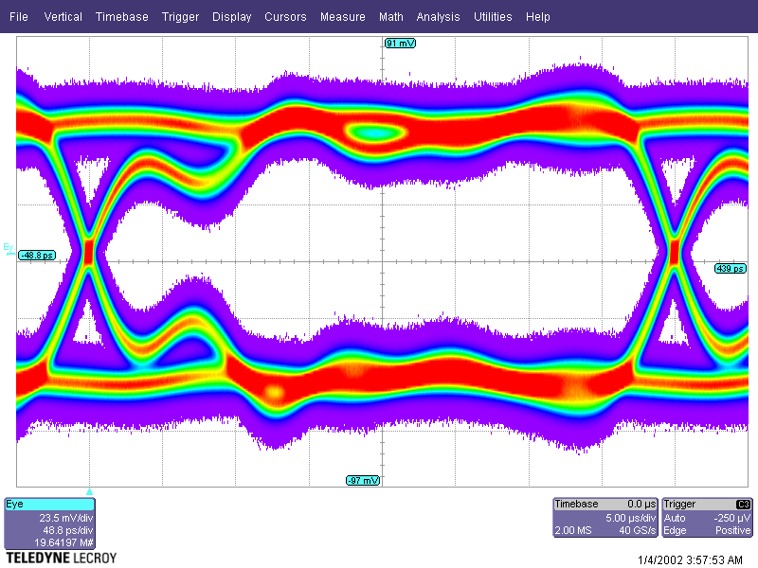
LpGBT Protocol
IC, Saclay
lpGBT uses FEC protocols
Initial integration of official lpGBT firmware
Initial implementation of lpGBT control sequences tested in firmware
Electrical/optical & internal eye-diagrams taken and looking good

Slide 18
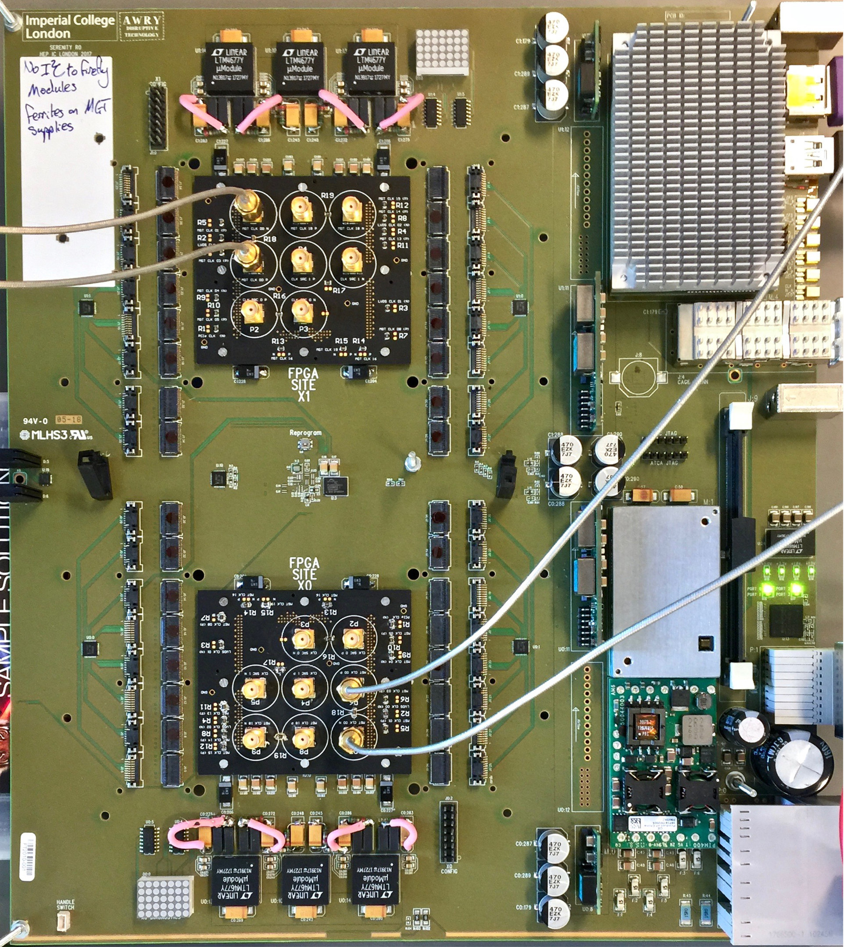
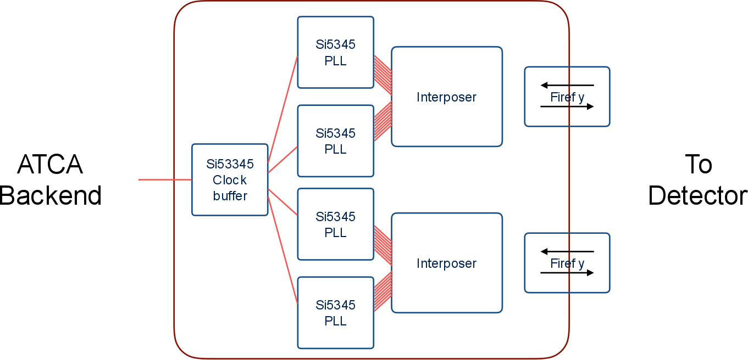
Clock-Distribution Tests
Saclay
Serenity is TDR proposal for CMS HGC DAQ, trigger, clocking and control board.
HGC & MTD require precision timing distribution
CEA Saclay have been testing whether Serenity’s clocking performance meets the requirements

Slide 19
Clock-distribution tests
Saclay
320.624MHz test clock (HGC precision-timing frequency)
External clock-source, RMS = 1.3ps
Serenity tested at 20GS/s (Eval board at 40GS/s)
Based on these results, Serenity’s contribution to system jitter is minimal and it can be considered a “pure clock distribution” node
Measurements by CEA Saclay | SI5444 Eval board for comparison (4 outputs) | Serenity North LHC clock (9 outputs) | Serenity South LHC clock (9 outputs) | Serenity Overall
Random Jitter | 0.9ps | 1.6ps | 1.4ps | 1.8ps
Deterministic Jitter | 1.9ps | 3.2ps | 3.1ps | 4.2ps
RMS | 1.3ps | 2.3ps | 2.1ps | 2.8ps

Slide 20
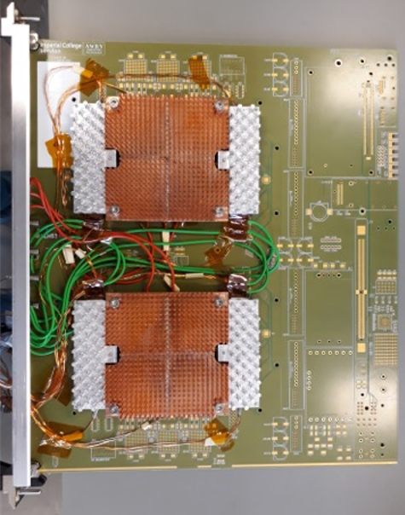
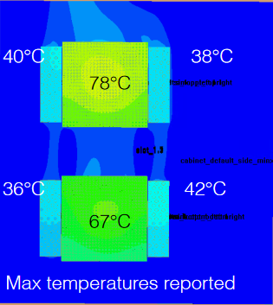
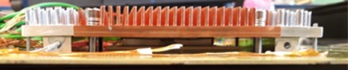
Thermal & Mechanical Tests
Thermal simulations
Physical thermal studies at CERN
Mechanical component design studies into stress on FPGA solder balls and stress on PCBs at IC

Slide 21
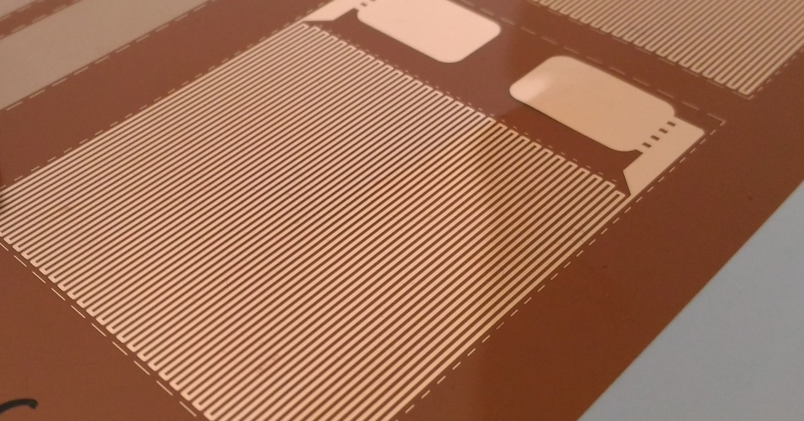
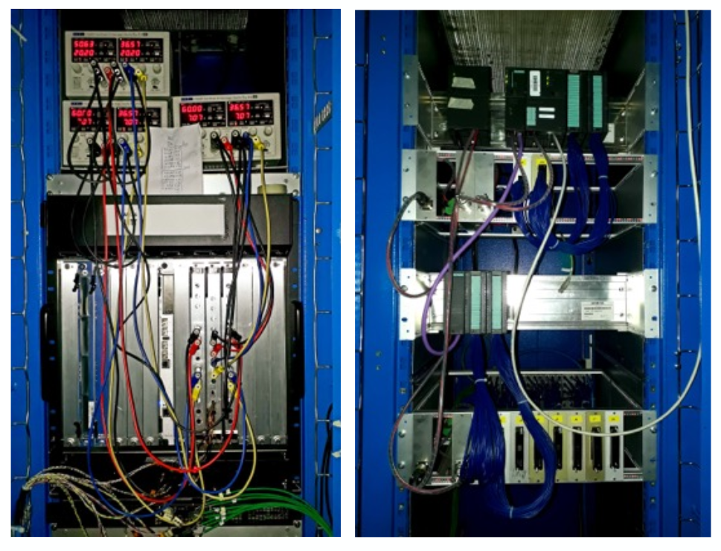
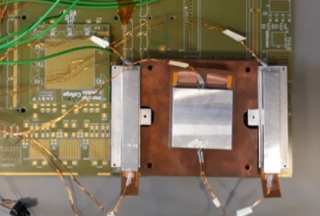
Test Stand At CERN
Pisa
Kapton heaters
Comtel Crate
  Front-Back Airflow

Slide 22
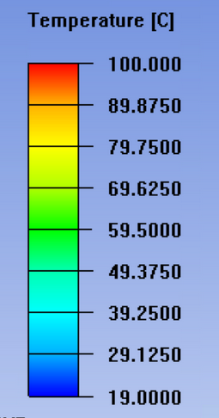
Thermal TEST RESULTS
Pisa
Measurement, Fan Speed 15
Simulation, Fan Speed 15
35°C
42°C
40°C
38°C
Standard CERN crate made by Schroff, Vertical Airflow
  FPGAs @ 90W each
  Max temperature 100 °C
  Optics @ 10W each
  Max temperature 50 °C
  May increase to 20W so need margin
Simulation by Ansys
82°C
78°C
33°C
37°C
36°C
42°C
73°C
67°C
Unoptimized heatsink
Unoptimized heatsink

Slide 23
Fan Speed
Pisa
Measurement, Fan Speed 10
Measurement, Fan Speed 13
Measurement, Fan Speed 15
39°C
47°C
36°C
44°C
35°C
42°C
91°C
85°C
82°C
34°C
39°C
34°C
37°C
33°C
37°C
78°C
75°C
73°C

Slide 24
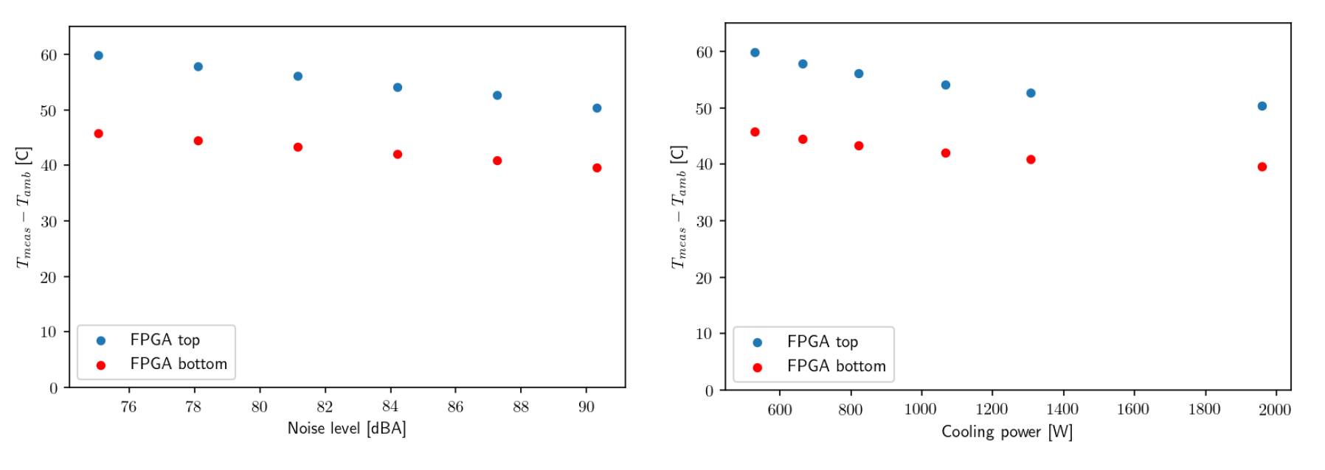
Noise & Cooling vs. Power
  Measurements taken at fan speed settings from 10 to 15 (maximum)
  Higher fan settings produces only a limited reduction in temperature but does result in significant additional noise and power consumption.
Fan Setting 10
Fan Setting 15

Slide 25
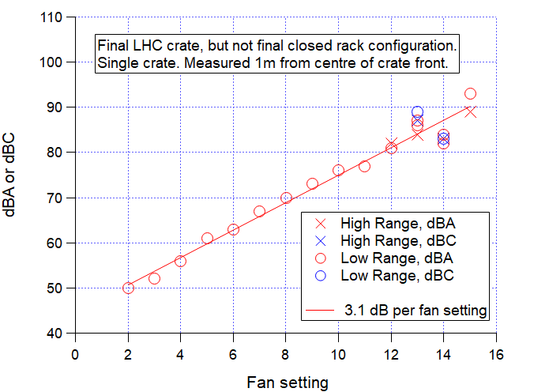
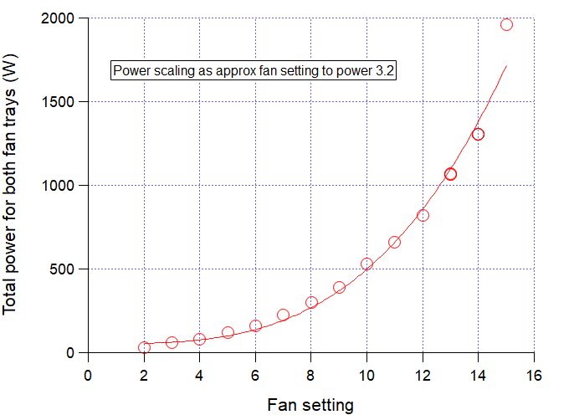
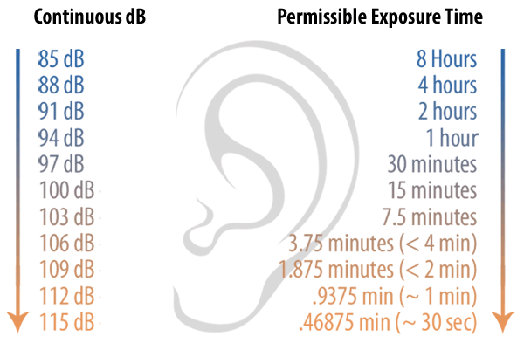
Crate Noise & Power
Pisa, IC
Measurements of the running ATCA system still a cause for concern regarding
  Aural (acoustic) health and safety
  Power-consumption required to cool system

Slide 26
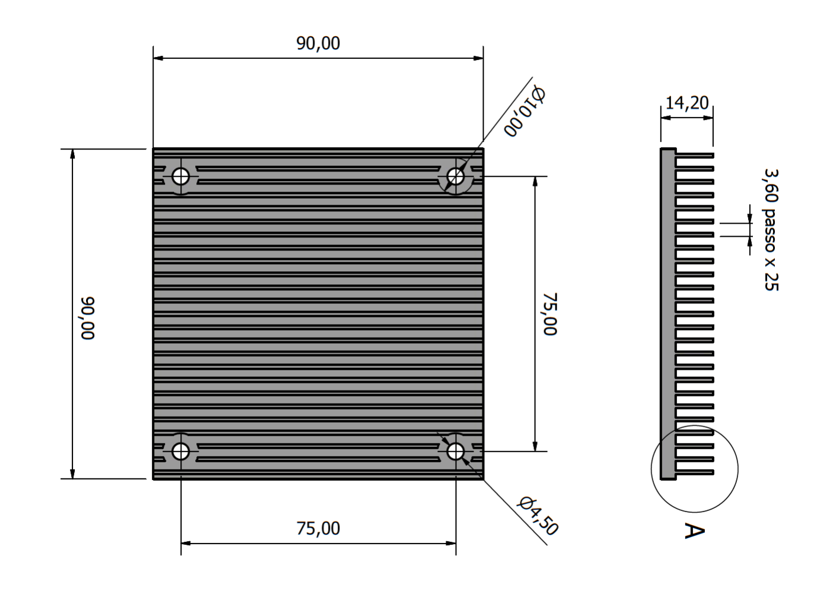
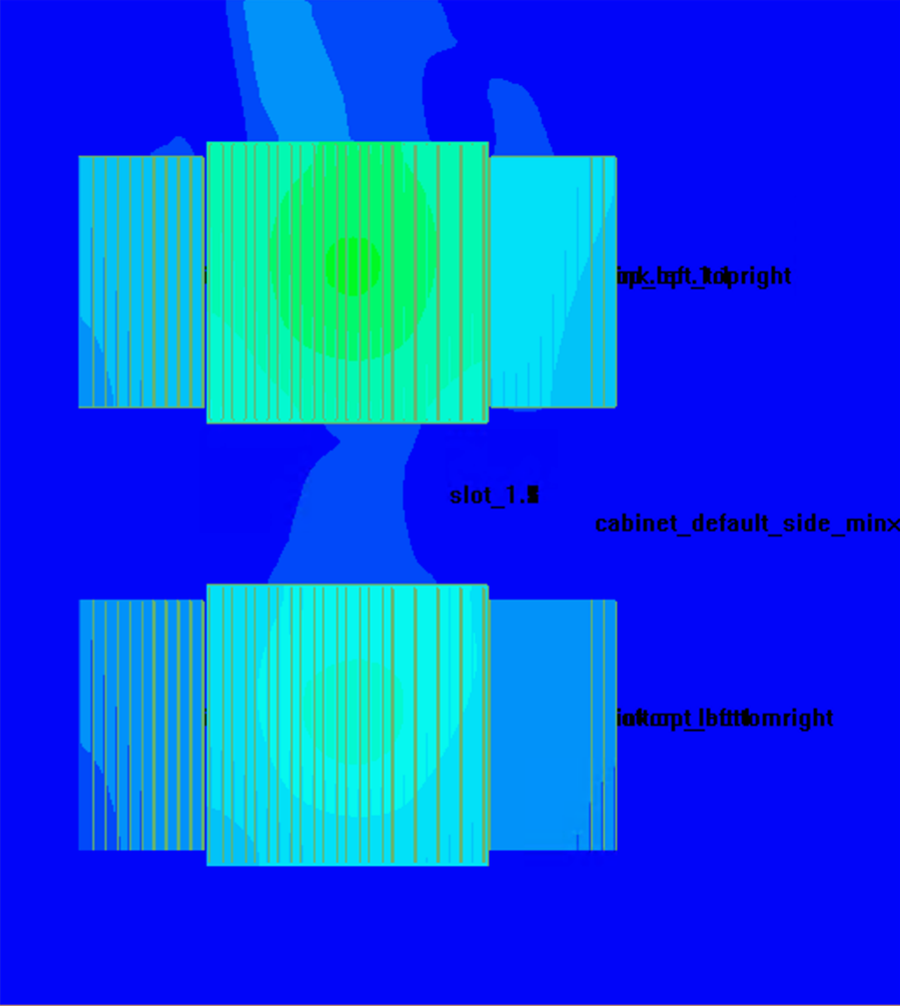
Final Heatsink Design
Pisa
Heatsink design found to be much more important than fan speed
  Fan speed 10/15
  90W/FPGA
  20W/Optics
37°C
43°C
Aluminum
  cheaper and lighter
25 fins/90 mm
4 mm base
  Increase rigidity
14.2 mm total height
1 mm fin thickness
  extrudable
79°C
34°C
36°C
64°C

Slide 27
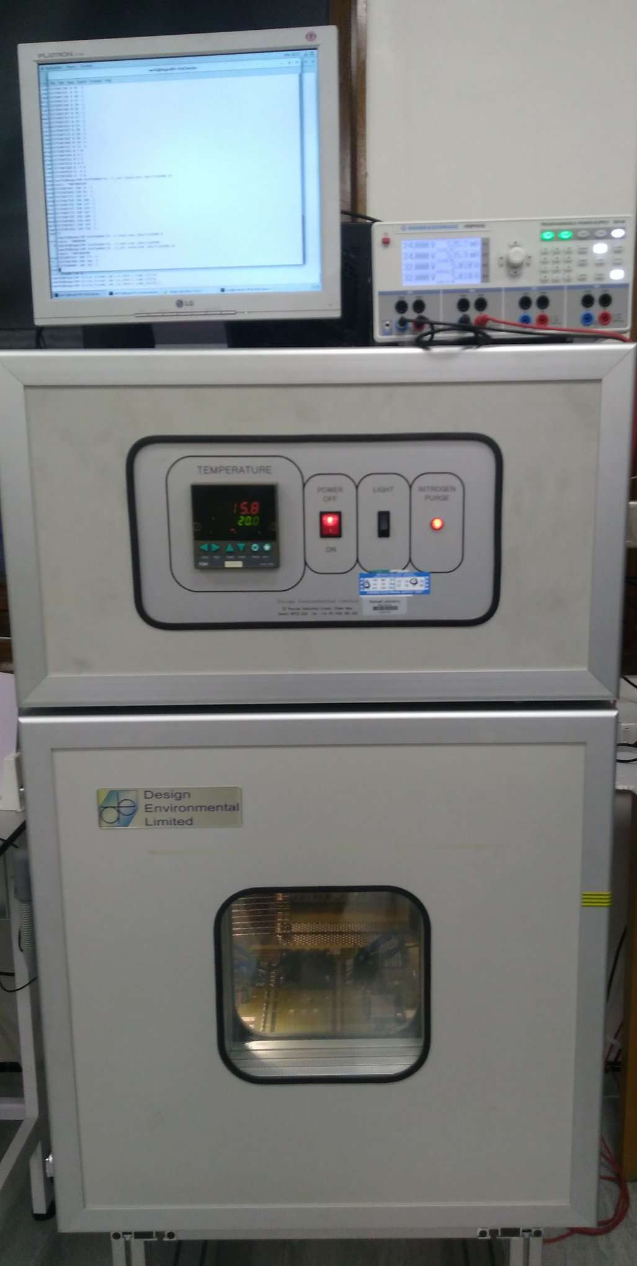
Thermal Cycling
Test-stand
Control PC
Vivado Lab
USB-controlled power supply
Software for monitoring and controlling temperature of chamber
Software for monitoring and controlling board’s 48V supply
Standard Serenity link-test firmware and software tools installed
Monitoring FPGA die temp. via Sysmon over JTAG
USB-controlled environment chamber
Serenity 1.1
KU15P SO
Digilent
GbE feed

Slide 28
Measurement Process
Ramp chamber temperature from 0C to 60C and back in 10C steps
  After each step wait 2mins for FPGA to thermalize
    I checked – this is long enough!
  Run 10⁻⁷ eyescan on each link
Repeat ad infinitum

Slide 29
Datapath
TX
20cm Micro Coax
RX
Daughtercard
Daughtercard
Interposer
Interposer
Firefly
Firefly
2” PCB
Firefly boot
Firefly boot
2” PCB
KU15P, GTH & GTY transceivers at 16G, LPM
Firefly copper cables
  Can safely be exposed to higher temperatures than optical modules
  No retimers
A harsh test

Slide 30
Status (as of 10/02/20 20:30 GMT)
Running time | 32 days, 12 minutes, 9 seconds
Number of thermal cycles | 377.08
Number of samples | 4,525
Number of eyescans | 271,500
New results hourly at: http://www.hep.ph.ic.ac.uk/~awr01/ThermalCycleTests.pdf

Slide 31
Thermal cycling tests
We were primarily interested in “catastrophic” mechanical failure
  Not yet seen
But we have a lot of data, so can we say anything useful about the ongoing performance?

Slide 32
Time-series data (GTY)
GTY’s very stable vs temperature

Slide 33
Time-series data (GTH)
Some GTH channels close up at very low die temperatures

Slide 34
Eye-temperature correlation
GTH
GTY

Slide 35
Is there a global trend?
Is there a coherent change in link-performance over time?
We want to separate the trend from the factors affecting the absolute value
  Absolute temperature
  GTH vs. GTY
  Trace-lengths & -geometries
Linear fit for each phase and each link
  Reduces 271,500 data points to 720 gradients
Histogram the gradients

Slide 36
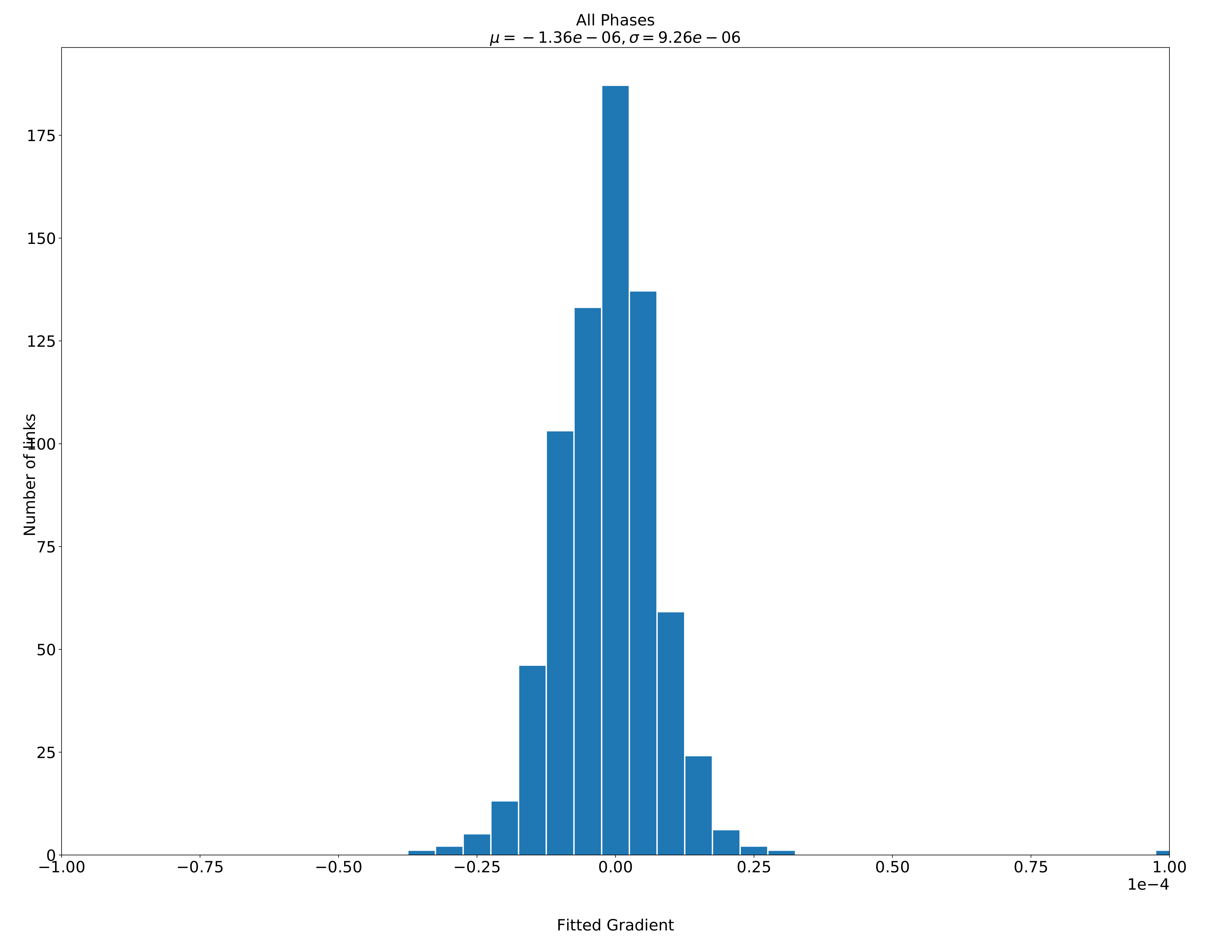
Trend over time
Mean rate of
eye-closure is (currently) 1.36×10⁻⁶% per thermal cycle
Width of distribution is ~9.26×10⁻⁶%
Completely dominated by statistical fluctuations

Slide 37
Hardware conclusion
A large number of people have thrown a vast array of tests at the hardware and it just works

Slide 38
An observation
One of Serenity’s main strength is it’s structural reconfigurability:
  It can take any FPGA
  It can take one or two FPGAs
  It can take any* number, direction, speed or medium of FireFly

Slide 39
An observation
One of Serenity’s main strength is it’s structural reconfigurability:
  It can take any FPGA
  It can take one or two FPGAs
  It can take any* number, direction, speed or medium of FireFly
Serenity’s main difficulty is it’s structural reconfigurability:
  It can take any FPGA
  It can take one or two FPGAs
  It can take any* number, direction, speed or medium of FireFly

Slide 40
An observation
One of Serenity’s main strength is it’s structural reconfigurability:
  It can take any FPGA
  It can take one or two FPGAs
  It can take any* number, direction, speed or medium of FireFly
Serenity’s main difficulty is it’s structural reconfigurability:
  It can take any FPGA
  It can take one or two FPGAs
  It can take any* number, direction, speed or medium of FireFly
Supporting 1 board design is hard
Supporting in excess of 10⁷ permutations is a little harder

Slide 41
An observation
Ad hoc solutions are doomed to fail
Project-by-project solutions are doomed to fail
Rigour is the order of the day
Supporting 1 board design is hard
Supporting in excess of 10⁷ permutations is a little harder

Slide 42
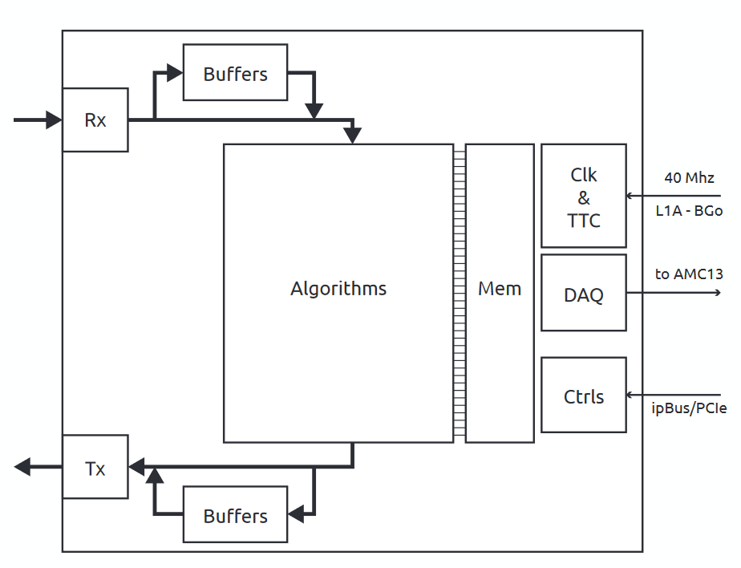
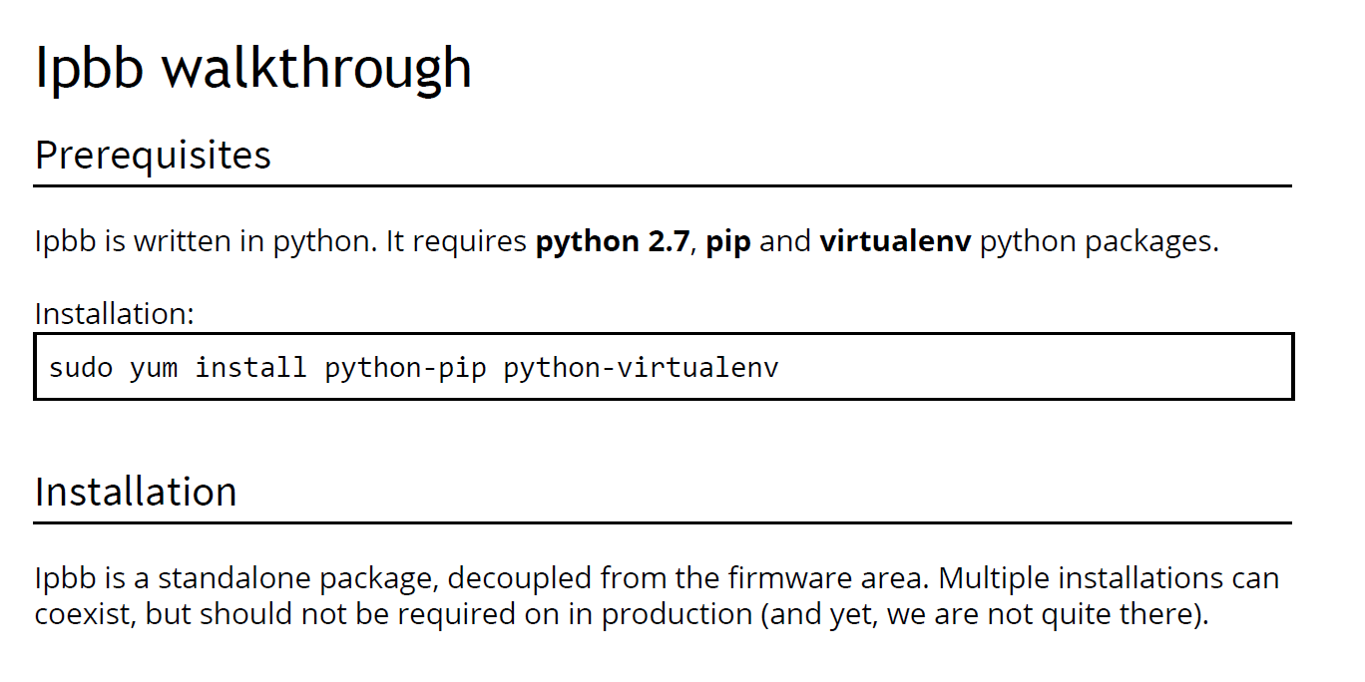
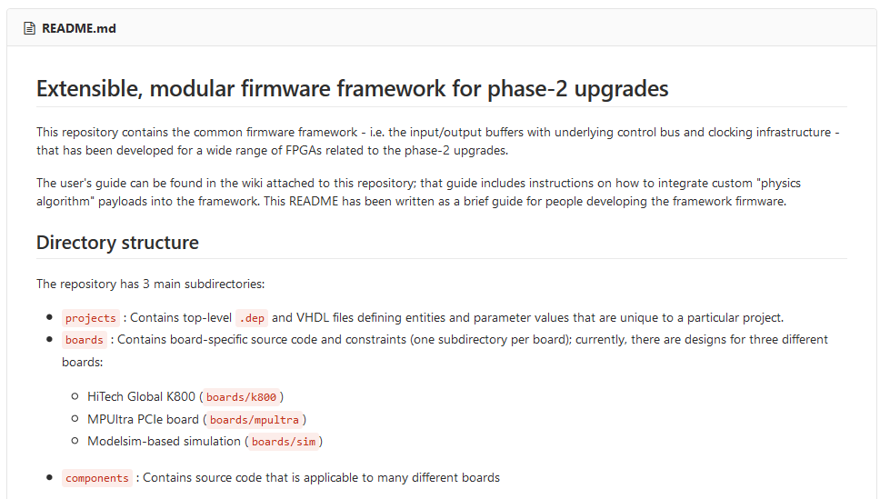
EMP Firmware
RAL, TIFR
Have built upon the success we had with MP7 model in Phase-1 upgrades
  Infrastructure firmware – EMP
  Build Tool - IPBB
Infrastructure separated from payload for algorithms

Slide 43
EMP FIRMWARE
RAL, TIFR
Still constrains infrastructure to the edge of the chip
But now…
  Supports any type of Xilinx FPGA
  Has support for arbitrary numbers, distributions, types and speeds of links
  Has support for IPbus-over-PCIe and IPbus-over-AxiC2C
  Systematic link validation procedures
  Separates out physical device configuration from design configuration
Which means that with a single line change you can build the same payload for…

Slide 44
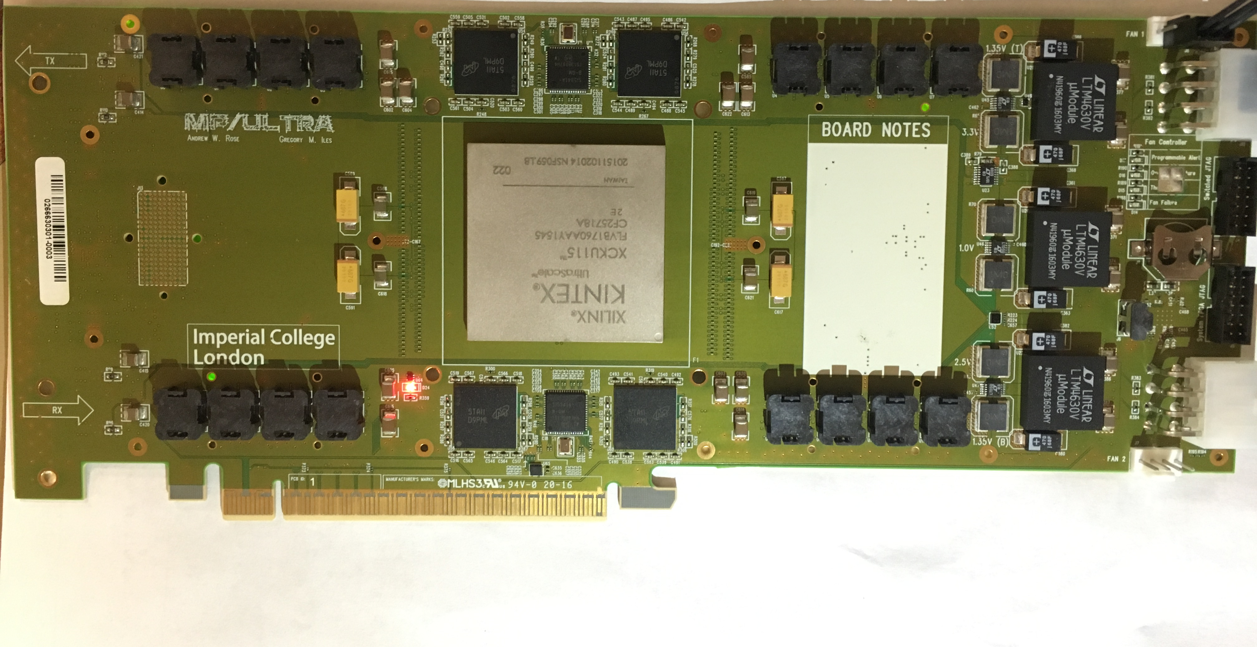
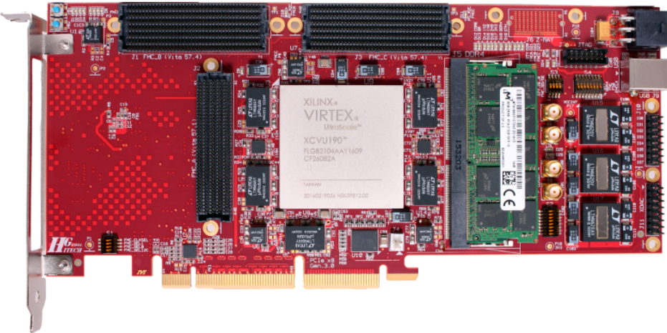
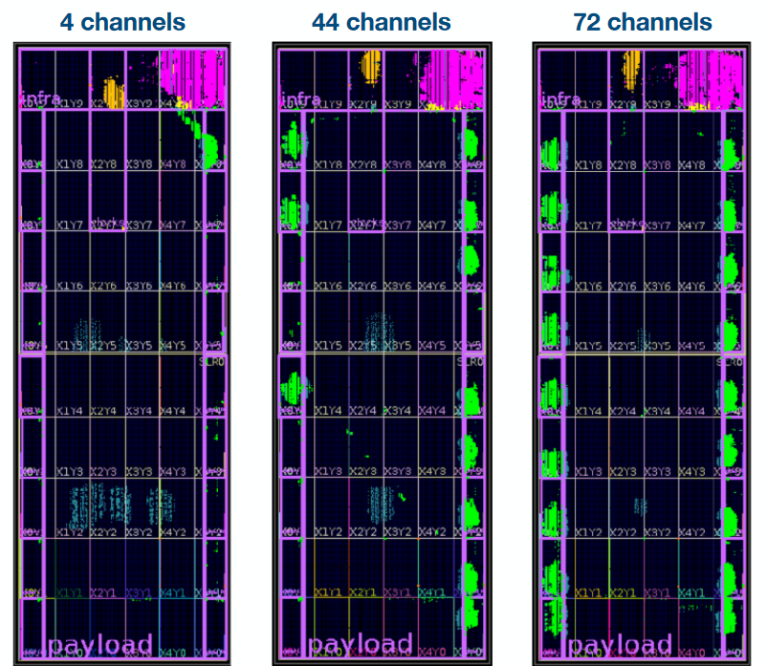
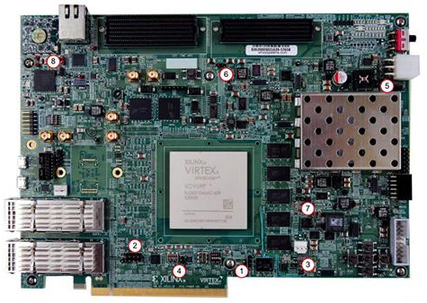
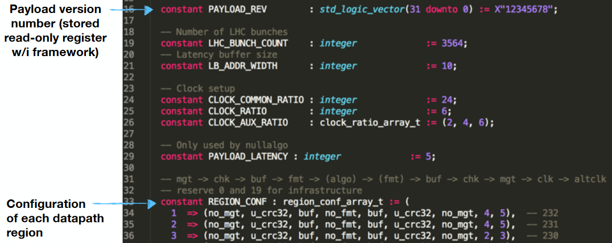
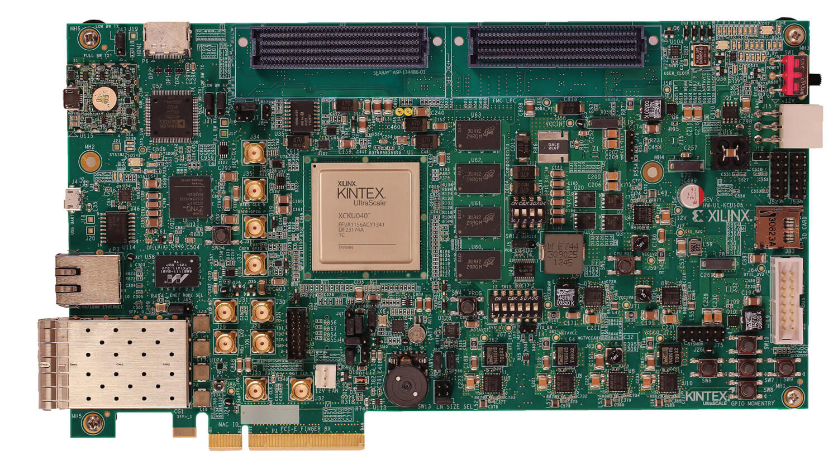
EMP Firmware
RAL, TIFR
Different boards
Different link configurations
x4

Slide 45

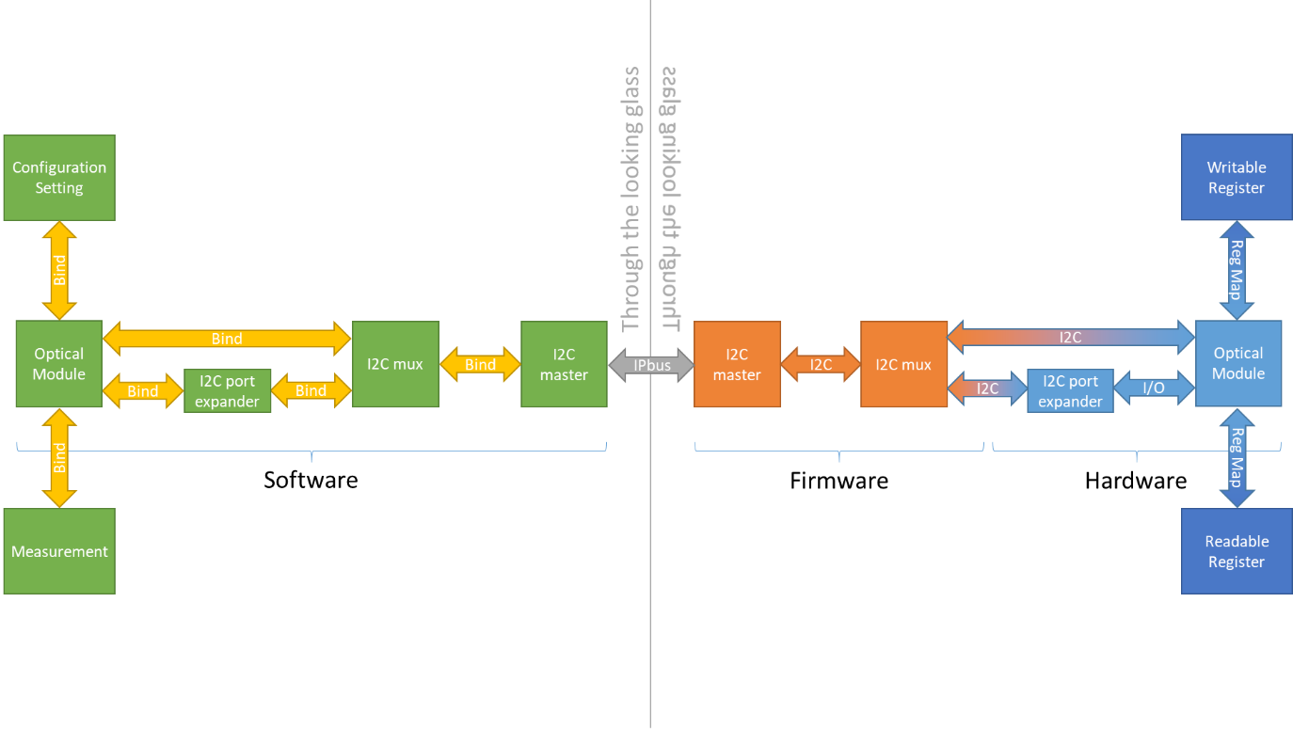
: The Serenity Management Shell
The usual problem in writing generic, reusable control software is the complex interdependence of different components
New board = new software
In the past, major structural changes to a board design and entirely new board designs happened on a sufficiently infrequent basis as to be manageable, albeit inefficient, way of working.

Slide 46
: The Serenity Management Shell
SMASH builds a “mirror” image of the system in software
You tell it how the system is connected, SMASH works out how to route the messages
No time for details in this talk!

Slide 47
: The Serenity Management Shell
DESPITE THE NAME IT IS NOT SPECIFIC TO SERENITY

Slide 48
: The Serenity Management Shell
SMASH is a hardware-agnostic hardware control software
Configured with a hardware description file
No component knows how any other component works
  Components talk to each other, they don’t depend on each other
Speaks whatever protocol is required
  IPbus, PCIe, USB, I2C, JTAG, GPIO, etc.
  Including protocol-over-protocol
Interactive console with tab-completion for debugging

Slide 49
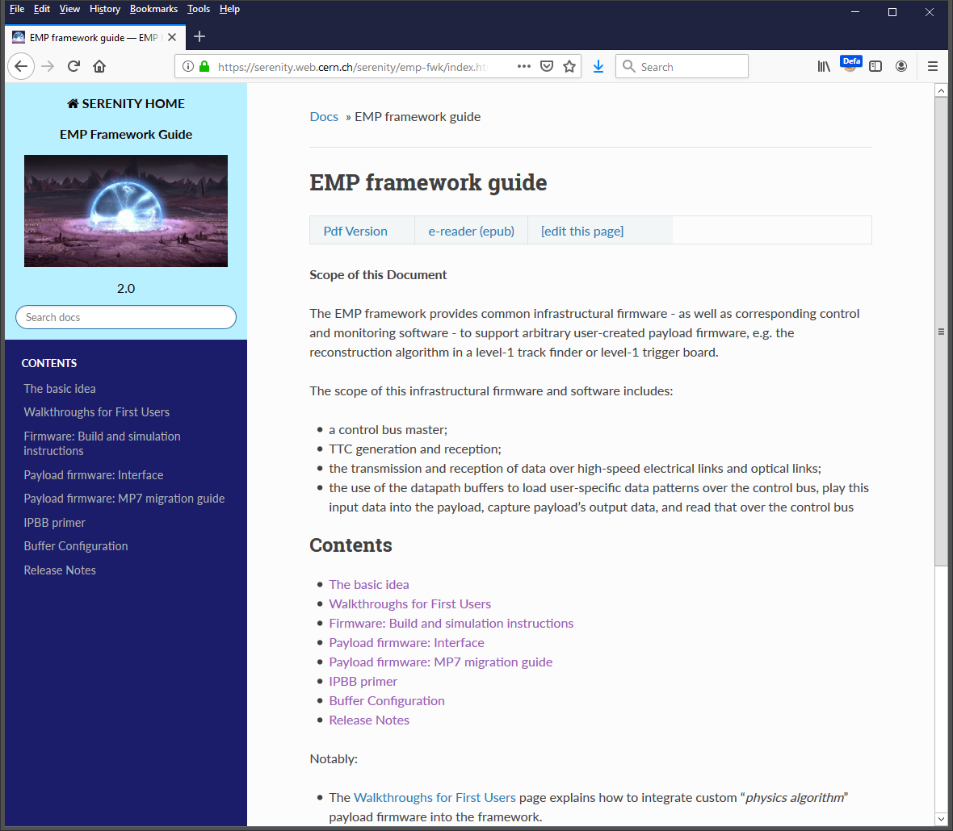
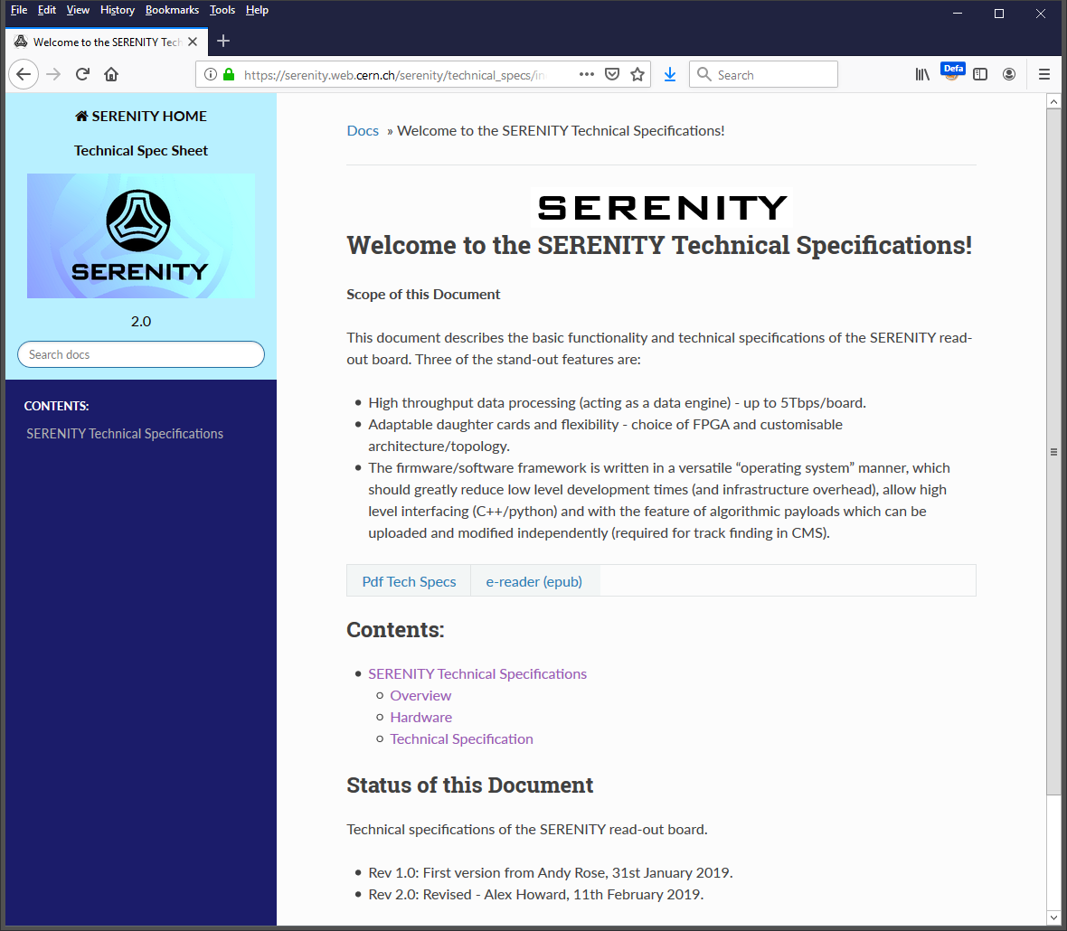
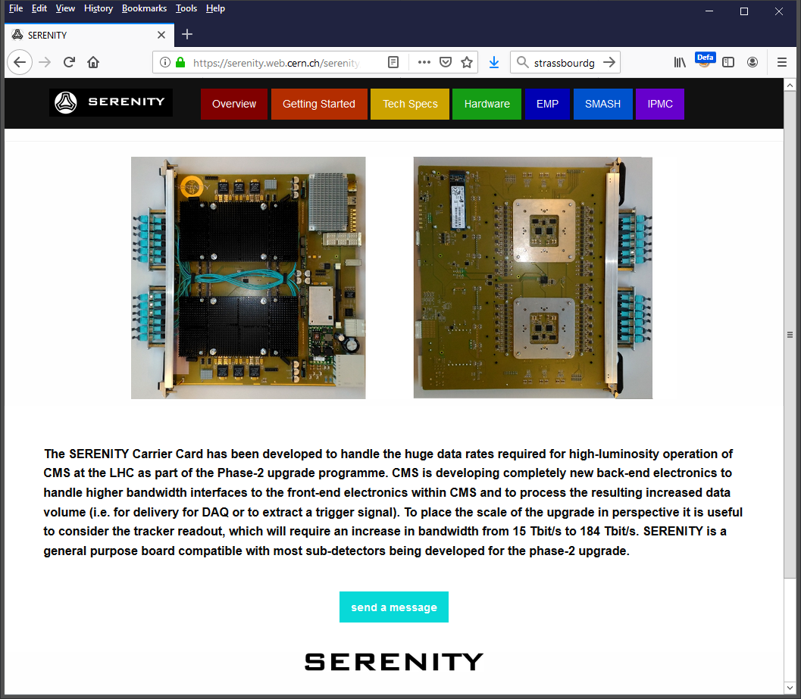
Documentation
A single slide in this talk, but it requires significant effort to properly document system
http://cern.ch/serenity
Already have large sections on
  Hardware
  Firmware – EMP
  Low level software – SMASH
  IPMC functionality
Some sections have extended walkthroughs to guide those new to the system

Slide 50
The most remarkable feat
Perhaps Serenity’s most remarkable feat is the way that it has cut across subdetector projects
  lpGBT being worked on by MTD & Tracker
  Back-End links by L1T & Barrel-muons
  Slow Control /DAQ by HGC
  … and so on

Slide 51
Future: Serenity 1.2

Slide 52
Serenity 1.1 Open questions
Serenity 1.1 works very well, which led to much intense debate on the evolution of the design; Notably:
  Keep interposers or move to a standardized mounted FPGA?
    Which FPGA? One FPGA or Two? How to deal with future devices?
  Stick with interposers until strong motivation given otherwise
  Zynq or Com-express?
    Direction of others? On module (If so, which, as no industry standard)? On board (break backward compatibility)? IPMC functionality in Zynq (unproven) or via CERN module? Enough CPU power in Zynq for what some people are proposing?
  Provide NATIVE compatibility for ALL options on Serenity 1.2
    A significant feat, but we have a plan…

Slide 53
Required changes
DESIRABLE CHANGES
Add support for 10Gbps TCDS
Move payload backwards to simplify fibre-routing
Support for 120+ link FPGAs
Rationalize the design for simplicity of manufacture
Design for testing & mass manufacture

Slide 54
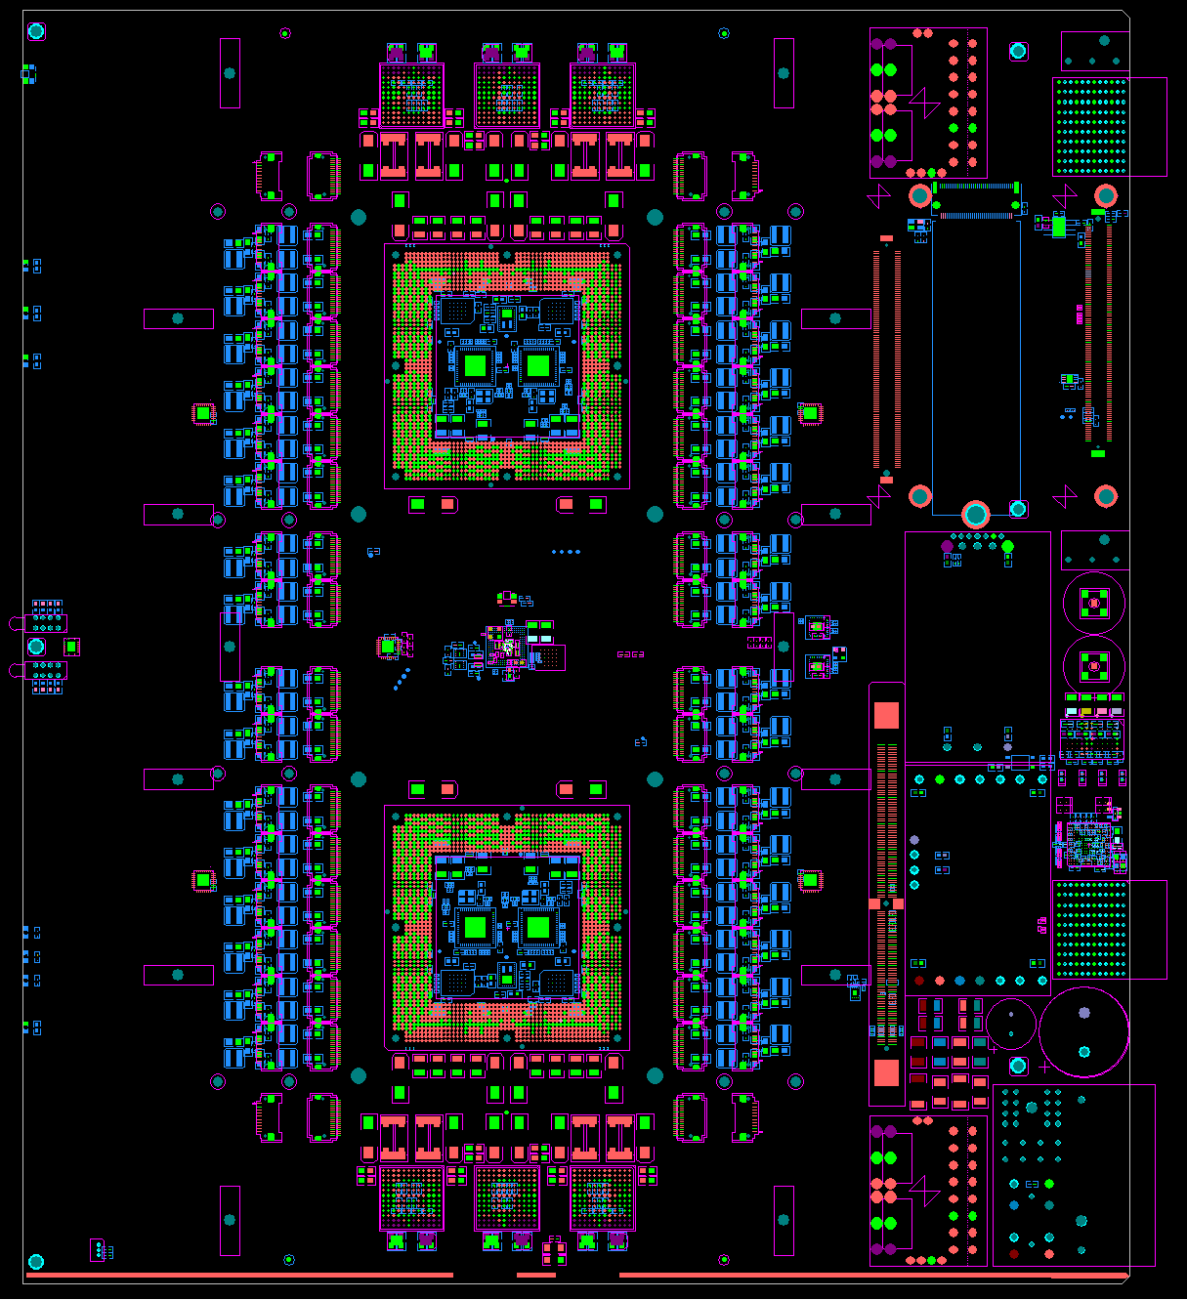
Serenity 1.2
Rearrange service zone
Move payload 20mm backwards to free up space for fibre-routing

Slide 55
Serenity 1.2
Aux connector outside CMX footprint
  Fully compatible with PICMG com-express standard
  Custom Zynq “CMX” or Zynq SOM adapter can use both connectors
IPMC functionality routed to both CERN IPMC and aux connector
I2C and JTAG chains accessible via aux connector
Example

Slide 56
Serenity 1.2
Interposer 1
CMX /
Zynq
Distribute 10Gbps TCDS via X-point
  Complete flexibility
  Backward compatible change to DC spec
Add “Reserved 10GbE” lines and “Hub B” lines to X-point
  Could be useful at some point in the future
4
4
2+2
4+4
Artix
X-point
Legacy TTC
10G TCDS
1+1
2+2
4
4+4
Interposer 2
ATCA

Slide 57
Upgraded optics
Upgraded
Clocks
Upgrade clock synths
  Higher performance
  12 output synthesizers necessary for 120+ link FPGAs
Length match all clock pairs
Backward compatible change to DC spec
Remove shared QSFP
  Add two “4+4” FireFlys to each interposer
  Backward compatible change to DC spec
Systems seem to be crystalizing towards a general preference for more optical I/O
  Reroute 48 channels of the inter-interposer bus from each FPGA to the “spare” FireFlys
208 Firefly channels per FPGA

Slide 58
Serenity 1.2
Single debug connector in Zone-3
Simplify manufacture by rationalizing the design
Makes producing an automated test-stand simple
  Test every card before they leave the assembly line

Slide 59
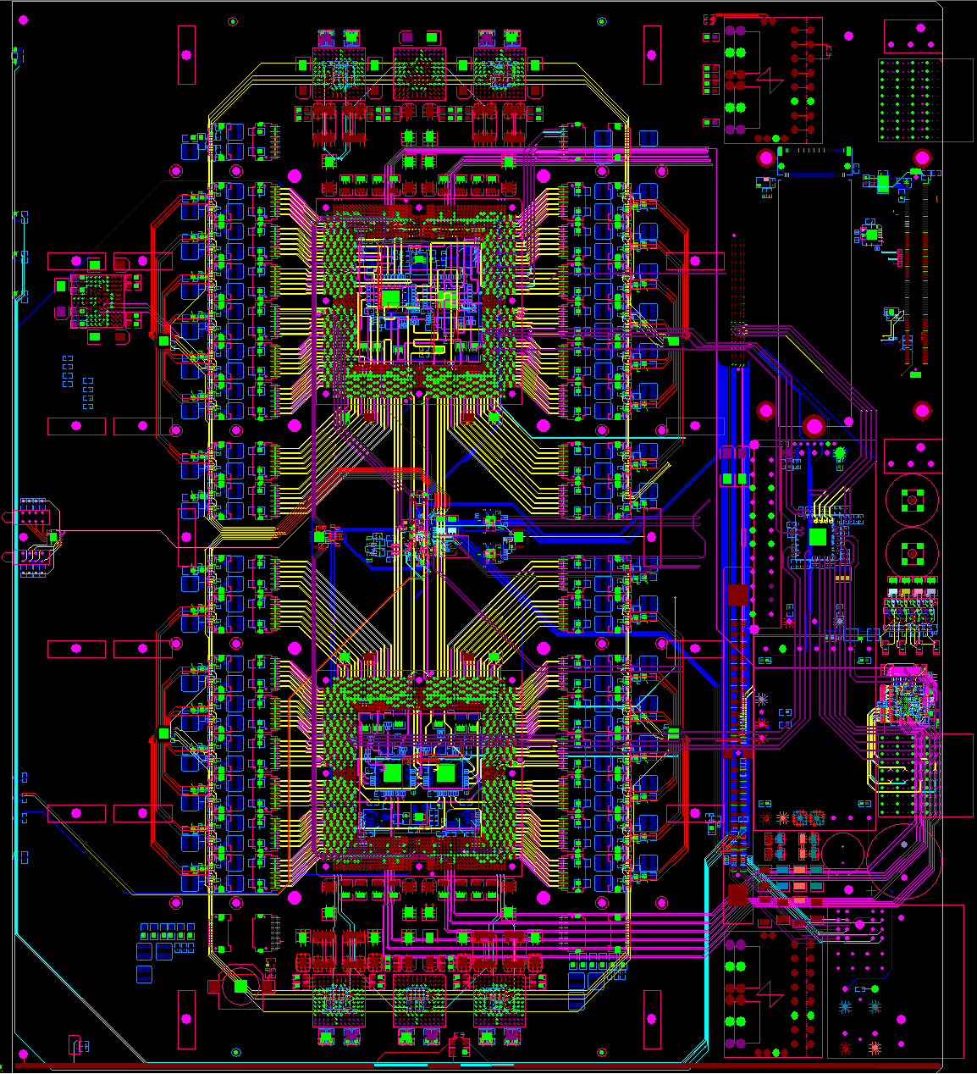
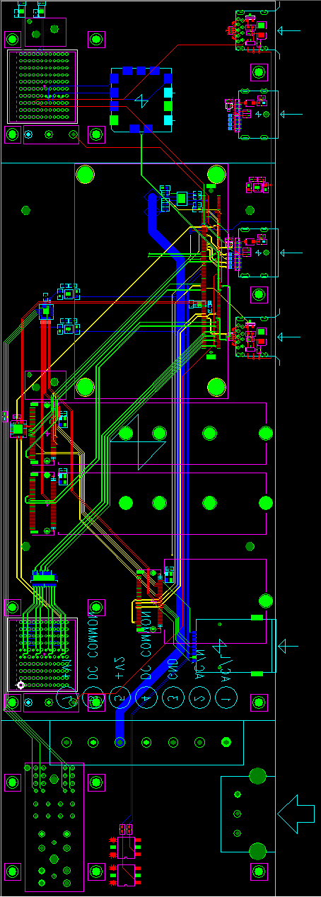
Serenity 1.2 & Blade tester Progress

Slide 60
Conclusion
Serenity 1.1 has demonstrated excellent performance in every area

Slide 61
Conclusion
Serenity 1.1 has demonstrated excellent performance in every area
But much more than that, has demonstrated that the philosophy of a common hardware project which cuts across subdetectors not only works, but works very well

Slide 62
Conclusion
Serenity 1.1 has demonstrated excellent performance in every area
But much more than that, has demonstrated that the philosophy of a common hardware project which cuts across subdetectors not only works, but works very well
Serenity 1.2 should be even better
  Higher performance
  More links
  Easier to manufacture and validate

Slide 63
Conclusion
Serenity 1.1 has demonstrated excellent performance in every area
But much more than that, has demonstrated that the philosophy of a common hardware project which cuts across subdetectors not only works, but works very well
Serenity 1.2 should be even better
  Higher performance
  More links
  Easier to manufacture and validate
I am personally looking forward to see where this collaborate approach takes us

Slide 64
Thanks for listening!
Any Questions?
CEA Saclay: Ozgur Sahin, Pierre-Anne Bausson
CERN: Paschalis Vichoudis, Andromachi Tsirou
IC: Andrew Rose, Duncan Parker, Greg Iles, Mark Pesaresi, Vito Palladino, Kirika Uchida, David Monk, Alex Howard
INFN Pisa: Giacomo Fedi, Piero Giorgio Verdini
KIT: Luis Ardila, Matthias Balzer, Thomas Schuh
RAL: Tom Williams, Alessandro Thea, Kristian Harder
TIFR: Shashi Dugad, Raghu Shukla, Irfan Mirza
University of Ioannina: Stavros Mallios, Kosmas Adamidis

Slide 65
Spares & Backup

Slide 66
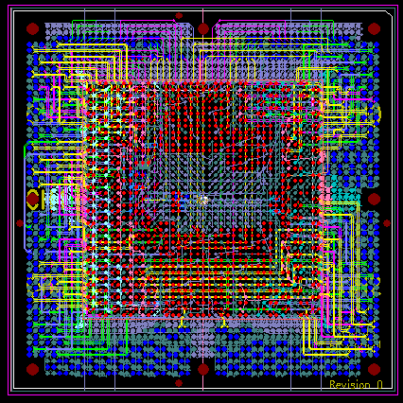
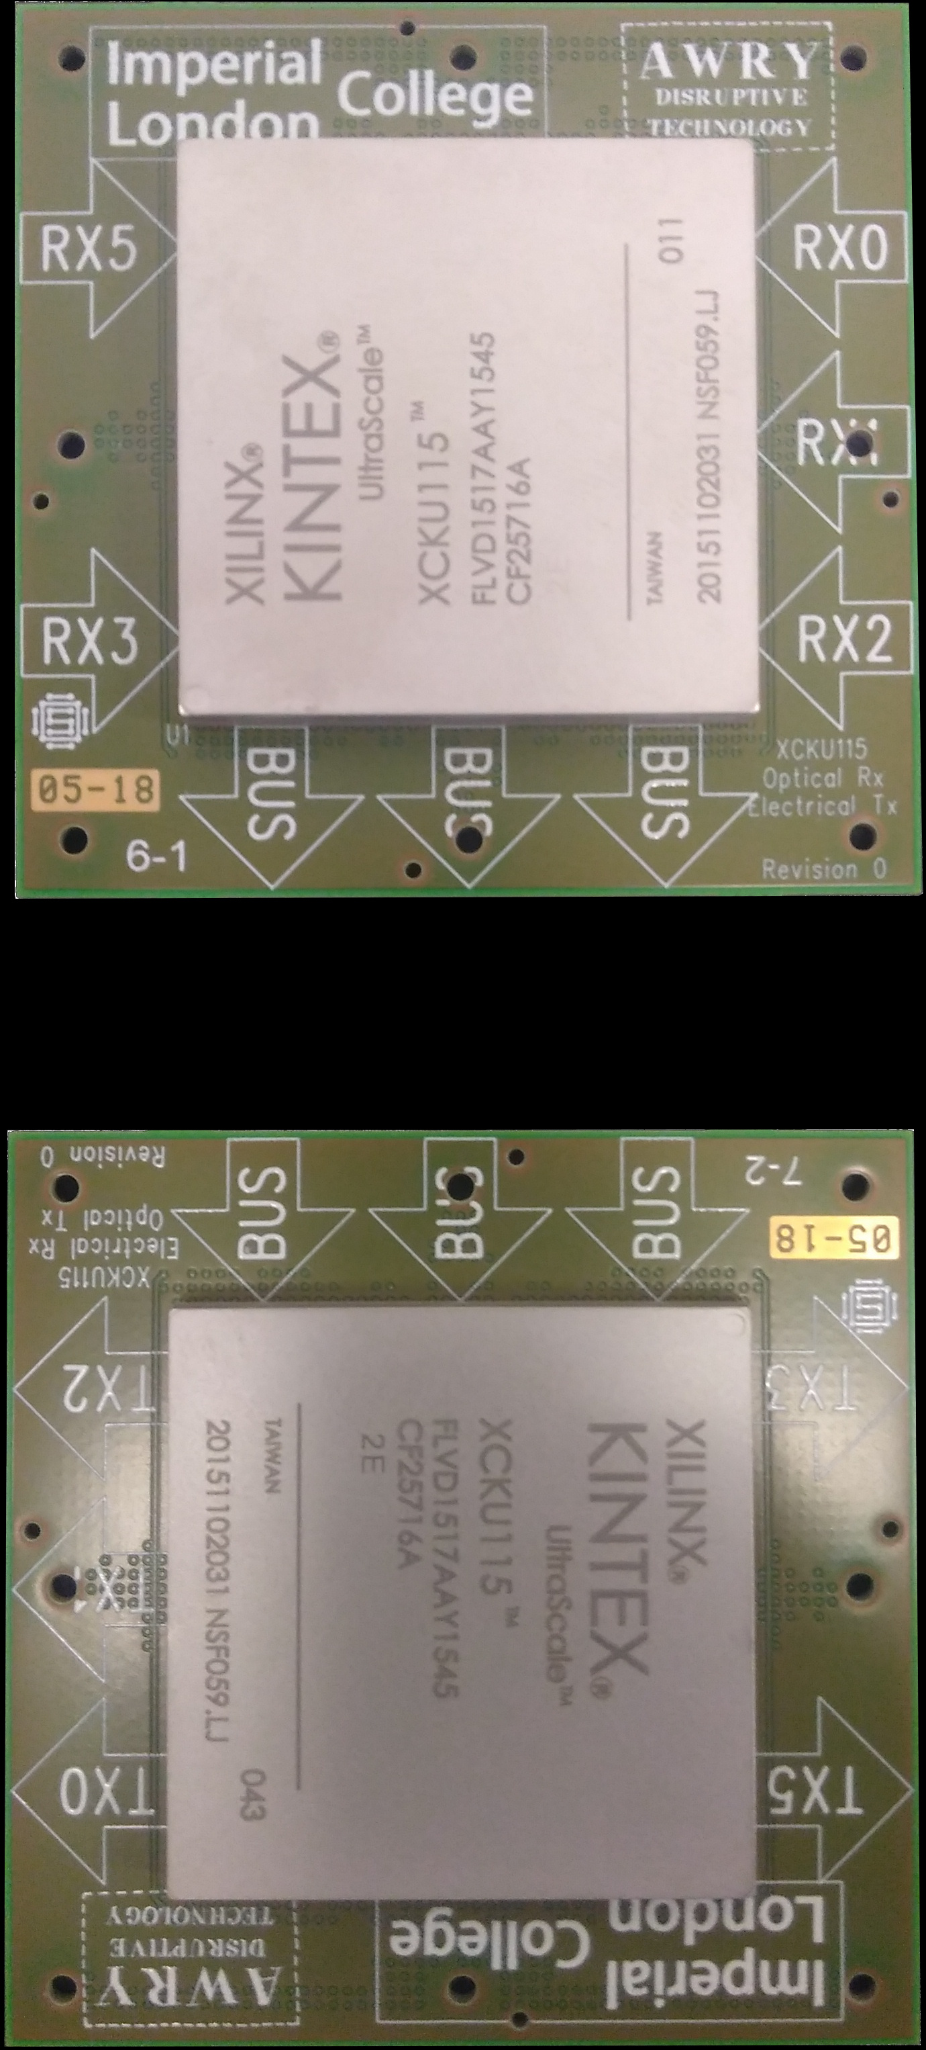




Can different groups produce daughter-cards?
All optical
KU115, Imperial
Daisy-chain, optical in
KU115, Imperial
IC - Xilinx KU115: Symmetric & Daisy Chained
KIT - Xilinx KU15P
TIFR - Xilinx VU9P
Saclay – a clock-network analysis daughter card
No photo!
Oops!
✓
✓
Under test
Bolted under a heatsink before a photo was taken
✓
✓
✓
✓
All optical
KU15P, Imperial
Mixed optical/electrical
KU15P, KIT
Clock-performance analyzer
CEA Saclay
All optical
VU9P, TIFR

Slide 67


link tests in TIF
Test procedure
  Reset and configure TTC & link firmware
  Configure tx buffers to send patterns
  Read link status registers (QPLL locked, CRC error counters, …)
    Check that values are “good”
  Capture data in rx buffers
    Check that it perfectly matches expectation
Repeated test > 50 times
  5 minute gaps between resets
  Repeated status register and rx buffer checks repeatedly in these gaps

Slide 68
Blade Tester
Zone 3
?
Zone-3 USB3
USB3
Connector
Zone-3 DisplayPort
DisplayPort Connector
Zone2
Zone-3 Artix JTAG
Digilent
CMX
USB3
Connector
Zone-3 Artix PCIe
DisplayPort Connector
Zone-2
GbE A
GbE
mux
Zone-2
Data
Insertion detection
M.2 SATA SSD
Zone 1
Zone-2
GbE B
Zone-2
Clocks
PCIe clk fanout
M.2 PCIe/USB
(WIFI/RJ45/Other)
Zone-1
IPMB A
I2C
mux
Zone-1
IPMB B
M.2 WWAN/GPS
via USB
Zone-1
-48V A
Opto
iso
Mains to
48V & 12V
Mains
In
Zone-1
-48V B
Opto
iso

Slide 69

Daughter card Tester
FLASH
Config
JTAG
Digilent
CMX
USB3
Connector
DisplayPort Connector
DC
M.2 SATA SSD
PCIe
PCIe clk fanout
M.2 PCIe/USB
(WIFI/RJ45/Other)
M.2 SATA SSD
Sysmon
I2C
mux
EEPROM
M.2 WWAN/GPS
via USB
12V
In
And mechanics to allow testing without screwing the card down!
TCDS lines

Slide 70
HOW SMASH?
Each type of hardware or firmware has a separate class representation, which is referred to as an “element”.
Each element is a self-contained entity and has no dependence on any other element.

Slide 71
HOW SMASH?
Like physical components, which interact with each other by exposing interfaces, be that GPIO, I2C, SPI, JTAG, USB, GbE, PCIe or some other, so do SMASH elements.
SMASH elements do this through bound function calls, which in SMASH parlance are called “ports”.

Slide 72
HOW SMASH?
Any element which provides a service, such as an I2C master or a GPIO-driver, creates and exposes a port.
Any element which uses a service, such as an I2C slave or a component configured by a GPIO, uses a copy of a bound function (not caring where it came from) as a tool to perform the required operation
  It has and needs no knowledge of the mechanism by which it is implemented, maintaining the conceptual independence of the service provider and the service consumer

Slide 73
HOW SMASH?
Ports are native C function calls
Because of the diversity of hardware, firmware and software elements, all exposed interfaces (other than the “ports”) use strings as the interface mechanism
  Which has the additional advantage of making SMASH highly suitable for scripting and interactive use.

Slide 74
Is it just for Serenity?
No, it was developed for Serenity, but has already been used on
  Two different revisions of Serenity
  Serenity in different form-factors (i.e. with a pizzabox adapter mezzanine)
  Prototype Serenity Board Tester
  Serenity 1.2 Daughter-Card Tester
  Bodged-together systems using an old PC, an old passive board, and some long lengths of wire
My definition of generic truly means generic

