Slide 1
ESR 11 Update
Radiation-Tolerant CMOS Image Sensors

Slide 2
Outline
Prototype status
Current work
Future work

Slide 3
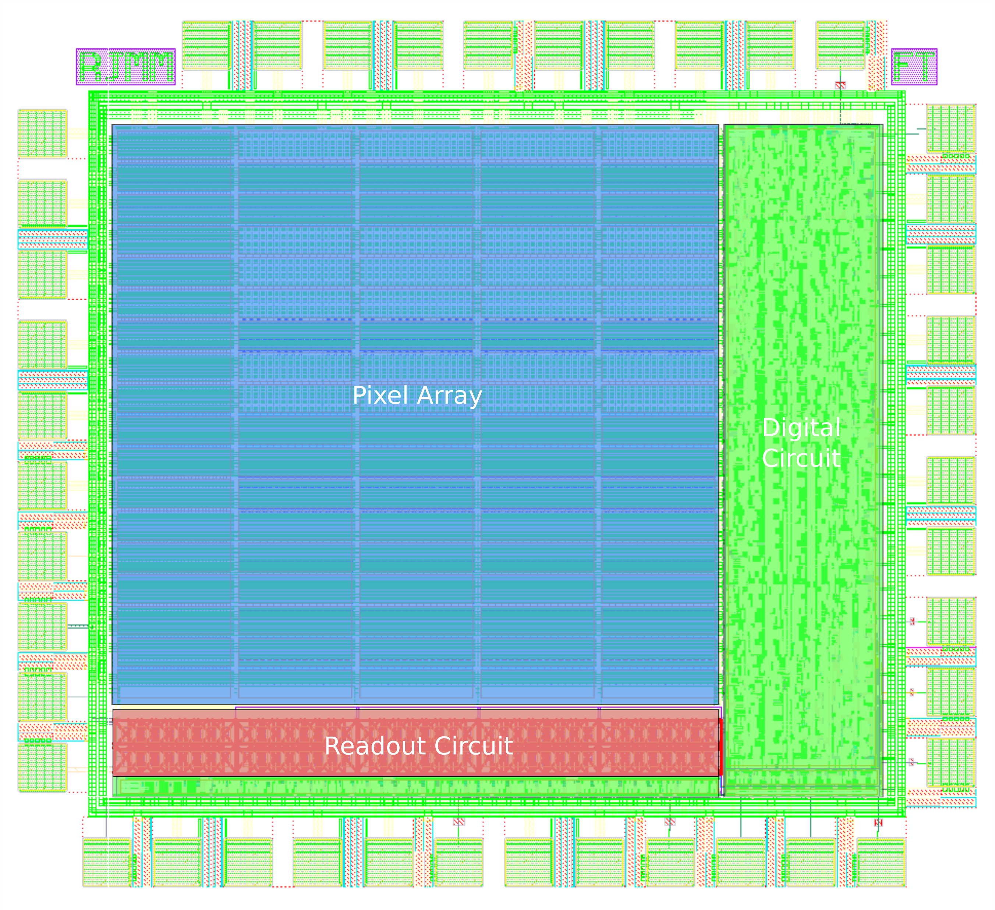
Prototype Status
Taped out a simple image sensor system with multiple test pixels last 21 Aug 2019
Chips arrived last week (9 Dec 2019)

Slide 4
Current work
PCB soldering
  Three types of PCB designs: all are already here, just need to solder components
Finishing test setup
  FPGA programming
  Scripts to automate testing of chip

Slide 5
Future work
Post-processing of chip
  January
Testing of chip
  January to April
Thermal annealing secondment
  April to May
Other irradiations

Slide 6
Future work: Post-processing of Chip
Need to do the following for the chip (January):
  Dicing of dies
  Grinding of dies
    Experiments should be done first since a handle wafer will be used and the goal is too thin
  Passivation of backside
    Needs to passivate backside with AlO2 after grinding

Slide 7
Future work: Testing of Chip
Base testing (without irradiation)
  Starts in January if everything went well in post-processing
  At KU Leuven: Campus Leuven
X-ray irradiation and testing (for TID effects)
  At KU Leuven: Campus Geel

Slide 8
Future work: Secondment
Secondment in Montpellier
  4th week of April to 2nd week of May (3 weeks)
  Effects of thermal annealing
Could use Co60 for TID and then do thermal annealing

Slide 9
Future work: Other irradiations
May onwards
TID effects and displacement effects are the focus for the chip
  Digital cells in the chip are not radiation hardened (SEE)
Two-Laser Photon Absorption equipment in Geel will be used to check SEE in non-digital blocks
Possible tests for displacement damage
  High energy protons: 10-500MeV
  Neutrons: 1-20 MeV

