Slide 1
HTCondor and
HTCondor-CE News
WLCG Grid Deployment Board
January 2021 Meeting
Todd Tannenbaum and Brian Lin
Center for High Throughput Computing
Department of Computer Sciences
University of Wisconsin-Madison

Slide 2
News!
In fall 2020 we were notified by the NSF that our proposal titled “Partnership for Advanced Throughput Computing (PATh)” was fully funded for five years with an annual budget of $4.5M
  “The Partnership to Advance Throughput Computing (PATh) project will expand Distributed High Throughput Computing (dHTC) technologies and methodologies through innovation, translational effort, and large-scale adoption to advance the Science & Engineering goals of the broader community.”
www.nsf.gov/awardsearch/showAward?AWD_ID=2030508

Slide 3

PATh - a powerful partnership
  PATh is a partnership between the UW-Madison Center for High Throughput Computing (CHTC) and the Open Science Grid (OSG) Consortium
  PATh brings together the technology (of HTCondor) and the services (of OSG) under one unified project
  We have funding to implement our roadmap for another 5 years…
  PATh leadership: Brian Bockelman (Co-PI), Miron Livny (PI), Lauren Michael (Co-PI), Todd Tannenbaum (Co-PI), Frank Wuerthwein (Co-PI)
https://path-cc.io/about/

Slide 4
HTCSS
The transition from the "Condor System"
to the "HTCondor Software Suite (HTCSS)"
  Software elements of the HTCSS can be used “stand alone” or “mix and match”
  On-the-fly and hot deployment and upgrades of HTCSS elements
  HTCSS interfaces with “other/external” technologies, execution environments and services
  HTCSS leverages functionality of widely adopted tools

Slide 5
HTCondor Release Series
Stable Series (bug fixes only)
  HTCondor v8.8.x – first introduced Jan 2019
  (Currently at v8.8.12)
Development Series (should be 'new features' series)
  HTCondor v8.9.x (Currently at v8.9.10)
Detailed Version History in the Manual
  https://htcondor.readthedocs.io/en/latest/version-history/

Slide 6

What's new in v8.8 and/or cooking for v8.9 and beyond?

Slide 7
UI and API Enhancements
Working to simplify installation, e.g.
curl –fsSL https://get.htcondor.org | bash
Rethinking of the command-line UI
  condor <noun> <verb>, e.g.
  condor job status instead of condor_q
  condor pool status instead of condor_status
Removed Web Service API in v8.9
Python API and REST API work …

Slide 8
Python
Bring HTC into Python environments incl interactive environments e.g. Jupyter Notebooks
HTCondor Bindings (HTCondor's Python API) has become very popular
Added new Python APIs: DAGMan submission, DAG creation (htcondor.dags), credential management (i.e. Kerberos/Tokens)
Initial integration with Dask
Released our HTMap package
  No HTCondor concepts to learn, just extensions of familiar Python functionality. Inspired by BNL!

Slide 9
htcondor package
import htcondor
# Describe jobs
sub = htcondor.Submit('''
executable = my_program.exe
output = 'run$(ProcId).out'
''')
# Submit jobs
schedd = htcondor.Schedd()
with schedd.transaction() as txn:
clusterid = sub.queue(txn,count = 10)
# Wait for jobs
import time
while len(schedd.query(
constraint='ClusterId=='+str(clusterid),
attr_list=['ProcId'])):
time.sleep(1)

Slide 10
import htmap
# Describe work
def double(x):
return 2 * x
# Do work
doubled = htmap.map(double,range(10))
# Use results!
print(list(doubled))
# [0, 2, 4, 6, 8, 10, 12, 14, 16, 18]
htmap
package
See https://github.com/htcondor/htmap

Slide 11


REST API
Python (Flask) webapp for querying HTCondor jobs, machines, and config
Runs alongside an HTCondor pool
Listens to HTTP queries, responds with JSON
  Built ontop of Python API
  other cool tools coming
  courtesy Python API…
  ….like condor_watch_q !
https://htcondor.readthedocs.io/en/latest/man-pages/condor_watch_q.html

Slide 12



REST API, cont
$ curl "http://localhost:9680/v1/status\
?query=startd\
&projection=cpus,memory\
&constraint=memory>1024"
Client
HTTP GET
JSON
[
{
"name": "slot4@siren.cs.wisc.edu",
"type": "Machine",
"classad": {
"cpus": 1,
"memory": 1813
}
},
…
]
condor_restd
Collector.query()
condor_collector
Notes:
Fetch all execute node slots that have more than 1 gigabyte of RAM….

Slide 13

REST API, cont
Swagger/OpenAPI spec to generate bindings for Java, Go, etc.
Evolving, but see what we've got so far at
  https://github.com/htcondor/htcondor-restd
Potential Future improvements
  Allow changes (job submission/removal, config editing)
  Add auth
  Improve scalability
  Run under shared port
Notes:
Although Python is by far the most popular, not everyone is using Python clients…. More on Friday

Slide 14
Federation of Compute resources:
HTCondor Annexes

Slide 15
HTCondor "Annex"
Instantiate an HTCondor Annex to dynamically add additional execute slots into your HTCondor environment
Want to enable end-users to provision an Annex on
  Clouds
  HPC Centers / Supercomputers
    Via edge services (i.e. HTCondor-CE)
  Kubernetes clusters
Notes:
Learn more about work on all three of these fronts on Thursday

Slide 16
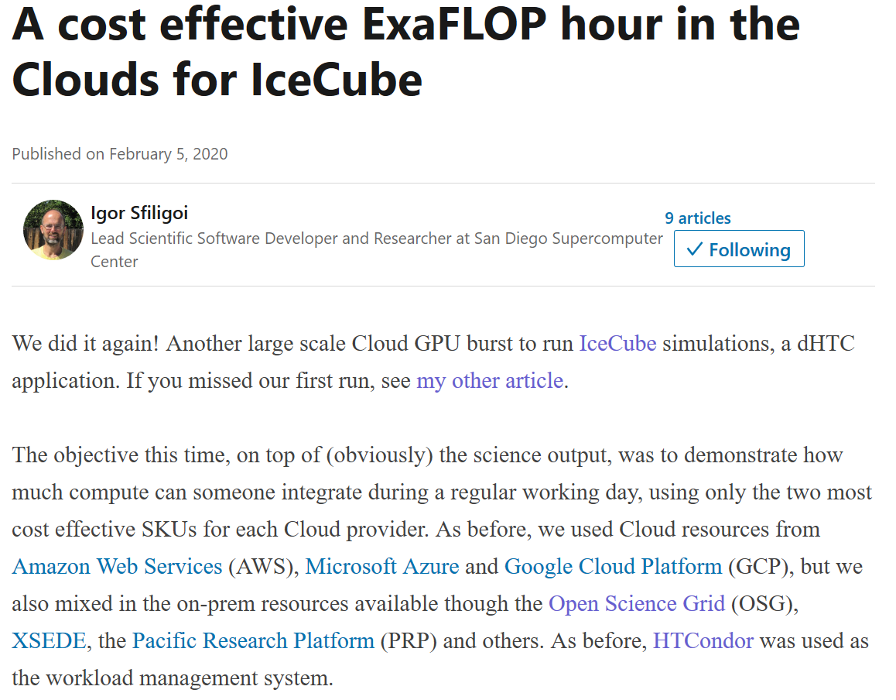
https://www.linkedin.com/pulse/cost-effective-exaflop-hour-clouds-icecube-igor-sfiligoi/

Slide 17


No internet access to/from HPC nodes?
File-based communication between execute nodes
JobXXX
condor_starter
condor_starter'
request
status.1
status.2
status.3
input
input
output
input
output
output
Read more about our current approach at http://tiny.cc/f158cz
Notes:
A major challenge of HPC sites is network connectivity… Learn more on Thursday!

Slide 18
Containers and Kubernetes

Slide 19

HTCondor Singularity Integration
What is Singularity?
Like Docker but…
  No root owned daemon process, just a setuid
  No setuid required (as of very latest RHEL7)
  Easy access to host resources incl GPU, network, file systems
HTCondor allows admin to define a policy (with access to job and machine attributes) to control
  Singularity image to use
  Volume (bind) mounts
  Location where HTCondor transfers files

Slide 20
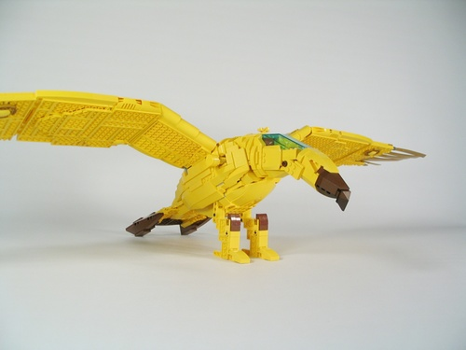
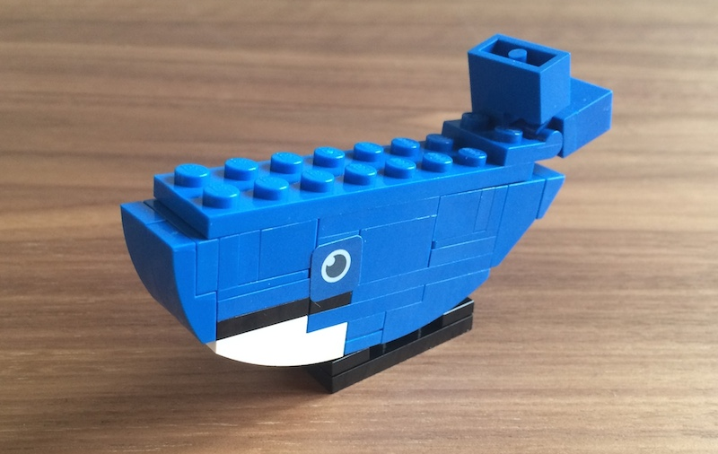
Docker Job Enhancements
Docker jobs get usage updates (i.e. network usage) reported in job classad
Admin can add additional volumes
Conditionally drop capabilities
Condor Chirp support
Support for condor_ssh_to_job
  For both Docker and Singularity
Soft-kill (SIGTERM) of Docker jobs upon removal, preemption

Slide 21
More work coming
From "Docker Universe" to just jobs with a container image specified
Kubernetes
  Package HTCondor as a set of container images
    Check it out https://github.com/htcondor/htcondor/blob/master/build/docker/services/README.md
  Launch a pool in a Kubernetes cluster
  HTCondor-CE provision resources from a Kubernetes cluster (ie submit pilot pods)

Slide 22
GPUs
HTCondor has long been able to detect GPU devices and schedule GPU jobs (CUDA/OpenCL)
New in v8.8:
  Monitor/report job GPU processor utilization
  Monitor/report job GPU memory utilization
In the works: simultaneously run multiple jobs on one GPU device
  Specify GPU memory for scheduling ?
  NVIDIA Multi-Instance GPU (MIG) for partitioning ?
  Working with LIGO on requirements

Slide 23
Scheduling Enhancements

Slide 24
2 kinds of scheduling today:
Submitters (users)
"Fair Share"
Keeps historical usage
Proportional priority
No ceiling
Ordered by priority, always!
Groups
Quotas with max
Hierarchy of groups share quota
No historical usage
Starvation order
  But configurable!

Slide 25
Nikhef had some questions…
How do we meet SLAs with communities?
We've got monthly guarantees?
How about a classical physics model?
  "Power" vs "Work"
  (i.e. percentage of cluster vs annual allocation)

Slide 26
Work in Progress:
Merge Groups & submitters
Hierarchy of groups ending in individual submitters
Each group can have
  History (optional)
  Maximum
  Minimum
  Configurable ordering
And knobs to allow existing system, if you like it
Submitters (users)
"Fair Share"
Keeps historical usage
Proportional priority
No ceiling
Ordered by priority, always!
Groups
Quotas with max
Hierarchy of groups share quota
No historical usage
Starvation order
  But configurable!

Slide 27
Security Enhancements
Modernize ciphers support
  No more MD5
  AES encryption (hardware assisted)
Tokens, tokens, tokens!

Slide 28
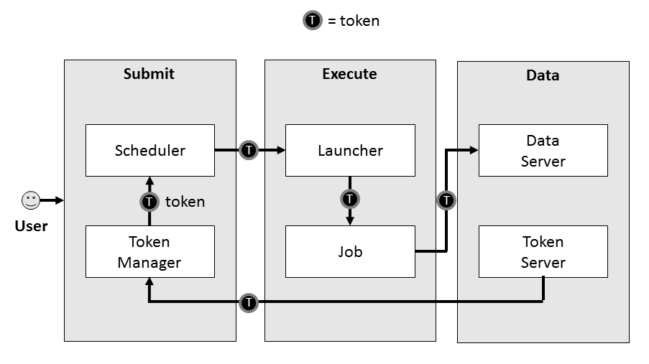

SciTokens: From identity certs to authorization tokens
HTCondor has long supported GSI certs
Then added Kerberos/AFS tokens w/ CERN, DESY
Now adding standardized token support
  SciTokens (http://scitokens.org) for HTCondor-CE, data
  OAuth 2.0 Workflow → Box, Google Drive, AWS S3, …

Slide 29
IDTOKENS
Authentication Method
Several Authentication Methods
  File system (FS), SSL, pool password….
Adding a new "IDTOKENS" method
  Administrator can run a command-line tool to create a token to authenticate a new submit node or execute node
  Users can run a command-line tool to create a token to authenticate as themselves for job submission

Slide 30

… and this is a good time to transition to news about the HTCondor-CE!
@HTCondor
https://twitter.com/HTCondor

