Slide 1

What’s Next for the HTCondor-CE?
WLCG GDB: 13 January 2021
Brian Lin and Todd Tannenbaum
University of Wisconsin–Madison

Slide 2
Impending changes: Tokens, Python 3, and EL 8
Python 3 and Enterprise Linux 8 support expected in a release this month
SciTokens/WLCG Tokens
  SciTokens are already supported with HTCondor-CE 4 and HTCondor 8.9.5+!
  GSI is still supported but SciTokens/WLCG Tokens is preferred
  Demonstrated token-based job submission with GlideinWMS and Harvester
  HTCondor-CE configuration and troubleshooting documentation to come

Slide 3
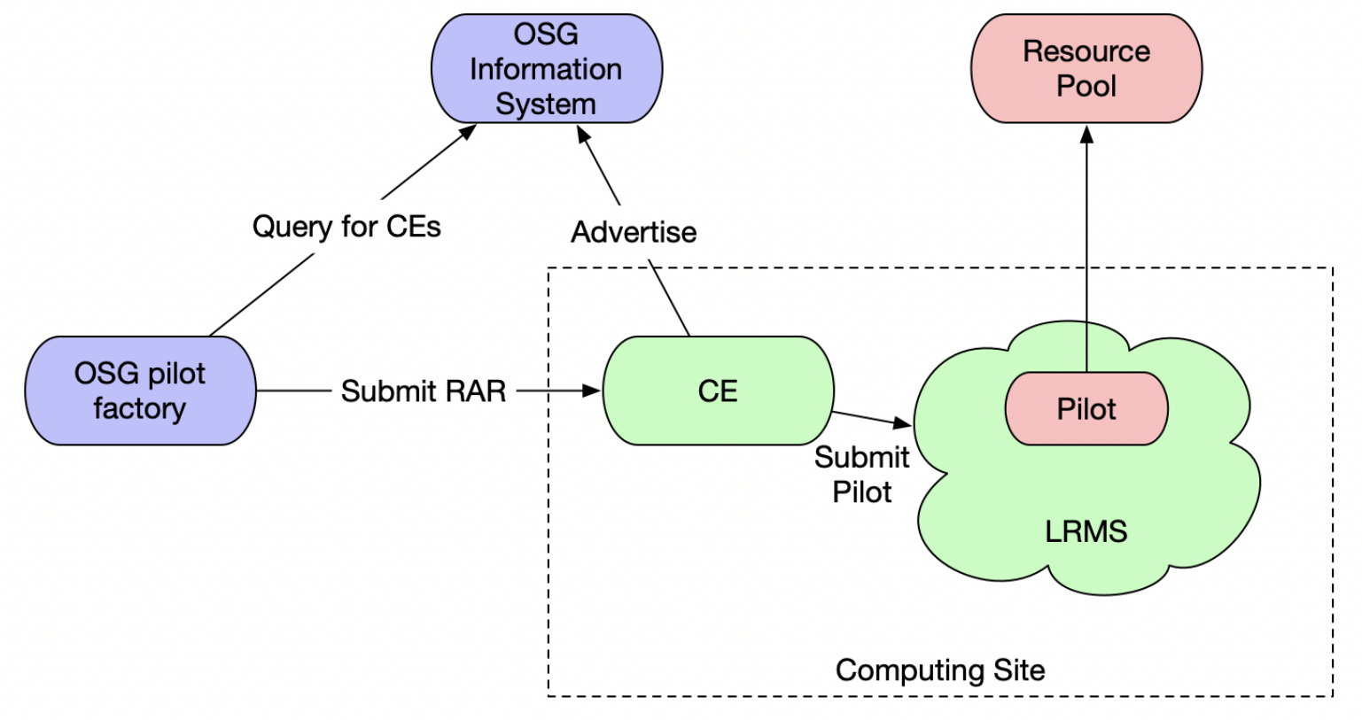
Today’s Grid Trust Model

Slide 4
Today’s Grid Trust Model
Host cert and CA certificates
Host cert and CA certificates
Host cert and CA certificates
GSI Proxy

Slide 5
Today’s Grid Trust Model
DNS records
Host cert and CA certificates
Host cert and CA certificates
DNS records
Host cert and CA certificates
DNS records
GSI Proxy

Slide 6
Today’s Grid Trust Model
DNS records
Host cert and CA certificates
Host cert and CA certificates
DNS records
Host cert and CA certificates
DNS records
VO client
GSI Proxy

Slide 7
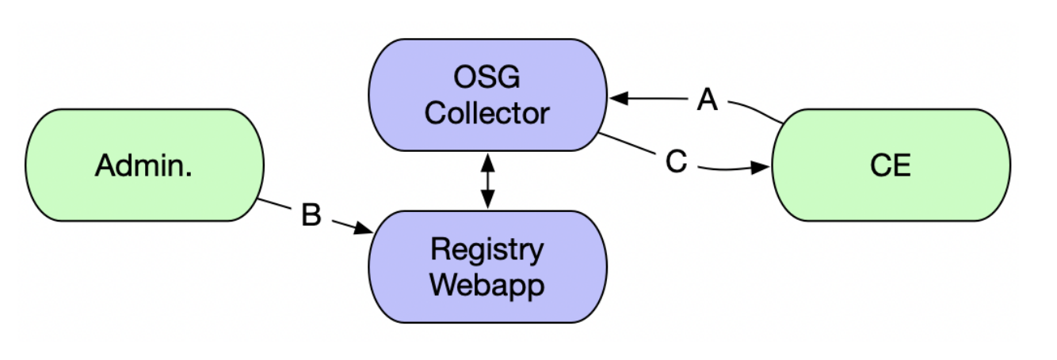
Re-imagining Grid Trust: HTCondor-CE Registry
Establishing trust without host or CA certificates (or even a public IP!):
0. Admin registers new CE in a grid service + contact database (approved by grid operators)
A. Admin runs command from the CE to start registration flow, gets Registry URL
B. Admin visits Registry URL to validate the registration; HTCondor-CE Registry verifies admin identity and cross-checks identity + request with database in 0.
C. Upon validation, the HTCondor-CE Central Collector issues an IDTOKEN for the HTCondor-CE

Slide 8
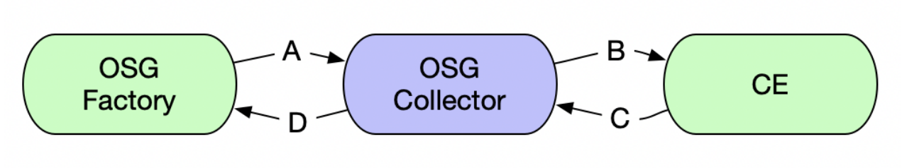
Re-imagining Grid Trust: HTCondor-CE Registry
Using the HTCondor-CE Central Collector as a trusted intermediary, a pilot job factory will exchange a VO SciToken/WLCG Token with the CE (A. + B.) receiving an IDTOKEN in response (C. + D.)
Resultant IDTOKEN is narrowly scoped to job submission from this factory on behalf of the original VO to this CE!

Slide 9
Re-imagining Grid Trust: HTCondor-CE Registry
DNS Records
Host Cert
VO Token issuer data
Using the HTCondor-CE Central Collector as a trusted intermediary, a pilot job factory will exchange a VO SciToken/WLCG Token with the CE (A. + B.) receiving an IDTOKEN in response (C. + D.)
Resultant IDTOKEN is narrowly scoped to job submission from this factory on behalf of the original VO to this CE!

Slide 10
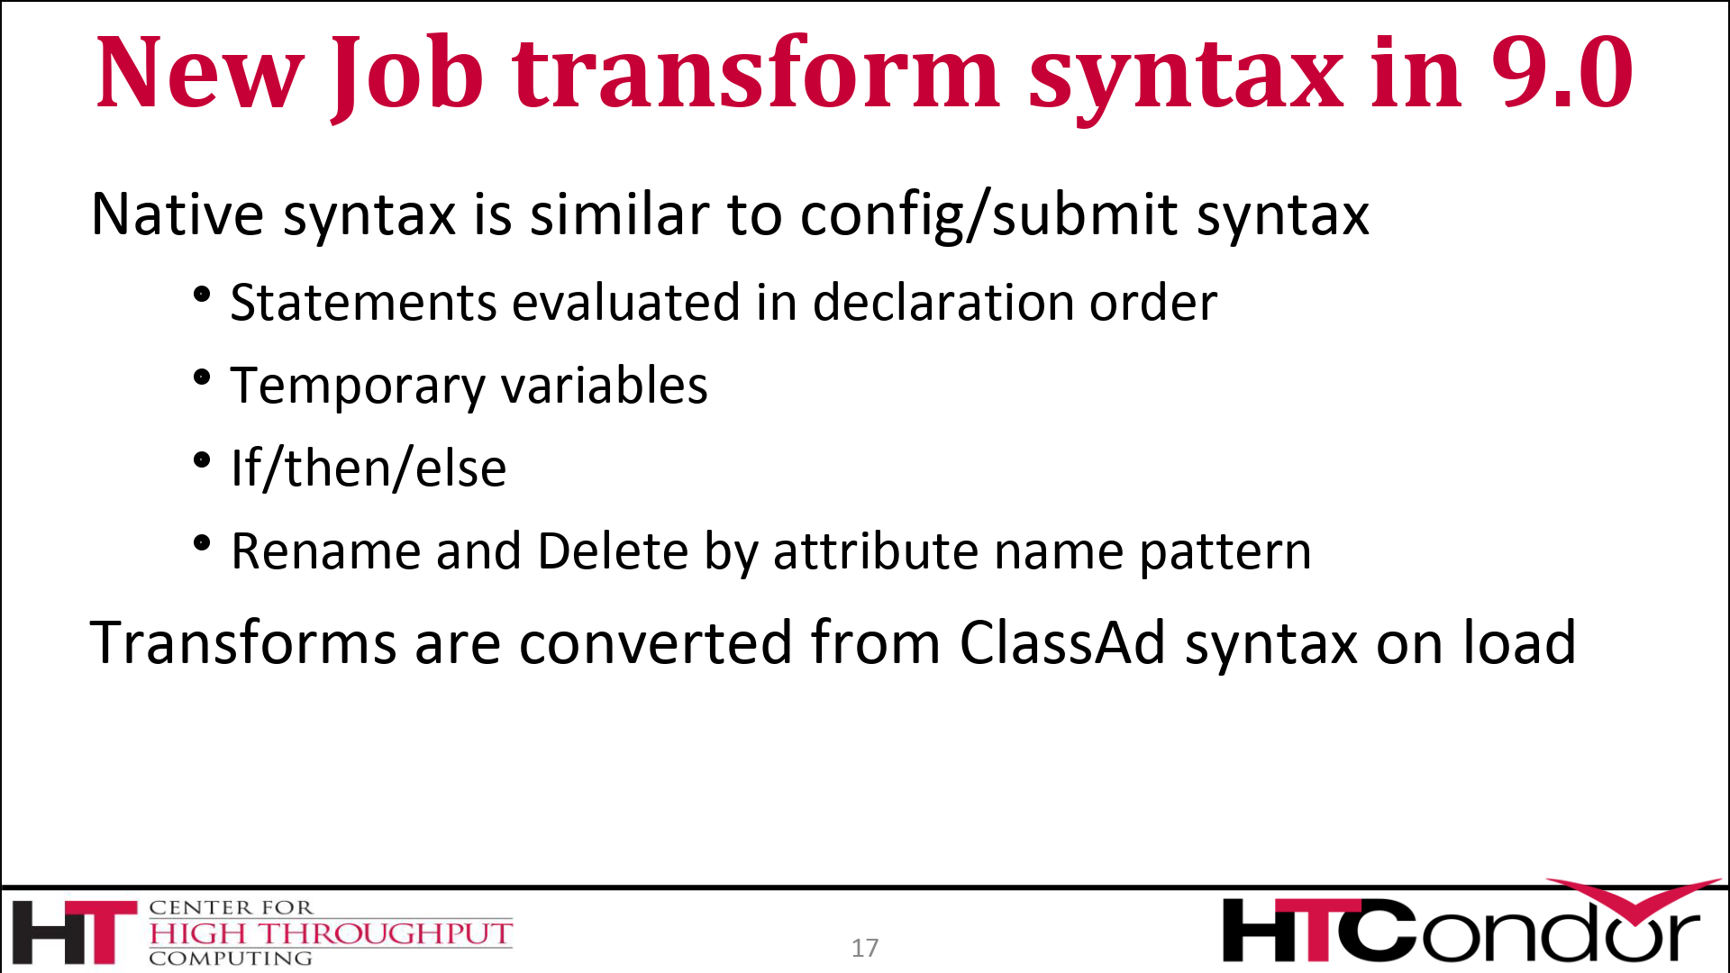
Improved Job Router Configuration Syntax
HTCondor-CE uses the old job transform style for Job Router configuration
Old-style evaluation order of ClassAd verbs is limiting and confusing!
HTCondor-CE will use the new style transform available in HTCondor 9.0
New style transforms have many more features (see TJ’s talk yesterday)!

