Slide 1
EOSC Future: Platform and Portal concept
GDB
Matthew Viljoen (thanks to Owen Appleton for slides)

Slide 2
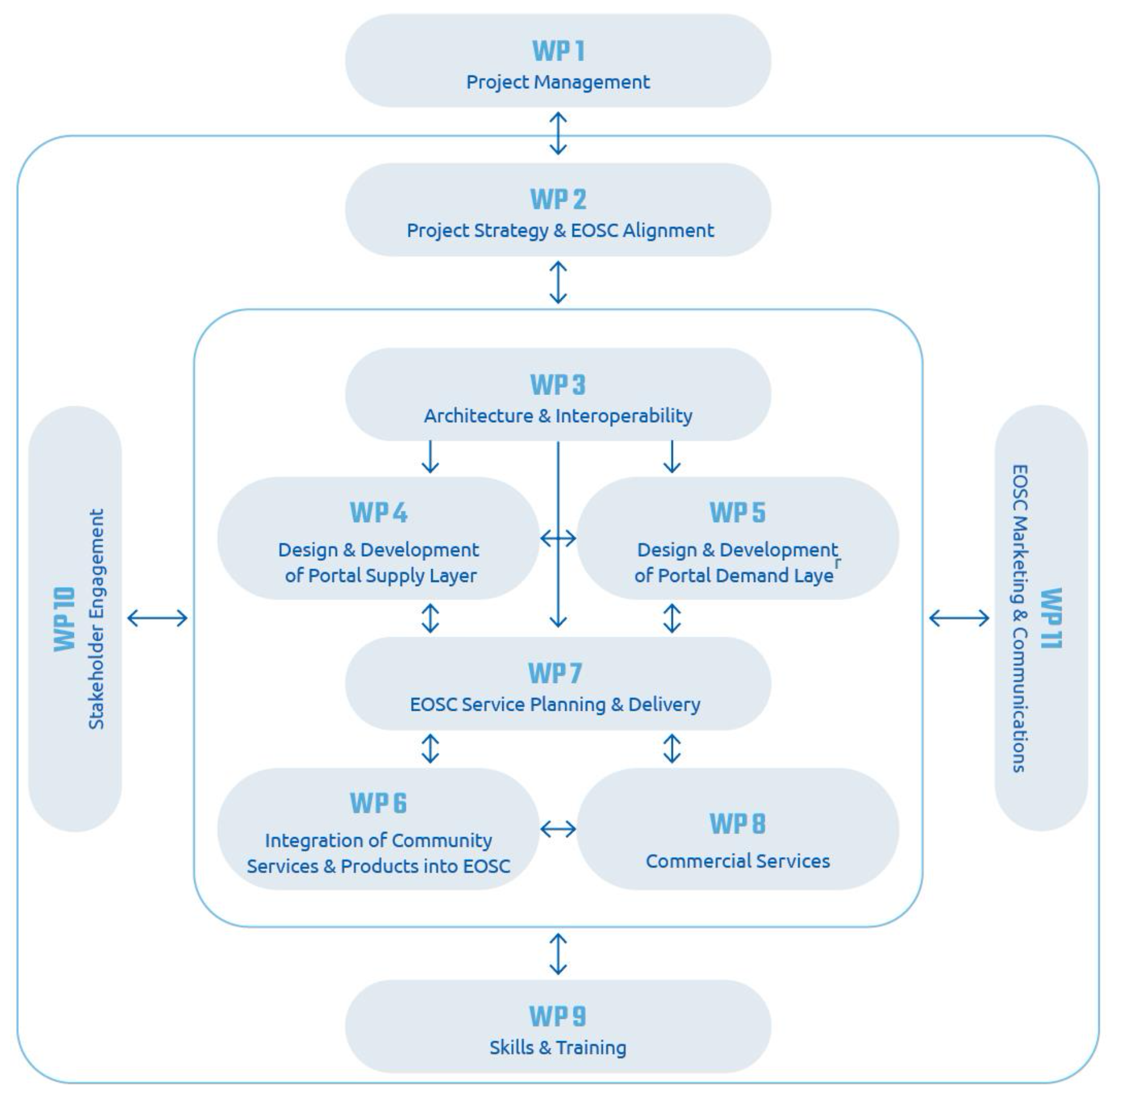
Project Activities

Slide 3
EOSC Resources
EOSC Resources
Services
Combine human activities (operations, support etc) with Research products (software, data, documentation etc)
Operational, active, delivered, managed
Research Products
Digital objects. Contain value which is realised through their examination, processing, combination or other use.
Object, storeable, FAIR
Data processing
Storage & archiving
Thematic environment
...
Content source
Data sets
Software
Publications
FDOs
...
Data source
Software repo
Publisher repo
....

Slide 4

Provider view: The old idea
Researcher / Research Group /
Research Performing Organisation
EOSC is not just a listing of services on a website
Portal = EOSC
EOSC Portal
Resource
Resource
Resource
Resource

Slide 5
Researcher view: different benefits
Organised Community (WLCG, …)
Community (HEP)
New and Emerging communities
Researcher
Researcher
Researcher
Researcher
Researcher
Researcher
Researcher
Researcher
Researcher
Researcher
Researcher
Researcher
Researcher
Researcher
Researcher
Researcher
Community consensus tools, portals, workflows and resources.
Offer discovery of a comprehensive set of resources + experiments in resource composability
Offer a space to for emerging research communities.
Access portals, tools and workflows from other communities a researcher is a member of - e.g. national
Community Platform
Community Platform
EOSC Portal
Tools
Workflows
Community Portal
Tools
Workflows
APIs
APIs
Comprehensive Resource Catalogue
EOSC Core Platform
Integrate:
-Resources from EOSC, making them available to community members: services, data, other research products
- Core services to add extra basic functionalities to community platforms
Composite resources
Thematic Provider A
Thematic Provider B

Slide 6
Provider view: Platform level integration
Researcher / Research Group /
Research Performing Organisation
Researcher / Research Group /
Research Performing Organisation
EOSC Platforms allow for Integration with EOSC Core services
Community Platform
EOSC Portal
Tools
Workflows
Community Portal
Tools
Workflows
APIs
APIs
Marketplace
Resource Catalogue
EOSC Core Platform
Resource Catalogue
Monitoring & Accounting
Ordering
Helpdesk
AAI Fed registry
…
AAI
federation
Resource records
Provider portal
Platform integration

Slide 7
Key messages
EOSC Core platform offers value to research communities in different ways
  Enrich community platforms (in the background) with additional resources from EOSC Exchange and functions from EOSC-Core
  Connect community platforms and foster their greater coherency and increased value
  Offer a comprehensive view of EOSC resources that is also an ‘enterprise bus’ for EOSC catalogues
  Provide a space for experiments in composability and added value services
  Provide a space for emerging / long tail / orphan communities
EOSC portal is one view on the EOSC Core platform and entries in the EOSC Exchange
  Web based view
  Also API based access to Core Platform from tools, workflows etc
The view of EOSC as a set of platforms forming a system of systems is better supported by communities

