Slide 1


Multi-factor Authentication for the IAM
Sam Glendenning
STFC

Slide 2
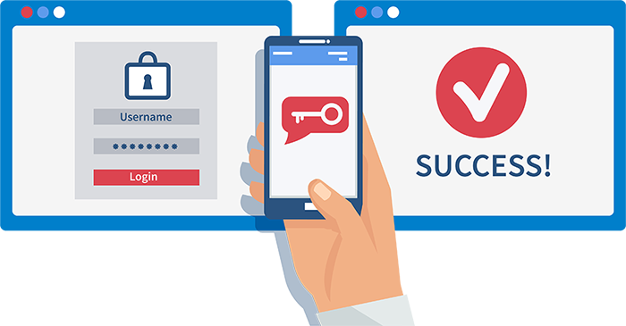
What is MFA?
Providing an additional login factor to verify your identity
One-time usage passcode or hyperlink
Why so important?
Login credentials alone may not be enough for account security
The IAM protects:
  Sensitive accounts
  Important online infrastructure
  Sensitive research data

Slide 3
Objectives for MFA in the IAM
Easily enabled on any new or existing IAM instantiation
Customisable by an IAM admin based on wants and needs
Safe and secure
Adoptable by everyone

Slide 4
Workflow
Individual users may decide whether or not they want MFA to be enabled on their account
However, an IAM administrator may enforce MFA on all of their user accounts if they wish
Once implemented, users will enable MFA in their account settings
They can then control their MFA settings through their account settings page

Slide 5
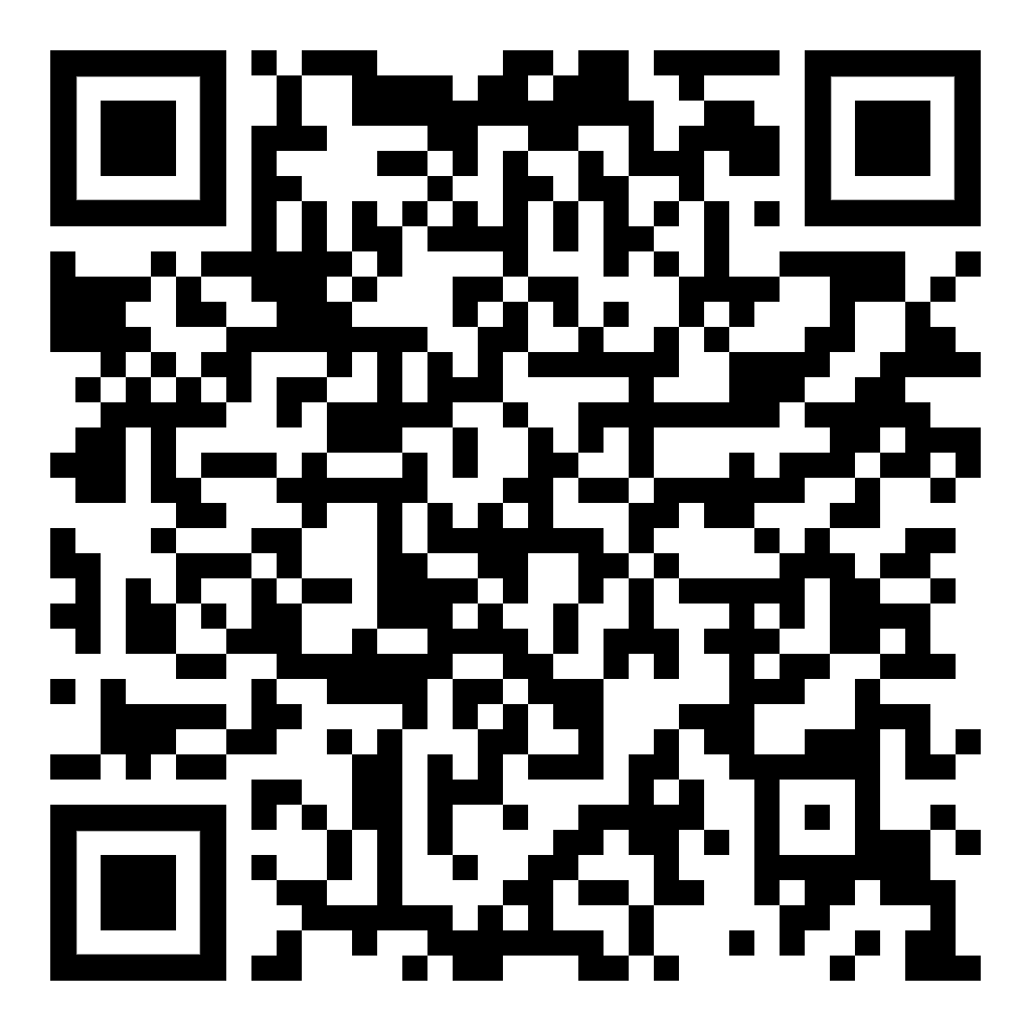



Multi-factor secret key
MFA will initially be available through the use of an authenticator app for mobile devices
Examples include Google Authenticator, Microsoft Authenticator, Authy, etc.
These apps allow for a QR code containing an MFA secret (plus additional account details) to be scanned and imported through the device’s camera (alternatively, the user can manually enter this information)
This secret can then be used by the app to generate time-based one-time passwords every 30 seconds
The IAM also possesses this secret so both the user’s app and IAM generate the same passwords at the same time
Thus, this can be used for verification of the user

Slide 6
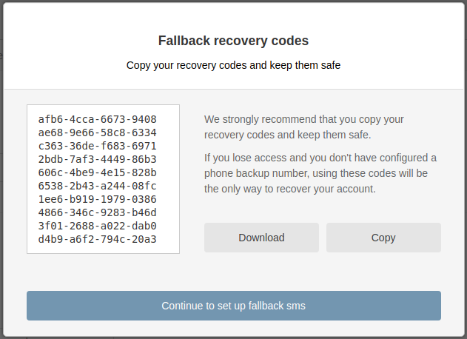
Recovery codes
To prevent account lockout in the event of the user losing access to their mobile device, emergency scratch codes are generated for the user’s account
These are single-use passwords used in conjunction with the main account password to restore access
They are regenerated when used and can be regenerated whenever the user wishes
Scratch codes can be viewed at any time in the account settings

Slide 7
Information Security
Multi-factor secrets and emergency scratch codes are stored in a secure database
All sensitive information is hashed and/or encrypted to a high standard
Users have control over their multi-factor settings
Can enable/disable MFA as they please (if their federation allows it)
Can regenerate scratch codes at their leisure
Accounts will be locked after a number of failed attempts
Step up authentication - prompt for another one-time passcode if performing certain actions

Slide 8
Current progress
I am the primary developer implementing multi-factor authentication to the IAM.
Main work so far is a basic prototype of a user login system using multi-factor authentication and scratch codes
Java
Spring Boot framework (highly customisable and flexible)
Entirely localised authentication (no need for external APIs for code verification or QR code generation)
MFA using a soft token through an authenticator app
Accounts can choose to enable or disable MFA
This can then be implemented into the IAM codebase

Slide 9
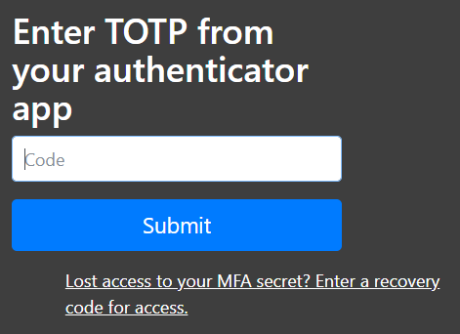
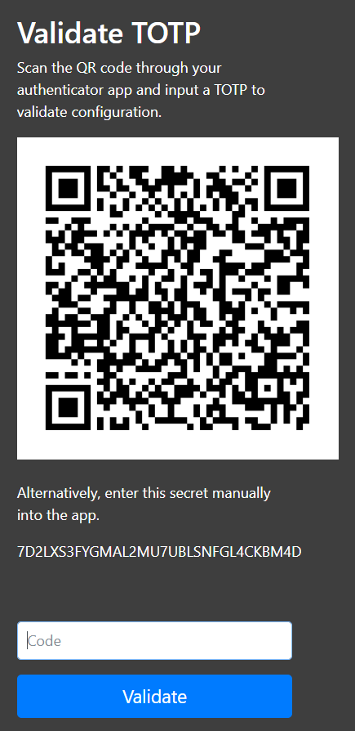
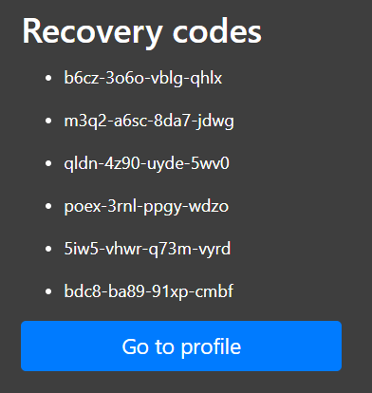

Slide 10
Targets (not necessarily in this order)
Implement prototype work into IAM codebase
Solution needs to be flexible to allow:
  Expansion of supported factors of authentication (email, YubiKey, WebAuthn, etc.)
  Individual identity providers to customise their MFA setup (if they choose to enable MFA at all)
Analyse solution for security flaws and carry out risk assessments
Document and test
Communicate with end users to gather thoughts and feedback
Release in a few months

Slide 11
Questions?
Facebook: Science and Technology Facilities Council
Twitter:@STFC_matters
YouTube: Science and Technology Facilities Council

