Slide 1



Analysis of measurements from the LHC Vacuum Pilot Sector (VPS)
Elena Buratin
CERN Supervisor,
Dr. Vincent Baglin
EPFL Supervisor,
Prof. Ambrogio Fasoli
Electron Cloud Meeting #73, January 24th 2020

Slide 2
OUTLINE
1. Introduction
2. EC and pressure as a function of beam parameters and surface status:
number of bunches
bunch population
accumulated electron dose
bunch length
3. EC energy spectrum
4. EC along LHC fills: comparison of filling schemes
5. EC along during 2 years
6. Conclusions
Elena Buratin

Slide 3
1. Introduction
Elena Buratin

Slide 4
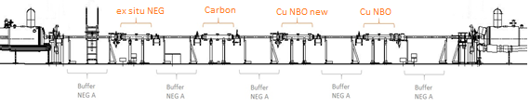
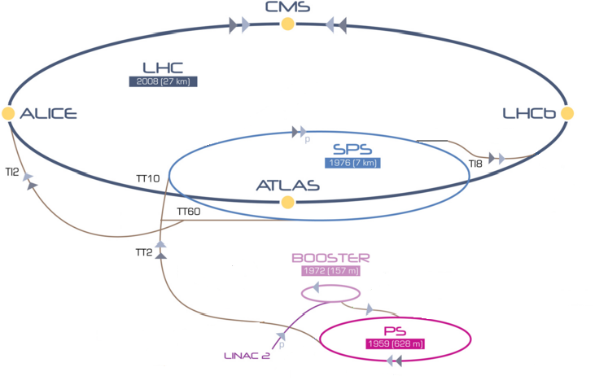

“Vacuum Pilot Sector” (VPS)
80 mm diameter beam pipe
At room temperature
In a straight section of LHC (point 8)
No magnetic field
4 stations (baked at 80⁰C) separated by Activated NEG buffers:
  Ex situ NEG: $1.5−2 μm$ thickness,
  Activated in the lab, vented, installed in the LHC (2016)
  Amorphous carbon coated: $400−600 nm$ thickness (2016)
  OFE unbaked copper (2016)
  OFE unbaked copper (2014)
Q5
Q4
18 meters
Elena Buratin

Slide 5
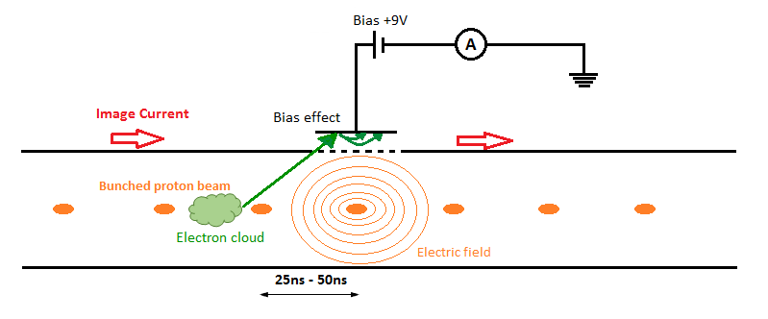
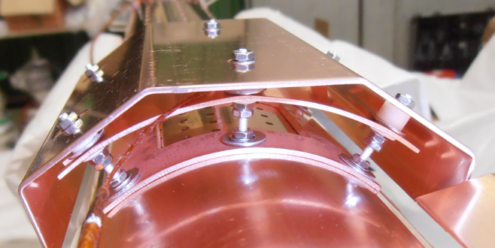
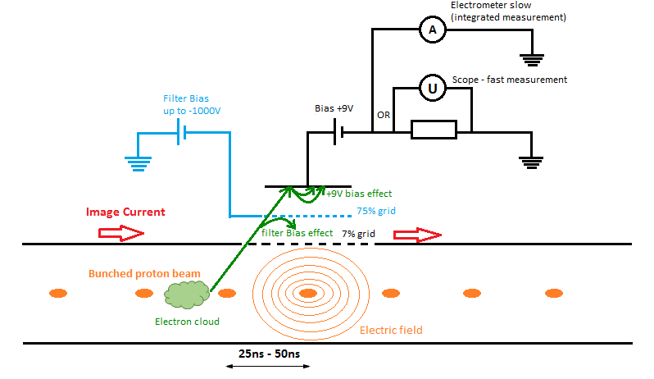
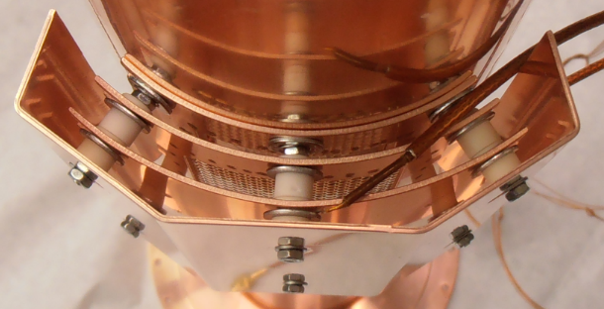
VPS instruments
Shielded pick-ups are used to acquire, by an oscilloscope and a picoammeter, the EC signals
  grid: 7% transparency
  polarised electrode: +9V
  top position
Electron energy spectrum: analyser of the energy spectrum of the electrons (Station 4, copper)
Bayard-Alpert gauges and Penning gauges (total pressure)
Elena Buratin

Slide 6
2. EC and pressure as a function of
beam parameters and surface status
data partially presented at AIV 2019
(paper to be published)
Elena Buratin

Slide 7

  2.1 Electrical signal of EC as a function of:
          Number of bunches ($N_{b}$)
          Number of protons per bunch ($ppb$)
          Accumulated electron dose ($D$) during the scrubbing run
          Bunch length ($σ$)
Elena Buratin

Slide 8

LHC schedule
EC = function (Nb, ppb, accumulated dose, σ)
Fills 5979 (25 ns) and 5980 (50 ns)
Elena Buratin

Slide 9
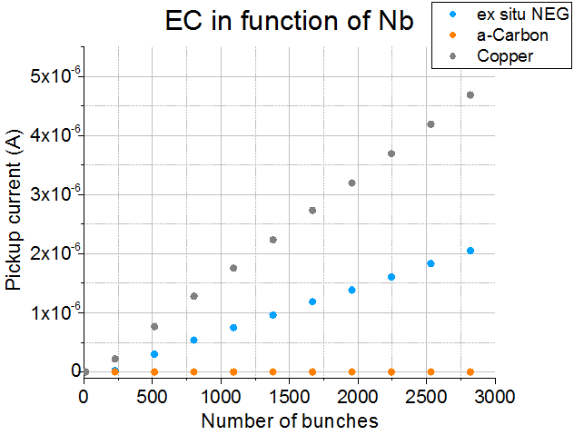
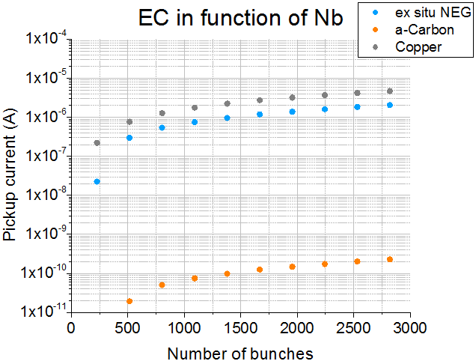
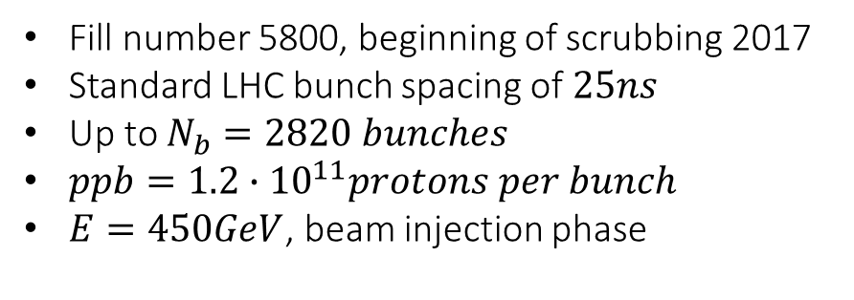
    Number of bunches ($N_{b}$)
Fill number 5800, beginning of scrubbing 2017
Standard LHC bunch spacing of $25ns$
Up to $N_{b}=2820 bunches$
$ppb=1.2∙{10}^{11}protons per bunch$
$E=450GeV$, beam injection phase
Linear scale
Log scale
Elena Buratin

Slide 10
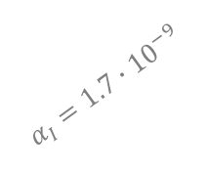

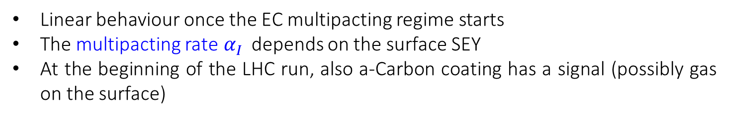
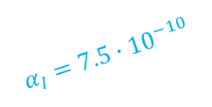
    Number of bunches ($N_{b}$)
Linear behaviour once the EC multipacting regime starts
The multipacting rate$α_{I}$ depends on the surface SEY
At the beginning of the LHC run, also a-Carbon coating has a signal (possibly gas on the surface)
$$I_{EC}=α_{I}∙N_{b}+β_{I}$$
Linear scale
Log scale
increasing SEY
increasing SEY
$$α_{I}=1.7∙{10}^{−9}$$
$$α_{I}=7.5∙{10}^{−10}$$
Elena Buratin

Slide 11
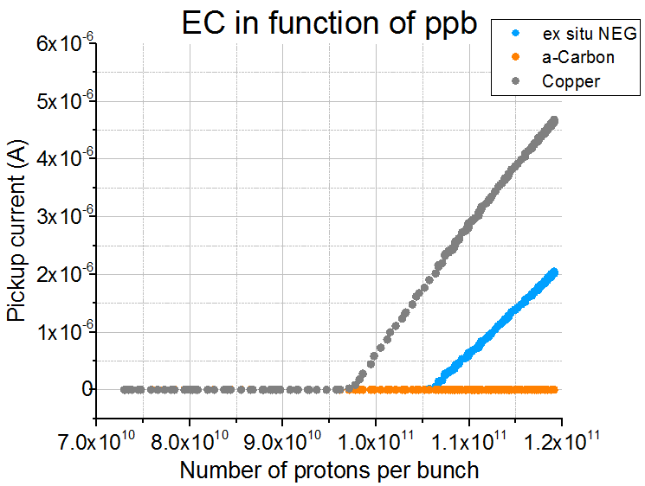
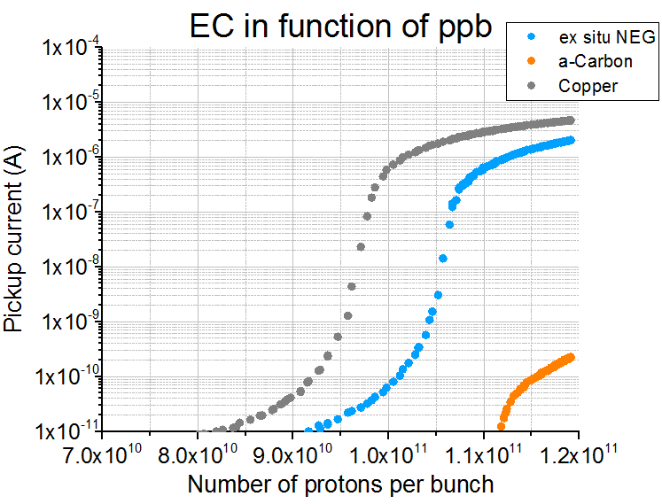
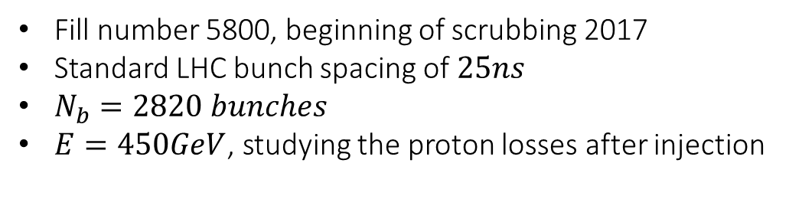
    Number of protons per bunch ($ppb$)
Fill number 5800, beginning of scrubbing 2017
Standard LHC bunch spacing of $25ns$
$N_{b}=2820 bunches$
$E=450GeV$, studying the proton losses after injection
Linear scale
Log scale
Elena Buratin

Slide 12







    Number of protons per bunch ($ppb$)
The surface SEY defines the slope $γ_{I}$of the EC multipacting:
And the threshold $t_{I}$:
At the beginning of the LHC run, also a-Carbon coating has a signal (possibly gas on the surface)
$$I_{EC}=γ_{I}∙ppb+ε_{I}$$
$$I_{EC}=γ_{I}∙ppb+ε_{I}=0$$
$$th_{I}\left[ppb\right]=−ε_{I}/γ_{I}$$
Linear scale
Log scale
increasing SEY
increasing SEY
Multipacting
regime
$${th}_{1}$$
$${th}_{2}$$
$${th}_{3}$$
First
seeds
Elena Buratin

Slide 13
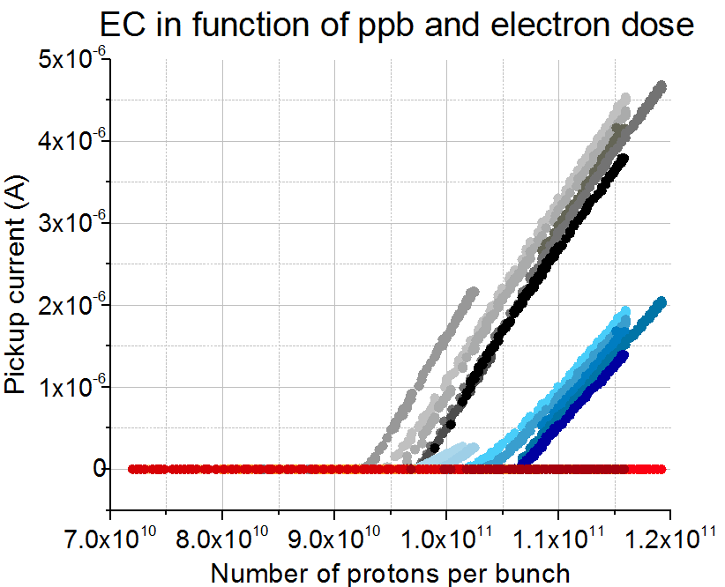
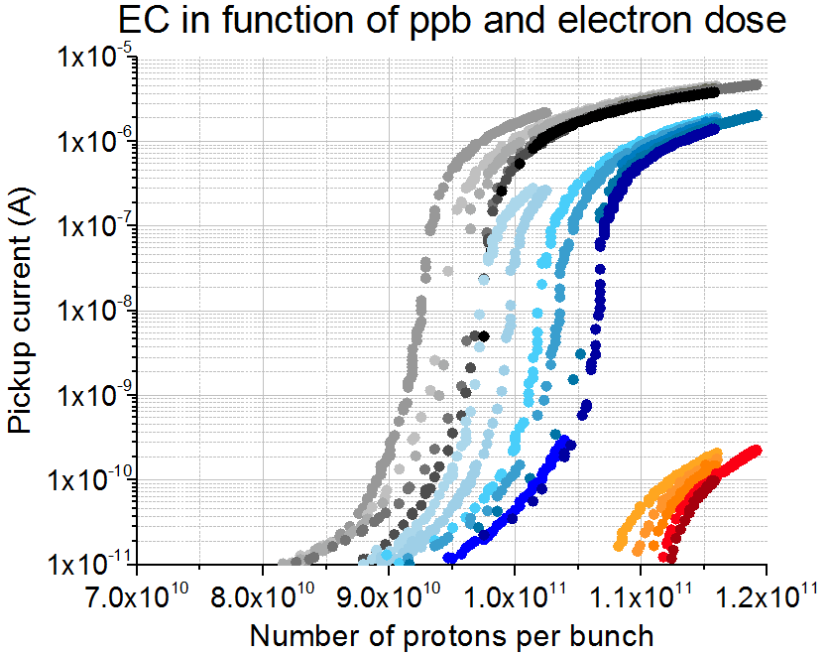
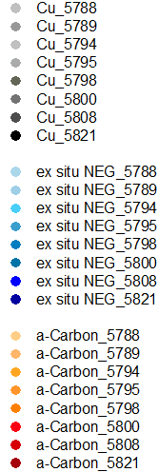

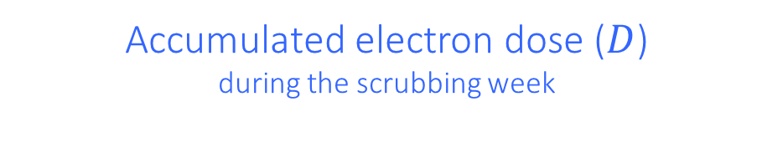
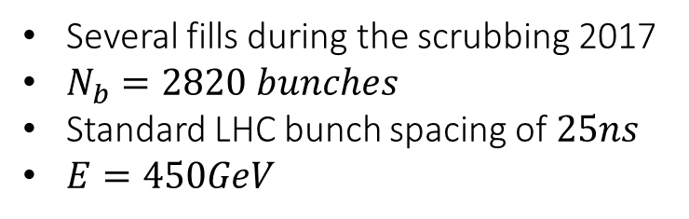
          Accumulated electron dose ($D$)
          during the scrubbing week
Several fills during the scrubbing 2017
$N_{b}=2820 bunches$
Standard LHC bunch spacing of $25ns$
$E=450GeV$
With the dose, the thresholds increase
Linear scale
Log scale
Dose
Dose
Elena Buratin

Slide 14
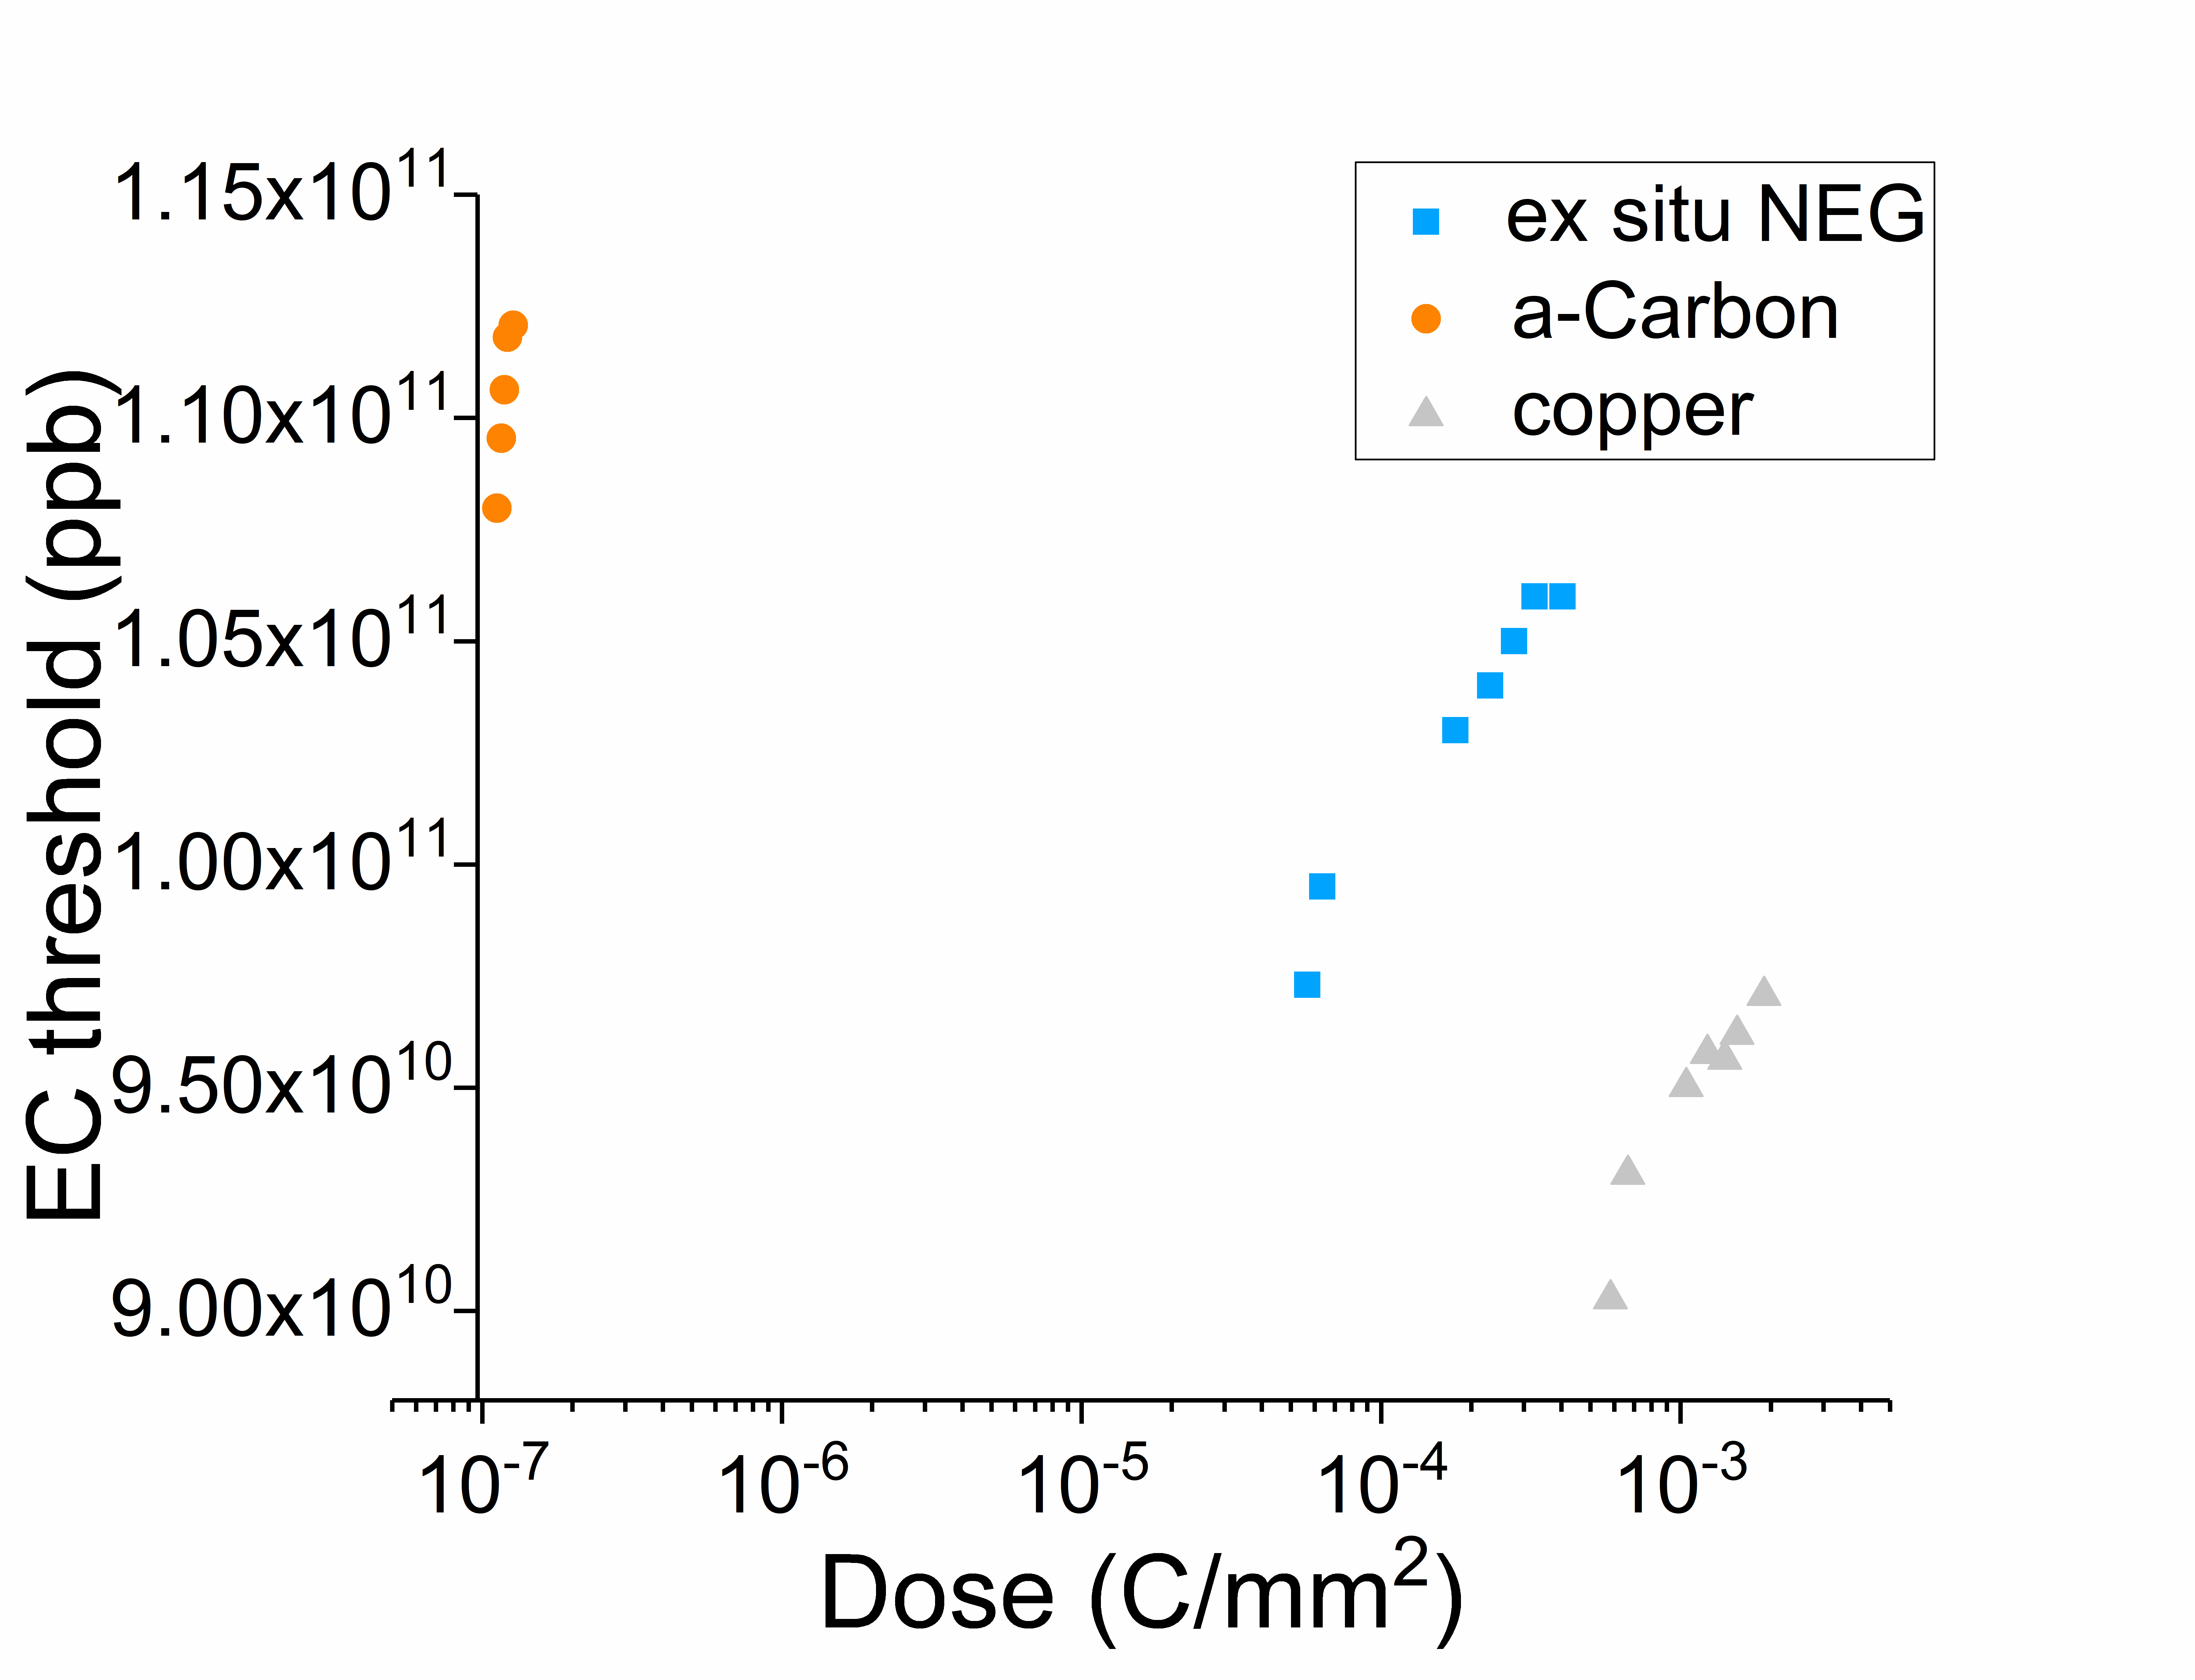
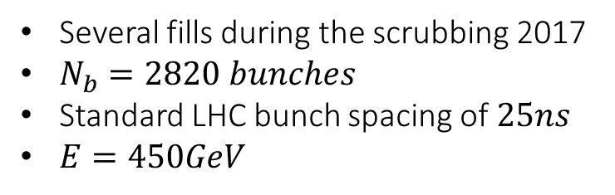

          Threshold evolution with
          accumulated electron dose ($D$)
          during the scrubbing week
Several fills during the scrubbing 2017
$N_{b}=2820 bunches$
Standard LHC bunch spacing of $25ns$
$E=450GeV$
With the dose, the thresholds increase
Log scale
Elena Buratin

Slide 15
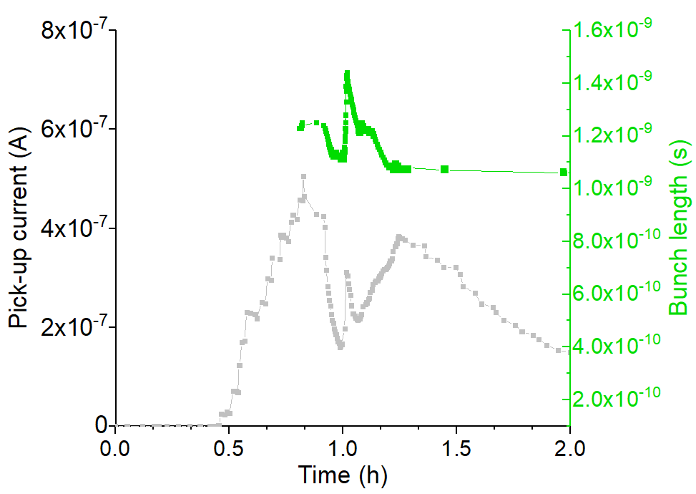
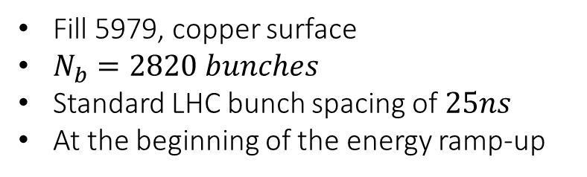
          Bunch length ($σ$)
Fill 5979, copper surface
$N_{b}=2820 bunches$
Standard LHC bunch spacing of $25ns$
At the beginning of the energy ramp-up
Presented in ECLOUD’18
Elena Buratin

Slide 16
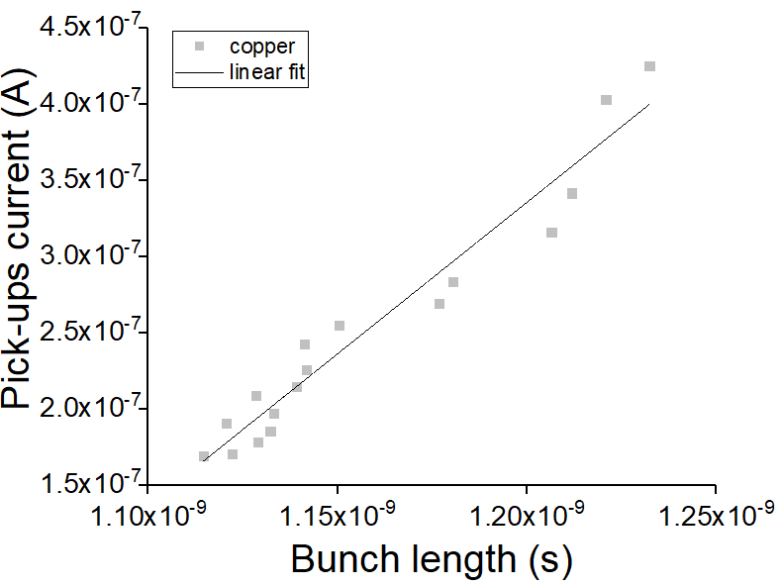
          Bunch length ($σ$)
Fill 5979, copper surface
$N_{b}=2820 bunches$
Standard LHC bunch spacing of $25ns$
At the beginning of the energy ramp-up
Linear scale
Presented in ECLOUD’18
Linear behaviour
Elena Buratin

Slide 17
  2.2 Pressure behaviour
Elena Buratin

Slide 18
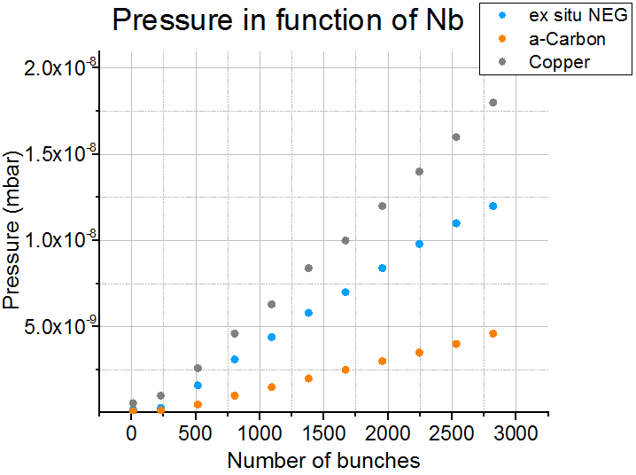
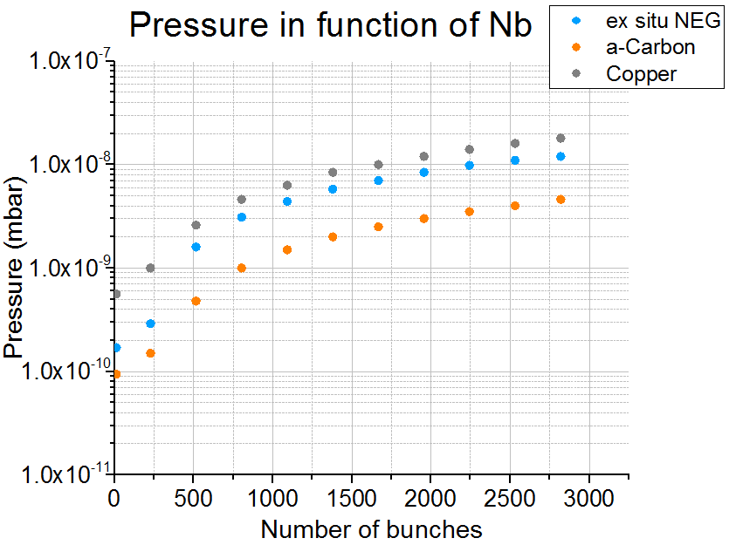
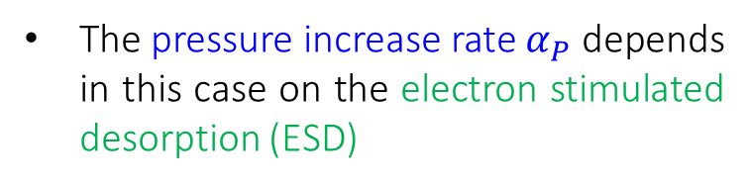

    Number of bunches ($N_{b}$)
Linear behaviour once the EC multipacting regime starts
The pressure in the a-C station is affected by the gas transmitted from the nearby stations!
The pressure increase rate $α_{P}$ depends in this case on the electron stimulated desorption (ESD)
$$P_{EC}=α_{P}∙N_{b}+β_{P}$$
Linear scale
Log scale
Elena Buratin

Slide 19
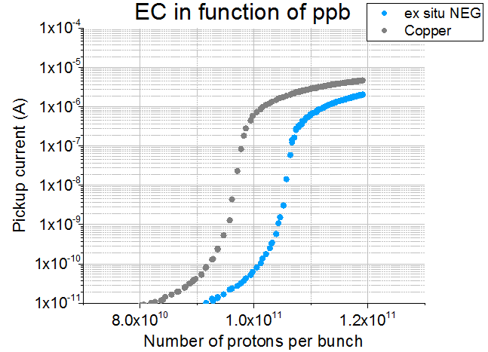
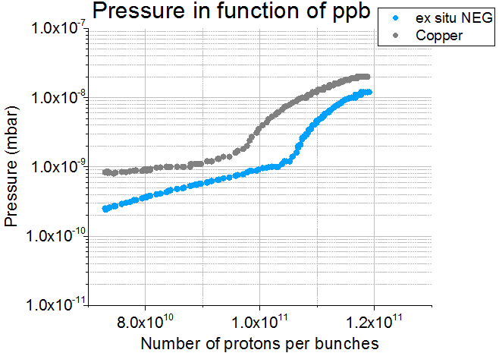




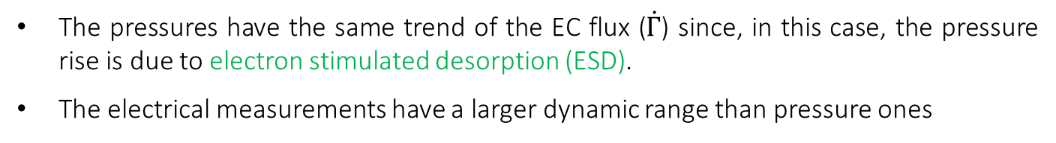

    Number of protons per bunch ($ppb$)
Electrical data vs Pressure behaviour
The pressures have the same trend of the EC flux ($\dot{Γ}$) since, in this case, the pressure rise is due to electron stimulated desorption (ESD).
The electrical measurements have a larger dynamic range than pressure ones
$$P \sim \dot{ Γ}∙ESD desorption yield$$
Log scale
Log scale
$${th}_{1}$$
$${th}_{2}$$
$${th}_{1}$$
$${th}_{2}$$
Elena Buratin

Slide 20
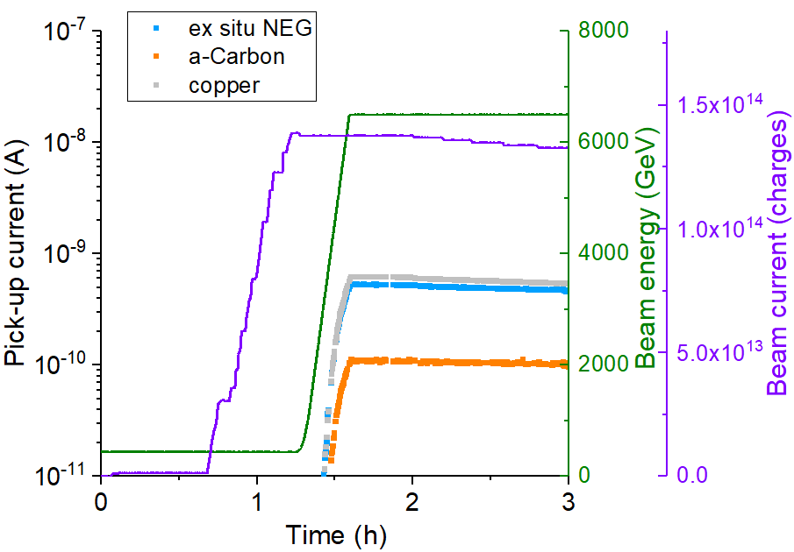
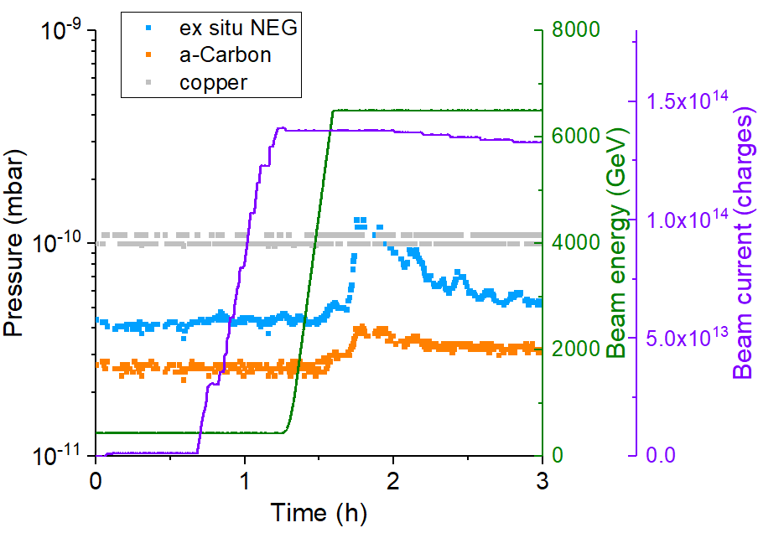
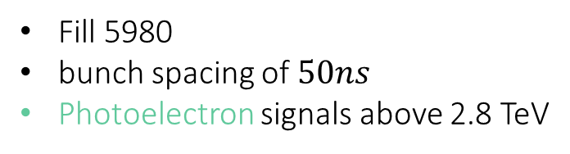
    Not only EC!
Electrical data vs Pressure behaviour
Fill 5980
bunch spacing of $50ns$
Photoelectron signals above 2.8 TeV
Presented in ECLOUD’18
Elena Buratin

Slide 21
    Not only EC!
Electrical data vs Pressure behaviour
Fill 5980
bunch spacing of $50ns$
Photoelectron signals above 2.8 TeV
Be aware of other desorption mechanisms
Presented in ECLOUD’18
Elena Buratin

Slide 22
3. EC energy spectrum at 6.5 TeV
Elena Buratin

Slide 23
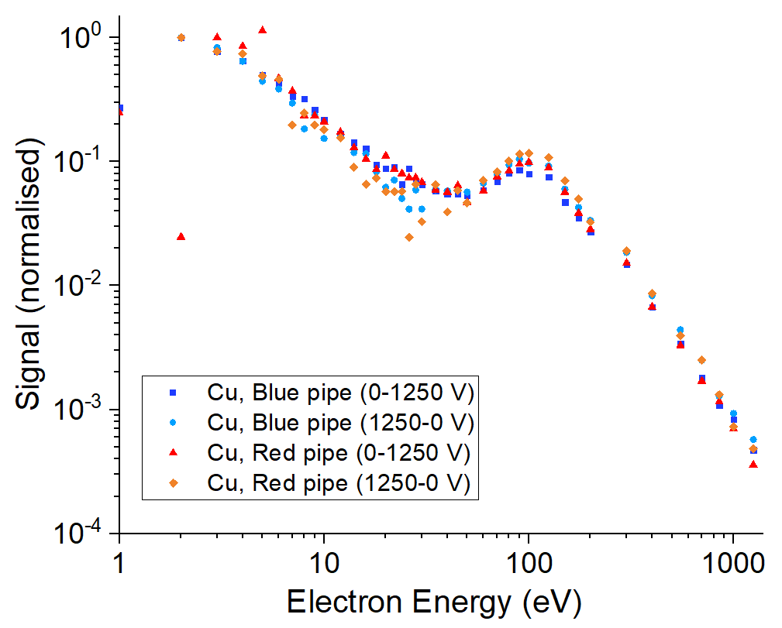
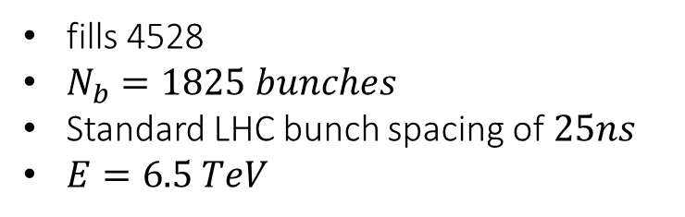
  Preliminary measurements of
  an energy spectrum at 6.5 TeV
fills 4528
$N_{b}=1825 bunches$
Standard LHC bunch spacing of $25ns$
$E=6.5 TeV$
Secondaries below 30 eV
Accelerated electrons at 100 eV
Elena Buratin

Slide 24
4. EC along LHC fills: comparison of filling schemes
      8b4e (fill 6174, Nb=1916 bunches)
      12 bunches per batch (fill 5717, Nb=75 bunches)
      Standard 48 bunches per batch (fill 5887, Nb=2556 bunches)
      Normalised by the standard LHC beam current
Elena Buratin

Slide 25
LHC schedule
Fill 5887 (2556 b)
Fill 5717 (75 b)
Fill 6174 (8b4e)
Elena Buratin

Slide 26
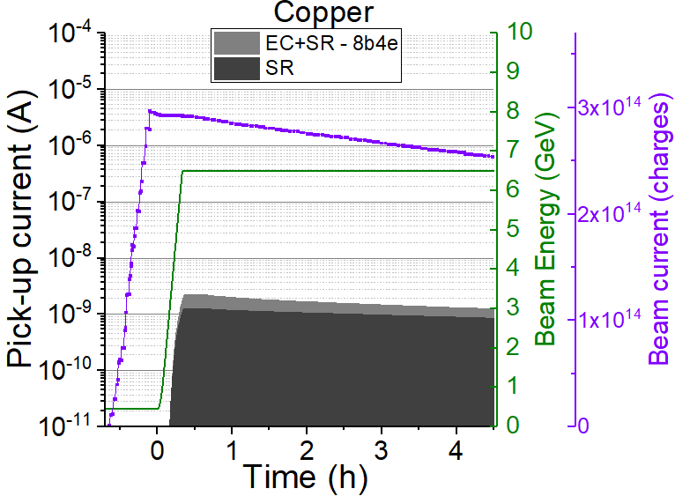
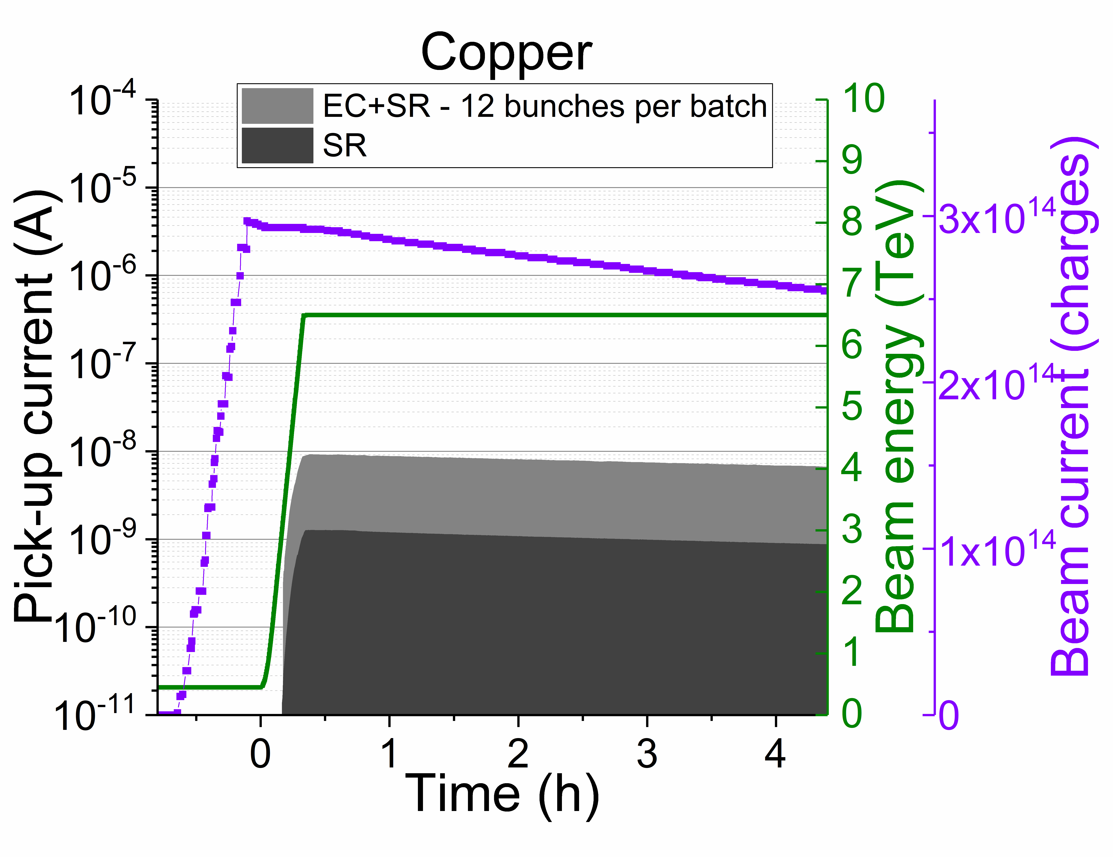
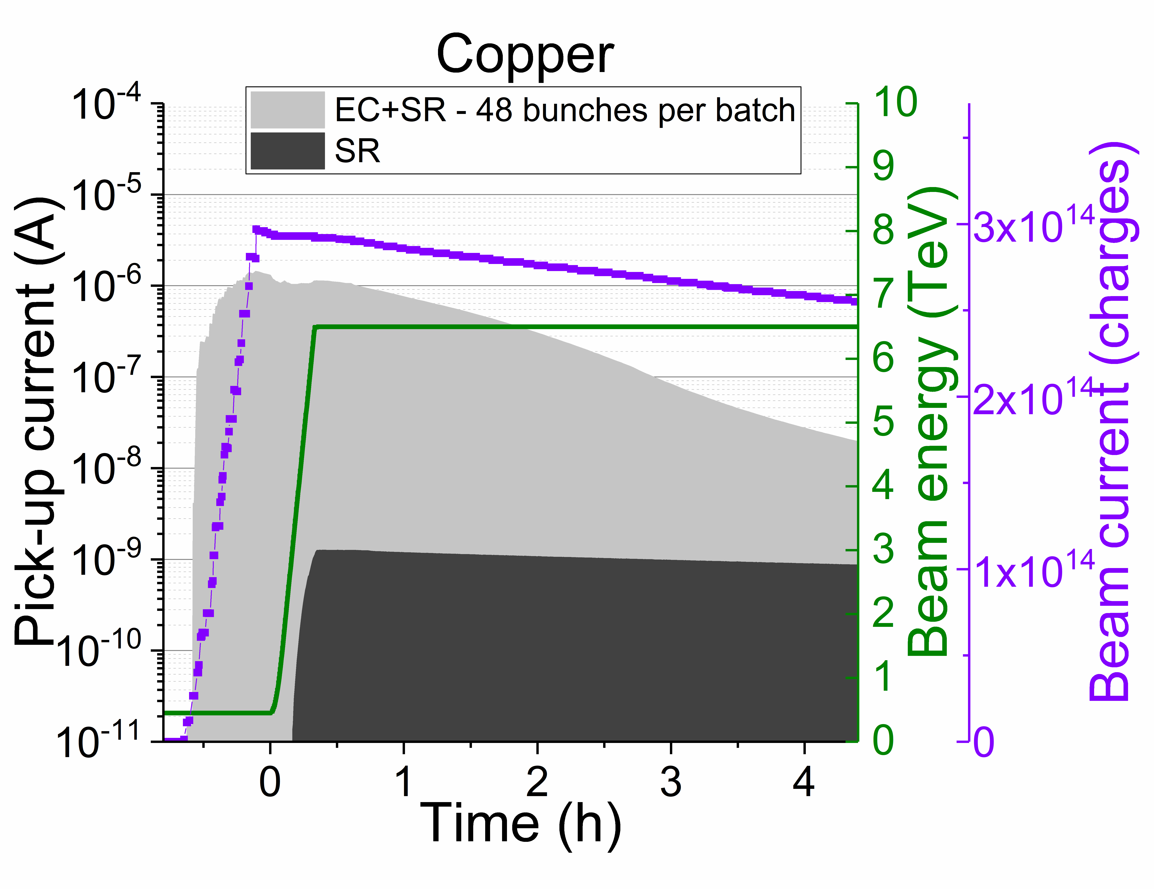
EC along several fills
8b4e
12b per batch
48b per batch
Copper
Elena Buratin

Slide 27
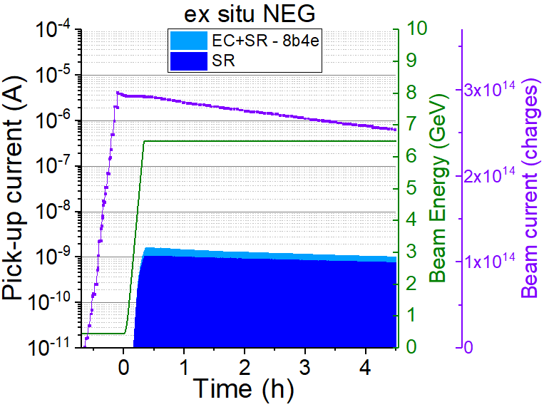
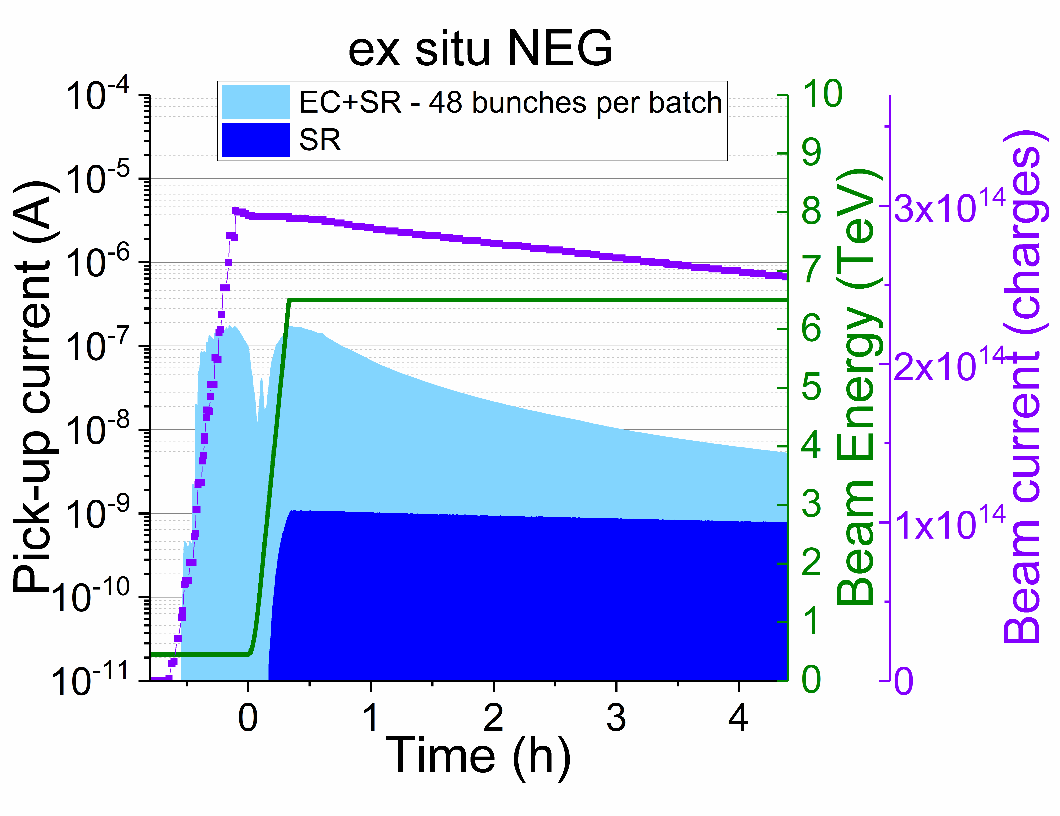
EC along several fills
8b4e
12b per batch
48b per batch
Copper
Ex situ NEG
Multipacting on ex situ NEG and Copper
The ex situ NEG multipacting (and SEY) is lower than the copper one
Elena Buratin

Slide 28
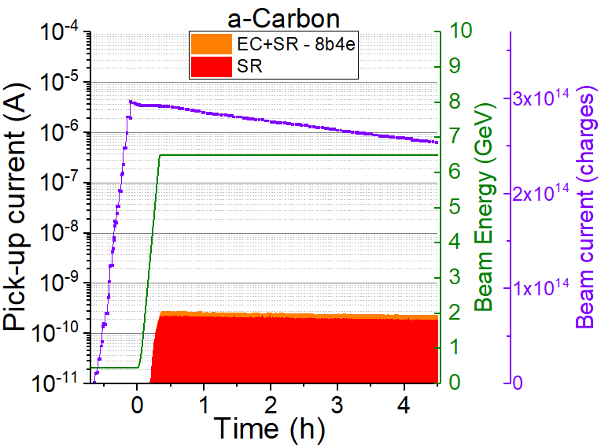
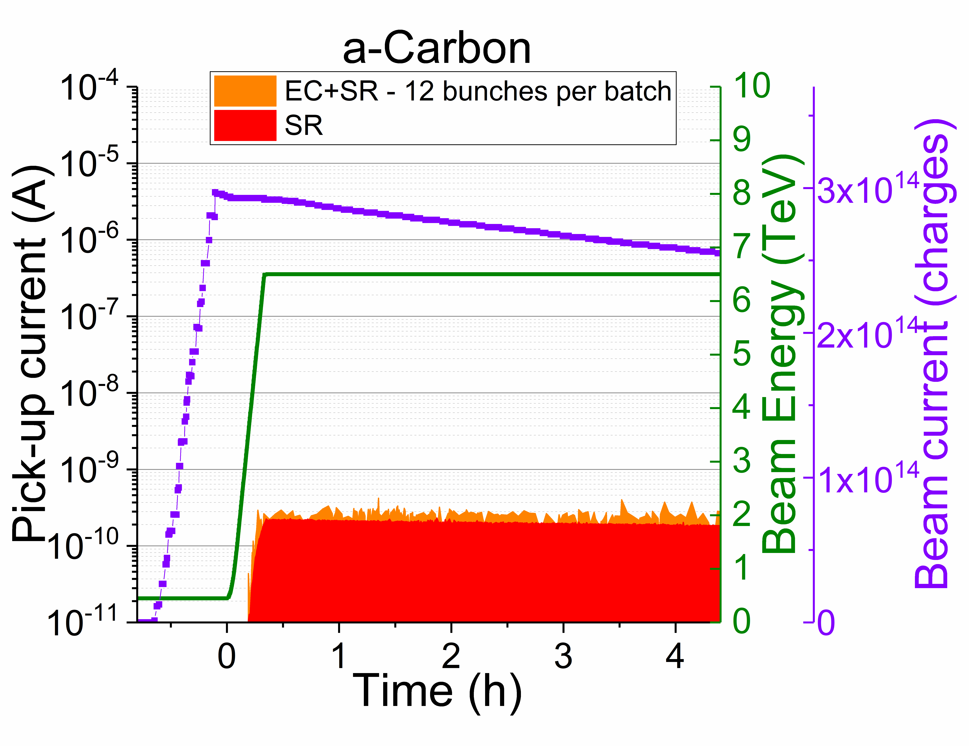
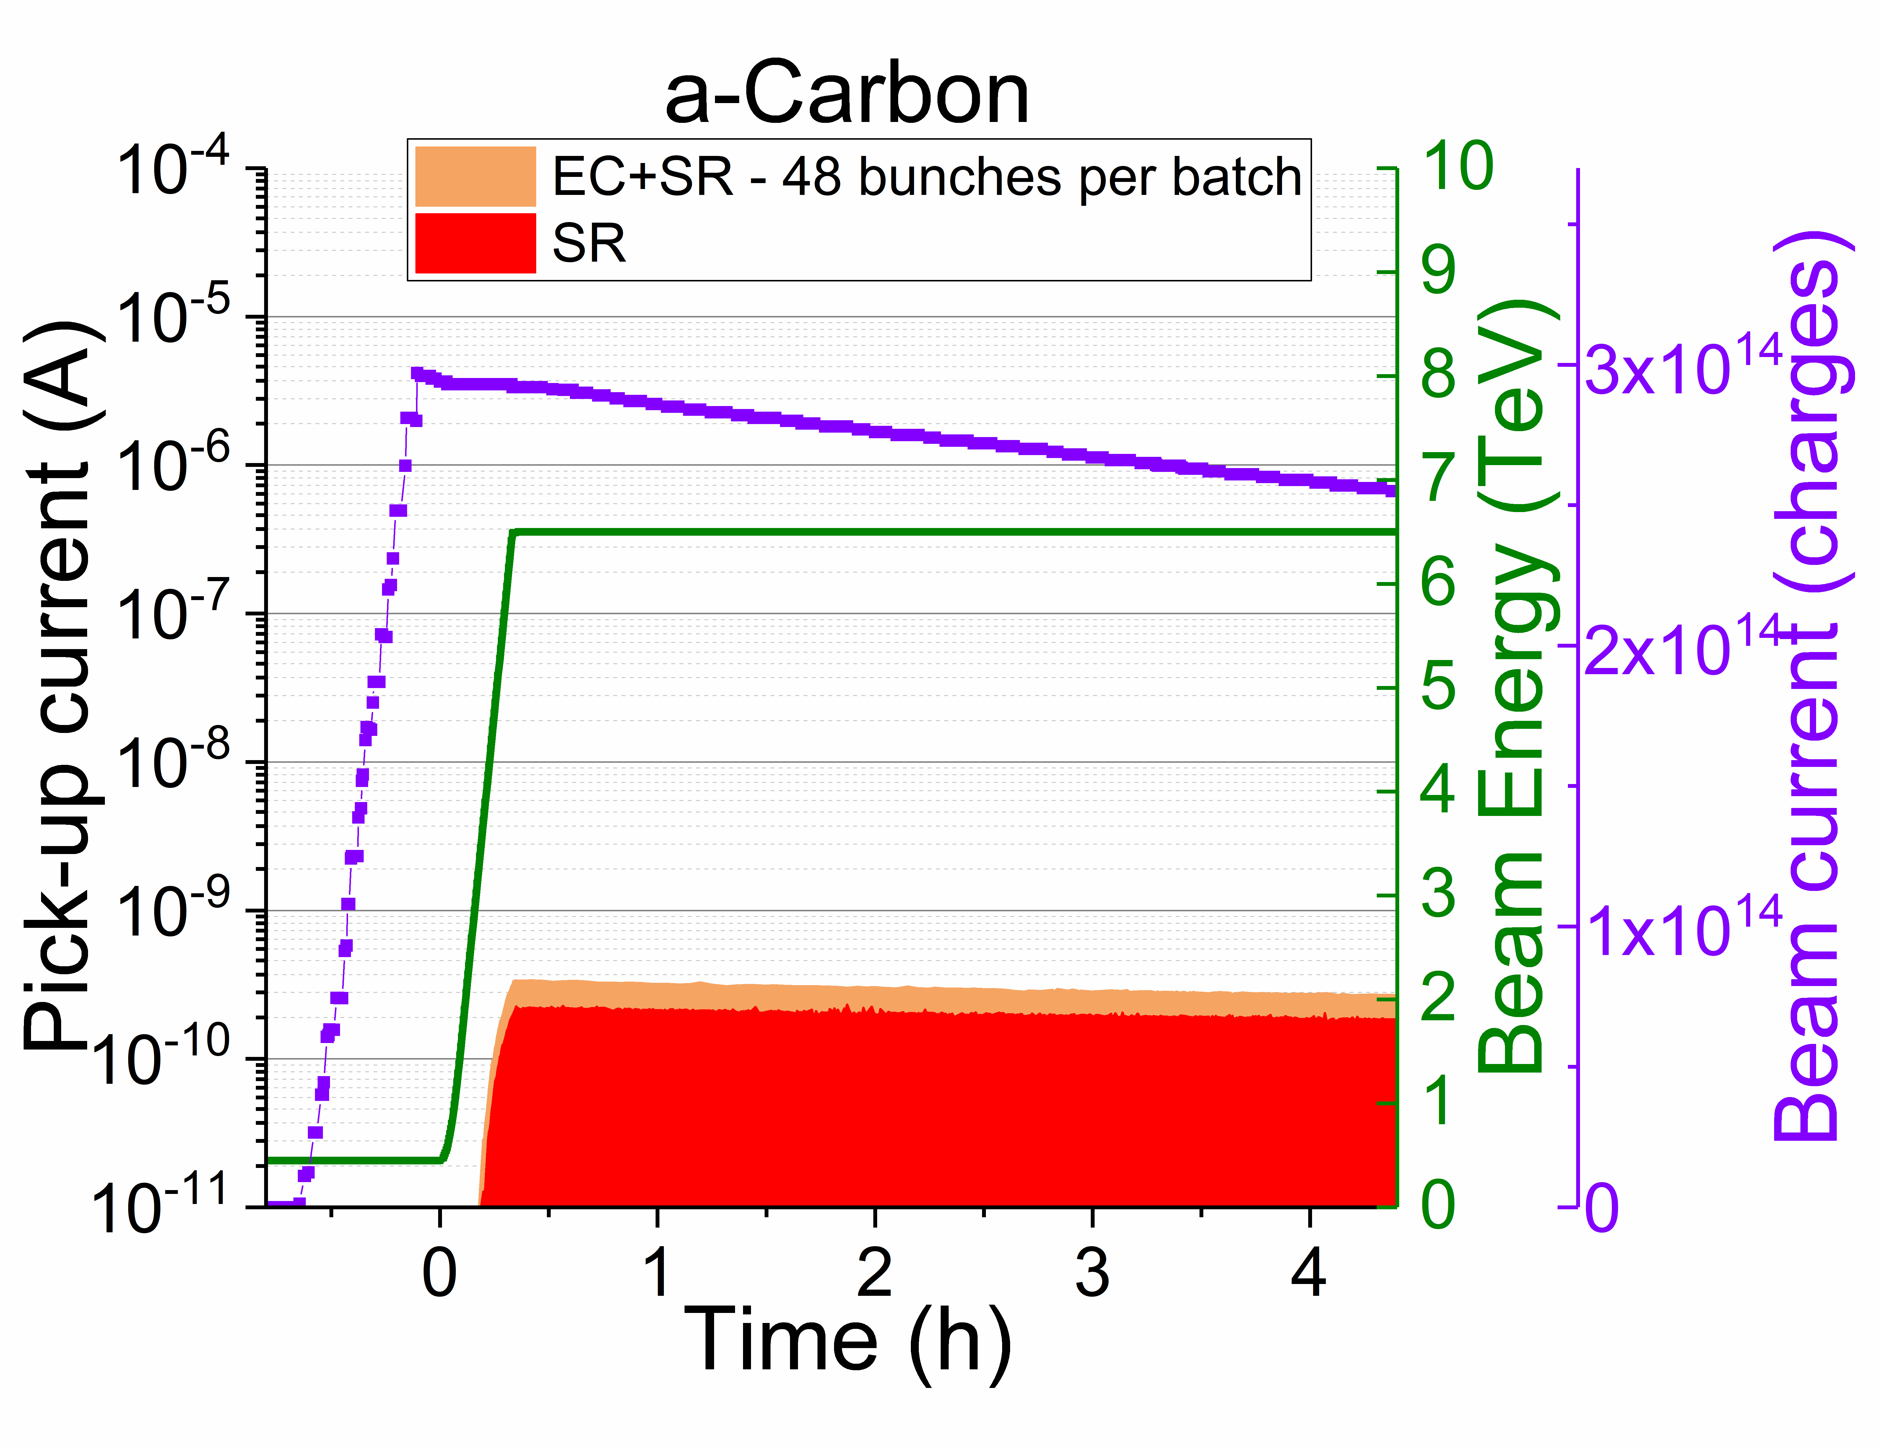
EC along several fills
8b4e
12b per batch
48b per batch
Copper
Ex situ NEG
a-C
Elena Buratin

Slide 29
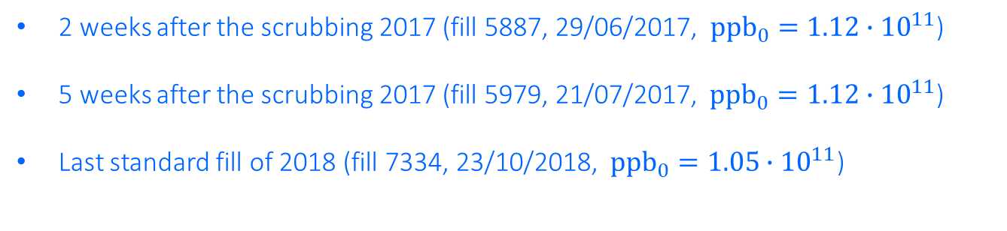
5. EC along 2 years
(standard LHC fills with 2556 b)
2 weeks after the scrubbing 2017 (fill 5887, 29/06/2017, ${ppb}_{0}=1.12∙{10}^{11}$)
5 weeks after the scrubbing 2017 (fill 5979, 21/07/2017, ${ppb}_{0}=1.12∙{10}^{11}$)
Last standard fill of 2018 (fill 7334, 23/10/2018, ${ppb}_{0}=1.05∙{10}^{11}$)
Time
Elena Buratin

Slide 30
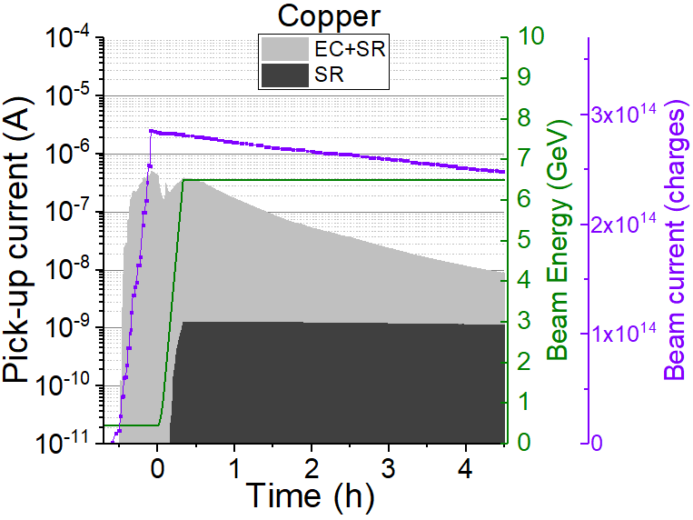
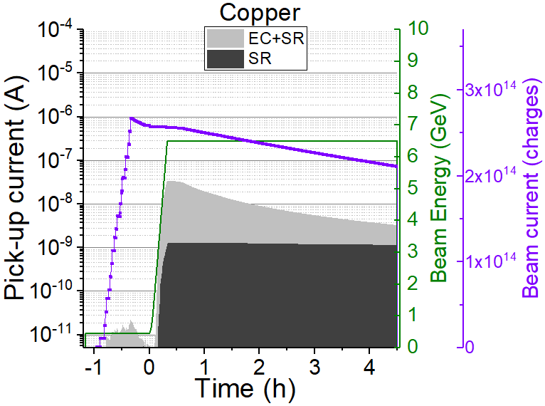
  EC along 2 years
2 weeks after the scrubbing 2017
5 weeks after the scrubbing 2017
Last standard fill of 2018
Copper
Time

Slide 31


  EC along 2 years
2 weeks after the scrubbing 2017
5 weeks after the scrubbing 2017
Last standard fill of 2018
Copper
Ex situ NEG
Time

Slide 32


  EC along 2 years
2 weeks after the scrubbing 2017
5 weeks after the scrubbing 2017
Last standard fill of 2018
Copper
Ex situ NEG
a-C
Time

Slide 33
6. Conclusions
Elena Buratin

Slide 34

  Conclusions
The Vacuum Pilot Sector (VPS) is able to detect EC and SR signals in the LHC.
In the multipacting regime, the EC is linearly dependent with the number of bunches ($N_{b}$).
EC is linearly dependent with the bunch population ($ppb$), above a certain threshold that defines the multipacting regime.
The $ppb$threshold at which the EC multipacting starts increases with the electron dose ($D$) due to beam conditioning.
EC is linear with the bunch length.
The EC multipacting threshold can be identified in both electrical and pressure signals for ex situ NEG and Copper. Be aware that the pressure increase cannot be always attributed to EC activity.
The comparison between different surfaces shows that amorphous carbon coating reduces drastically the EC build-up, thanks to its low SEY.
Elena Buratin

Slide 35
  Conclusions
The energy spectrum performed at 6.5 TeV identifies a peak at 100 eV for a RT chamber (d=80 mm).
The number of bunches per batch strictly influences the EC dynamics. The 12 bunches per batch shows multipacting at 6.5 TeV. The 8b4e filling scheme has the lowest activity, triggered by photoelectrons.
In 2 years, in the copper surface the EC multipacting is reduced of five orders of magnitude at 450 GeV. The conditioning continues along the years.
The amorphous carbon coating surface is stable with time.
Elena Buratin

Slide 36
Back-up slides
Elena Buratin

Slide 37






Shielded pickups and unshielded pickups
- Unshielded pickup:
Detectors to acquire the presence of photoelectrons,
used as trigger
- Shielded pickup:
Detector to acquire electrical signals of the electron cloud
  with different transparencies of grids

Slide 38

Energy spectrum
- Electron kicker detector:
Analyser of the energy spectrum of the electrons
Elena Buratin

Slide 39





Calorimeters
- Temperature sensors
3 PT100 to detect the power deposition on the liners

Slide 40







Gas measurements
- Bayard-Alpert gauge (BAG) and Penning
- Vacuum Quality Moniteur (VQM)
Elena Buratin

