Slide 1
Ion energy spectrum for the LHC arcs
L. Mether
Acknowledgements: G. Iadarola, K. Poland, G. Rumolo

Slide 2
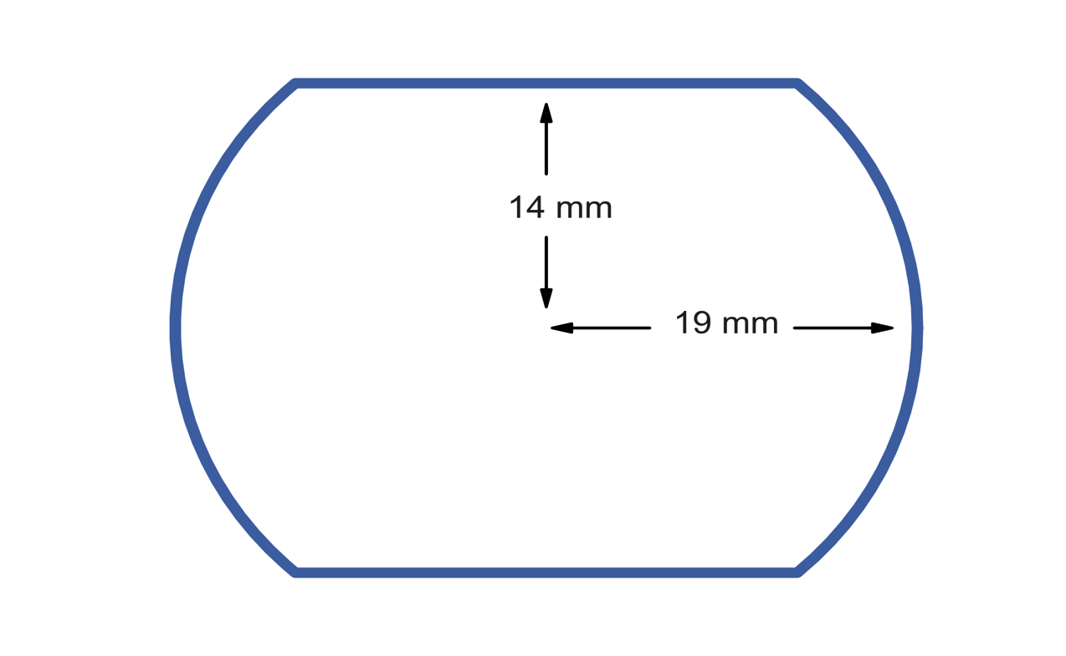
Introduction
In the past years, new tools have been developed for studying the LHC 16L2 events
Multi-species simulations, allowing to simulate electrons and ions together
Cross-ionization, allowing to add electron-induced ionization to the simulations
Do the new ingredients have an effect on previous results for the LHC arcs?
  Does the presence of ions impact the electron cloud and/or related observables?
  Is electron-induced ionization important in this regime?
What are the characteristics of the ion distribution (in the presence of e-cloud)?
  Does electron-induced ionization have any impact?
Beam-induced ionization
Electron-induced ionization

Slide 3
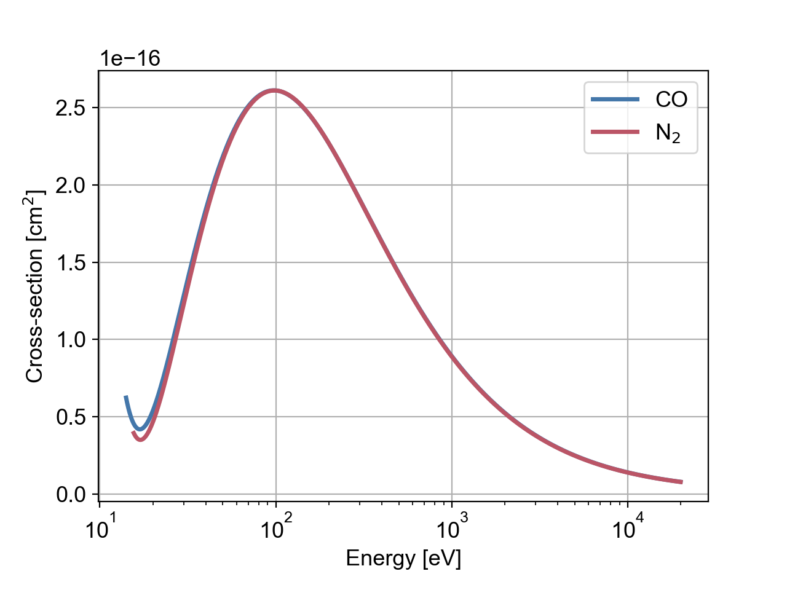
Simulation specifications
We set up a simulation scan of the LHC arc dipoles at 7 TeV with CO gas
Gas pressure similar to nominal vacuum level: P = 10 nTorr ≈ 1.3 × 10⁻⁸ mbar
CO gas is very similar to N₂ gas, studied for 16L2
  The same mass number, A = 28
  Very similar cross-section for electron-induced ionization

Slide 4
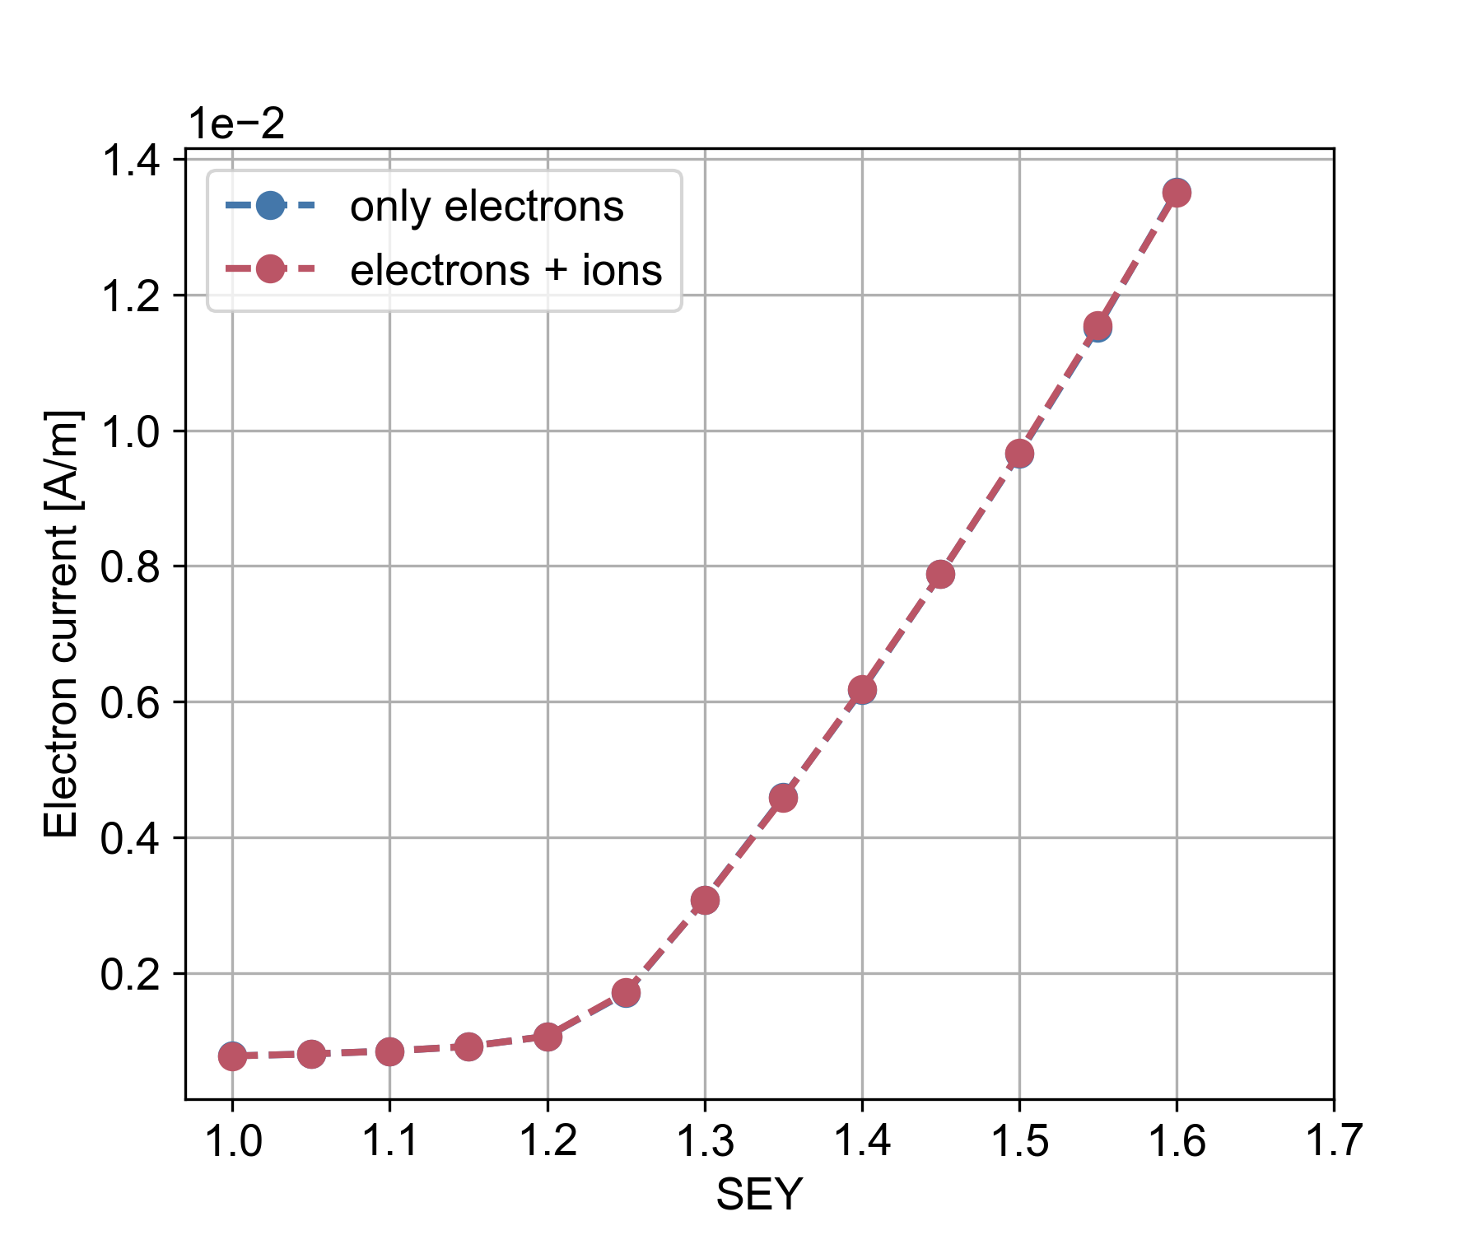
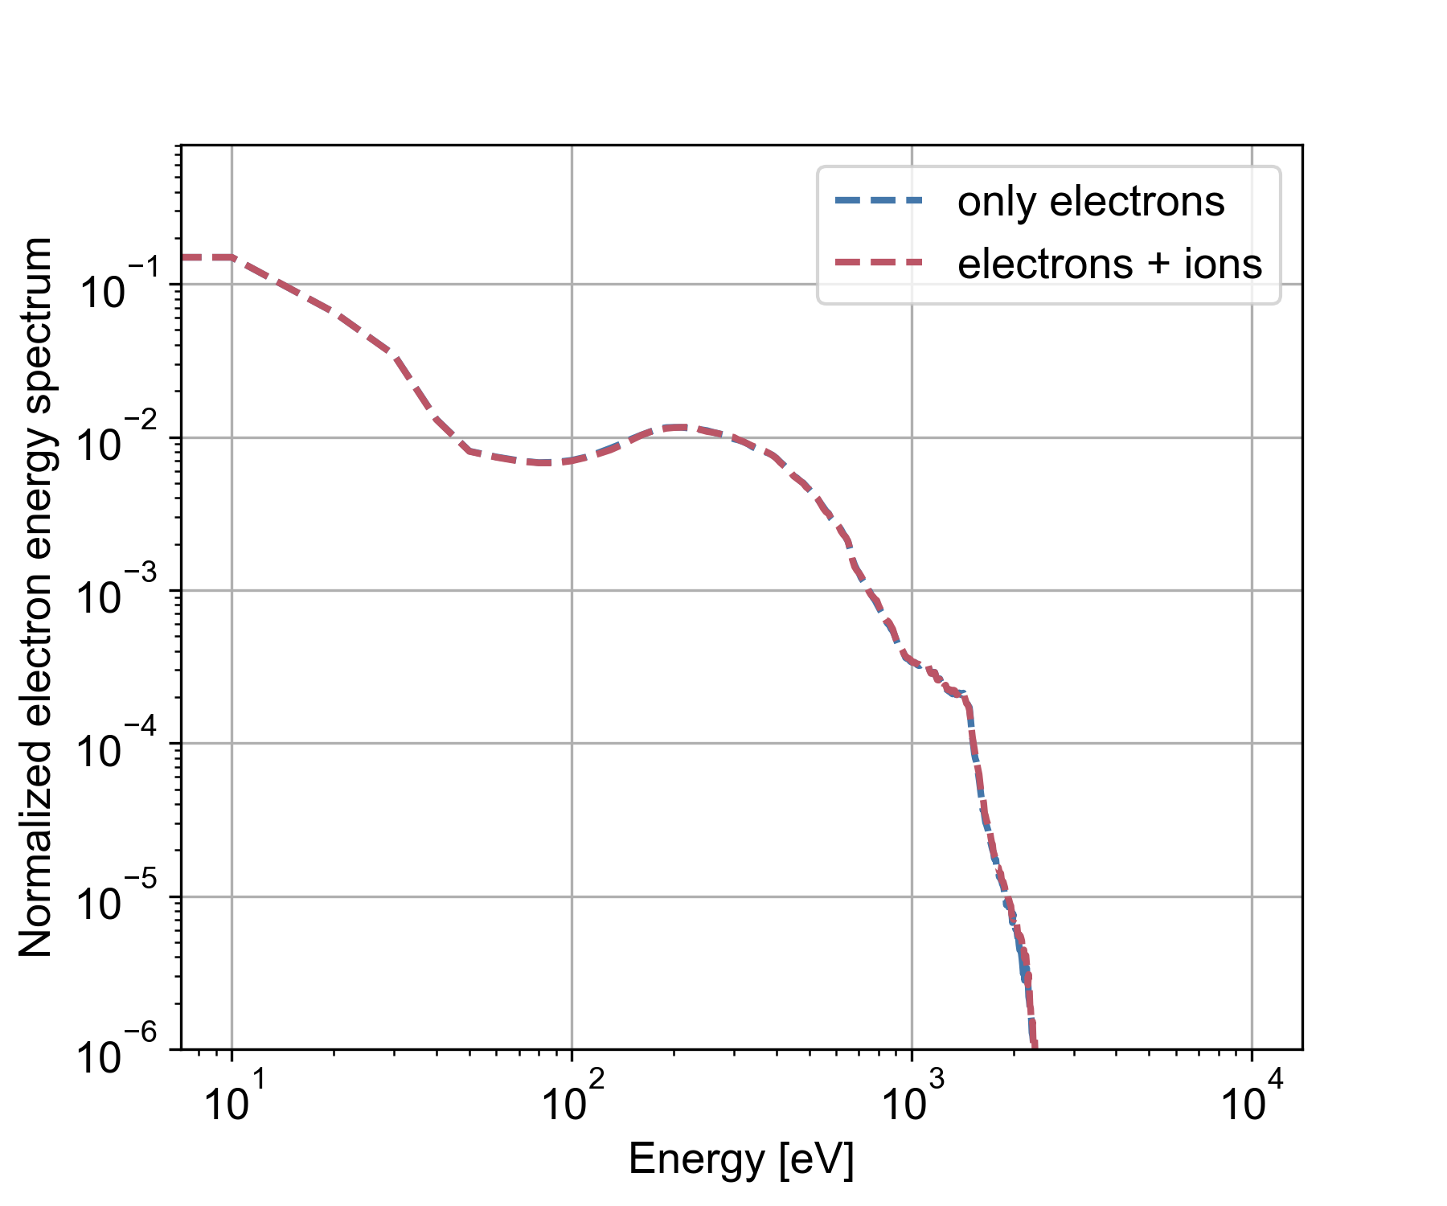
Effect of ions
The build-up of the electron cloud is not significantly affected by the presence of ions
In agreement with previous results for hydrogen gas (K. Poland)
In agreement with 16L2 simulations (effect seen as of n = 10²⁰ m⁻³ , P ≈ 3 × 10⁶ nTorr)

Slide 5
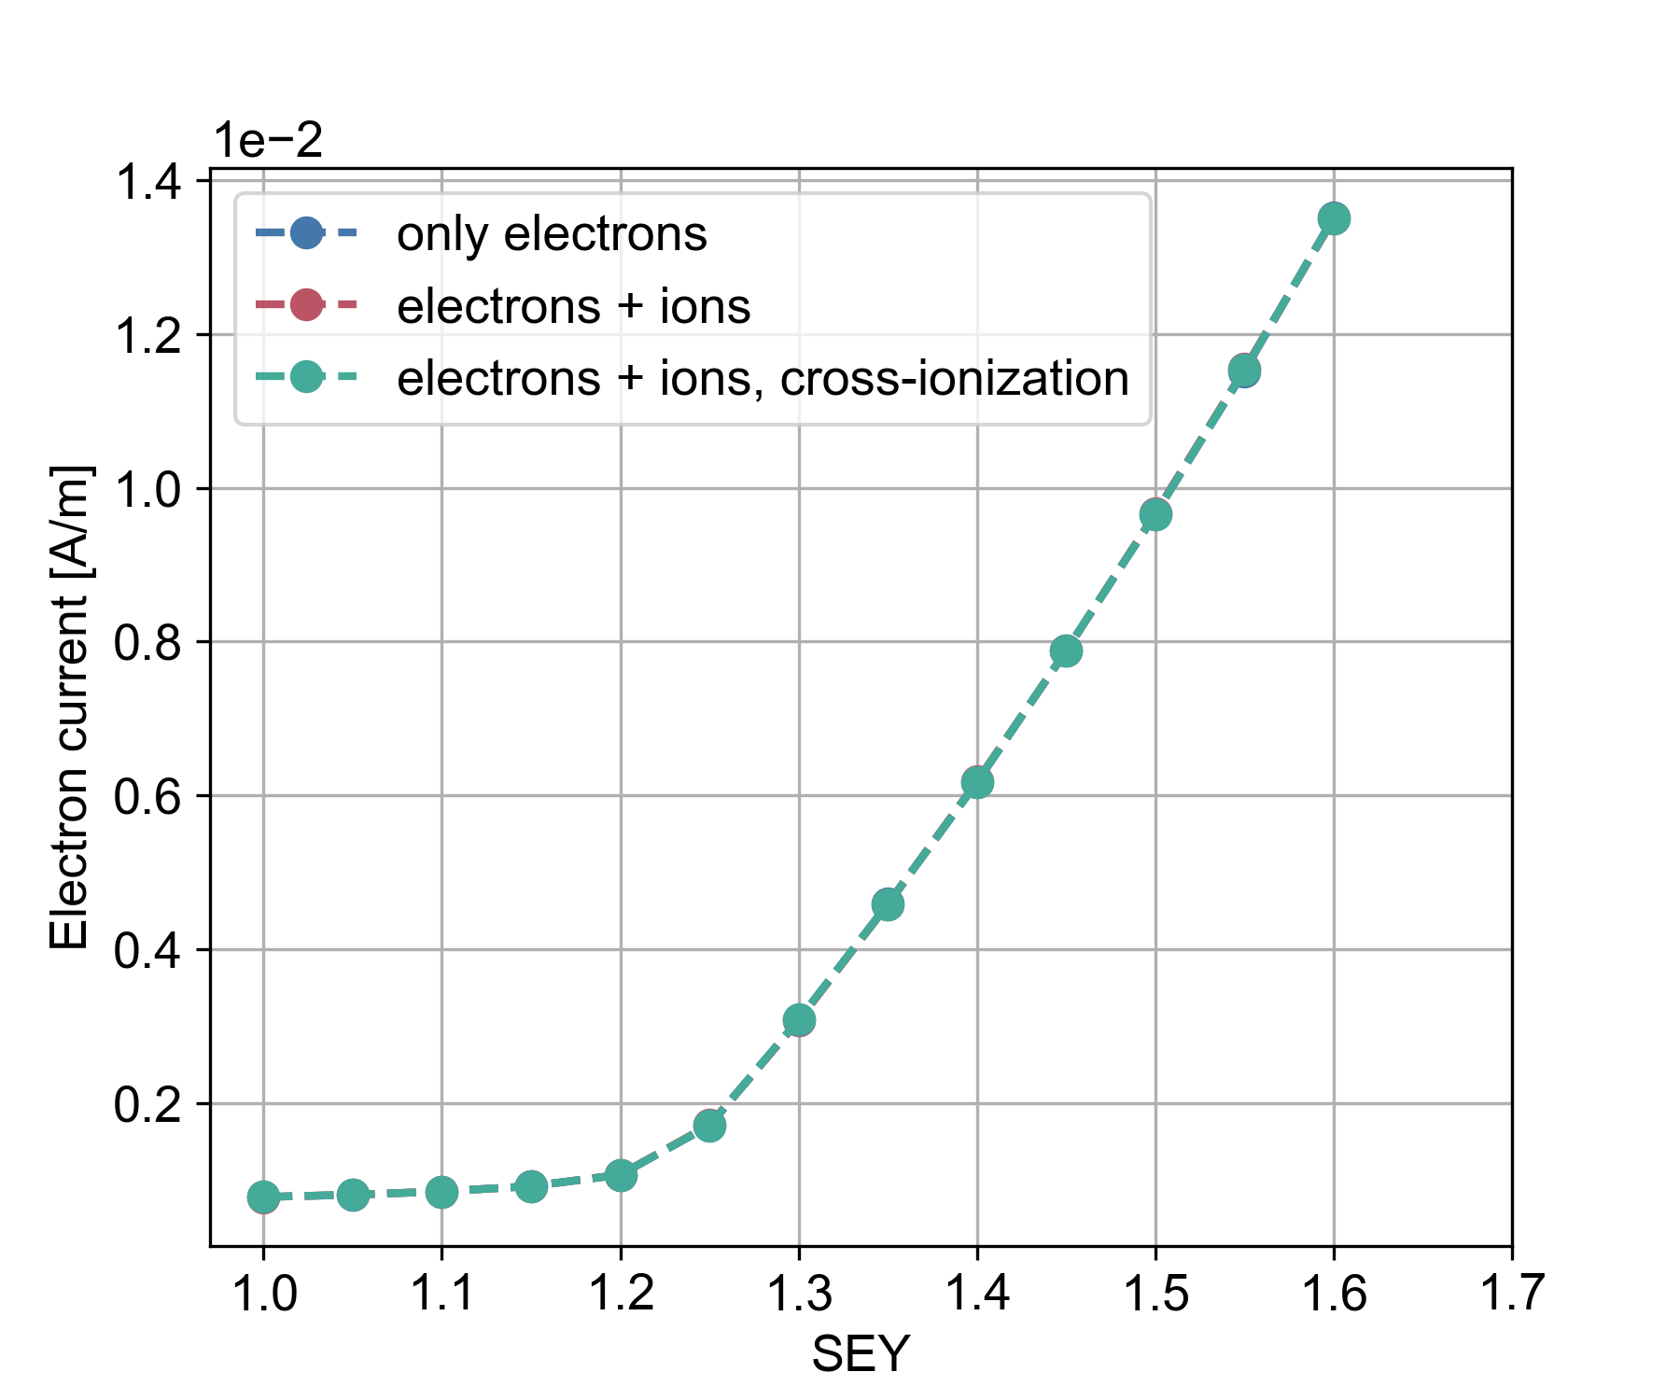
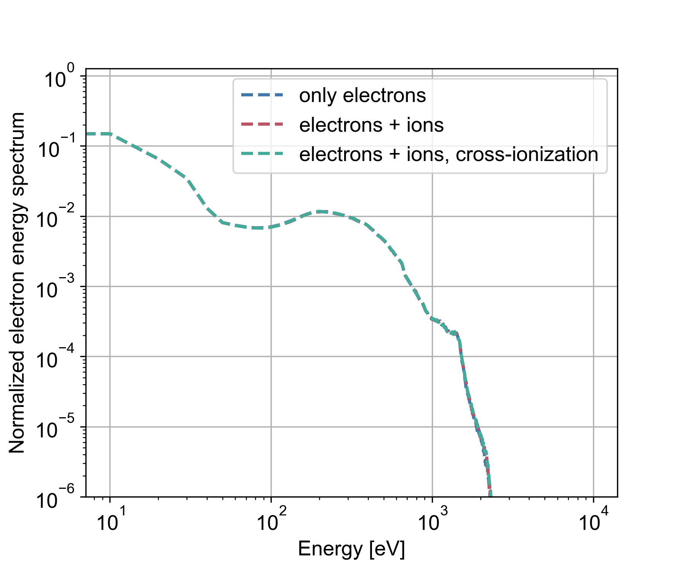
Effect of cross-ionization
Electron-induced ionization doesn’t change the picture
In agreement with estimates from electron energy spectra for 16L2 studies
In agreement with 16L2 studies with cross-ionization
(Effect expected/observed as of n = 10²⁰ m⁻³, P ≈ 3 × 10⁶ nTorr)

Slide 6
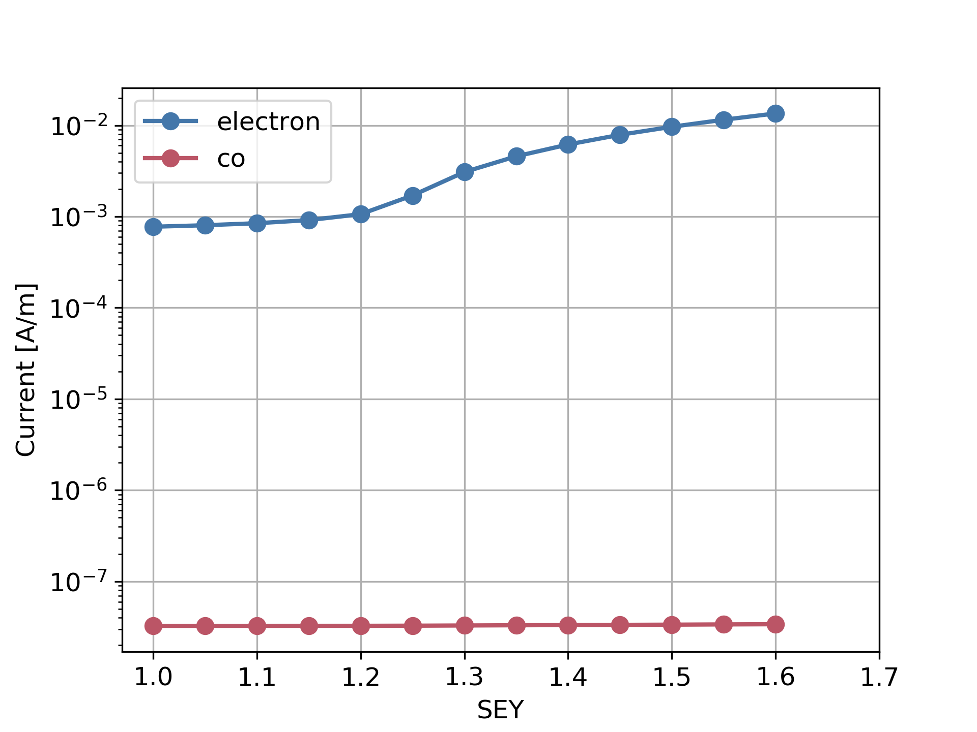
The ion distribution
We now know that the ions don’t affect the electron distribution – is the ion distribution itself relevant?
For low gas densities, only a small number of particles are produced through ionization
The electron population is dominated by secondary emission
The ion current is very small compared to the electron current (by roughly 4 orders of magnitude)

Slide 7
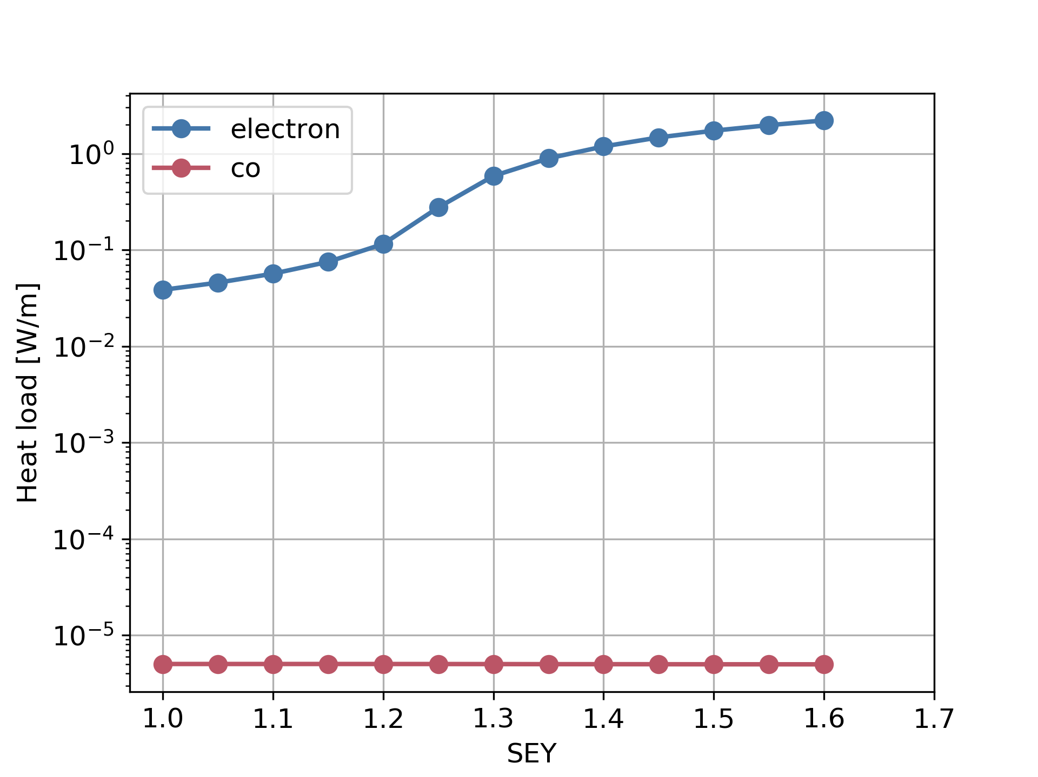
The ion distribution
We now know that the ions don’t affect the electron distribution – is the ion distribution itself relevant?
For low gas densities, only a small number of particles are produced through ionization
The electron population is dominated by secondary emission
The ion current is very small compared to the electron current (by roughly 4 orders of magnitude)
The small number of ions is insignificant for the heat load
In agreement with previous results for hydrogen gas (K. Poland)
…but could perhaps be relevant for the surface chemistry of the beam screen

Slide 8
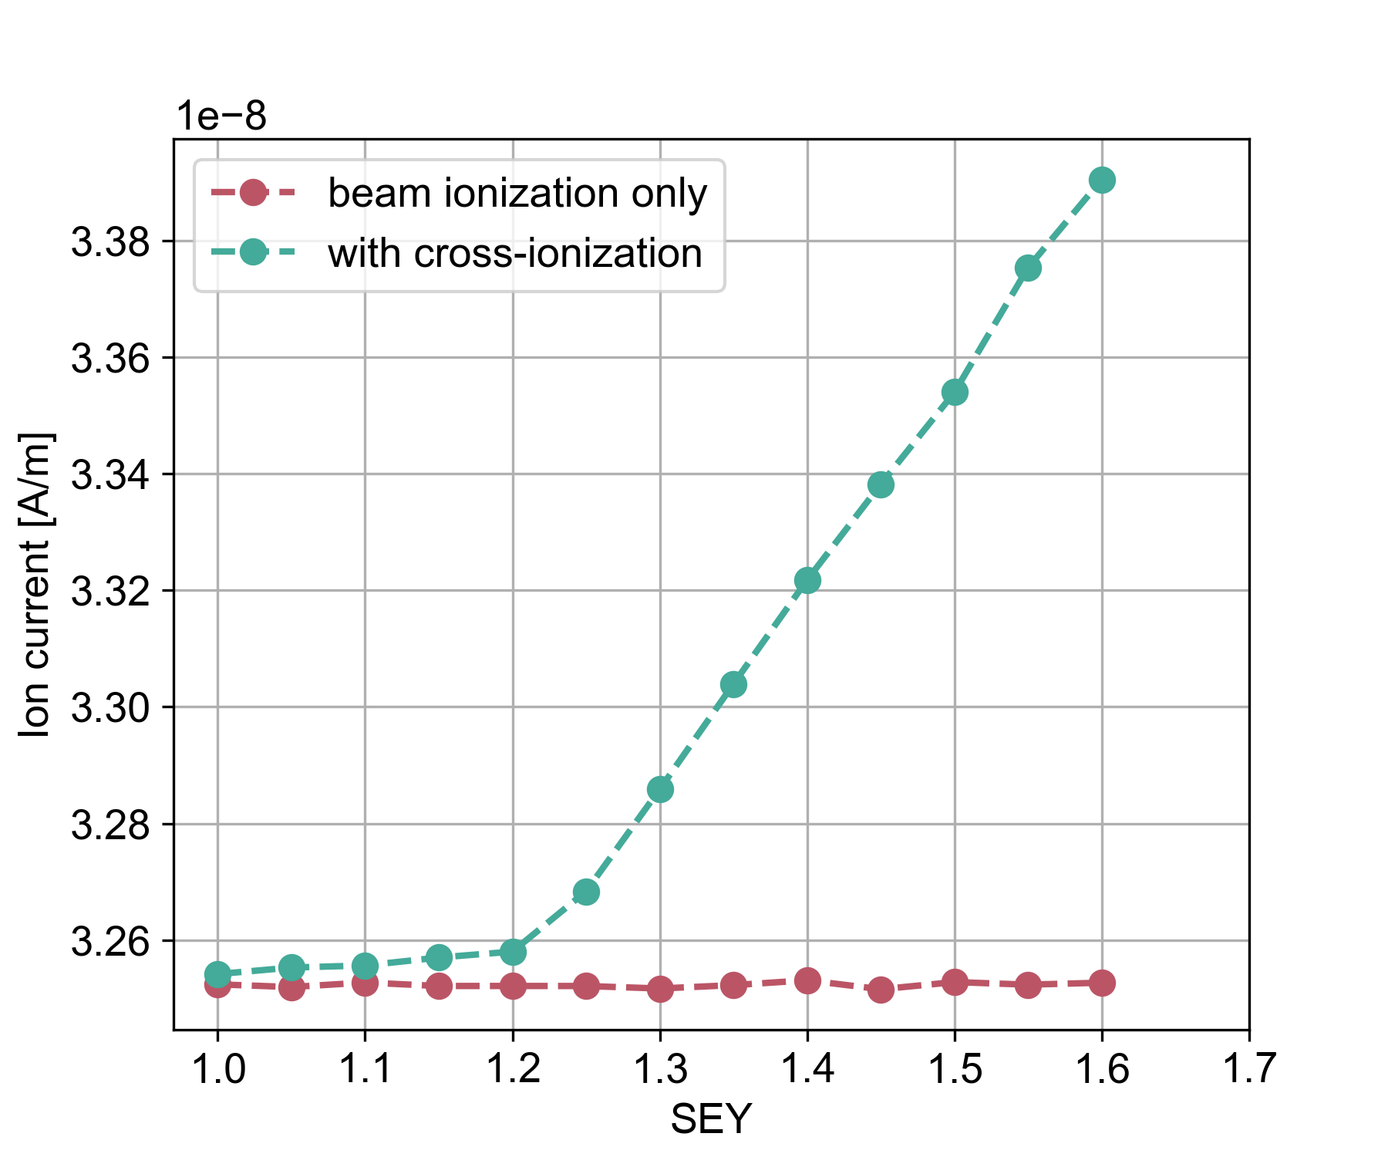
The ion current
The ion current amounts to around 33 nA/m (for P = 10 nTorr ≈ 1.3 × 10⁻⁸ mbar)
With electron-induced ionization, the current depends very mildly on the SEY
(the change is on the level of a few % going from SEY = 1.0 to 1.6)

Slide 9
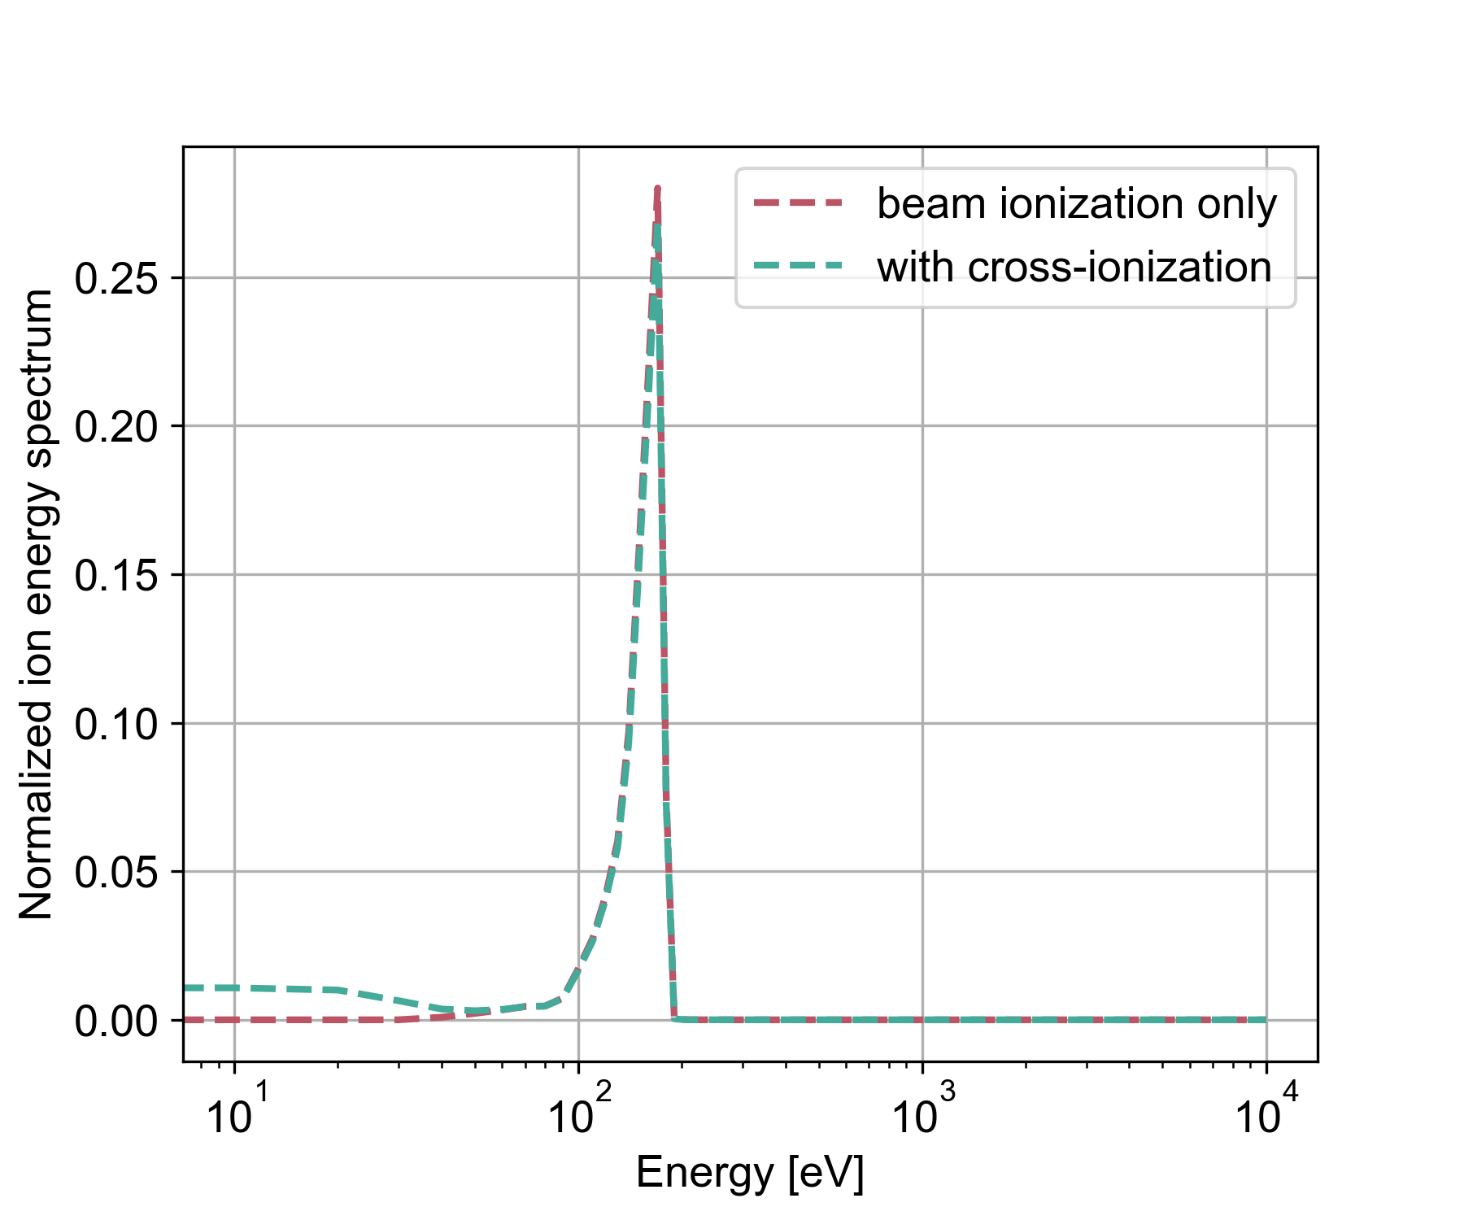
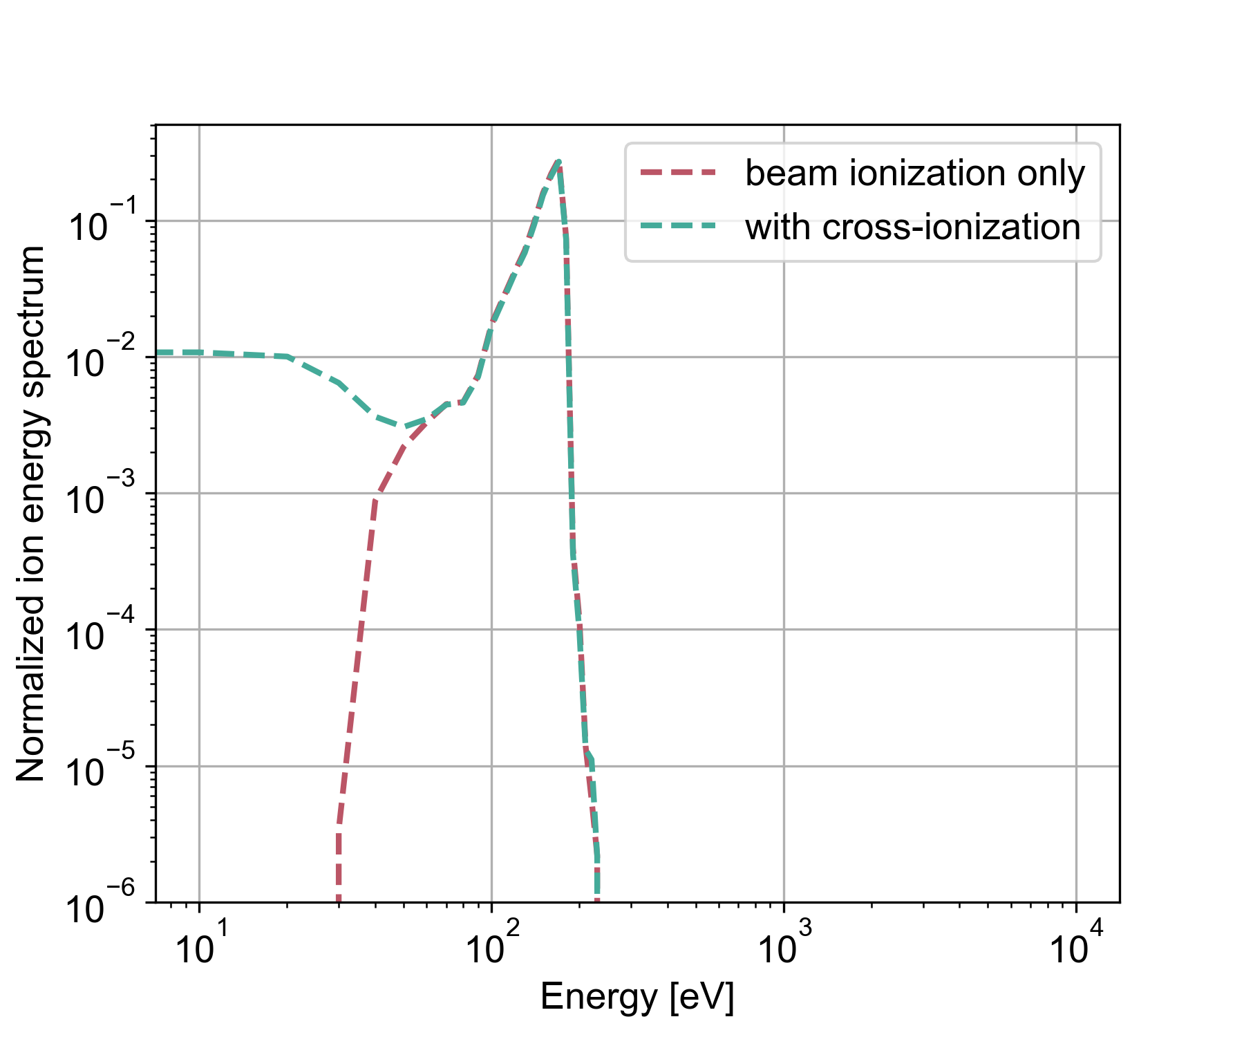
The ion energy spectrum
The ion energies reach up to 200 eV
There is hardly any change in the peak or maximum ion energies with cross-ionization
  The peak is determined by the beam (beam-induced ionization and acceleration)
  Cross-ionization introduces a shoulder in the spectrum at low energies (this may depend on the assumed initial energy of the ions, here taken to be 0)

Slide 10
Conclusion
Under nominal LHC vacuum, ionization processes are insignificant for the electron cloud build-up process and for the heat loads on the beam screen
The energy spectrum and current of the ion population produced through ionization have been estimated, to help determine if they can be relevant e.g. for the beam screen surface chemistry
Electron-induced ionization impacts the results only marginally

Slide 12
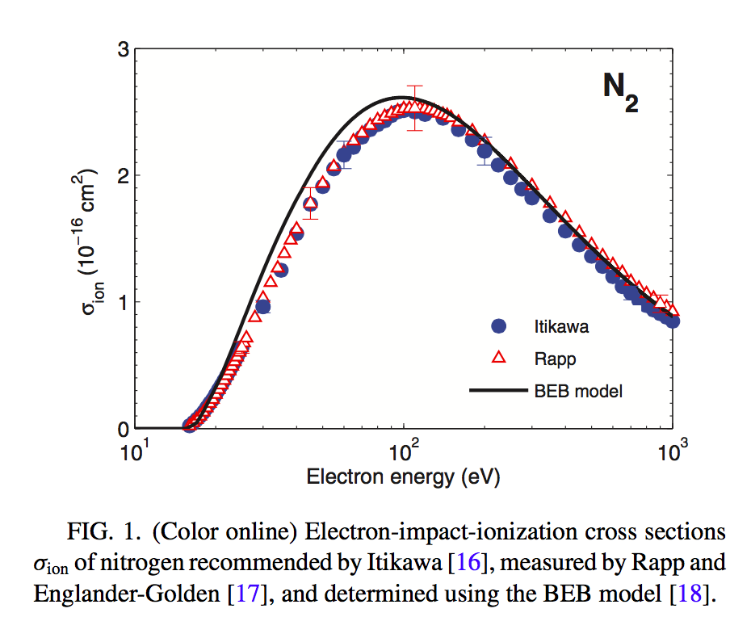
Electron-induced ionization
The discrepancy could be due to a missing ingredient in the model
Electrons in the energy range of 50 – 500 eV have a 50 – 100 times larger ionization cross section than the beam particles
Electron ionization cross-section
Beam ionization cross-section
BUG et al., Phys. Rev E.88

Slide 13
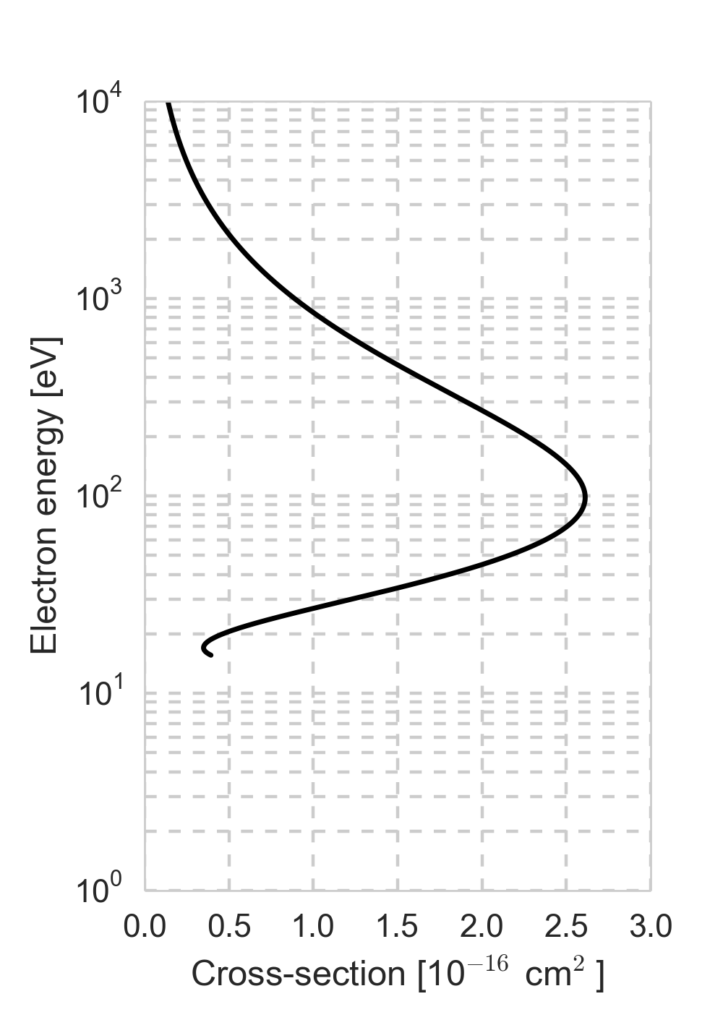
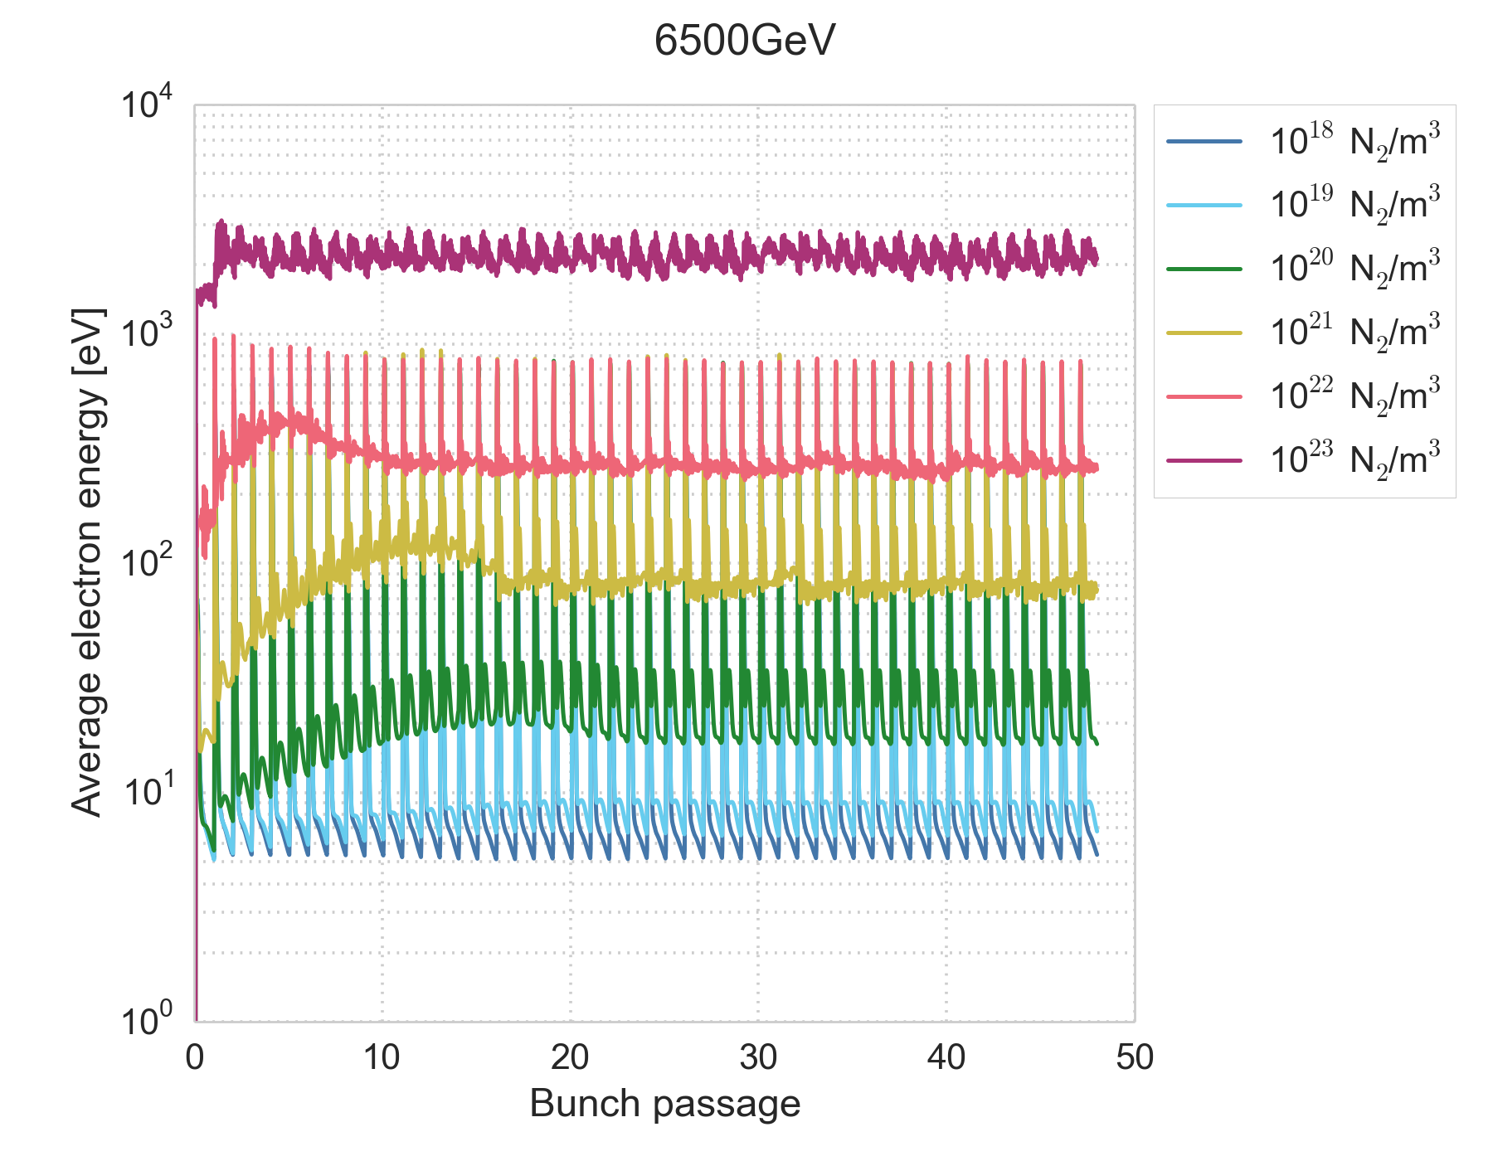
Electron-induced ionization
The amount of ionization depends on the electron energy distribution
In simulations, electron energies are favourable for electron impact-ionization in particular for gas densities of 10²⁰ – 10²² N₂/m⁻³
  See e-cloud meeting #67

