Slide 1
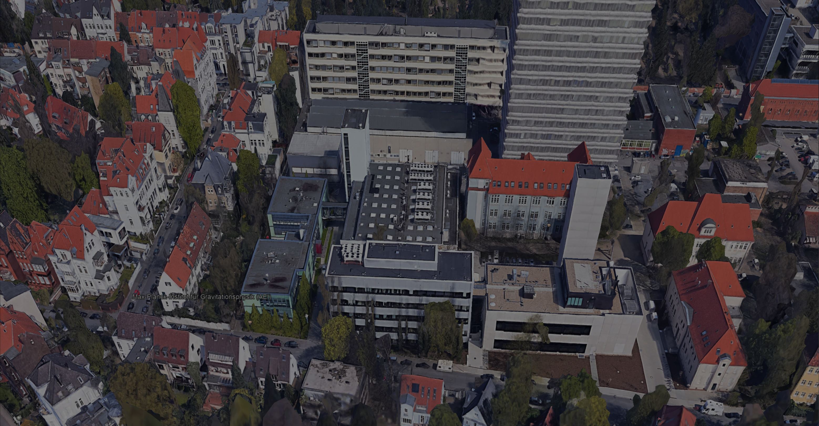


Einstein Telescope
German Community Meeting
(Instrumental Focus)
Harald Lück
Leibniz Universität Hannover
&
Max-Planck Institut für Gravitationsphysik
Callinstr. 38, 30167 Hannover

Slide 2
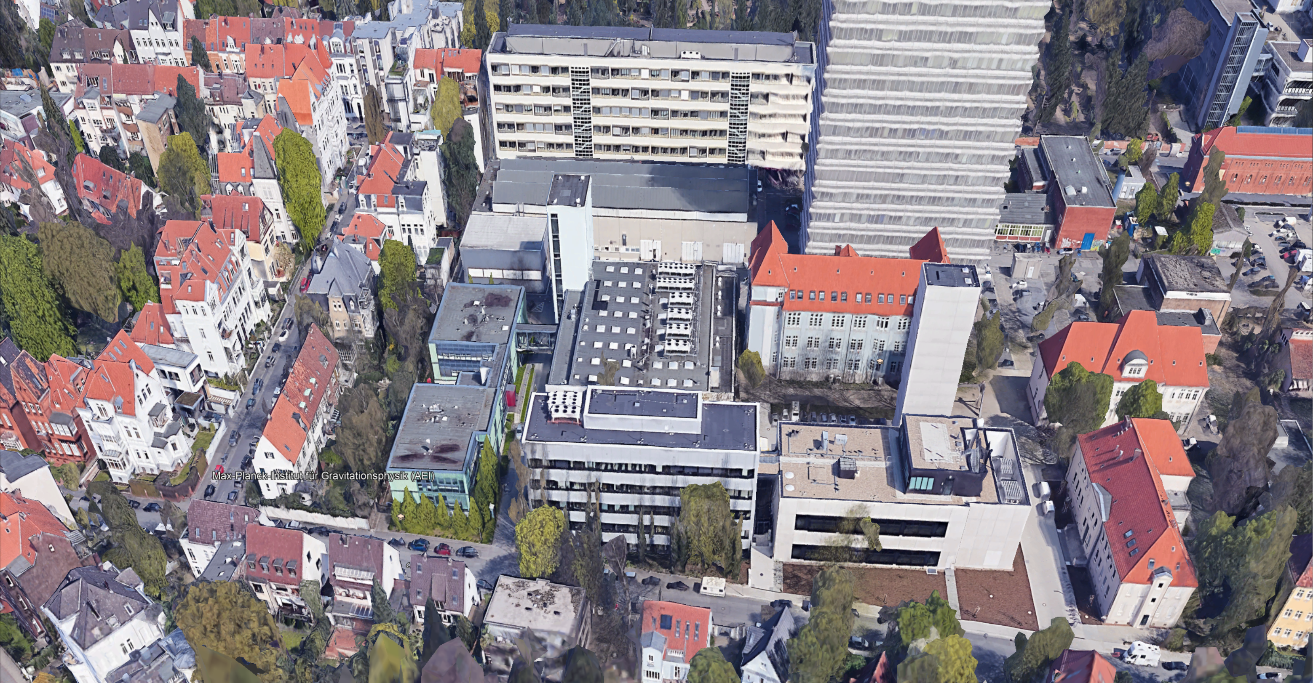

Slide 3
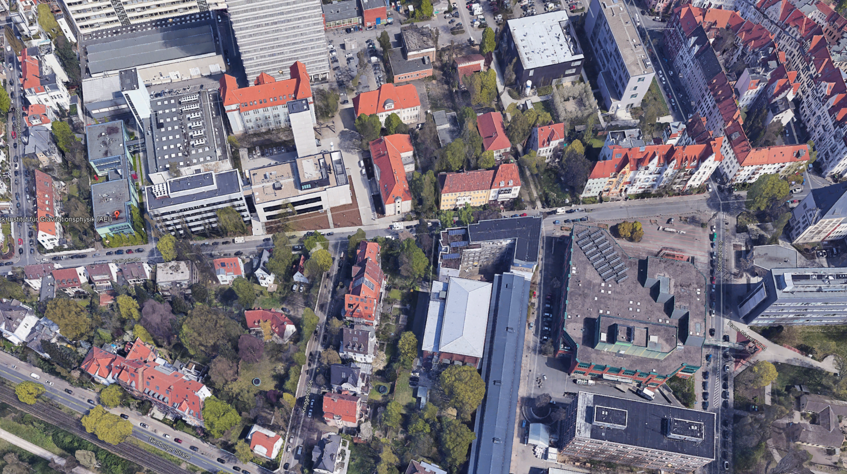
MENSA

Slide 4
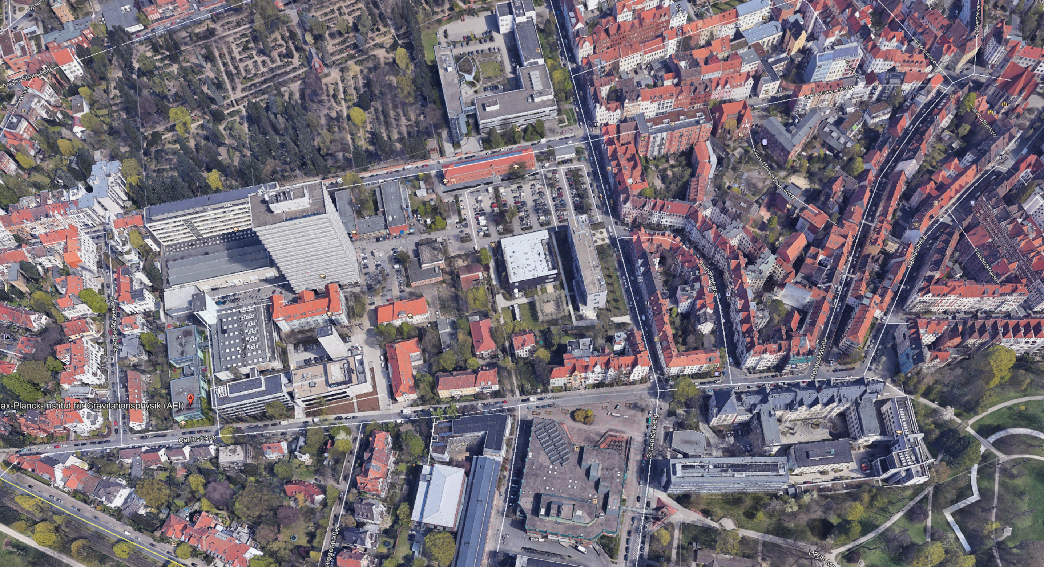
v
Dinner: (ca. 700m)
Restaurant „Zwischenzeit“
Schaufelderstr. 11
Next to Hotel Schlafgut

Slide 5
Internet Access
Eduroam
Tickets available

Slide 6
Goals of this meeting
Get to know each other within the widening German and neighbouring ET community
Introduce the current state-of-the-art of various subsystems, outline the needs for ET and show possible paths towards success

Slide 7
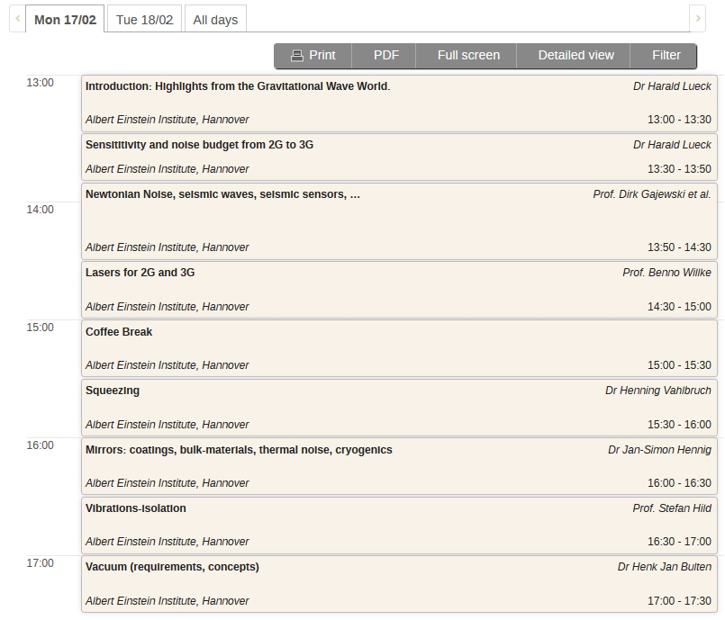
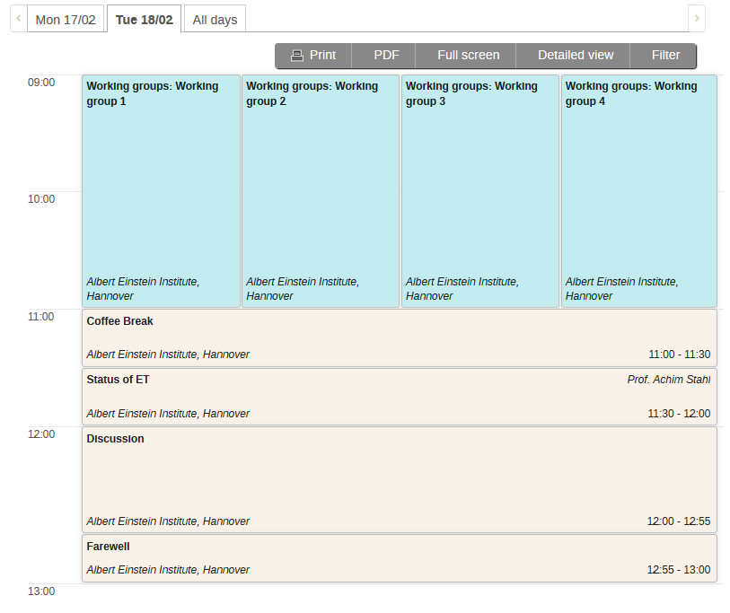
Agenda
Agenda

