Slide 1


Vector Boson Scattering in CMS
Duje Giljanović
2022 LHC Days in Split

Slide 2
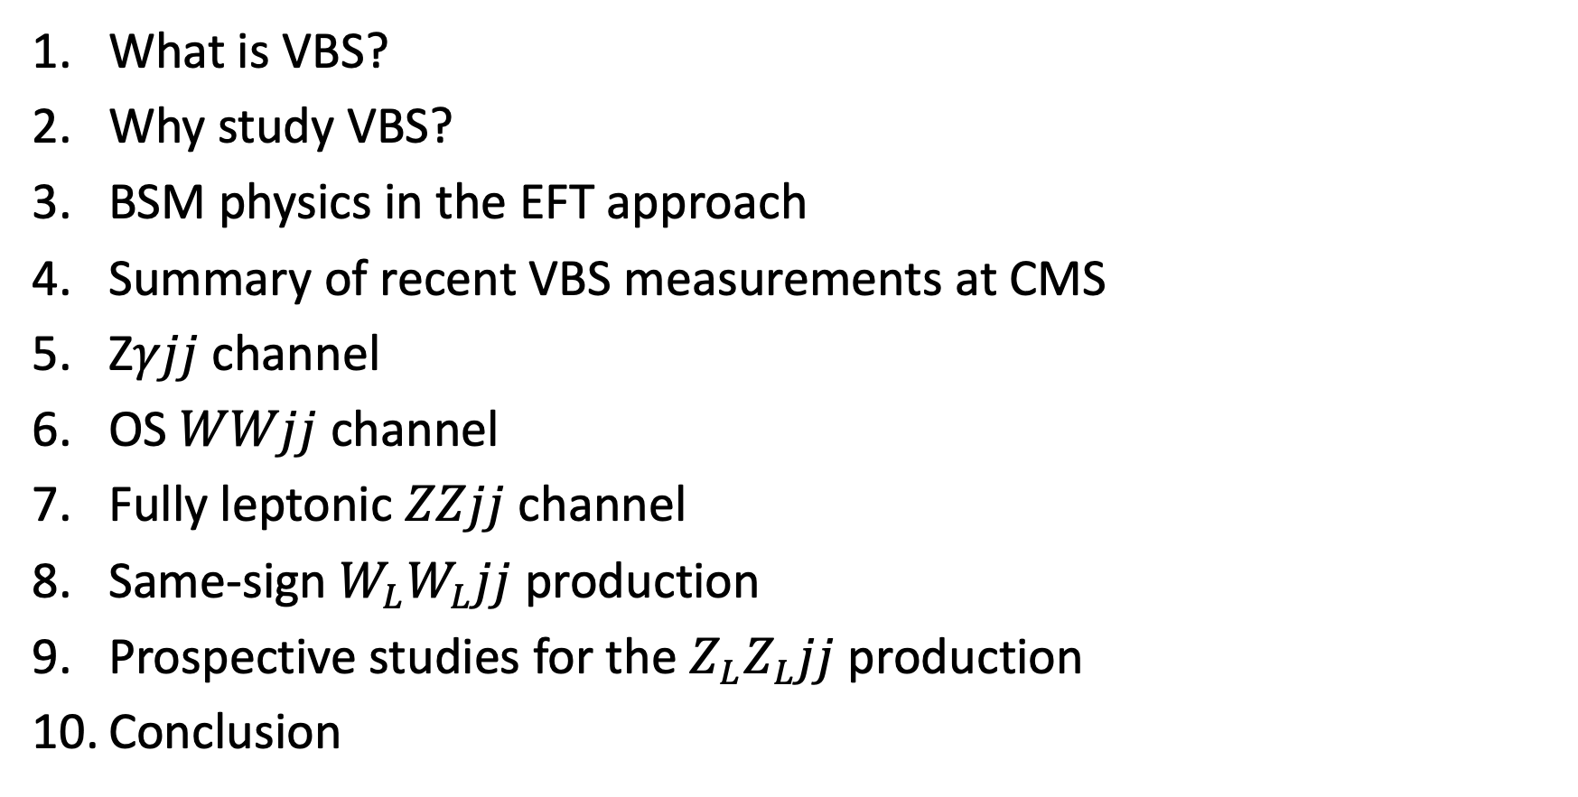
Outline
What is VBS?
Why study VBS?
BSM physics in the EFT approach
Summary of recent VBS measurements at CMS
Z$γjj$ channel
OS $WWjj$ channel
Fully leptonic $ZZjj$ channel
Same-sign $W_{L}W_{L}jj$ production
Prospective studies for the $Z_{L}Z_{L}jj$ production
Conclusion
introduction
most recent
CMS analyses

Slide 3
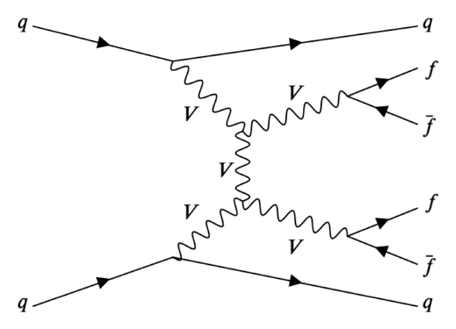
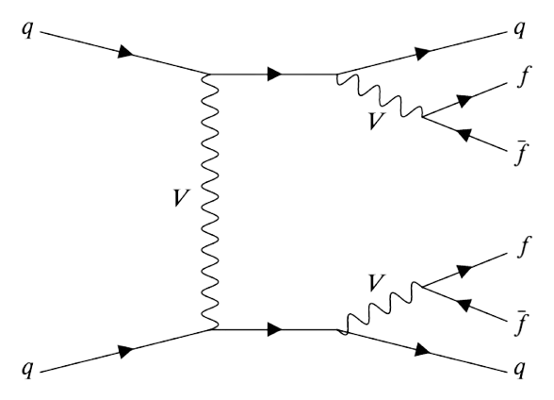
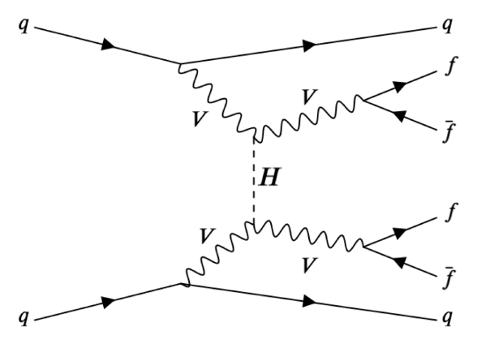
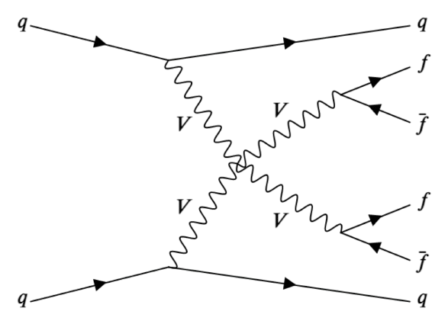
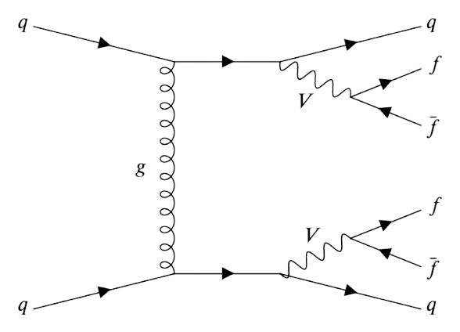
What is VBS?
subset of EW processes in which VV pair is radiated from two initial quark lines
non-VBS production
of the 4l2j final state
VBS production of the 4l2j final state
QCD-induced product.
of the 4l2j final state

Slide 4
Why study VBS?
massless gauge fields in the EW sector gain longitudinal degrees of freedom due to EWSB
longitudinal VVs exhibit interesting high-energy behaviour
  at high energies scattering amplitude becomes constant
  the cross-section decreases linearly - scattering of longitudinal VVs = scattering of Goldstone bosons of the EWSB
if there is no Higgs boson or even if its coupling to the VV differ from SM values --> cross-section diverges
VBS enables
  precise study of Higgs couplings
  studying the non-Abelian structure of EW sector by probing the quartic vertices (WWZZ, WWZγ, WW γ γ and WWWW)

Slide 5
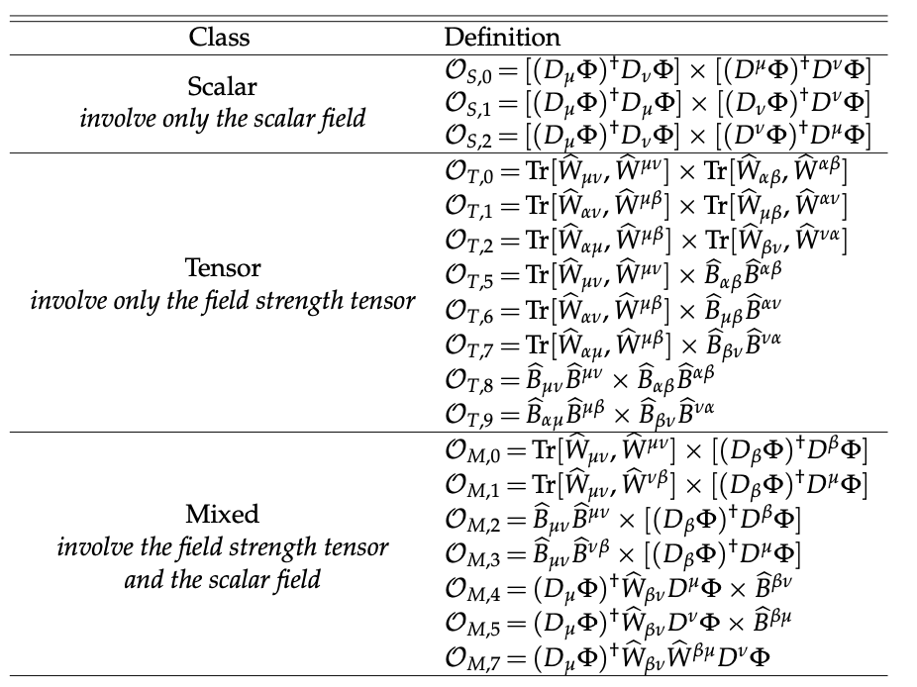

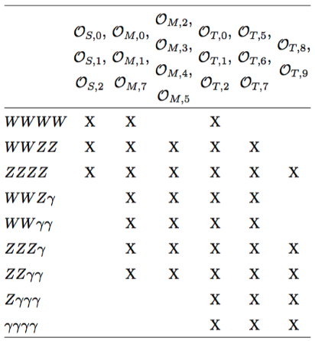
BSM physics in the EFT approach
some BSM phenomena can be described
in the EFT approach
EFT Lagrangian
dim-8 operators lead to anomalous
quartic gauge couplings (aQGCs)
  VBS is sensitive to aQGCs!
effect of aQGC is to enhance production
xs for large boson scattering energies
vertices modified
by aQGC operator

Slide 6
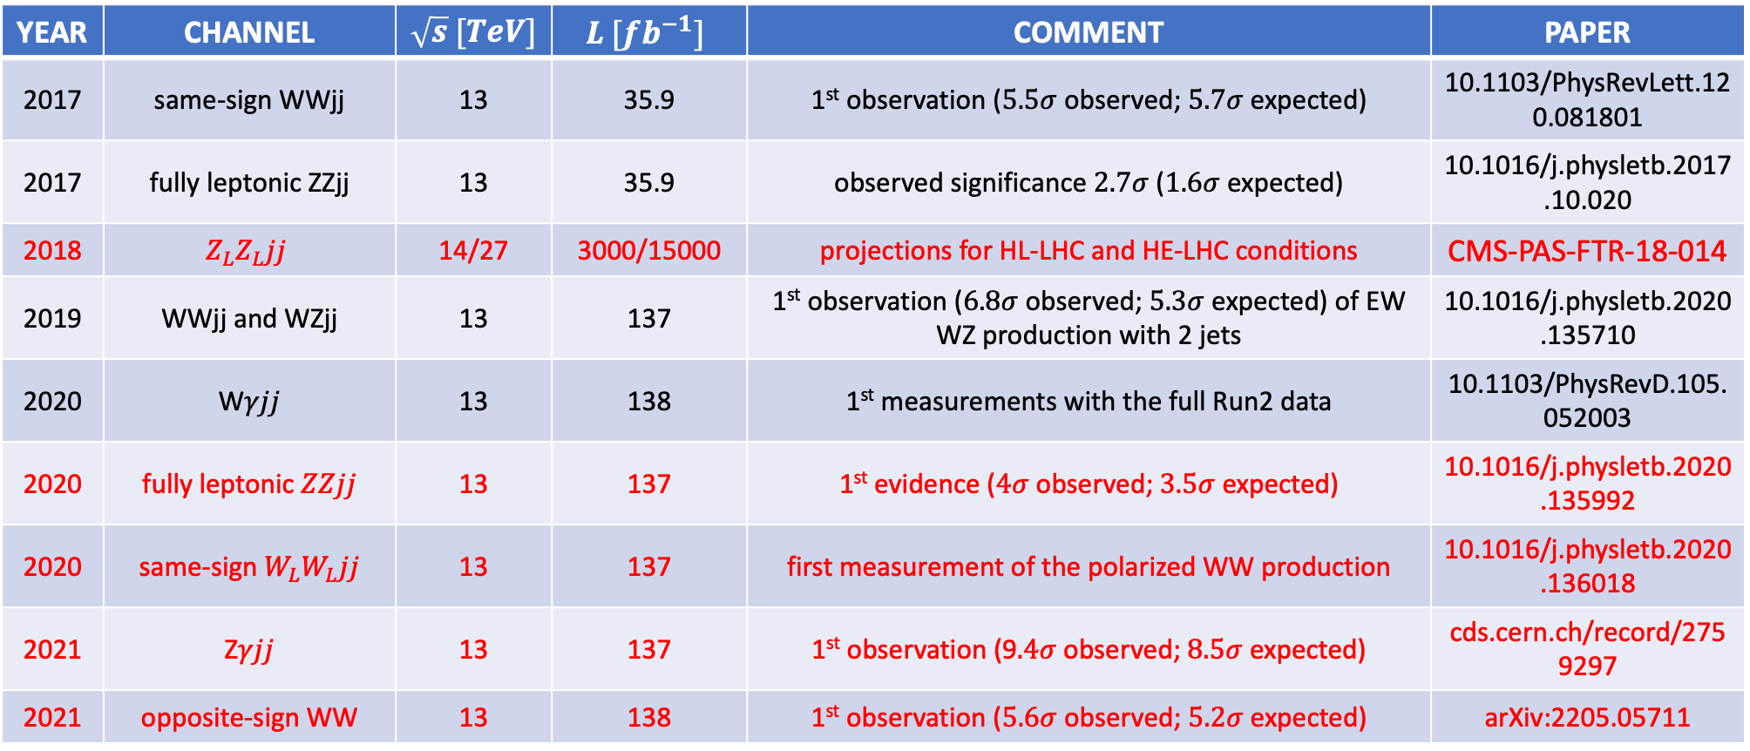
Summary of recent VBS measurements at CMS
YEAR | CHANNEL | $\sqrt{s} [TeV]$ | $$L [fb^{−1}]$$ | COMMENT | PAPER
2017 | same-sign WWjj | 13 | 35.9 | 1st observation ($5.5σ$ observed; $5.7σ$ expected) | 10.1103/PhysRevLett.120.081801
2017 | fully leptonic ZZjj | 13 | 35.9 | observed significance $2.7σ$ ($1.6σ$ expected) | 10.1016/j.physletb.2017.10.020
2018 | $$Z_{L}Z_{L}jj$$ | 14/27 | 3000/15000 | projections for HL-LHC and HE-LHC conditions | CMS-PAS-FTR-18-014
2019 | WWjj and WZjj | 13 | 137 | 1st observation ($6.8σ$ observed; $5.3σ$ expected) of EW WZ production with 2 jets | 10.1016/j.physletb.2020.135710
2020 | W$γjj$ | 13 | 138 | 1st measurements with the full Run2 data | 10.1103/PhysRevD.105.052003
2020 | fully leptonic $ZZjj$ | 13 | 137 | 1st evidence ($4σ$ observed; $3.5σ$ expected) | 10.1016/j.physletb.2020.135992
2020 | same-sign $W_{L}W_{L}jj$ | 13 | 137 | first measurement of the polarized WW production | 10.1016/j.physletb.2020.136018
2021 | Z$γjj$ | 13 | 137 | 1st observation (9$.4σ$ observed; $8.5σ$ expected) | cds.cern.ch/record/2759297
2021 | opposite-sign WW | 13 | 138 | 1st observation ($5.6σ$ observed; $5.2σ$ expected) | arXiv:2205.05711

Slide 7
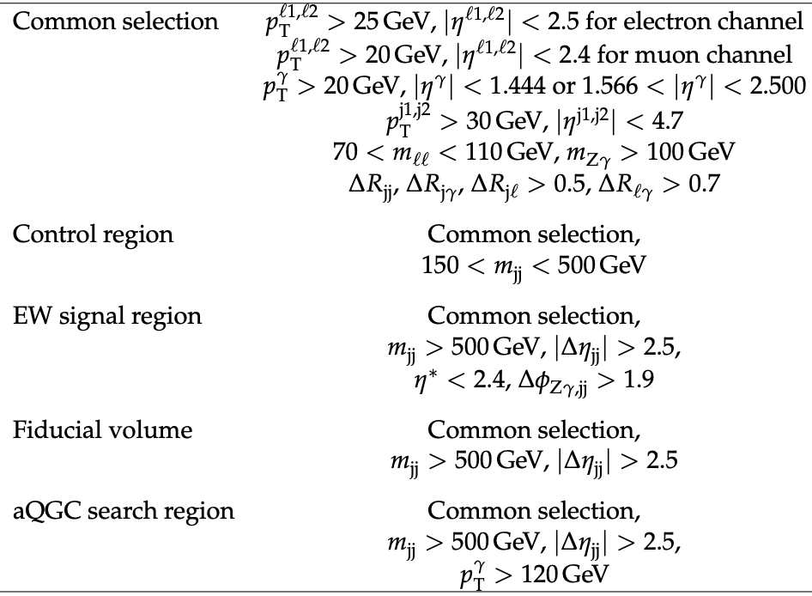

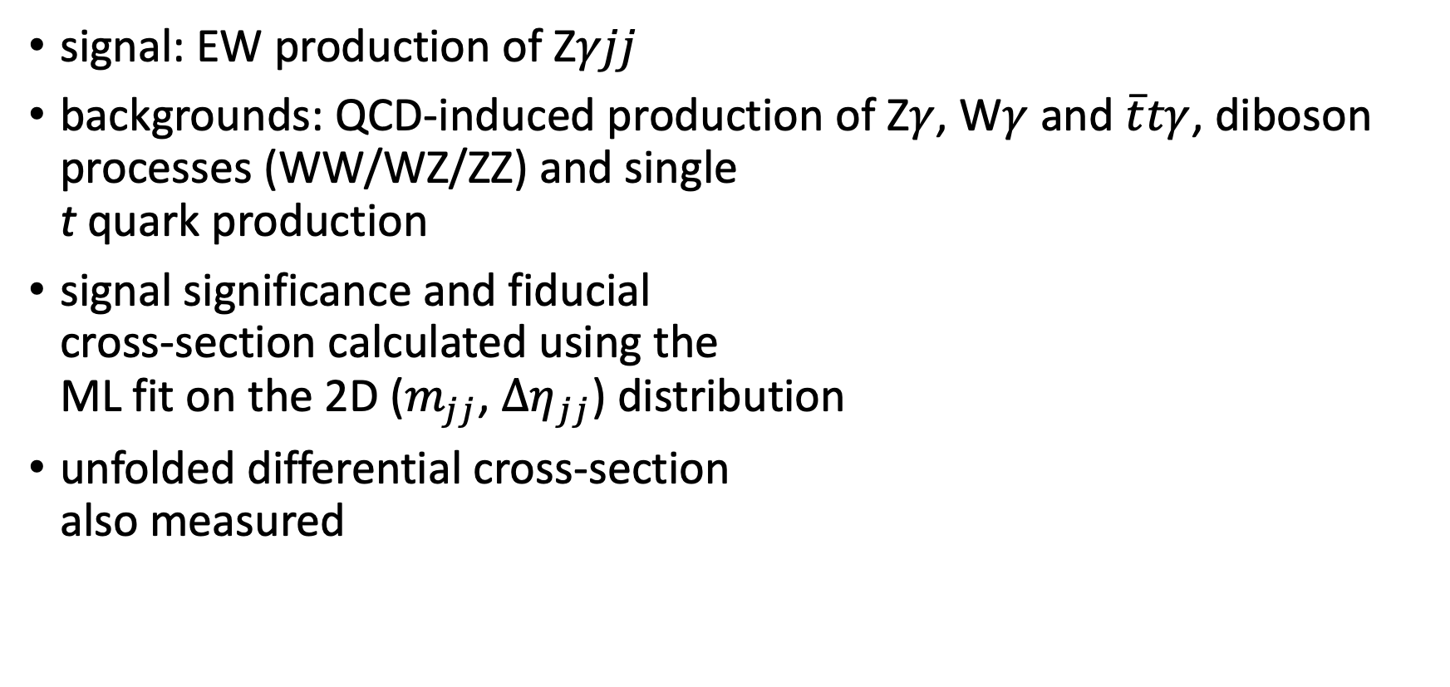
Z$γjj$ channel
signal: EW production of Z$γjj$
backgrounds: QCD-induced production of Z$γ$, W$γ$ and $\overline{t}tγ$, diboson processes (WW/WZ/ZZ) and single
t quark production
signal significance and fiducial
cross-section calculated using the
ML fit on the 2D ($m_{jj}$, $Δη_{jj}$) distribution
unfolded differential cross-section
also measured

Slide 8
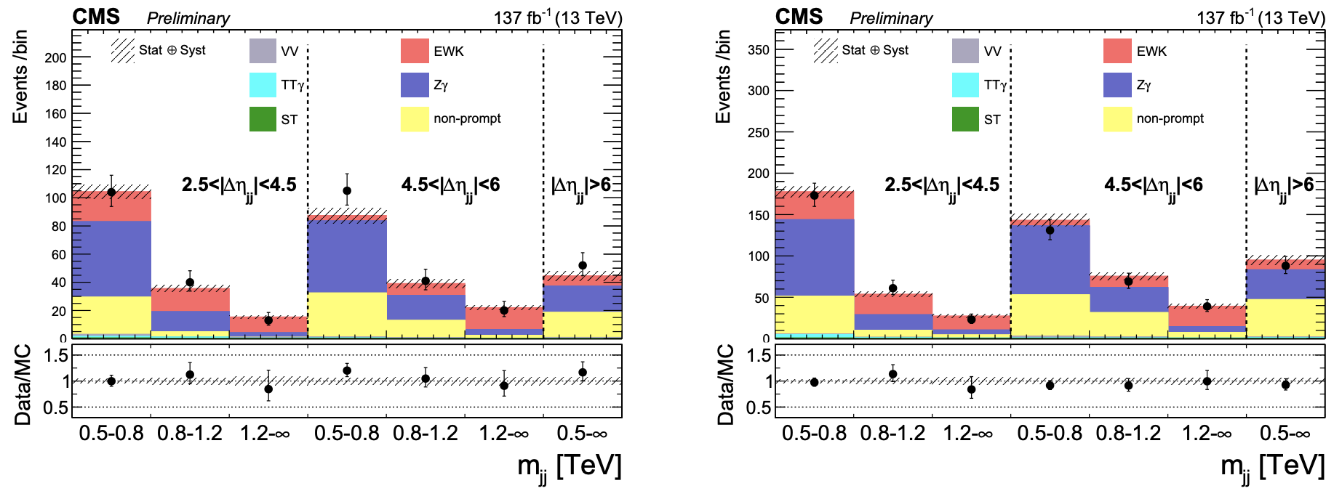
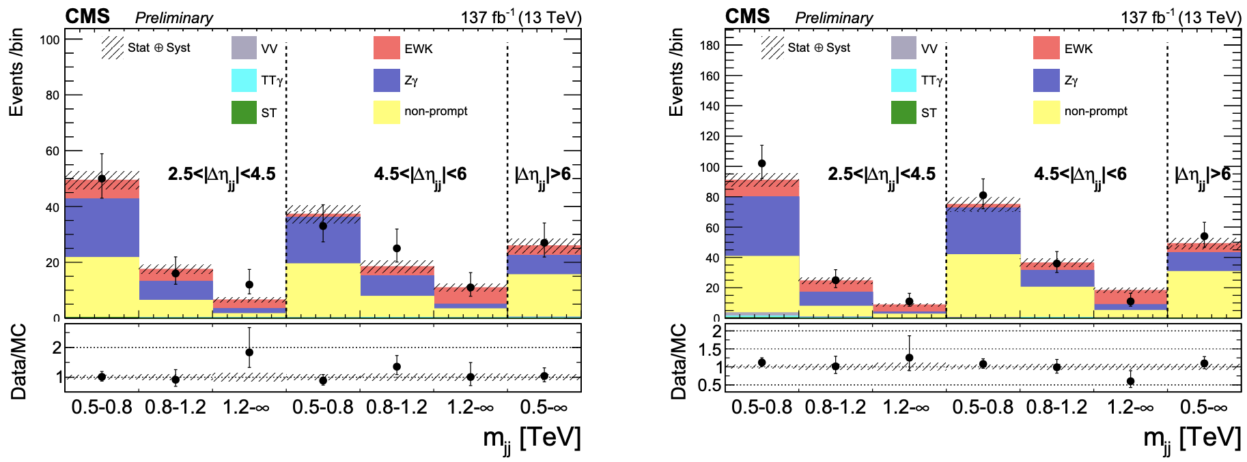



Z$γjj$ channel (cont’d)
observed significance $9.4σ$
reported ($8.5σ$ expected)
$σ_{EW}^{fid}=5.21±0.76 fb$
$σ_{EW+QCD}^{fid}=14.7±1.53 fb$
signal strength and unfolded
xs measured in bins of leading
photon, lepton and jet p_{T} and
in bins of two variables
barrel
$$m_{jj}−Δη_{jj}$$
endcap

Slide 9
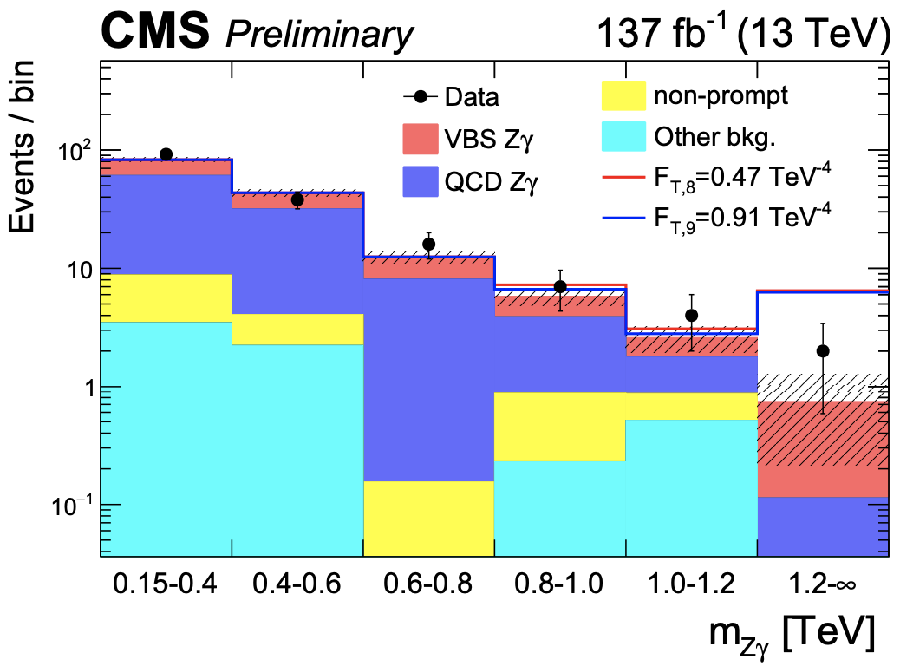
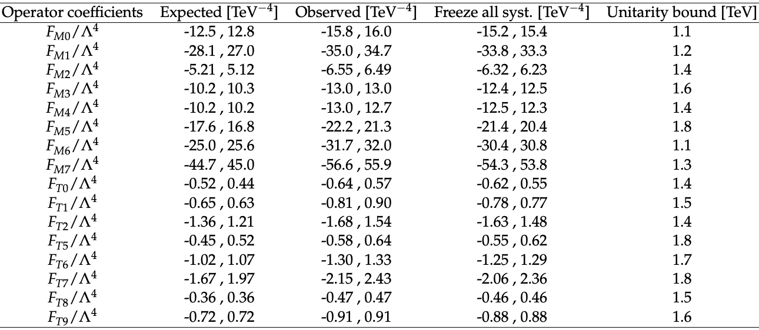
Z$γjj$ channel (cont’d)
limits imposed on aQGCs in the EFT approach
most stringent limits on the neutral-current operator T9
95% CL exclusion limits for $F_{M_{0−7}}$ and $F_{T_{0−2,5−9}}$ parameters

Slide 10
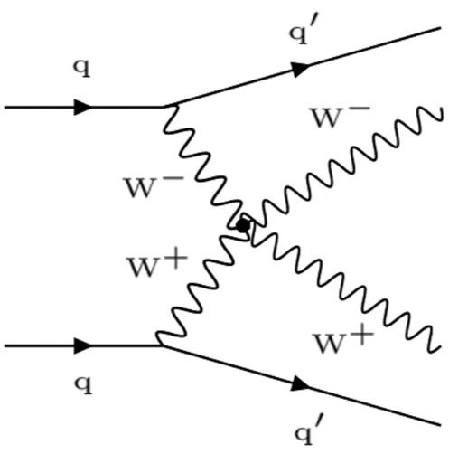
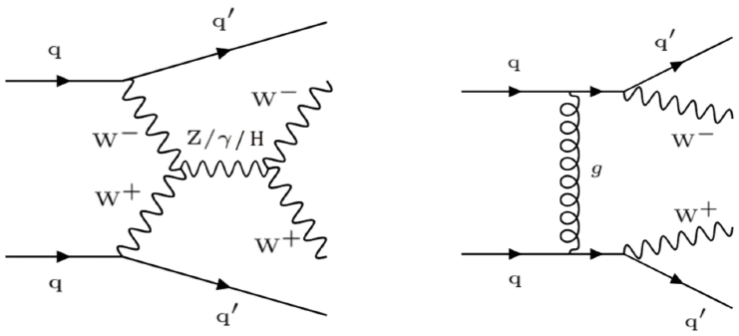

Opposite-sign WWjj channel
signal: EW production of 2 OS, leptonically decaying Ws
background: QCD-induced production of the $W^{+}W^{−}$jj,
reducible bkg. from $t\overline{t}$ production, DY+j and W+j production
more challenging than $W^{±}W^{±}$because of OS bkg from $t\overline{t}$ prod.
only recently first NLO calculation fpr the
EW production of $W^{+}W^{−}$ become available
selection: 2 OS leptons with $m_{ll}>50 GeV$,
$p_{T}^{ll}>30 GeV$, $p_{T}^{l_{1}(l_{2})}>25\left(13\right)GeV$,
$p_{T}^{miss}>20 GeV$, at least 2j with $p_{T}>30 GeV$
$m_{jj}>300 GeV$ and $Δη_{jj}>2.5$

Slide 11
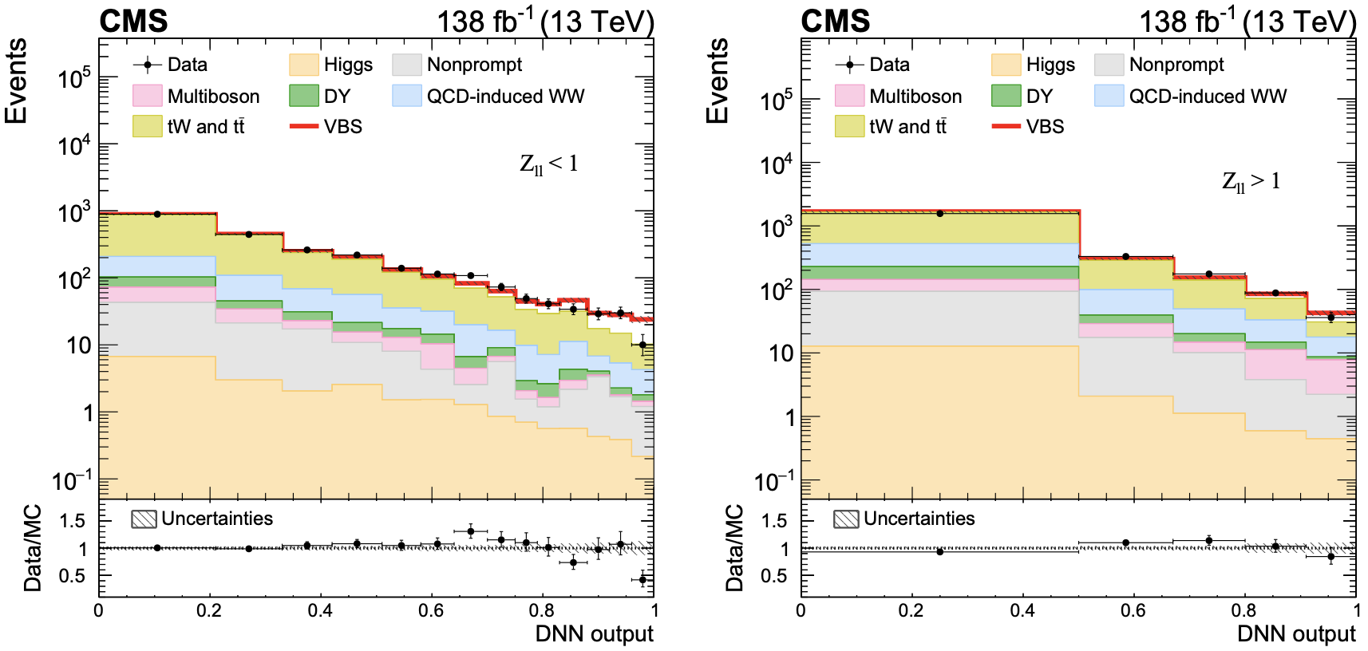

Opposite-sign WWjj channel (cont’d)
deep neural network (DNN) used to separate VBS signal from QCD-induced and $t\overline{t}$ backgrounds
  for optimization, 2 models built: for the region with low ($Z_{ll}<1$) and high ($Z_{ll}>1$)values of the Zeppenfeld variable
observed (expected) signal
significance 5.6$σ$ (5.2$σ$)
fid. xs $10.2±2.0 fb$ in
agreement with the SM
prediction $9.1±0.6 fb$

Slide 12
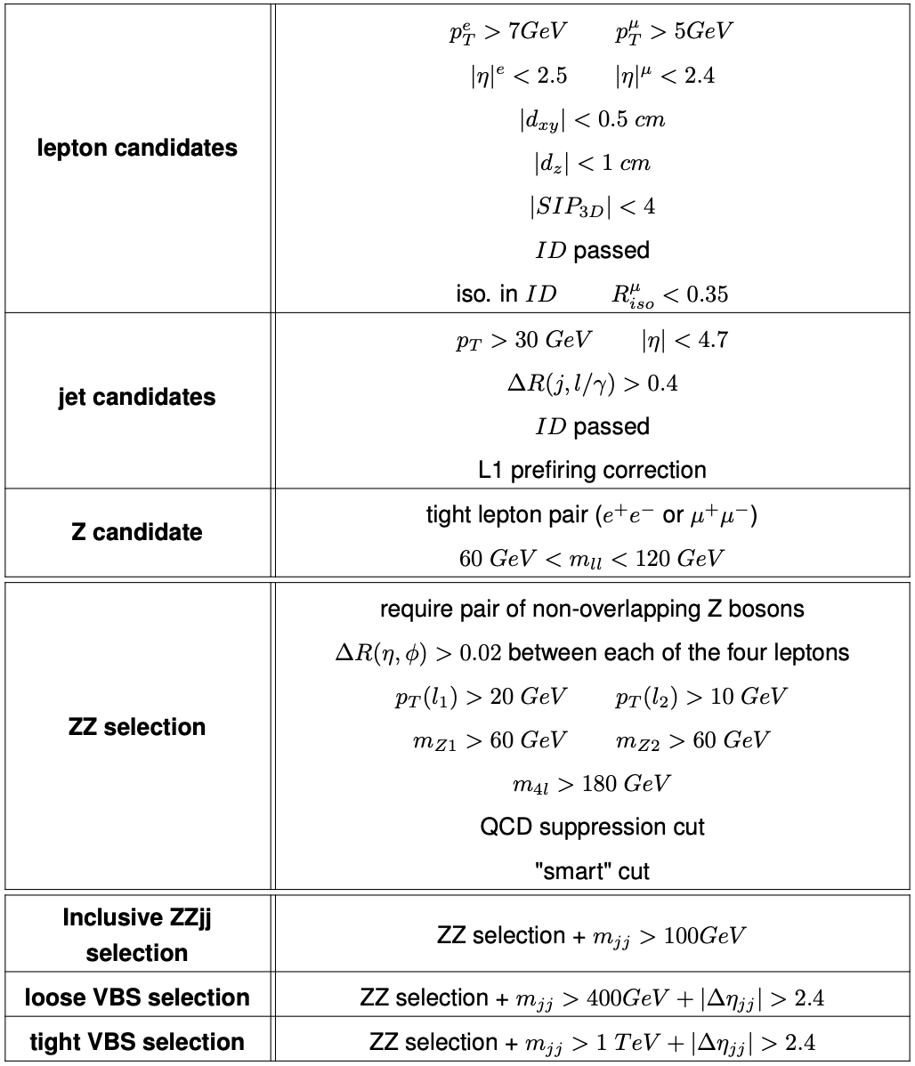
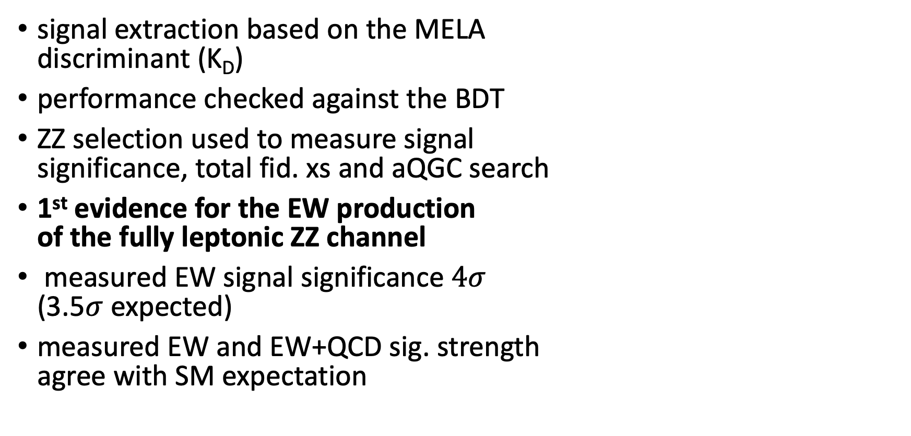

Fully leptonic $ZZjj$ channel
signal extraction based on the MELA
discriminant (K_{D})
performance checked against the BDT
ZZ selection used to measure signal
significance, total fid. xs and aQGC search
1st evidence for the EW production
of the fully leptonic ZZ channel
measured EW signal significance $4σ$
(3.5$σ$ expected)
measured EW and EW+QCD sig. strength
agree with SM expectation

Slide 13
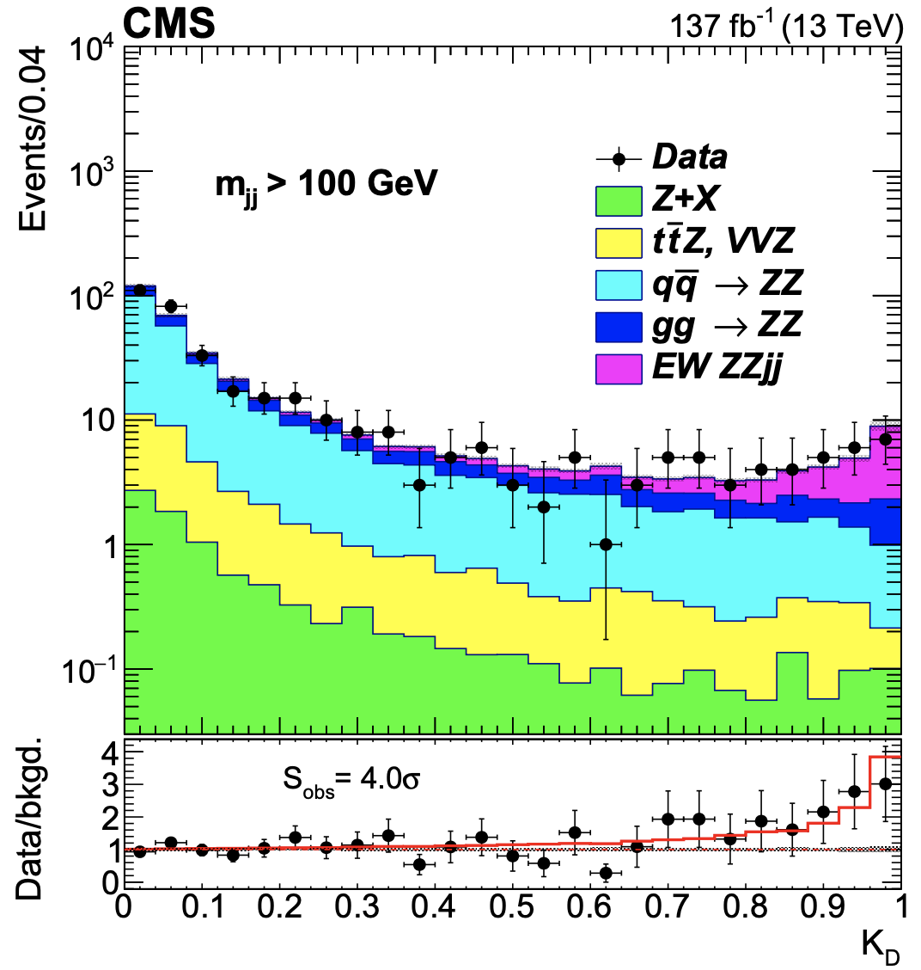
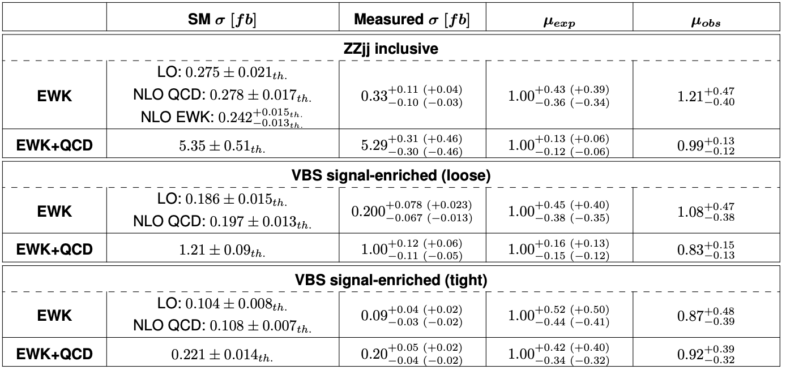

Fully leptonic $ZZjj$ channel (cont’d)
cross-section measured in 3 fiducial regions
SM predictions extracted from generated events
in MC samples
for EWK, theory predictions at NLO included

Slide 14
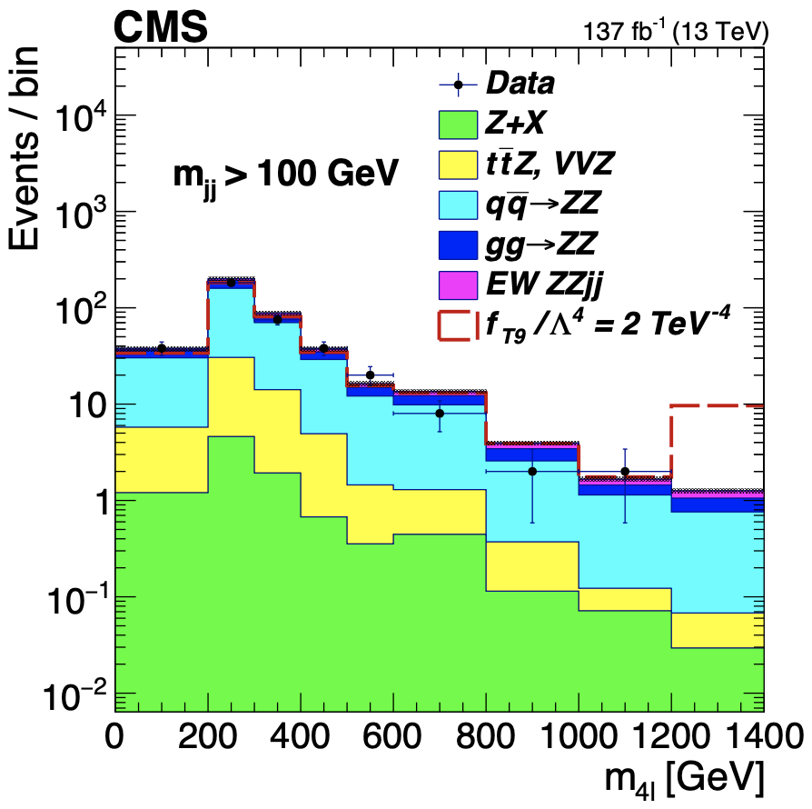
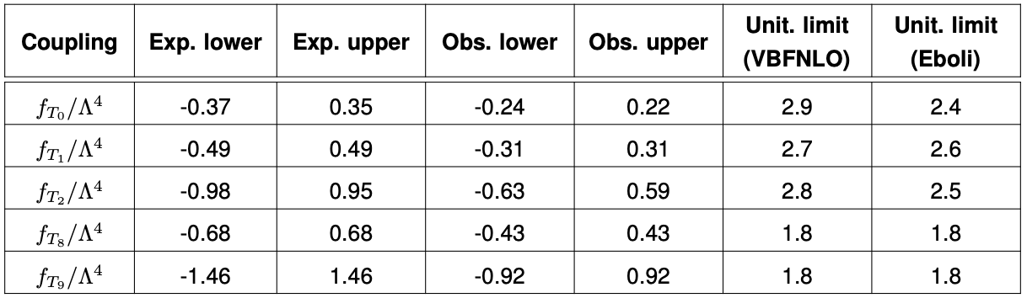
Fully leptonic $ZZjj$ channel (cont’d)
95% CL limits on couplings of operators
T_{0,1,2,8,9} imposed in the EFT framework

Slide 15
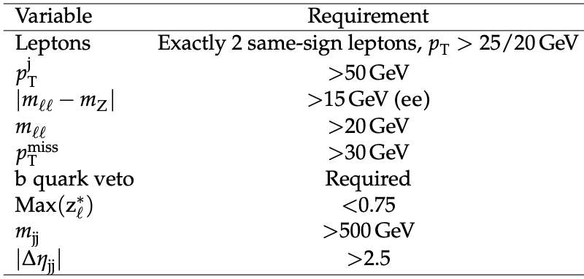
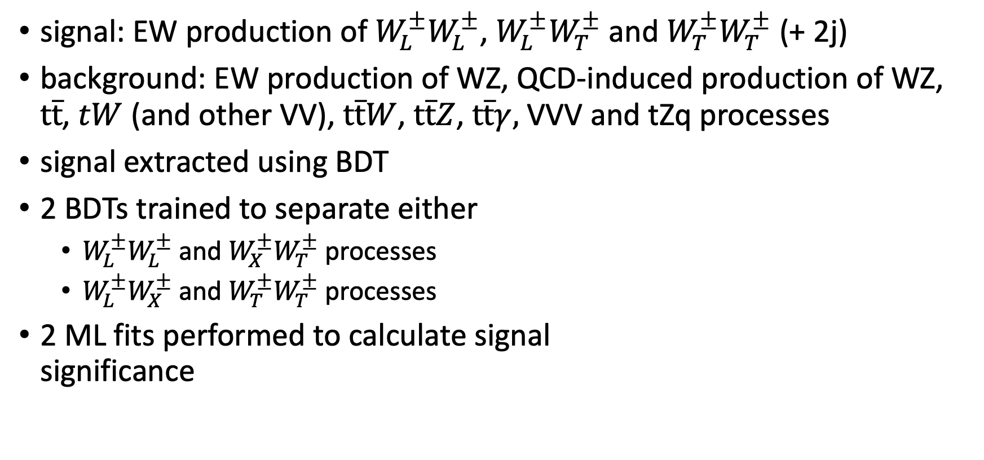


Same-sign $W_{L}W_{L}jj$ channel
signal: EW production of $W_{L}^{±}W_{L}^{±}$, $W_{L}^{±}W_{T}^{±}$ and $W_{T}^{±}W_{T}^{±}$ (+ 2j)
background: EW production of WZ, QCD-induced production of WZ,
$t\overline{t}$, $tW$ (and other VV), $t\overline{t}W$, $t\overline{t}Z$, $t\overline{t}γ,$ VVV and tZq processes
signal extracted using BDT
2 BDTs trained to separate either
  $W_{L}^{±}W_{L}^{±}$ and $W_{X}^{±}W_{T}^{±}$ processes
  $W_{L}^{±}W_{X}^{±}$ and $W_{T}^{±}W_{T}^{±}$ processes
2 ML fits performed to calculate signal
significance
requirements defining $W^{±}W^{±}$ SR

Slide 16
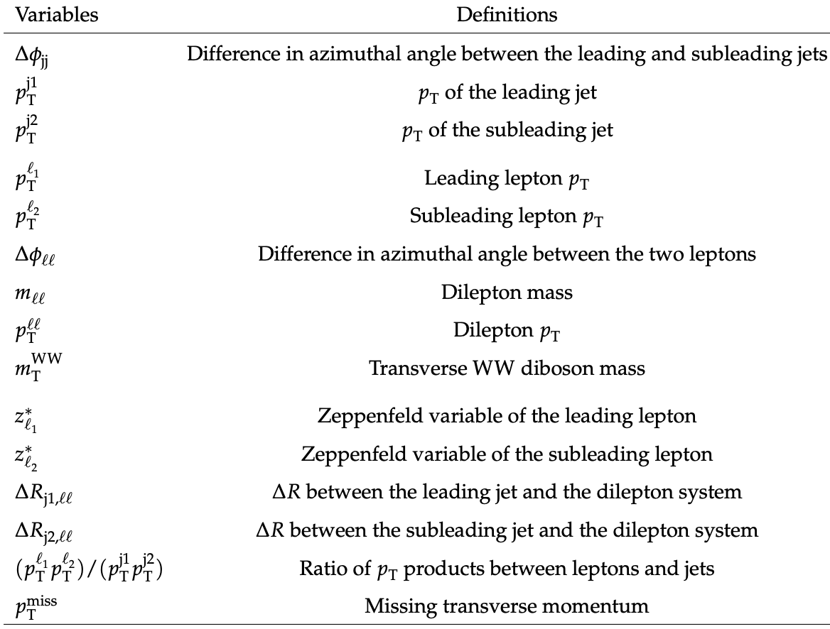

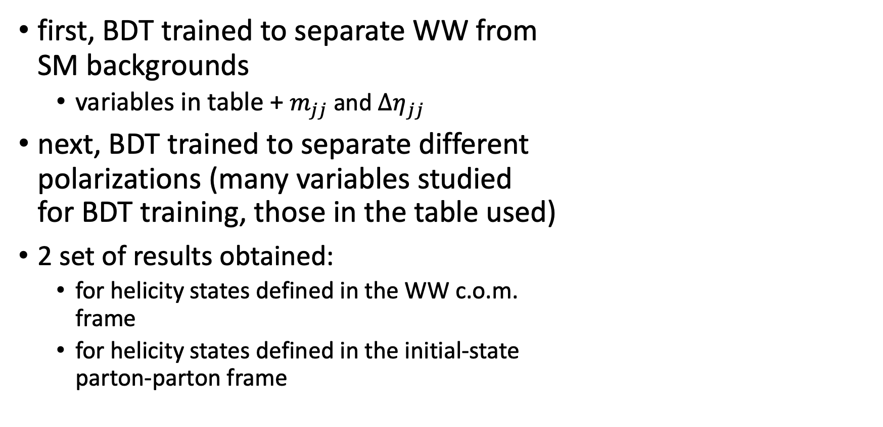
Same-sign $W_{L}W_{L}jj$ channel (cont’d)
first, BDT trained to separate WW from
SM backgrounds
  variables in table + $m_{jj}$ and $Δη_{jj}$
next, BDT trained to separate different
polarizations (many variables studied
for BDT training, those in the table used)
2 set of results obtained:
  for helicity states defined in the WW c.o.m.
  frame
  for helicity states defined in the initial-state
  parton-parton frame

Slide 17
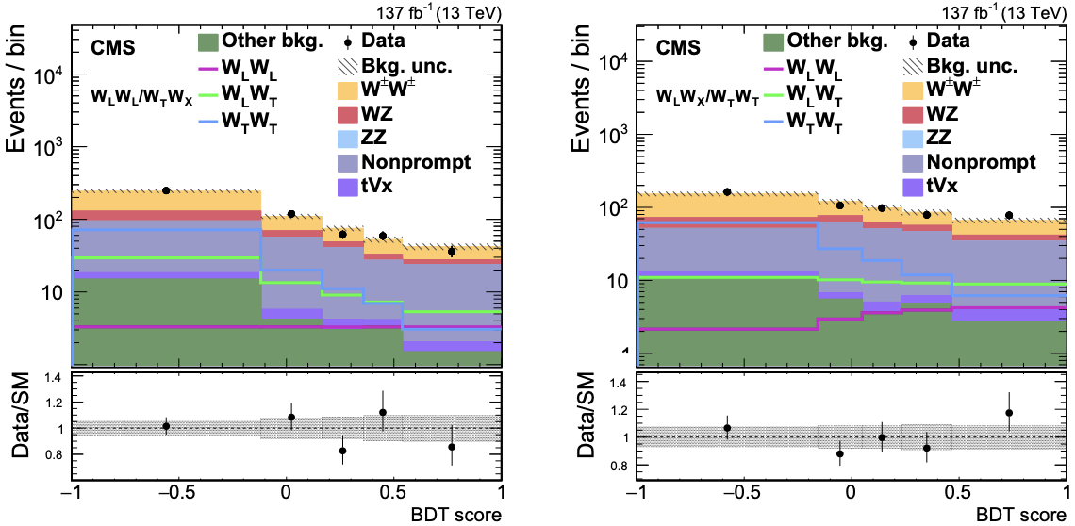
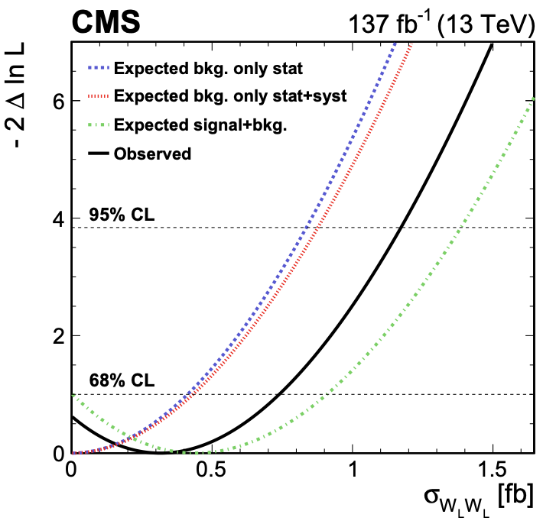
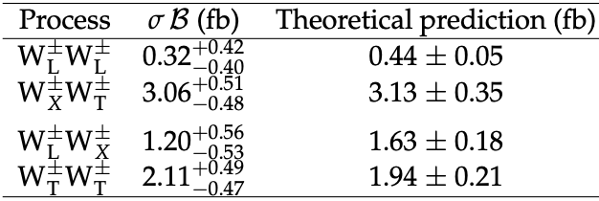
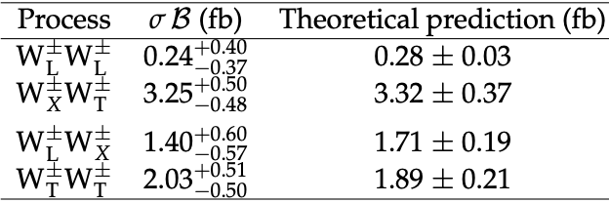
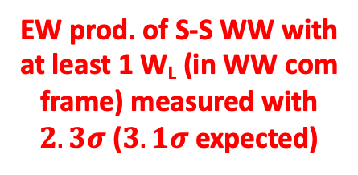
Same-sign $W_{L}W_{L}jj$ channel (cont’d)
scans of the negative profile log-likelihood as a function of W_{L}W_{L} xs
observed UL
@95%CL = 1.17 fb
EW prod. of S-S WW with
at least 1 W_{L} (in WW com
frame) measured with
$2.3σ$ ($3.1σ$ expected)
part.-part. c.o.m.
WW c.o.m.
fiduc. xs.

Slide 18
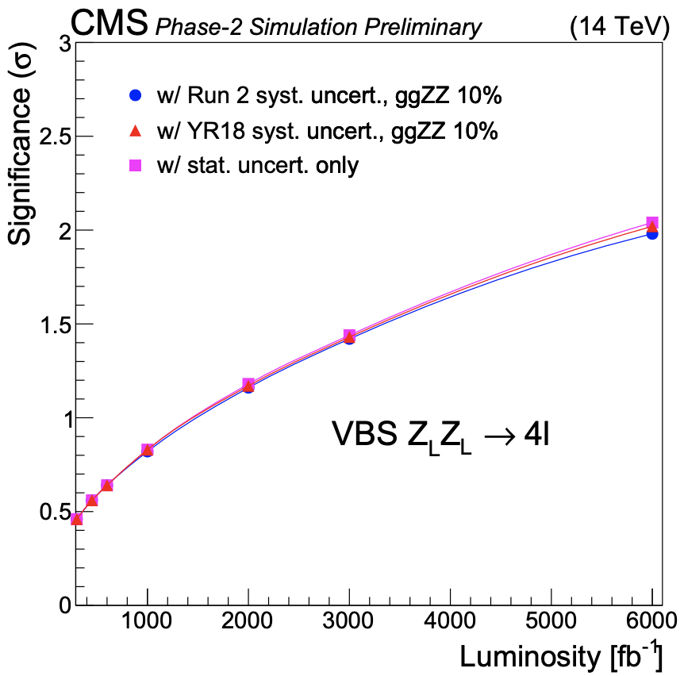
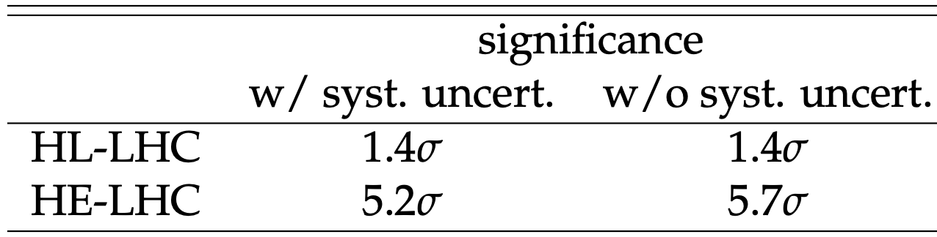
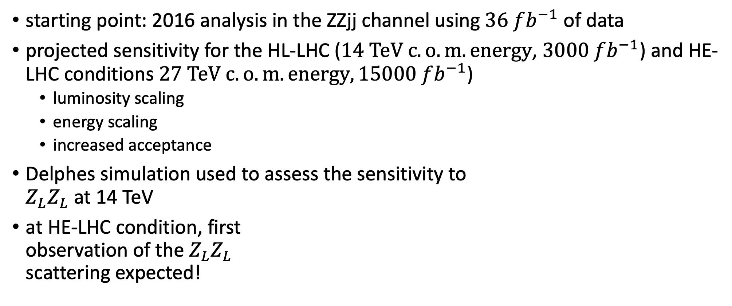

Prospective studies for the $Z_{L}Z_{L}jj$ production
starting point: 2016 analysis in the ZZjj channel using $36 fb^{−1}$ of data
projected sensitivity for the HL-LHC ($14 TeV c.o.m. energy$, $3000 fb^{−1}$) and HE-LHC conditions $27 TeV c.o.m. energy,15000 fb^{−1}$)
  luminosity scaling
  energy scaling
  increased acceptance
Delphes simulation used to assess the sensitivity to
$Z_{L}Z_{L}$ at 14 TeV
at HE-LHC condition, first
observation of the $Z_{L}Z_{L}$
scattering expected!

Slide 19
Conclusion
Full CMS Run2 data analyses brought significant new results:
  first observation of WZjj
  first evidence of ZZjj
  first observation of OS WWjj
  first measurements of longitudinal scattering in the SS WWjj channel
  important test of the EWSB mechanism
  more stringent limits on the aQGC parameters
ToDo: extraction of the polarisation components in the VVjj channels,
further constraints on the aQGC
at the HE-LHC conditions the first observation of the longitudinal scattering in the ZZjj channel expected significant benefit of further energy increase for further understanding EW sector of the SM

