Slide 1
Innovative Accelerator Technologies
Frank Zimmermann, CERN
2022 LHC Days in Split, 7 October 2022

Slide 2
Colliders constructed & operated
A. Ballarino
Colliders with
superconducting RF system
Colliders with
superconducting arc magnet system
Colliders with
superconducting magnet & RF
advances by new technologies and new materials

Slide 3
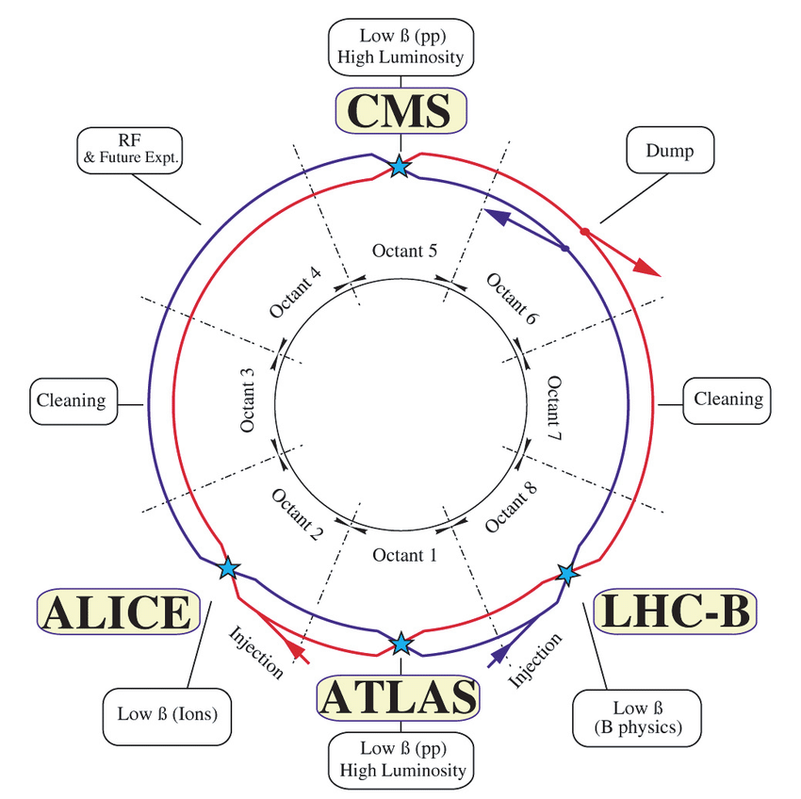
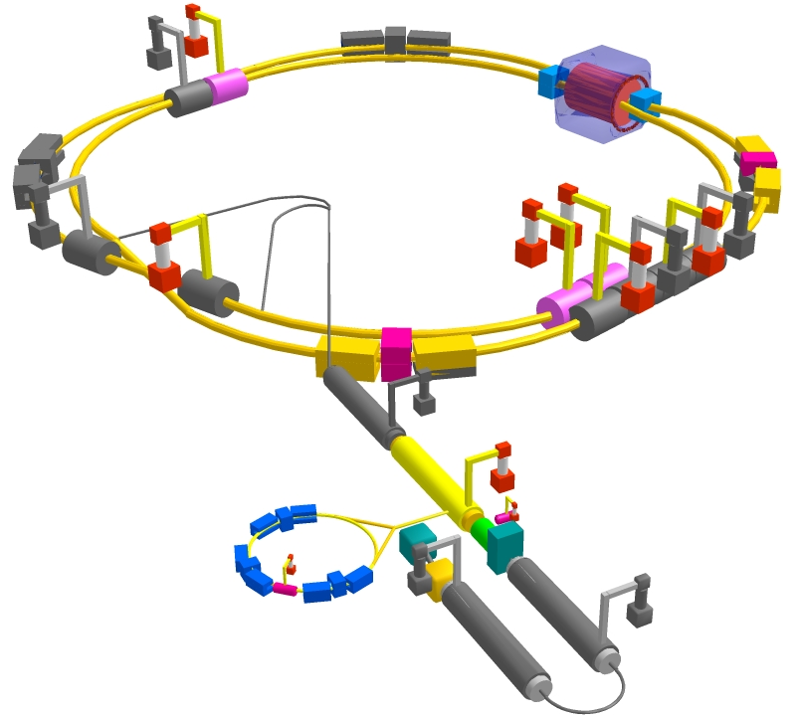
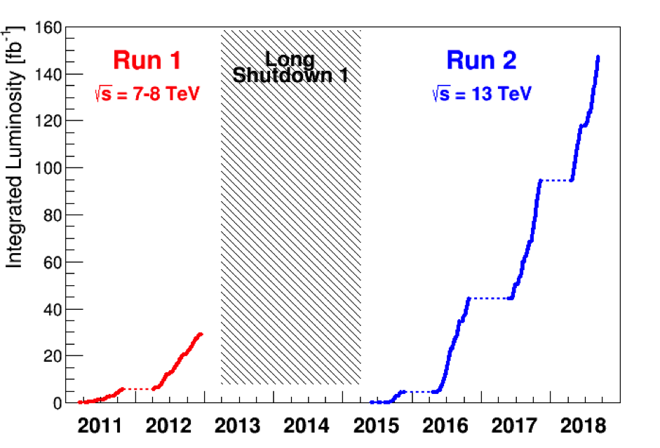
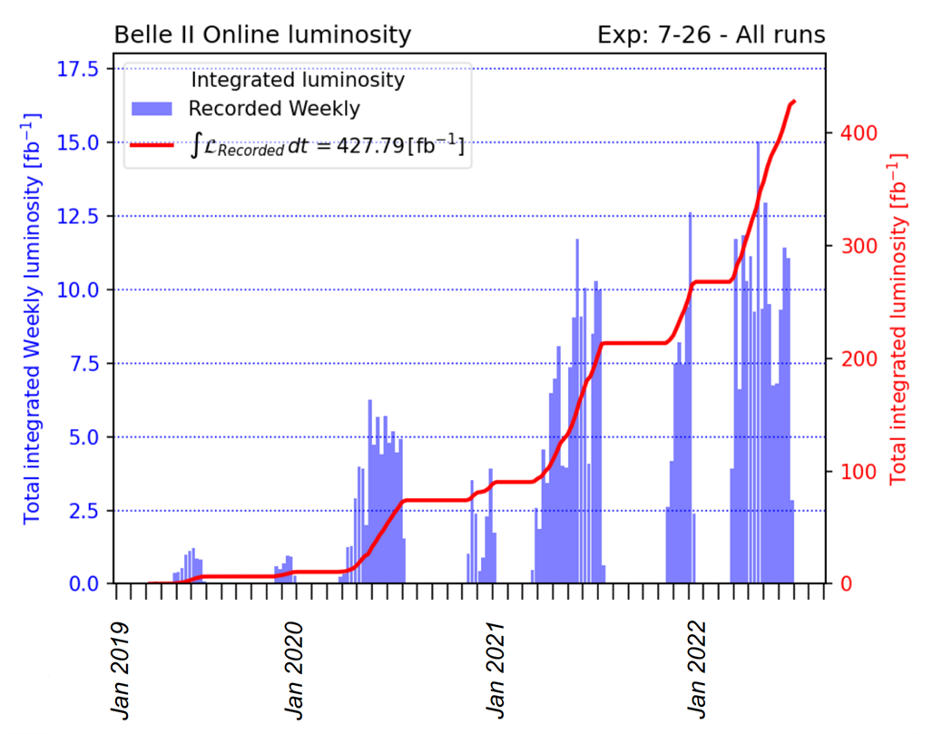
Collider State of the Art
Large Hadron Collider
LHC
SuperKEKB

Slide 4
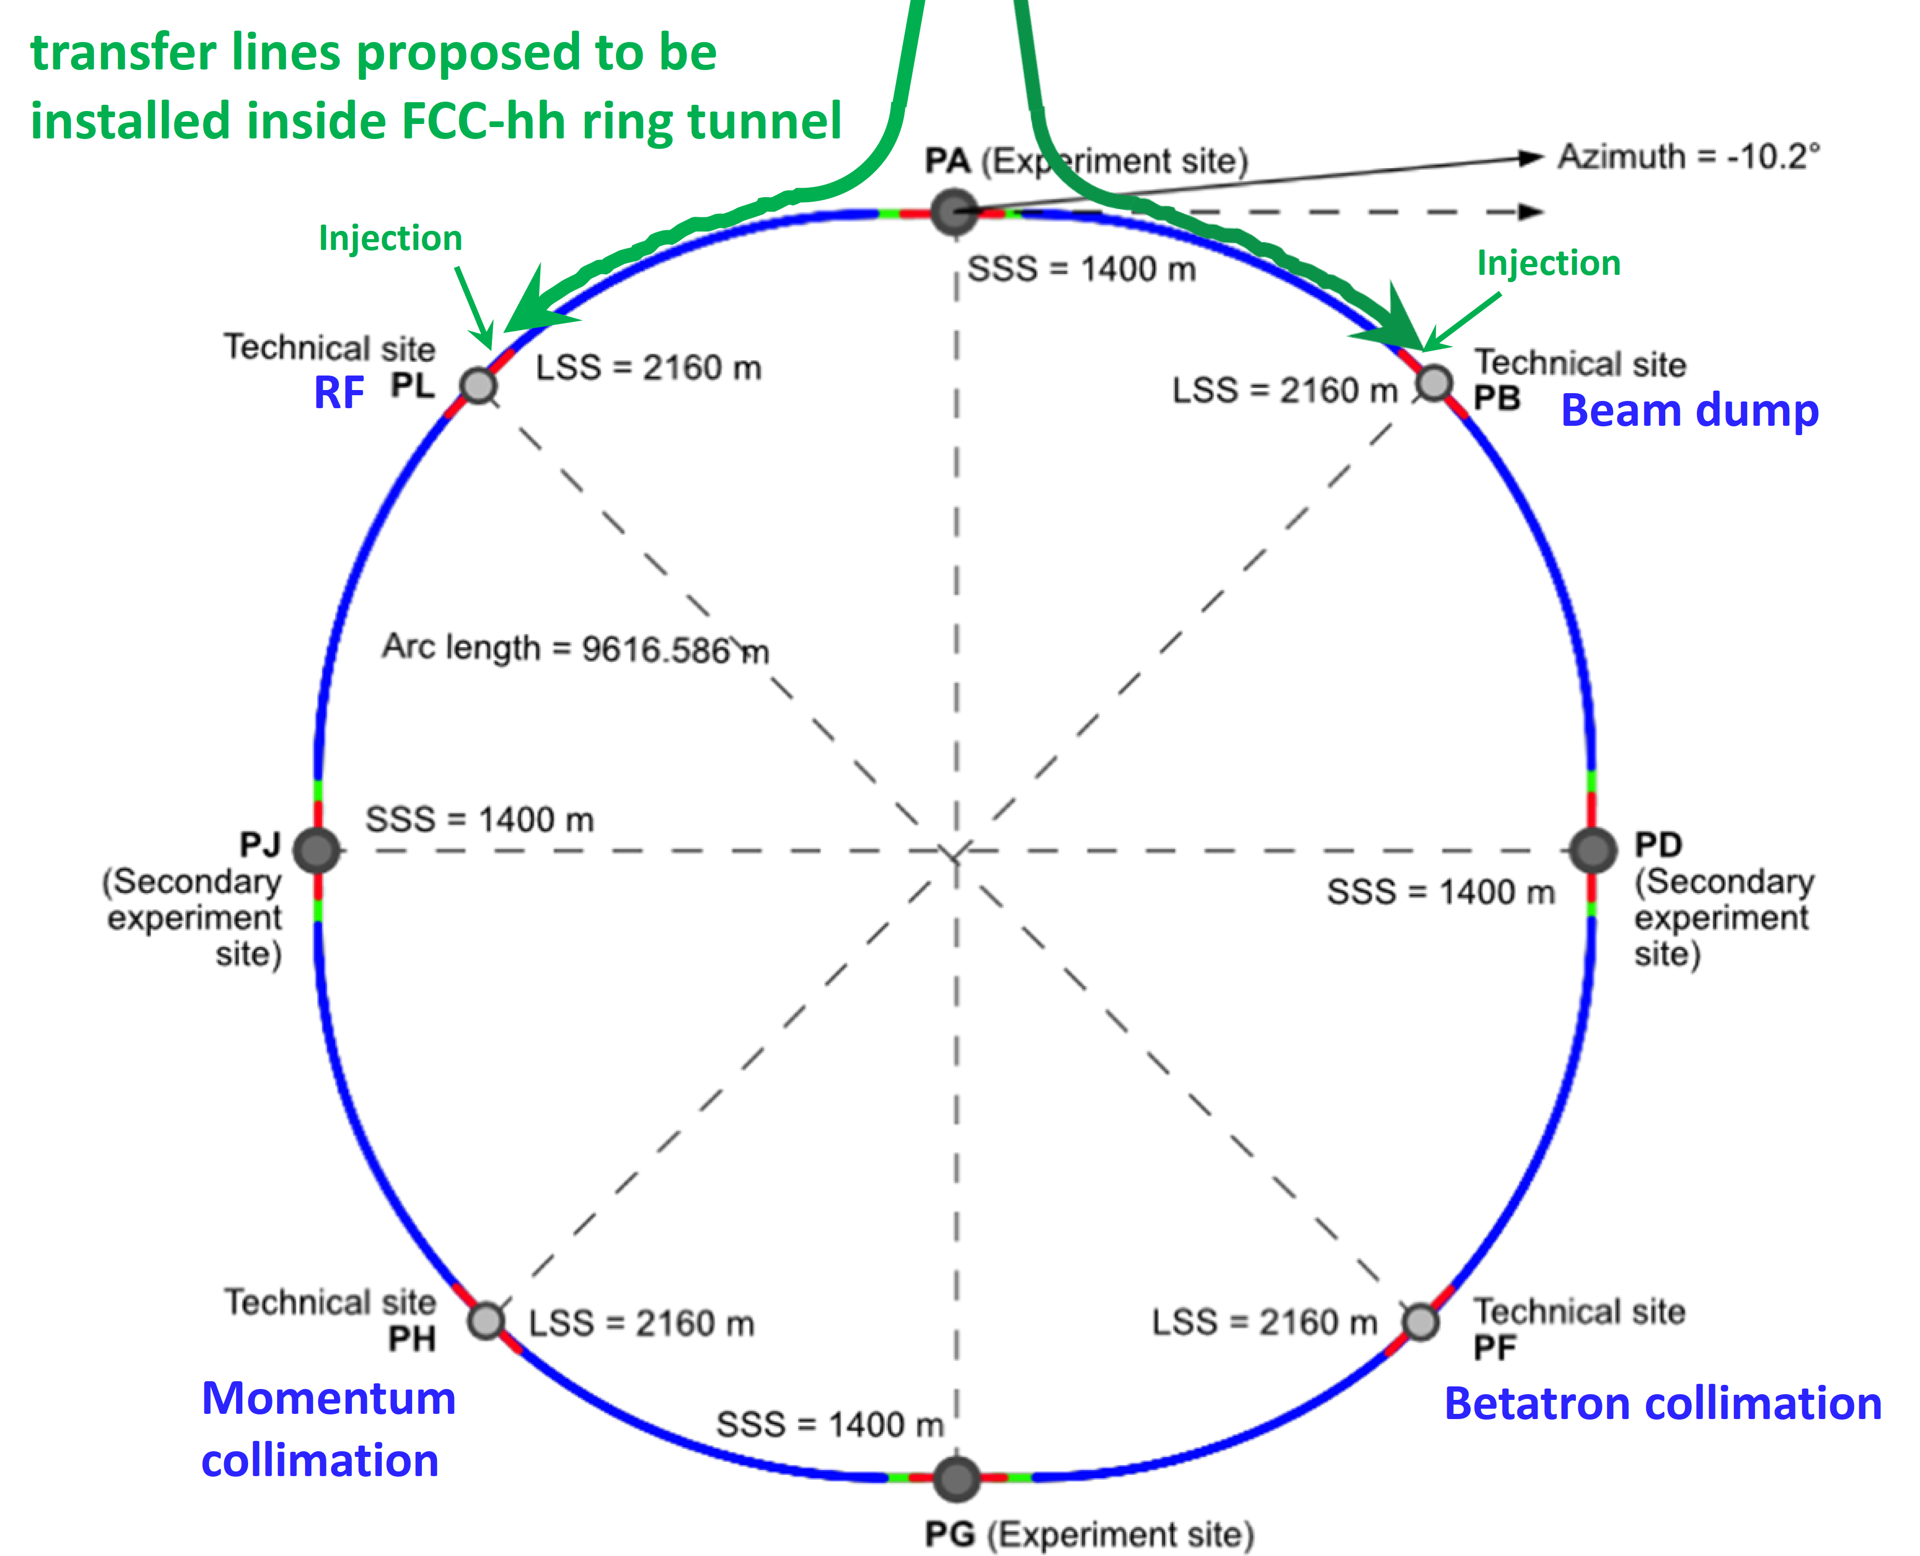
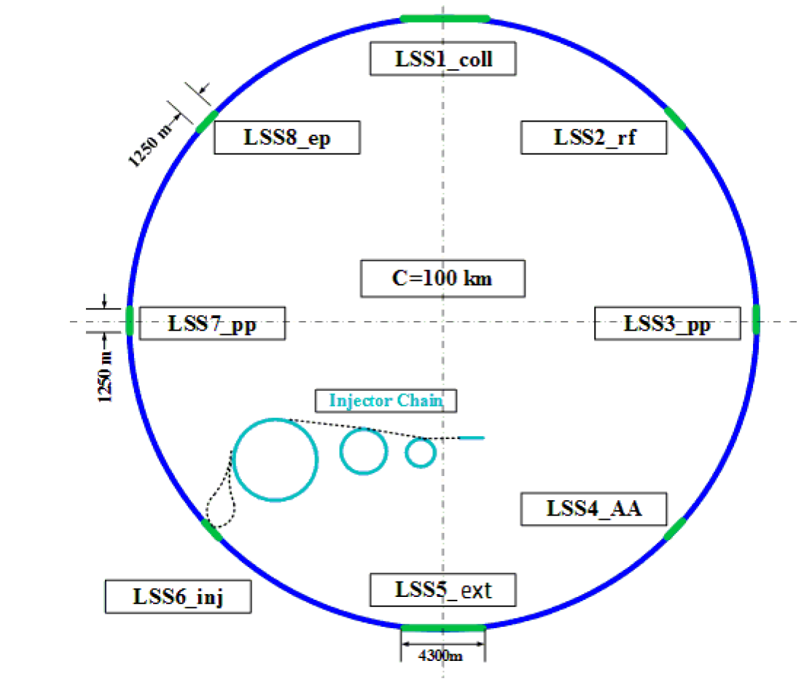
Proposed Higher-Energy Hadron Colliders
FCC-hh
SPPC
Snowmass ‘21

Slide 5
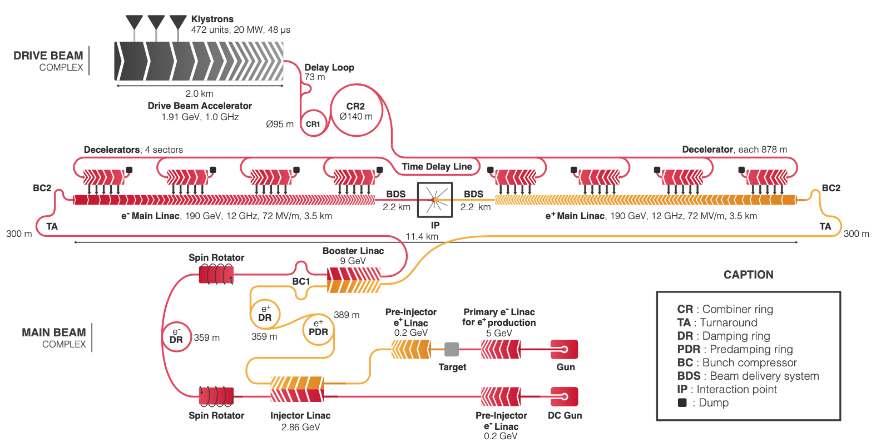
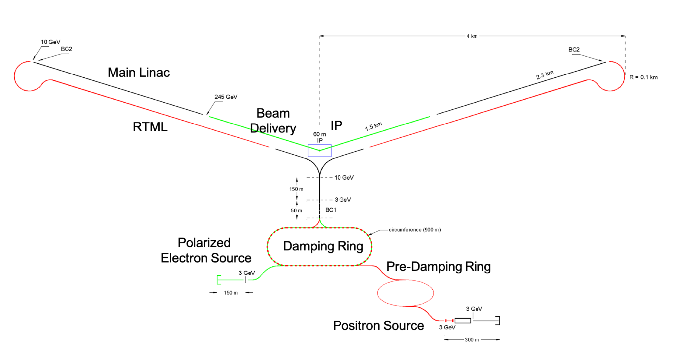
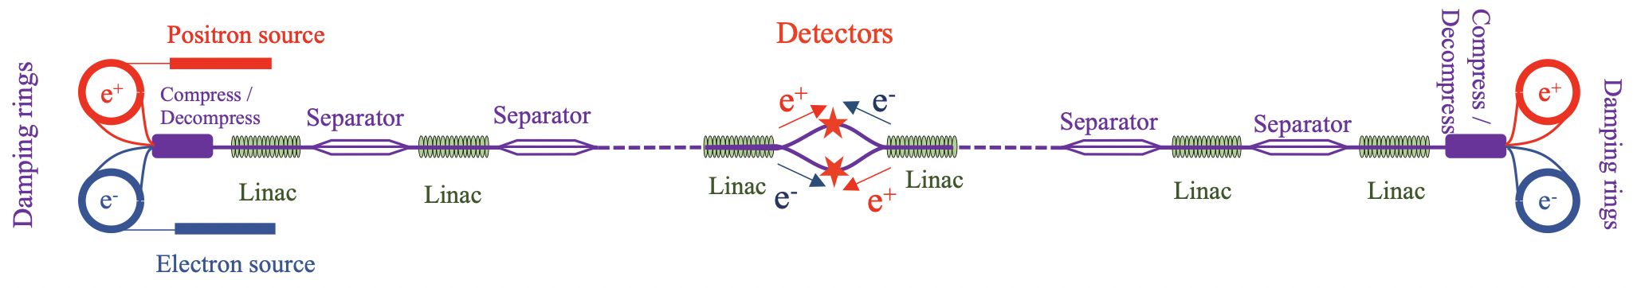
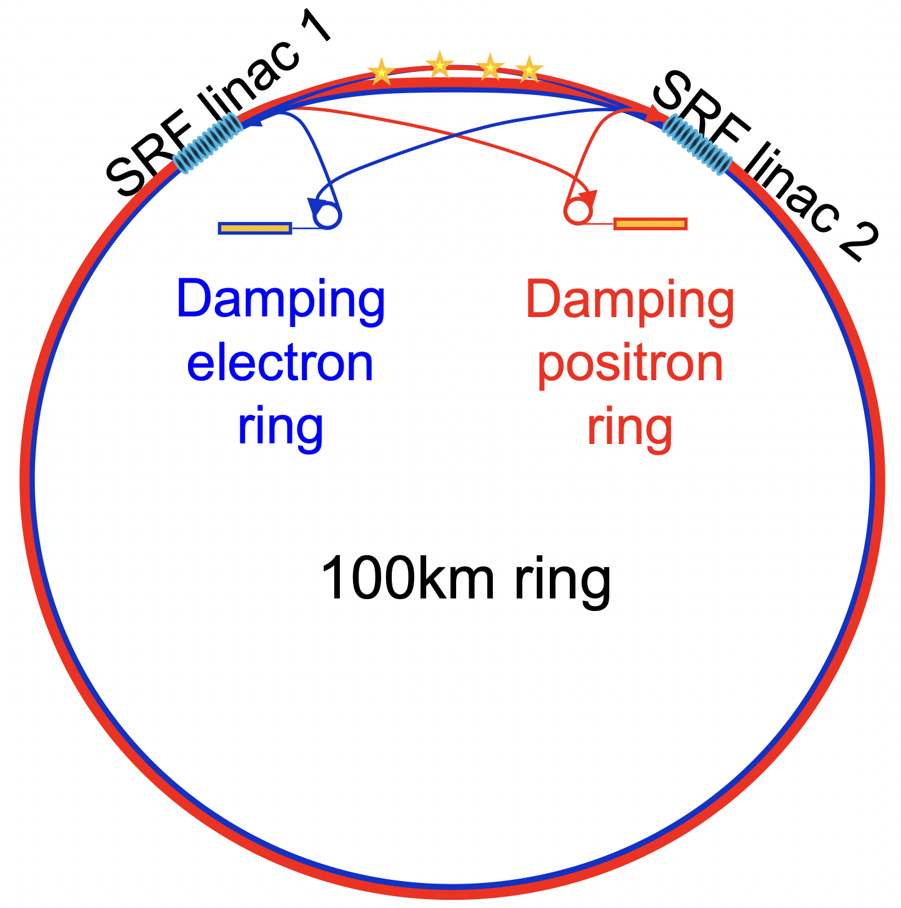
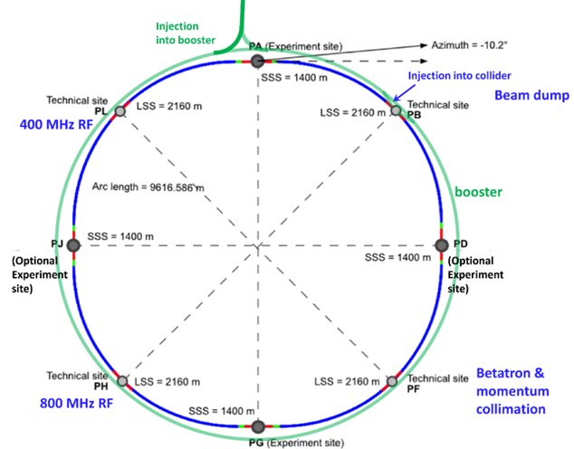
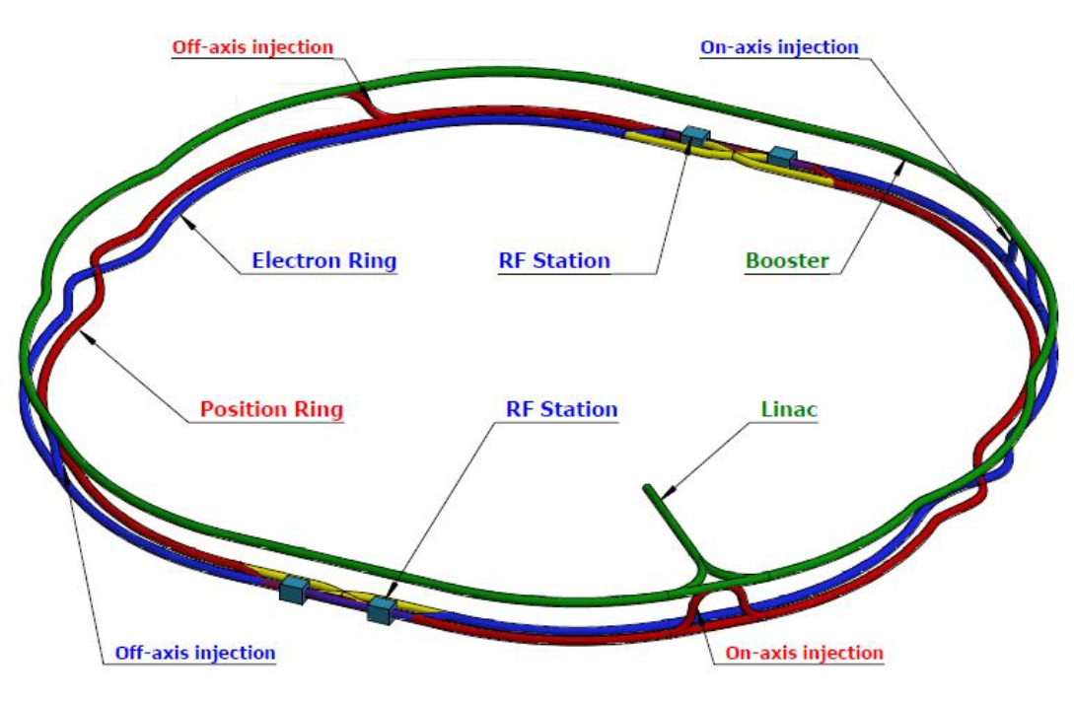
Proposed e⁺e⁻ Higgs & EW Factories
ILC
CLIC
C³
HELEN
RELIC
CEPC
CERC
FCC-ee
Snowmass ‘21

Slide 6
Towards the next, next-next and next-next-next generation of accelerators – main themes
Energy Recovery Linacs
γγ colliders
Muon Collider(s)
Advanced Accelerator Concepts
Sustainability
High-field magnets
SC Radiofrequency systems
Efficient RF power sources
e⁺ production
Gamma Factory
Monochromatization

Slide 7
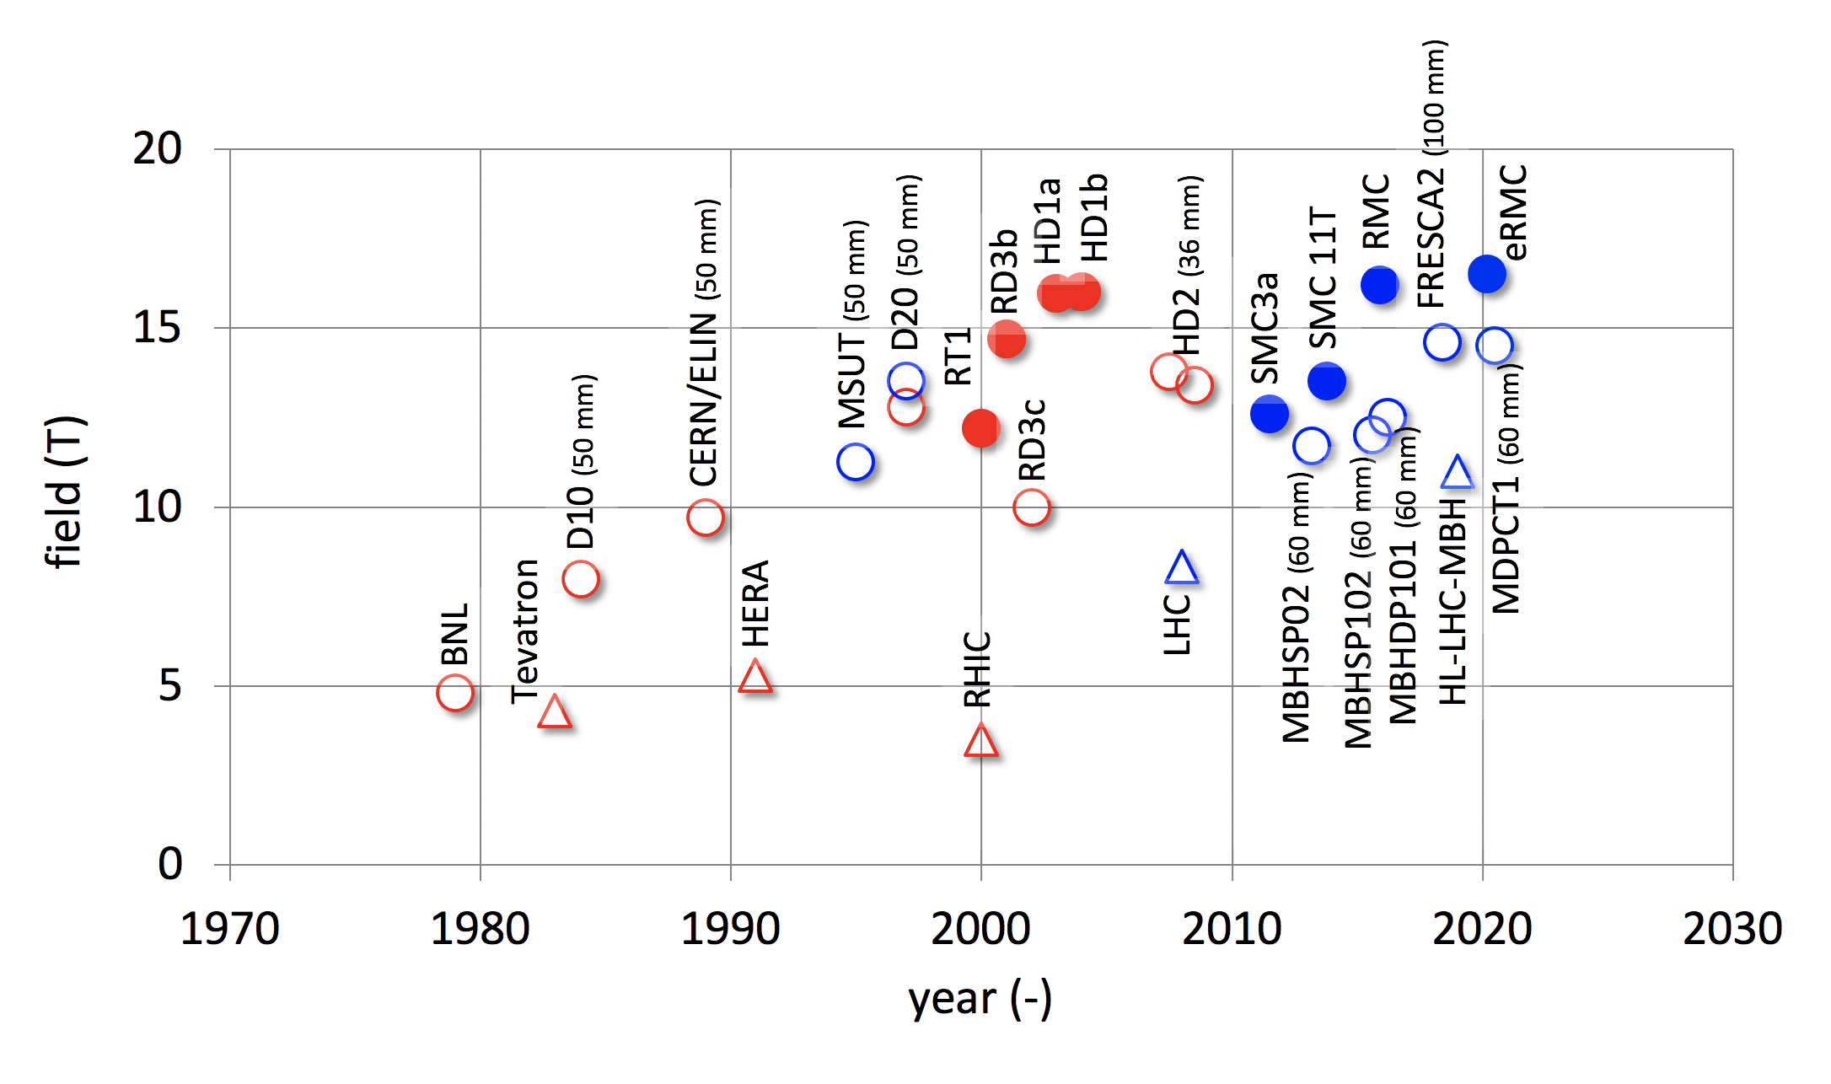
High-Field Magnet – historical progress
Luca Bottura

Slide 8
CERN High-Field Magnet Program
Development of robust and cost-efficient processes
LHC
Robust Nb₃Sn
HL-LHC QXF
Logical step for a next phase (2027-2034)
HL-LHC 11T
D20
Ultimate Nb₃Sn
Fresca2
MDPCT1
Exploration of new concepts and technologies
HTS
Luca Bottura

Slide 9
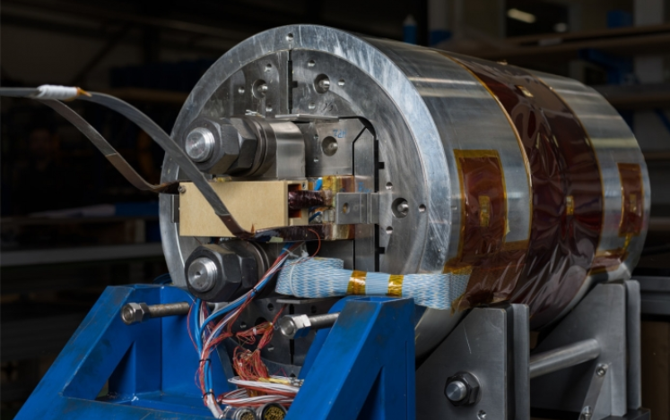
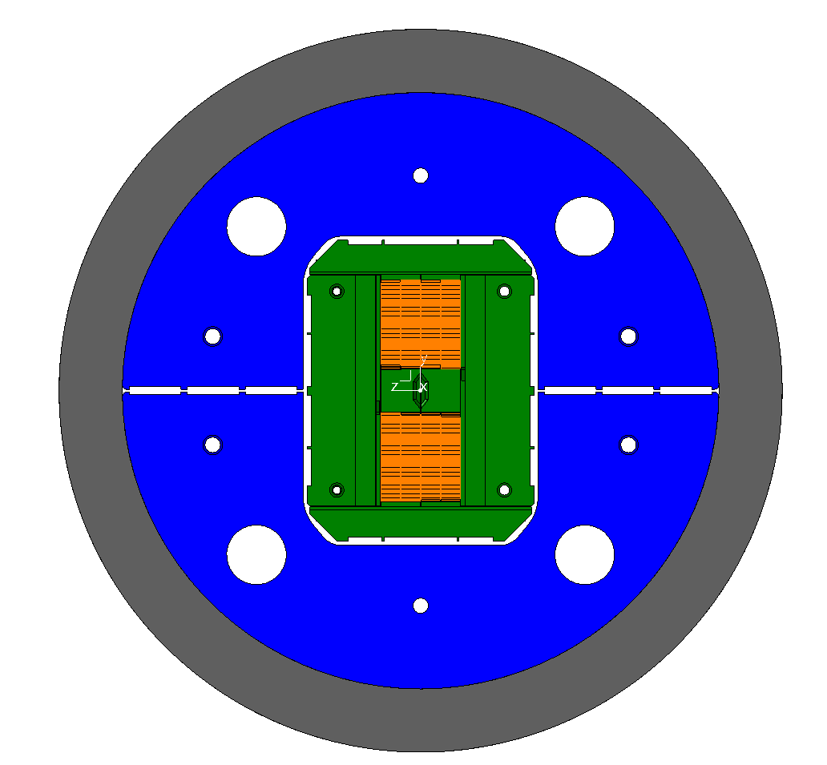
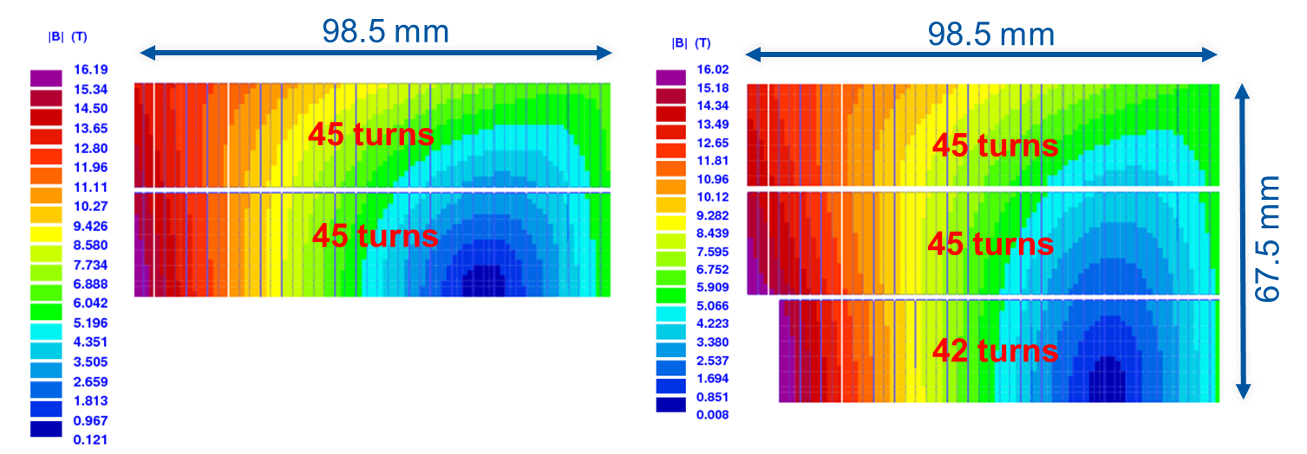
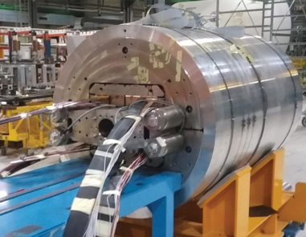
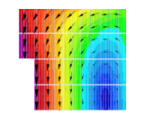
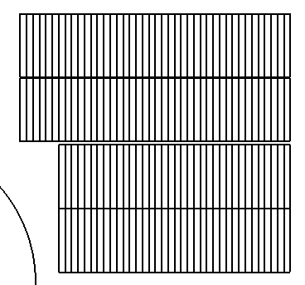
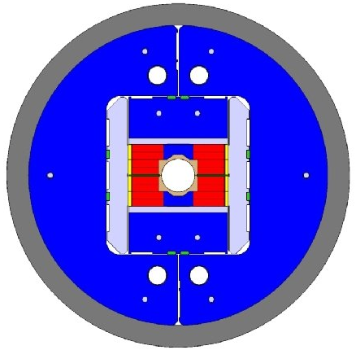
High-Field Nb₃Sn Magnets
CERN
FNAL
RMC/eRMC (2-decks, no aperture), 16.5 T
MDPCT1 (4-layer graded coil, 60 mm), 14.5 T
FRESCA2 (4-decks, 100 mm), 14.6 T

Slide 10
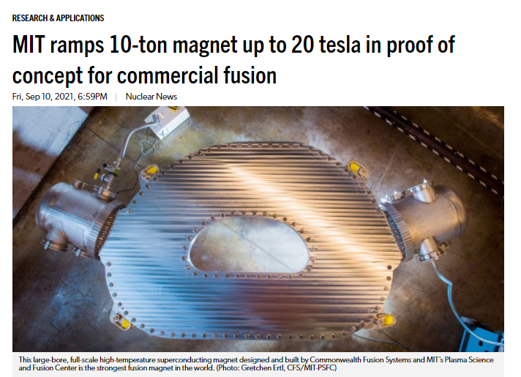
Nuclear Fusion HTS Magnet Progress
September 2021
toroidal model coil
HTS material:
REBCO
synergies
with accelerator magnet
developments

Slide 11
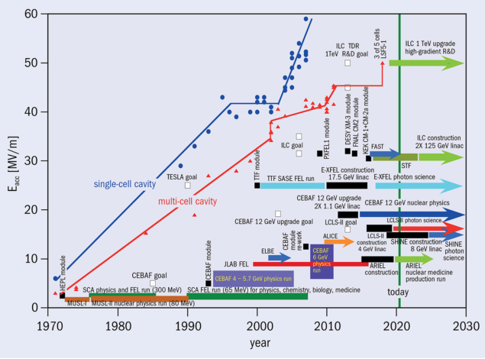
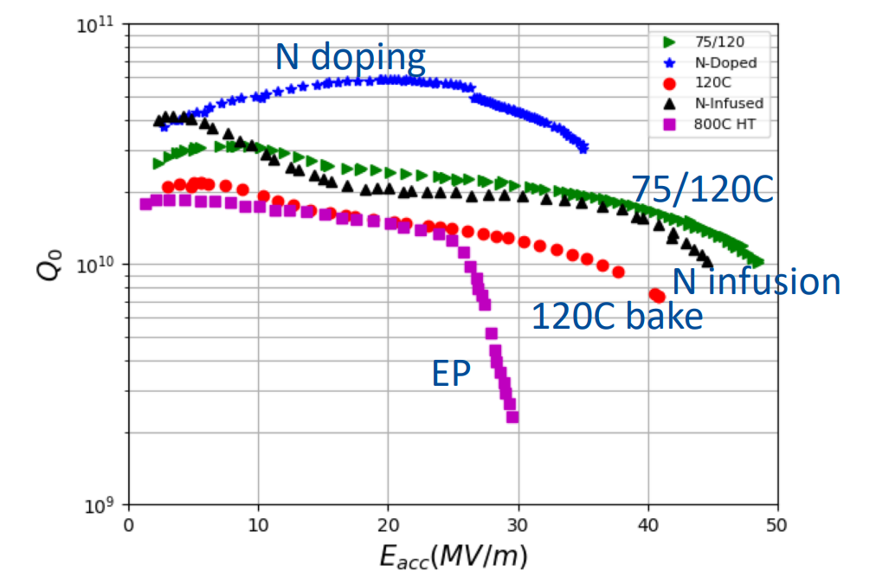
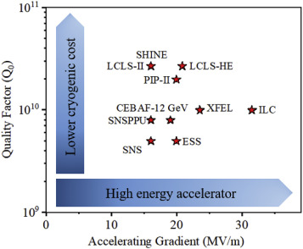
SC Radiofrequency Systems
Anna Grasselino
P. Dhakal
Gradient growth SRF linac accelerating gradient achievements and application specifications since 1970 (CERN Courier., Nov. 2020)

Slide 12
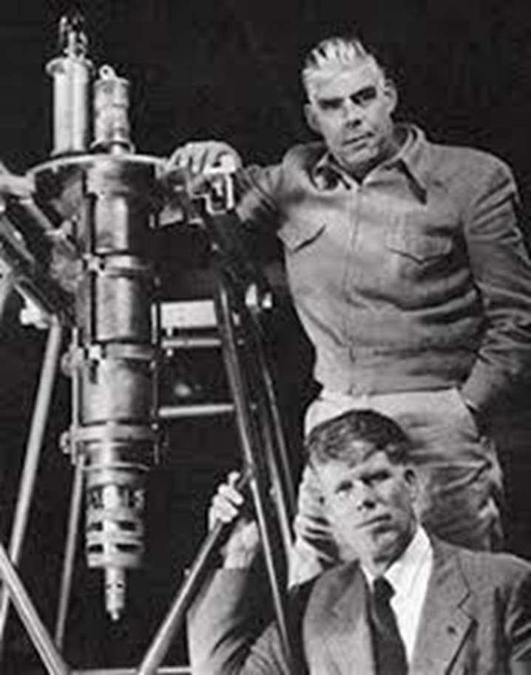
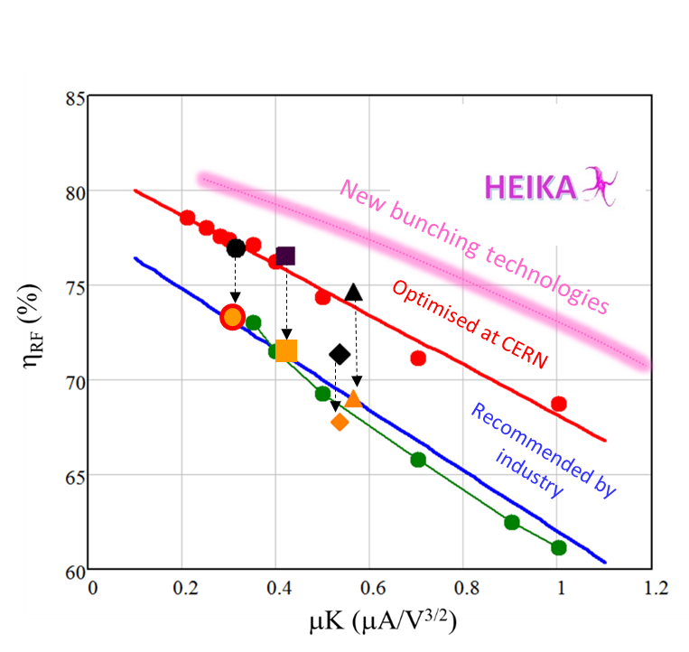

More Efficient RF Power Sources
1937: the Varian brothers
of Palo Alto invent
the klystron
80 years later, another breakthrough in klystron technology
I. Syratchev
New bunching technologies

Slide 13
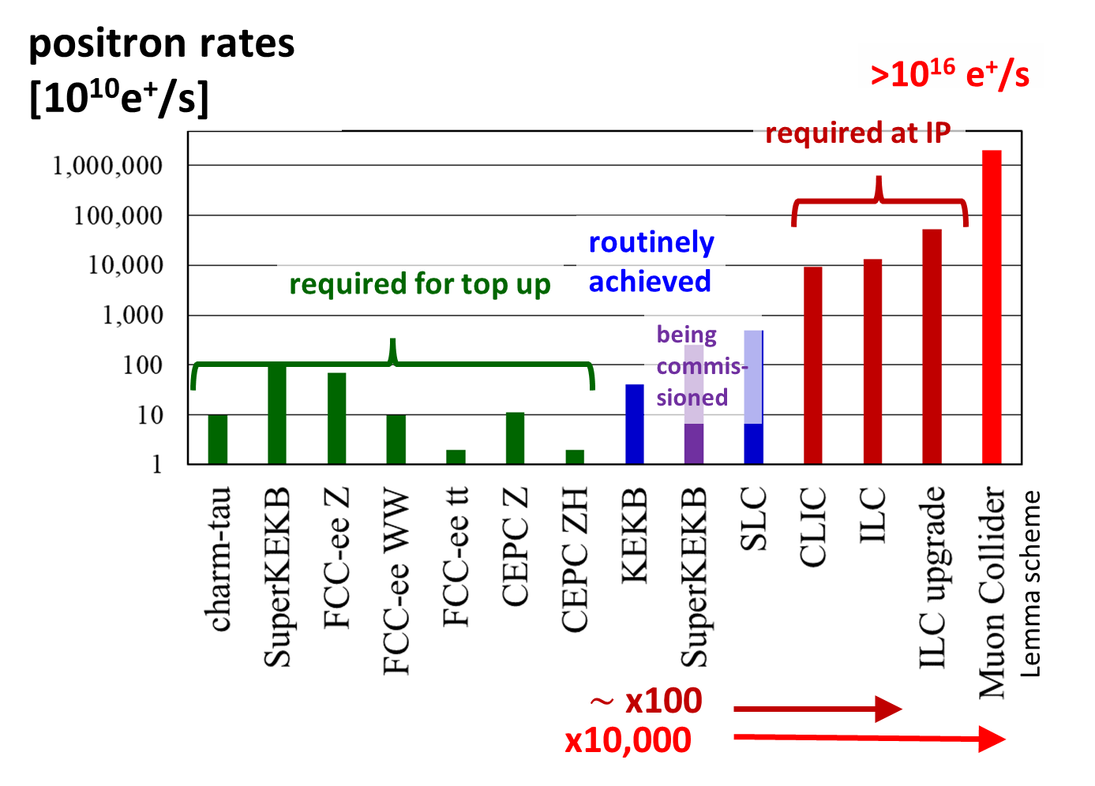
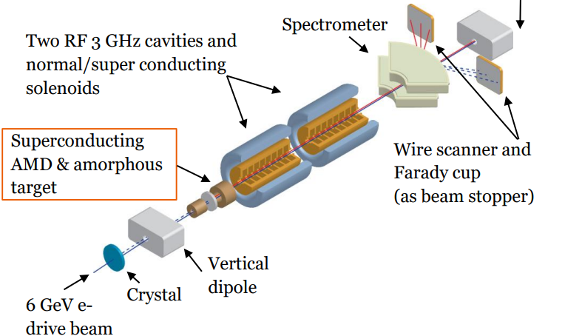
Positron Production
Challenging demands
Innovative high-yield source
P³: PSI e⁺ production experiment with HTS solenoid at SwissFEL
planned for 2024/25

Slide 14
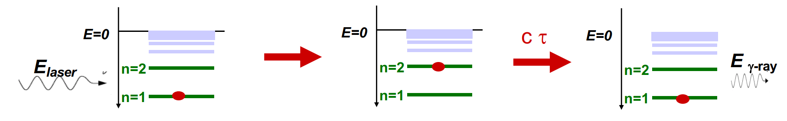

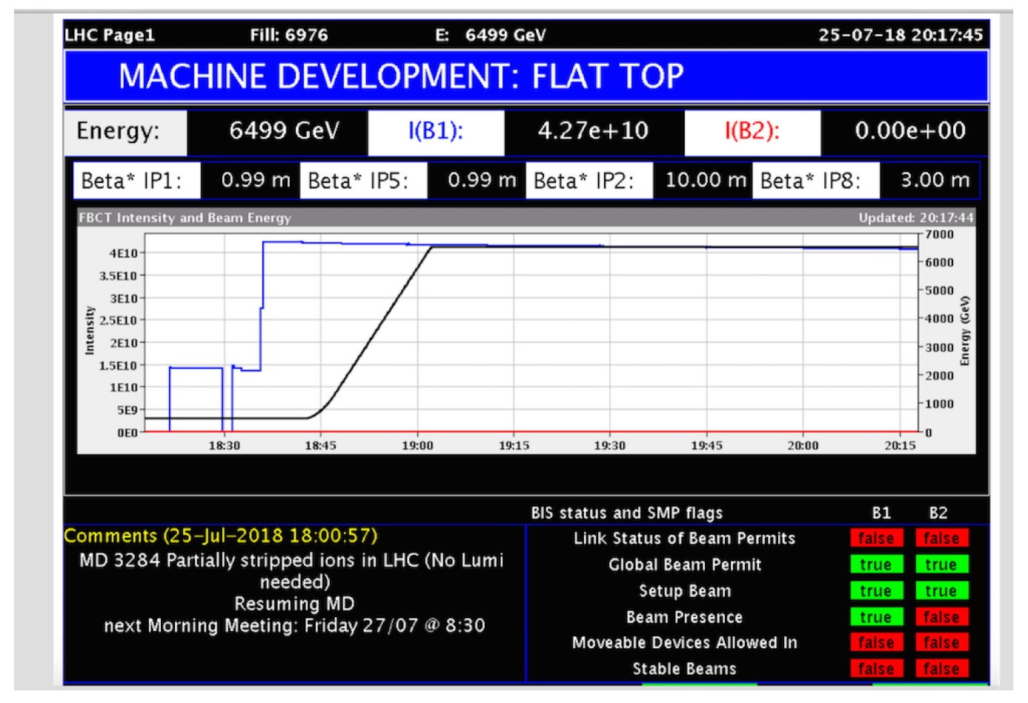
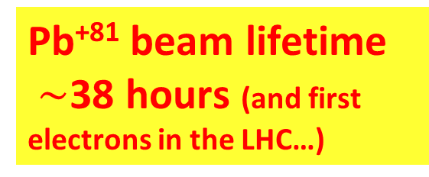
Gamma Factory concept
Witek Krasny
arXiv:1511.07794
partially stripped heavy-ion beam in LHC (or FCC):
resonant scattering of laser photons off ultrarelativistic
atomic beam; high-stability laser-light-frequency converter
Gamma Factory proof-of-principle experiment in the LHC
proposed applications:
intense source of e⁺ (10¹⁶-10¹⁷/s) , π, μ etc
doppler laser cooling of high-energy beams
HL-LHC w. laser-cooled isocalar ion beams
Pb⁺⁸¹ beam lifetime
$\sim$38 hours (and first electrons in the LHC…)

Slide 15
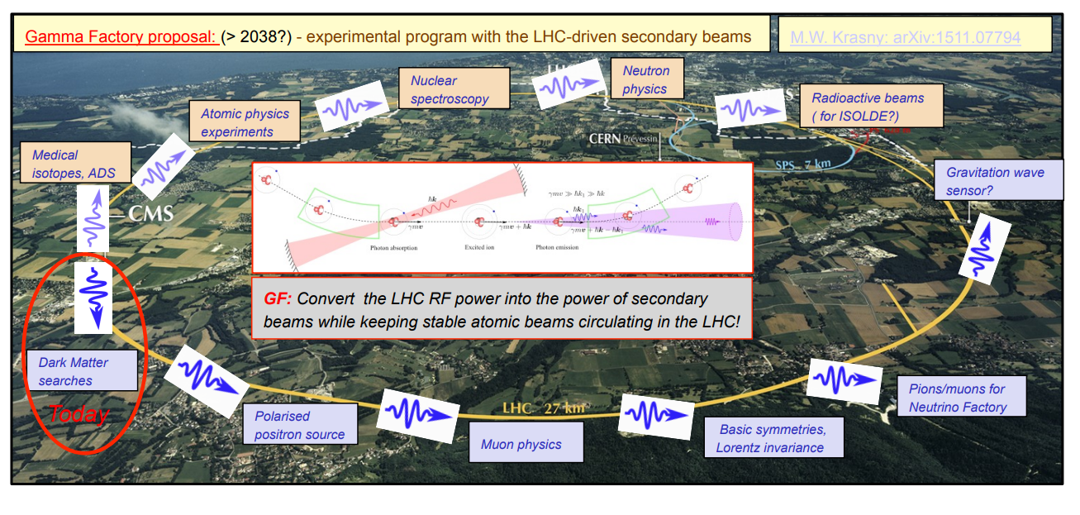
The LHC as a driver of secondary beams
Schematic transformation of the LHC into a Gamma-Factory-based driver of secondary beams [Witek Krasny].

Slide 16
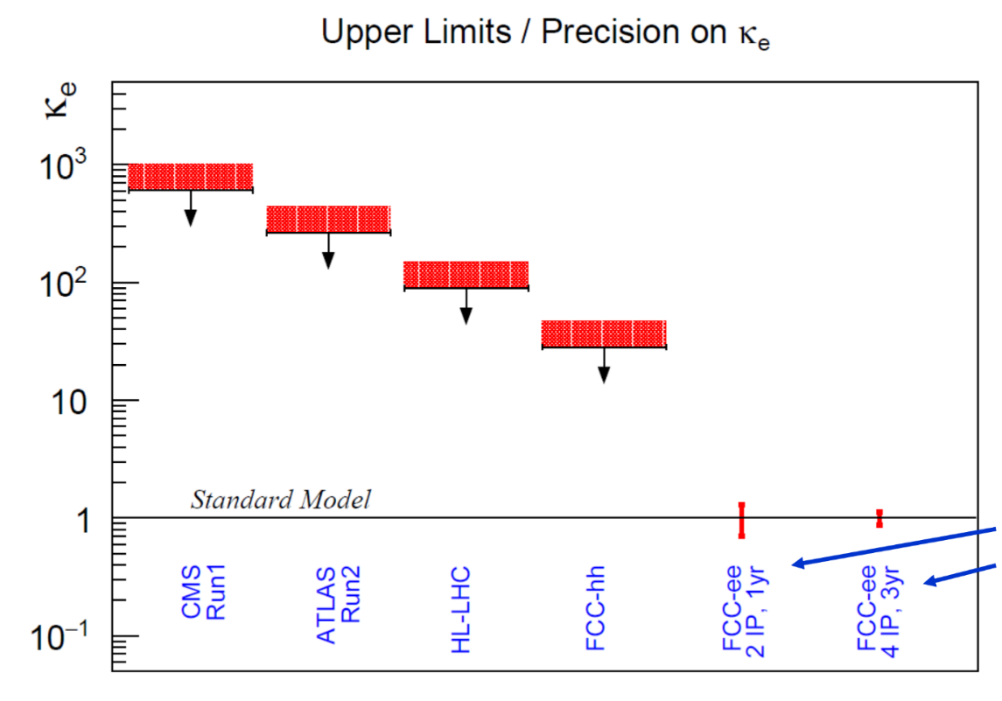
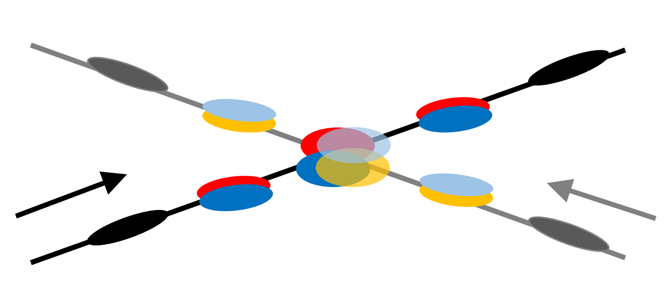
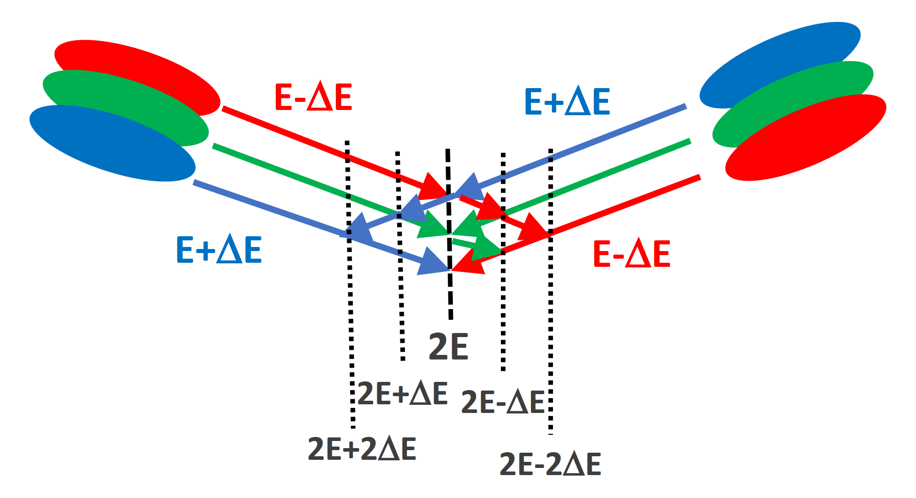
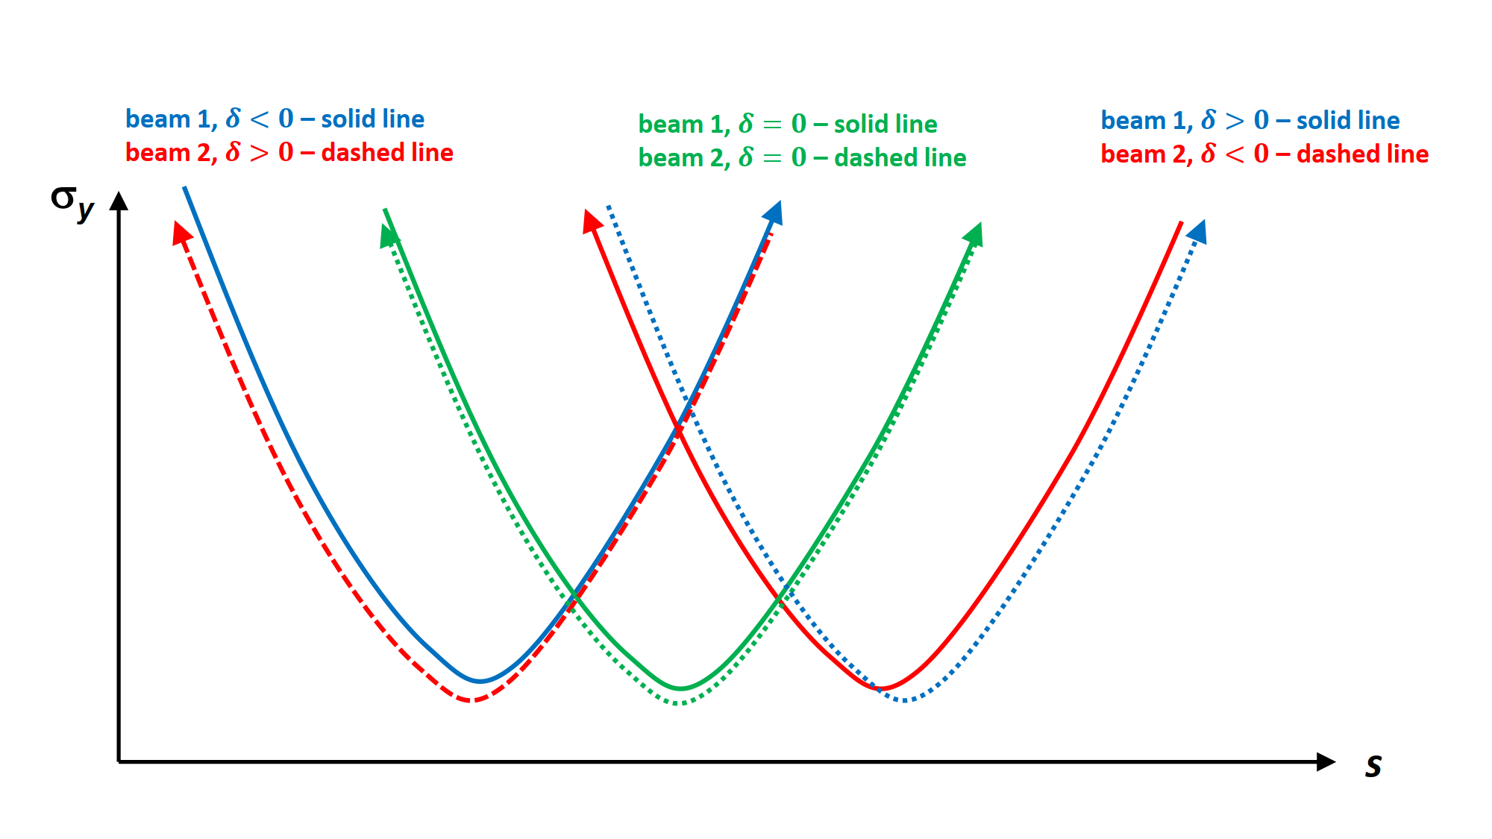


Monochromatization Schemes
nonvanishing IP dispersion
w crab cavities
e⁻ Yukawa coupling
$$D_{x}^{∗}≠0$$
w/o crab cavities
$$D_{x}^{∗}≠0$$
chromatic waist shift
Pantaleo
Raimondi
EPJ Plus 137,
31 (2022)

Slide 17
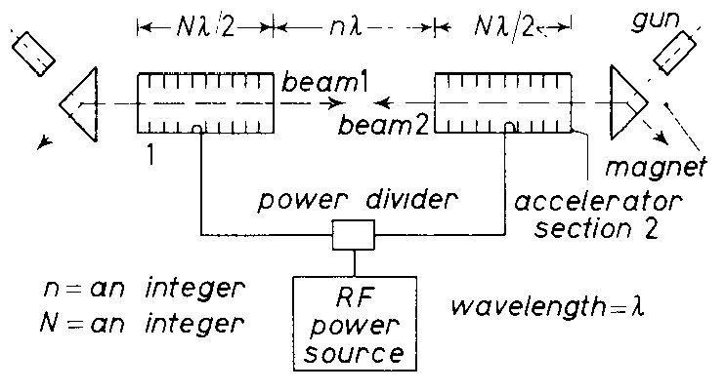
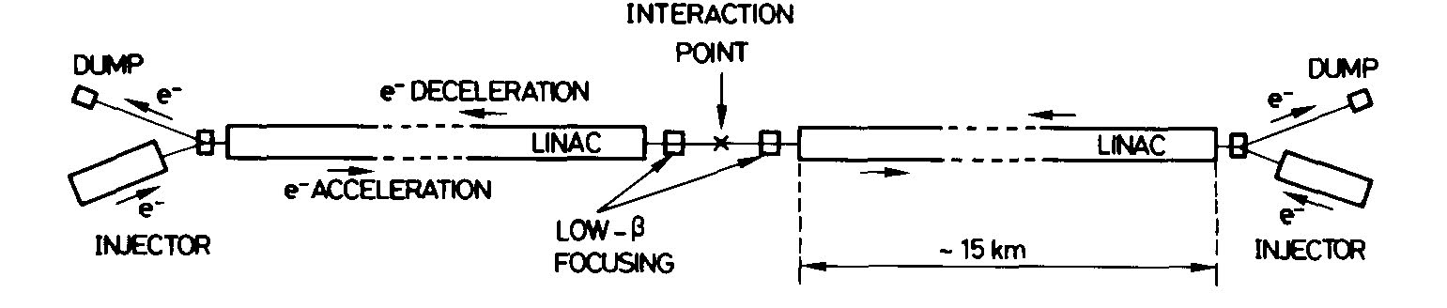
Energy Recovery Linacs - Historical Proposals 1960s & 70s
early linear-collider proposals
1-6 GeV c.m.
Maury Tigner, “A Possible Apparatus for Clashing-Beam Experiments”, Nuovo Cimento 37, 1228 (1965)
these early proposal always
recovered the energy of the spent beam!
Ugo Amaldi, “A possible scheme to obtain e-e- and e+e- collisions at energies of hundreds of GeV”, Physics Letters B61, 313 (1976)
300 GeV c.m.

Slide 18
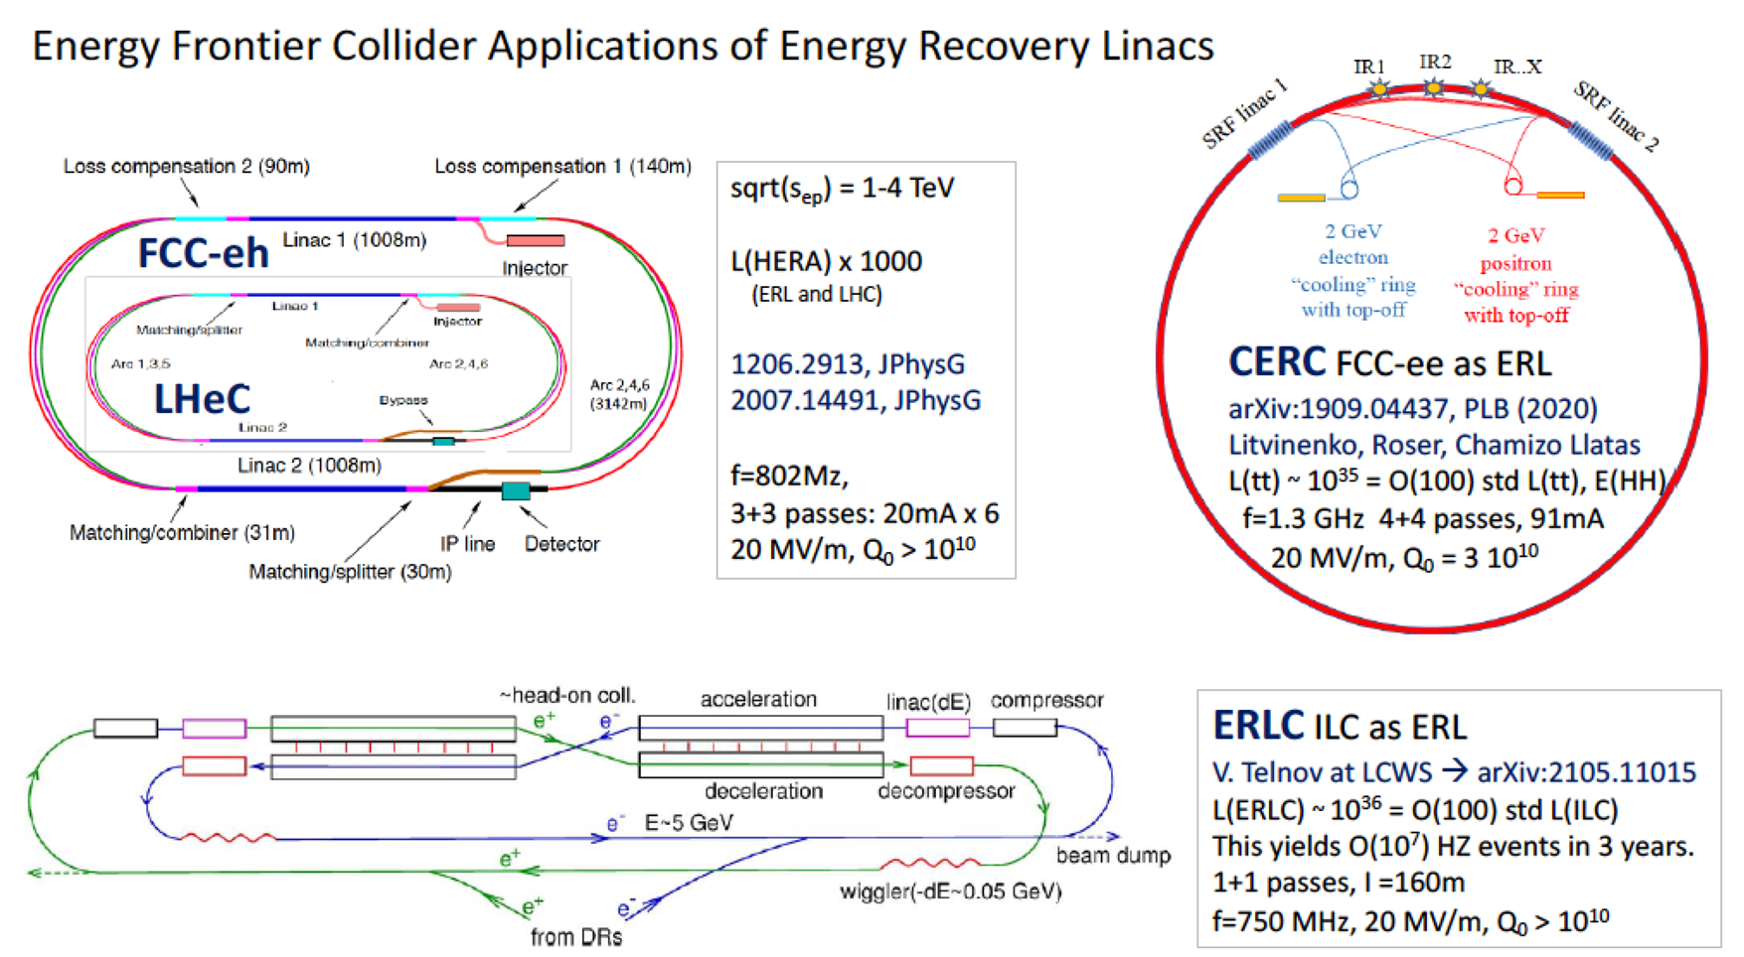
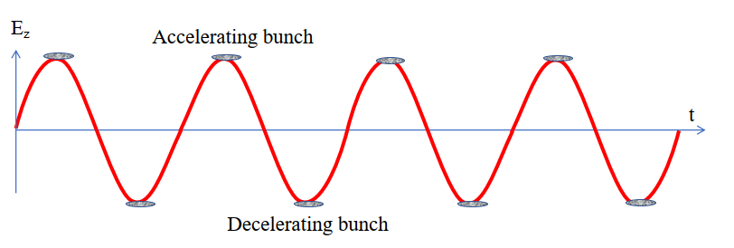
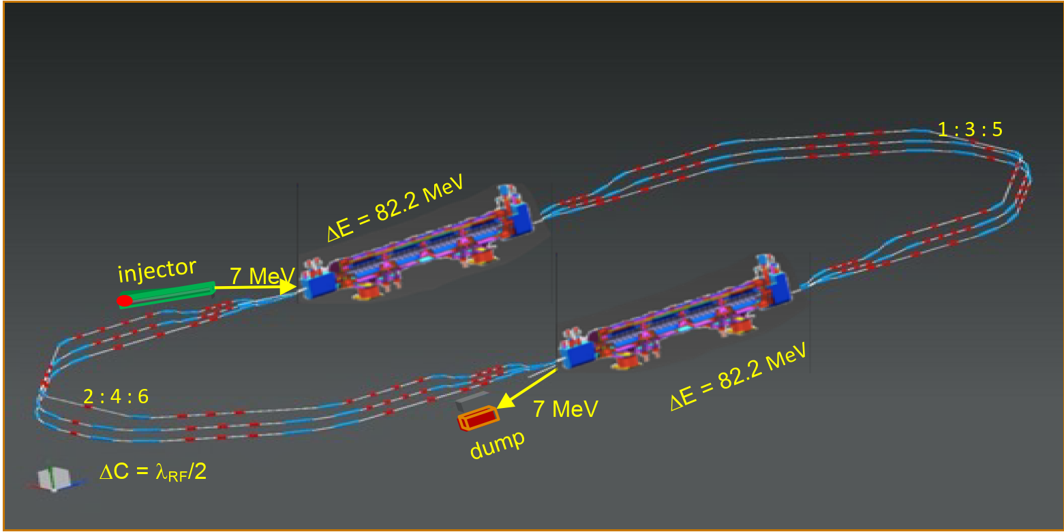
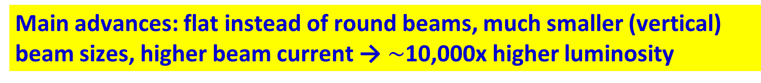
Energy Recovery Linacs : Revival since 2019
European LDG roadmap
V. Litvinenko et al.
test Facility PERLE at IJClab
(high current, multi-turn)
to complement MESA, CBETA, bERLinPRO & EIC cooler
Main advances: flat instead of round beams, much smaller (vertical) beam sizes, higher beam current →$\sim$10,000x higher luminosity

Slide 19
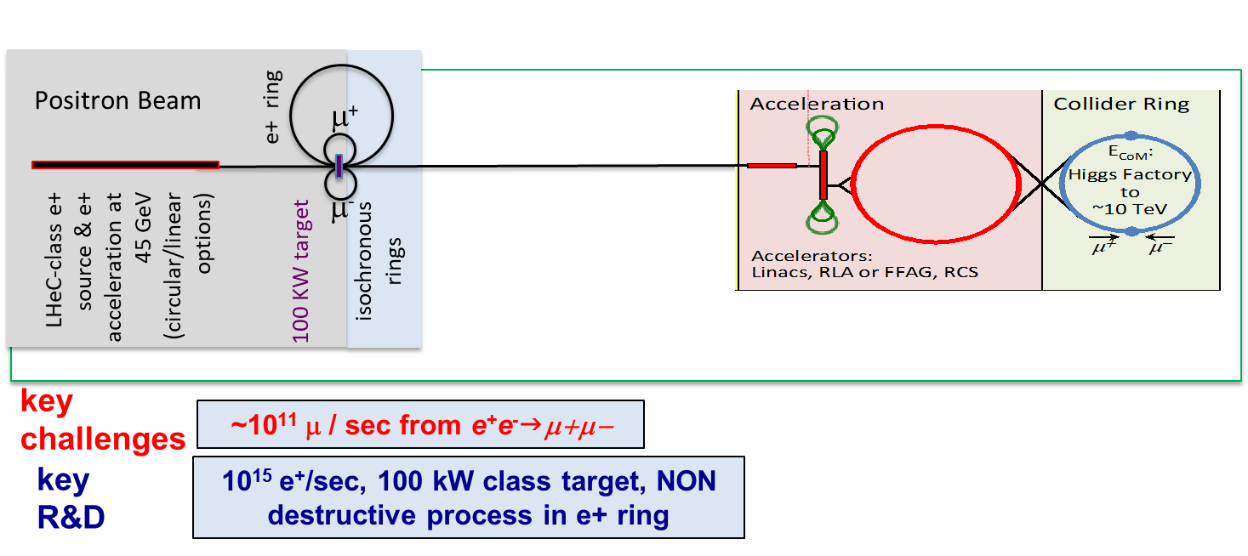
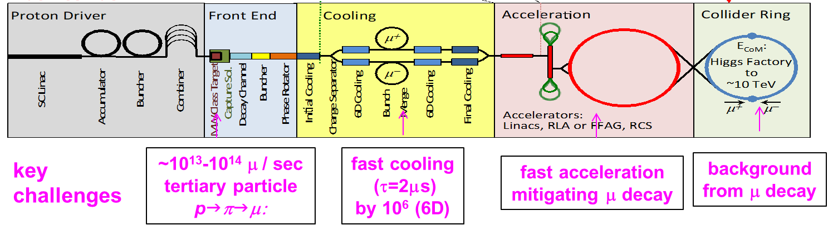
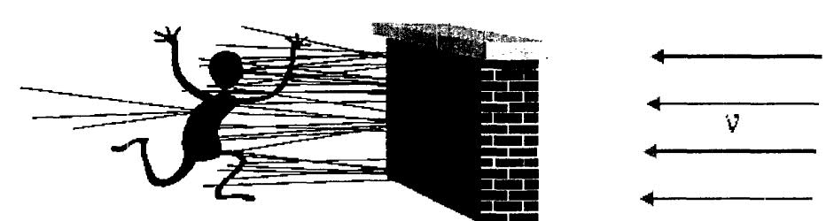

Muon Colliders
$\sim$1.6x10⁹ x less SR than e⁺e⁻, no beamstrahlung problem
two production schemes proposed
US-MAP (2015) p-driven
Italian LEMMA (2017) e⁺-annihilation
needs large 45 GeV e⁺ ring like FCC-ee, possible upgrade path to FCC-μμ
μ‘s decay within a few 100 - 1000 turns:
→ rapid acceleration
(perhaps plasma?)
→ ν radiation hazard
(limits maximum μ energy)
Bruce King 1999
$$σ_{ν}∝E, flux ∝E^{2} (Lorentz boost)$$
solution beyond 10 TeV unclear

Slide 20
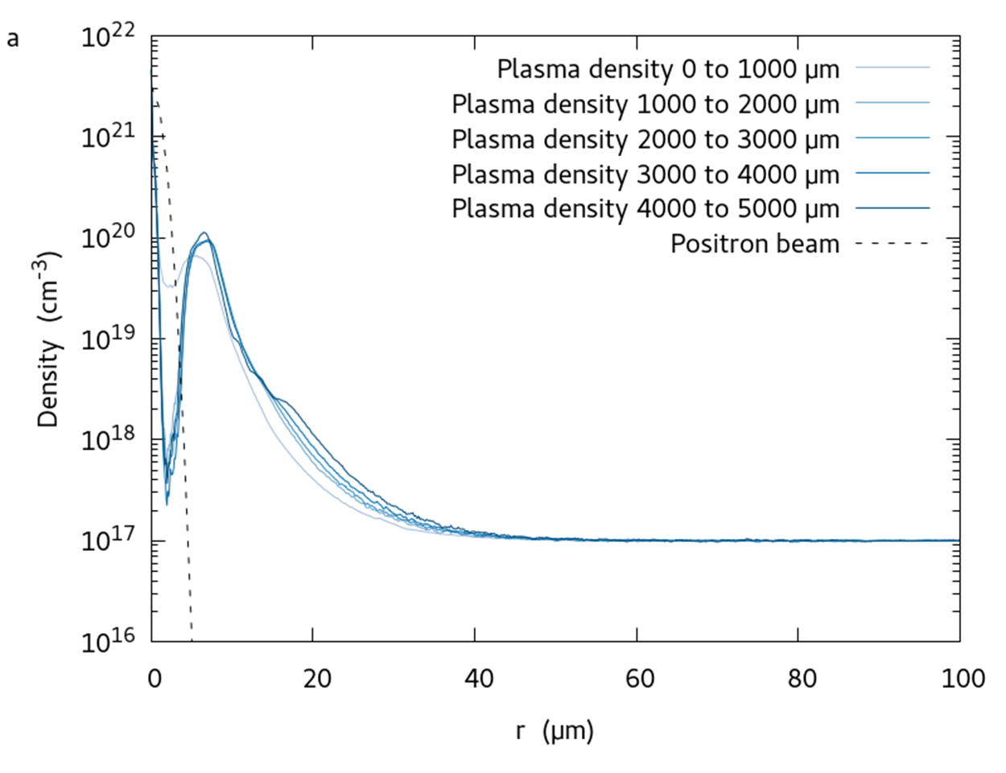
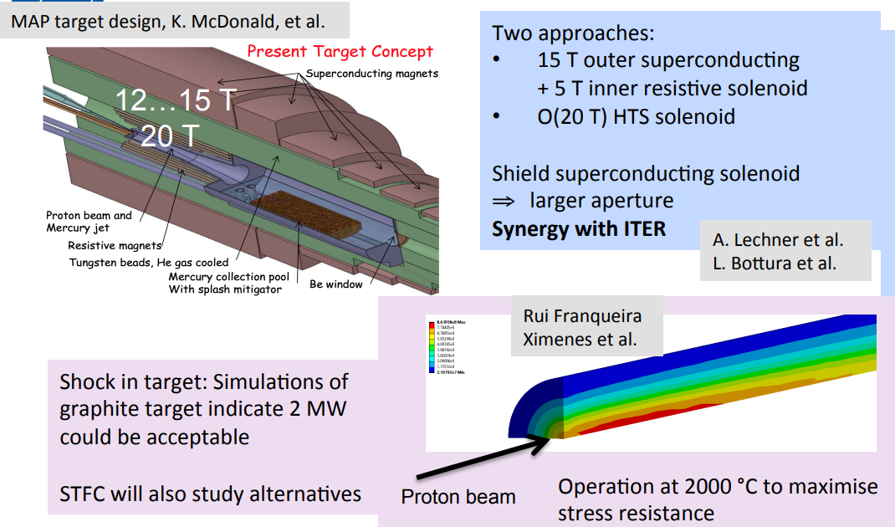
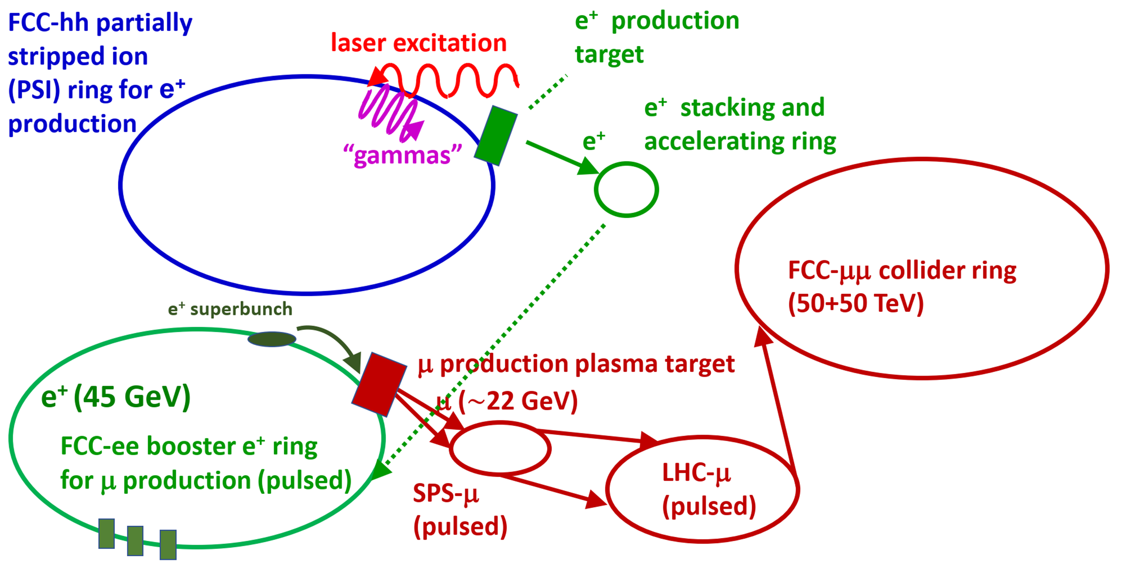
Muon Colliders – Example Challenges
target design for p driven μ collider
plasma target for e⁺ driven μ collider
D. Schulte, IPAC’22
J. Farmer et al., IPAC’22

Slide 21
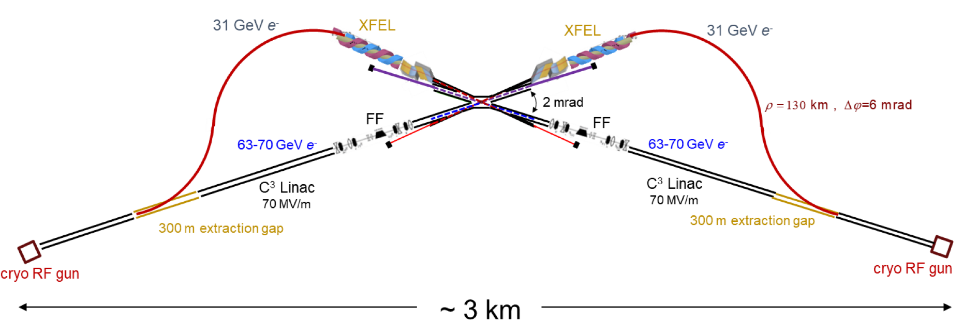
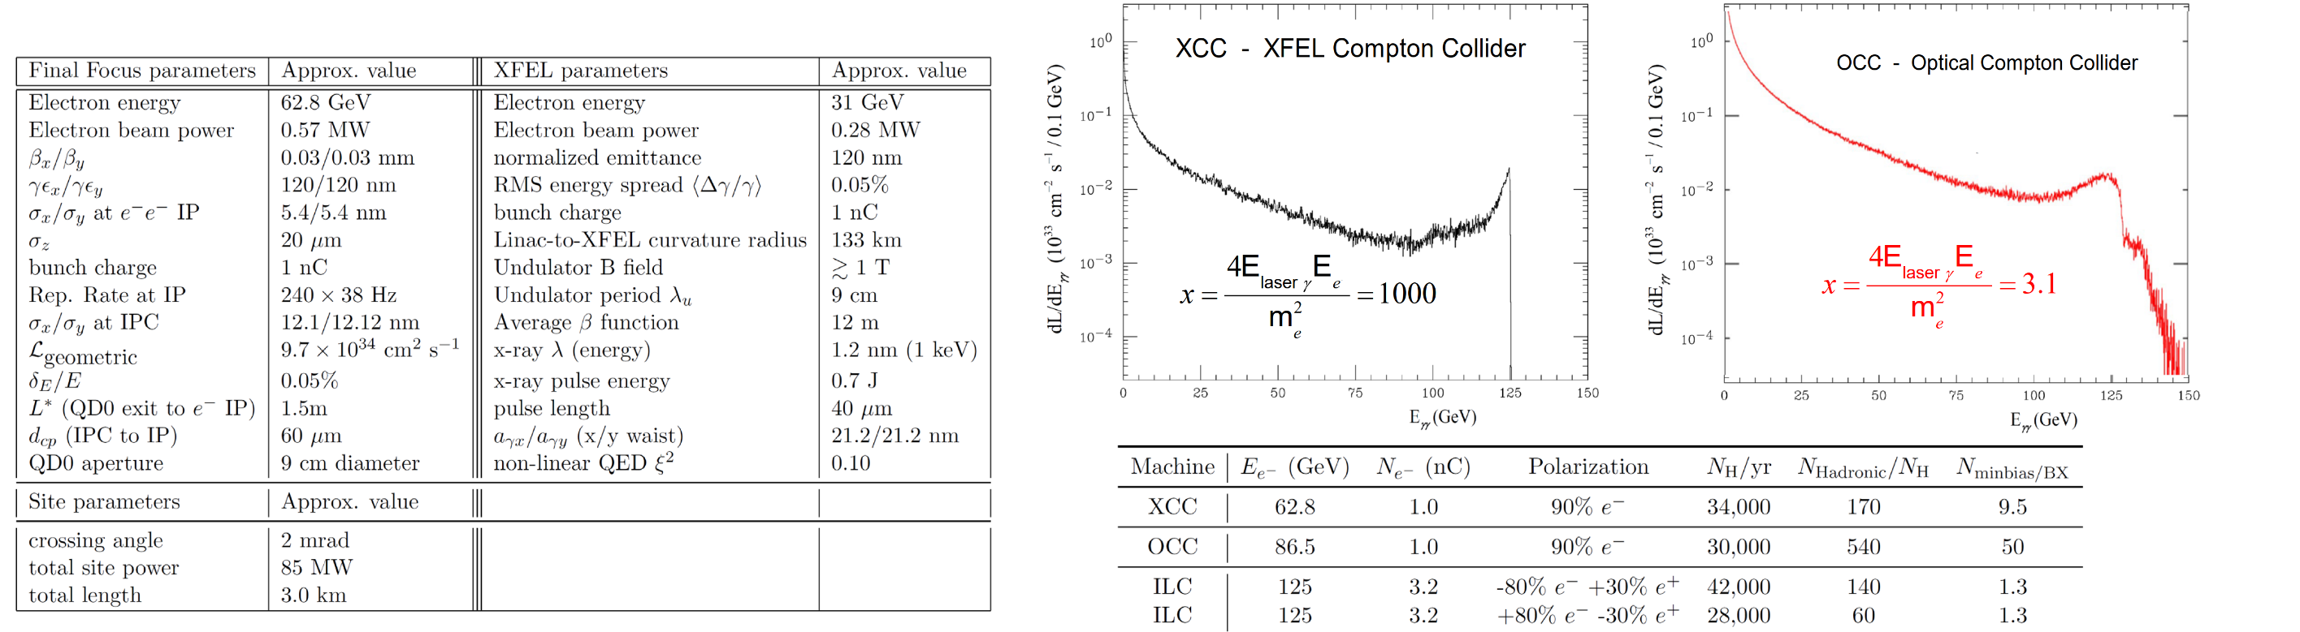
γγ colliders
XCC
HE - HL γγ Collider
E. Barzi, Snowmass ‘21
T. Barklow, Snowmass ‘21

Slide 22


Advanced Accelerators: Plasma
R. Assmann
A plasma cell compared with the superconducting accelerator FLASH (credit DESY)
R. Assmann, E. Gschwendtner, R. Ischebeck, LDG Draft

Slide 23


Advanced Accelerator “Demonstrator” EuPRAXIA
R. Assmann,
iFAST BWS2022
construction
at INFN-LNF

Slide 24



Plasma Accelerator Challenge: Positron Acceleration
“ballistic injection”: a ring-shaped laser beam and a coaxially propagating Gaussian laser beam are employed to create donut and center bubbles in the plasma, resp.
Z.Y. Xu

Slide 25

Advanced Accelerator Types
Required parameters for a linear collider with advanced high gradient acceleration [R. Assmann]. Three published parameter cases are listed. This table is taken from the LDG report [N. Mounet (ed.), “European Strategy for Particle Physics - Accelerator R&D Roadmap”, arXiv:2201.07895 CERN-2022-001]
Dielectric Laser Accelerators (DLAs) may help explore the dark sector

Slide 26


Dielectric Laser Accelerators
The insets show the accelerating and deflecting gradients across the channel for illustrated optical phases 𝜃θ.
Scanning electron micrograph of the dual pillar accelerator structure.
The structure has 14 periods and its 15 μm long gratings are sitting on a 75 μm tall mesa.
Dual pillar dual-drive mode profiles with force vectors superimposed on the 𝐸𝑧 acceleration field color map at different relative drive phases.
Insets show accelerating and deflecting gradients across channel for illustrated optical phases 𝜃.
Kenneth J. Leedle, Dylan S. Black, Yu Miao, Karel E. Urbanek, Andrew Ceballos, Huiyang Deng, James S. Harris, Olav Solgaard, Robert L. Byer, "Phase-dependent laser acceleration of electrons with symmetrically driven silicon dual pillar gratings," Opt. Lett. 43, 2181-2184 (2018); https://www.osapublishing.org/ol/abstract.cfm?uri=ol-43-9-2181

Slide 27
back to the next generation

Slide 28

Energy efficiency: Higgs factories
Total luminosity per electrical power. (Nature Physics vol. 16, 402, 2020)

Slide 29
Carbon Footprint - examples
TWh / year for the “Higgs factory” centre-of-mass energy
Patrick Janot
    √s = 240 GeV for CEPC/FCC-ee, 250 GeV for ILC/C³, 380 GeV for CLIC
CLIC | ILC | C³ | FCC-ee | CEPC
0.8 | 0.9 | 0.9 | 1.1 | 2.0
P. Janot and A. Blondel, The carbon footprint of proposed e+e− Higgs factories, arXiv 2208.10466 (2022); https://arxiv.org/abs/2208.10466
Energy consumption in MWh / Higgs
CLIC | ILC | C³ | CEPC | FCC-ee
30 | 20 | 21 | 10 | 3.3
      becomes 2 MWh / Higgs for FCC-ee with 4 IPs
Present carbon footprint for electrical energy in tons CO₂ / Higgs
CLIC@CERN | ILC@KEK | C³@FNAL | CEPC@China | FCC-ee@CERN
2.1 | 7.8 | 8.5 | 6.1 | 0.24
0.14 ton CO₂ / Higgs for FCC-ee with 4 IPs

Slide 30



Futher sustainability considerations
Higher magnet temperature helps
1.9 K Nb-Ti or Nb₃Sn magnets
→ 4.5 K/20 K Nb₃Sn/HTS magnets
Future: fluctuating energy sources
Simulation for Germany 2050
varying #bunches
in circular colliders
still far from ideal Carnot efficiency
M. Seidel

Slide 31
A few conclusions
Great progress in SC RF and in high-field magnets
Accelerators & colliders getting ever more efficient
Synergies with other applications and other fields
Numerous innovative concepts and challenges for future colliders
Sustainability has become important design criterion
Several promising paths forward

Slide 32









surely great times ahead !
“Pief” Panofsky
Kjell Johnsen
thank you !
Helen Edwards
Mike Lamont
Steve Myers
Robert H. Wilson
Lyn Evans
Herwig Schopper
Satoshi Ozaki

