Slide 1

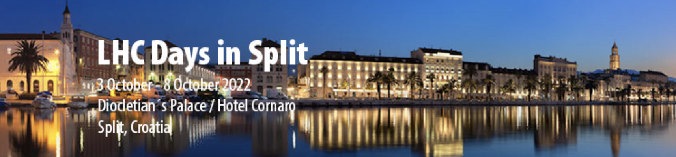

New Experiments at the LHC
Albert De Roeck
CERN, Geneva, Switzerland
Antwerp University Belgium
UC-Davis California USA
NTU, Singapore
6th October 2022

Slide 2
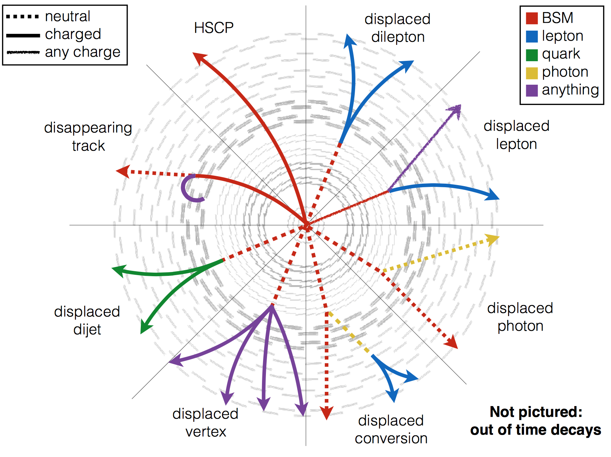
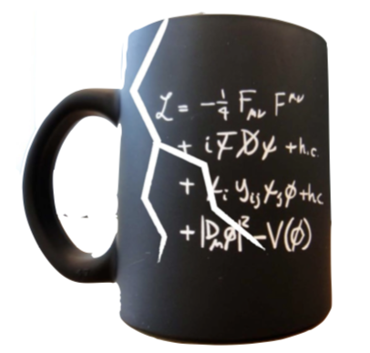
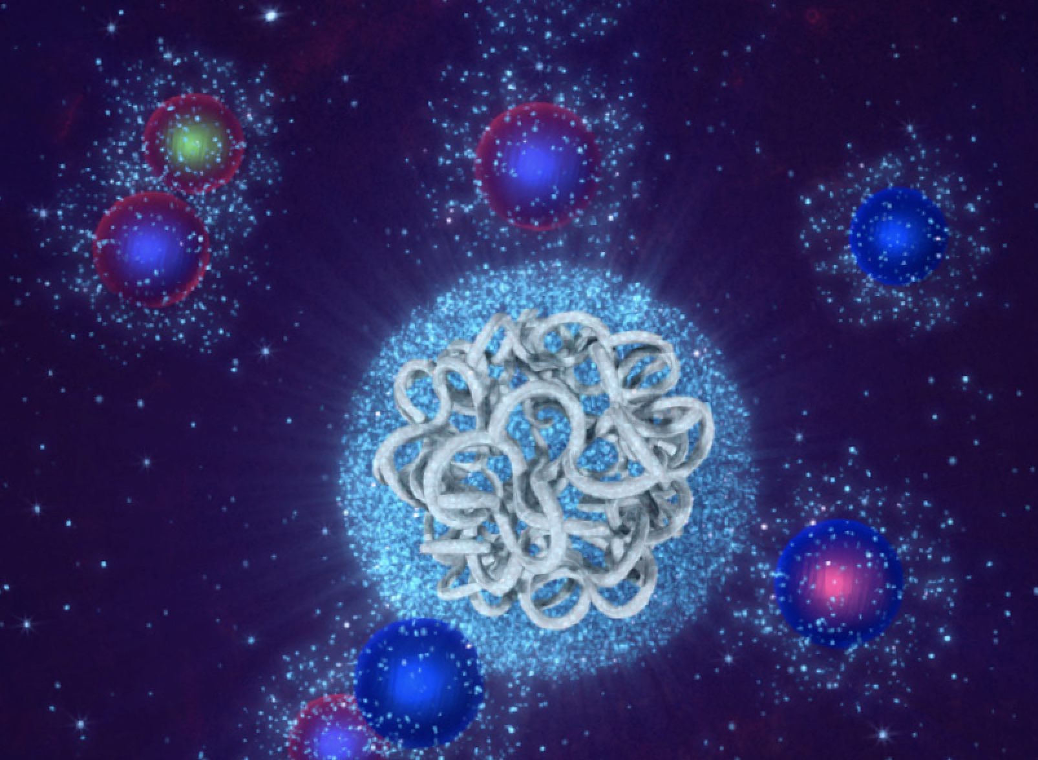
Outline
Introduction: Why new proposals
from new experiments @ LHC ?
Long Lived Particles
Forward experiments
Transverse experiments
Summary/Outlook

Slide 3
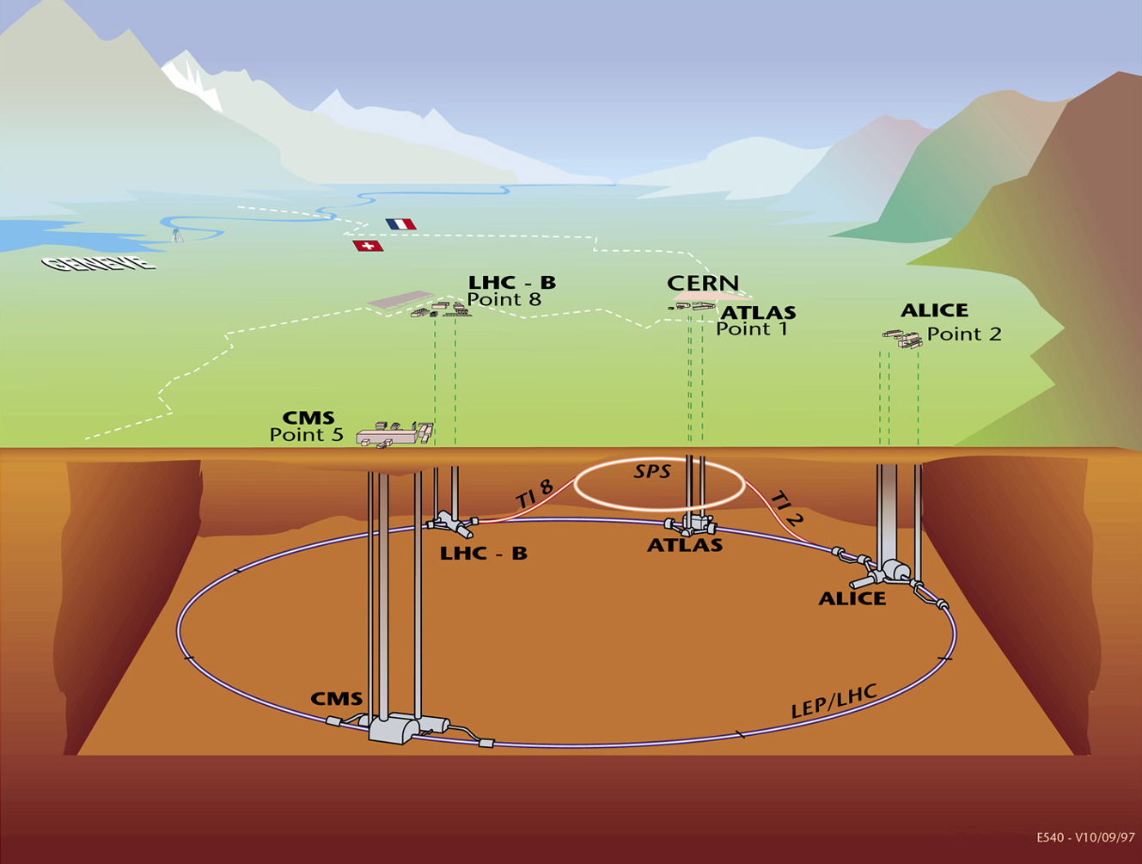
The Large Hadron Collider and Experiments
The LHC Machine and Experiments
MoEDAL
LHCf
FASER
SND@LHC
totem
Run-3 started in July after a 3.5 year shutdown
9 experiments are now can take data…

Slide 4
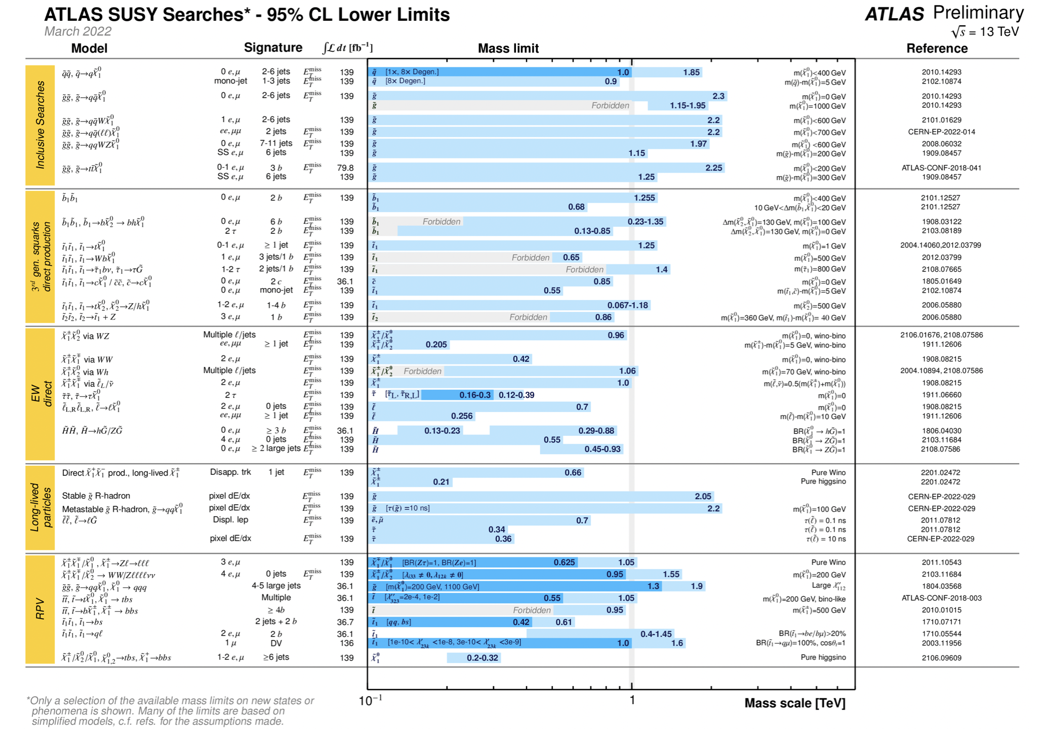
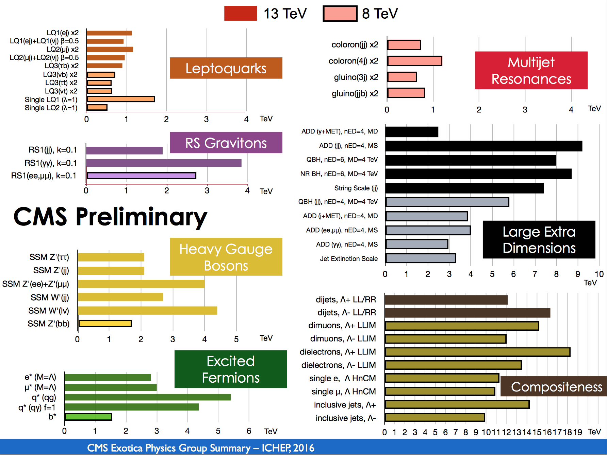
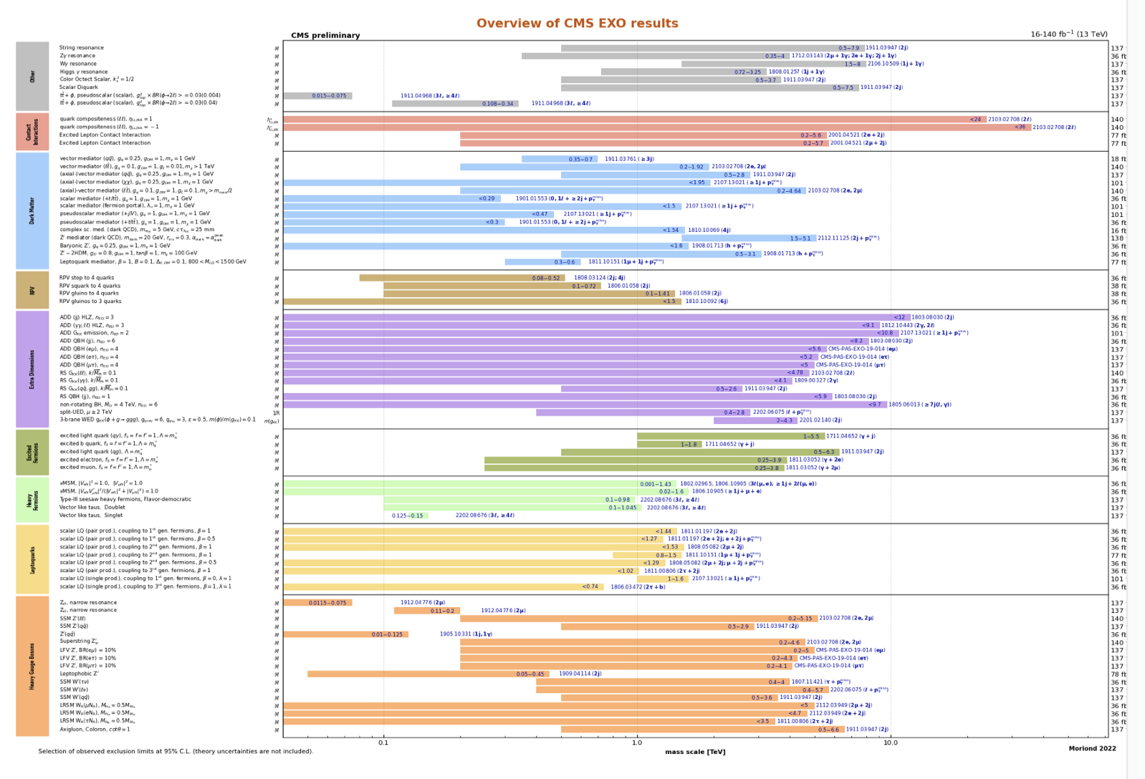
LHC: So far no new physics
Classical Searches
Superymmetry
Exotica
Flavor Universality
…
No signal of new physics so far!!
LFU “violation” in LHCb intruiging…

Slide 5
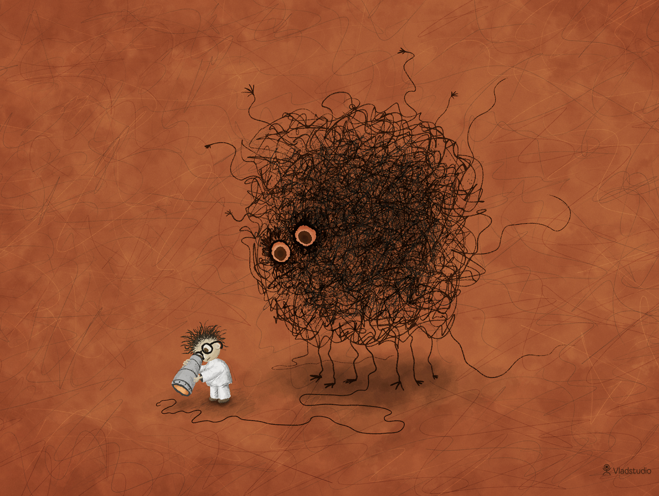
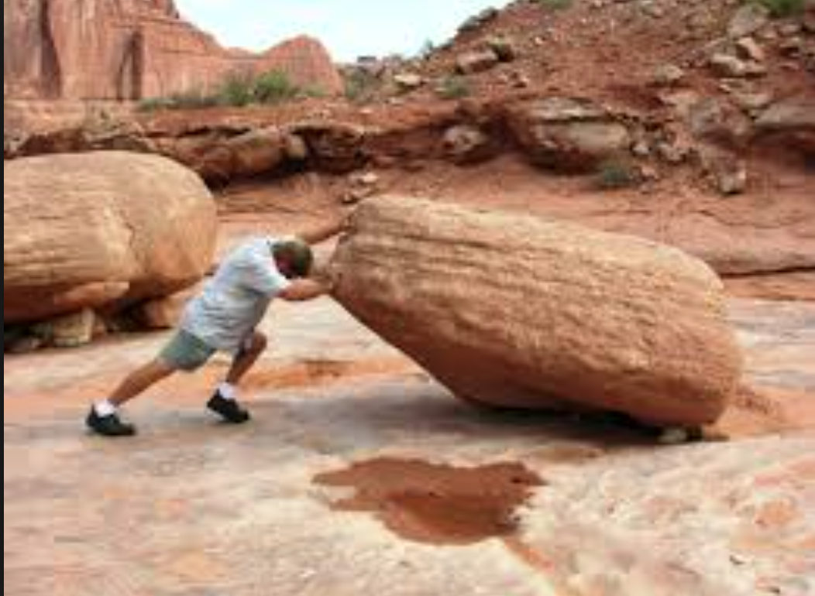
Are we leaving no stones unturned?
The LHC BSM searches are indispensable and should be continued in the new energy regime and with increasing statistics (higher mass, lower couplings)
But are we looking at the right place and do we leave not stones unturned? -> Recent focus on long lived particles
Time for more effort in thinking of complementary searches: -> What could the LHC miss with the present detectors?
Are we looking at the right place?
Leave no stone unturned!!

Slide 6
New Experimental Proposals: Searching for Long Lived Particles
Opportunities for forward QCD measurements at the LHC
and measurements of Cosmic Rays

Slide 7
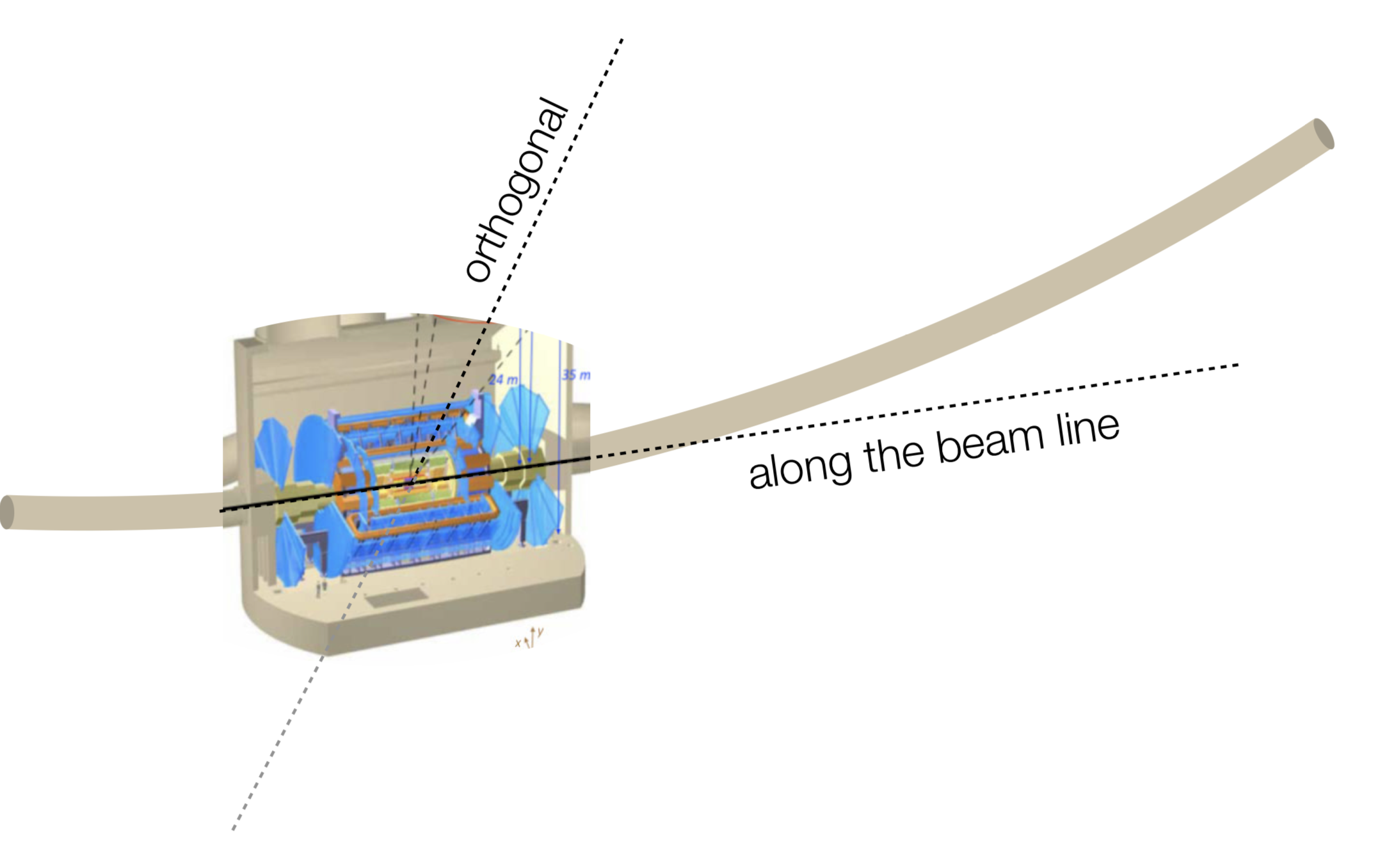
New Directions/Experiments
ANUBIS
MATHUSLA
CODEX-b
MILLIQAN
MAPP (MoEDAL)
Proposals/ideas
Approved/ data in Run-3
FASER(𝛎)
SND@LHC
FACET
FPF
Examples:
• Axions/Axion-like particles
• Heavy Neutral Leptons
• Millicharged particles
• Dark Sector scalars
• Light Dark Matter
• QCD Topics
“Transverse Experiments” have minimal to no impact on the LHC machine

Slide 8
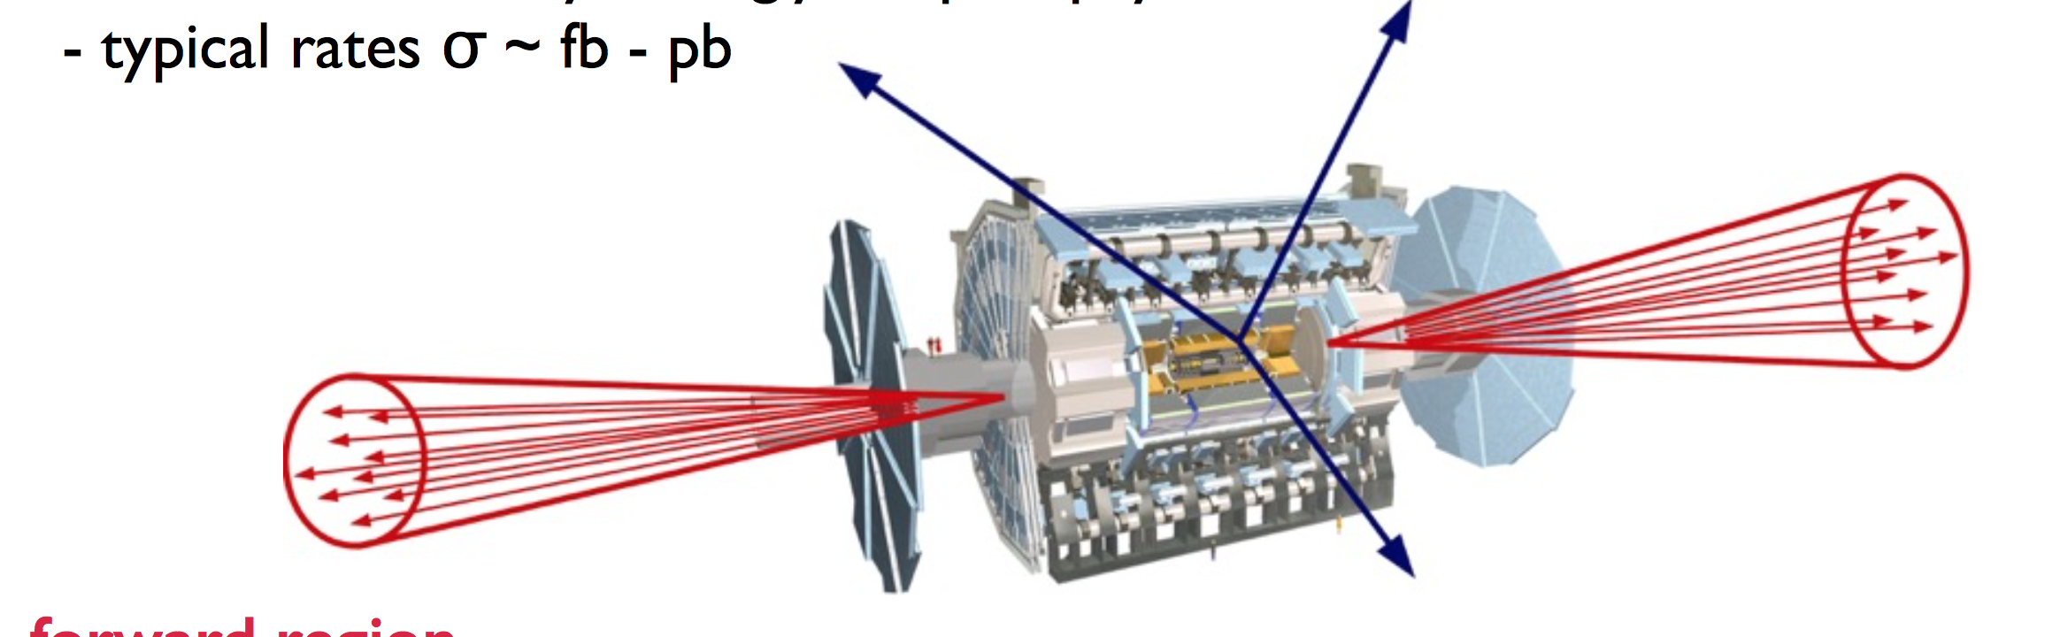
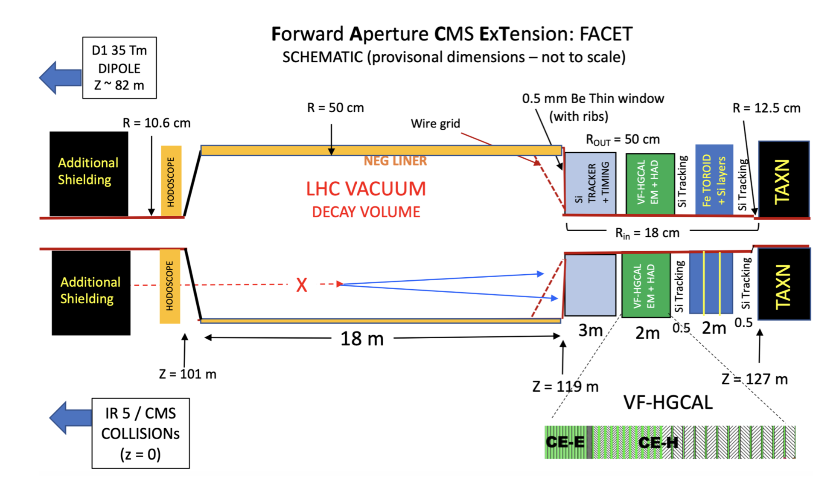
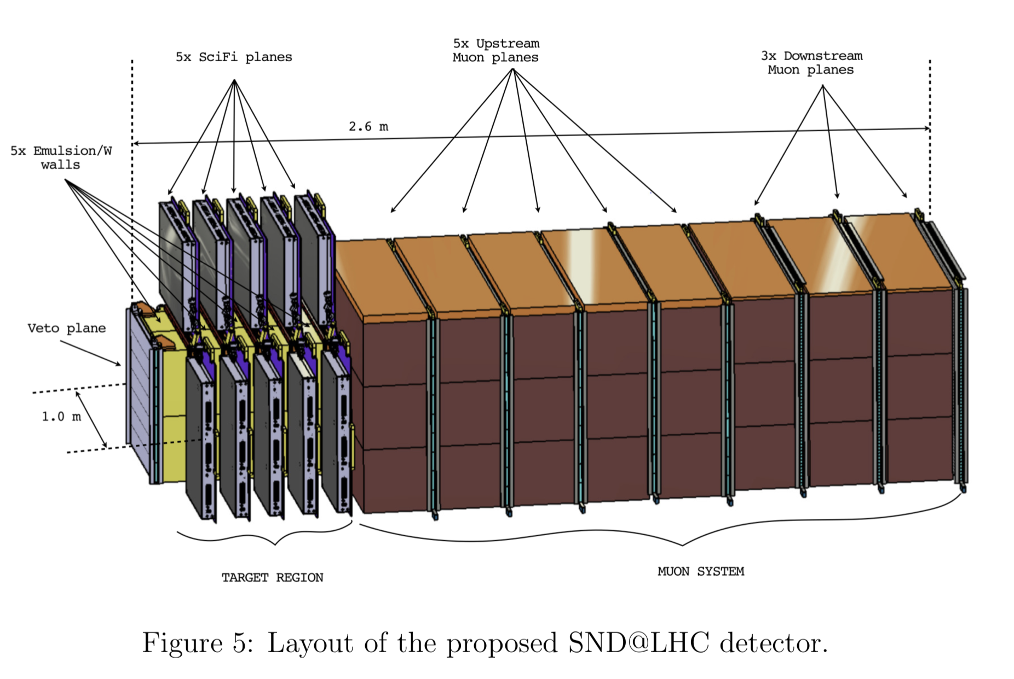

New Forward Detector Proposals
FASER(𝛎): searches for long lived dark
photons-like particles, neutrinos
FACET: Instrumented Beampipe
for CMS
SND@LHC: neutrino measurements
and long lived particle searches
FPF: A Facility for Forward Physics
Containing several experiments
FASER and SND@LHC have been approved in 2019/2020 and were ready
in time to take data at the start of Run 3 in 2022; taking data now!

Slide 9
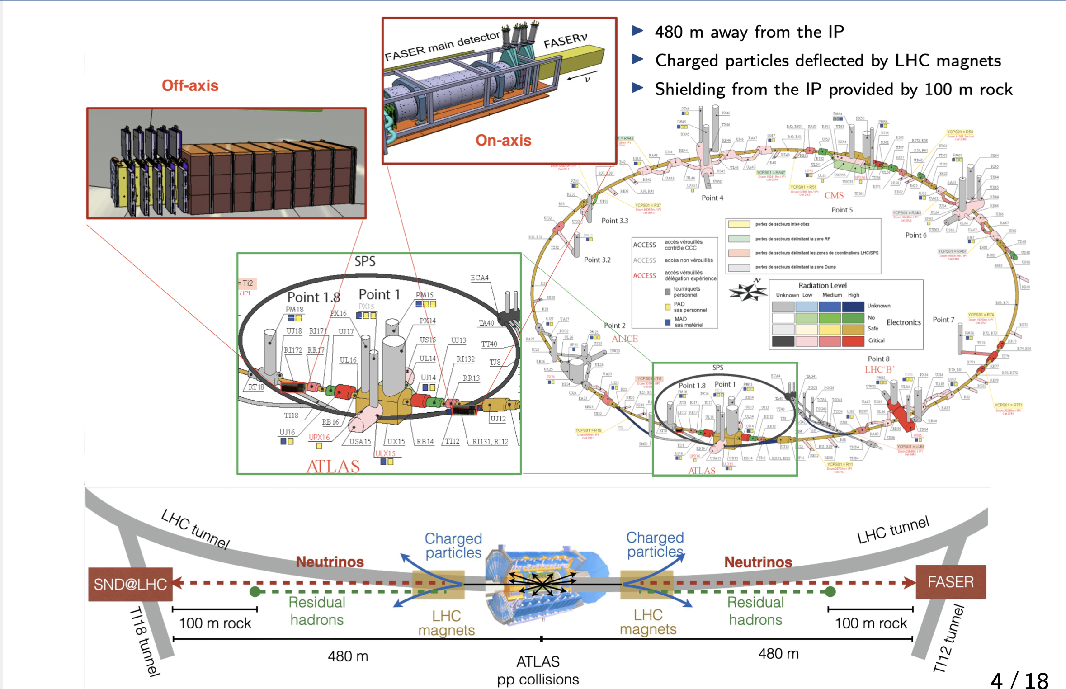
SND@LHC and FASER(Nu)

Slide 10
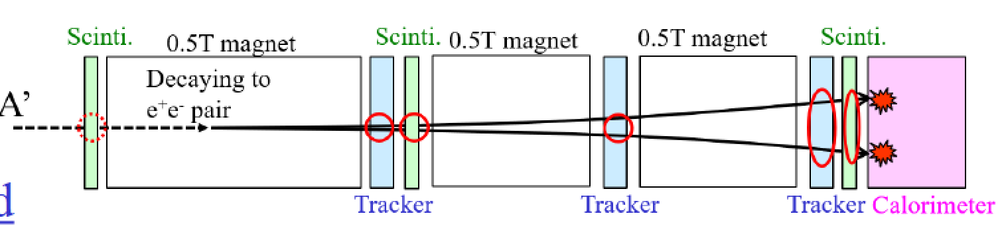
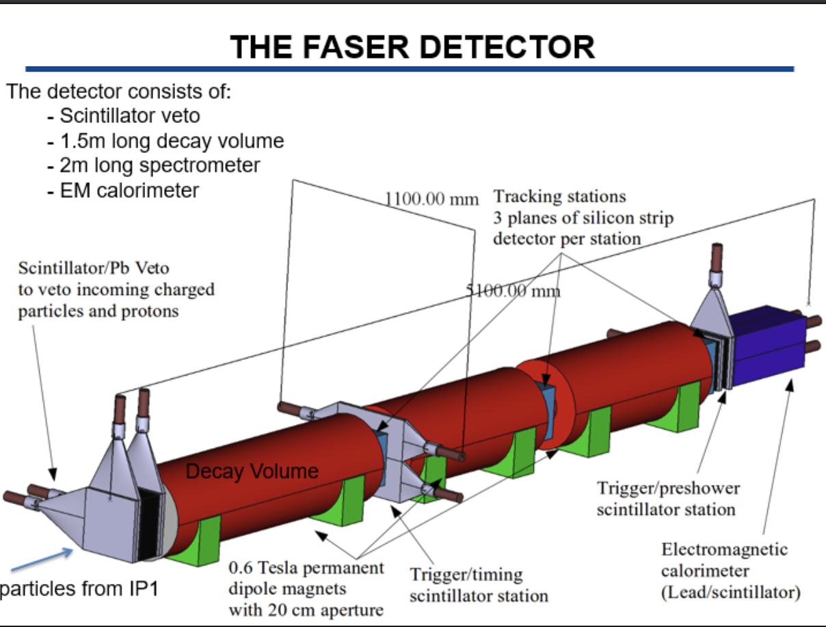
FASER Experiment
The FASER experiment (phase 1) has been approved March 5th 2019
arXiv:1901.04468
Use spare ATLAS SCT silicon
tracking modules and LHCb EM
calorimeter modules

Slide 11
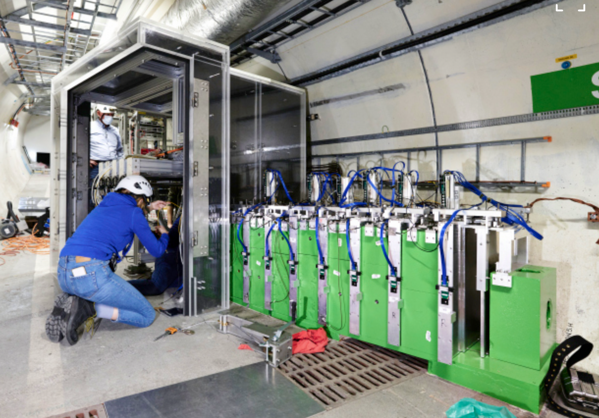
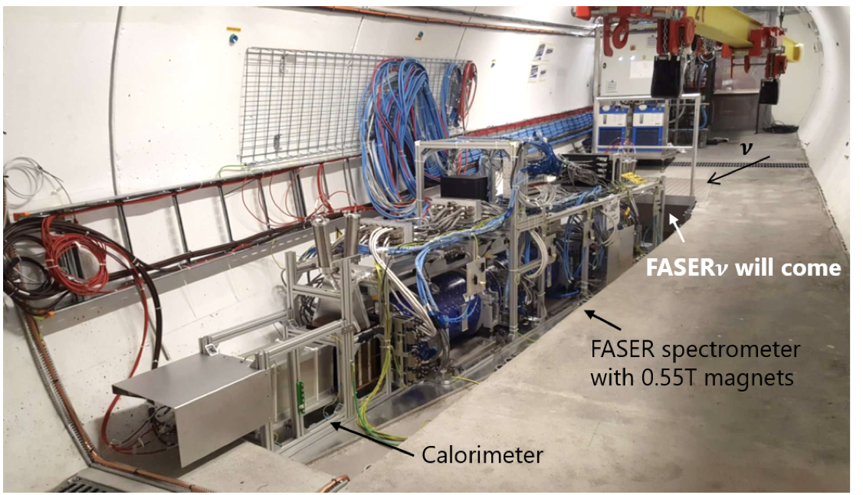
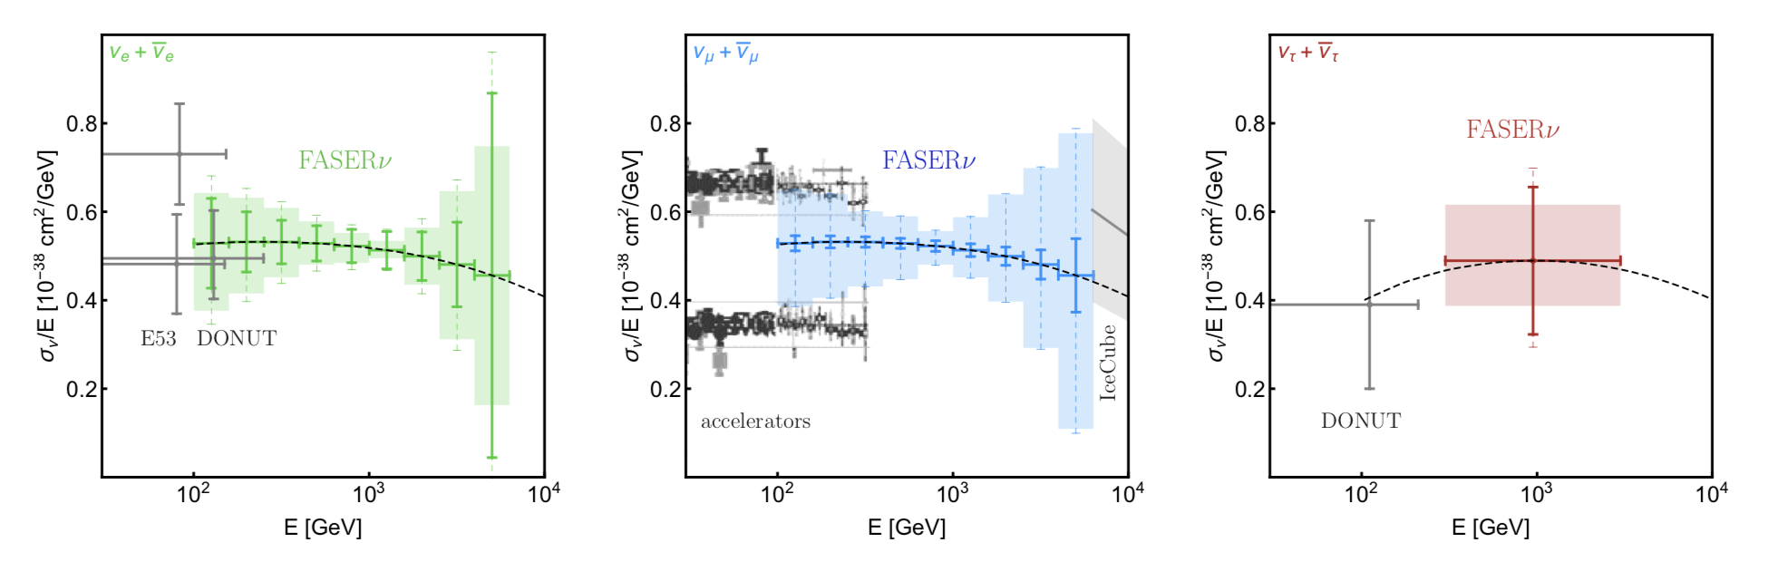
Neutrinos @ the LHC: SND@LHC & FASER𝛎
SND@LHC: approved March ‘21
SND@LHC/FASER𝝼 are 480m forward and
can study TeV-neutrinos with emulsion and
tracking+muon/calo detectors
SND= Scattering and Neutrino Detector
SND@LHC
FASER(𝝼)
Prospects for Run 3

Slide 12
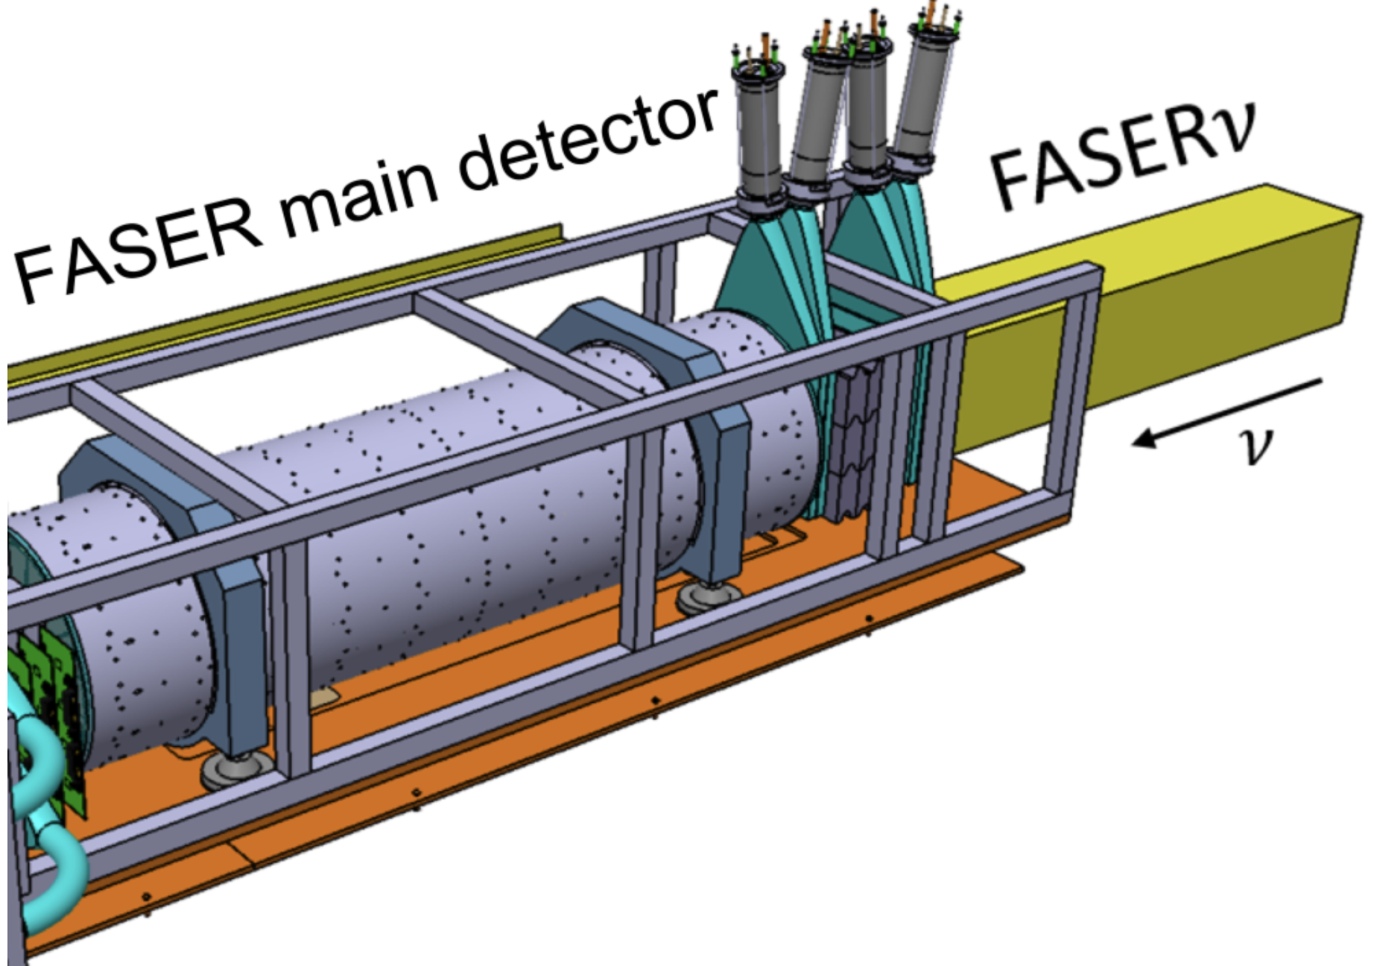
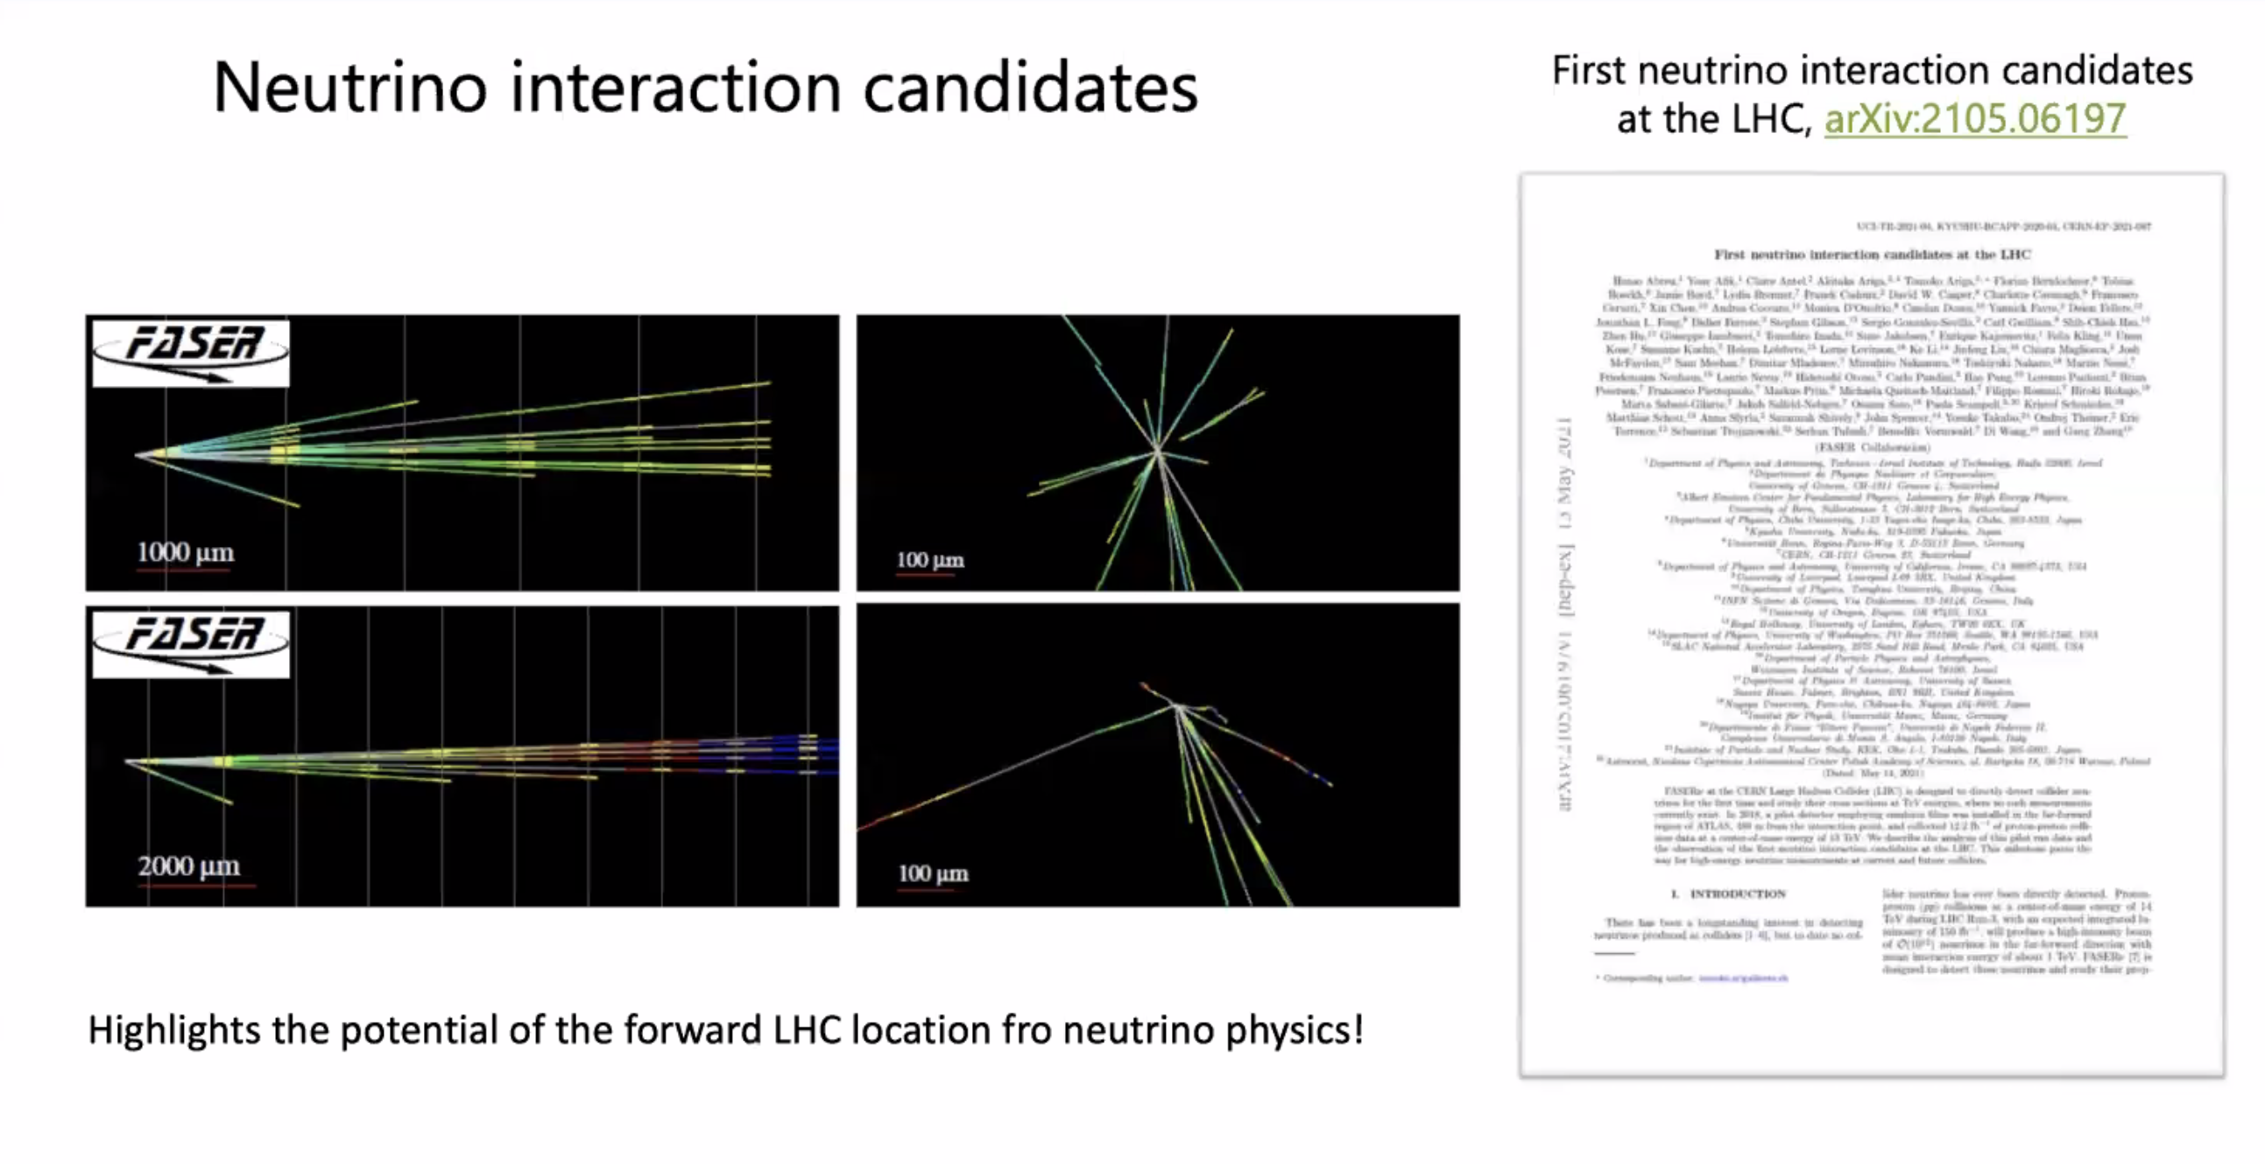
First Observed Neutrinos in FASER-𝞶
These are the first ever directly observed neutrinos at the LHC!!
Results from emulsion exposure tests in 2018
Emulsion/Tungsten
target of 1.2 tons
for Run-3

Slide 13
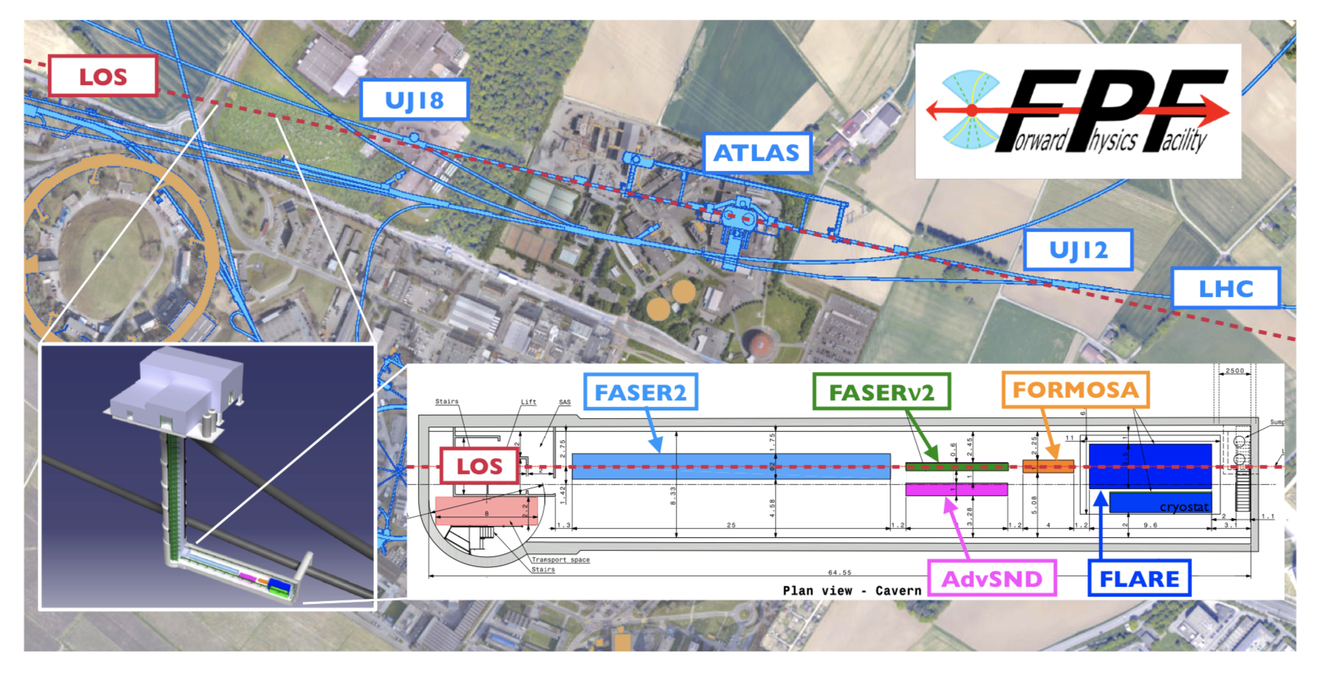
NEW: The Forward Physics Facility
Origine: Letter of intent contributed to the Snowmass21 process.
Based on the FASER experience and studies: propose to have a Forward
Physics Facility (FPF) experimental hall with room to include forward
detectors for new physics searches (and QCD): FASER2, others
2203.05090
FASER->FASER2, SND@LHC->AdvSND, MilliQan->FORMOSA, FLARE->LAr/LKr TPC

Slide 14
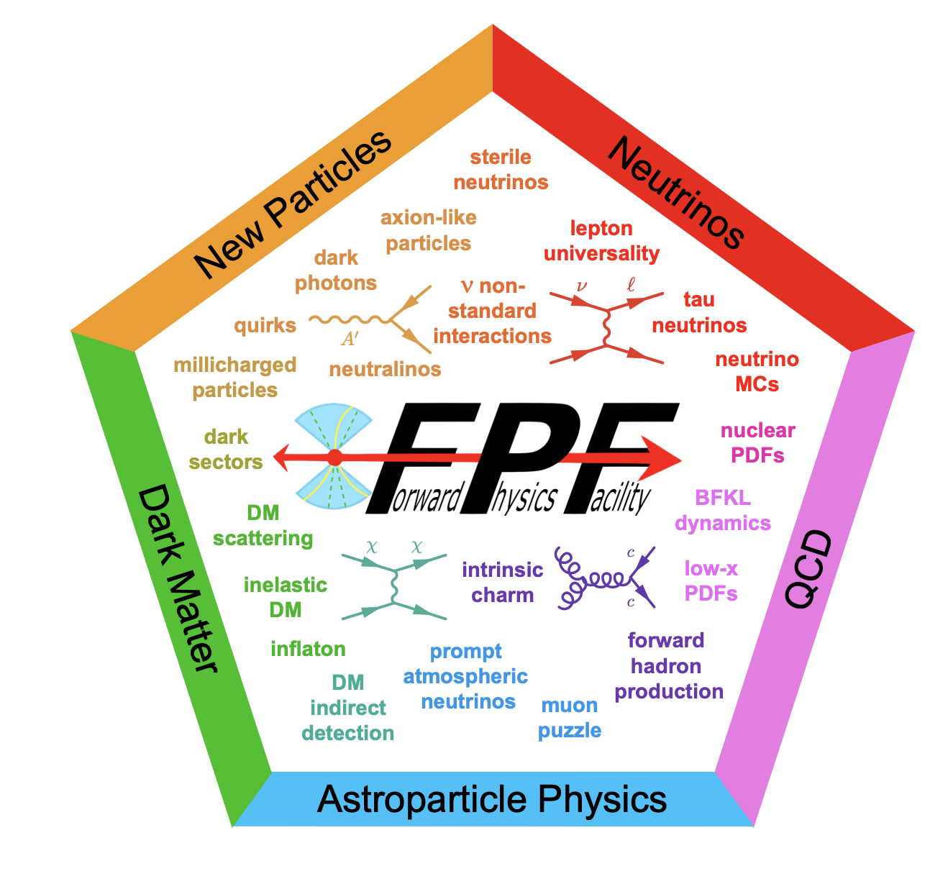
NEW: The Forward Physics Facility
2203.05090
Originally for searches for New Physics
Extended to cover Neutrinos, QCD, Astroparticle Physics, Dark Matter Searches
QCD: PDFs, very forward
production of light and charmed
mesons, very low-x (10⁻⁷)
and very high-x regions eg
intrinsic charm, 𝛎-DIS…
Neutrino: TeV scale neutrinos,
about 1000 Tau neutrinos, tau
and anti- neutrino separation…
Astroparticle physics: improve
the modelling of high-energy
hadronic interactions in the
atmosphere. Help to understand
the atmospheric neutrino flux
Timeline: a proposal for Run4 starting ~ 2030

Slide 15
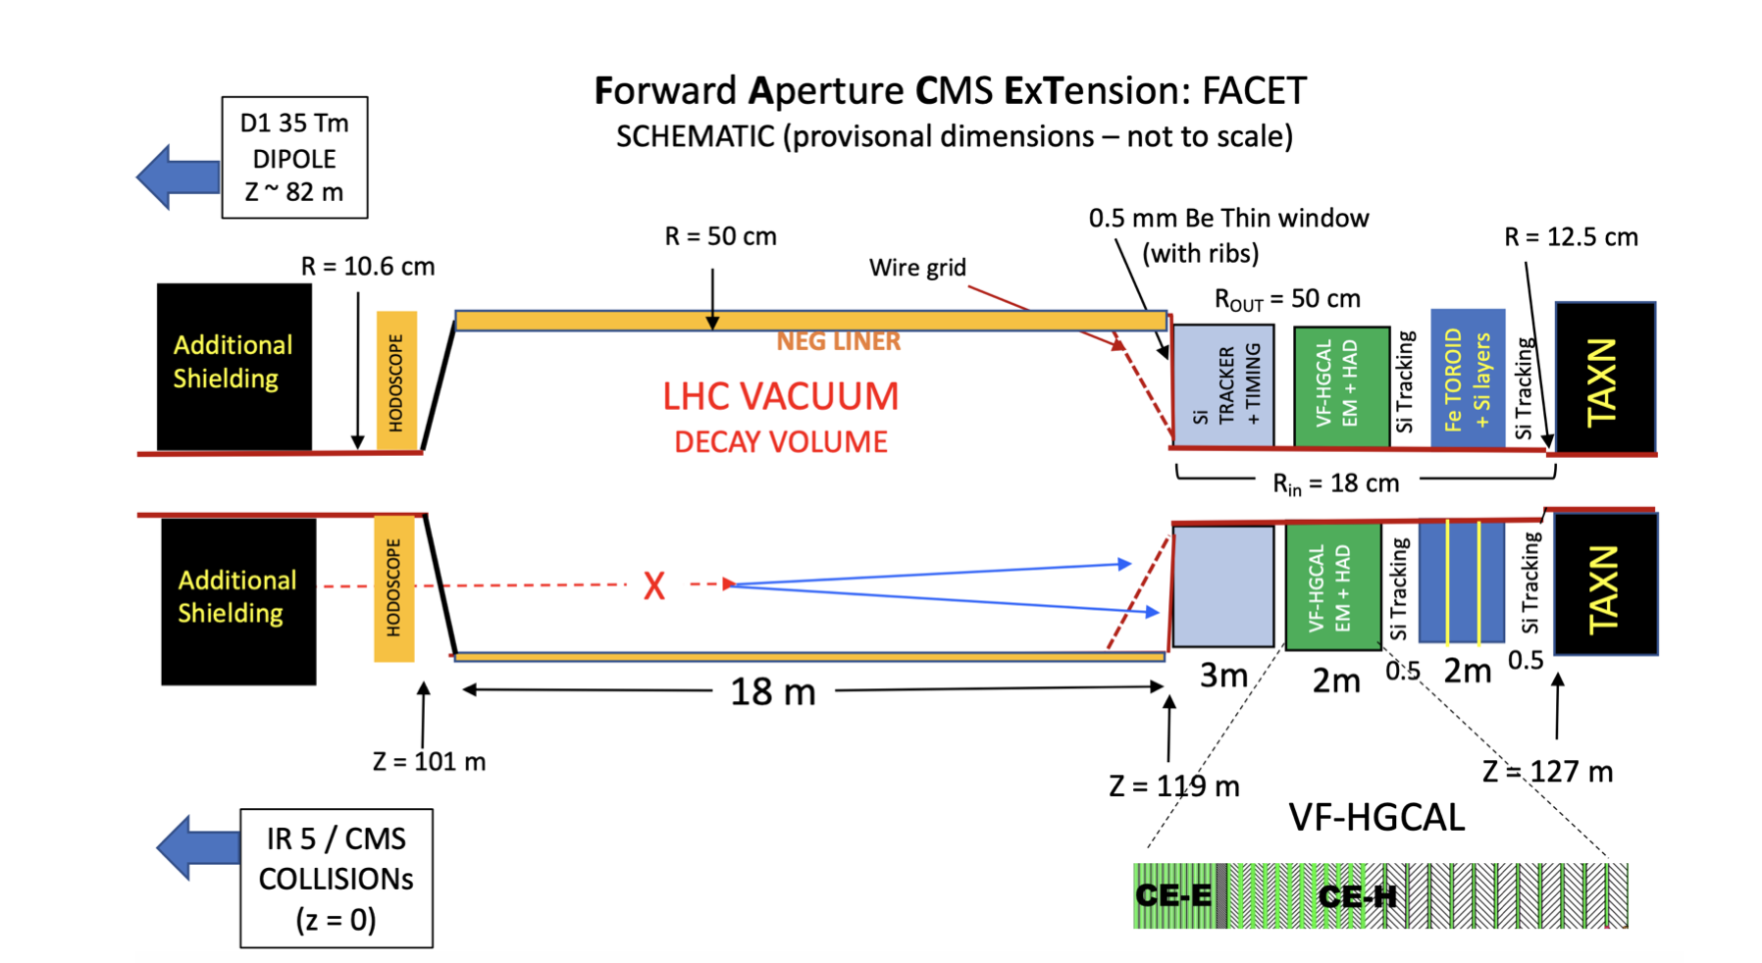
FACET
Forward-Aperture CMS ExTension will be sensitive to any particles that can
penetrate at least 50 m of magnetized iron and decay in an 18 m long,
1 m diameter vacuum pipe. The decay products will be measured in detectors
using identical technology to the planned CMS Phase-2 upgrade.
2201.00019
Instrumented extended
radius beampipe from
10 to 50 cm
Considered as an
extension of the
CMS experiment
● Cover the forward region 7.6 > η > 6.2
● The decay volume is at high vacuum (LHC quality: part of the LHC beam pipe)
Essentially all the SM backgrounds having direct paths from the IP are
eliminated
Timeline: a proposal for Run4 starting ~ 2030

Slide 16
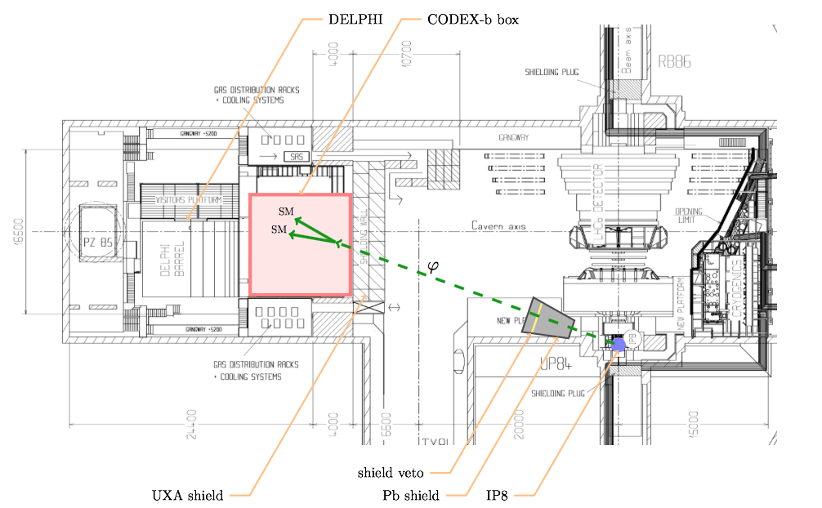
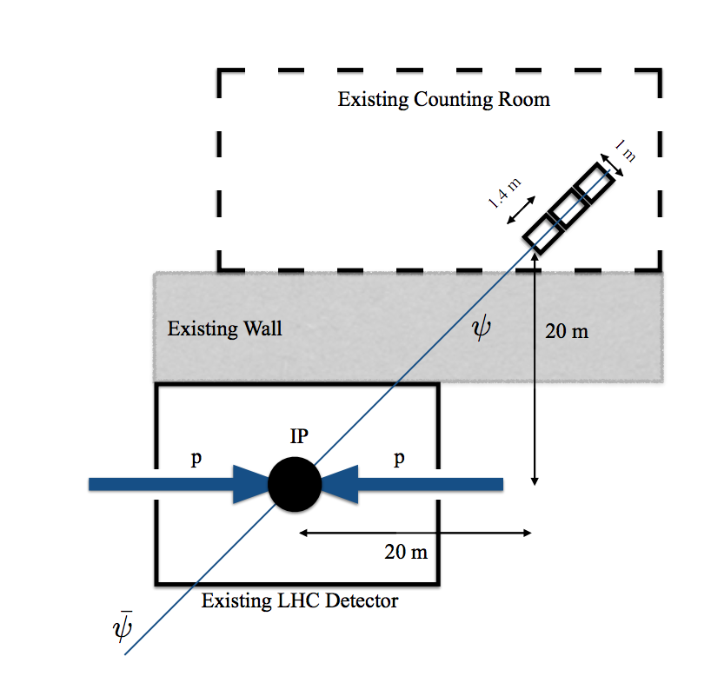
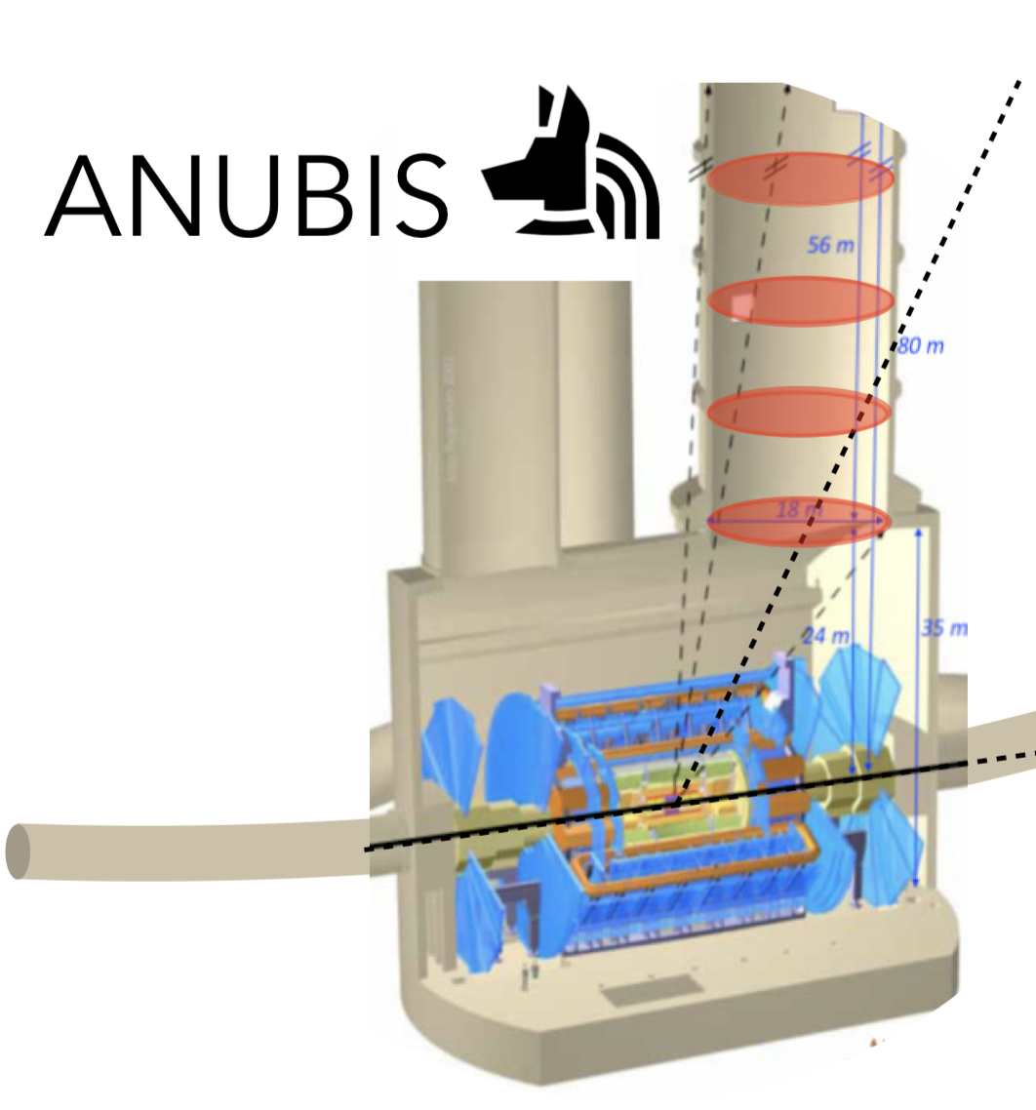
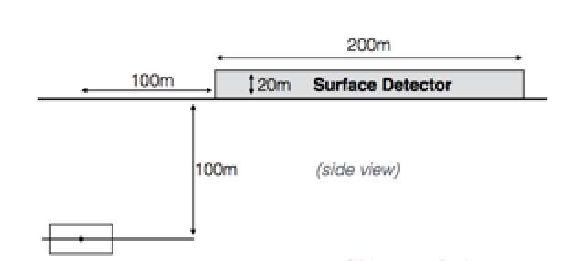
New Transverse Experiment Proposals
MilliQan: searches for
millicharged particles
MAPP: MoEDAL upgrade
CODEX-b: searches for long lived
weakly interacting neutral particles
Also: AL3X (‘ALICE’ for LLP arXiv.1810.03636)…
MATHUSLA: searches for long lived
weakly interacting neutral particles
ANUBIS: searches
for long lived weakly
interacting neutral
particles
+Recently (2021):
a new detector
for CMS cavern..

Slide 17
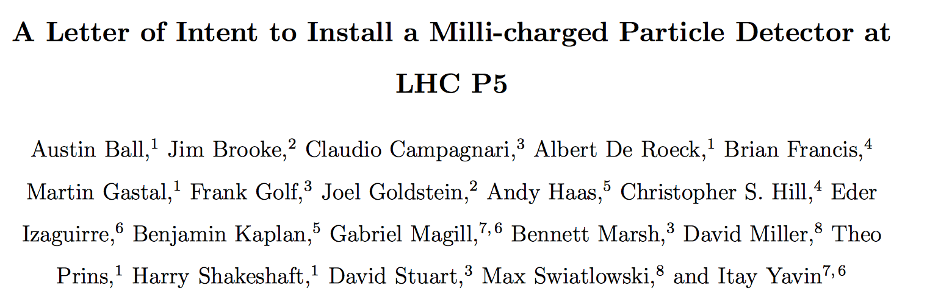
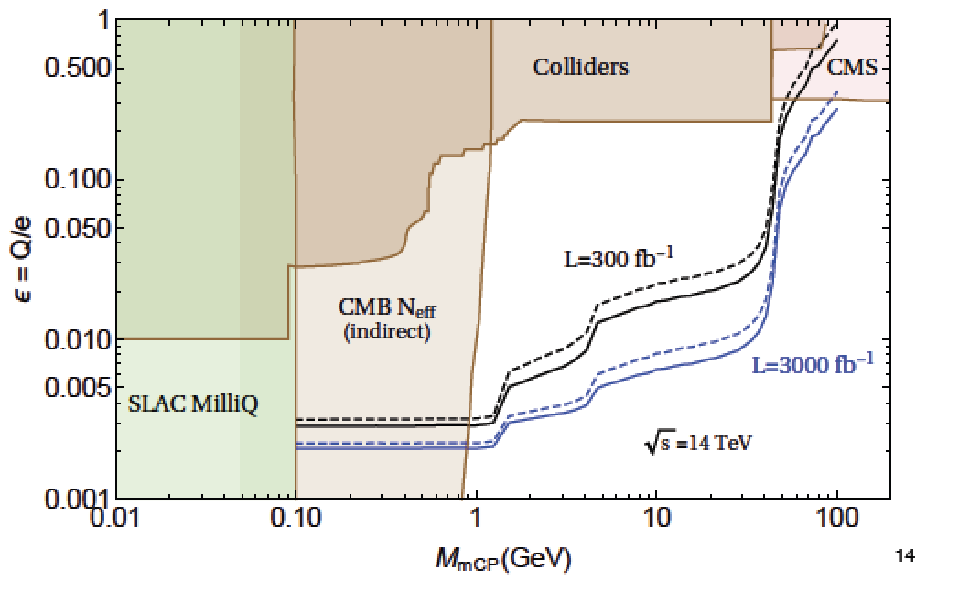
Particles with Milli-Charges?
Idea -> Hunting for particles with charges ~ 0.3-0.001e
Baseline paper: arXiv:1410.6816
Proposal for a new experiment/CMS subdetector.
Demonstrator (1%) took data from mid-2017 to end 2018
arXiv:1607.04669
MilliQan Experiment
Motivation:
•“Dark QED” ie QED in the dark
sector that kinematically mixes
with the SM QED.
•The EDGES anomaly…?
Detection technique:
scintillators-> low photon signals

Slide 18
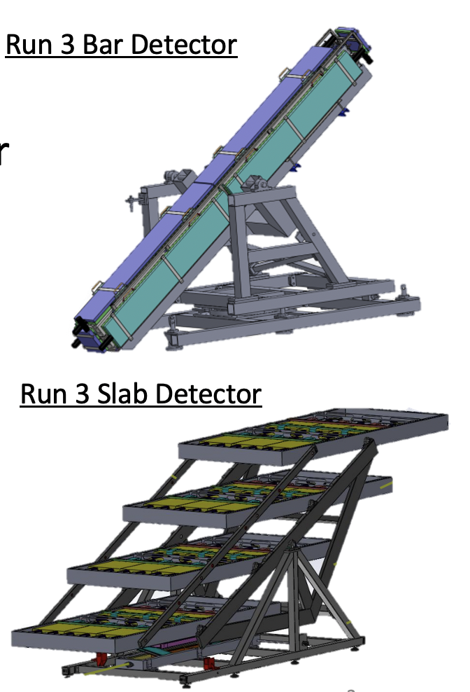
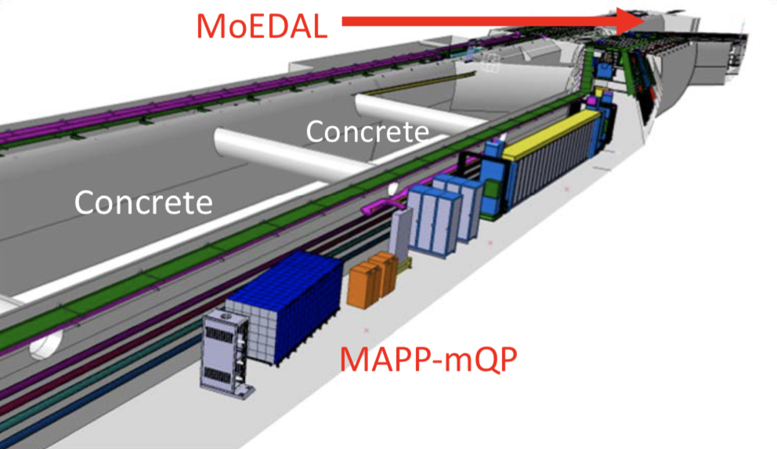
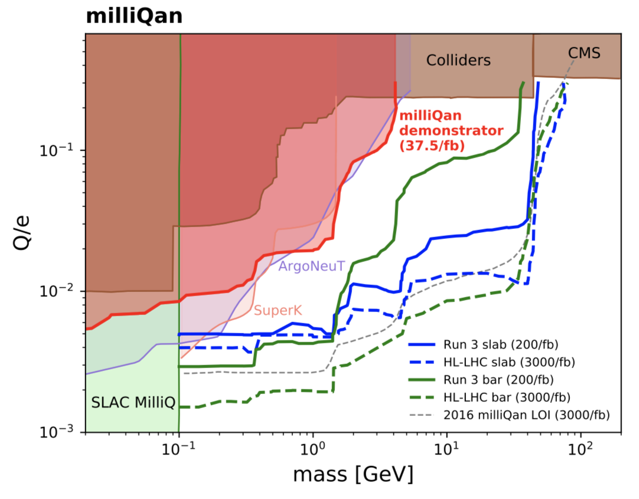
Millicharged Particles
Search for Millicharges: Particles with very small charges, compared to
the electron, expected e.g. in Dark Sector theories.
•MilliQan and MAPP now LHCC endorsed/approved projects, and being installed
•Scintillator bar and slab based detectors
Both are being
installed for
Run 3 right now

Slide 19
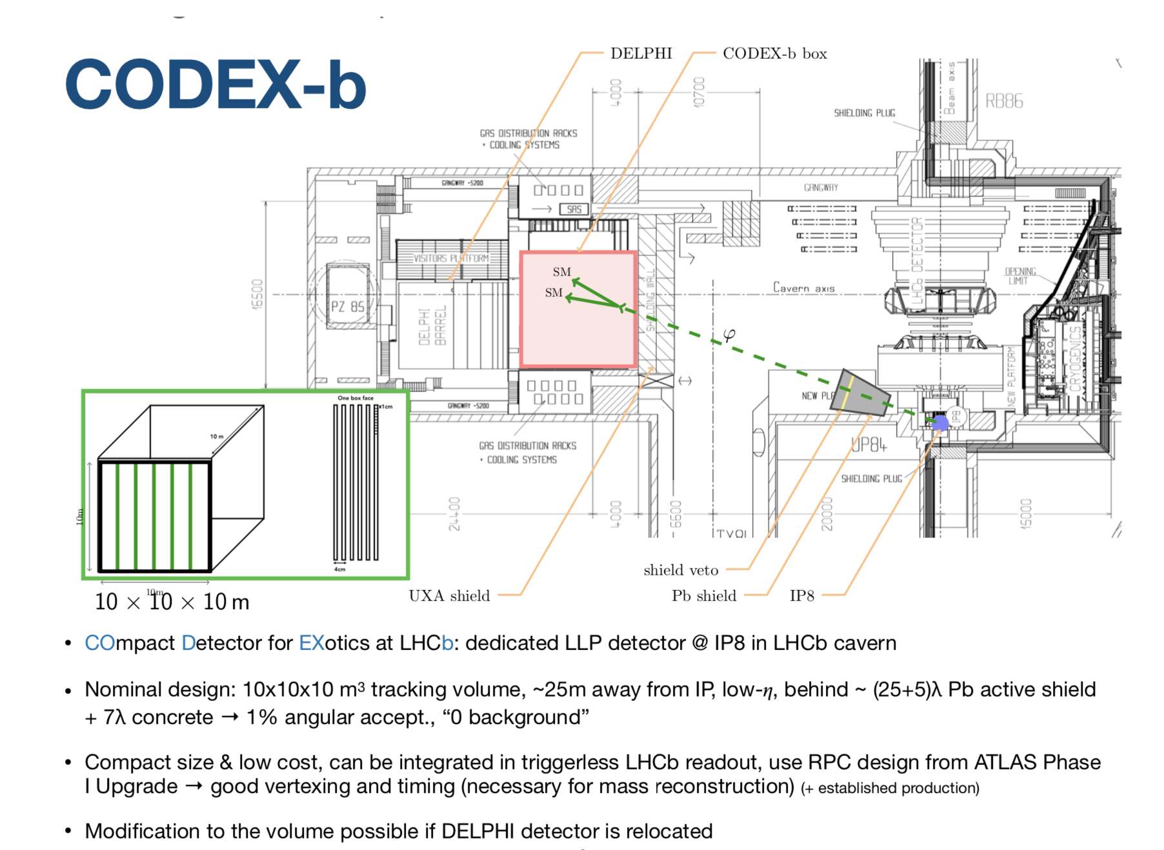
CODEX-b
COmpact Detector for EXotics at LHCb: a dedicated LLP detector@ IP8
First ideas: 1708.09395
EOI: 1911.00481
Backg. studies: 1912.03846
Search for weakly
interacting neutral
Long Lived Particles
• Nominal design: 10x10x10m³ tracking volume 25 m away from the IP, preceeded
by an active shield of (25+5)𝝀 Pb + 7𝝀 concrete -> 1% angular acceptance
• RPC tracking detectors (ATLAS Phase 1 upgrade), integrated in LHCb triggerless
readout -> Good vertexing and timing
• Demonstrator in preparation: 2x2x2m volume test- set up with RPCs

Slide 20
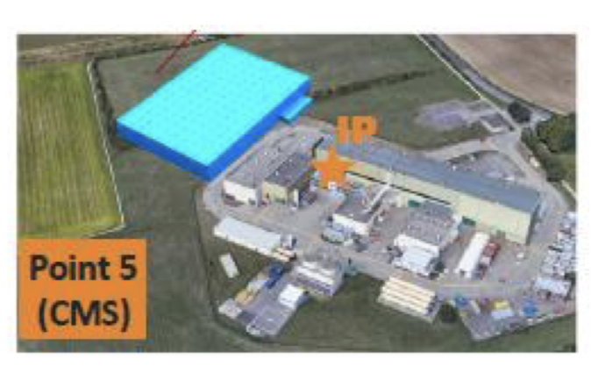
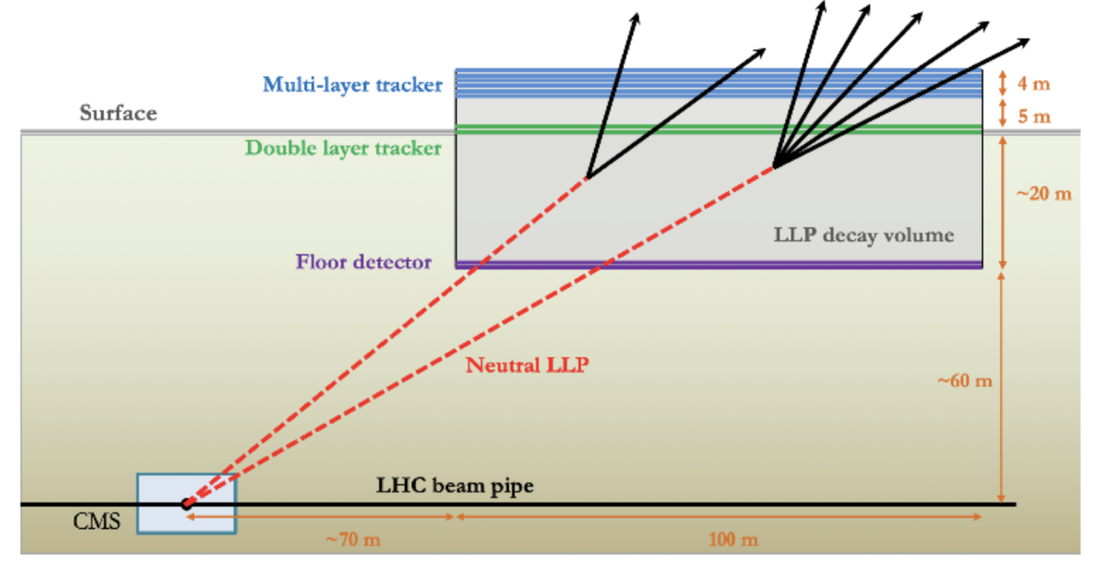
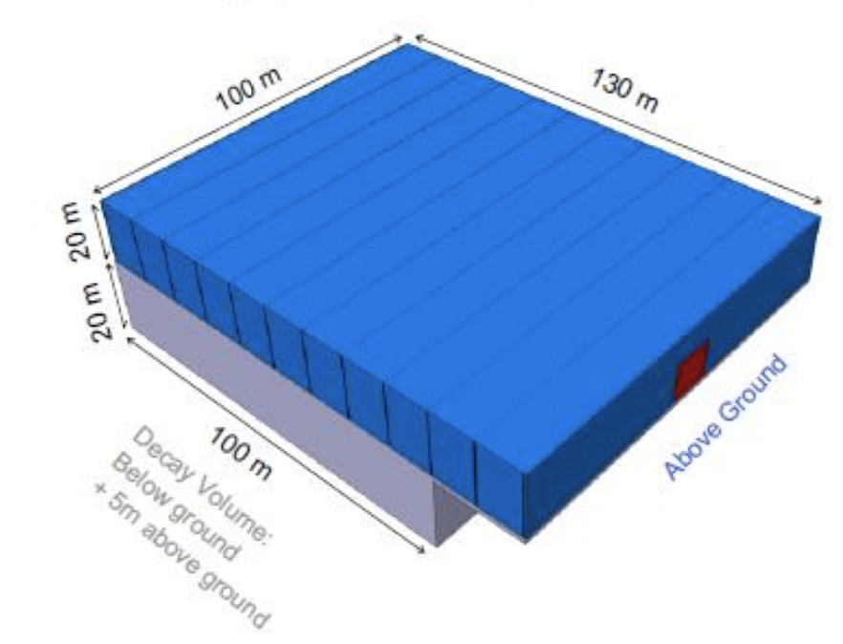
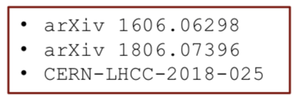
MATHUSLA
MATHUSLA: MAssive Timing Hodoscope for Ultra-Stable neutraL pArticles
Dedicated detector sensitive to neutral long-lived particles with lifetime
up to the Big Bang Nucleosynthesis limit (10⁷ – 10⁸ m) for the HL-LHC
Proposed large area surface detector
located above CMS with robust tracking
and background rejection
• Large volume ~100x100x30m³
• 4D tracking with ~ns time resolution
• Can run standalone or “combined” to CMS

Slide 21
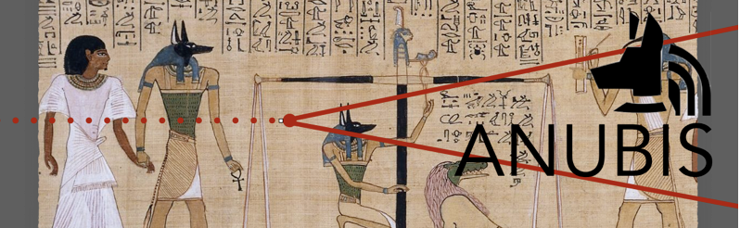
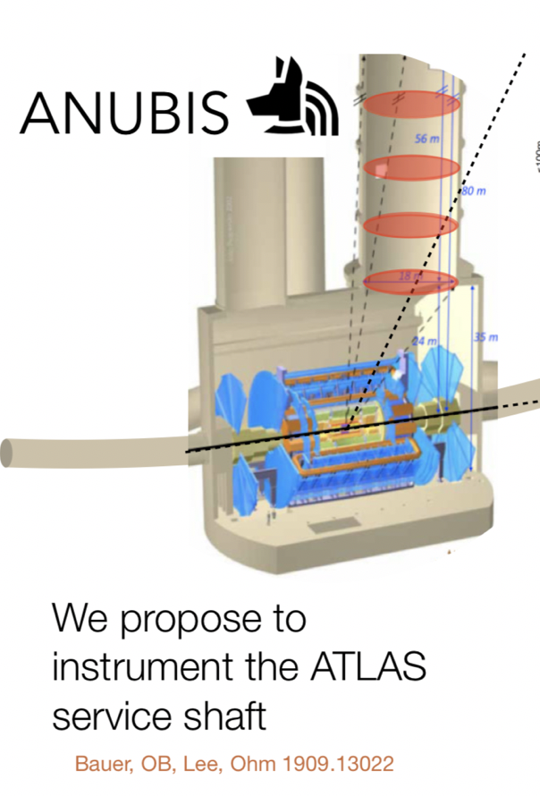
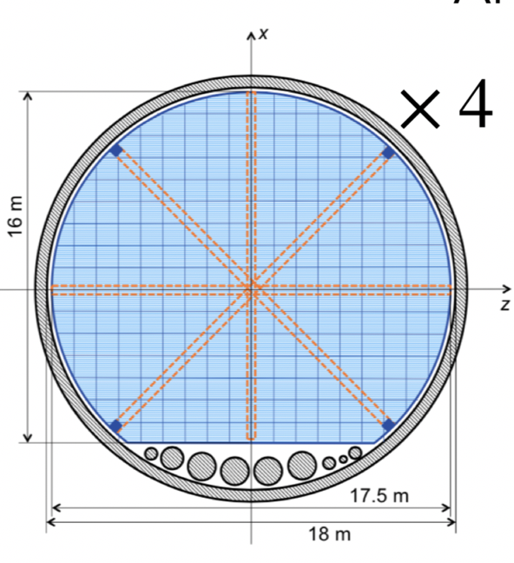
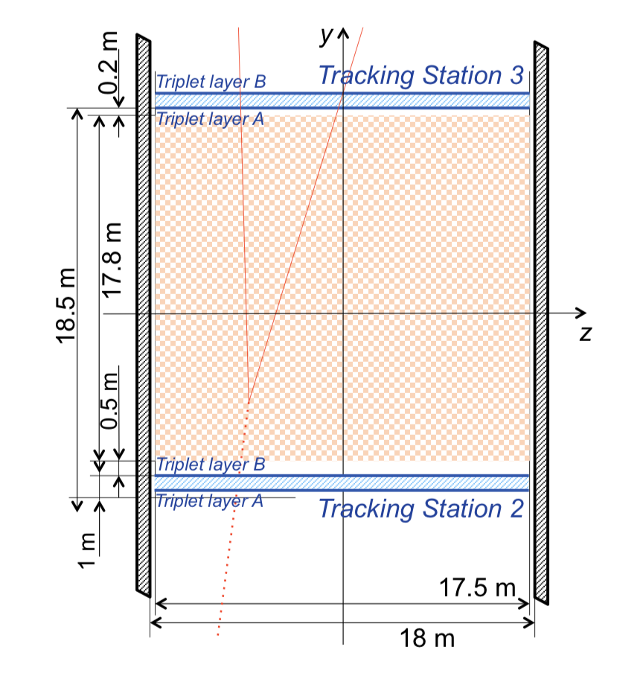
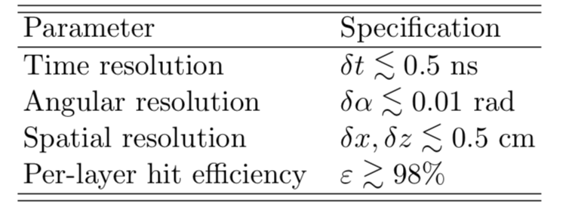

ANUBIS
ANUBIS: searches for long lived weakly interacting neutral particles
• 4 tracking stations
of ATLAS phase-2
upgrade RPCs
• Total about 2300 m²
of instrumented area
• Each tracking station
weighs 30 tons
• Propose to have
2x1x1m³ test set-up

Slide 22
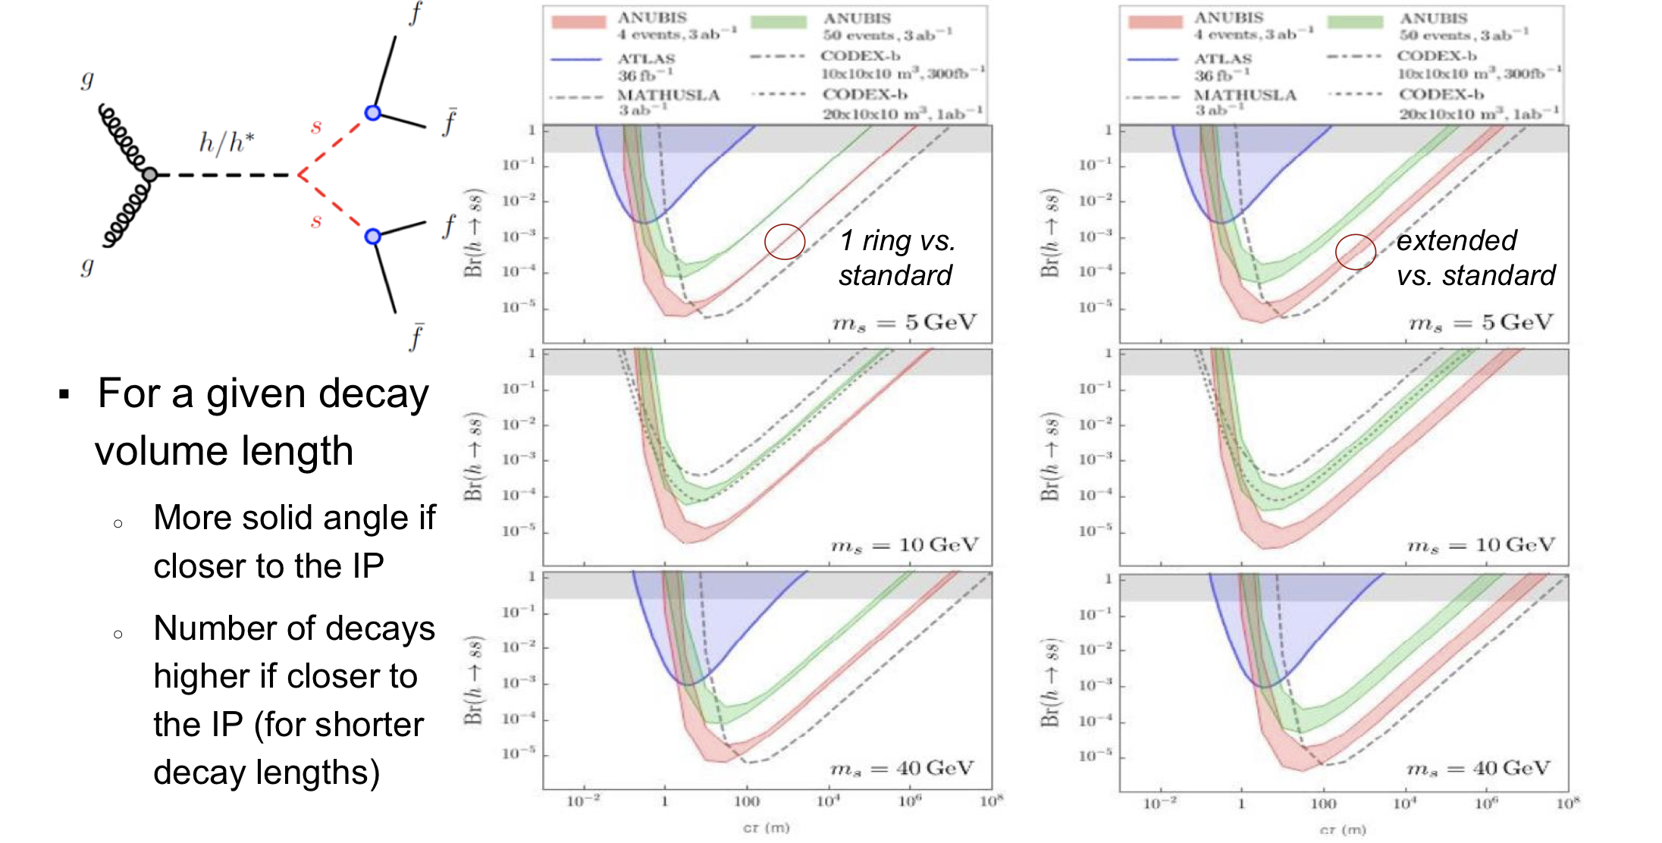
Example Process
Higgs as a portal to the Dark Sector, with a long lived scalar states s
ct (m)
10⁸
ct (m)
10⁸
The different proposals have different strengths and levels of complementarity
Studies regularly reported in PBC, FIP, and LLP meetings

Slide 23
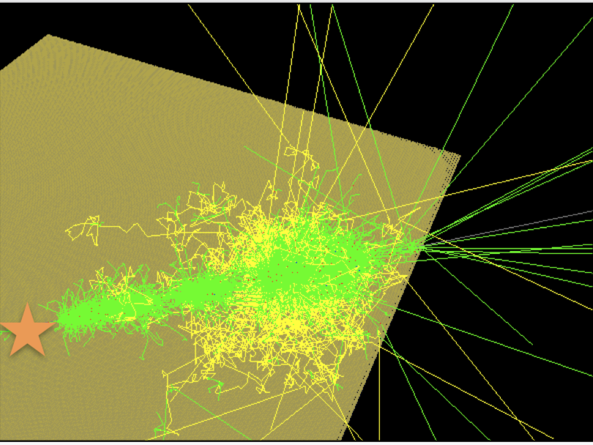
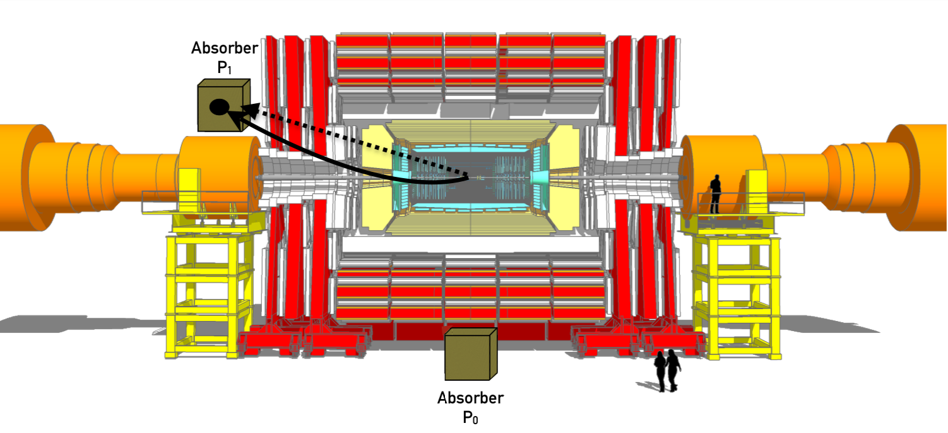
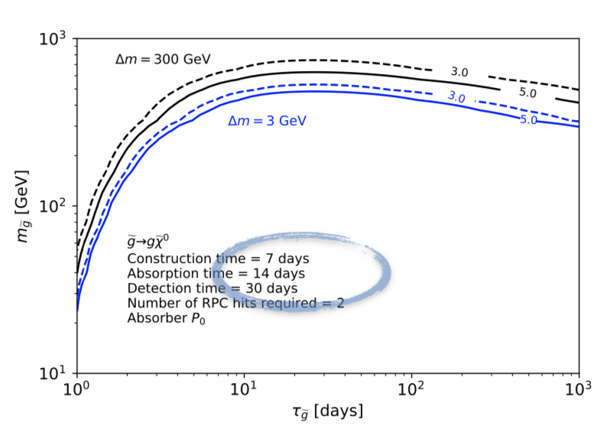
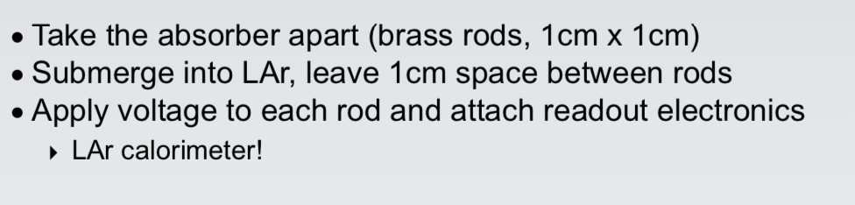

New: Trapping Particles
arXiv:2110.13837
Proposal for Detecting LLPs Trapped in detector material:
-> 2x2x2m³ dense target (rods), turned into a LAr calorimeter
Sensitivity studied for e.g. R-hadrons
Trap the particles and wait for its decay
Reach longer lifetimes: > weeks, months!

Slide 24

Summary
LHC so far had seven operational experiments ALICE, ATLAS, CMS, LHCb, LHCf, MoEDAL & TOTEM
For Run-3 there will be two new experiments FASER(𝛎) and SND@LHC and two extensions/upgrades MilliQan and MAPP
New ideas for additional small experiments at the LHC to increase the coverage: MATHUSLA, CODEX-b, AL3X, ANUBIS, and Forward Physics Facility and FACET. Several have test set-ups for Run-3 and will move to proposals/TDRs
Mostly for Long-Lived Particle/New Physics Searches but some coverage of QCD, astroparticle physics
Snowmass21 process: . Several new ideas for experiments at the LHC: FPF, FACET..
If we would observe one significant anomaly …

Slide 25
Backup

Slide 26
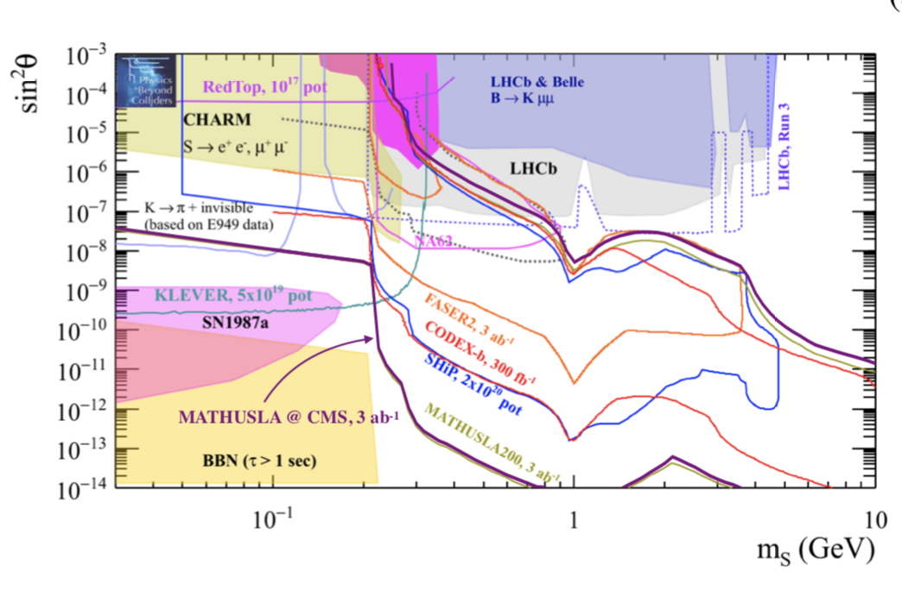


More Example Processes
Singlet Scalar mixing with Higgs
2009.01693
Inelastic Dark Matter Model
1810.01879
Heavy neutral leptons

Slide 27

CODEX-𝝱
Demonstrator to test technologies planned for CODEX-b
Integration with LHCb DAQ, measure backgrounds,
develop & test reconstruction algorithms &
simulation, + physics performance (but no shield)
• 2x2x2m³ cube in LHCb HLT D1 server room in Run 3
• 14 triplets of RPC designed for ATLAS Phase I
upgrade of muon spectrometer. Cost O(200 kCHF)
Expect 10⁷ K_{L} to decay in the demonstrator volume. Some reach for a search of multi-tracks (4+) LLP decays (appear eg in Hidden Valley models)
TDR-like installation plan document for CODEX-β being written and
will be reviewed by the LHCb technical board.
->Overall timeline shifted by 1 year w.r.t. EOI timeline

Slide 28
CODEX-b Progress
Progress on CODEX-β
  Design support structures, gas services, technical drawings…
  RPC readout integration with LHCb DAQ boards
  Materials for RPC manufacturing being purchased
  TDR / detailed installation plan being completed
Progress on CODEX-b
  Fast simulation framework based on reweighing for fast scanning over detector geometries and tracker configurations
  Reconstruction algorithms & fast simulation development
  Integration of detector & detector components in Geant4 full simulation
Plan to complete an LOI for the LHCC in 2022

Slide 29


MATHUSLA
MATHUSLA will be build up from 9x9x30m³ modules
• 6-layer tracking/timing detectors at the top
• Additional double tracking/timing layer at ground level
• Double tracking/timing layer at the floor level
Baseline technology: extruded scintillator bars
with wavelength shifting fibers (WLSF) connected
to SiPMs. Geometry optimization ongoing
->2018 RPC test-stand feasibility study (2005.02018)
To reconstruct hit position along scintillator bar:
use difference in arrival time between separate
measurements at two ends
Lab tests ongoing: Target timing resolution ~1 ns

Slide 30

MATHUSLA
Measurements of cosmic ray showers
provide a guaranteed physics return!!
Physics case being made for adding
a layer of RPC detector to current
scintillator layers for CR studies
Significant progress is being achieved on multiple fronts in MATHUSLA
  • DAQ design
  • Detector plane layout
  • Scintillator/fiber/ SiPM characterization
  • Simulations of rare backgrounds
  • Track & vertex reconstruction software
  • Cosmic ray studies,
Plan to finish TDR by end 2022, followed by prototype module construction
and tests; next plan towards a full detector for HL-LHC

Slide 31



Cosmic Rays & TeV Neutrinos
MATHUSLA and ANUBIS ‘on surface’
Cosmic Ray measurements possible
Topics under study in MATHUSLA –
like KASCADE but with full coverage
● Add RPC Layer for CR studies?
● Vertical Detector layers?
● Tailored electronics for CR studies…
Possible Physics Study Topics
● Primary CR spectra and composition
● Cosmic Ray Anisotropies/point sources
● Highly inclined showers
● Studies of EAS/hadronic int. models
● High Multiplicity Muon Bundels
● Combine with CMS experiment
● …
MATHUSLA: Detailed report on CR
studies in preparation
ANUBIS: To be looked into ..
Cosmic rays
particle
density
in 10¹⁵ eV
airshower

Slide 32

ANUBIS
The ANUBIS (AN Underground Belayed In-Shaft) search experiment will probe neutral LLPs with decay lenghts > 1m and masses > 1 GeV
Sensitivity to large decay lengths is established by instrumenting a large decay volume (e.g. the ATLAS cavern + service shaft)
Optimization and G4 based simulation studies ongoing
Plan:
• proANUBIS for
background study
• EOI to LHCC in
due time

Slide 33

ANUBIS
ProANUBIS, a 2x1x1 m³ prototype of one tracking
station unit module for ANUBIS based on BIS-7/8
RPC technology or a Phase 2 upgrade technology
Goal to install proANUBIS during Run 3
as demonstrator; study backgrounds
More information on
https://twiki.cern.ch/twiki/bin/view/ANUBIS/WebHome#Current_efforts

Slide 34

Data taking in TI18

Slide 35



New Physics Hunters @ the LHC
The ATLAS experiment
The CMS experiment
…And also LHCb and MoEDAL

