Slide 2
Contract management in TE-CRG
Thomas Ytterdal on behalf of TE-CRG-ML
03/02/2020
Thomas Ytterdal
2

Slide 3
Contract S176
Operation and maintenance of cryogenic installations at CERN
The contract is divided into two parts
  Result-oriented
  Task-oriented
03/02/2020
Thomas Ytterdal
3

Slide 4

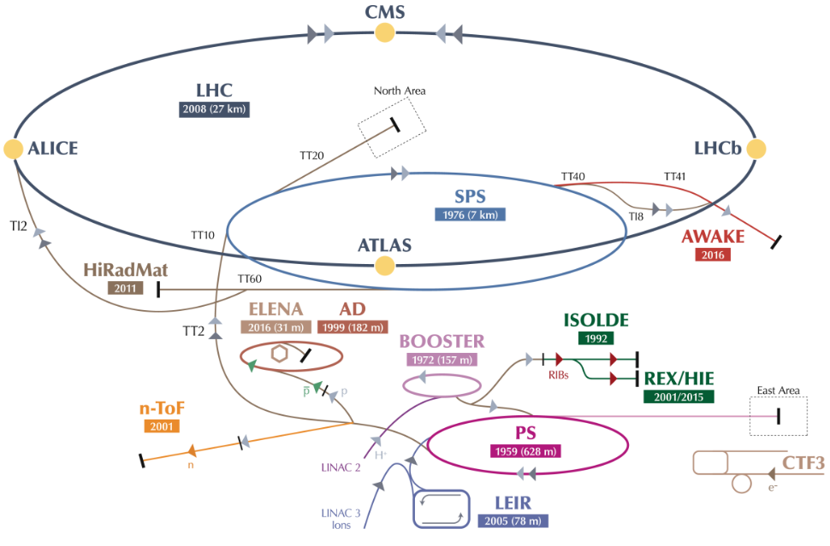
Cryogenic test and experimental facilities
LHC ACCELERATOR and EXPERIMENTS
TEST FACILITIES
SM18 Magnet Testing facility
West Area Testing facility
Cryo LAB 163
CENTRAL LIQUEFIER
Central Liquefier 165
Helium recovery center 243 - 253
NORTH AREA & P8
NA61.1/NA61.2 NA62 Neutrino NP02&04
ATLAS H8 CAST
CMS-RD5 COMPASS
OTHER ACCELERATORS
SPS-BA4-COLDEX HIE ISOLDE
SPS-BA6
LHC cryogenics
ATLAS cryogenics
CMS cryogenics
18 cryoplants in addition to LHC machine
Serving more than 20 key users
frederic.ferrand@cern.ch
Notes:
Total for 8 sectors:
Compressors: 64
Turbines: 74
Cold Comp.: 28
Leads: 1’200
I/O signals: 60’000
PID loops: 4’000
4

Slide 5
Cryogenic test and experimental facilities
LHC ACCELERATOR and EXPERIMENTS
TEST FACILITIES
SM18 Magnet Testing facility
West Area Testing facility
Cryolab 163
CENTRAL LIQUEFIER
Central Liquefier 165
Helium recovery center 243 - 253
NORTH AREA & P8
NA61.1/NA61.2 NA62 Neutrino NP02&04
ATLAS H8 CAST
CMS-RD5 COMPASS
OTHER ACCELERATORS
SPS-BA4-COLDEX HIE ISOLDE
SPS-BA6
LHC cryogenics
ATLAS cryogenics
CMS cryogenics
TASK
ORIENTED OPERATION
Operation support under CERN’s supervision
MAINTENANCE
METHODOLOGY
RESULT
ORIENTED OPERATION
Full delegation of responsibility to the contractor
frederic.ferrand@cern.ch
Notes:
Total for 8 sectors:
Compressors: 64
Turbines: 74
Cold Comp.: 28
Leads: 1’200
I/O signals: 60’000
PID loops: 4’000

Slide 6
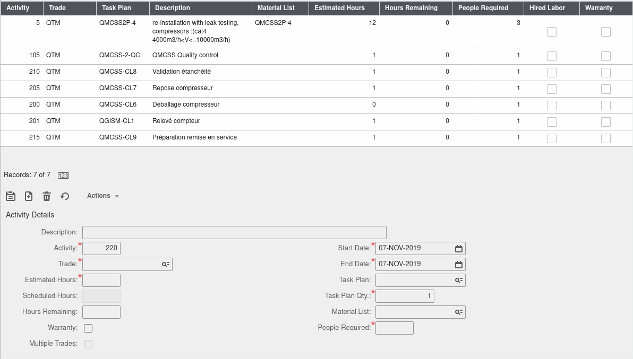
Work order activities
Activities are added to work orders from a predefined list of task plans
Each task plan has an associated contract sale price
Several activities can be attached to a single work order
03/02/2020
Thomas Ytterdal
6

Slide 7
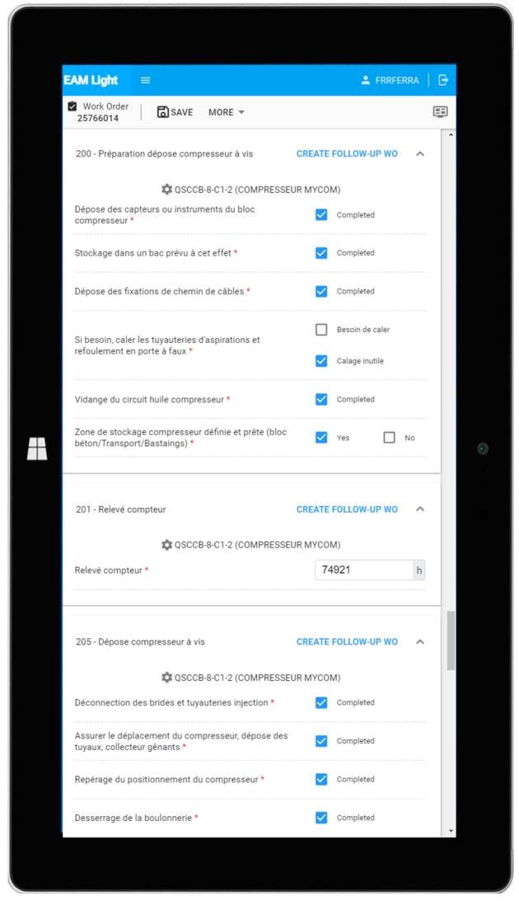
Checklists
Checklists can be added as a part of an activity.
Are used to gather information about the execution
  Certain key steps completed
  Meter readings
Must be completed before the work order can be closed
03/02/2020
Thomas Ytterdal
7

Slide 8
Preventive Maintenance Schedules
Helps managing recurring work orders
Based on time intervals or meter readings
Two main types in Infor EAM
  Fixed
  Variable
03/02/2020
Thomas Ytterdal
8

Slide 9
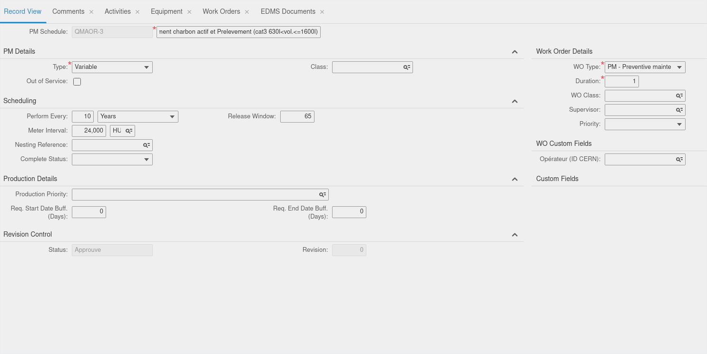
03/02/2020
Thomas Ytterdal
9

Slide 10
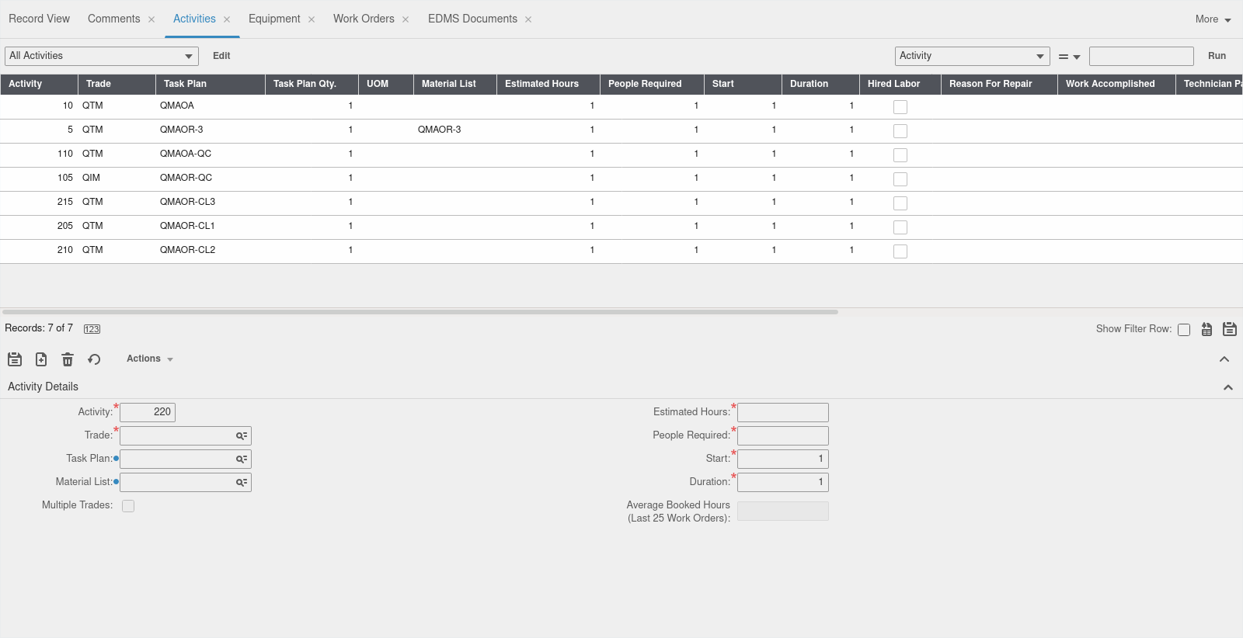
03/02/2020
Thomas Ytterdal
10

Slide 11
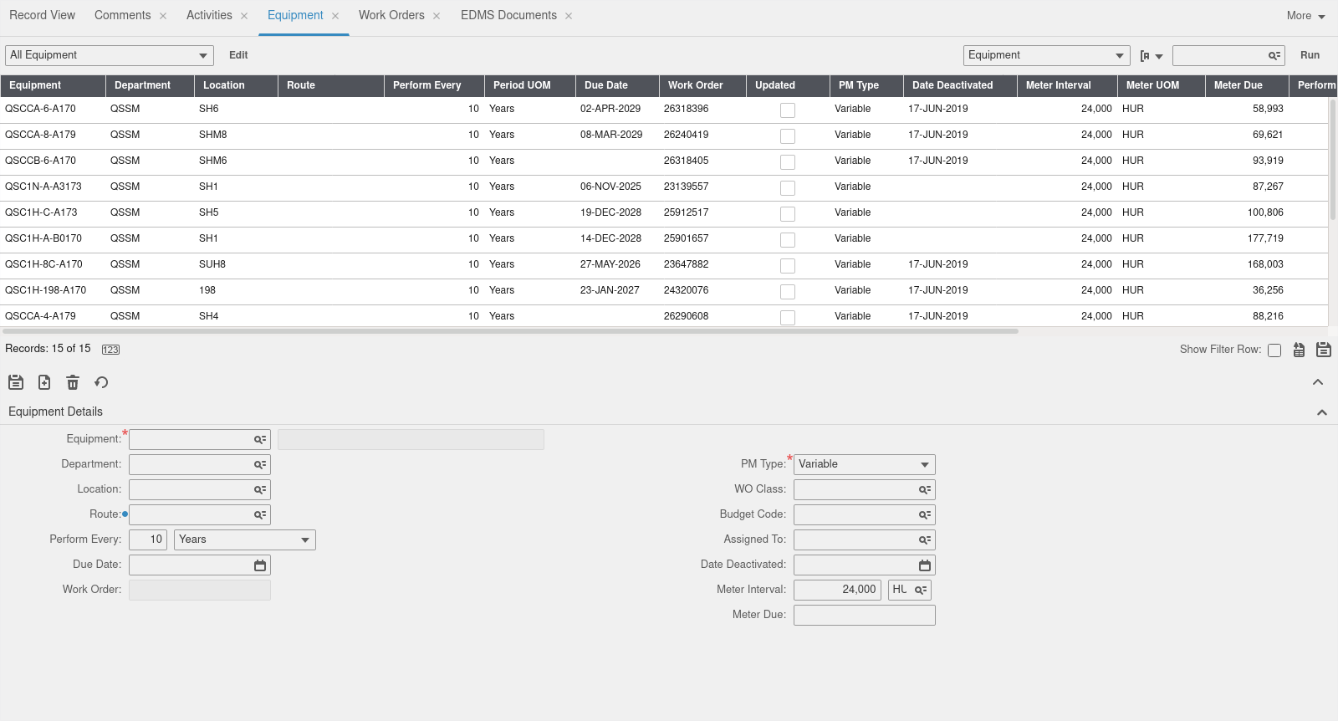
03/02/2020
Thomas Ytterdal
11

Slide 12
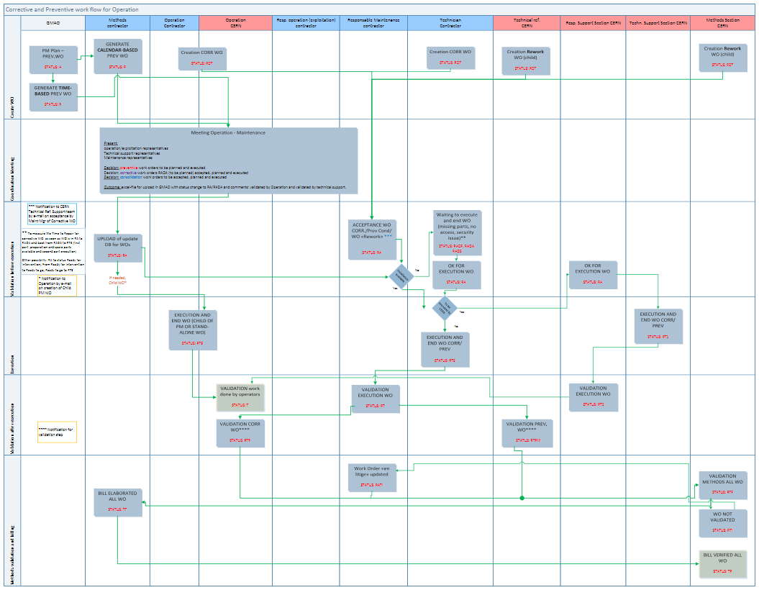
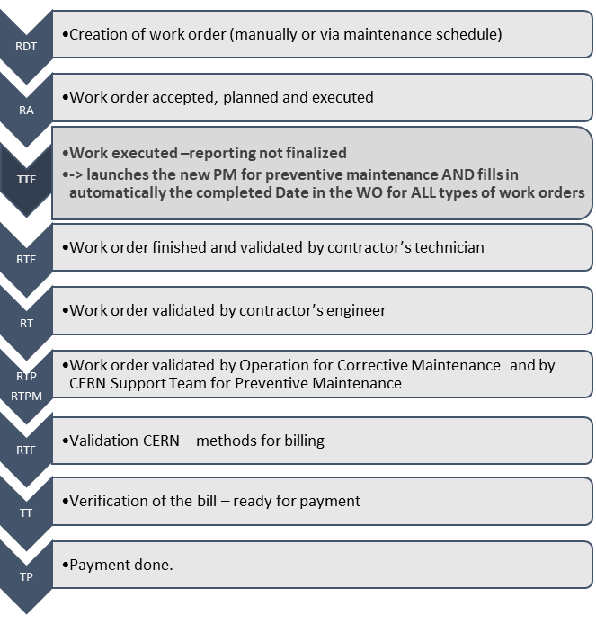
Work order flow
03/02/2020
Thomas Ytterdal
12

Slide 13
Billing
Done on a monthly basis
The total price is calculated based on the activities added to the work orders and their unit sales price
03/02/2020
Thomas Ytterdal
13

