Slide 1
Summary of ELQA measurements on LMBHA001 in SM18
Mateusz Bednarek, Jaromir Ludwin,
Tiago Catalão da Rosa
With important input form Felix Rodriguez Mateos and Jan Petřík

Slide 2
Brief overview of tests in SM18
2019-11-27: First tests with the ELQA hardware up to 2.6 kV,
  The insulation was perfect up to 2.6 kV (leakage current of 200 nA)
  The test at 2.8 kV was interrupted by a power-cut, during the voltage ramp.
  DC precision voltage measurements
2019-11-28: Magnet tested up to 2.7 kV,
  High leakage current first appeared at about 2.74 kV, then the on-set voltage varied
  DC precision voltage measurements continued
2019-11-29: Magnet tested up to 2.6 kV
  HV tests mostly below the high leakage current on-set, observation of partial discharges
  Differential measurements across magnet coils with an oscilloscope
2019-12-03: Magnet tested up to 2.7 kV
  HV tests mostly below and at the high leakage current on-set, observation of partial discharges
  Oscilloscope fast measurements of leakage current and voltage to ground between all magnet coils

Slide 3
Test at 2700 V
Voltage ramp rate 20 V/s
Increased leakage current appeared at 2170 V
Charging current
High leakage appears

Slide 4
High leakage on-set comparison
No degradation
Random behaviour, always between 2 kV and 2.75 kV
Test | start of increased leakage
 | V
2019-11-28_10-37 | 2741
2019-11-28_11-29 | 2150
2019-11-28_17-29 | 2440
2019-11-28_17-39 | 2140
2019-12-29_16-07 | 2596
2019-11-29_16-23 | 2200
2019-11-29_16-37 | 2200
2019-12-03_09-52 | 2700
2019-12-03_10-16 | 2160
2019-12-03_10-52 | 2140

Slide 5
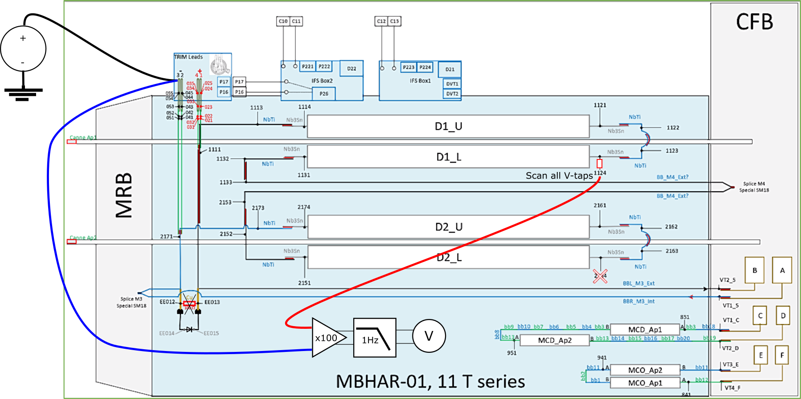
DC precision voltage measurements
Not completely conclusive
Not fully understood
Grouping of V-taps observed

Slide 6
Test at 2000 V
Partial discharge activity during the ramp and the plateau

Slide 7
Situation on 2019-12-04
High leakage current that appears at about 2 kV during the HV test was observed with both instruments (SM18 and ELQA)
Multiple measurements were performed testing various scenarios
Very difficult to localise this kind of fault, especially in a superconducting magnet
The fault location was not identified
The fault did not persist at warm

