Slide 1
Field repeatability of MQXF
CERN, 18/02/2020

Slide 2
Content
Factors limiting the measurement precision
Measurement results on short models:
  MQXFS6b
    Main field
  MQXFS4a
    Main field
    Multipoles
Conclusions

Slide 3
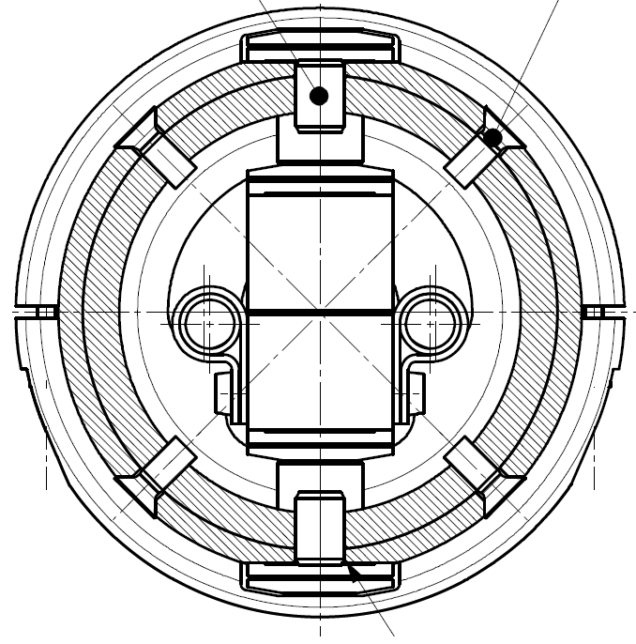
Measurement system for short models
  Vertical shaft rotating in the helium bath
  Fiberglass epoxy
  Length 2.1 m
    Measurement coils at a radius of ~43 mm
    Coil width ~21 mm
  The precision of the field
  measurement is given by:
    For the main field in a quad
      stability of the radius
      10⁻⁵ * 50 mm = 0.5 µm
    For the multipoles
      the radius
      the bucking factor (compensation)
      the sensitivity as function of the multipole order (kn)
        zero sensitivity: 21 mm / 43 mm → 27 degrees → n = 13

Slide 4
MQXFS6b: repeatability of TF
      1 unit
Cycle |  | I [A] | Relative Δ |  | TF [T /m /kA] | Relative Δ
1 |  | 16469.19 | 0 |  | 8.18839 | 0
2 |  | 16469.23 | 2.1E-06 |  | 8.18843 | 4.9E-06
3 |  | 16469.23 | 2.0E-06 |  | 8.18847 | 9.7E-06
      1 unit
    The cycle-to-cycle repeatability of the
    main field is better than 0.1 units (10⁻⁵)
    Limited by the measurement precision

Slide 5
MQXFS4a: repeatability of TF
      0.2 unit
Plateau | I [A] | std [A] | Rel std [-]
1 | 16470.000 | 5.3E-03 | 3.2E-07
2 | 16469.999 | 5.6E-03 | 3.4E-07
3 | 16469.999 | 5.5E-03 | 3.3E-07
4 | 16469.999 | 5.1E-03 | 3.1E-07
 |  |  |  |  | Cycle-to-cycle
Plateau | TF [T m⁻¹ kA⁻¹] | std [T m-1 kA-1] | Rel std [-] |  | relative diff
1 | 8.447506 | 3.7E-04 | 4.3E-05 |  | 1.5E-05
2 | 8.447382 | 3.3E-04 | 3.9E-05 |  | 0.0
3 | 8.447379 | 3.8E-04 | 4.5E-05 |  | -3.2E-07
4 | 8.447403 | 4.1E-04 | 4.8E-05 |  | 2.4E-06
      2 units

Slide 6
MQXFS4a: repeatability of multipoles
n | bn [units] |  |  |  |  | std
3 | 2.636 | 2.643 | 2.638 | 2.641 |  | 0.003
4 | 0.560 | 0.559 | 0.563 | 0.568 |  | 0.004
5 | -3.155 | -3.157 | -3.159 | -3.157 |  | 0.002
6 | -3.741 | -3.713 | -3.721 | -3.706 |  | 0.015
7 | 0.314 | 0.315 | 0.318 | 0.310 |  | 0.003
8 | -0.002 | 0.001 | 0.013 | 0.001 |  | 0.007
n | an [units] |  |  |  |  | std
3 | -1.172 | -1.179 | -1.171 | -1.180 |  | 0.005
4 | -4.749 | -4.751 | -4.754 | -4.755 |  | 0.003
5 | -0.215 | -0.216 | -0.221 | -0.216 |  | 0.003
6 | -0.370 | -0.367 | -0.363 | -0.367 |  | 0.003
7 | -0.194 | -0.194 | -0.189 | -0.194 |  | 0.003
8 | -0.783 | -0.787 | -0.785 | -0.787 |  | 0.002
    The cycle-to- cycle repeatability of
    multipoles is better than 0.01 units (10⁻⁶)
    Limited by the measurement precision

Slide 7
Conclusions
The cycle-to-cycle repeatability of the field in MQXF magnets is
better than 10⁻⁵ for the main field (n=2)
better than 10⁻⁶ for the multipoles (n>2)
The measurement precision is the limiting factor

