Slide 1
Revisiting flux jumps impact on orbit
D. Gamba, R. Tomas, G. Arduini, M. Martino, M.C. Bastos,
L. Fiscarelli, J. Coello de Portugal
167th HiLumi WP2 – 18 Feb 2020

Slide 2
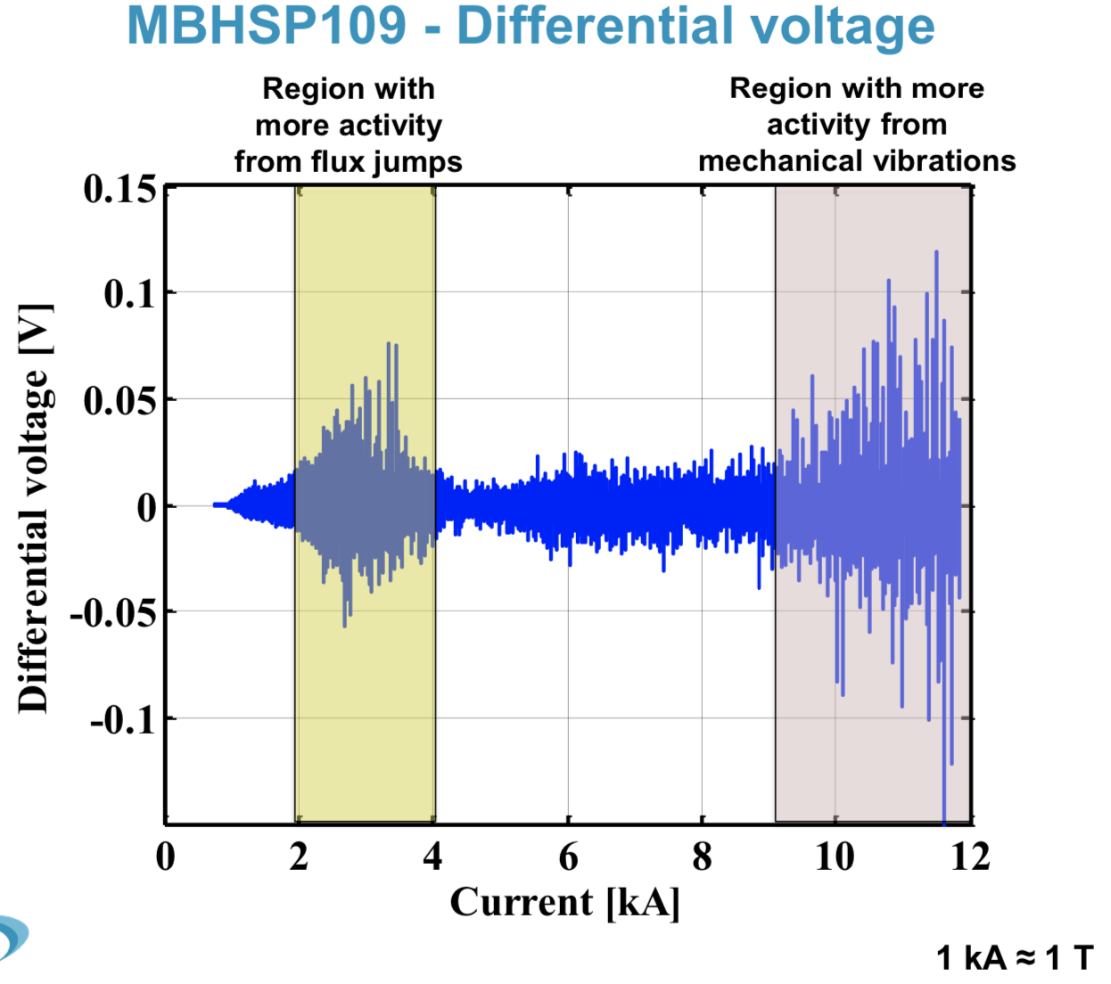
When do we expect Flux Jumps?
Typically, most of them well between 1-3 TeV
  2 kA @10A/s are made in about 200 s
Impact on beam ∝ time integral
Mechanical vibrations:
Possible measurement artefact due to the high frequency of the actual mechanical vibration, but negligible amplitude
Repeatability of main field in MQXFS6b over consecutive plateaus better <10⁻⁵ =0.1 units
WARNING: we speak about 0.2 units flux jumps -> only x2 stronger…
Here we see the “speed” as amplitude…. So since they are very fast, then actual field change is negligible….
+ expected to be different in production series, especially in quads.
  No worries.
  Not expected such vibrations, especially on quads!
Flux jump signature
Mechanical oscillation
From L. Fiscarelli– 144th WP2 Meeting (indico)

Slide 3
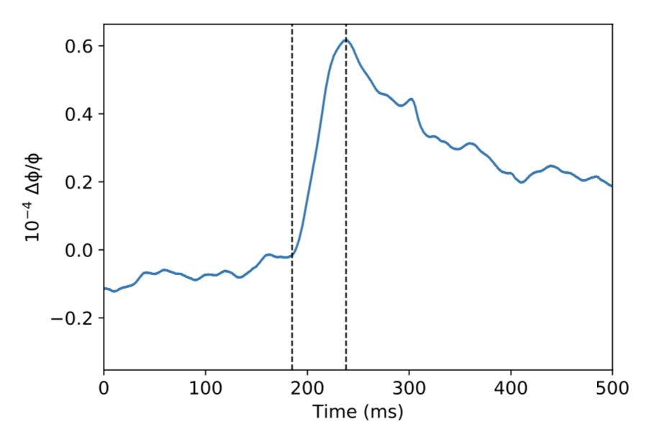
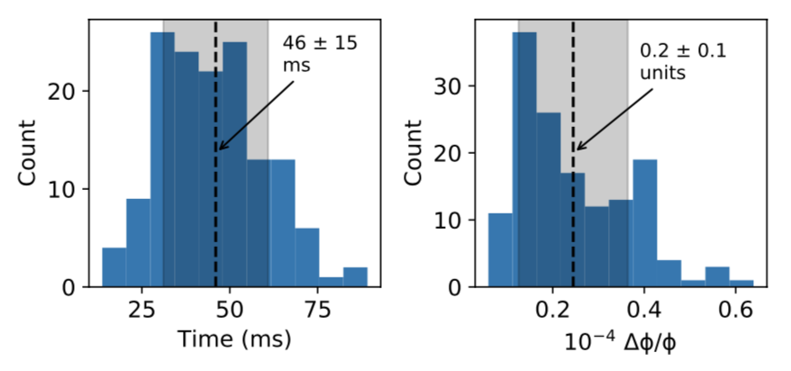
How fast/long?
Typically: 4.4 jumps/second
  Only measured on 11T short model.
  We don’t know for the quadrupoles in the triplet
    Michele estimated about 2.5 jumps/second in this case [link]
    We need more measurements!!!
Rise time ~50 ms. Let’s say FWHM ~120 ms.
  120x4.4=~500 ms: ~half of the time a magnet is experiencing a jump, which can be either positive or negative.
FWHM
From J. Coello de Portugal – Impact of flux jumps in future colliders (PRAB)

Slide 4
How intense?
Size of a Flux Jump in single magnet:
  0.2 units (for the main field)
    i.e. B0 in 11T, B1 for quadrupoles in the triplet,…
  WARNING1: we don’t know about dipole field jump on a quadrupole
  WARNING2: neglected here the 0.15 units up-down gradient measured on 11T
Biggest PC-jump induced by flux jump:
  0.06 units on whole RQX circuit (at injection only)
    It becomes negligible at top energy (<0.06 units)
    Note: PC linearity+short term stability of the order of 0.2 units at injection, even though those are variations at very low frequency (<1 Hz)
  negligible for 11T dipoles (~0.06 units at injection only)
  WARNING3: PC-jumps studied only for RQX and 11T trim circuits, assuming single event in a single magnet with some *arbitrary* hypothesis on scaling laws. Dedicated studies needed!
From J.C. de Portugal – Impact of flux jumps in future colliders (PRAB)
D. Gamba – 150th WP2 Meeting (indico)

Slide 5
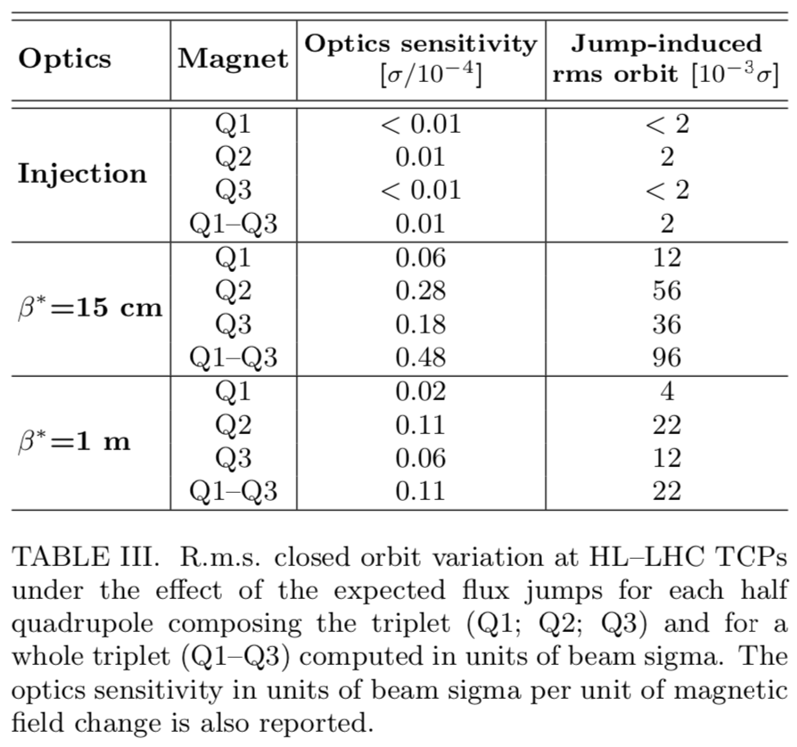
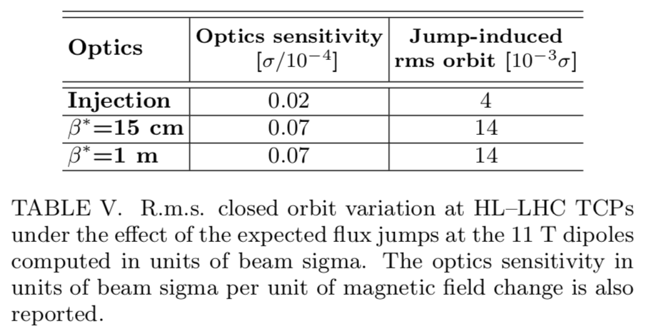
Impact of flux jump on orbit at TCPs
Each value represents the orbit jump induced by the most effective single half-magnet affected by a jump of 0.2 units
Assumptions:
2.5 um norm. emit.
7 TeV for 1m and 15 cm optics
450 GeV for injection optics
=> A jump in some key magnet could lead to ~2% beam sigma jump at TCPs
From J. Coello de Portugal – Impact of flux jumps in future colliders (PRAB)

Slide 6
Some numbers
Affected magnets:
  2 halves x 2 sides P7 of 11 T dipoles
    Acting mainly on horizontal plane
  2 halves x 2 sides x 1 IP1/5 of Q1 + Q2 + Q3
    Each IP is acting mainly on one plane due to crossing angle
Number of events:
  Over 200 s (one ramp, from ~1.2 to ~2.3 TeV), we expect 200x4.4 = 880 jumps for each single magnet
  Number of fills in lifetime of HL-LHC:
    10 years x 300 fills/year = 3000 fills.
    Total number of events/magnet = 2.64x10⁶

Slide 7
Some probability of concurrent jumps
At a given time, probability of a single magnet to be in a jump of a given sign is ¼.
At a given time, probability that n magnets are in a jump of a given sign is therefore (¼)^{n}
Additional assumptions:
  Assuming 1 m optics at 3 TeV (still conservative)
    need to scale optics sensitivity values by sqrt(3/7) = 0.65 as beam size is then bigger, i.e. size of jump in beam sigma is smaller.
  no cross-talk between magnets
  all flux jump of 0.2 units, 120 ms long, 4.4 isolated events/s
  neglected the contribution of the power converters
  Considering here only the horizontal plane

Slide 8
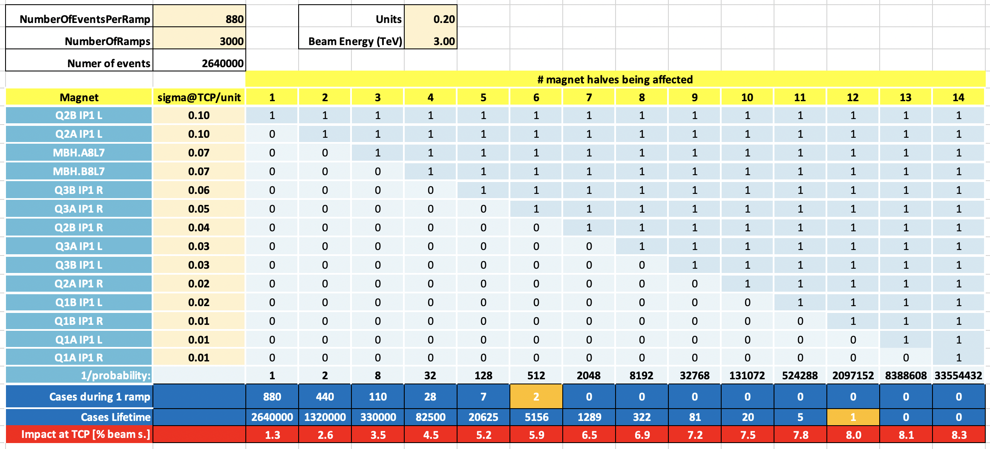
First order estimate of cases
At least one event of ~6% σ_{beam} jump/ramp (~8% σ_{beam} during HL-LHC lifetime)
Similar in vertical/diagonal direction (i.e. x3 number of “bad” events)
One can be more conservative (i.e. 0.6 units jumps => up to ~20% σ_{beam} jumps)

Slide 9
Conclusions
Typically, a few % σ_{beam} orbit jumps at TCPs
  For every ramp: >1 case with a jump up to ~6% σ_{beam}
  During HL-LHC lifetime, >1 case with a jump up to ~8% σ_{beam}
  Values can be scaled up to x3 to be very conservative
We have limited knowledge on:
  PC behavior for complex circuits like the triplet
  Amplitude of B₀ jump in a quadrupole magnet
Run3 will be fundamental to collect more data from 11T:
  Firing 6k-turn-by-turn BPM data every “second”
  ADT spectra
  BPM 25Hz rms data
  Other signals? BLM data?
String tests could be another place where to learn more.
Thank you for your attention and comments!

Slide 10
Backup

Slide 11
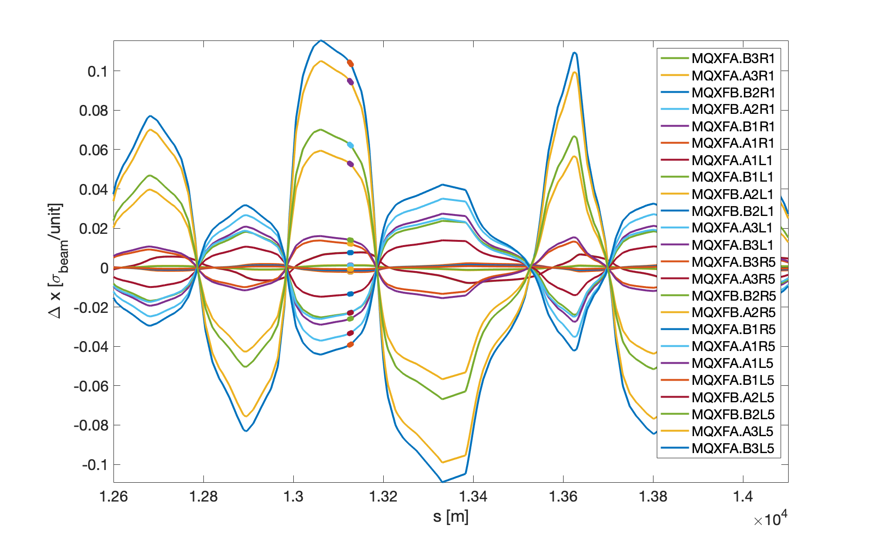
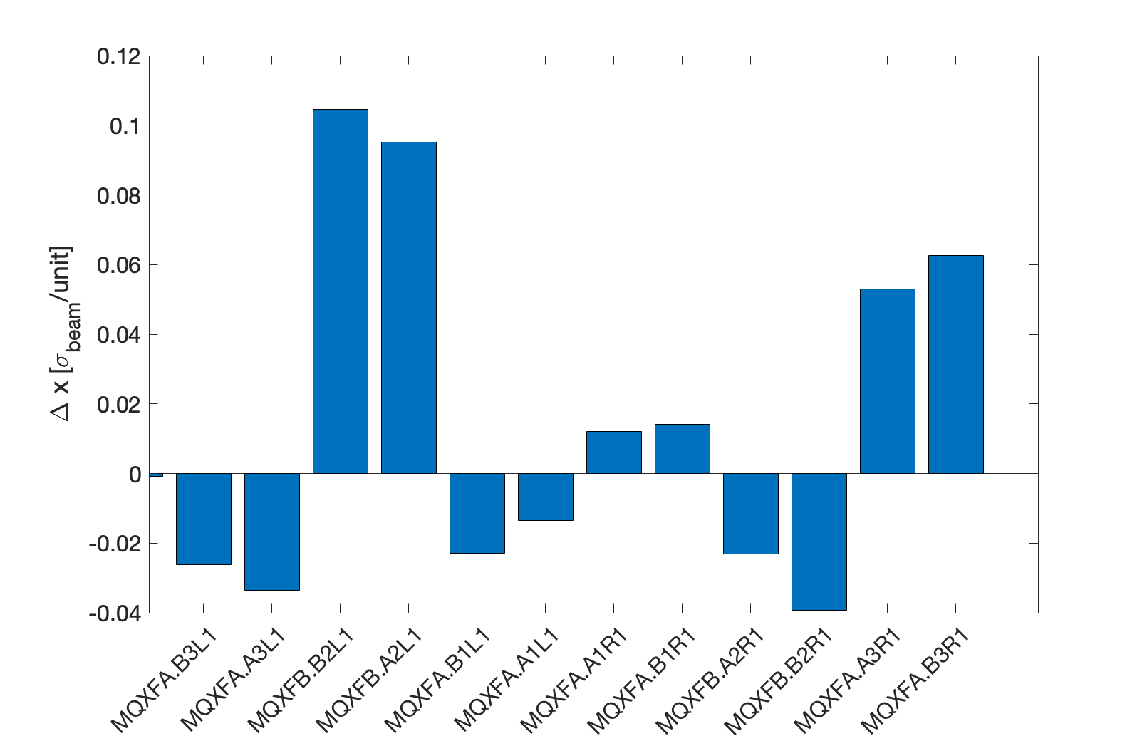
Impact of quads @TCP @1m beta* @7TeV @295 urad crossing

Slide 12
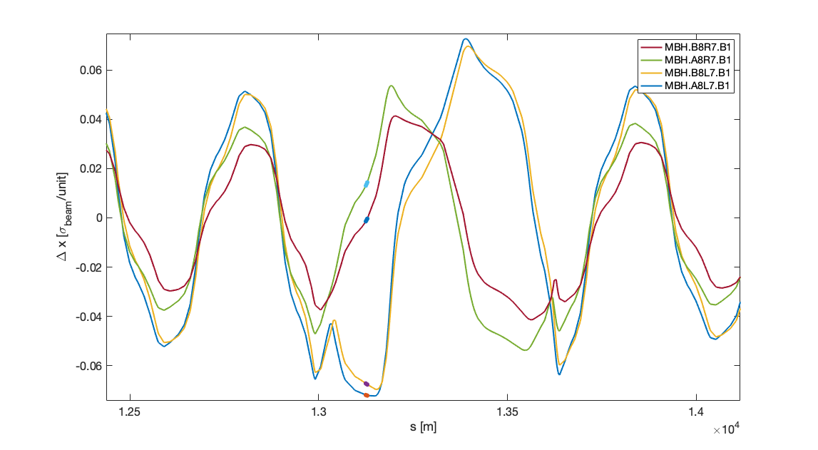
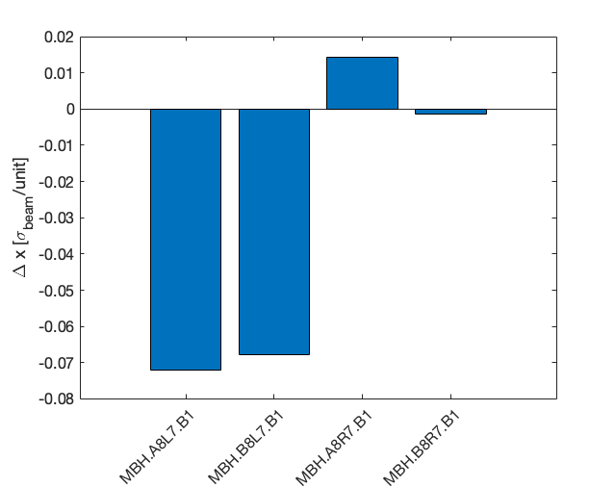
Impact of 11T @TCP @1m beta* @7TeV

Slide 13
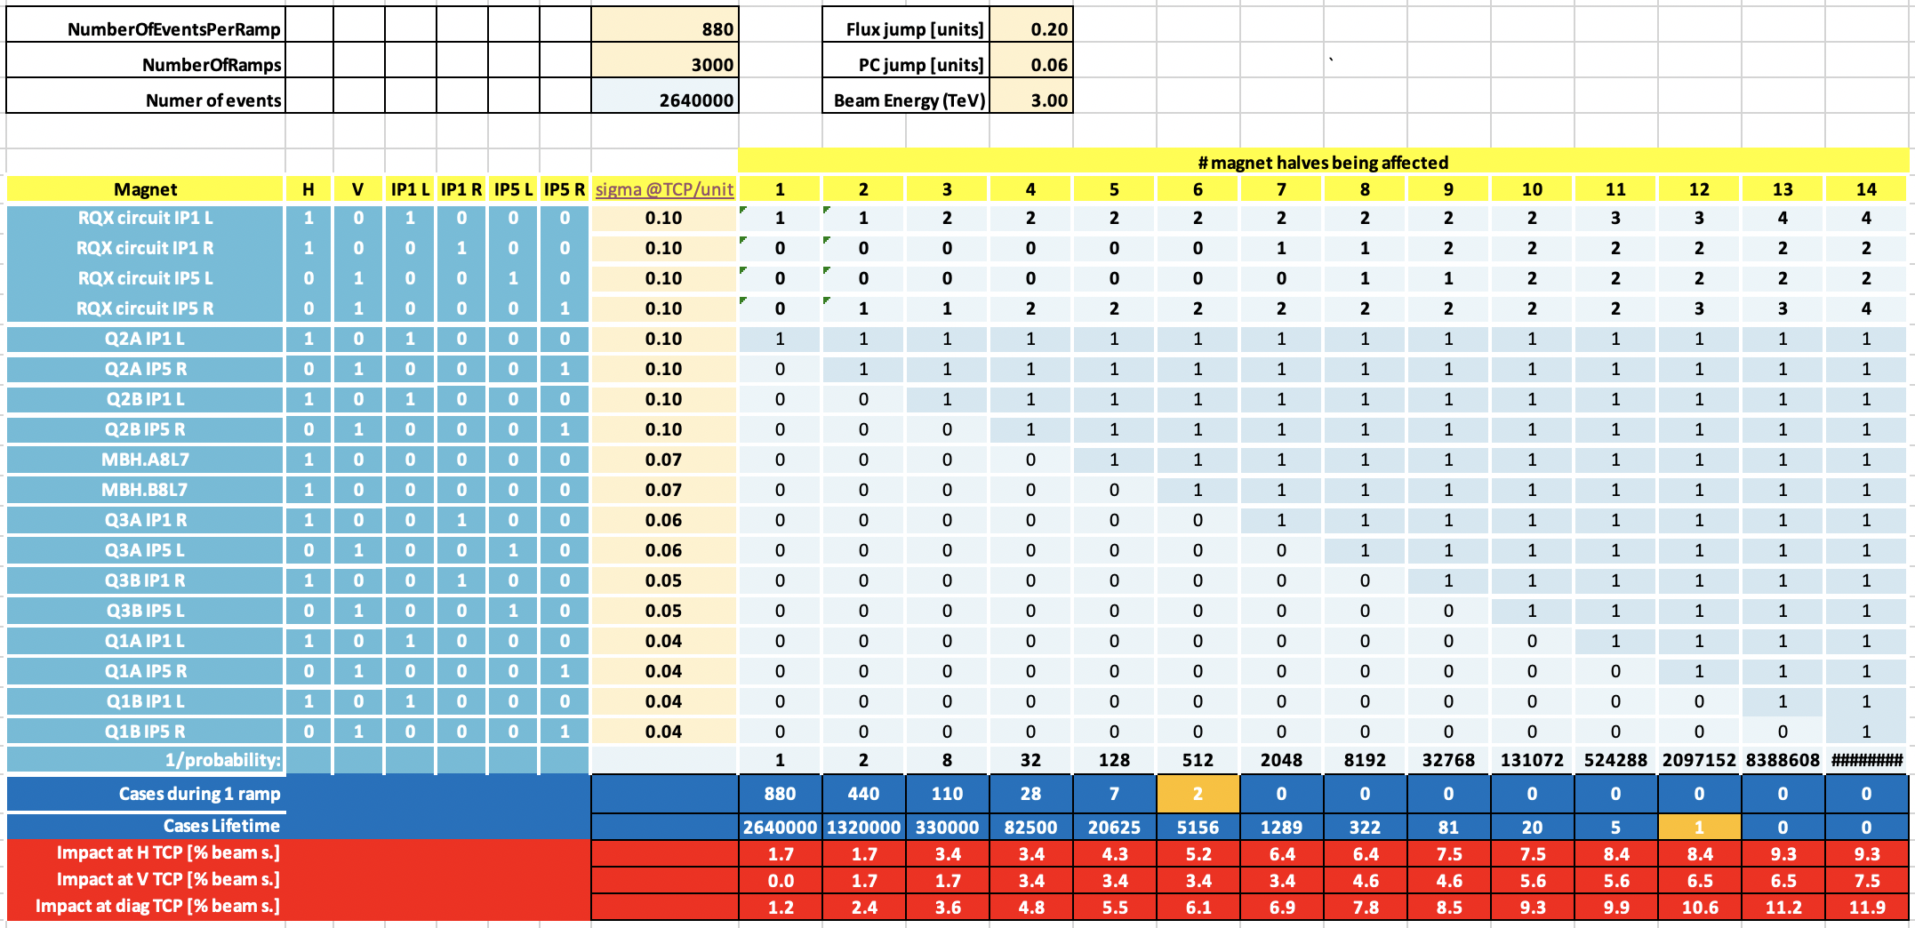
More complicated: diagonal kick + PC effect
Actual result is very similar (within 10-20%) to horizontal plane computation only.
Still missing full analysis of PC behavior

