Slide 1
PyHEADTAIL centroid offset vs number of macro-particles
L. Mether and G. Iadarola
Acknowledgements: K. Li, N. Mounet, G. Rumolo

Slide 2
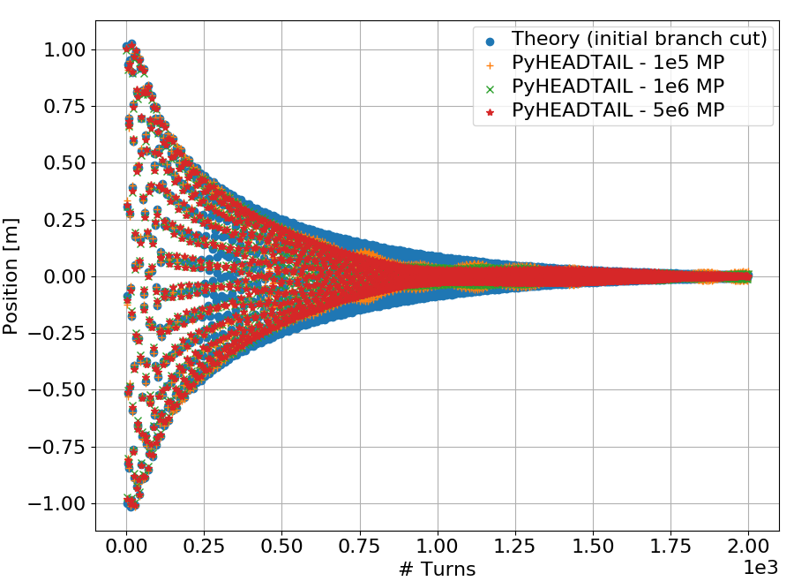
Introduction
At the previous section meeting Nicolas presented a comparison between theory and PyHEADTAIL simulations
In some cases he found an oscillating behaviour in the extent of the bunch centroid offset, “blobs”, with amplitude depending on the number of bunch macroparticles
Wake field + amplitude detuning
Is the amplitude of the blobs reasonable?
What is causing these blobs?
Or is there an issue in PyHEADTAIL?

Slide 3
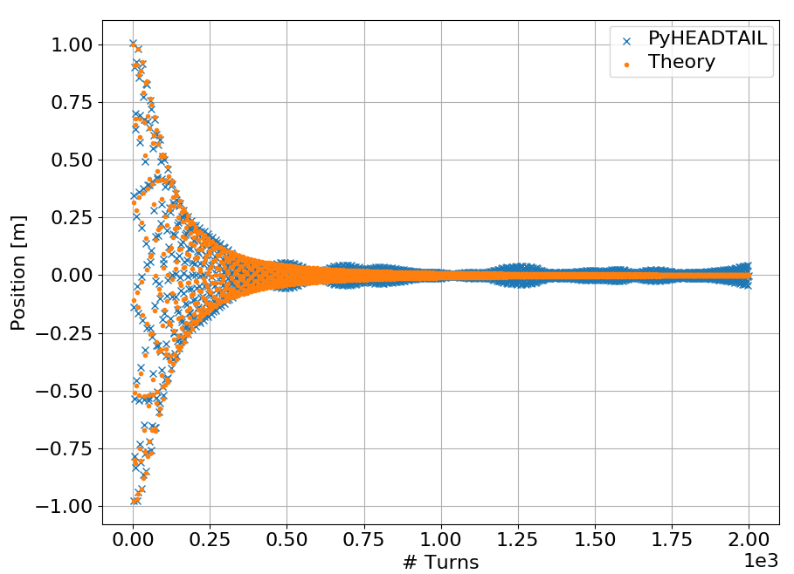
Nicolas’ test case
A “crêpe” bunch, with zero length (no longitudinal motion or chromaticity)
The bunch was tracked transversely (smooth approximation) in the presence of
  A wake field and amplitude detuning
  A wake field without amplitude detuning
  Amplitude detuning without a wake field
Blobs were observed for the cases with detuning
Only amplitude detuning
An initial kick was given to the bunch

Slide 4
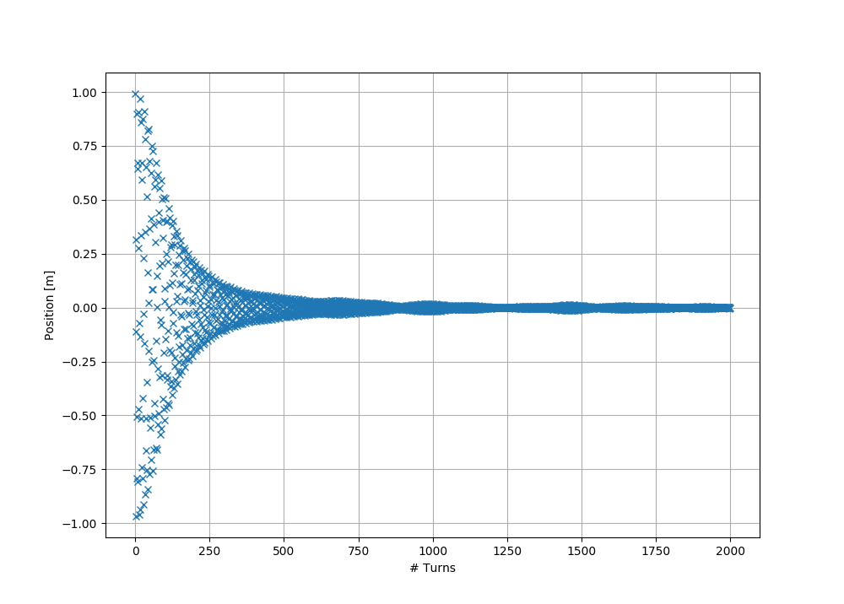
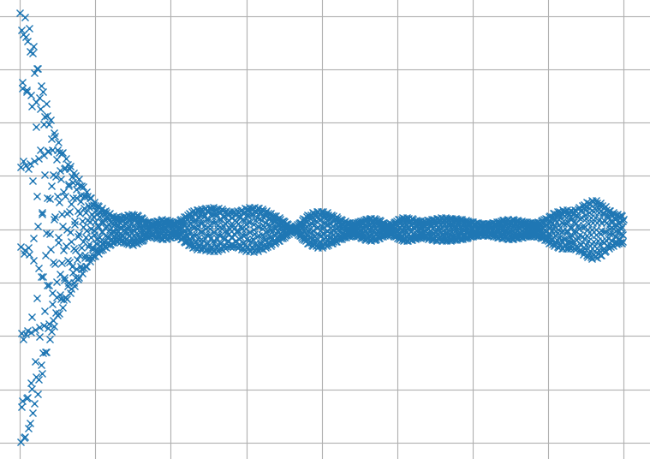
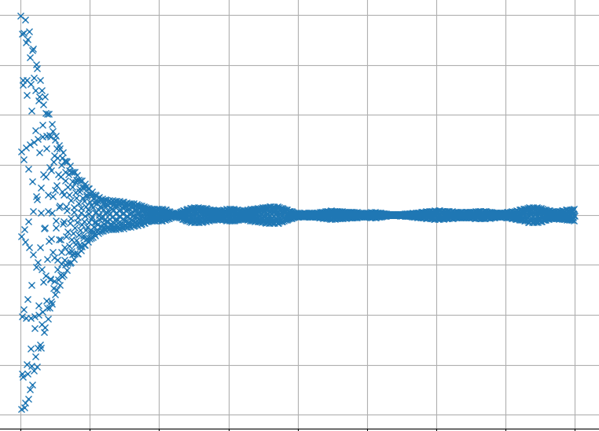
Nicolas’ test case
Nicolas provided us his simulation script and some figures for different numbers of bunch macroparticles (MPs)
The scaling of the blob sizes with number of MPs is evident
Only amplitude detuning
× 1e4 MPs
× 1e5 MPs
× 1e6 MPs

Slide 5
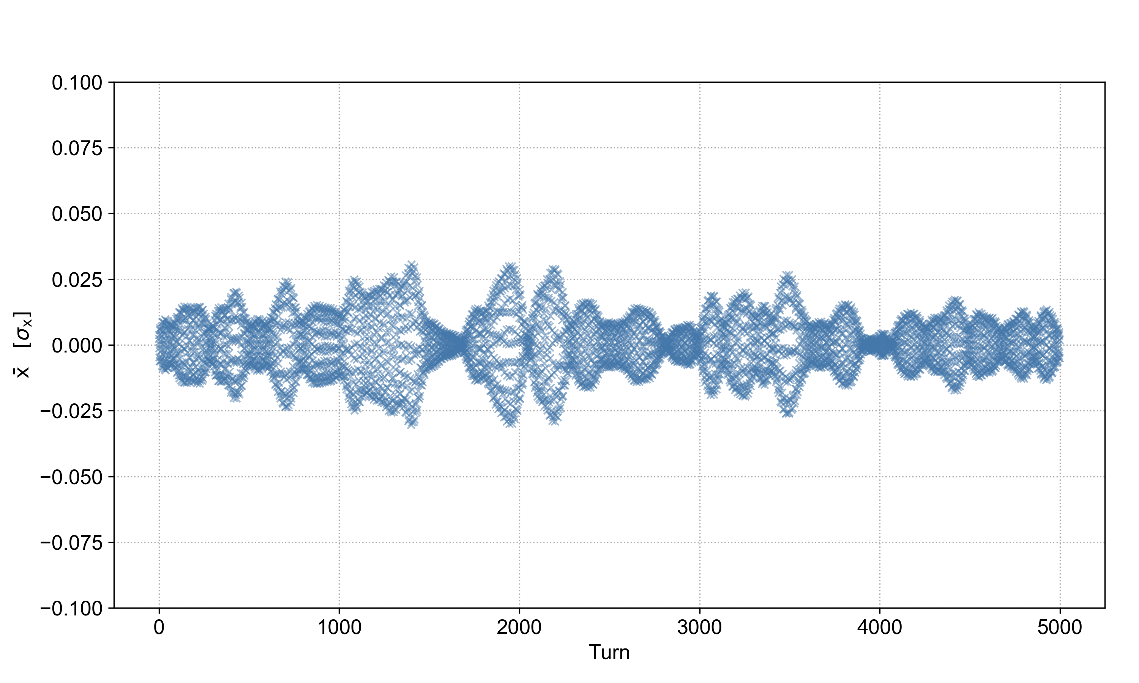
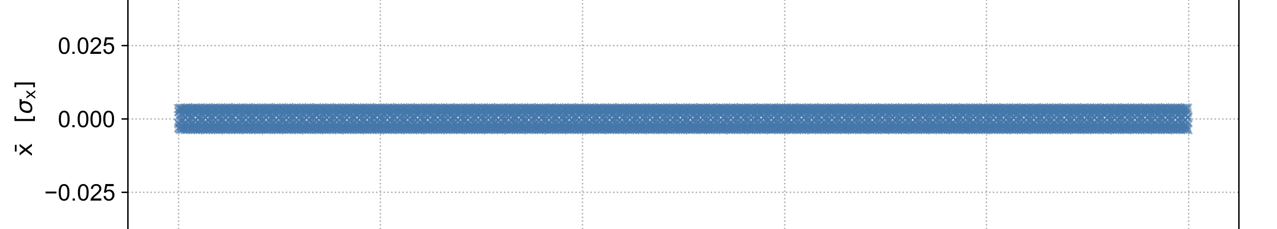
What causes the blobs?
An oscillating amplitude of the centroid offset is clearly correlated with amplitude detuning
Only transverse tracking
Transverse tracking with amplitude detuning

Slide 6
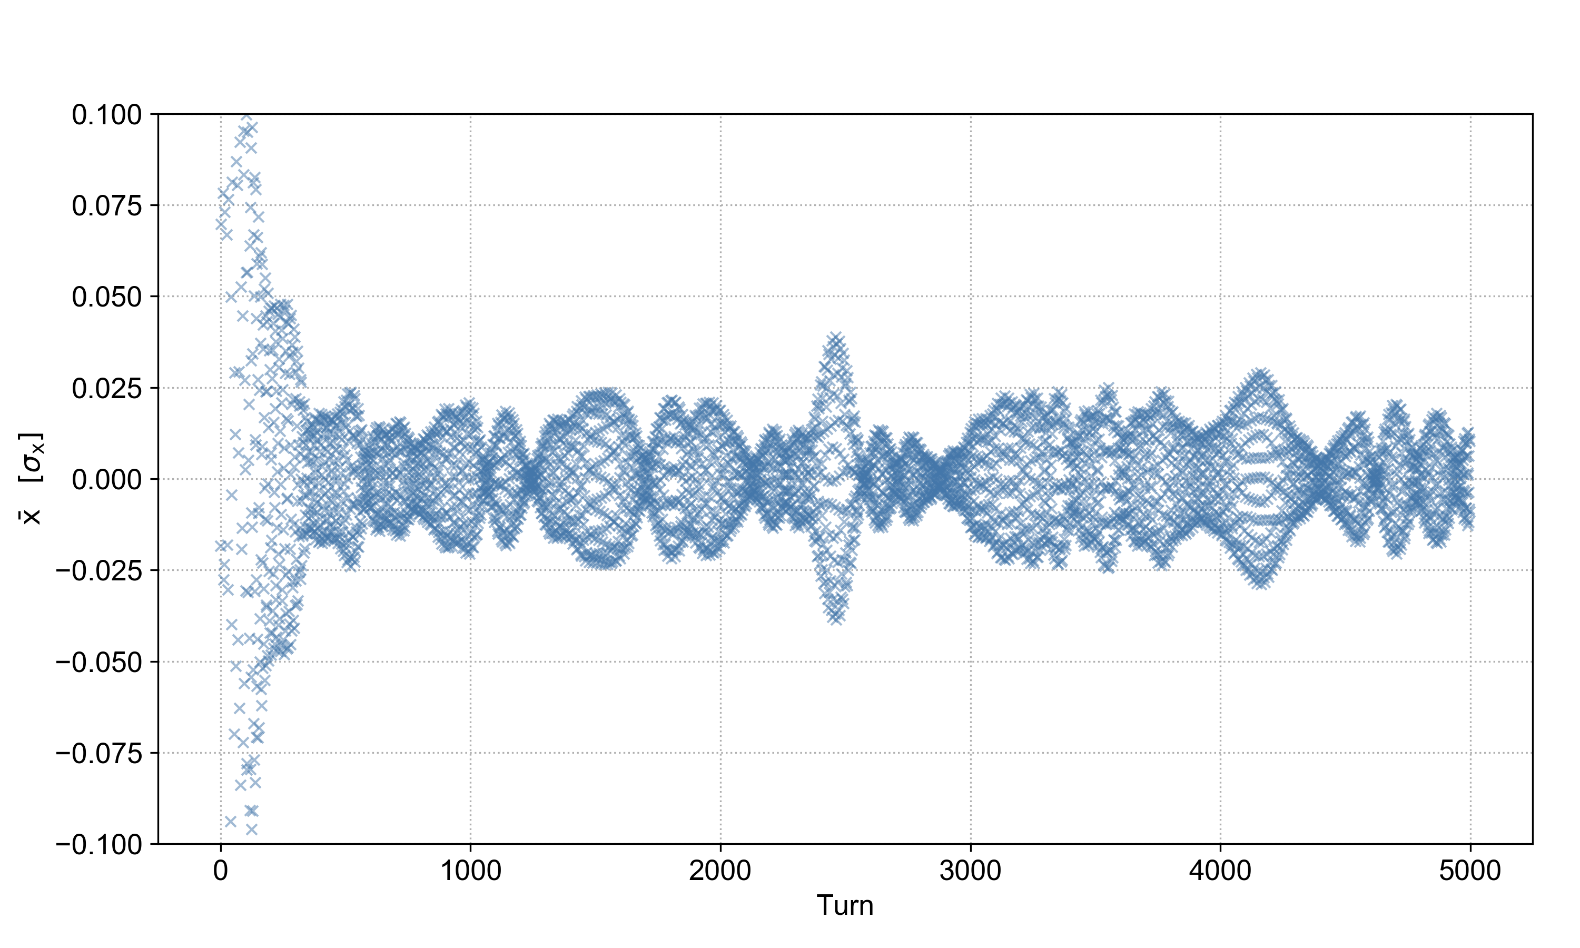
What causes the blobs?
An oscillating amplitude of the centroid offset is clearly correlated with amplitude detuning
Whether the bunch receives an initial kick or not is not relevant
With initial kick
Without initial kick

Slide 7
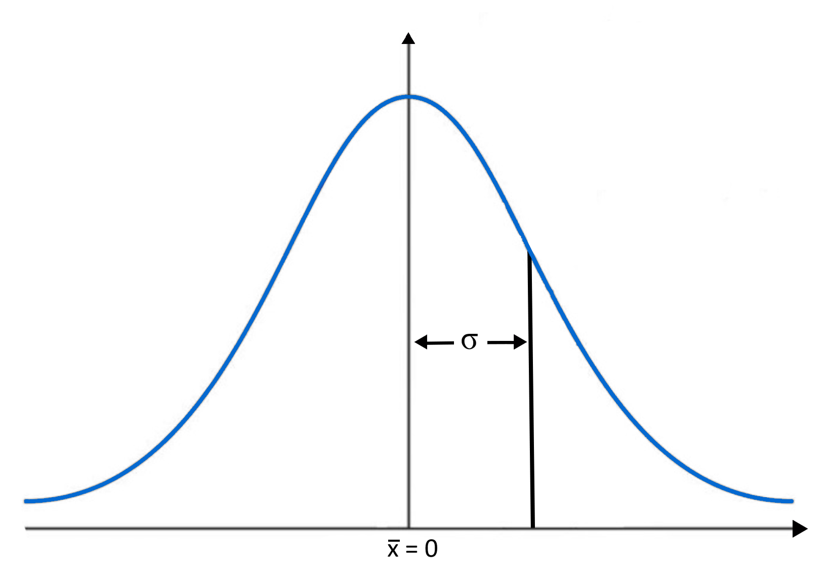
The numerical bunch
When we generate a numerical bunch with N macroparticles, we are creating a sample of the real bunch population
In our particular case, for each transverse phase space coordinate, we assume that the real bunch population is a Gaussian with mean = 0 and standard deviation σ

Slide 8
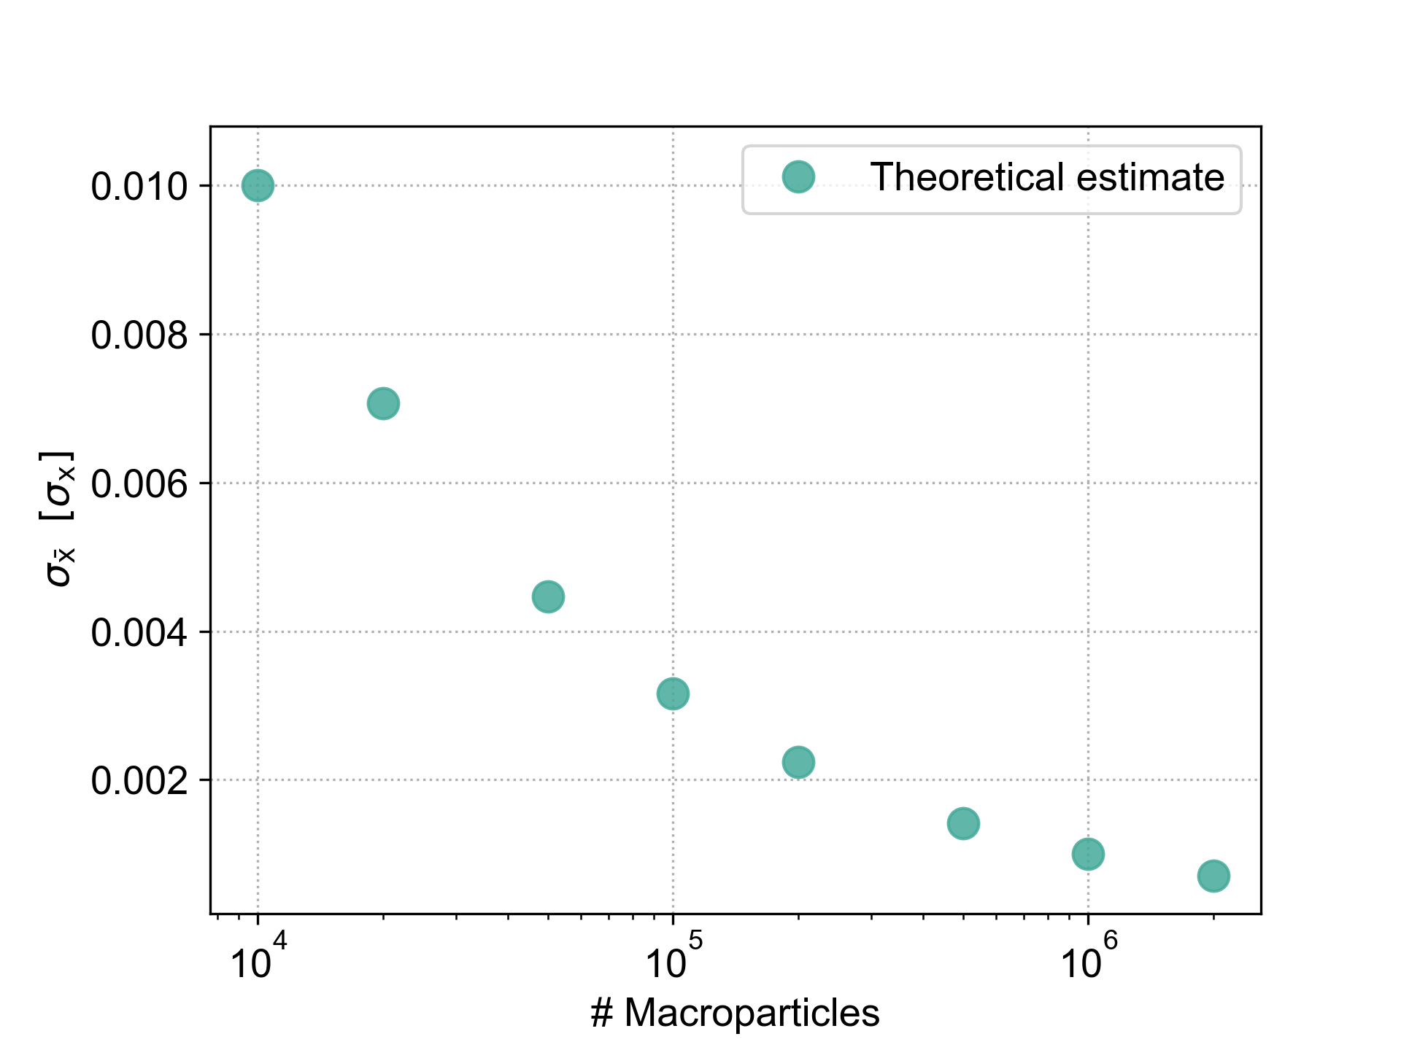
The standard error
Statistically, the mean of a sample of size N deviates from the mean of the real population by the standard error of the mean:
This is the expected standard deviation of the sample mean in a collection of samples

Slide 9
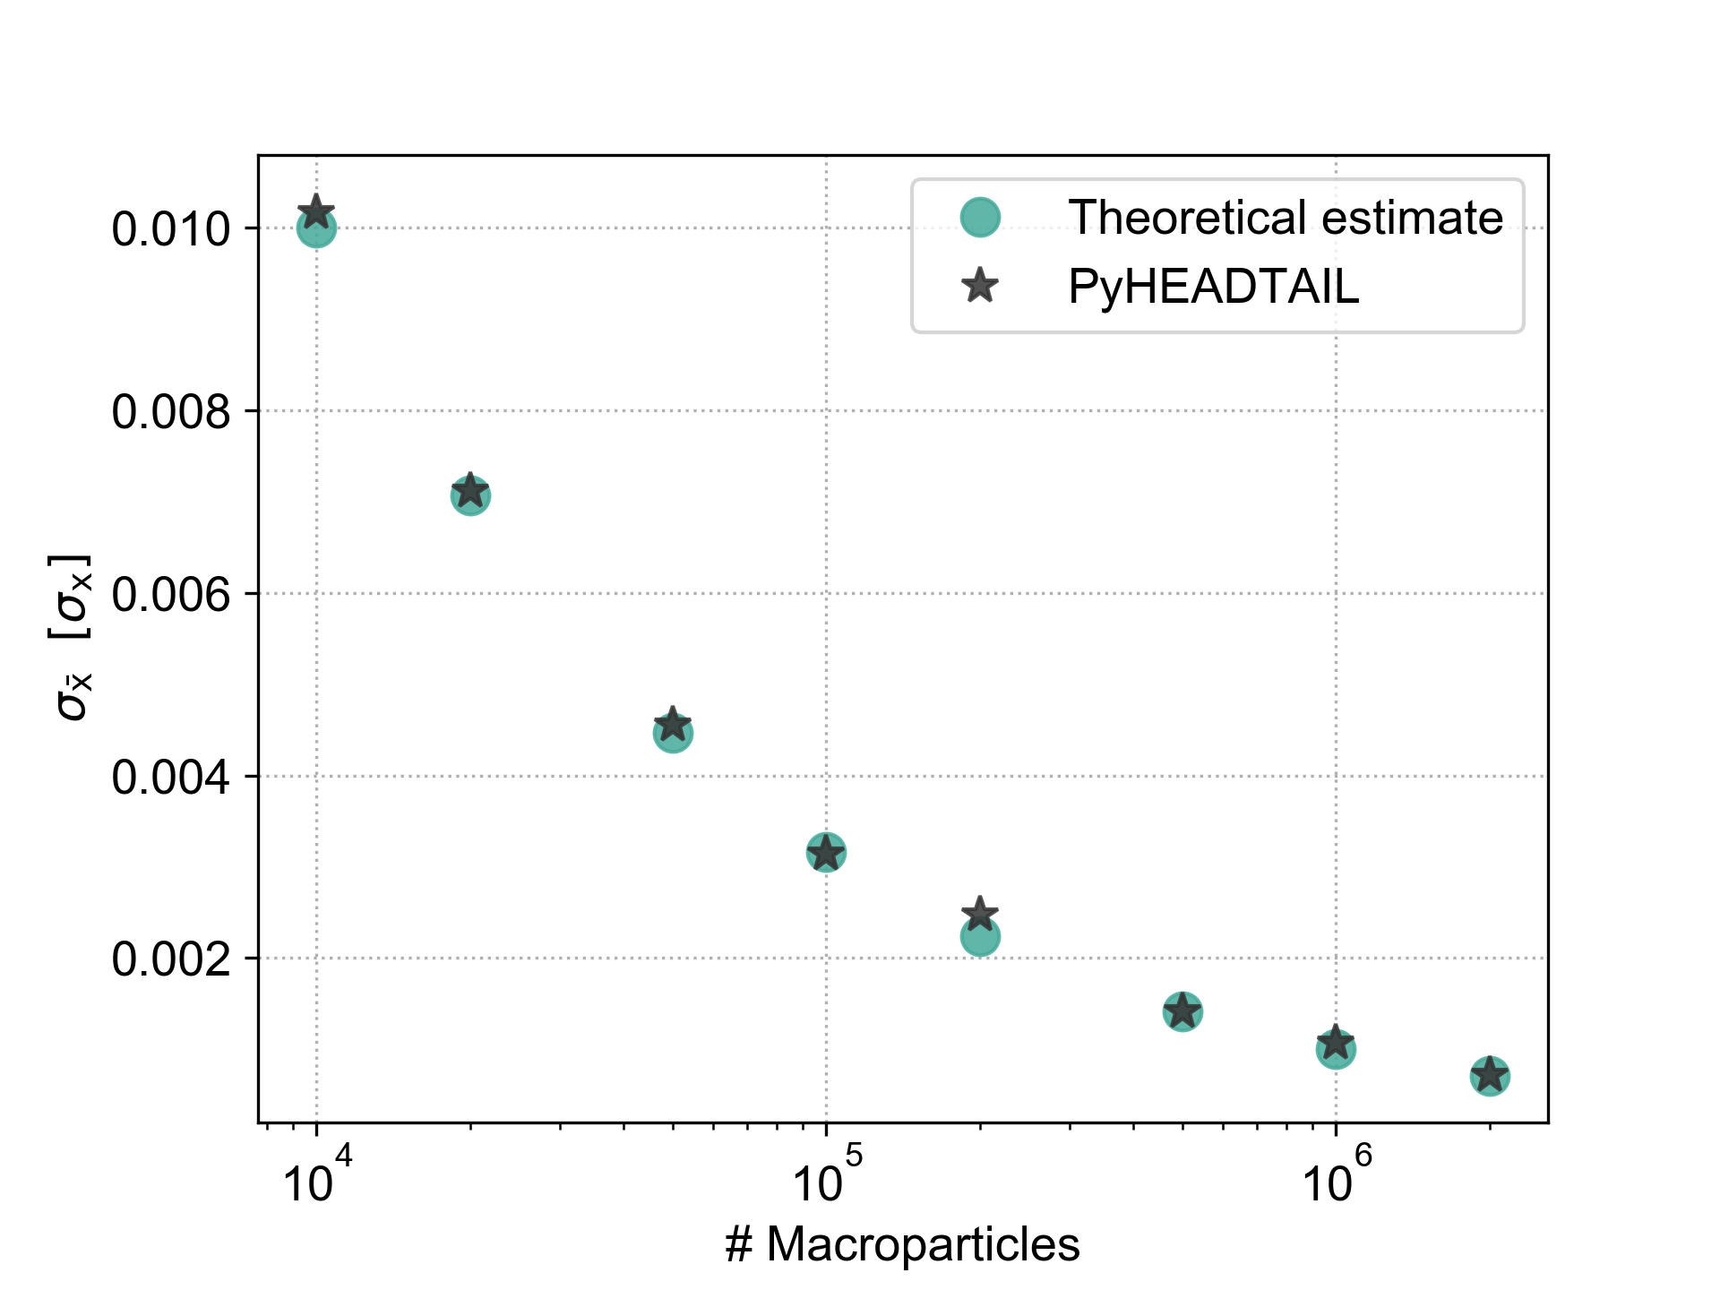
Comparison with PyHEADTAIL
Let’s consider PyHEADTAIL simulations with detuning for different numbers of bunch MPs
If we calculate the standard deviation of the bunch centroid (ie. the mean) over many turns, it corresponds to the theoretically estimated standard error
Due to the detuning, a single (numerical) bunch over many turns samples the phase space similarly to a collection of independent bunches

Slide 10
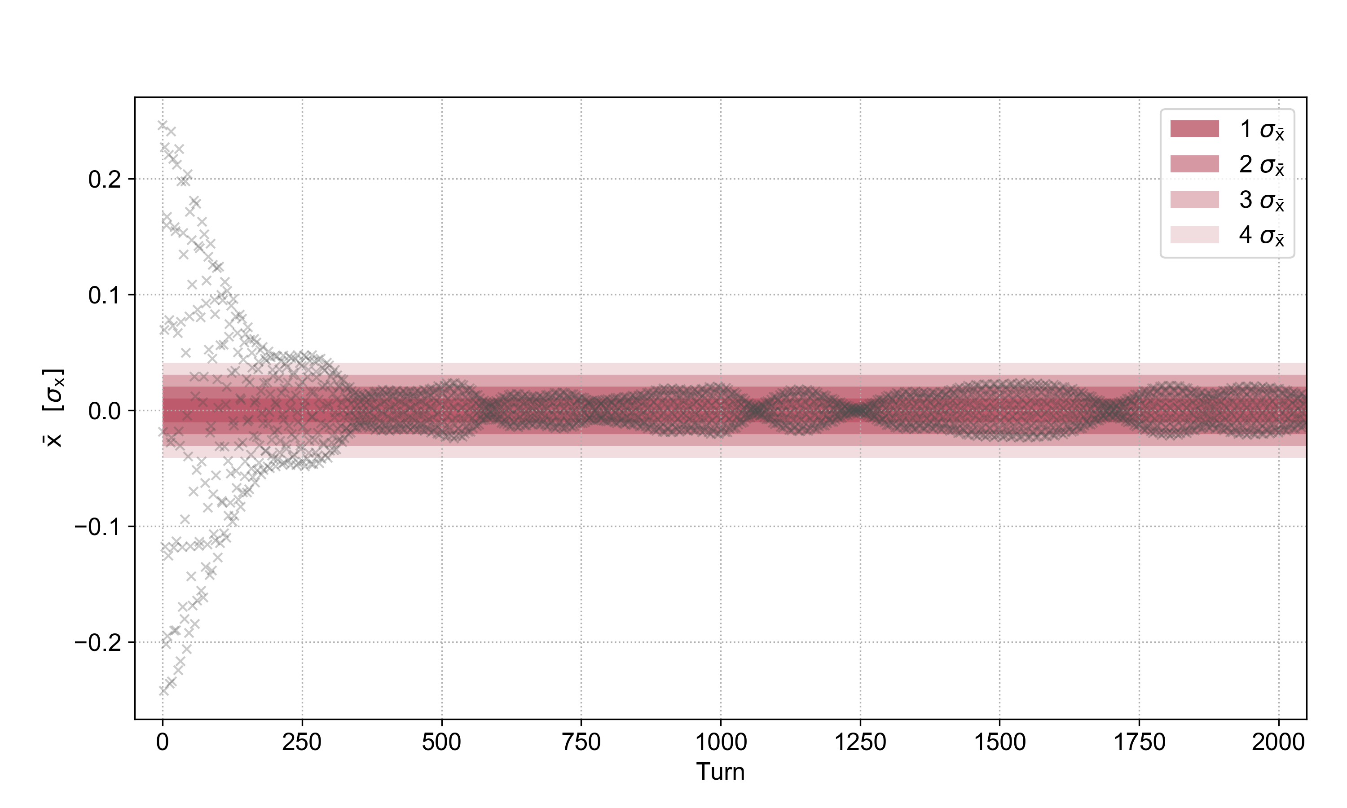
Conclusion
The bunch centroid offsets are in agreement with the statistical expectations for the number of macroparticles used in the simulations
to the theoretically estimated standard error
# MPs = 1e4

Slide 11
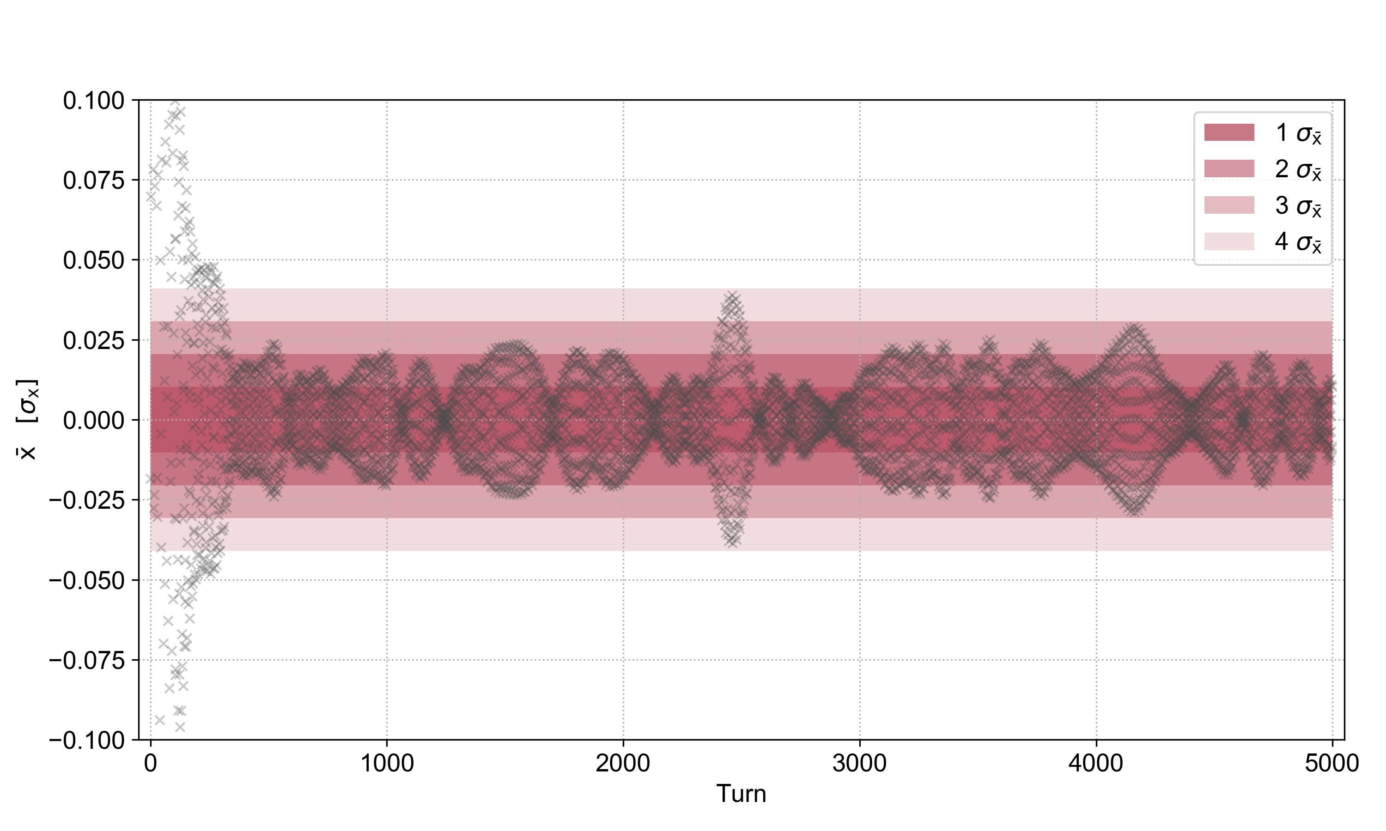
Conclusion
The bunch centroid offsets are in agreement with the statistical expectations for the number of macroparticles used in the simulations
# MPs = 1e4
Zoomed with more turns

Slide 12
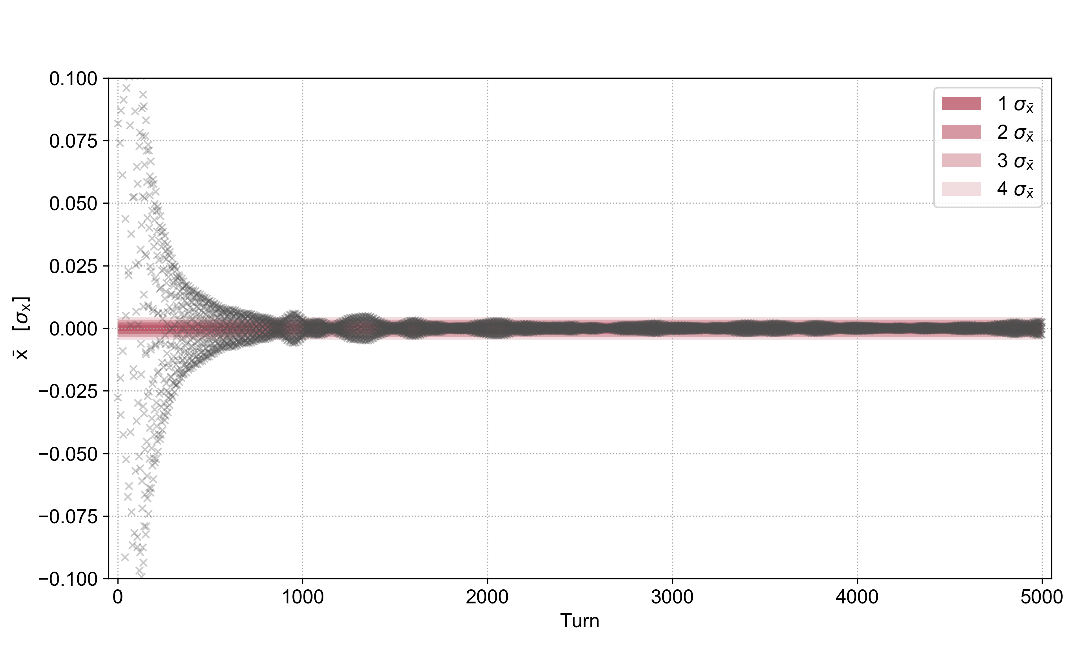
Conclusion
The bunch centroid offsets are in agreement with the statistical expectations for the number of macroparticles used in the simulations
# MPs = 1e6
Zoomed with more turns

