Slide 1

Electron cloud MDs in Run 3
G. Iadarola for the e-cloud team and the heat load task force
LHC MD Day 2020

Slide 2
Outline
Introduction
Heat loads on cryogenic beam-screen
  Characterization of ring after LS2
  Measurements with LIU beams
  Validation of backup schemes
e-cloud instabilities at injection energy
  Characterization measurements
  Tests with LIU beams
Incoherent effects

Slide 3
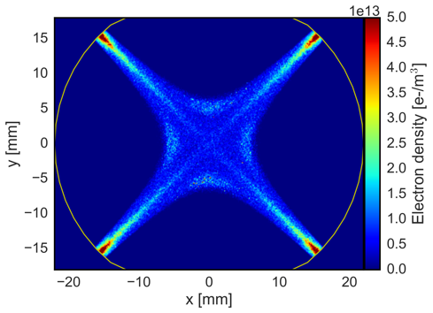
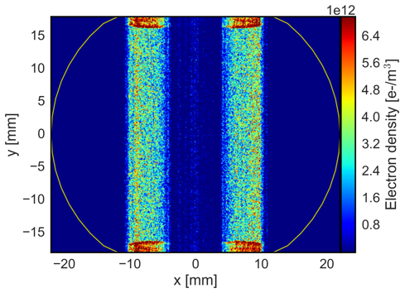
Introduction
Run 2 marked an important milestone with respect to e-cloud effects in the LHC, i.e. the usage of the 25 ns bunch spacing for most of the p-p physics operation
  With 25 ns spacing e-cloud effects are much stronger than with 50 ns spacing (used for luminosity production in Run 1)
Even after years of conditioning (mostly parasitic during high-intensity operation) effects of the e-cloud remained very visible:
  Heat loads in cryogenic magnets (with puzzling differences among sectors)
  Impact on beam quality (instabilities, losses, emittance growth)
Arc quadrupole
Arc dipole

Slide 4
Outline
Introduction
Heat loads on cryogenic beam-screen
  Characterization of ring after LS2
  Measurements with LIU beams
  Validation of backup schemes
e-cloud instabilities at injection energy
  Characterization measurements
  Tests with LIU beams
Incoherent effects

Slide 5
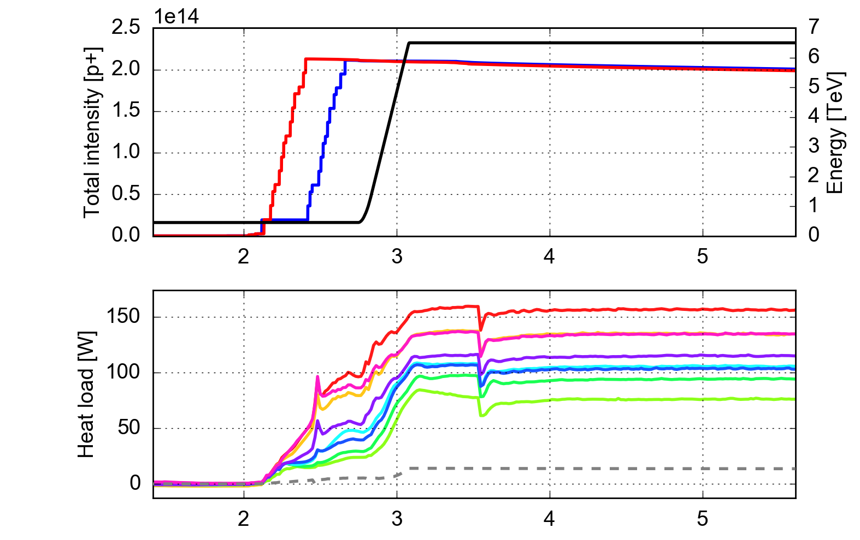
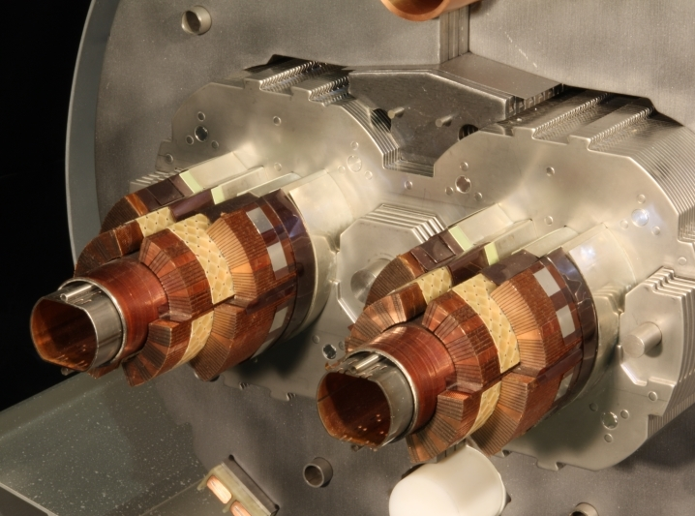
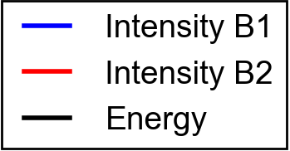
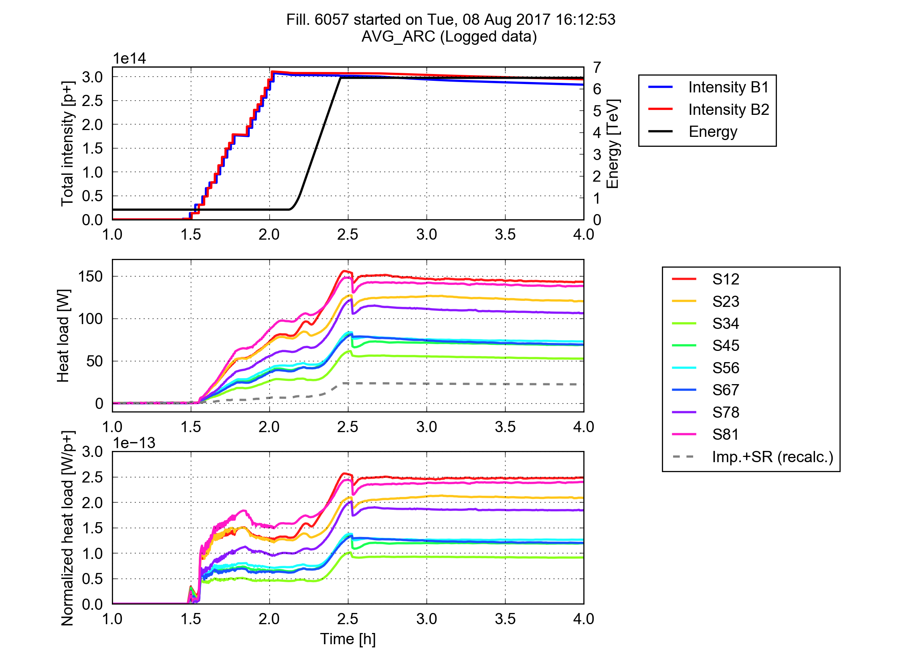
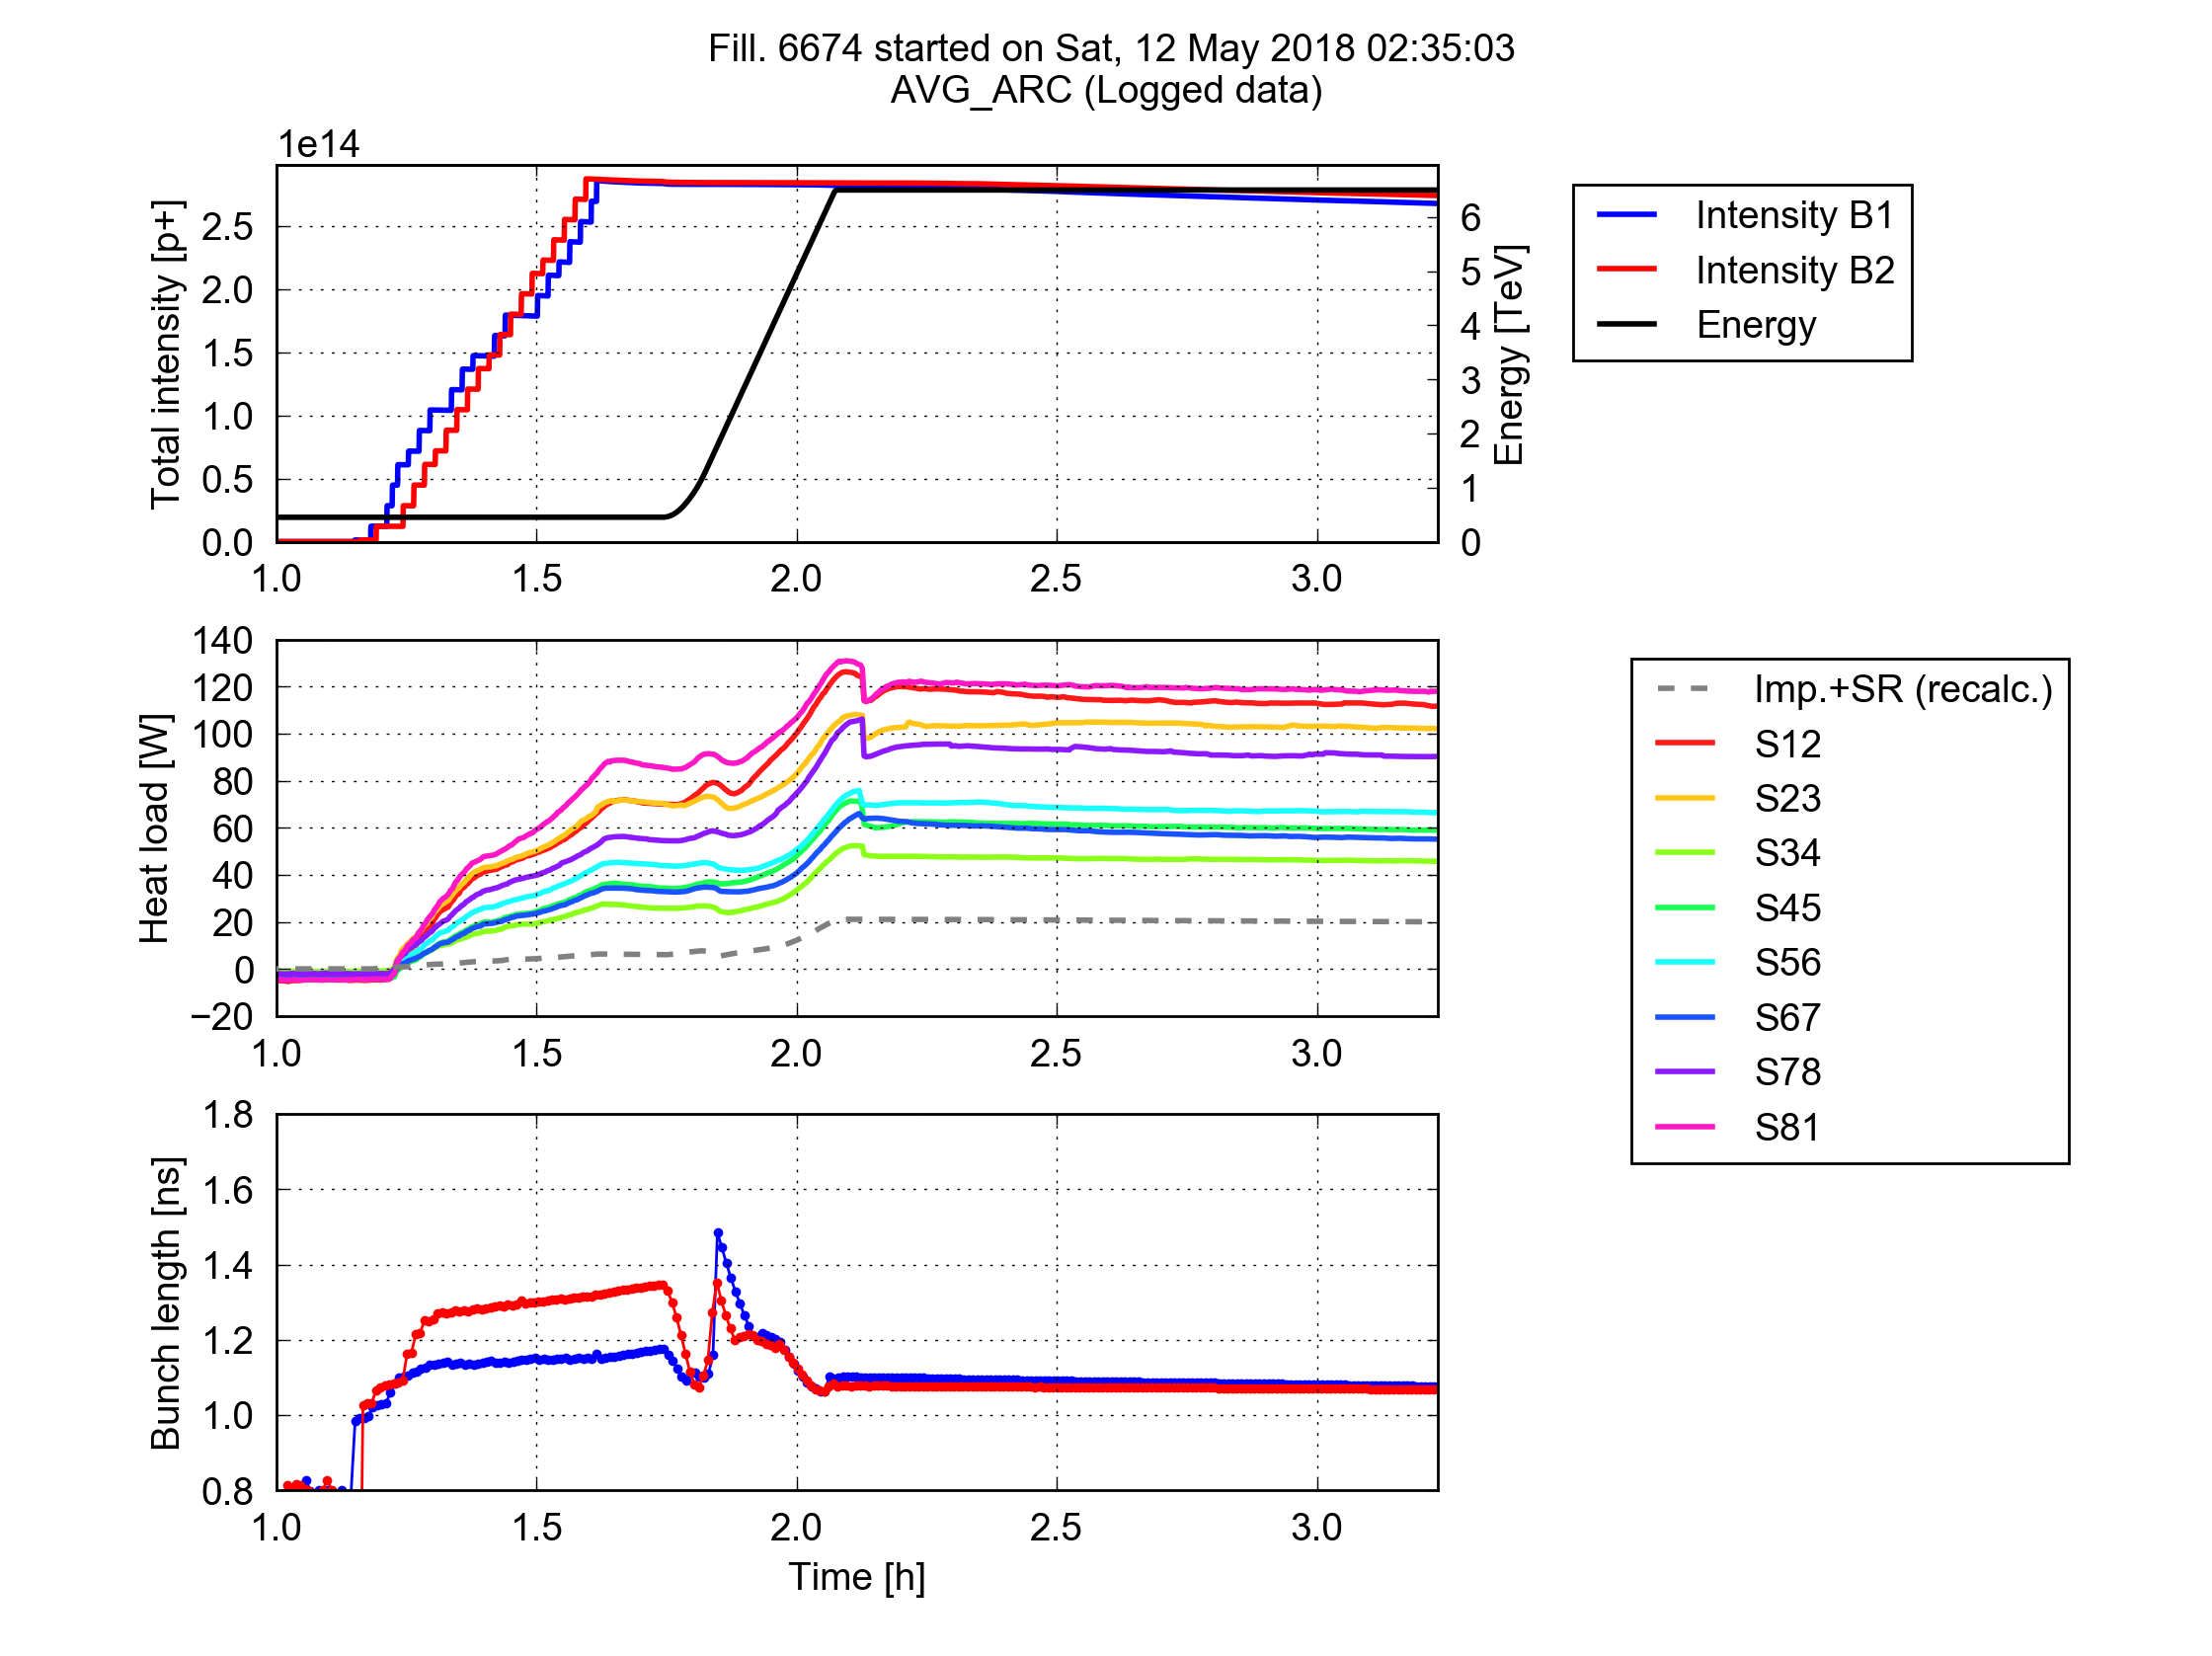
Heat loads on the arc beam-screens
  Electrons deposit energy on the beam screens of the LHC arc magnets
    Heat load that needs to be absorbed by the cryogenics system
    For some sectors at the limit of the design cooling capacity (160 W/half-cell)
  Large differences observed among sectors: unexpected!
    → Object of investigation by dedicated task force
Fill 4485 (Oct 2015)
25 ns, 1825b, 72b-trains, 1.15e11 p/bunch
    Cooling circuit
    (He, 5-20 K)
  LHC main dipole
Avg. per half cell
    Beam screens
For more details see CERN-ACC-NOTE-2019-0057

Slide 6
Heat loads: underlying mechanisms
How do we know that the heating source is the e-cloud?
We reviewed the mechanisms that can transfer energy from the beam to the beam-screen and evaluated their compatibility with observations (MDs!)
Beam
Observations
Total power associated to intensity loss is less than 10% of measured heat load
N.A.
Heat load increases only moderately during the energy ramp
✓
Radiation (synchrotron radiation)
e-cloud
Beam particles (losses)
Electromagnetic coupling
Heat loads with 50 ns are >10 times smaller than with 25 ns
✓
Measured dependence on bunch intensity and bunch length
✓
✓
= Good quantitative agreement
= Excluded
Beam screen
= Excluded
For more details see CERN-ACC-NOTE-2019-0057

Slide 7
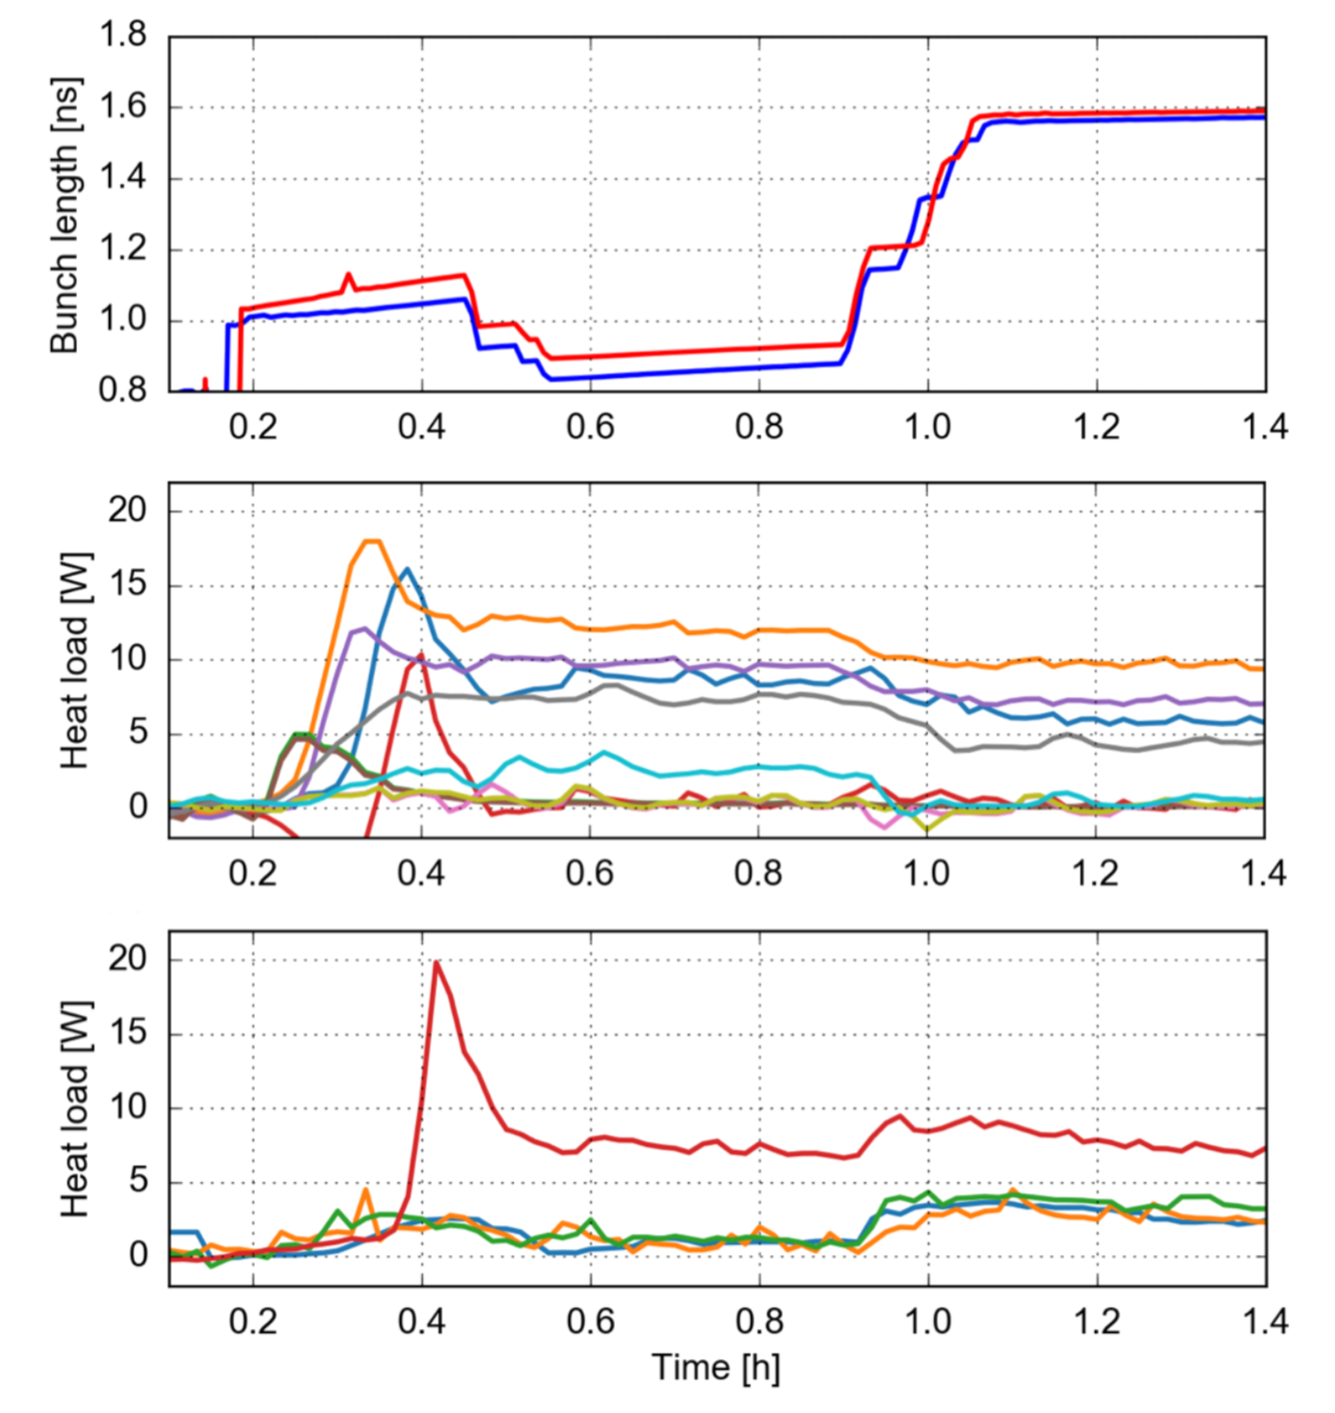
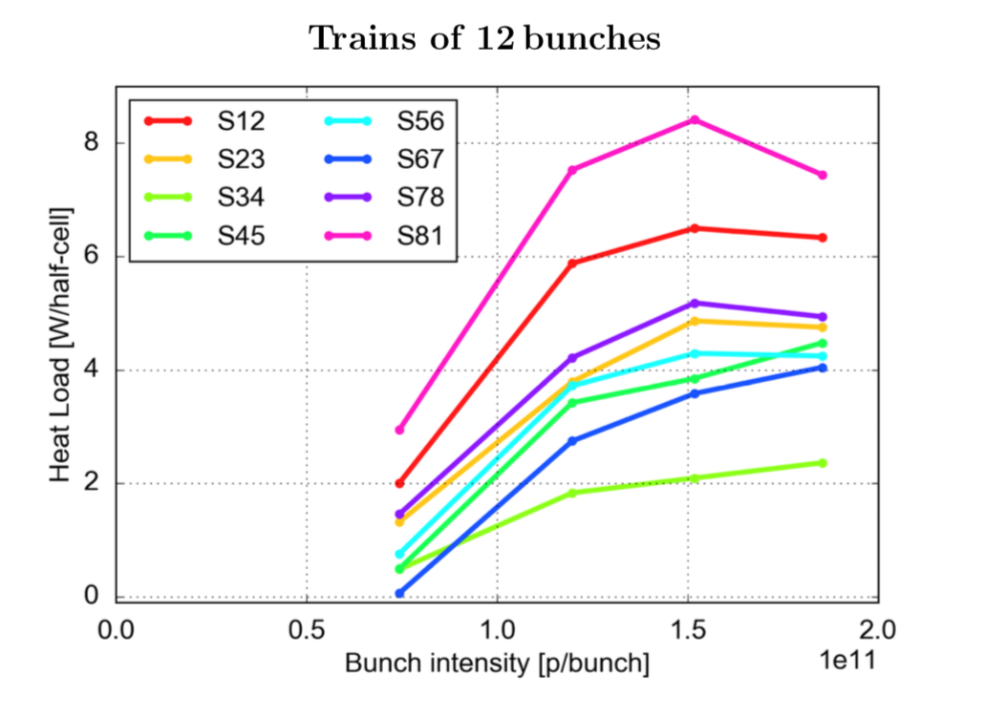
A couple of highlights from Run 2 MDs
Confirmed different behavior w.r.t. bunch length in dipoles and quadrupoles
Confirmed non-monotonic behavior w.r.t. bunch intensity
Instrumented dipoles
Instrumented quadrupoles
For more details see CERN-ACC-NOTE-2019-0057

Slide 8
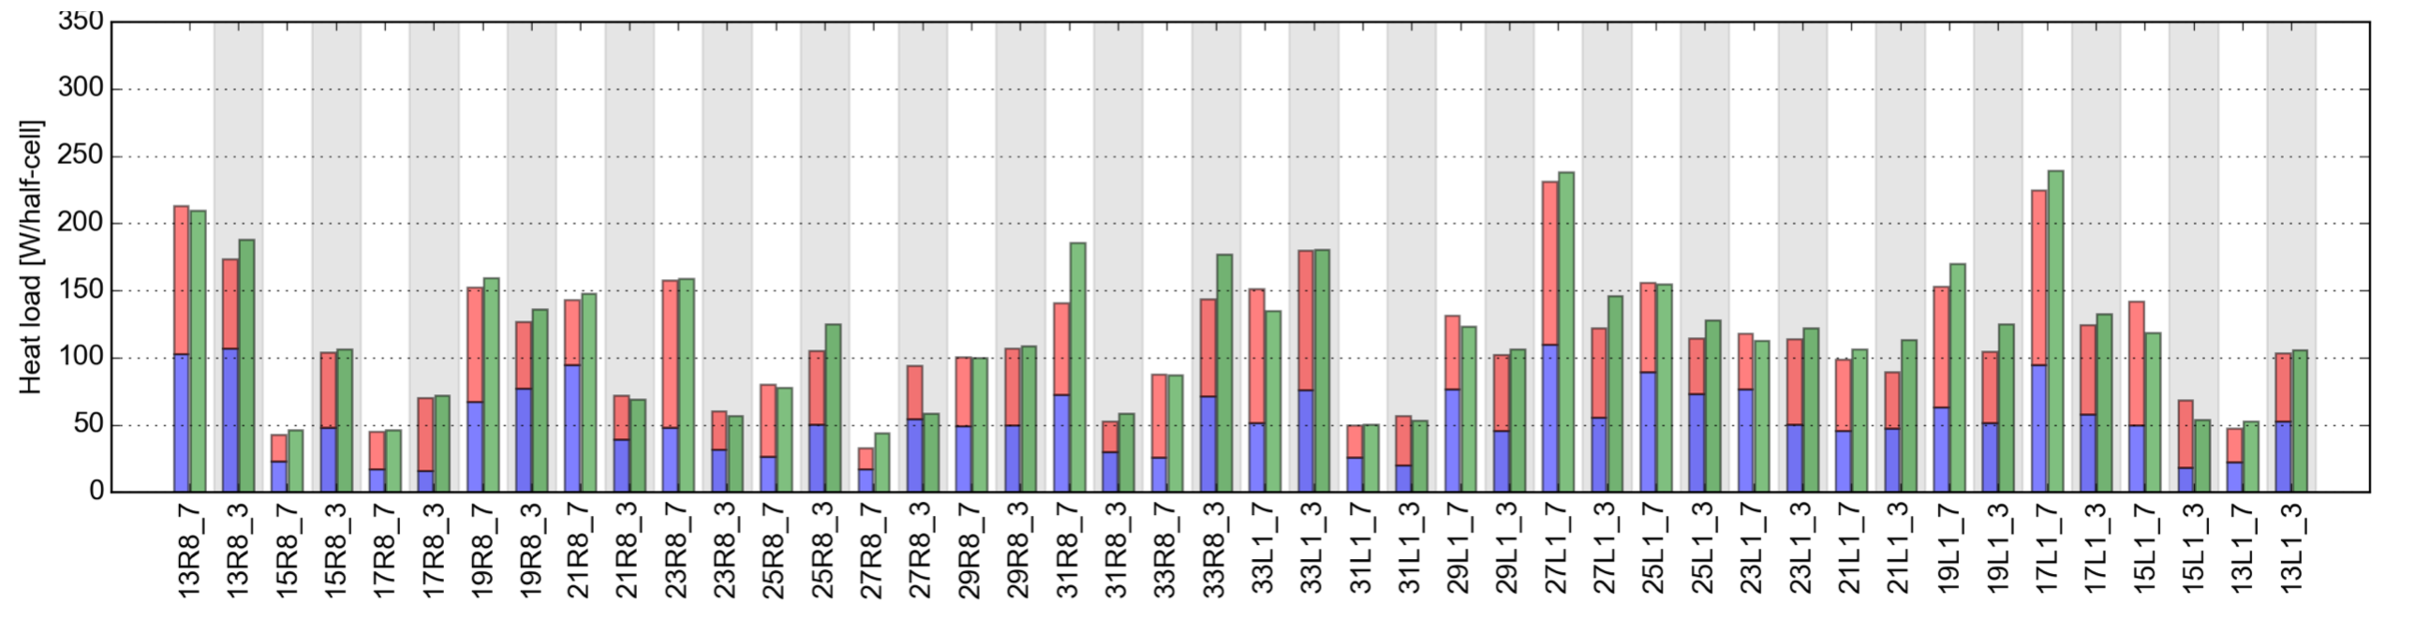
Heat load MDs in Run 3: ring characterization
The first objective will be to identify changes in the beam screen surfaces that took place during LS2 (as strong changes were observed after LS1)
Needs two fills (top-energy) with B1 and B2 alone to build the cell-by-cell heat load maps
Sector 81 (characterization from 2018 MD)

Slide 9
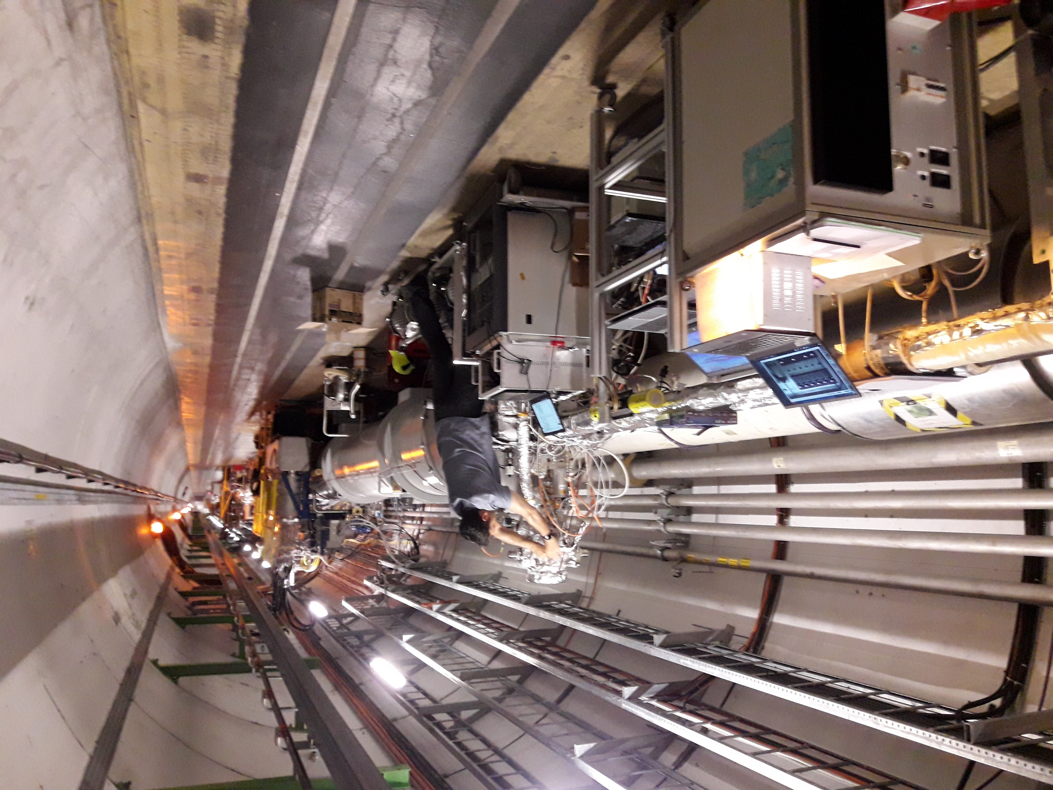
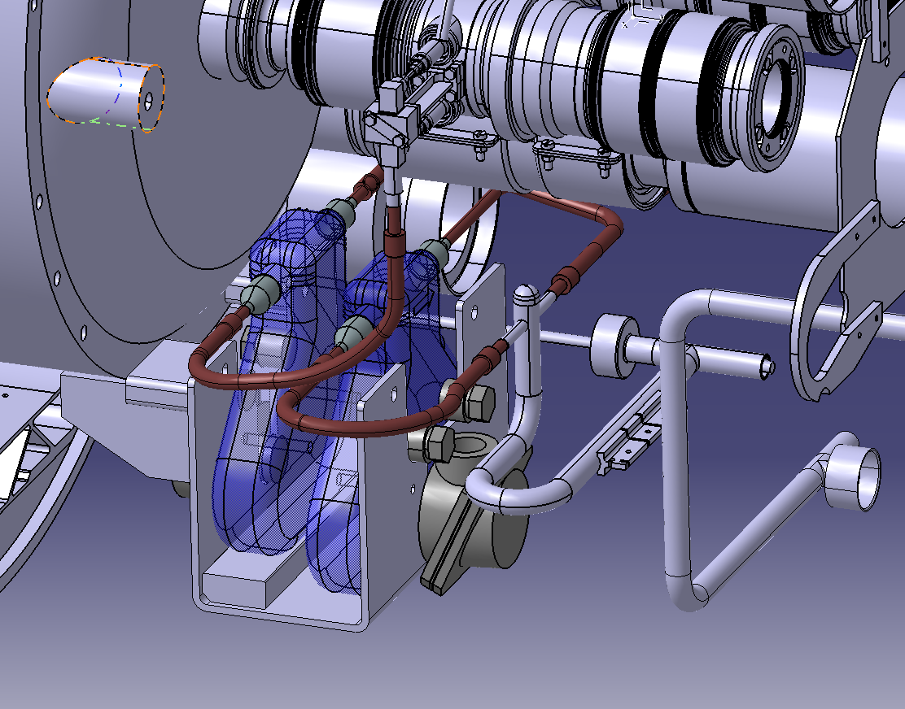
Heat load MDs in Run 3: ring characterization
The first objective will be to identify changes in the beam screen surfaces that took place during LS2 (as strong changes were observed after LS1)
Needs two fills (top-energy) with B1 and B2 alone to build the cell-by-cell heat load maps
  Will also allow characterizing the behavior of amorphous carbon coating applied in stand-alone magnets during LS2
  Useful test for the new diagnostics (e.g. flow-meters, RF transmission)
  To be performed after machine re-conditioning (end of 2021 proton run)
Dependence of heat load on bunch length in newly instrumented half-cells should also be measured (450 GeV)
Arc-cell cold flow-meters

Slide 10
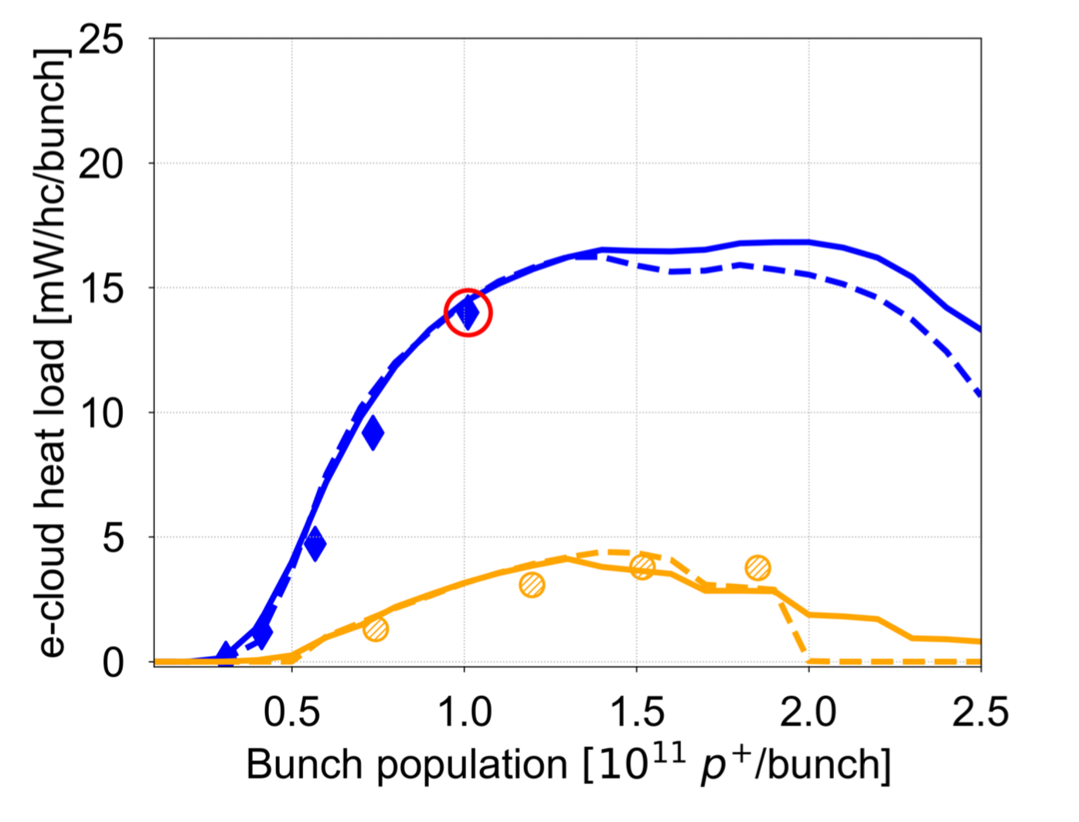
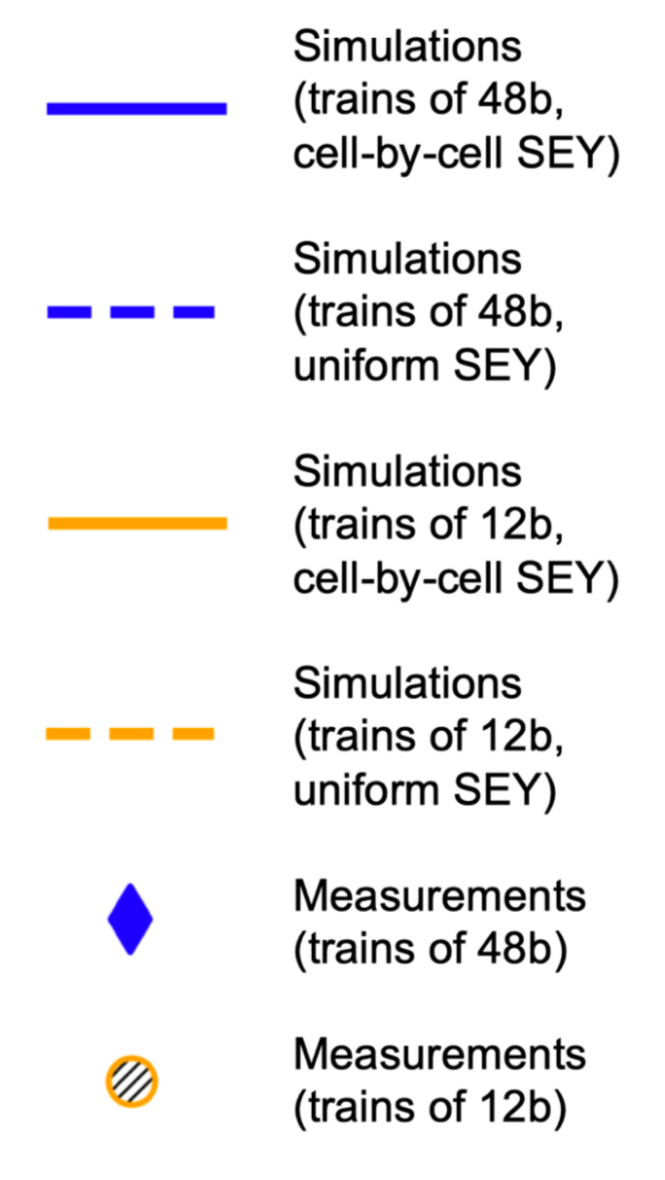
Heat load MDs in run 3: dependence on bunch intensity
The dependence of the heat loads on bunch intensity is a key factor for performance in Run 3 and for HL-LHC
With the available models, simulations foresee a relatively favourable behavior
Due to intensity limitations in the injectors, this dependence could be tested only with short bunch trains (12b) in Run 2
Direct tests with longer bunch trains (48b or more) with high bunch intensity should take place in Run 3 (LIU beams):
  Aiming at 1.8 x 10¹¹ p/bunch in 2022
  Test full HL-LHC beam at 450 GeV by 2024 (2.3 x 10¹¹ p/bunch, 2760b)
2018 MDs
Point used to fit the SEY
For more details see CERN-ACC-NOTE-2019-0057

Slide 11
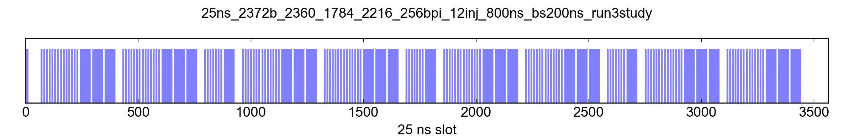
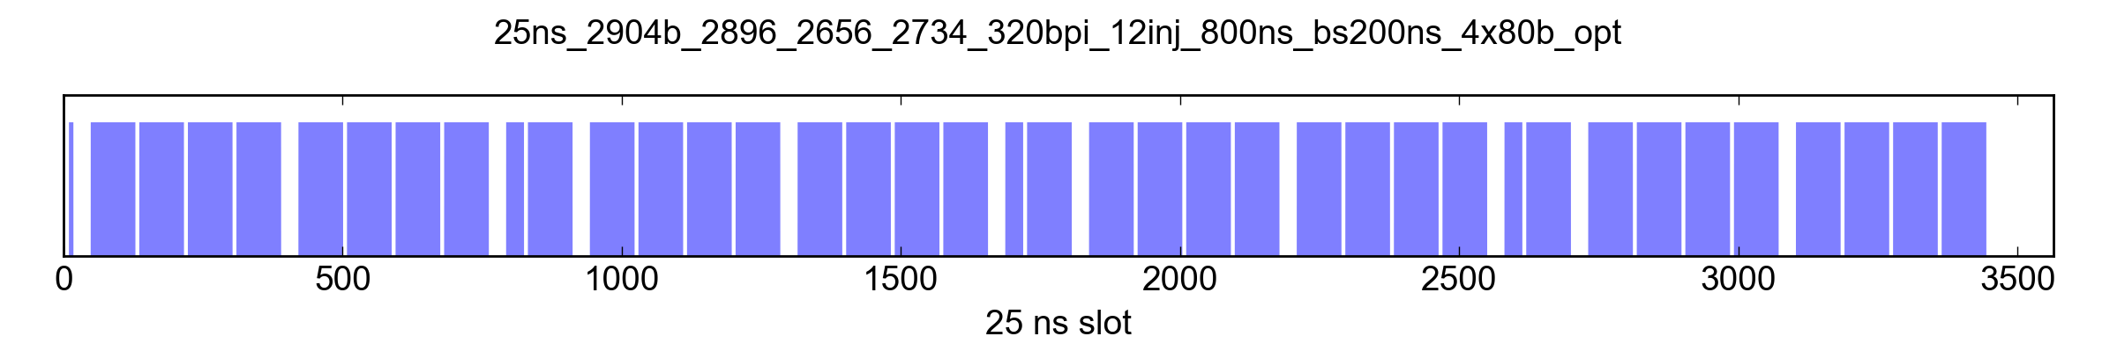
Heat load MDs in run 3: backup schemes
In case of strong limitations from the e-cloud heat loads, hybrid schemes mixing 25 ns and 8b+4e trains will have to be used:
To optimize the number of bunches we need to combine the trains already in the SPS
The same approach can be used to push the number of bunches in the nominal scheme
Production and injection of this type of patterns have never been done and should be tested in Run 3
Hybrid scheme
(80+32)b scheme
More details at https://indico.cern.ch/event/788818

Slide 12
Outline
Introduction
Heat loads on cryogenic beam-screen
  Characterization of ring after LS2
  Measurements with LIU beams
  Validation of backup schemes
e-cloud instabilities at injection energy
  Characterization measurements
  Tests with LIU beams
Incoherent effects

Slide 13
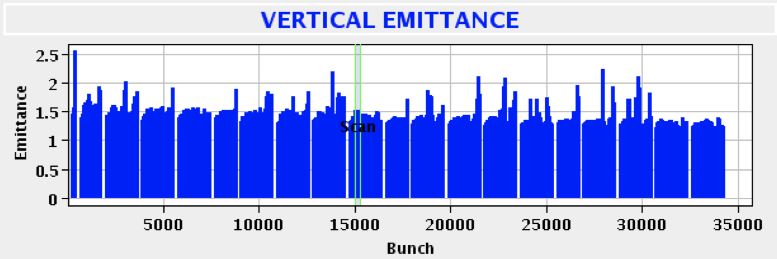
Instabilities at injection energy
In Run 2 weak instabilities were often taking place at injection energy:
Well contained with a high chromaticity (15-20) and octupole current (~50A)
Significant advances on simulation models made during LS2:
  Need a consistent and complete set of experimental data to validate the models
For more info: X. Buffat, “Transverse Instabilities”, Evian19
L. Sabato and G. Iadarola: “Single bunch instabilities at injection energy”, e-cloud meeting #71

Slide 14
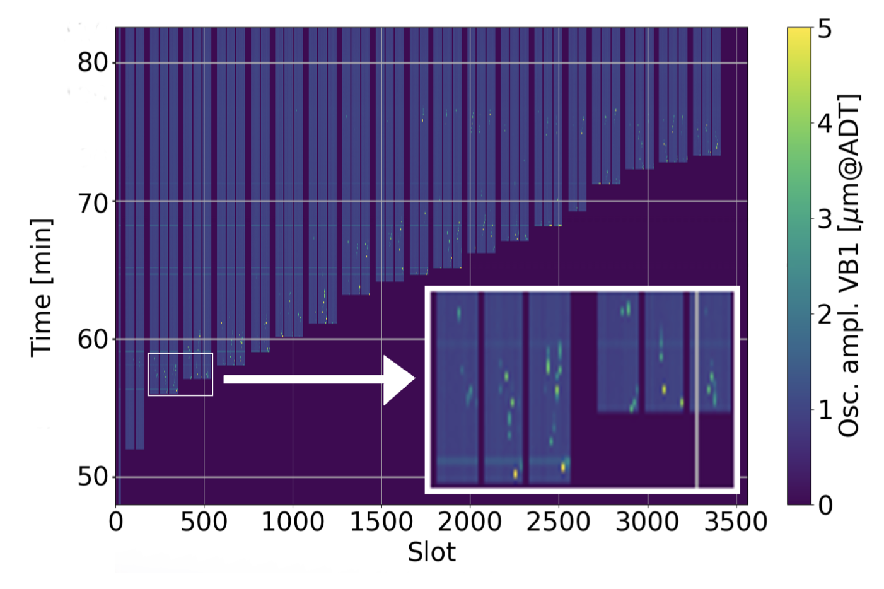
Instabilities at injection energy – characterization MDs
Goals for stability MDs with nominal intensity at 450 GeV:
  Characterize instabilities w.r.t. chromaticity, octupoles and ADT settings
  Characterize bunch-by-bunch tune shift exciting individual bunches with the ADT (possibly use also BTF measurements)
  Characterize coupled-bunch instabilities with respect to ADT settings (gain and bandwidth)
  Optimize diagnostics (e.g. instability trigger settings, gate of HeadTail monitor on most sensitive bunches) → for deployment in operation
It would be useful to collect some data already at the beginning of 2021 - before scrubbing - when instabilities are stronger (data easier to compare against simulations)
For more info: X. Buffat, “Transverse Instabilities”, Evian19

Slide 15
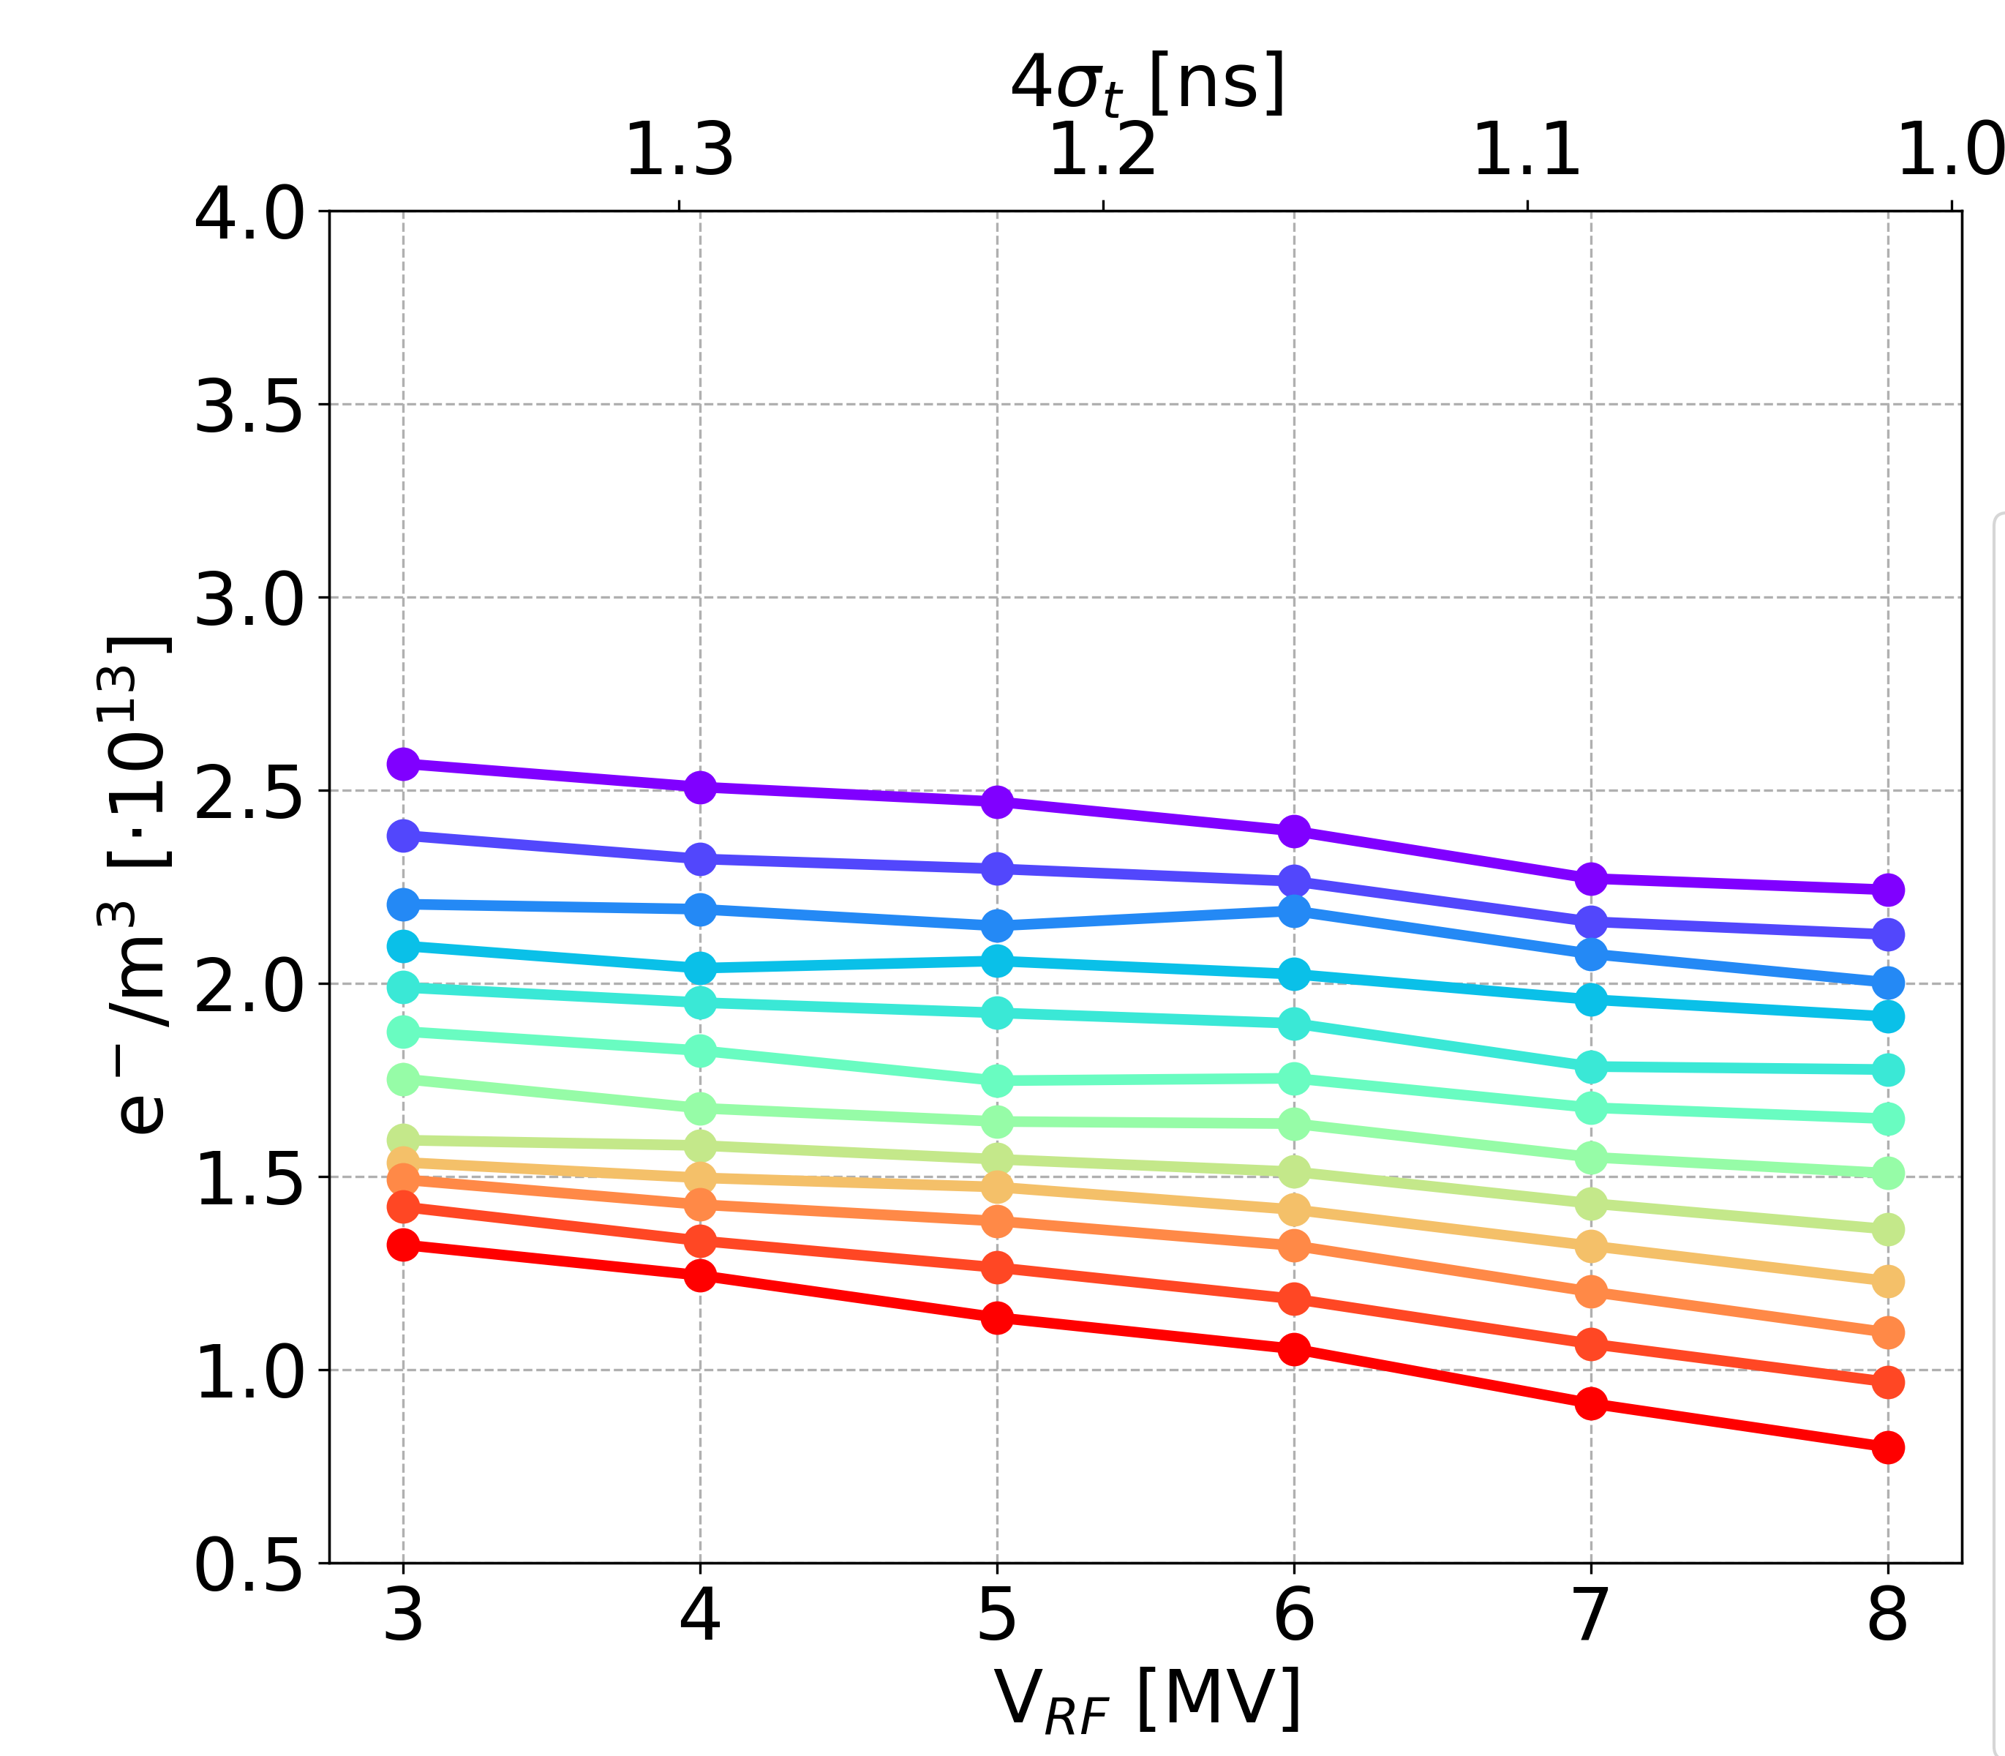
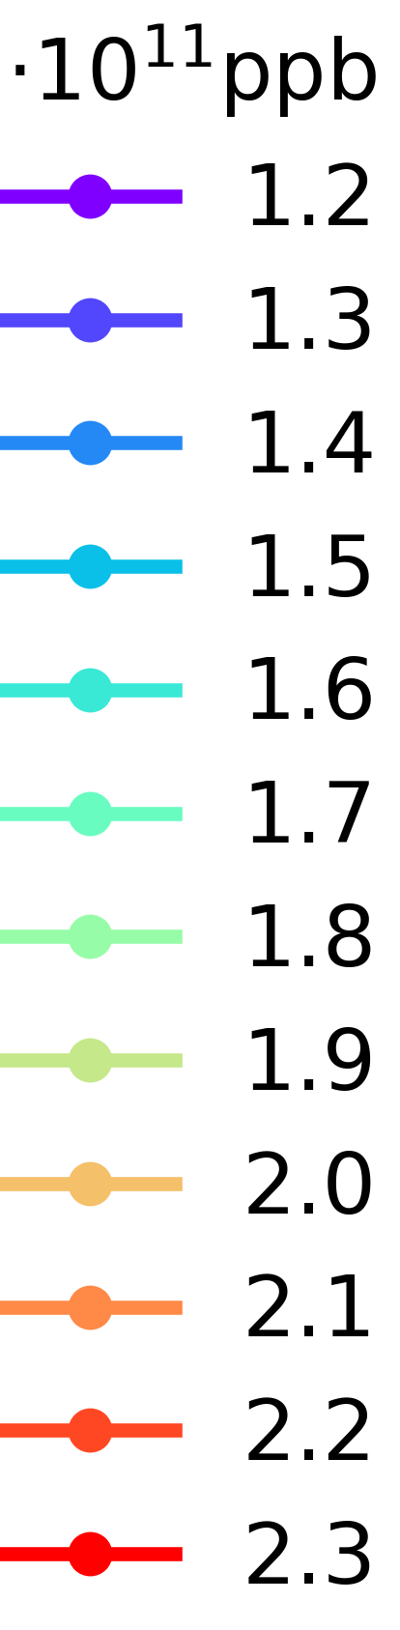
Instabilities at injection energy – bunch intensity scaling
Also with respect to instabilities, e-cloud simulations predict a favorable behavior when increasing the bunch intensity
This feature needs to be tested experimentally during Run 3 (checking limits w.r.t. octupoles, chromaticity, damper gain)
It would be useful to perform first tests with ~1.8 x 10¹¹ p/bunch already in 2022, to have time, if needed, to develop and test mitigation measures during Run 3
Arc quadrupole
L. Sabato
For more info: L. Sabato and G. Iadarola: “Single bunch instabilities at injection energy”, e-cloud meeting #71

Slide 16
Outline
Introduction
Heat loads on cryogenic beam-screen
  Characterization of ring after LS2
  Measurements with LIU beams
  Validation of backup schemes
e-cloud instabilities at injection energy
  Characterization measurements
  Tests with LIU beams
Incoherent effects

Slide 17
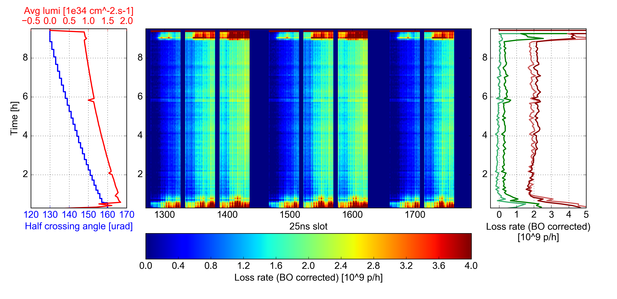
Incoherent effects
Even when the beam is kept stable the e-cloud is the source of incoherent effects which lead to significant beam degradation
  Beam losses and transverse emittance blow-up
  Visible at injection energy and in collision
Significant work being done during LS2 to develop methods and tools allowing to reliably model these effects
Selected
bunch families
Fill 7236 – B1
More info at https://indico.cern.ch/event/859514

Slide 18
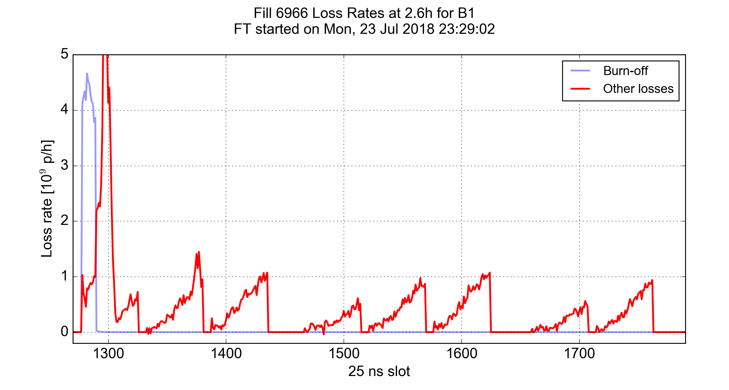
Incoherent effects
Main goals for Run 3 MDs on e-cloud incoherent effects:
Study the dependence of lifetime/emittance blow-up on the machine settings at 450 GeV
  Explore tune space below the diagonal (will provide information on the effect of dipoles and quadrupoles separately)
Study the dependence on the bunch intensity as LIU beams become available
  Collect data with one circulating beam at high energy to disentangle the effect of beam-beam
β* = 25 cm, φ = 130 μrad (single beam)
2018 MDs allowed identifying e-cloud in the triplet as the main source of the losses in collisions
More info at https://indico.cern.ch/event/859514

Slide 19
Summary
Several tests and studies ahead of us, main objectives:
  Heat loads:
    Characterize the impact on LS2 on the heat loads
    Study the dependence on bunch intensity with LIU beams
    Test “hybrid schemes” based on advanced pattern from the SPS
  e-cloud induced instabilities and incoherent effects:
    Characterize the behavior with respect to tune, Q’, octupoles and ADT
    Study the dependence on bunch intensity with LIU beams (also with one circulating beam at high energy)
    Optimize diagnostics (triggers, gating) to better capture instabilities at injection

Slide 20
Thanks of your attention!

Slide 21
For HSC discussion
Topic | 2021 | 2022-2024
Heat load characterization | 2.5 shifts (after 2 months of operation)
Heat loads - higher bunch intensity |  | 2 shifts / year
Heat loads – hybrid schemes |  | 1 shift (once)
Instabilities characterization and diagnostics | 1 shift before scrubbing 1 shift after two months of operation | 1 shift / year
Instabilities bunch intensity dependence |  | 2 shifts / year
Incoherent effects | 1 shifts (after 2 months of operation) | 1 shift / year

