Slide 1



Maintenance Procedures
Mixer
Sabino Zagaria
EP-DT-FS
20/01/2020

Slide 2
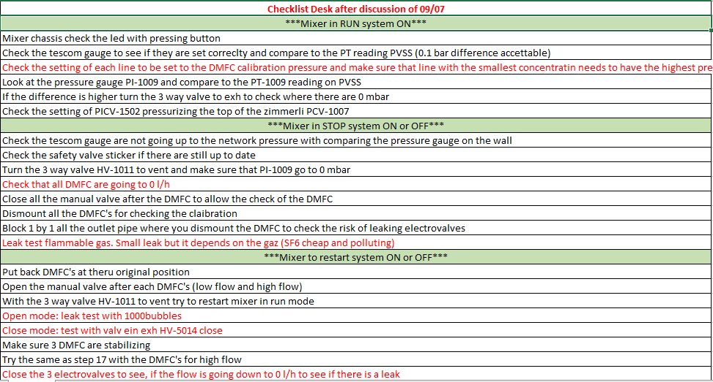
Starting point

Slide 3
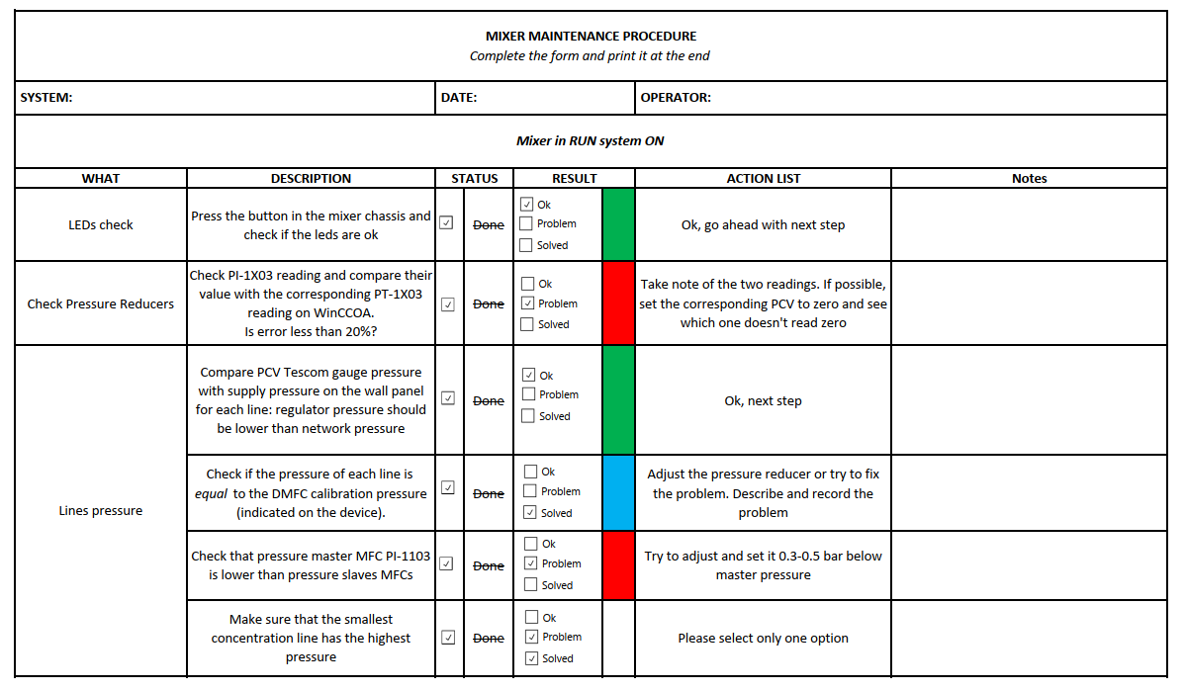
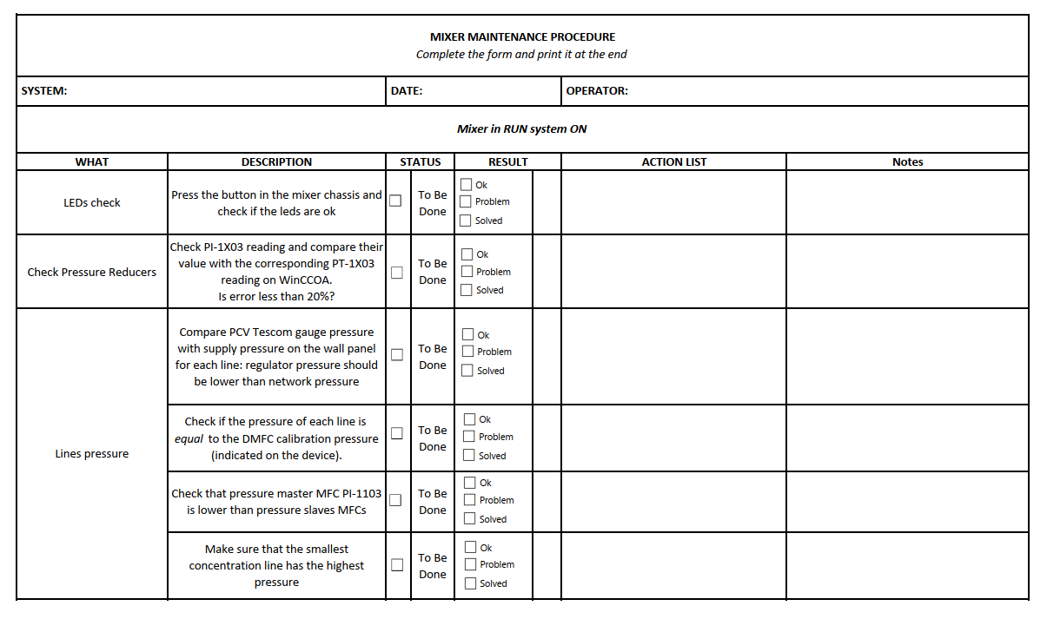
New Maintenance Procedure
Excel form to fill
Standard procedure, valid for every system
3 sections depending on the status of the system and the module
Includes Leak test procedure
Need to be tested: your feedback?

