Slide 1


Overview
F. Loddo
INFN-BARI
flavio.loddo@ba.infn.it

Slide 2
Outline
Power domains
SLDO floorplan in the Padframe
List of SLDO-related pads
SLDO operating modes
Bandgap scheme
Iref/Vref configuration
List of external resistors
Monitoring features

Slide 3
Power domains
Two power domains → two ShuntLDOs
Analog (VDDA, GNDA)
Digital (VDDD, GNDD)
The global p-substrate is biased by VSUB
CDR/PLL domain
Dedicated pads (1x VDD_PLL, 1x GND_PLL) to be connected on module preferably to VDDA and GNDA
CML driver domain
Dedicated pads (2x VDD_CML, 5x GND_CML) to be connected on module preferably to VDDA and GNDA

Slide 4
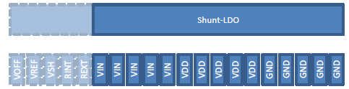
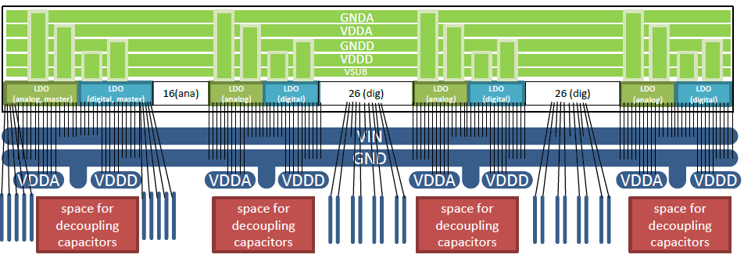
PADFRAME and WireBond scheme
Regulator configuration and placement
  4 blocks with sets of 5 WB per power net
  1 master (with bias pads) + 3 slaves
  20 pads/block, 2 mm wide
  500 mA/block → 100 mA/pad
  Analog and digital regulator blocks distributed along the padframe and placed back to back
1500 µm
Power pads:
20 VINA
20 VIND
20 VDDA
20 VDDD
20 GNDA
20 GNDD
3 VSUB
VINx
VDDx
GNDx
Chip bottom
LDO
analog slave
LDO digital slave
LDO
analog master
LDO digital slave
LDO
analog slave
LDO digital master
LDO
analog slave
LDO digital slave
Module
VINA – VIND are isolated inside the chip. Connected on the module to VIN (IIN)
GNDA – GNDD - VSUB are isolated inside the chip. Connected on the module to GND (IOUT)
VDDA – VDDD are isolated (Level shifters for domain crossing of digital configuration lines)

Slide 5
List of SLDO-BIAS PADS
Qty | Name | Type | Function
20 | VINA | passive in/out (OVT) | voltage/current input for analog regulator
20 | VDDA | power supply | analog supply
20 | GNDA | power ground | analog ground
20 | VIND | passive in/out (OVT) | voltage/current input for digital regulator
20 | VDDD | power supply | digital supply
20 | GNDD | power ground | digital ground
3 | VSUB |  | global substrate and VSS (ESD bus) connection
1 | IREF_TRIM0 | analog in/out, PU to VDD_PRE | trim bit 0 of the main current reference
1 | IREF_TRIM1 | analog in/out, PU to VDD_PRE | trim bit 1 of the main current reference
1 | IREF_TRIM2 | analog in/out, PU to VDD_PRE | trim bit 2 of the main current reference
1 | IREF_TRIM3 | analog in/out, PU to VDD_PRE | trim bit 3 of the main current reference
1 | VDD_PRE | power ground | pad for decoupling capacitor
2 | GNDA_REF | power ground | GND reference for voltage setting resistors
1 | R_IREF | analog in/out | IREF setting resistor
1 | VREFA | passive in/out (OVT) | voltage reference for VDDA (=VREFA), output for decoupling, input to override reference
1 | REXTA | passive in/out (OVT) | connection to external analog shunt resistor
1 | VOFS_OUT | passive in/out (OVT) | Vofs_half output: connect to resistor for shunt offset voltage (HP mode)
 | VOFS_IN | passive in/out (OVT) | Vofs_half input of VOFS buffer
1 | VOFS_LP | passive in/out (OVT) | voltage setting resistor for shunt offset voltage (LP mode)
1 | LP_EN_AC | passive in/out (OVT) | ac signal for LP mode enable
1 | VREF_ADC | analog in/out | ADC VREF setting resistor
1 | VREF_OVP | passive in/out (OVT) | over voltage protection overwrite (600mV default)
1 | VREFD | passive in/out (OVT) | voltage reference for VDDD (=VREFD*2), output for decoupling
1 | GNDD_REF | power ground | GND reference for voltage setting resistors
1 | REXTD | passive in/out (OVT) | connection to external digital shunt resistor
1 | VDD_SHUNT | passive in/out (OVT) | power supply for both analog and digital shunt error amplifier
Allow to implement the Common Voffset

Slide 6
SLDO operating modes
ShuntLDO mode (serial powering)
  VDD_SHUNT connected to VIND or VINA
  All shunt configuration resistors (R_VOFS*, R_EXT* ) must be connected
  Common Voffset for the 2 domains
  Current sharing is set only by R_EXTA and R_EXTD
High Power Mode (default)
Low Power Mode:
force higher Voffset, enabling an additional Rofs2 resistor
LDO mode
  VDD_SHUNT disconnected
  All shunt configuration resistors (R_VOFS*, R_EXT* ) can be left connected
Direct mode

Slide 7
Bandgap scheme
Vpre ~ 1.2
VOFS_IN
Voffset (common to both SLDOs)
Core Bandgap
V_BGR
Vofs_half
IREF TRIM DAC
VrefA
4-bit DAC
VrefD
4-bit DAC
VOFS_OUT
Rofs (High Power mode)
24.9k
30k
30k
VOFS_LP
Internally generated
The Core bandgap provides V_BGR stable with T and TID for the Iref generator
No trimming in the bandgap
V_BGR is converted into Iref using an external precise resistor Riref
The trimming to compensate for process variations is done using 4 IREF_TRIM pads

Slide 8
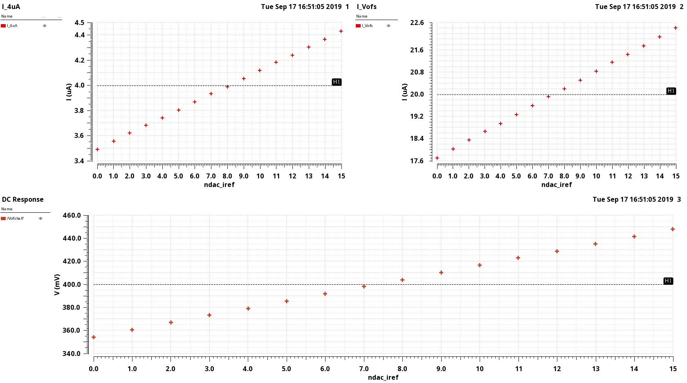
IREF/VOFS vs IREF_TRIM
IREF = 3.5 uA + Ndac* LSB, where LSB = 62.5 nA → LSB_{Vofshalf} = 6.25 mV (in case of Rofs = 20k → Vofs_half = 400 mV)
IREF
I_Vofs
Vofs_half
Since Vofs has no trimming for SEU immunity, the proposal is to trim the Iref wrt Vofs_half to minimize Voffset variations between chips

Slide 9
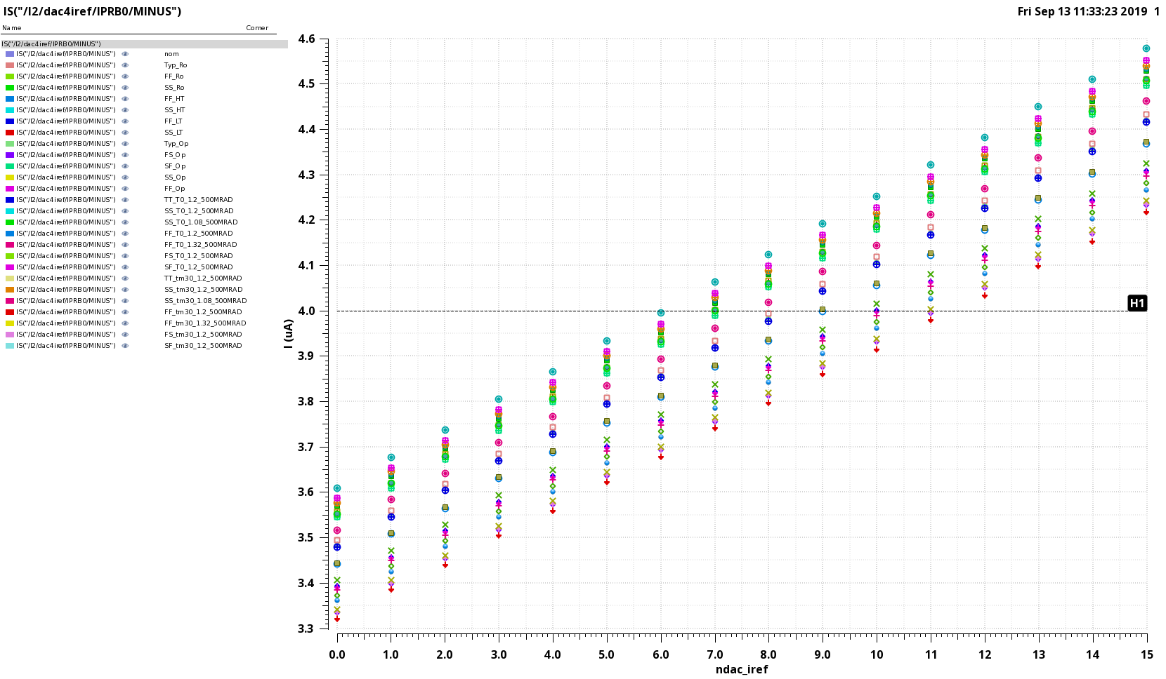
IREF vs Corners
Iref ~ 4uA can be achieved with 6 ≤ IREF_TRIM ≤ 11 but we must consider also mismatch

Slide 10
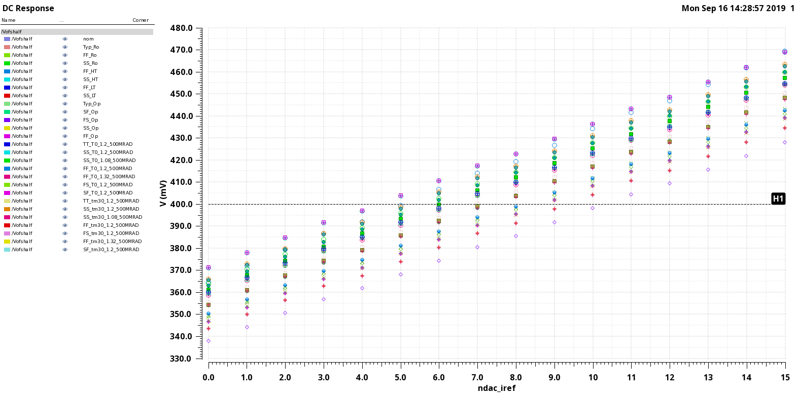
Vofs_half vs Corners

Slide 11
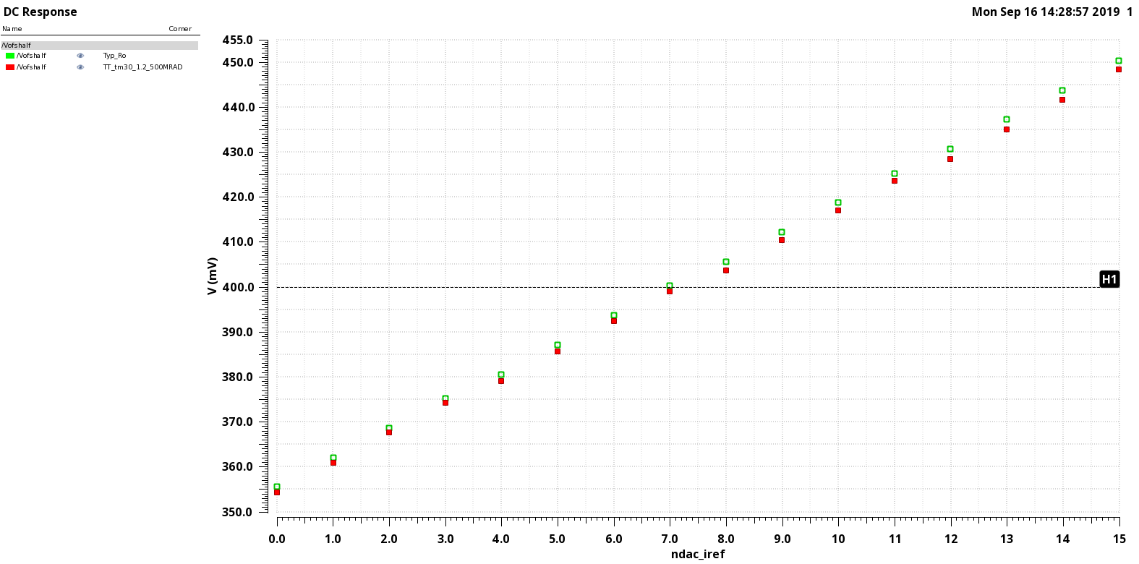
Vofs_half @ Typ,RoomT and 500Mrad, -30C

Slide 12
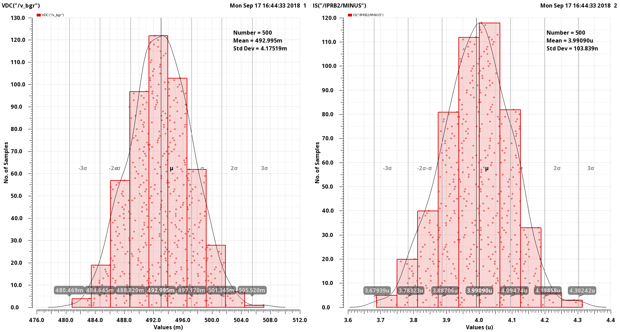
Mismatch sim. @ IREF_TRIM = 8
V_BGR
Iref
StdDev ~ 1.7 LSB
The DAC range should be still enough for most of the chips

Slide 13
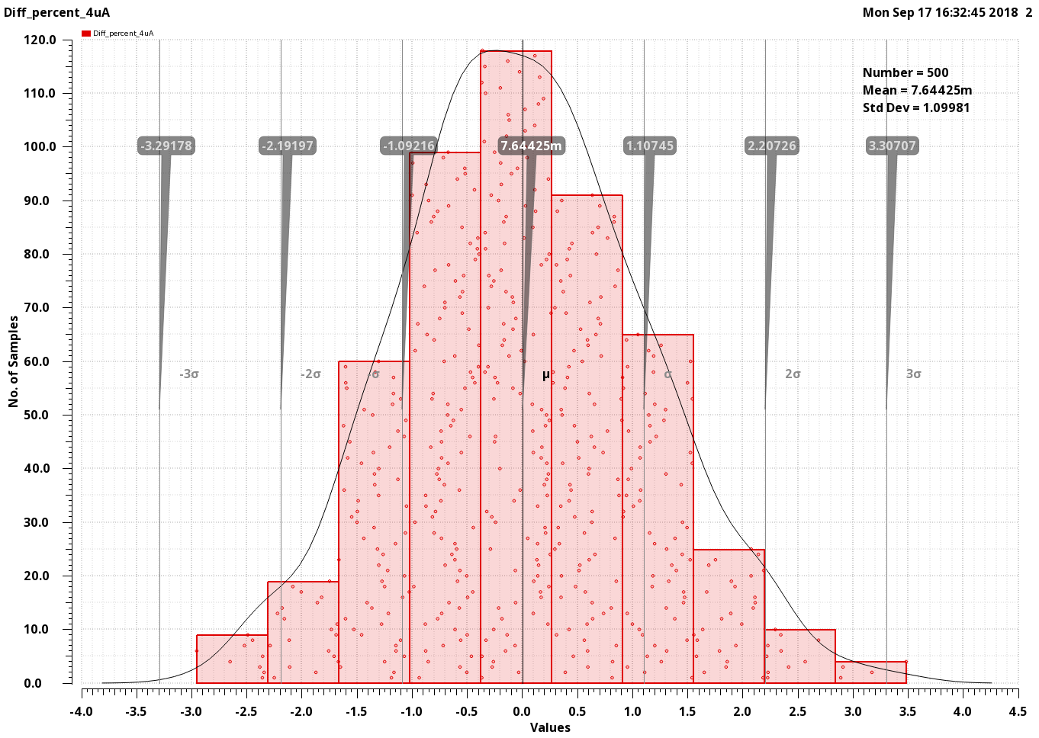
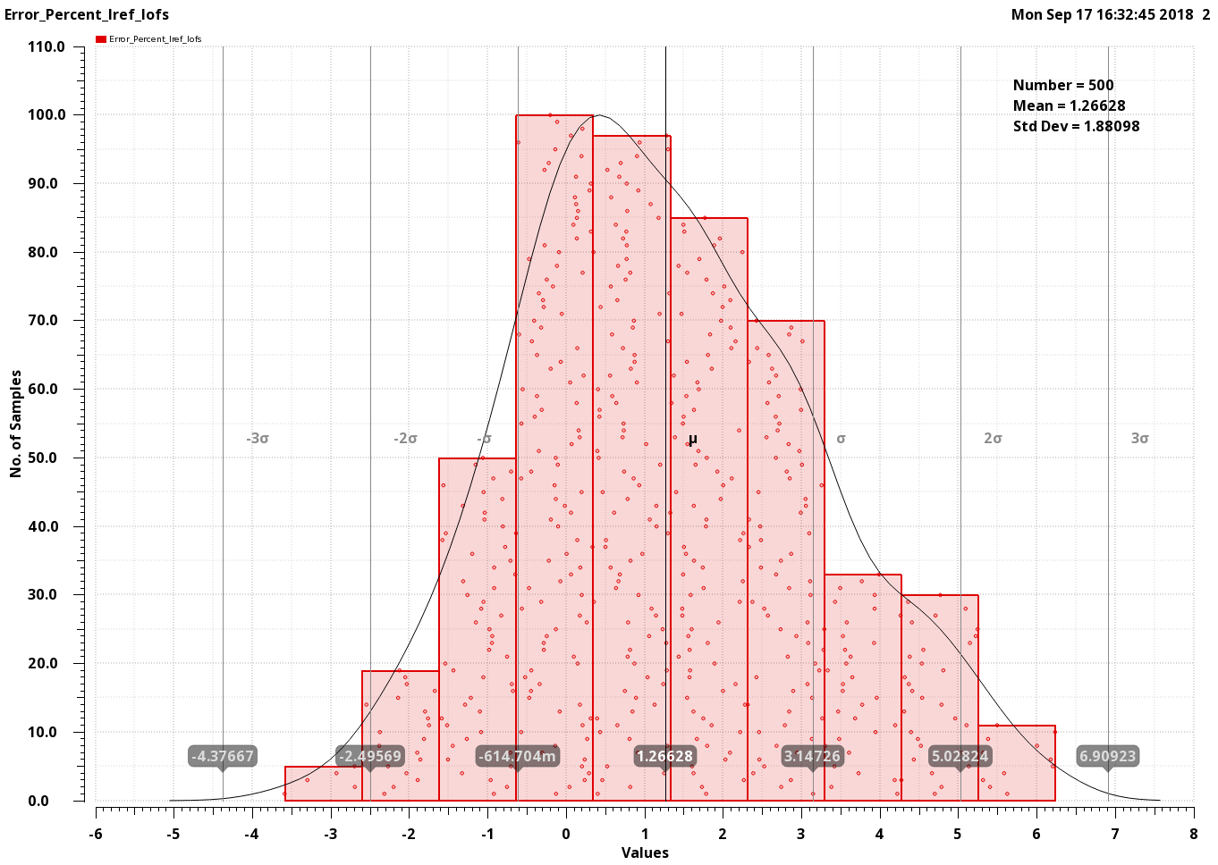
Mismatch sim. @ IREF_TRIM = 8
Mismatch% between two replicas of 4uA curr. mirror
Mismatch% between Iref (4uA curr.) and I_Vofs (~ Irefx5)

Slide 14
Table of external resistors (not only for SLDO)
Resistor | Value (Ohm) |  | Notes | Purpose
R_IREF | 24.9k |  | V_BGR = 490 mV --> I(R_IREF) = 20uA | Iref
R_VREFA | 30k |  | --> VrefA = 600mV | Analog VREF
R_VREFD | 30k |  | --> VrefD = 600mV | Digital VREF
R_VOFS | 24.9k |  | I=20uA --> Vofs_half = 500 mV | Vofs_half for High Power Mode. Terminal 1 connected to pad VOFS_OUT, terminal 2 connected to pad VOFS_LP
R_VOFS_LP | 10k |  | I=20uA --> Vofs_half = 700 mV | Additional resistor for Low Power Mode. Terminal 1 connected to pad VOFS_LP, terminal 2 connected to pad GNDA_REF
R_EXTA | 806 (???) |  |  | Slope of SLDOA
R_EXTD | 806 (???) |  |  | Slope of SLDOD
R_IMUX | 4.99k |  |  | IMUX to VMUX conversion
R_VREF_ADC | 84.5k |  | I=10uA --> Vref_ADC = 845 mV | ADC VREF
CMD_P/N | 100 |  | Termination (1 per module)
NTC/PT1000 |  |  | Constraints: @ I= 10 uA, Vmax (-40C) <= 800 mV --> R(-40) < 80k

Slide 15
Monitoring features
12-bit monitoring ADC. Using VREF_ADC = 850 mV → V_{lsb} = 208 µV and V_{FS} = 800 mV
The currents are converted into voltages on the external R_IMUX and read using the same ADC
Voltages | Notes
VINA | V_ADC = VINA/4
VIND | V_ADC = VIND/4
VDDA | V_ADC = VDDA/2
VDDD | V_ADC = VDDD/2
VREFA | V_ADC = VREFA
VREFD | V_ADC = VREFD
V_OFFSET | V_ADC = V_OFFSET/2
VREF_CORE | V_ADC = VREF_CORE (output of Core BGR)
VREF_PRE | V_ADC = VREF_PRE (output of Prereg BGR)
Currents | Notes
I_INA | I_ADC = IINA/21000
I_IND | I_ADC = IIND/21000
I_SHUNTA | I_ADC = I_SHUNTA/21600
I_SHUNTD | I_ADC = I_SHUNTD/21600
IREF | I_ADC = IREF

Slide 16
BACKUP

Slide 17
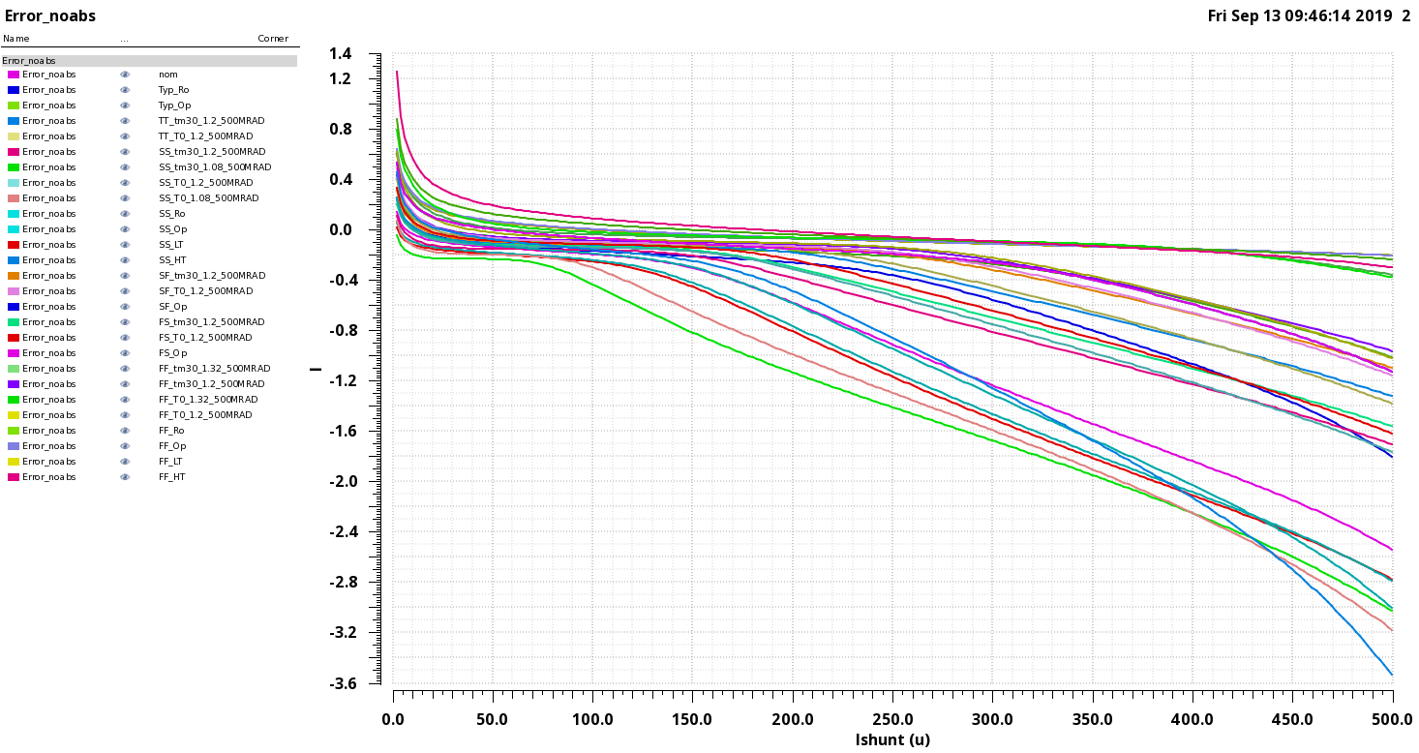
Ishunt Monitoring
Systematic error (%)
200 mA
1 A

Slide 18
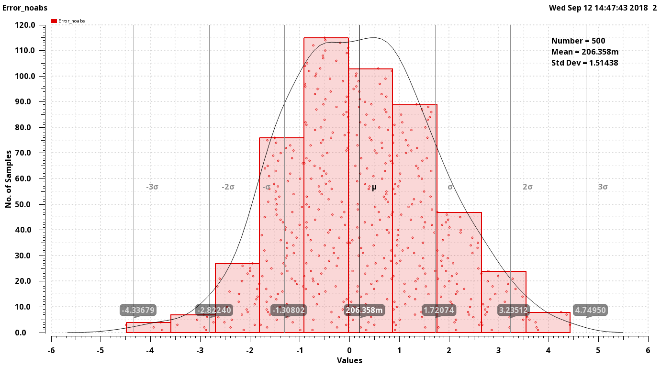
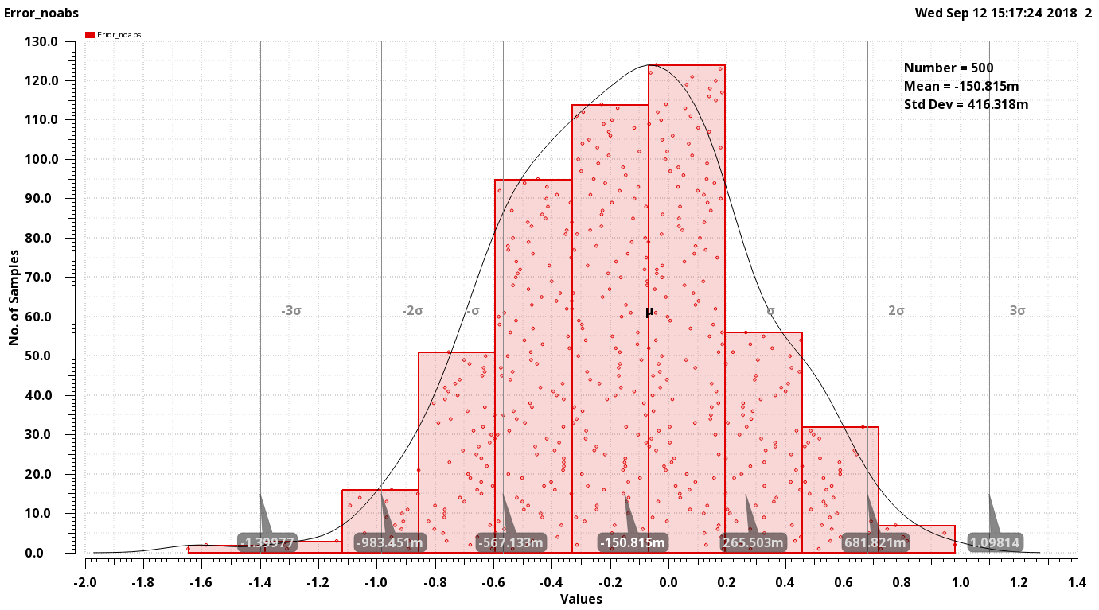
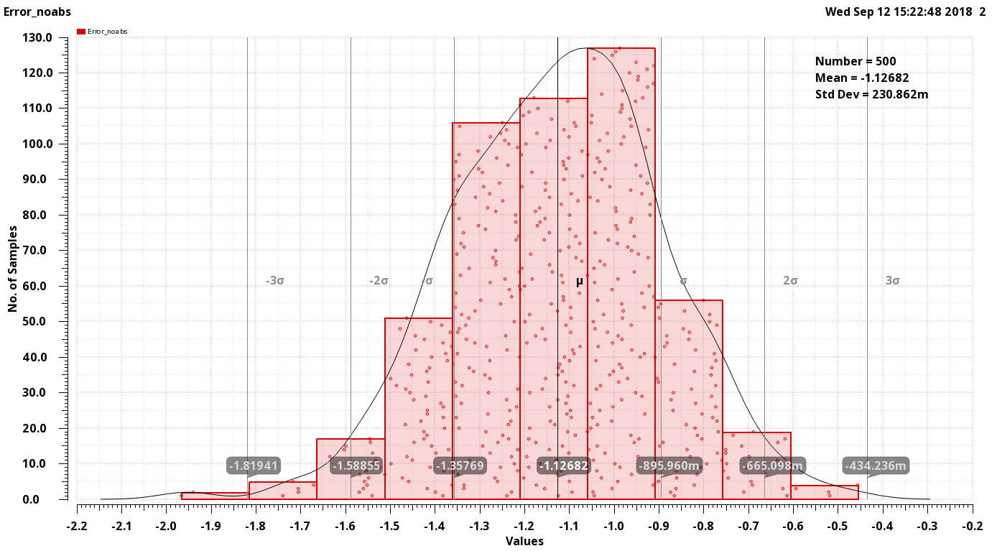
Ishunt Monitoring: mismatch sim
Error(%)
Ishunt = 432 mA
Error(%)
Ishunt = 21.6 mA
Error(%)
Ishunt = 1A

