Slide 1
Shunt-LDO Regulator
RD53B Features
23-January-2020
Michael Karagounis

Slide 2
Talk Outline
changes and improvements of RD53B with respect to RD53A SLDO version
focus on user perspective and expected regulator behavior
  limited information on implementation details
modifcations to core design
  minor issues like layout and connectivity
protection features
  overvoltage
  overload
new power mode

Slide 3




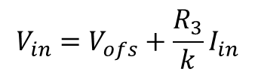

Design Concept
The Shunt-LDO regulator combines the functionality of an LDO voltage regulator with the capability of a shunt regulator to drain a constant current
Two control loops: 1) constant output voltage 2) constant current flow through the regulator
$$≈k\frac{V_{in}−V_{ofs}}{R_{3}}$$
$$I_{in}≈kI_{Ref}$$
$$I_{Ref}$$
$$I_{Ref}≈\frac{V_{in}−V_{ofs}}{R_{3}}$$
$$V_{in}=V_{ofs}+\frac{R_{3}}{k}I_{in}$$
k : 1
$$V_{out}=2V_{ref}$$

Slide 4






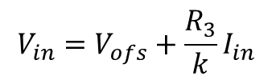


V/I Characteristic
$$V_{in}=V_{ofs}+\frac{R_{3}}{k}I_{in}$$
$$I_{in}$$
$$R_{in}$$
$$V_{in}$$
$$V_{ofs}$$
$$I_{in}$$
$$R_{in}$$
$$V_{in}$$
$$V_{ofs}$$

Slide 5
Modifications to Core Regulator Design
reference resistor R3 defining the input impedance is only available as external component
  integrated resistors show too large temperature and production variations
common VDD_SHUNT pad for analog and digital regulator
  regulators cannot be configured independent between Shunt/LDO mode
Vofs terminal connected to biasing circuit off-chip
  two addditonal pads Vofs_IN and Vofs_OUT available
  Can be used for common Vofs voltage on module level to improve current distribution

Slide 6
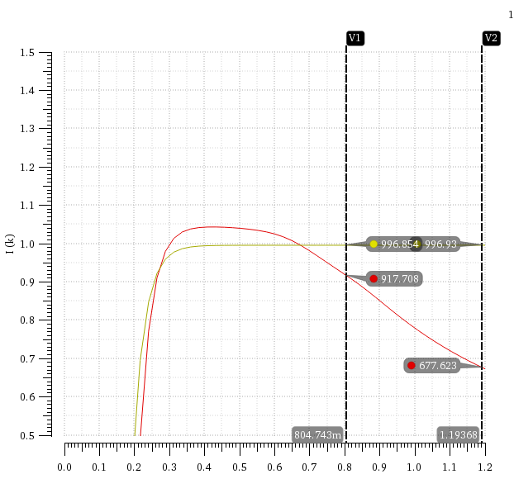
Modifications to Core Regulator Design
new layout of the power transistors to reduce influence of parasitic resistors
  measured input impedance (Vin slope) was larger than expected
  parasitic resistors influenced M1/M2 current mirror ratio

Slide 7
Improvements to Startup Behavior
RD53A used two independent bandgaps for the digital and analog regulator
  different startup timing of the digital and analog regulator
RD53B uses single bandgap for both the digital and analog regulator
  regulators should startup at the same time
Startup is supported by an newly introduced startup circuit
  Vofs is drawn to high value close to Vin to increase regulator impedance
  injection of additional current into the Rofs resistor
  switch-off current injection after start-up

Slide 8
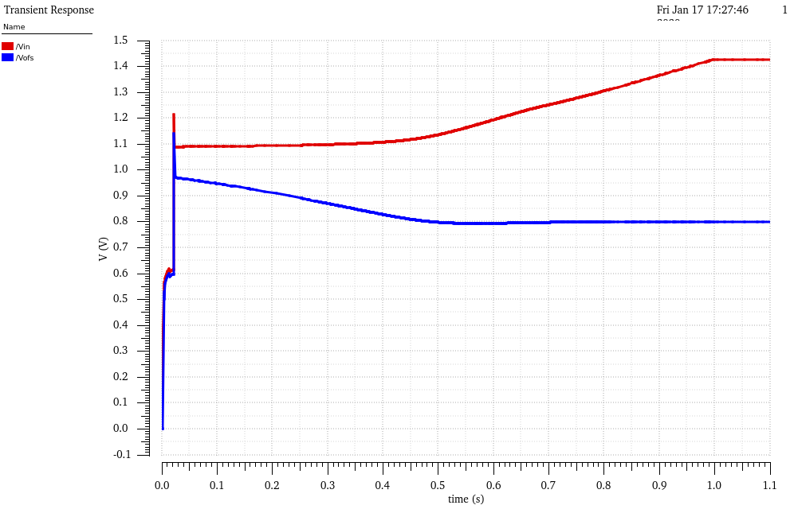
Simulation at 1A/1s start-up ramp
startup-circuit
active
startup-circuit
switched-off
Startup at very
low currents

Slide 9
Protection Feature: Overload Protection
With RD53A overload currents lead to collapse of regualtor input voltage
  This lead to overvoltages at other modules in the serial chain
RD53B protects against overloads which are considered as undershunt current scenarios
  high load current reduces shunt current
In undershunt current case Vout is reduced
  Vout is lowered by lowering Vref
Activation Threshold Ishunt < 10 mA
Vout minimimum value 700mV → Vref minimum value 350 mV

Slide 10
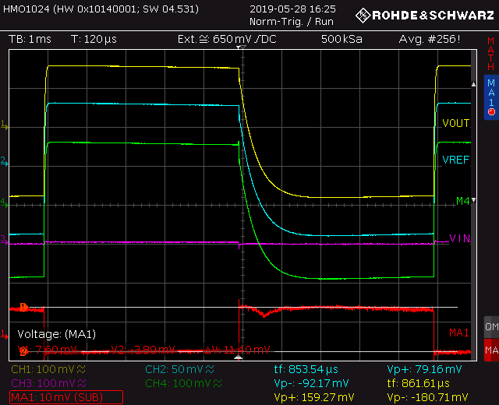
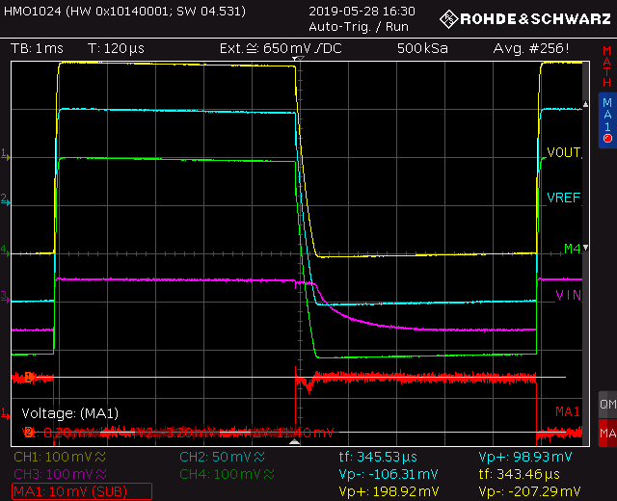
Measurement of Overload/Undershunt Protection

Slide 11
Protection Feature:
Overvoltage Protection Voltage Clamp
voltage clamp implemented as shunt regulator
  operated in parallel to SLDO
takes all excess current in case Vin =>2v
limits the voltage to 2V
can absorb up to 2A additional current per chip
OVP threshold defined by untrimmed bandgap
  voltage limit can vary +/- 5%

Slide 12
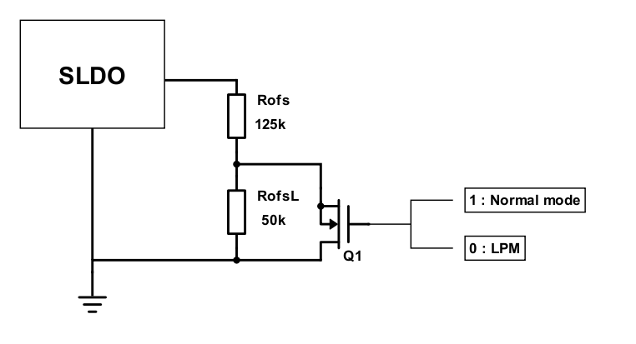
Low Power Mode
during installation the detector will be operated without active cooling
  to test connectivity
detector operation mode at lower power consumption required
SLDO has to reach the nominal operating point Vin=1.4V at lower input current
configurable offset-voltage Vofs required
  low Vofs for high power mode
  high Vofs for low power mode
switch introduce to enable/disable additional resistor in Vofs generation circuit
switch is controlled by rectified AC signal
Vofs_half
I_ref=20µA
Biasing
20k
13.7k

Slide 13
Rectification Circuit and Low Power Mode Interface
rectification circuit with 2x multiplication
AC signal is inverted and applied to a transistor in parallel two one of the Rofs resistors
  Inverter is supply by Vpre using a resistor instead of PMOS to avoid SEU issues
C1=100nF
C2=1pF
C3=1pF
C4=10pF
R2=10MΩ
R4=10MΩ

Slide 14
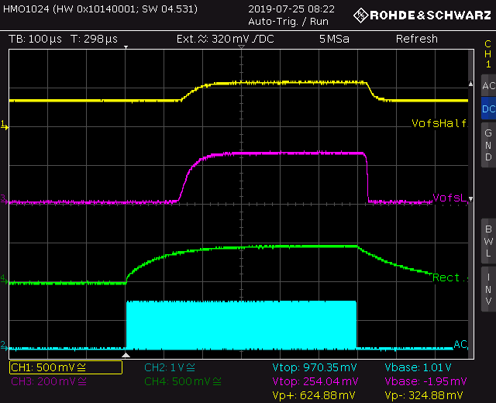
Measurement AC Rectifier interaction with Vofs

Slide 15
Summary and Conclusion
SLDO core design is almost the same
  layout optimization and wiring modifications
startup-behavior should become more deterministic
  less bandgaps involved
  startup-circuited integrated
higher robustness and reliability aimed by protection features
  overvoltage protection
  overload/undershunt current protection
Low Power mode initialization by Vofs configurability
  AC rectification circuit integrated

