Slide 1

RD53 serial power meeting 24/01/2020
RD53B SLDO system level simulations
A. Pradas

Slide 2
OUTLINE
Introduction
Start-up
“Undershunt” current protection
Transient response
Summary

Slide 3
1. Introduction
Main core of simulations with 4 or 8 SLDO (2 or 4 chips) in parallel using “RD53B_SLDO_LIB” with full “final” circuits of analog and digital chip parts.
Basic simulations connecting several modules in series (No problems have been seen due to serializing, so I will prioritize parallel simulations).
Start-up:
HPM and LPM (Iin = 1A and 0.15A per SLDO)
Different loads (0-100%) and ramp-up times (1-100ms)
Process and temperature corners (-40 to +40C)
Check if Vref and so Vout change depending on the start-up ramp speed (issue seen in RD53A)
“Undershunt” protection:
Current sharing during overload and recovery after it
Different overload and head-room cases
Could it be triggered by a strong transient in parallel chips?
Transient response to fast load changes of Vin and Vout, and stability:
Different working points (Vin, Iin, Vofs, Rext)
Parasitic elements effects
Common Vofs feature verification:
Reliability during start-up, “undershunt” condition, or chip failure
Comparison with/without feature
Current sharing analysis with Vofs and Slope mismatch (already done with testchip B model, shouldn’t have changed). Realistic possible mismatch values are needed to get good numbers.

Slide 4
1. Introduction
SYSTEM LEVEL VERIFICATION MODEL CONFIG
Cells used: from library “RD53B_SLDO_LIB”:
“shuldoMasterAnalog”
“shuldoMasterDigital”
“shuldoPowerTransistors” ->> this is 2 SLDO = 1 chip
Default CONFIGURATION per SLDO:
- I_load = 0.8A
- Iin = 1A (25% of headroom)
- Vofs = 1V ->> Vin = 1.5V (Rslope = 500Ω)
- All trimbits by default
- Undershunt protection is disabled by default

Slide 5
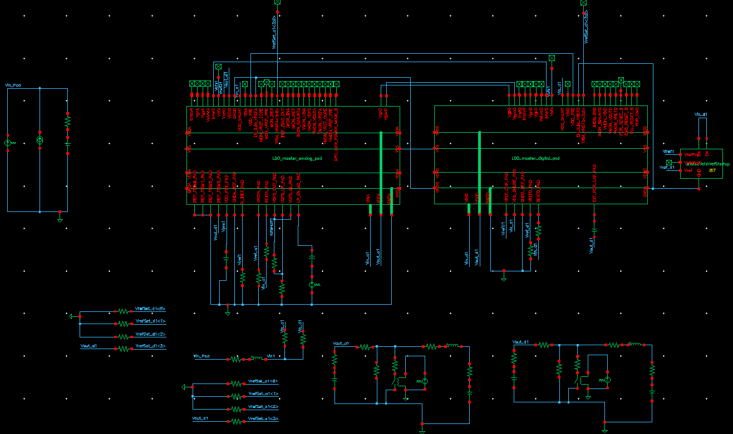
1 chip model: 2 SLDO in parallel
BGs core
Start-up circuit
LPM circuit
SLDOa control
Vrefd generation
OVP control
POR circuit
SLDOd control
Analog master
Digital master
Power supply
Output decoupling, loads and transients

Slide 6
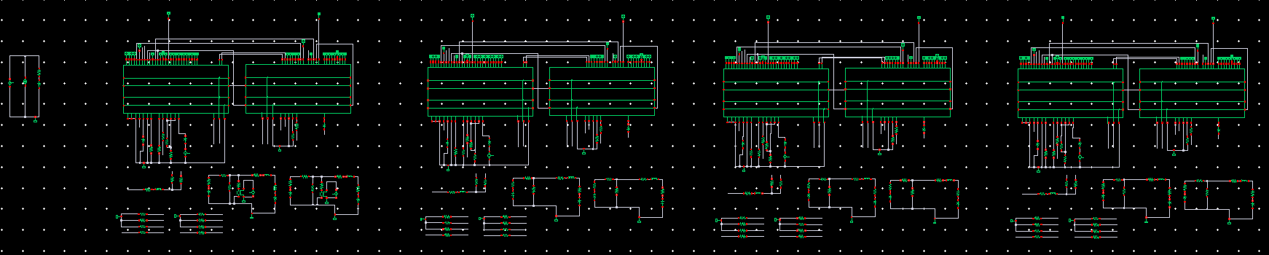
4 chip model: 8 SLDO in parallel
CHIP 1
CHIP 2
CHIP 3
CHIP 4

Slide 7
2. Start-up
The start-up circuit allows the SLDO to start with low input currents, even before the Bandgaps are ON (this was an issue from RD53A). It is a quite sensitive circuit that has been adjusted during last weeks.
An “asymmetry” was detected between analog and digital SLDO:
No Vref start-up circuit was included on digital
Bias circuit of digital SLDO was also used to bias the OVP transistors
Analog and Digital had different start-up timing and current sharing
Several versions with small changes have been developed to solve this issue.
With the final version, it is able of starting with lower currents and more stable.

Slide 8
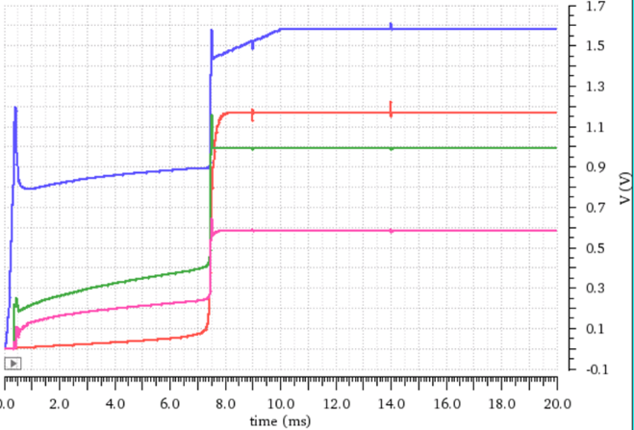
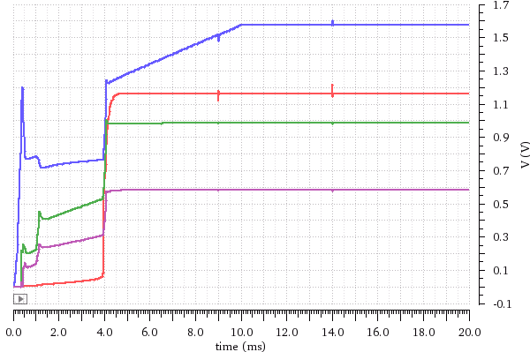
Only 1 chip (2 SLDO)
10ms start-up comparison
tt, room temperature
R_load = 1kΩ
0.75A
Vin
0.40A
BGs not working
Vout
Vofs
Vref
TESTCHIP A
TESTCHIP B
Similar to RD53A
Improved from TC A
10 ms current 1A ramp-up simulation

Slide 9
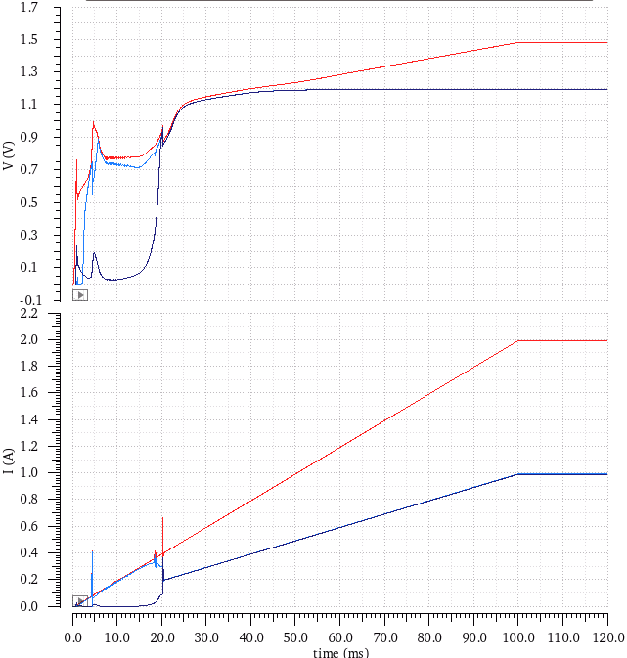
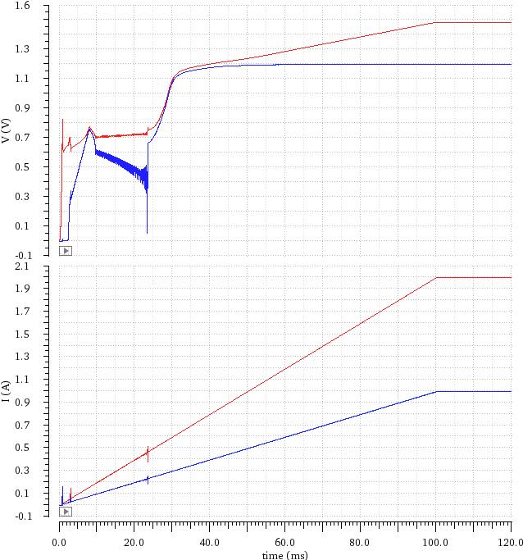
Only 1 chip (2 SLDO)
100ms start-up comparison
tt, room temperature
R_load = 10Ω
Current sharing during start-up improved
1- Initial RD53B version
2- BIAS issue solved
Vin
Vin
Vout_a
Vout_d
Vout_a
Vout_d
Iin
Iin
Iin_a
Iin_d
Iin_a
Iin_d

Slide 10
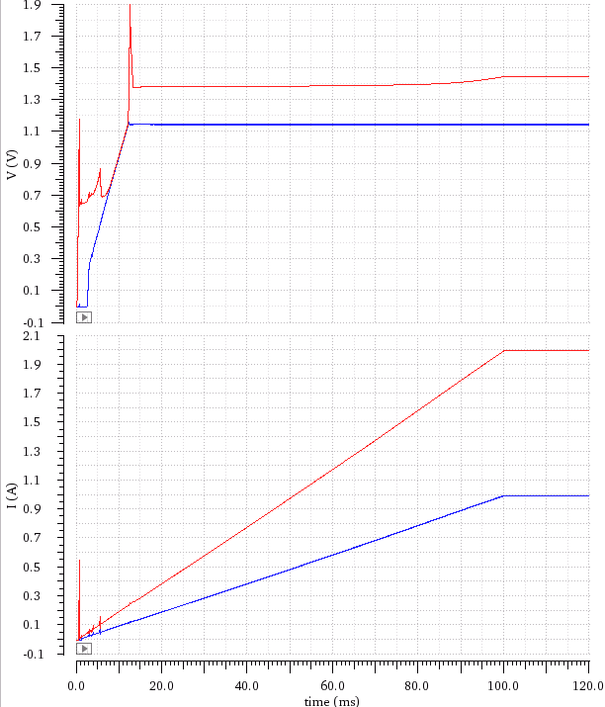
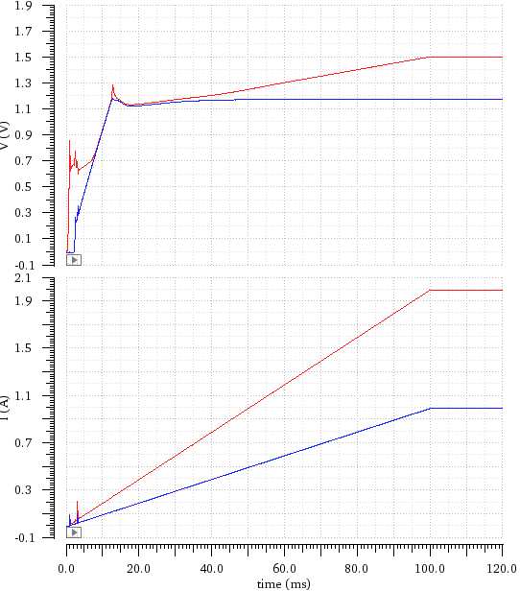
Only 1 chip (2 SLDO)
100ms start-up comparison
tt, room temperature
R_load = 10Ω
Minimum Vin has been reduced to ~1,25V
3- Start-up improved (no disabling signal)
4- Start-up threshold level improved
Vin
Vin
Vout_a
Vout_d
Vout_a
Vout_d
Iin
Iin
Iin_a
Iin_d
Iin_a
Iin_d

Slide 11
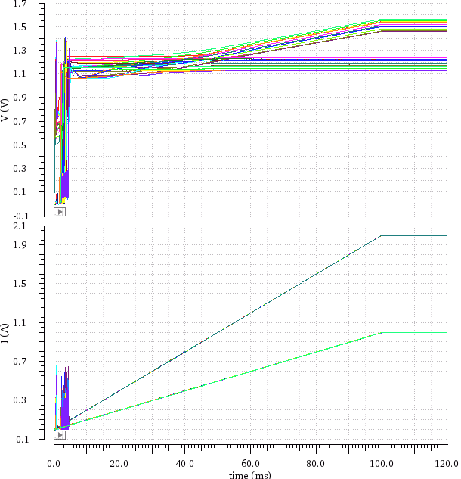
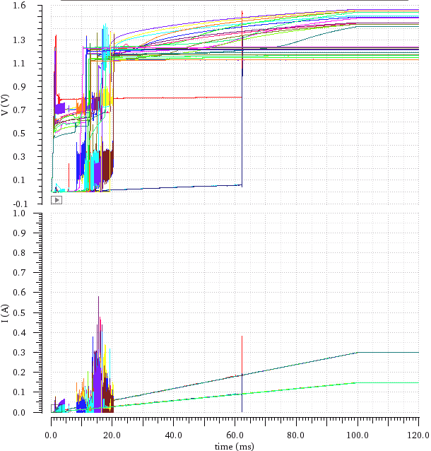
4 chip (8 SLDO)
100ms start-up comparison
All corners
R_load = 1kΩ (low load)
Current sharing unbalance between analog and digital parts has been solved
There are still some oscillations but only at -40C and (ss,sf) corners.
Vin
Vout_a
Vout_d
HPM
LPM
Iin
Iin_a
Iin_d

Slide 12
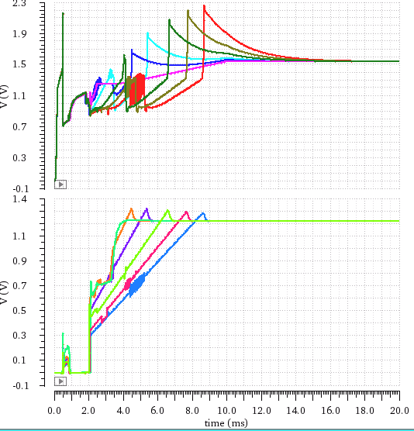
4 chip (8 SLDO)
100ms start-up comparison
ss, -40C
R_load = 1.5, 1,7, 2, 2.5, 3, 5Ω
2Ω
1.7Ω
2,5Ω
1.5Ω
3Ω
Overvoltage on Vin during start-up when:
Ramp time ~10ms -> for lower or higher ramps the issue is damped.
High load -> the higher the load the higher the overvoltage
Start-up should always be in low power consumption, so it shouldn’t be a problema.
5Ω
Vin
Vout_a

Slide 13
2. Start-up
START-UP CONCLUSIONS:
The SLDO is able of starting-up in HPM and LPM in all corners thanks to the Vofs start-up circuit.
The minimum Vin that can be configured is determined by the disabling threshold of the start-up circuit. >1.3Vin can be used across all corners.
Oscillations during start-up have been damped compared to previous versions. Only visible for some corners at -40C.
Vin overvoltage has been seen on some very specific cases:
High load ~10ms
Other combination of ramps and loads may get similar results (TBC)

Slide 14
3. Undershunt current protection
Simulations of last version of RD53B are ongoing....
Results shown are from October-November version but should not be very different.
The idea of these simulations is to see the impact of this protection at system level, when an overload happens in one SLDO of a 4 chips module.

Slide 15
3. Undershunt current protection
SYSTEM LEVEL OVERLOAD SIMULATION (4 CHIPS MODULE)
All simulations at room temperature
4 chips module -> 8 SLDO in parallel
CONFIGURATION per SLDO:
- I_load = 0.8A
- Iin = 1A (25% of headroom)
- Vin = 1.5V (Rslope = 500Ω)
- 1MΩ – 5pF filter on Vref to avoid oscillations of undershunt protection
OVERLOAD cases:
- CASE 1: 50% overload on 1 SLDO
- CASE 2: short-circuit on 1 SLDO

Slide 16
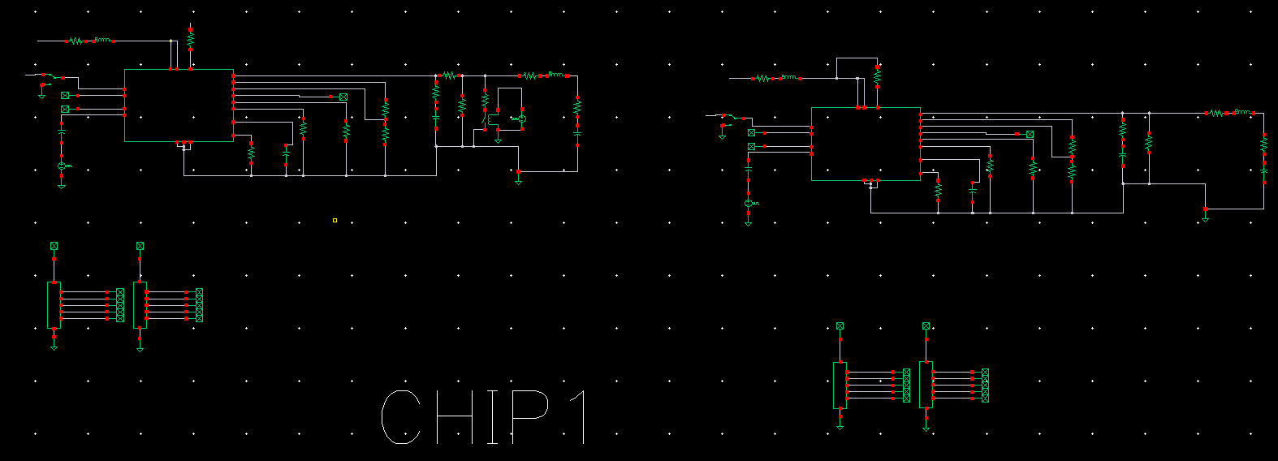
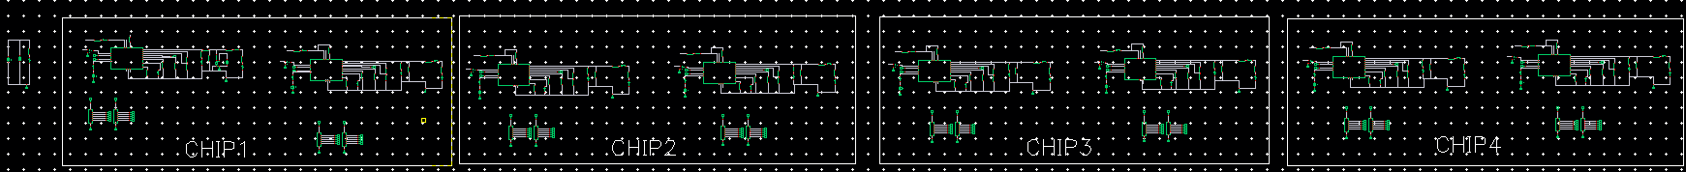
3. Undershunt current protection
1 chip model: 2 SLDO in parallel
1 module model: 4 chips in parallel

Slide 17
3. Undershunt current protection
CASE 1:
50% OVERLOAD on 1 SLDO

Slide 18
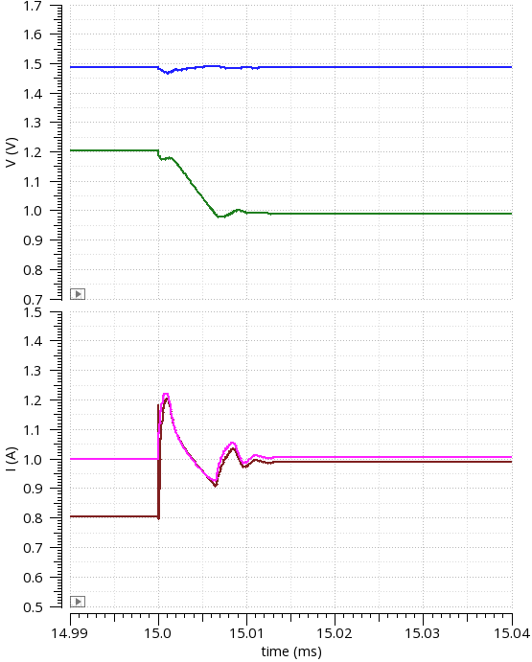
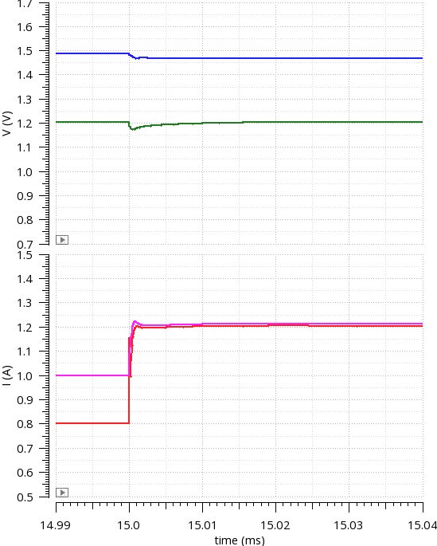
8 SLDO in parallel (4 chips module)
Iin = 1A per SLDO
CASE 1: 50% overload: 0.8A -> 1.2A on 1 SLDO
Undershunt protection ENABLED
Undershunt protection DISABLED
Vin: 1.49V -> 1.49V
Vin: 1.49V -> 1.49V
Vout: 1.20V -> 0.99V
Vin: 1.20V -> 1.20V
SIGNALS OF CHIP IN OVERLOAD
Iin: 1.00A -> 1.006A
Iin: 1.00A -> 1.21A
Iout: 0.8A -> 0.99A
Iout: 0.8A -> 1.20A

Slide 19
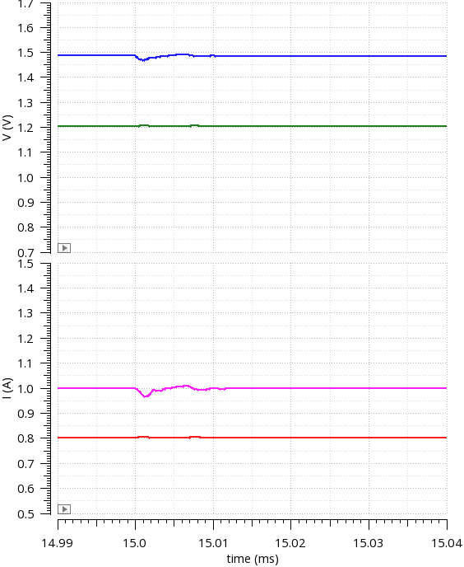
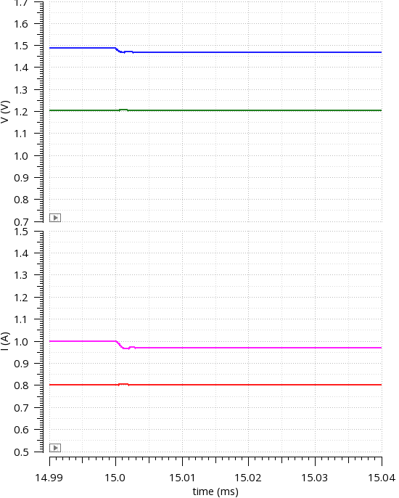
8 SLDO in parallel (4 chips module)
Iin = 1A per SLDO
CASE 1: 50% overload: 0.8A -> 1.2A on 1 SLDO
Undershunt protection ENABLED
Undershunt protection DISABLED
Vin: 1.49V -> 1.47V
Vin: 1.49V -> 1.47V
Vout: 1.20V -> 1.20V
Vin: 1.20V -> 1.20V
SIGNALS OF PARALLEL CHIPS
Iin: 1.00A -> 1.00A
Iin: 1.00A -> 0.97A
Iout: 0.8A -> 0.8A
Iout: 0.8A -> 0.8A

Slide 20
3. Undershunt current protection
CASE 2:
SHORTCIRCUIT on 1 SLDO output

Slide 21
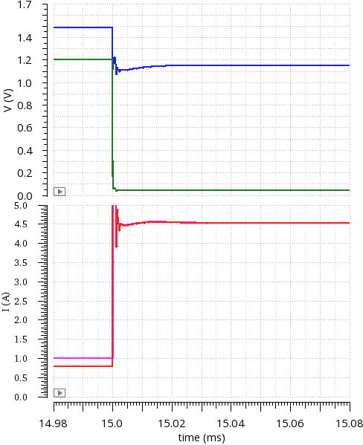
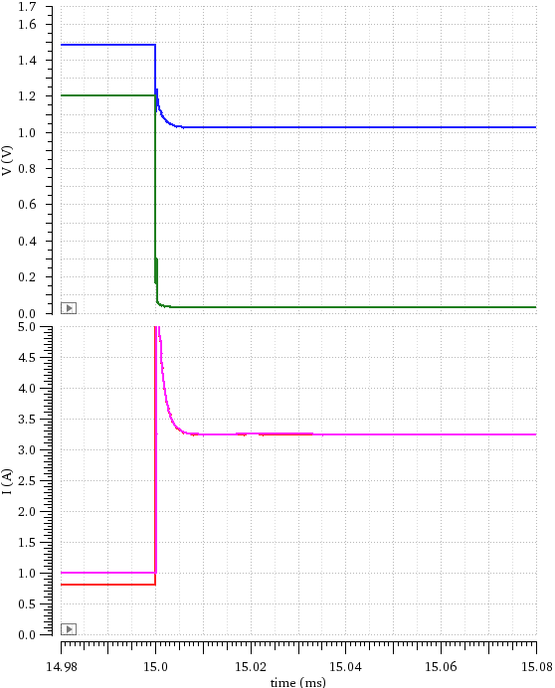
- 8 SLDO in parallel (4 chips module)
- CASE 2: Strong short-circuit (10mΩ) on 1 SLDO output
Undershunt protection ENABLED
Undershunt protection DISABLED
Vin: 1.49V -> 1.02V
Vin: 1.49V -> 1.15V
SIGNALS OF CHIP IN OVERLOAD
Vin: 1.20V -> 0.03V
Vout: 1.20V -> 0.04V
Iin: 1.00A -> 4.54A
Iin: 1.00A -> 3.25A
Iout: 0.8A -> 4.53A
Iout: 0.8A -> 3.24A

Slide 22
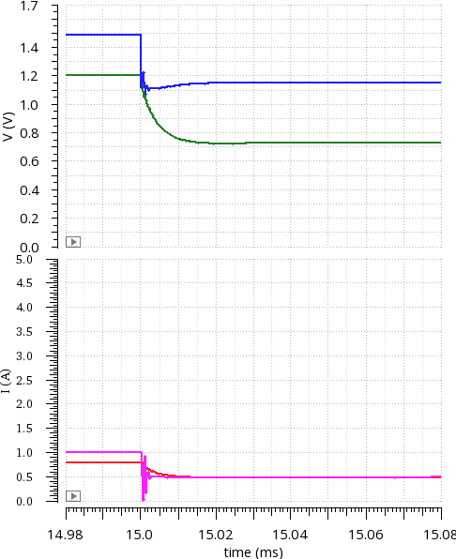
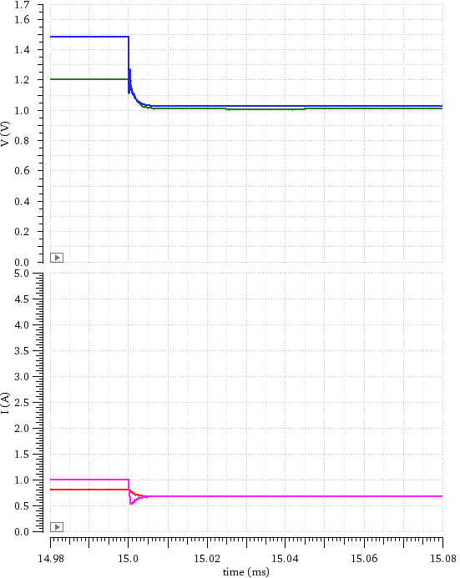
- 8 SLDO in parallel (4 chips module)
- CASE 2: Strong short-circuit (10mΩ) on 1 SLDO output
Undershunt protection ENABLED
Undershunt protection DISABLED
Vin: 1.49V -> 1.15V
Vin: 1.49V -> 1.03V
Vin: 1.20V -> 1.01V
Vout: 1.20V -> 0.72V
SIGNALS OF PARALLEL CHIPS
Iin: 1.00A -> 0.49A
Iin: 1.00A -> 0.68A
Iout: 0.8A -> 0.48A
Iout: 0.8A -> 0.67A

Slide 23
3. Undershunt current protection
CONCLUSIONS:
50% overload of 1 out of 8 SLDO:
The use of “undershunt” protection makes not much difference as the failing chip can take current from the others head-room. It would be useful when the head-room is very low.
50% overload takes a 15% of the total head-room of parallel chips (in this specific case)
Short-circuit (10mΩ) of 1 out of 8 SLDO:
When “undershunt” is enabled, all the SLDOs go into “undershunt” protection mode -> the shorted SLDO takes more current when “undershunt” is enabled.
I_short = 4.54 A (enabled)
I_short = 3.25 A (disabled)

Slide 24
4. Transient response
Load transient response and effect of parasitic inductances of input and output decoupling capacitors (Cin, Cout)
Vin
Vout
CHIP

Slide 25
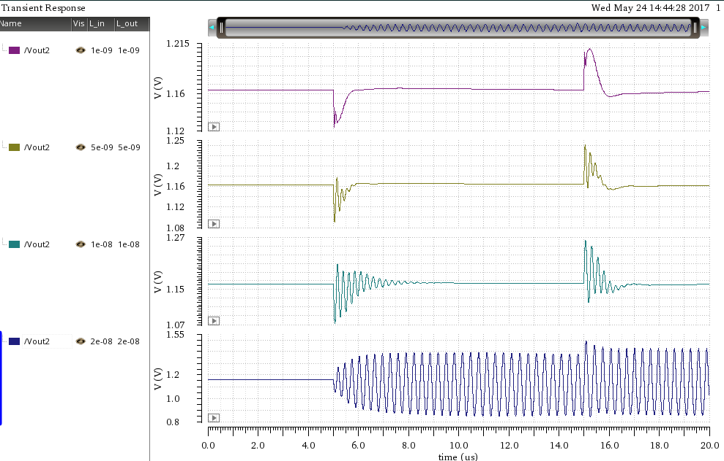
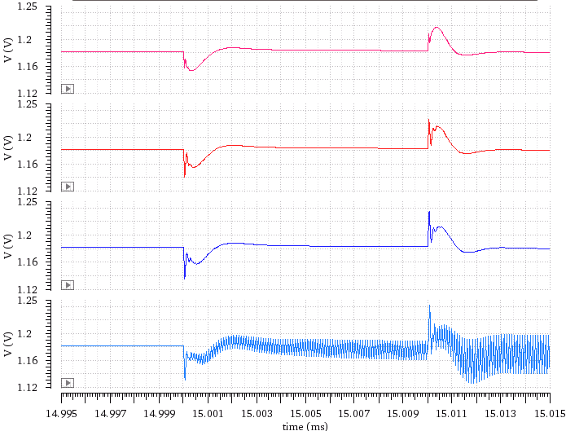
4. Transient response
Load transient (Vout) comparison between RD53A and RD53B SLDO (1chip model)
Effect of parasitic inductance on decoupling capacitors.
Typical corners
Very high inductance needed to make it unstable
RD53B seems to be a bit slower, but more stable and robust
0.2A
0.8A
0.2A
0.2A
0.8A
0.2A
L=1nH
RD53A
RD53B
L=5nH
L=10nH
L=20nH

Slide 26
5. Summary
Start-up:
HPM and LPM (Iin = 1A and 0.15A per SLDO)
Different loads (0-100%) and ramp-up times (1-100ms)
Process and temperature corners (-40 to +40C)
Check if Vref and so Vout change depending on the start-up ramp speed (issue seen in RD53A)
“Undershunt” protection:
Current sharing during overload and recovery after it
Different overload and head-room cases
Could it be triggered by a strong transient in parallel chips?
Transient response to fast load changes of Vin and Vout, and stability:
Different working points (Vin, Iin, Vofs, Rext)
Parasitic elements effects
Common Vofs feature verification:
Reliability during start-up, “undershunt” condition, or chip failure
Comparison with/without feature
Current sharing analysis with Vofs and Slope mismatch (already done with testchip B model, shouldn’t have changed). Realistic possible mismatch values are needed to get good numbers.
OK after some iterations
OK so far
(oscillations)
OK so far
TBD

