Slide 1
GEMROC Discussion

Slide 2
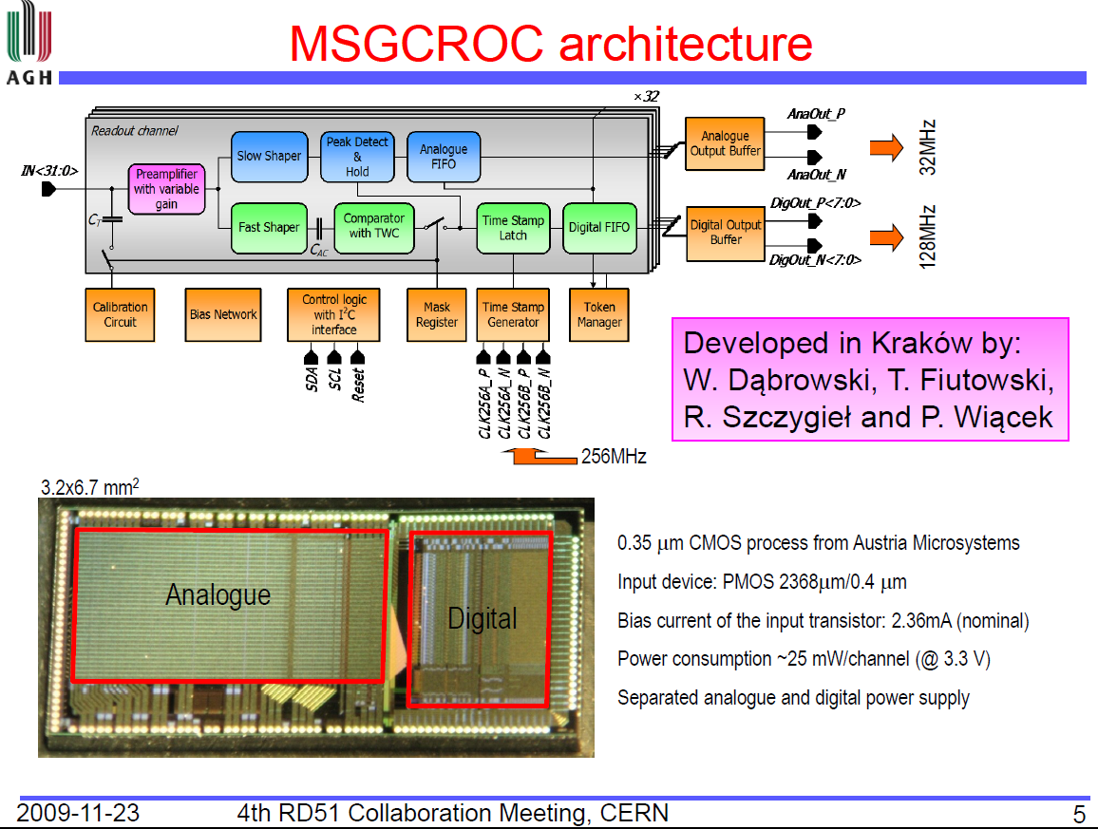

Slide 3
Front-End Architecture
Waveform sampling
Self-triggered channel
other channels
Preamp
Shaper
Pipeline
Signal processing
ADC
+
other channels
Shaper 1
Feature extraction
Timestamp
Memory
RAM/
Analog
ADC
Preamp
Feature 1
Feature 2
Shaper 2
Hit detection
other channels

Slide 4
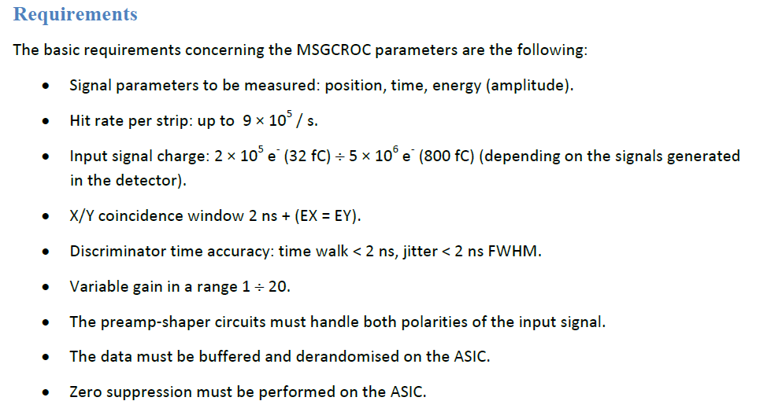
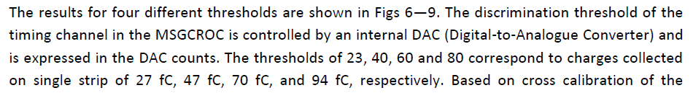
is this the full dynamic range or the end of scale for different gain settings?
what is the minimum threshold?

Slide 5
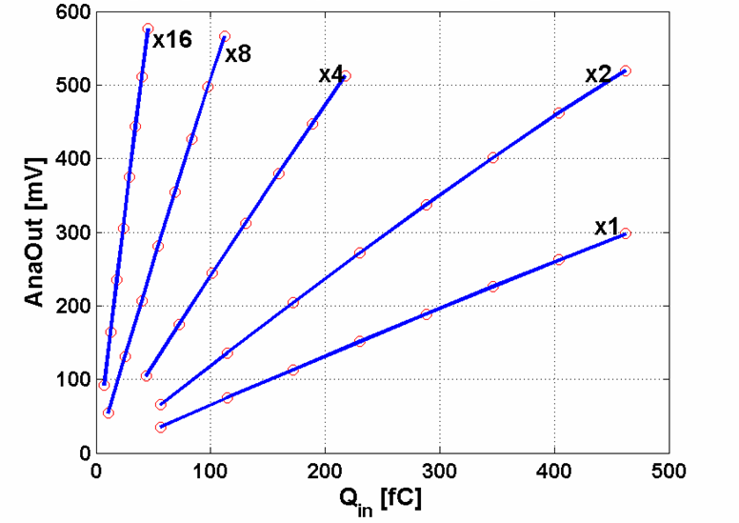
?

Slide 6
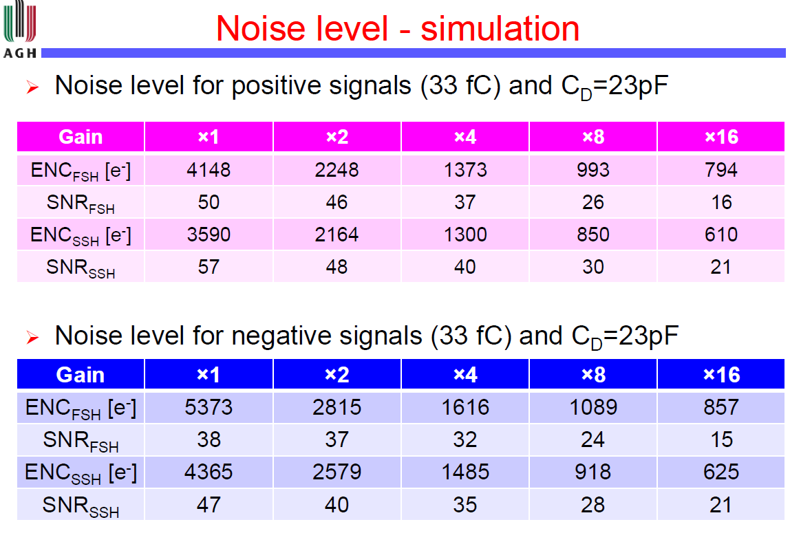
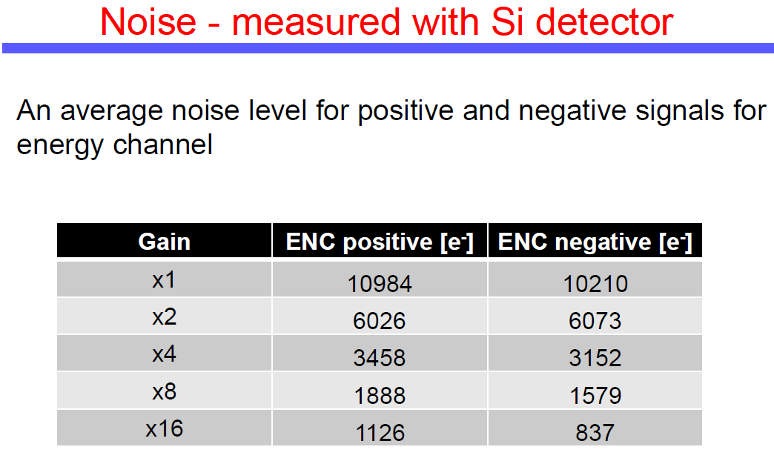
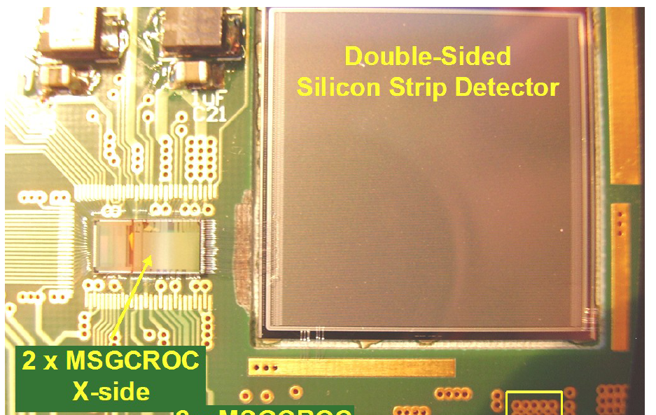
C_{D} = ?

Slide 7
Current Noise
detector capacitance
shaping time
White Noise
1/f Noise
* TSMC 0.35um data from the web

Slide 8
Current Noise
detector capacitance
shaping time
White Noise
1/f Noise
* TSMC 0.35um data from the web
variable shaping: 50 … 300 ns

Slide 9
Capacitive Matching
1/f noise dominant
white noise dominant
No preamplifier can provide optimum noise performance for every detector

Slide 11
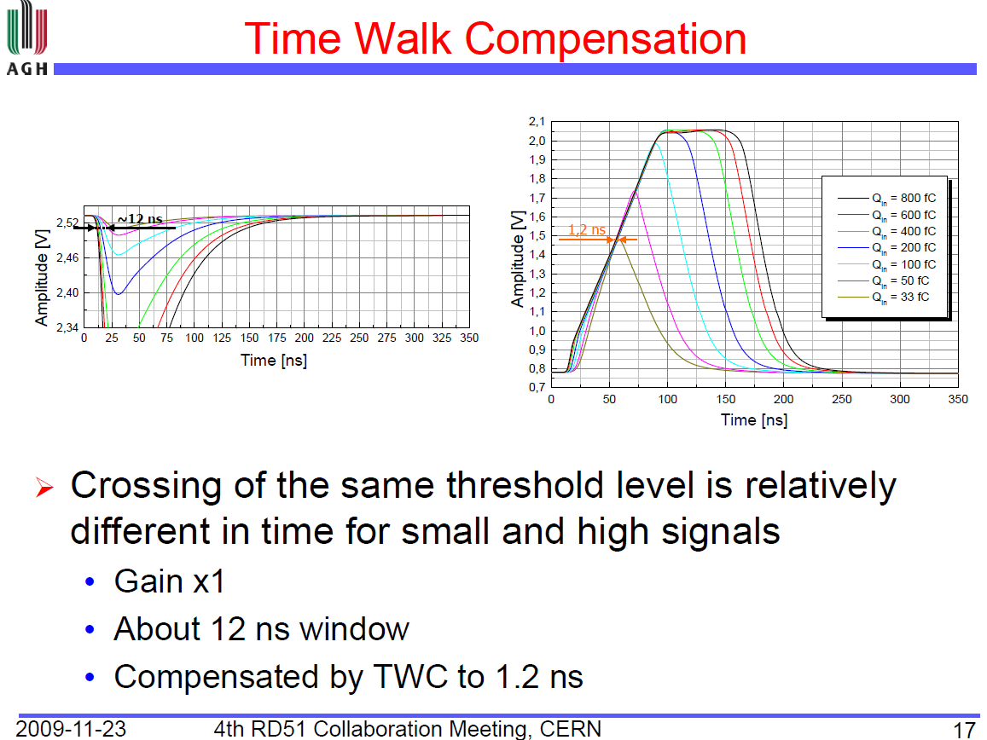
How accurate is this across process variations?
Option: offline compensation using analog information ?

Slide 12
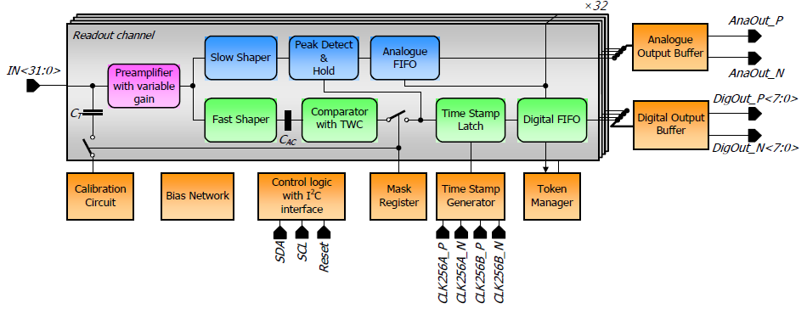
multiplexer for multiple chips?
32, 64, 128 channels? bonding/package?
too many digital outputs;
serializer (@256MHz) ?
since zero-suppression comes natural with architecture, data bandwidth is probably low -> low speed serial
fast-Or
variable shaping
reduce to minimum I/O count to DAQ
multipurpose I/O lines (eg. trg(read) + rst + testpulse)
internal synthesizer?
OK!

Slide 13
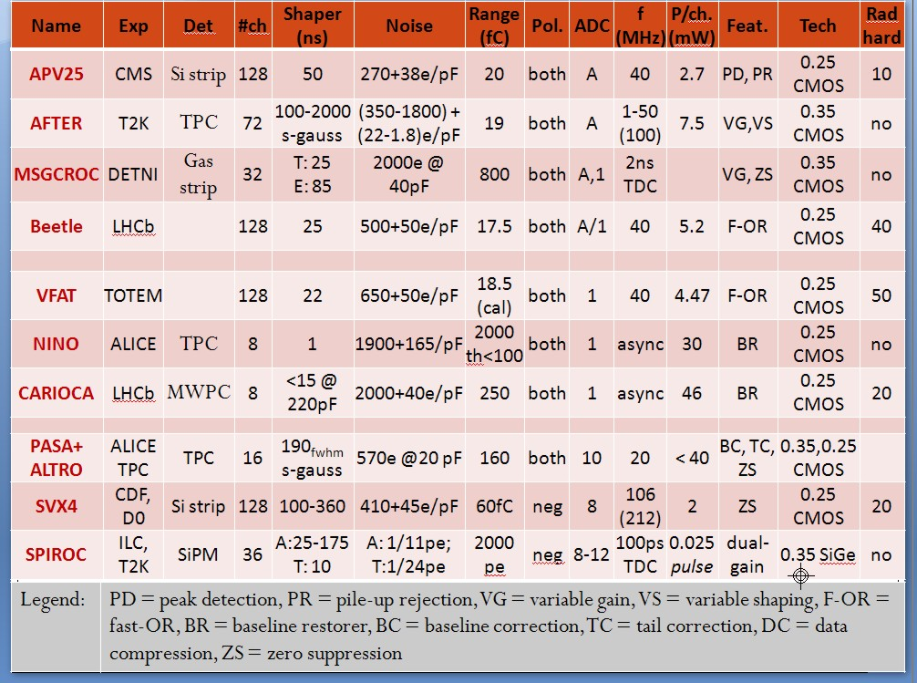
Features
Chip matrix
fast-OR,
variable gain,
variable shaping,
peak detection
pile-up rejection,
baseline restorer,
baseline correction,
tail correction,
data compression,
zero suppression
?

