Slide 1
Development of Multi-Via (MVIA) pixel with signal-charge division to realize high effective 10⁵ dynamic range for X-ray Free-Electron Laser applications
T. Hatsui
XFEL Project Head Office
RIKEN

Slide 2
Outline
X-ray Free Electron Laser Project at SPring-8
  Detector Requirements
Multi-via Pixel Concept
Experimental Results
  Gain
  Depletion depth
  Radiation hardness
System Development

Slide 3
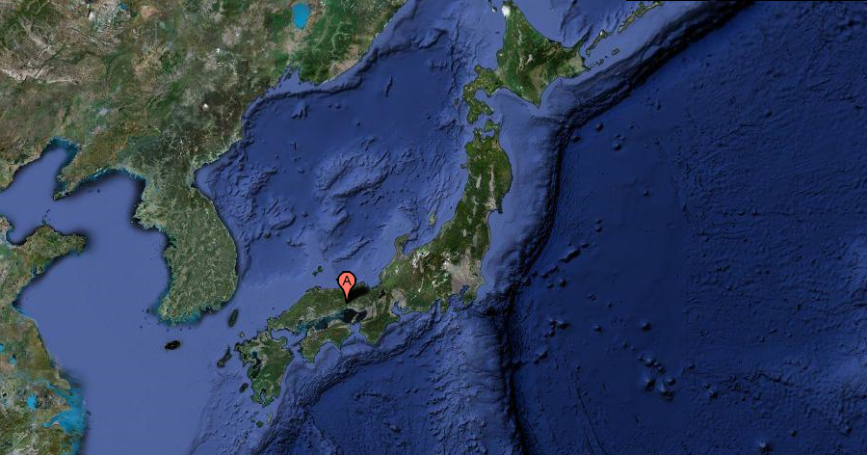
SPring-8 in Japan
Kyoto
SPring-8
Tokyo

Slide 4
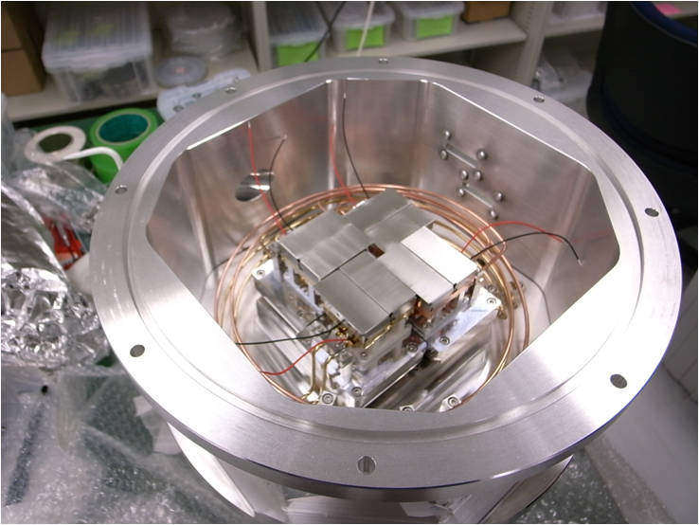
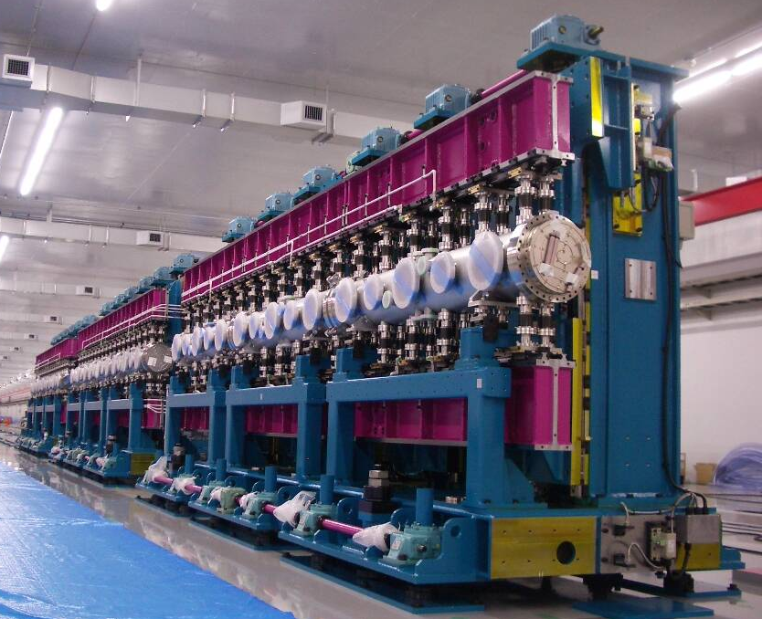
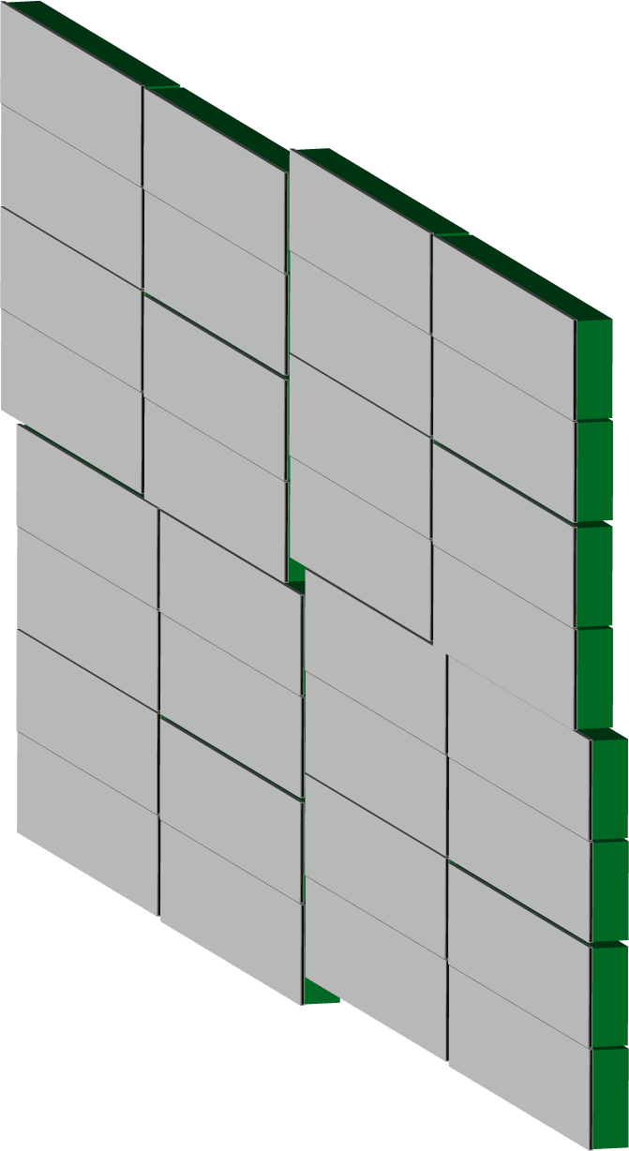
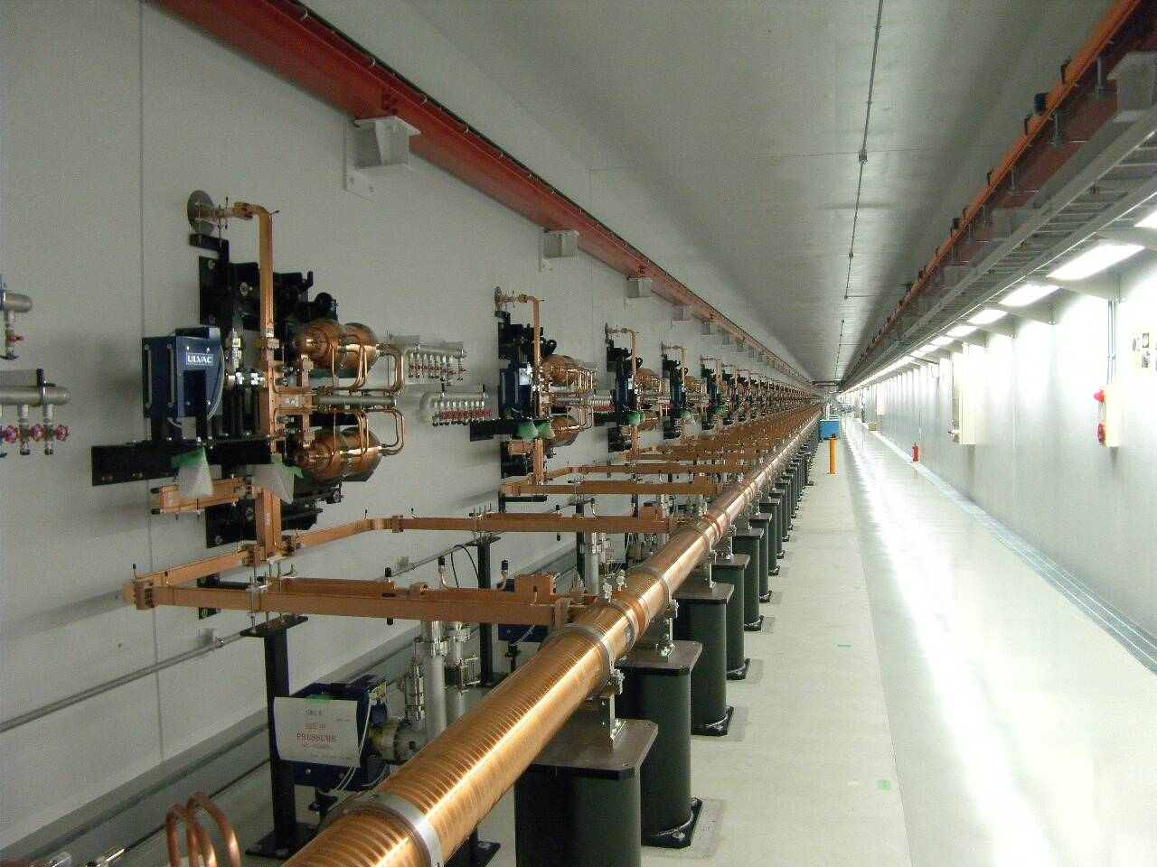
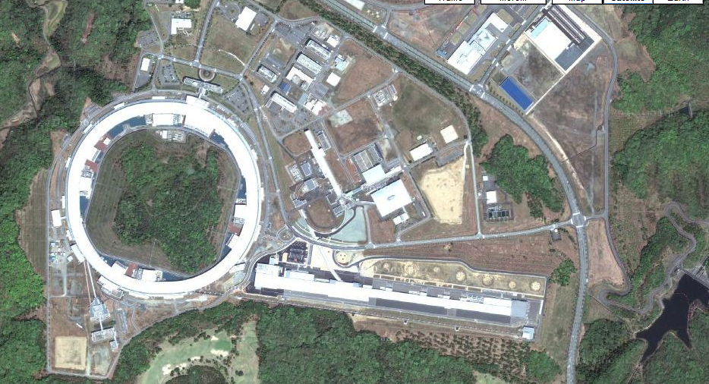
SPring-8 XFEL (2011-)
Multiport CCD: mechanical model
MVIA detector by using SOI sensor technology

Slide 5
SPring-8 X-ray Free-Electron Laser
High Peak brilliance
x10⁹
XFEL
Spatial
coherence
100%
x10³
Ultrafast pulse
< 10 fs
x10³

Slide 6
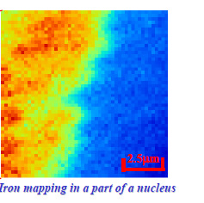
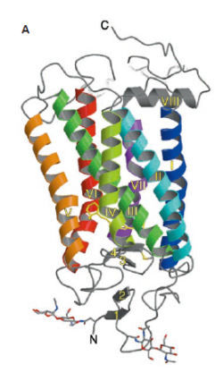
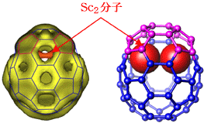
Elemental Mapping of Cell
X-ray Microscopy
100 nm
10 nm
1 nm
0.1 nm
Yamauchi Lab.,(Osaka Univ. )
Dr. Shimura (International Medical Center of Japan) et.al.,
Coherent Diffraction Imaging by using XFEL
X-ray Diffraction
Ultrafast motion of atoms
Miyano et.al.,Science Vol. 289 (2000) 739.
M. Takata et.al, NATURE | VOL 408 | 23 NOVEMBER 2000 p.426

Slide 7
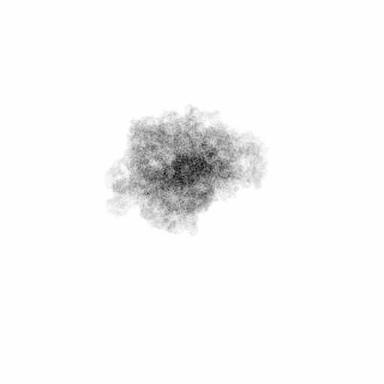
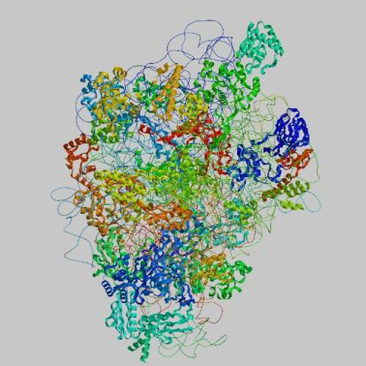
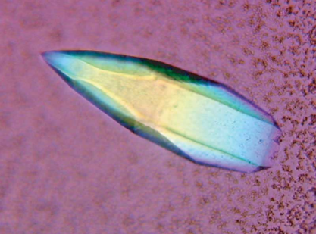
Look at atomic structure in microscopy way
Coherent X-ray Imaging by XFEL
XFEL
Crystallization
Notes:
分子量: 1.5 MDa, 総電子数: 0.7 × 10⁶

Slide 8
Spring-8 XFEL
X-ray 2D detector Requirements
X-ray Source Characteristics
60 Hz
Variation in each shot
Pulse intensity, Sample variation, etc.
Requirements
Frame rate > 60 Hz
Single Photon Detection Capability
What would be the definition?
Device life > 1 year
Optimization Parameters
Quantum Efficiency (Q.E.)
Full Well (FW) Capacity
Pixel Size

Slide 9
Motivation
What is limiting the Full Well Capacity?
Charge generated by single x-ray photon
For 6-12 keV,
1600-3200 electrons
In optical region
～1 electron
Charge/photon ratio: too large → smaller full well

Slide 10
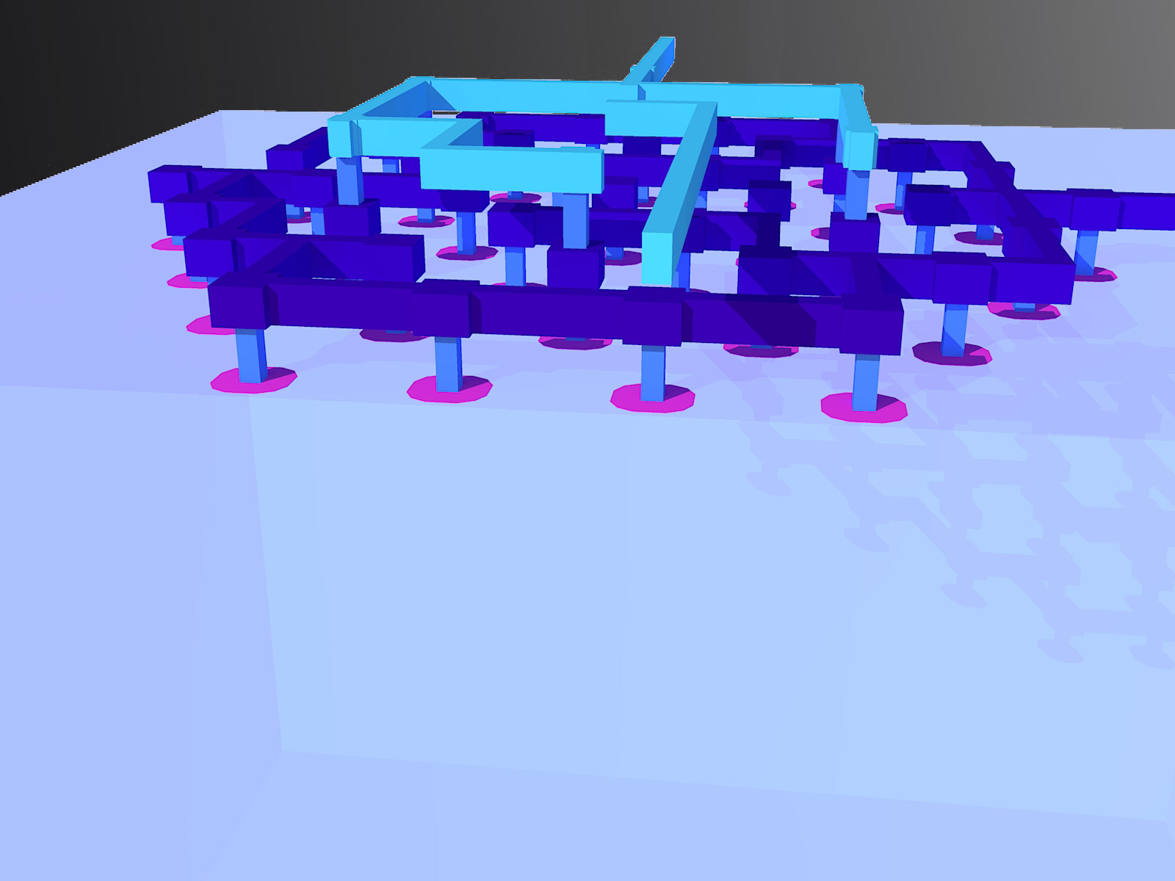
Multi-Via Concept for XFEL
3.2 um pitch via
Via-Via: 3μm
+
Distance
+- +- +- +- +- +- +-
+- +- +- +- +- +- +- +- +- +- +- +-
+- +- +- +- +- +-
X-ray
-

Slide 11
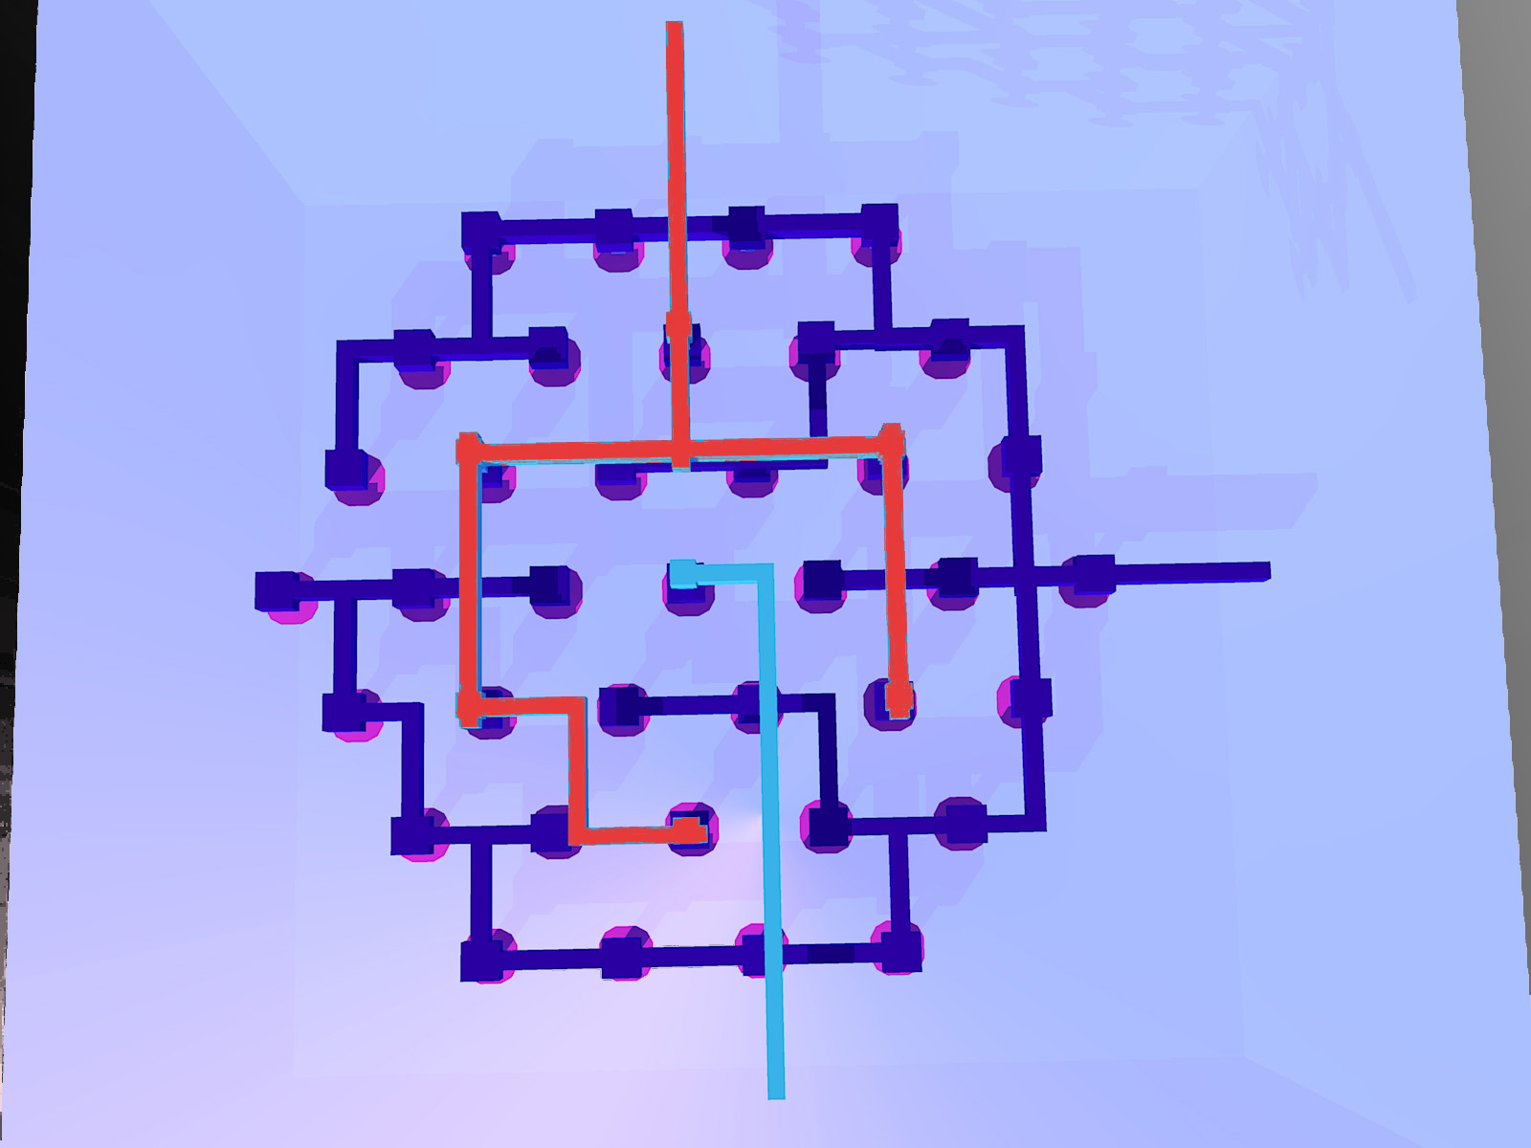
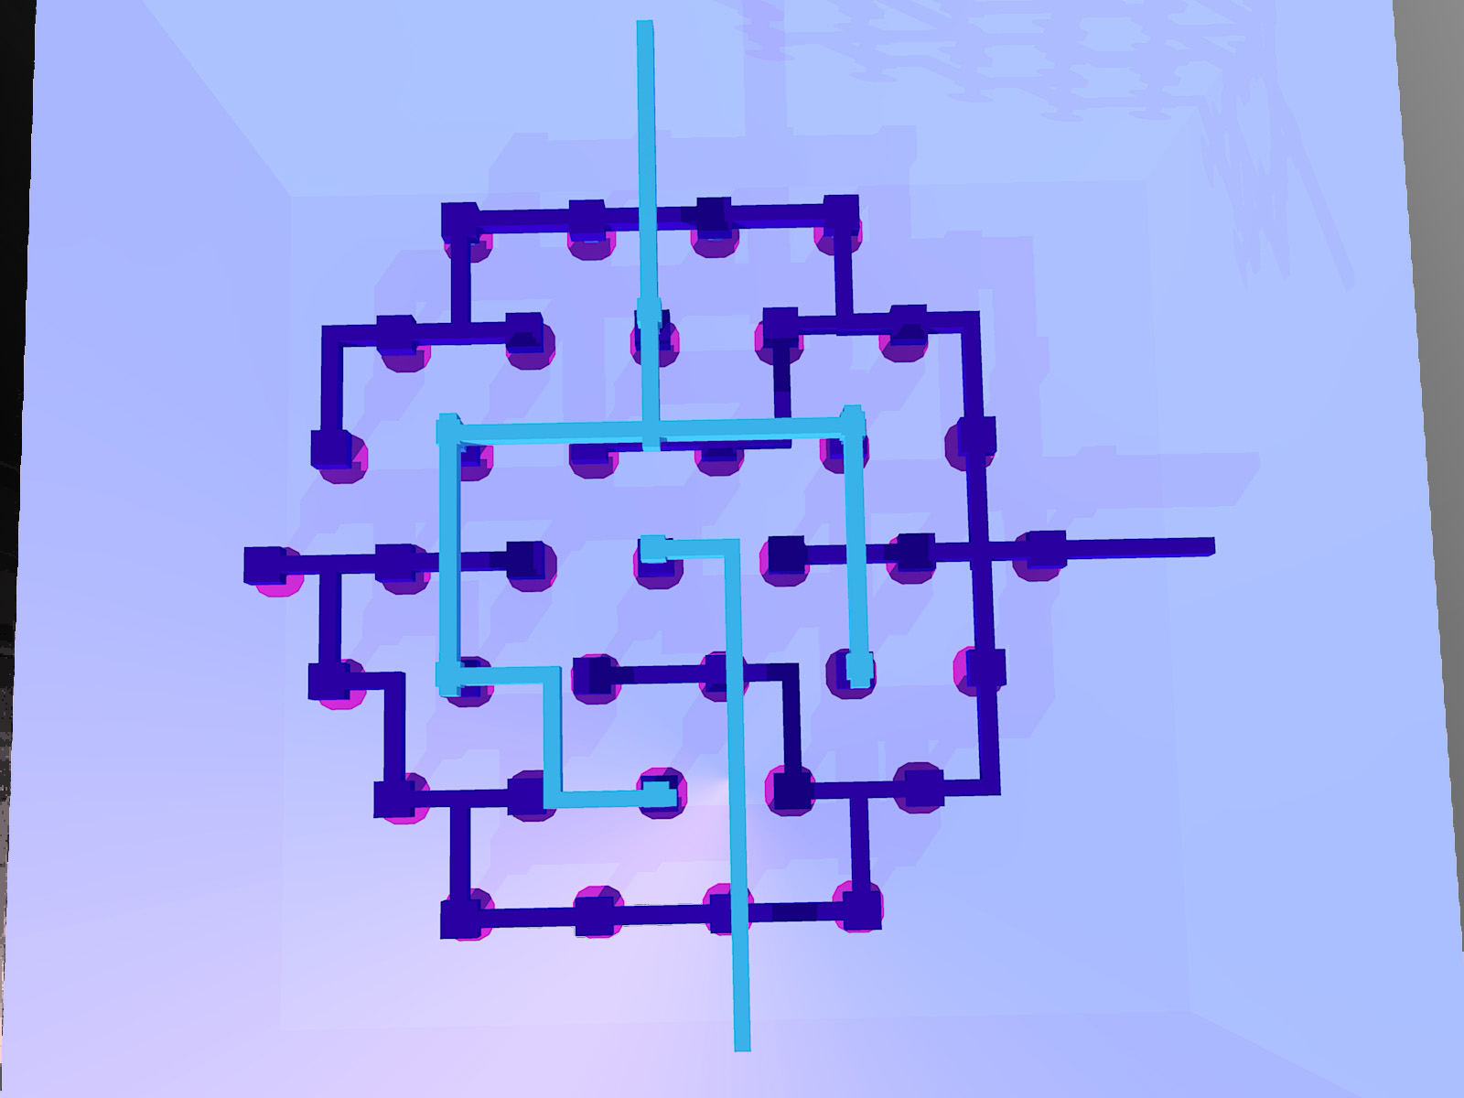
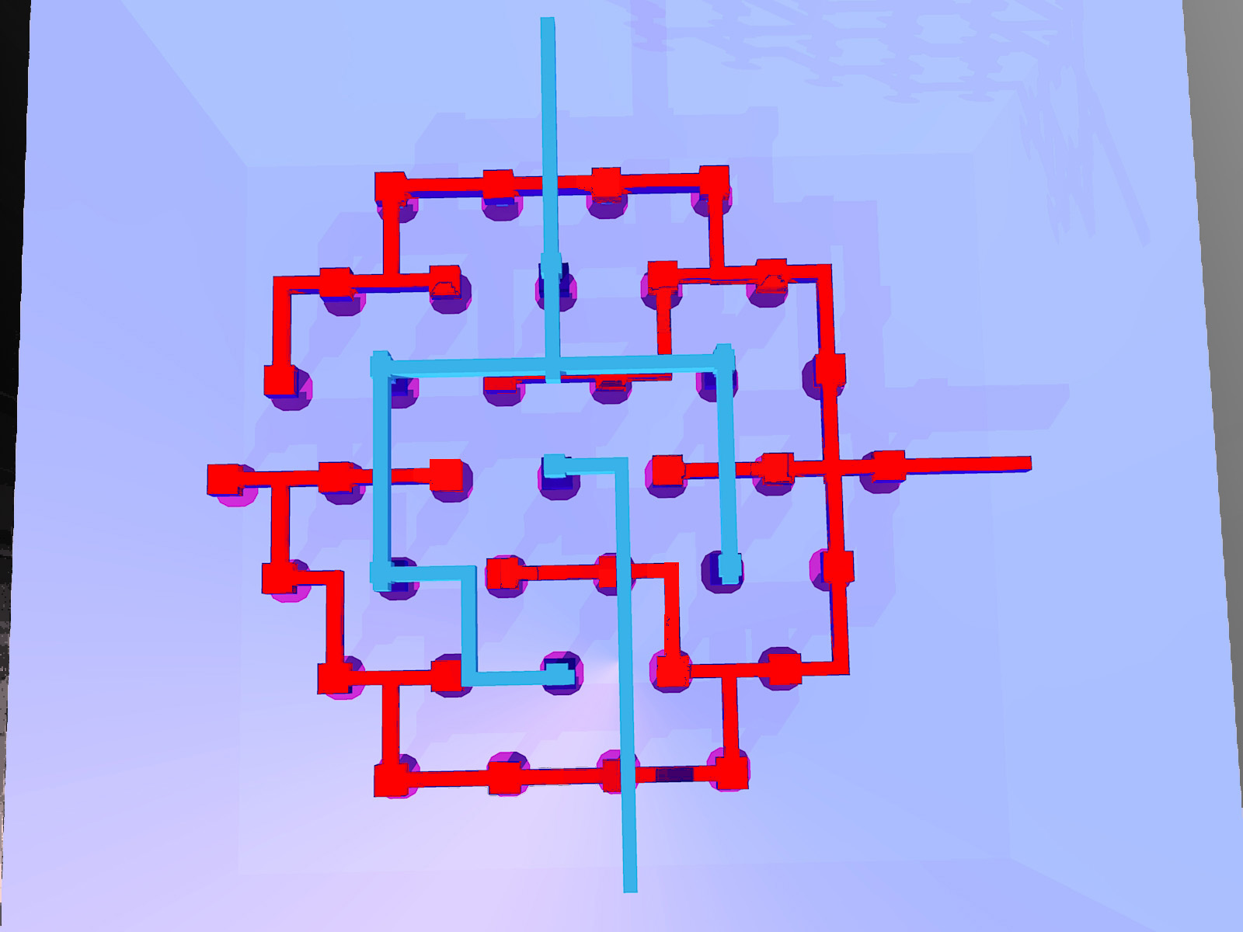
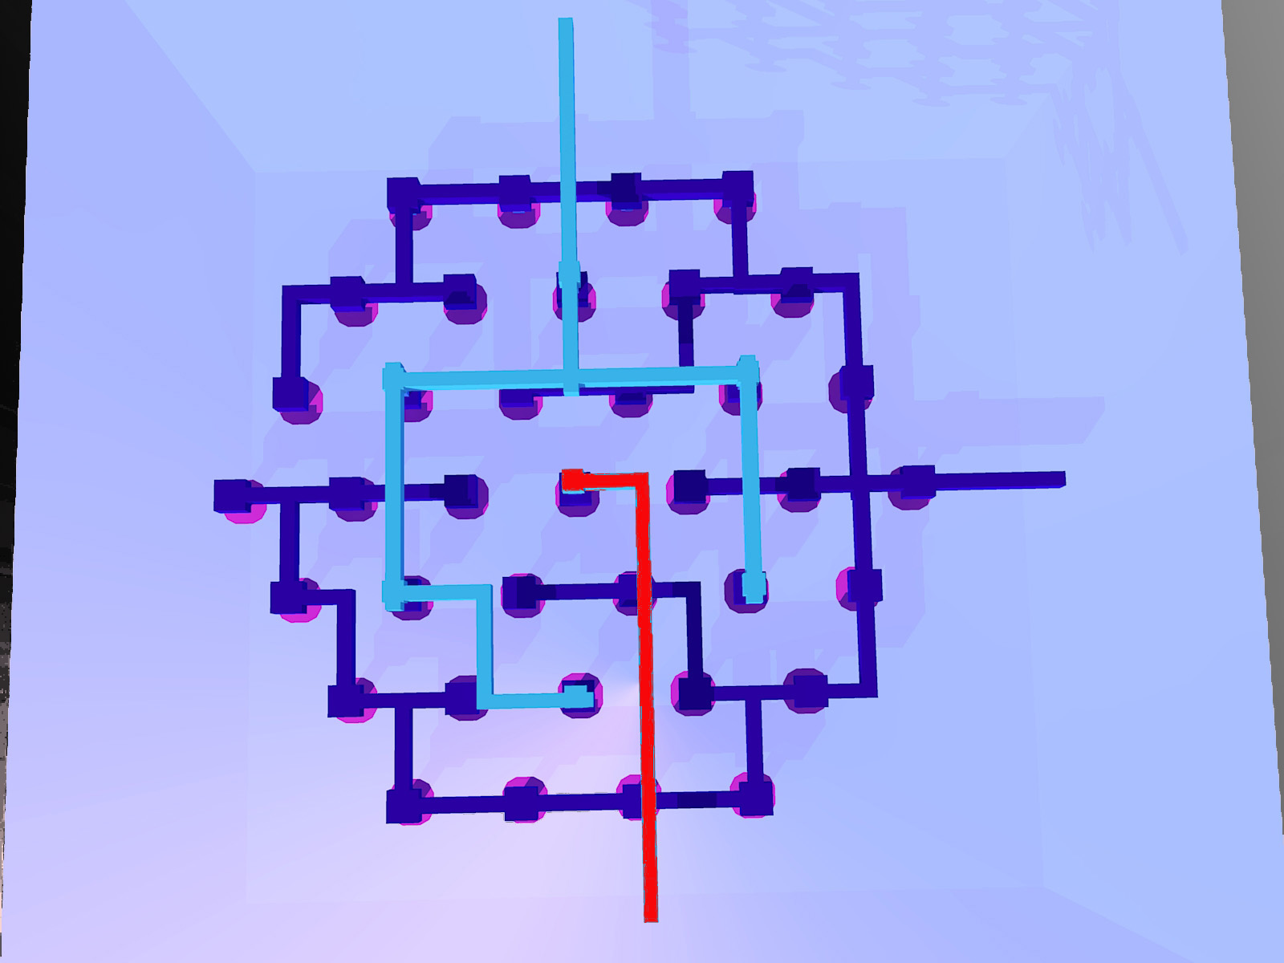
Multi-Via Concept for XFEL
Via-Via: 3μm
Mid Gain
High Gain
+- +- +- +- +- +- +-
+- +- +- +- +- +- +- +- +- +- +- +-
+- +- +- +- +- +-
Low Gain

Slide 12
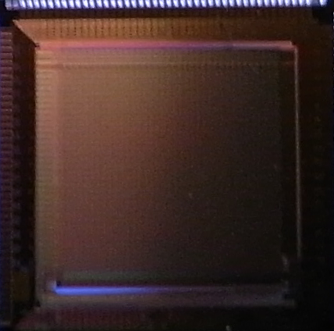
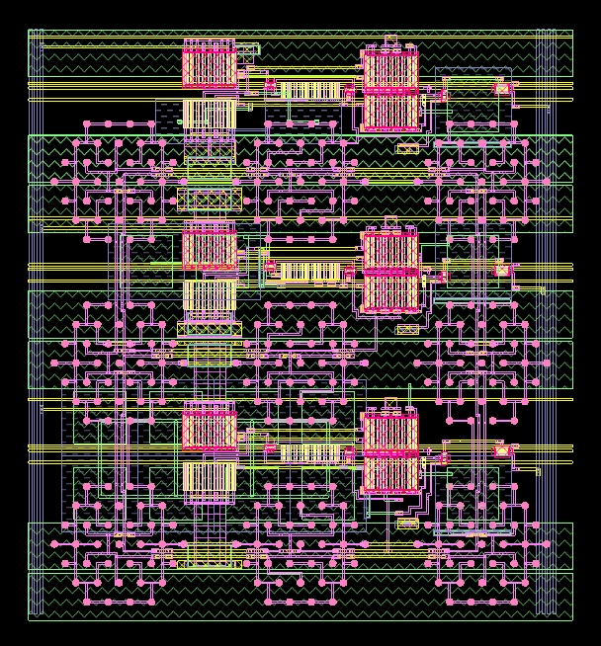
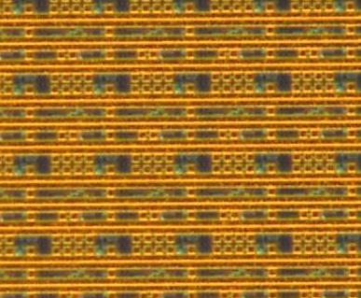
Layout in 2009-1 chip
A TEG with 32 x 32 pixels
(5 x 5 mm²)
Via Array
Pixel 85.8 x 85.8 um

Slide 13
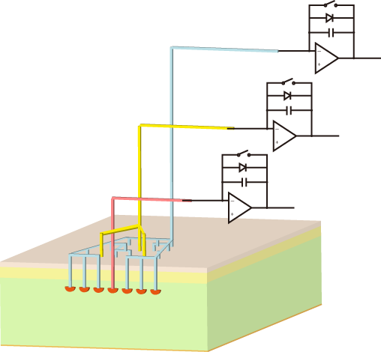
Pixel Core
Gain (∝N/Cf) | Via | Cf | Relative Gain
High | 270 | 50 | 480
Mid. | 54 | 200 | 24
Low | 9 | 800 | 1
Charge Amps and S/H
Most of charge to high-gain amp.
lower kTC noise
A little to low-gain amp.
Smaller Feedback capacitance
Smaller Pixel Size

Slide 14
Signal gain of FY09-1 chip
Experiment with electrical input
FZ SOI
high
mid.
low
100 Me-

Slide 15
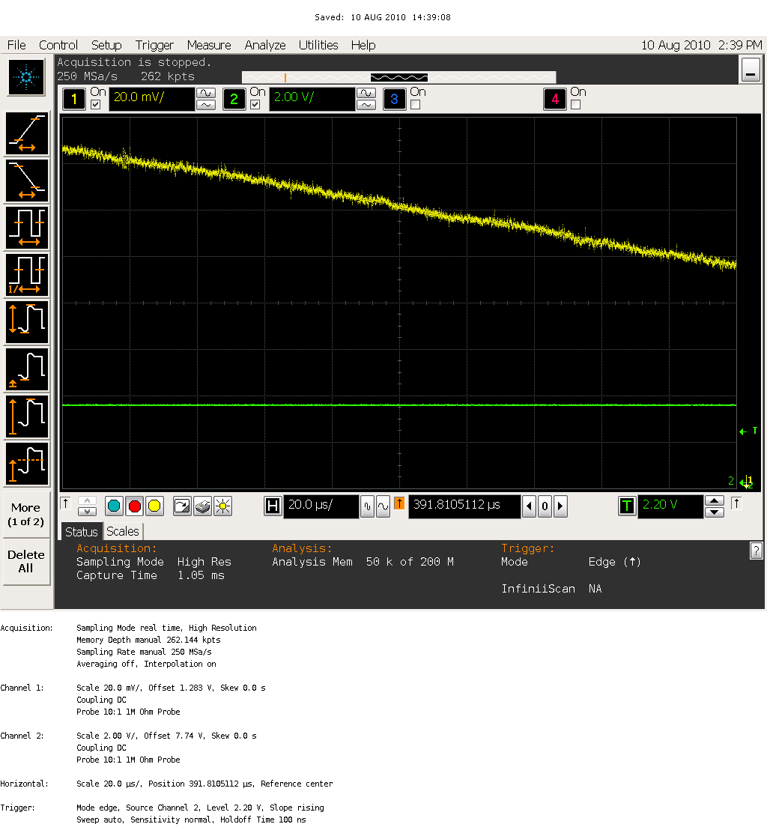
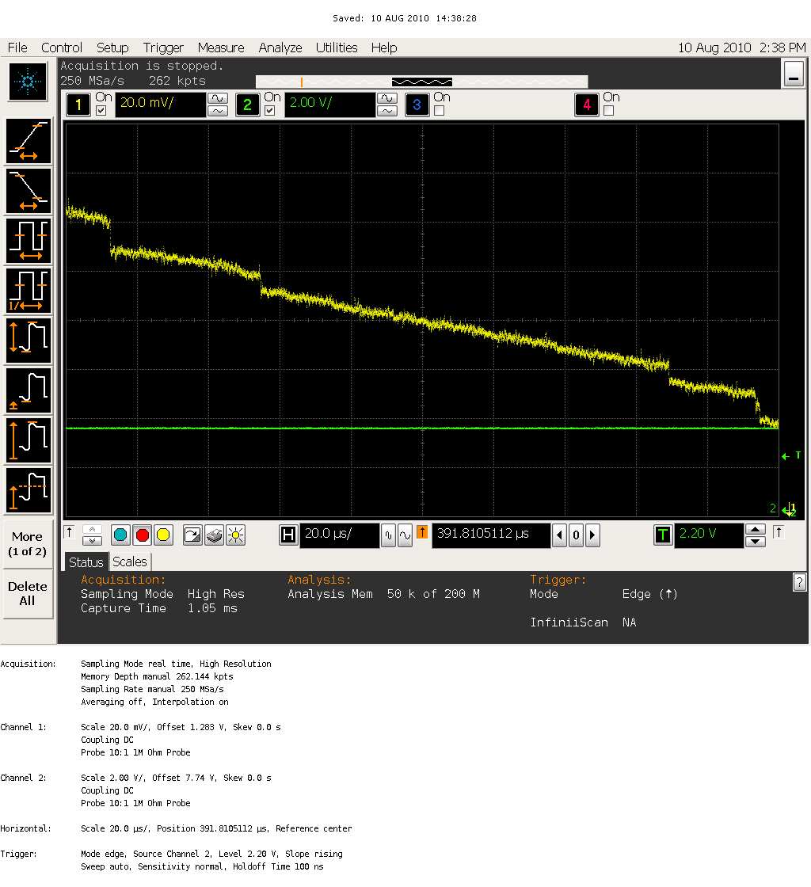
MVIA with FZ SOI wafer
2010-8-10：taken by Omodani
Leak Current
Single Photon of Mo K (18-19 keV)
Hor. 20 usec/div
Vert. 20 mV/div

Slide 16
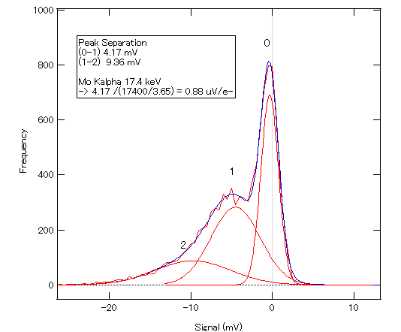
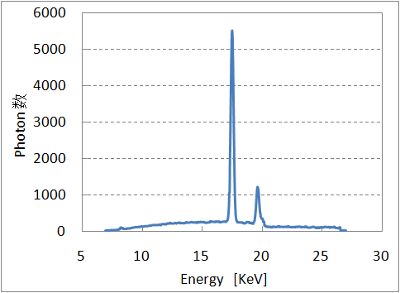
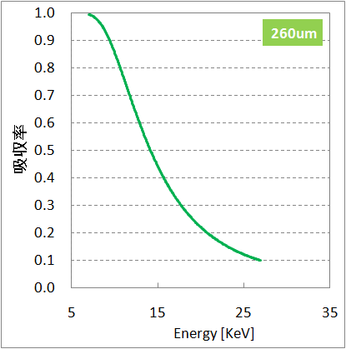

Depletion Depth Measurement preliminary bias 23 V for FZ SOI
Mo Kα
photons/pixel/sec
Q.E.
0.88 uV/e- for high gain
Mo Kα 60 %
E_{ph,effective} = 15.3 keV
Henke table
83 mV/msec
$$V_{obs}≒G_{det} \int{N_{0}\left(E_{ph}\right) QE\left(E_{ph}, W_{depletion}\right)\frac{E_{ph}}{W}}dE_{ph}$$
Experiment
QE_{exp} = 38.4 %
Theory for 260 um
QE_{theory} = 37%

Slide 17
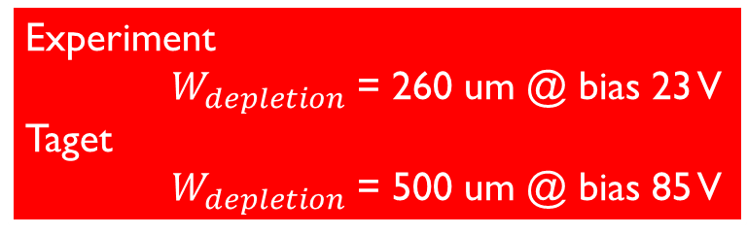
Radiation Damage and Q.E.
Thicker Depletion solve both the issues
Annual Fluence 30 Mrad
  Active Layer radiation hardness: 150 krad
レントゲン1000万～1億回分
Front-illumination
Experiment
$W_{depletion}$ = 260 um @ bias 23 V
Taget
$W_{depletion}$ = 500 um @ bias 85 V
Active Layer (transister etc.)
Photodiode (depletion)
Depletion Depth
Back-illumination
Notes:
写真撮影時の照射線量 1Rとして、10^14 photon/mm^2 -> 8.6 x 10^6 R （75000Gy）
大体1000万回程度

Slide 18
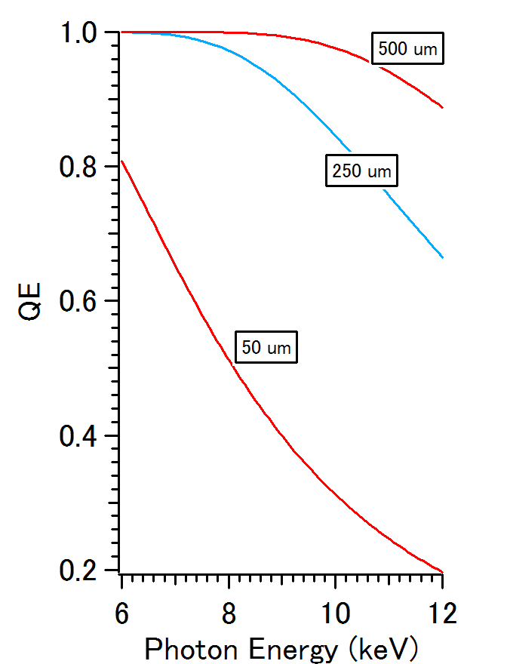
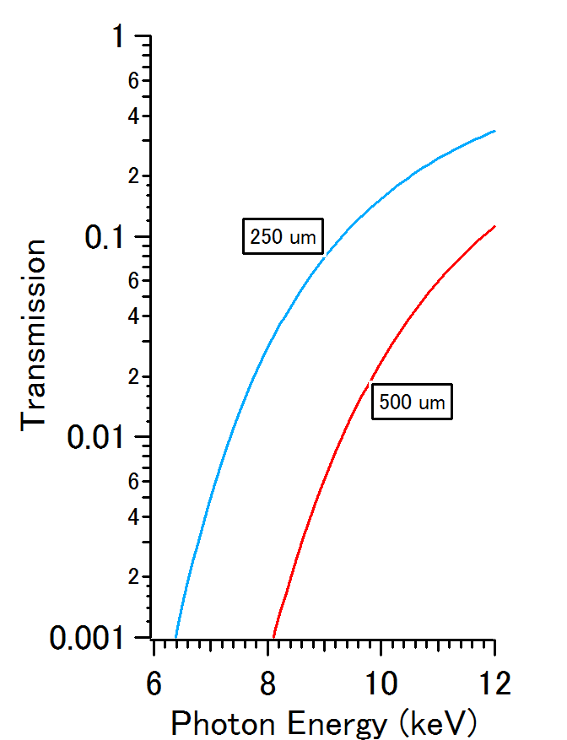
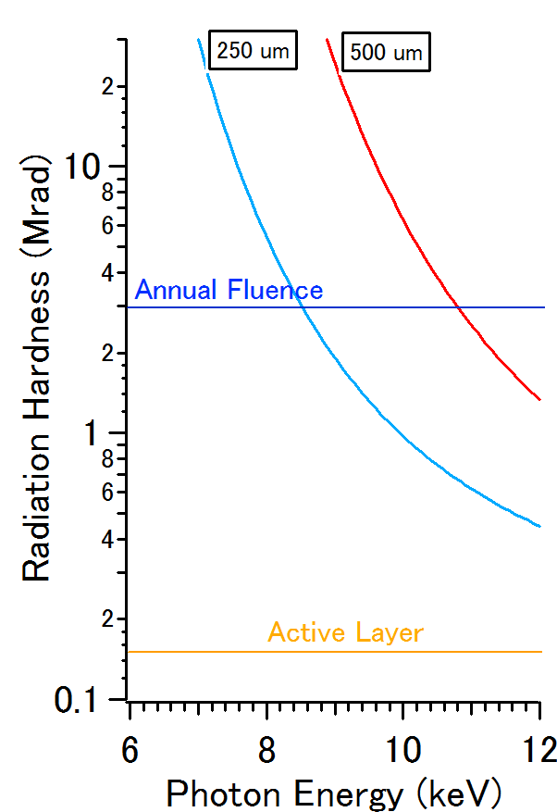

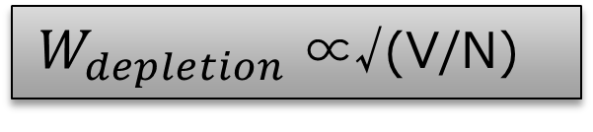
Q.E. and Radiation Hardness vs.
Depletion Depth ($W_{depletion}$), and Photon Energy
$W_{depletion}$ ∝√(V/N)
CZ wafer
FZ wafer
Phase I target

Slide 19
SYSTEM Development
Phase I: Single module detector
2010.4-2011.3
Phase II: Tiled Detector
2011.4-2012.3

Slide 20
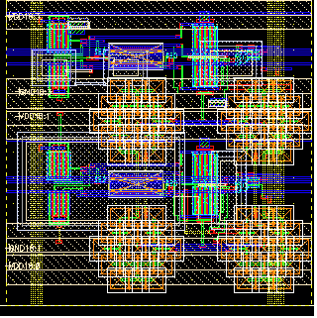
50 x 50 um Dual Gain MVIA pixel
Pixel | Shape | 50 μm square
 | Type | 2 gain Multi-via pixel
 | Noise | 100 e- (0.061 eq. photon@6 keV)
 | Full Well | 50 Me- (30 000 eq. photons@6 keV)
 | Depletion Depth | > 500 μm

Slide 21
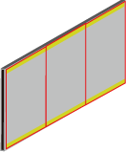
MVIA Detector (Dual Gain)
 |  | Target Performance
Sensor | Size (max) | 32 mm x 64 mm
 | Pixel Number | 640 x 426 (273k) / reticule 640 x 1278 (818 k) / die
 | Input (address) | 5 Serial line @ 100 MHz
 | Input (timing) | 3 (start, store, idle start)
 | Input (bias) | 1
 | Output node | 2 / reticule (high & low) 6 / module
 | off-chip ADC | 6 ch ADC (ENOB 11bit) 20 MS
Die has 3 reticule domains.
X-ray
(Flip chip)
I/O pads for wire-bonding
Notes:
縦
*print (512+2^7)*0.050
32
*print 512+2^7
640
横
*print (512-2^6)*0.050
22.4
*print (512-2^6)
448
読み出すべきピクセル数/sec
*print 640*448*60
1.72032e+07
17 Mpixel/sec

Slide 22
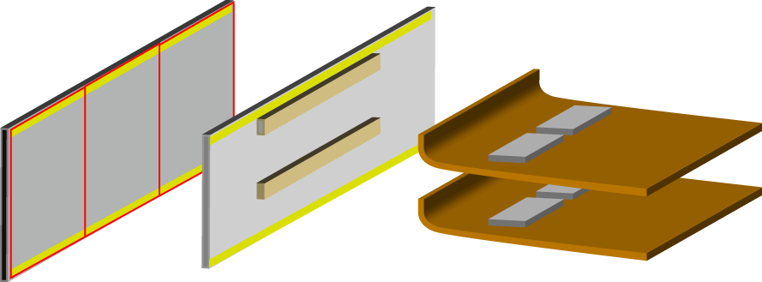
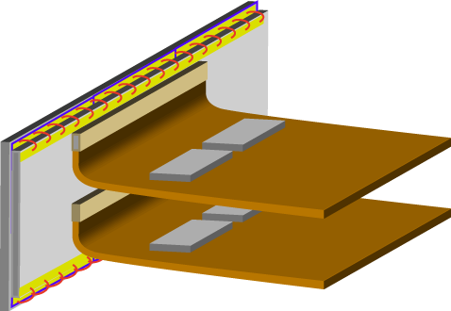
Packaging
Die (32 mm x 64 mm)
3 reticule units
I/O pad on top and bottom
Flip chip
Package
low height profile to meet industry standard
Analog Front-end
ADC and Control Logic onto flexi cables

Slide 23
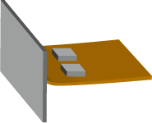
MVIA Phase I (-2012.3)
Air
Cameralink base config.
FPGA
Ultra-high Vacuum
11 bit ADC + gain info. (1bit) = 12 bit /pixel
0.82 M pixels
60 frame/sec
0.59 Gbps
Serial Data Transfer
Trigger
Power
CPLD & ADC
Notes:
*print 640 * 426 *3*60*12
5.88902e+08

Slide 24
MVIA Detector (-2013.3)
32 Array
 |  | Target Performance
System | Image Area | 256 mm x 256 mm
 | Tiling | 4 x 8
 | Pixel Number | 5.1 k x 5.1 k
 | Dead area | < 0.8 mm
 | Vacuum | <10^-7 Pa
 | Cooling | Water
Die
Notes:
横
15 x 20 mm 0.076 mm pixel
0.076*256 = 19.456
60 mm -> 256*3 = 768
768*4=3072
縦
192*0.076=14.592
192*

Slide 25
Conclusion
X-ray Free Electron Laser Project at SPring-8
  Detector Requirements
Multi-via Pixel Concept
  Charge division for higher dynamic range
Experimental Results
  Gain
  Depletion depth
    260 um achieved
    500 um anticipated
  Radiation hardness
    30 Mrad (Si) with some limitation
System Development

Slide 26
Collaborators
KEK
  Yasuo Arai, and SOIPIX collaboration
Private Sector
  OKI Semiconductor
  Rohm
  A-R-Tec Corp
  Kyocera

Slide 27
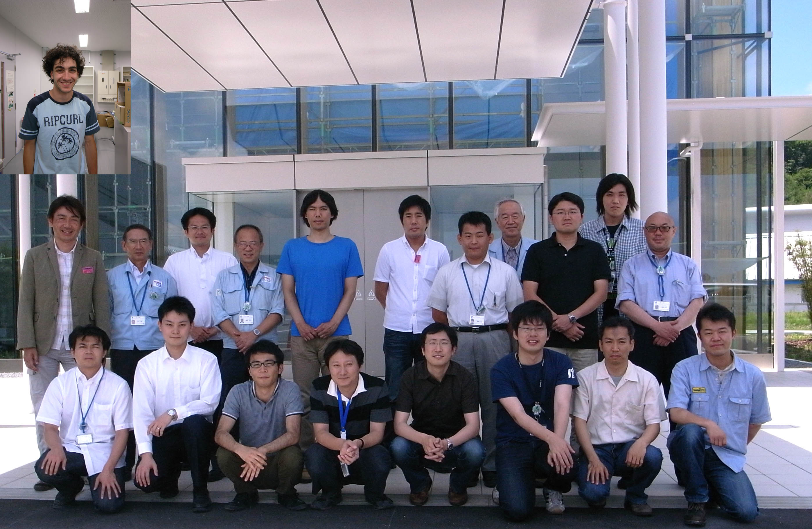
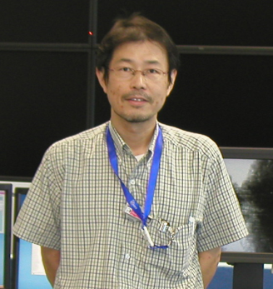
Detector Development Members
K. Kobayashi
T. Tatsumi
M. Omodani
H. Miyazaki
T. Kameshima
T. Hatsui
Y. Kirihara
T. Kudo

Slide 28
SPARE SLIDES

Slide 29
Remaining Issues
IR drop in large area format

Slide 30
IR drop
Power consumption
Each amp. 100 uA 1.8 V
Heat
Operation < 0.1 % yield 0.3 W
IR drop
0.5 V with current process
300 W (peak)
2 amp/pixel
VDD & GND
Add 5th Metal Layer
Quasi differential output
Lower current operation
IR drop < 130 mV
Notes:
print 818000*100*10^-6*2*1.8
294.48

Slide 31
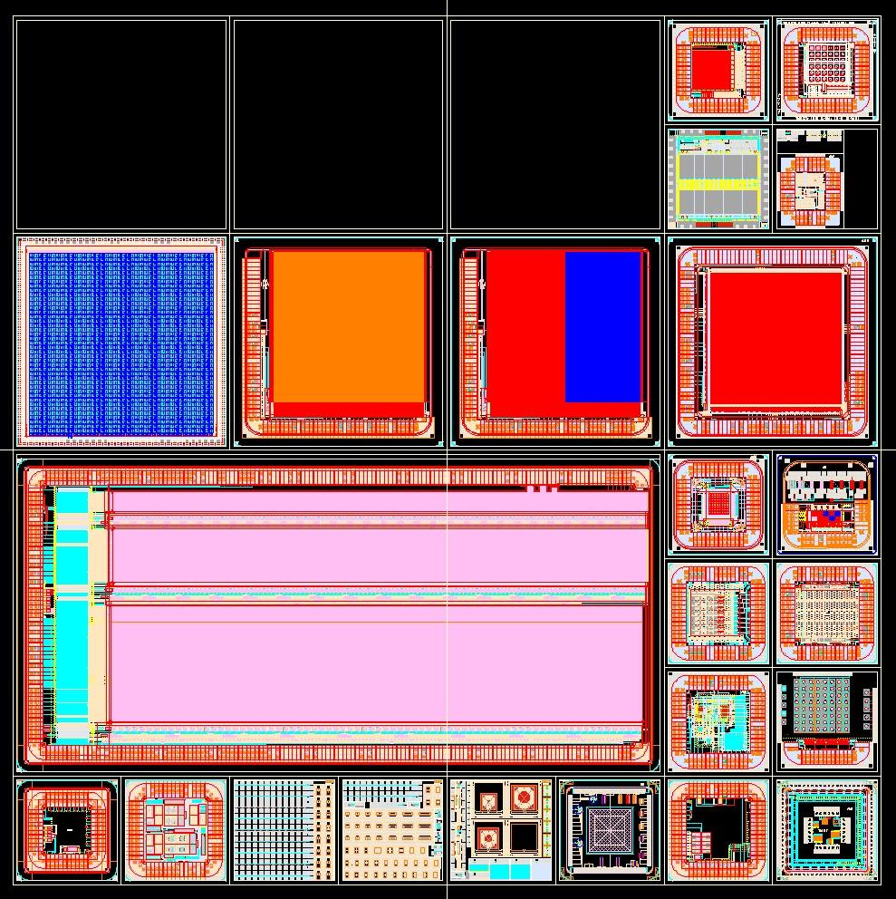
2010-1 Submission
Experiment the large area format to solve
  IR drop
  dummy output
RIKEN
MVIA chip
15 mm
16 mm
VDD & GND

Slide 32
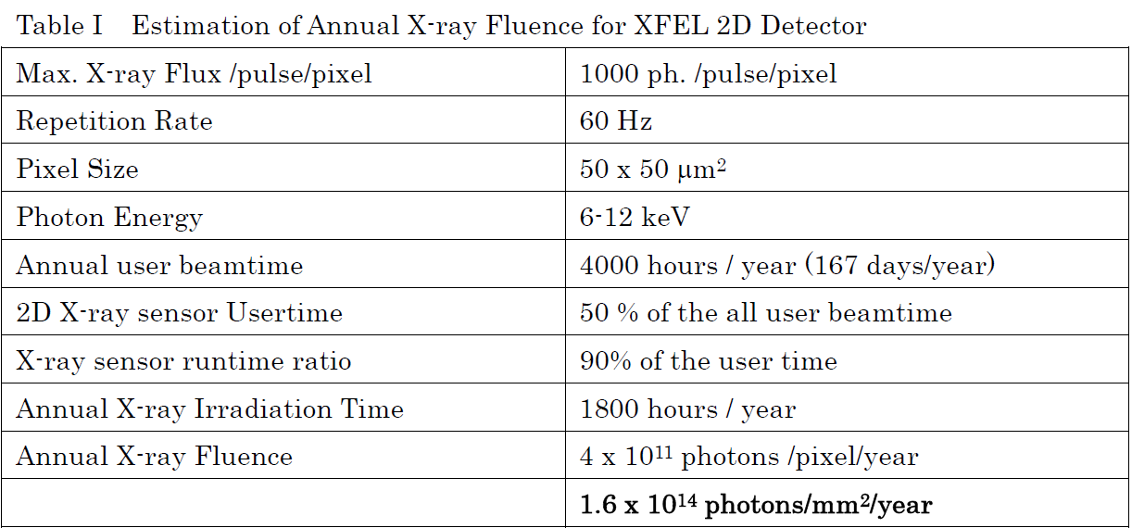
Radiation Hardness
Requirement
Device Life > 1 year
1.6 x 10¹⁴ photons (12 keV) /mm² = 30 Mrad (Si)

Slide 33
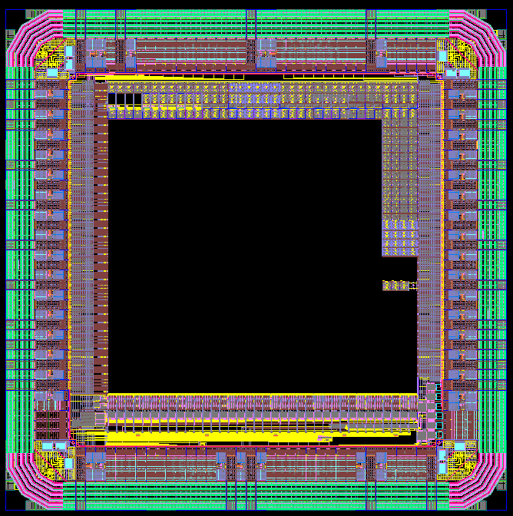
FY09
Guard ring widht 300 um
I/O pads 100 um x 100 um
M2-M3-M4 only

Slide 34
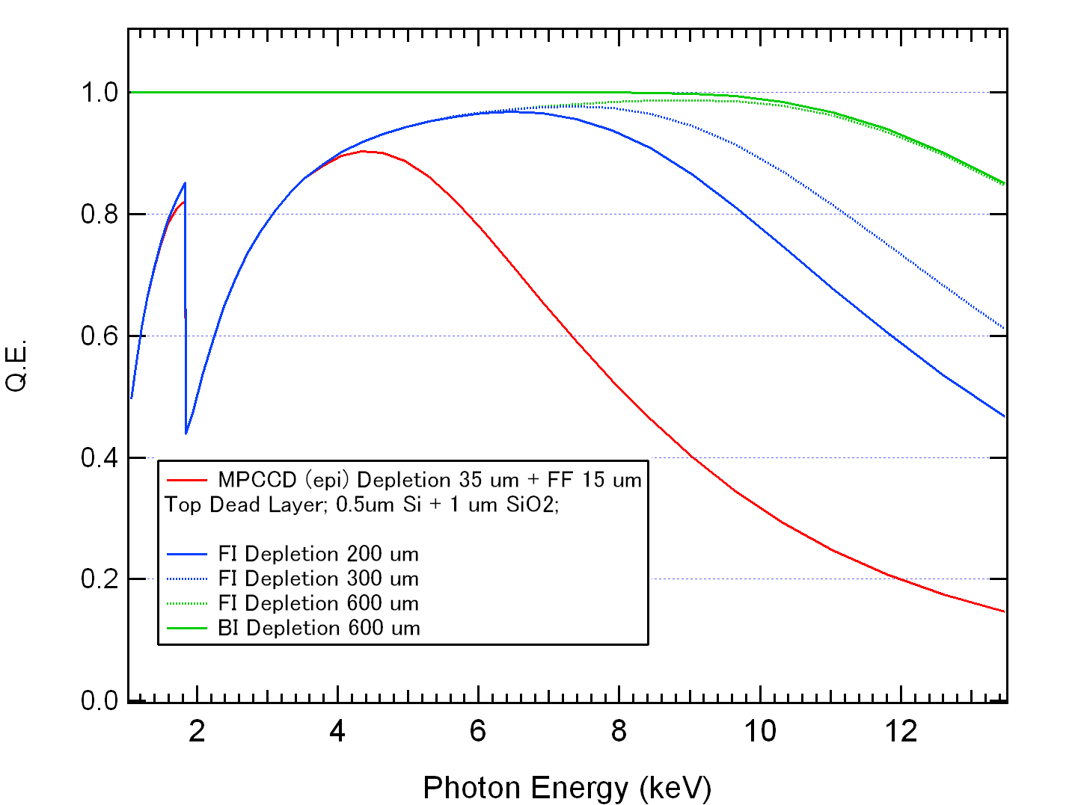
QE Improvement
Phase III
  MPCCD (high res.)
    Feasibility study has just started with free samples
    Targeted to be ready within FY2011
  MVIAPIX
    Now under feasibility study
    Production date
      Not clear
This Develop.
MPCCD Phase III

Slide 35
QE Improvement
600 um
This Develop.
200-300 um
MPCCD Phase III
50 um

Slide 36
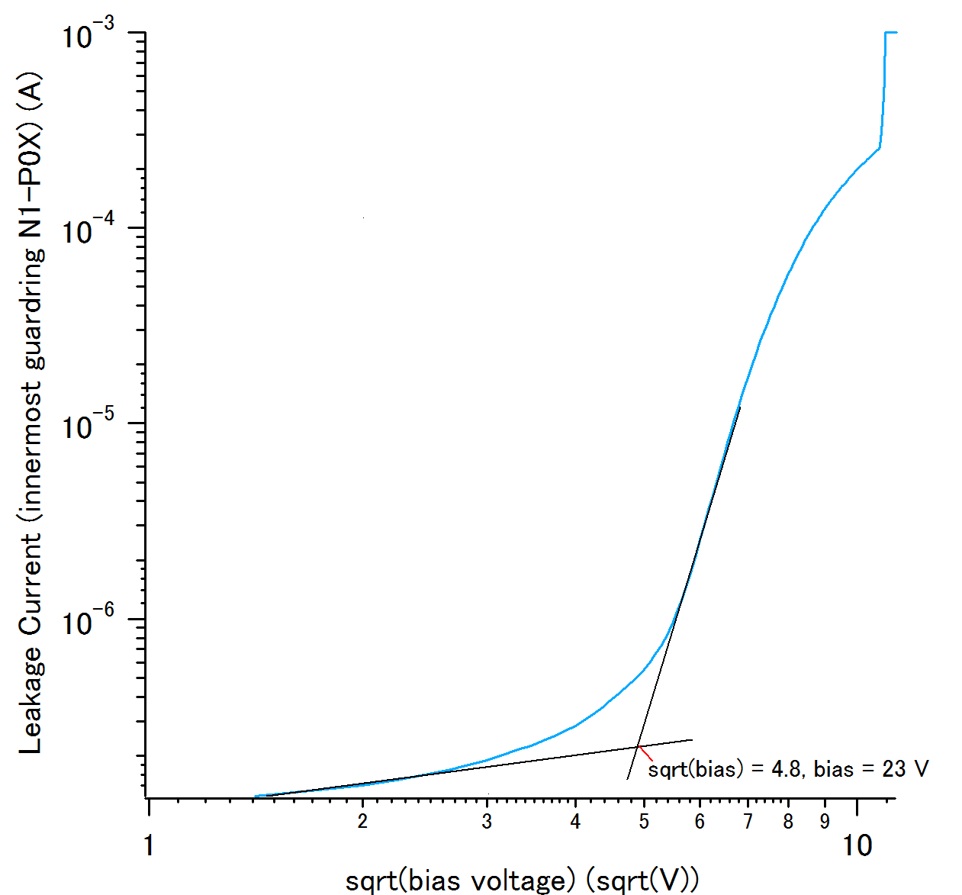
Leakage Current of guard ring

