Slide 1
Development of CdTe Pixel Detector with Window Comparator ASIC for High Energy X-Ray Application
Toko Hirono JASRI/Spring-8
H. Toyokawa¹, M. Kawase¹, Y. Furukawa¹,
T. Ohata¹, M. Sato¹, T. Honma¹, M. Takagaki¹,
H. Ikeda², G. Sato², S. Watanabe², T. Takahashi²
(¹JASRI/Spring-8, ²ISAS/JAXA)
PIXEL2010 Sep 6 – 10, 2010 Grindelwald, Switzerland
Notes:
Development of CdTe Pixel Detector with Window Comparator ASIC
for High Energy X-Ray Application
I’m hirono from Spring-8

Slide 2
Outline
Concepts of a new detector
Design of readout (ASIC)
Fabrication and Performances of detector
Results of beam test
Summary
Notes:
Outline of my talk.
First, I would like to talk the Concepts of a new detector
Then, explain the design of readout
Fibricaiton and perfonamces of new detector
Then, l would like to show the results of beam test
And summary.

Slide 3
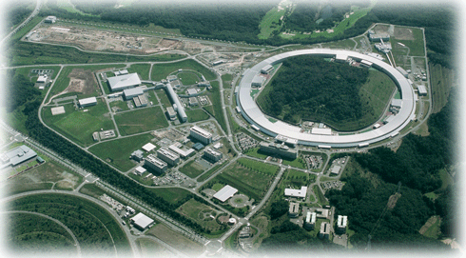
Concepts
SPring-8 is a synchrotron radiation (SR) facility with a 8GeV storage ring.
⇒ Experiments which requires high energy X-ray (-100keV) is one of the important experiments in SPring-8.
Notes:
SPring-8 is a synchrotron radiation (SR) facility with a 8GeV storage ring.
8GeV storage ring which can produce High energy X-ray
So, Experiments which requires high energy X-ray (-100keV) is one of the important experiments in SPring-8.

Slide 4
Concepts
Detector that is suite for SPring-8….
Photon-counting large-area-imaging hybrid pixel detector, like PILATUS, which are very powerful for SR experiments.
High sensitivity in high energy X-ray region (15 - 100keV)
  ⇒CdTe sensor
Function to cut high energy X-ray
  ⇒Readouts with a window-type comparator
Notes:
So, De…
Should High sensitivity in high energy X-ray region
(15 - 100keV)
we decided to use CdTe as sensor because..

Slide 5
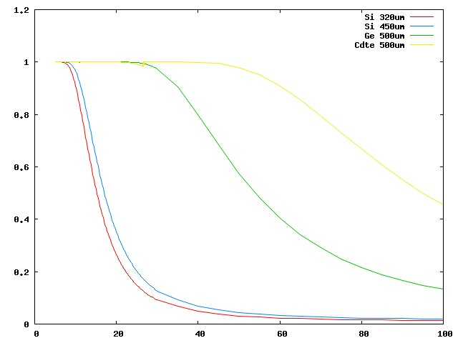
Concepts
Detection Efficiency of Sensors
100
CdTe 500μm
80
60
Detection Efficiency [%]
40
Ge 500μm
20
Si 320μm
(PILATUS)
Si 450μm
0
0
20
40
60
80
100
X-ray Energy [keV]
CdTe has almost 100% detection efficiency up to 40keV, more than 50% at 60-100 keV where Si has only 1.5%
Notes:
Compare to Si sensor, This is

Slide 6
Concepts
Detector that is suite for SPring-8….
Photon-counting large-area hybrid pixel detector, like PILATUS, which are very powerful for SR experiments.
High sensitivity in high energy X-ray region (15 - 100keV)
  ⇒CdTe sensor
Function to cut high energy X-ray
  ⇒Readouts with a window-type comparator
Notes:
So, De…
Should High sensitivity in high energy X-ray region
(15 - 100keV)
we decided to use CdTe as sensor because..

Slide 7
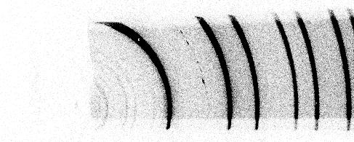
Concepts
Diffraction pattern of Si with lower-energy comparator only
(without higher-energy comparator)
Lower energy comparator at 30.8keV
Monochromator at 37.8keV
Without higher-energy comparator, higher order X-ray from monochromator was mixed with the target energy X-ray in the detected image.
⇒Window-type comparator is required for low background images
113keV
(3rd order of 37.8keV)
37.8keV
(Target energy)
Notes:
For example, this is
Lower com…
There are diffraction pattern of 37.8keV, but,

Slide 8
Concepts
3 steps to realize a large area imaging detector
SP8-01
SP8-02
SP8-03 (final design)
Pixel size : 200um x 200um
Number of pixel: 16 x 16 pixels
Chip size : 5mm x 5mm
180um x 180um
32 x 16 pixels
10mm x 5mm
10mm
…….
5mm
Single chip
2 x2 chips/module
Small chip, large pixel
ASIC with many parameter switches
2 side buttable
Nov. 2008-2010
Multi-chip module, small pixel
Optimized ASIC
3 side buttable
2010-2011
Large multi-chip module
4 side buttable
2012-2013
Notes:
We planned
We begin with

Slide 9
Concepts
Specification of SP8-01
Sensor
  CdTe
  200 x 200 um/pixel, 16 x16 pixels/chip
Contacts of sensors
  In/CdTe/Pt-pixel, Al-pixel/CdTe/Pt, Pt-pixel/CdTe/Pt
  Gold-stud bonding
Readout with..
  Analog amp. with time constant less than 100nsec
  Readable both positive and negative charge
  Switchable and adjustable gain: 15keV-40keV, 30keV-100keV
  Poll-zero circuit and offset adjustor
  Window-type comparator
  20 bits counter
Notes:
should

Slide 10
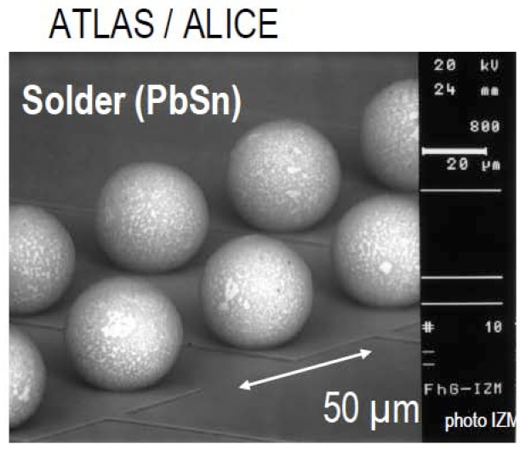
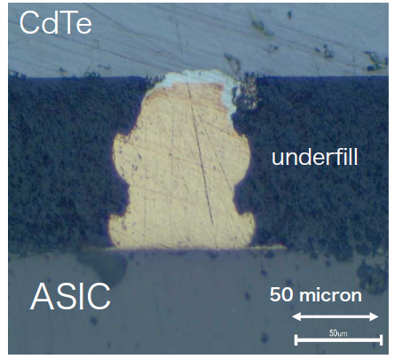
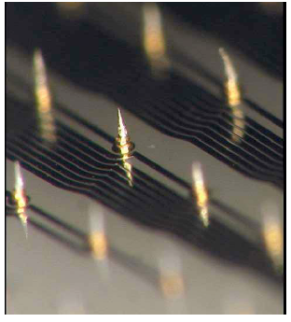
Concepts
Gold-stud bonding
Bump bonding
  Wafer level process
  High temperature and high pressure
  ◎ Si
  △ CdTe
In/Au stud bonding (Developed by JAXA)
  Chip level process
  low temperature and soft process
  ◎ CdTe

Slide 11
Concepts
Specification of SP8-01
Sensor
  CdTe
  200 x 200 um/pixel, 16 x16 pixels/chip
Contacts of sensors
  In/CdTe/Pt-pixel, Al-pixel/CdTe/Pt, Pt-pixel/CdTe/Pt
  Gold-stud bonding
Readout with..
  Analog amp. with time constant less than 100nsec
  Readable both positive and negative charge
  Switchable and adjustable gain: 15keV-40keV, 30keV-100keV
  Poll-zero circuit and offset trim
  Window-type comparator
  20 bits counter
Notes:
should

Slide 12
Design of ACIS
To realize all the requirements of the readout,
⇒ Custom-designed ASIC for SP8-01 was developed
Block diagram of readout for 1 pixel
R_{p2}
V_{bias}
SW(LG)
C_{p2}
R_{s2}
Photon
(E)
Low energy Threshold
High energy Threshold
R_{p}
6bit trim
Detector
Pos/Neg
C_{p}
C_{s1}
C_{s2}
Q(E)
V_{aout1}
V_{aout2}
C_{cal}
Pre-Amp.
Shaper
Window comparator
w/ 6bit trim
Counter
Test Pulse Input
Analog
Digital
Notes:
This is the block diagram of readout of one pixel
Gain switch.

Slide 13
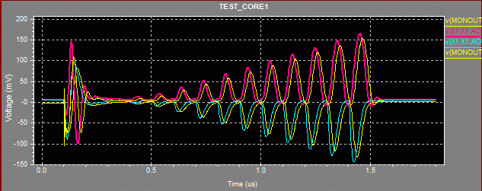
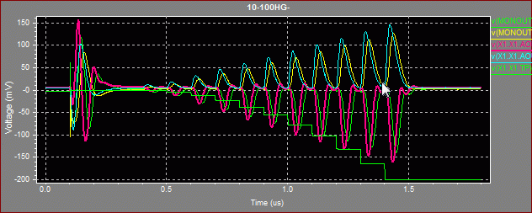
Design of ASIC
Result of Simulation of Analog Amp.
Pre-amp output
100
90
80
Shaper output
70
60
50
40
30
10
20
+charge, low gain
0.1usec
-charge, low gain
10
20
30
40
50
60
70
80
90
100
ASIC was simulated with input charge correspond to 10 -100keV in 100nsec
⇒All the parameter s of circuit was fixed to match requirements.
Notes:
This is simulation where test pulse correspond to 10 to 100 keV in 100nsec interval
Pulse can be detected. for – charge and + charge

Slide 14
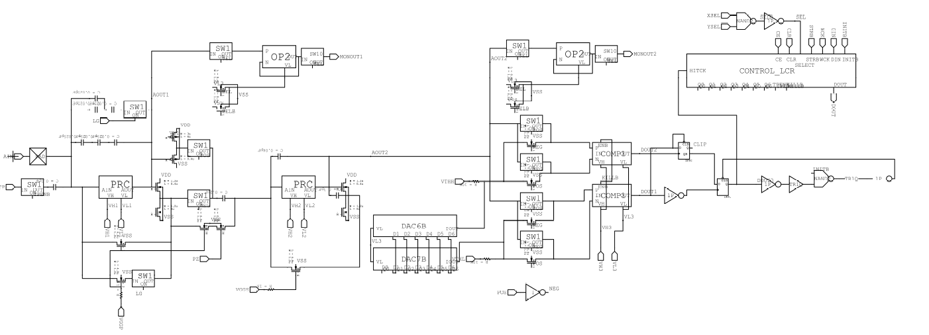
Design of ASIC
Circuit for 1 pixel
Counter
Pre-Amp monitor
Shaper monitor
Gain Switch
Charge switch
Shaper
Comparator w/ offset adjustor
Pre-Amp
Analog
Digital
Notes:
So, we implemented actual circuit.

Slide 15
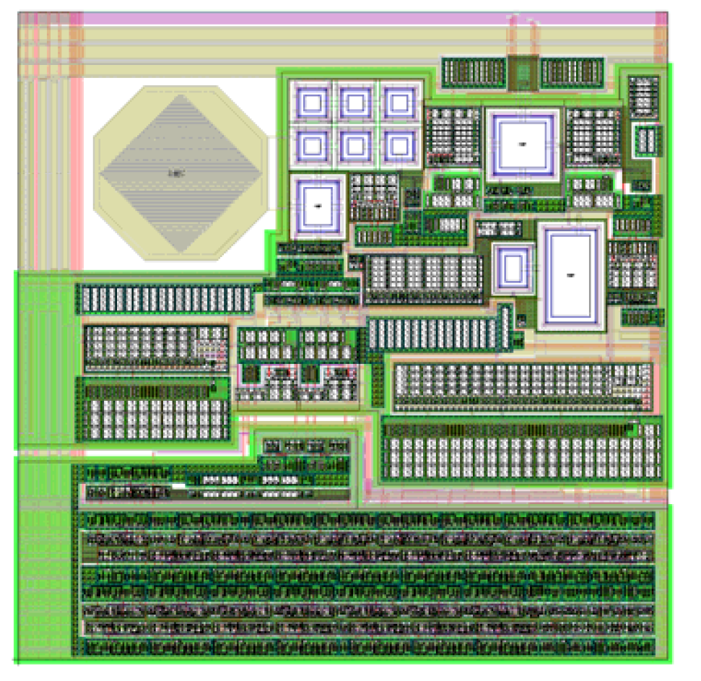
Design of ASIC
Layout of a single pixel
50μm
200μm
Analog
Digital
200μm
Notes:
And made a layout. in 200um x 200um
ASIC layout for 1 pixel . There is a 50u x 50u pad for gold stat bonding.

Slide 16
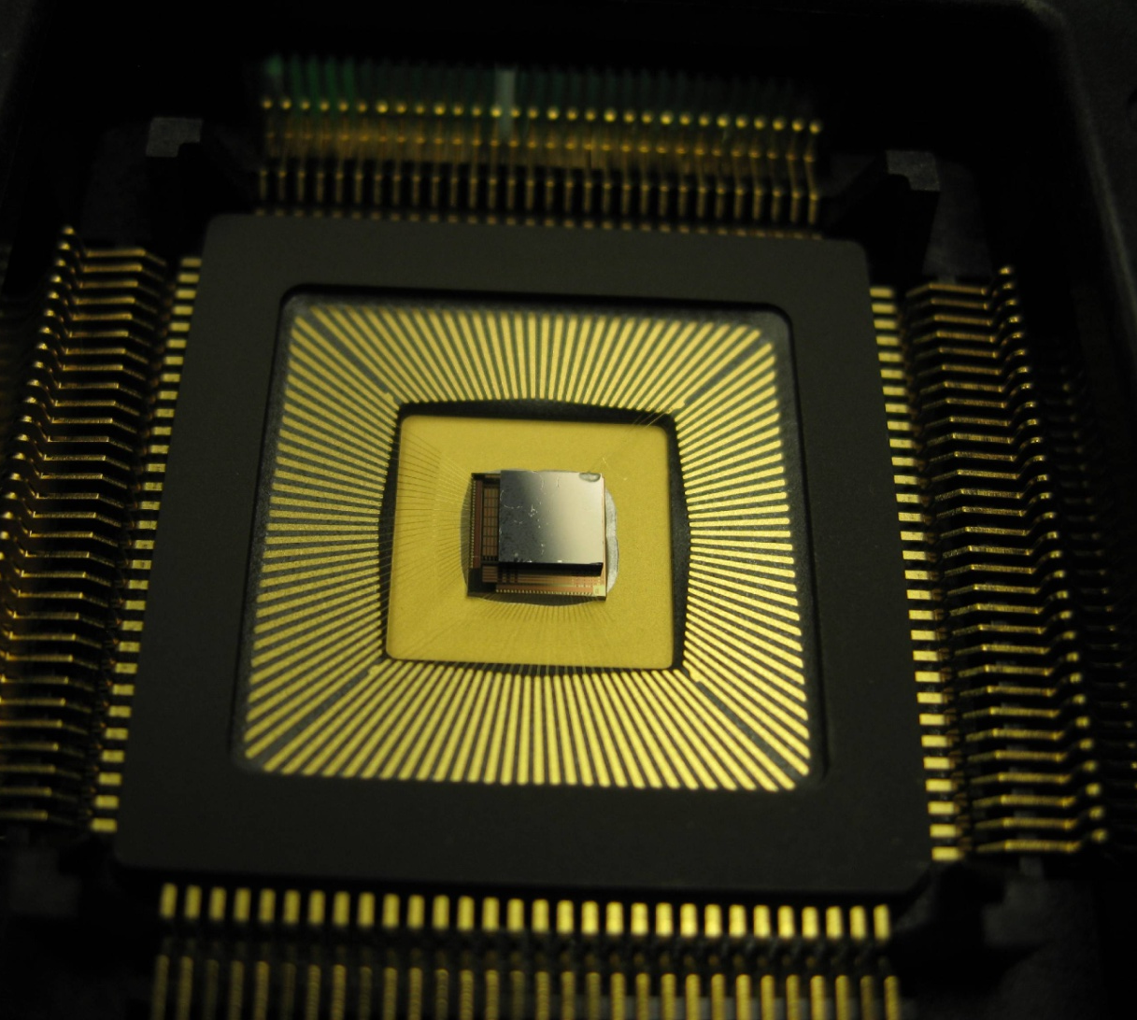
Fabrication of Detector
ASIC was fabricated
  TMC 0.25um
  5mm x 5mm
and CdTe was bonded to the ASIC.
  500um thick
  Gold-stud bonding
  3 types of electrode
    Pt-pixel/CdTe/Pt
    Al-pixel/CdTe/Pt
    In/CdTe/Pt-pixel
CdTe
ASIC
Notes:
ASIC was facilitated by TMC .25um processes and CdTe with 3 types of electrode was bonded to ASCI by gold-stat bonding,

Slide 17
Performance of ASIC
V_{bias}
Pre-Amp
Shaper
R_{p}
R_{s2}
Lower Threshold
Photon
(E)
Upper Threshold
Detector
Offset
C_{p}
C_{s1}
C_{s2}
Q(E)
V_{aout1}
V_{aout2}
V_{dout3}
C_{cal}
The output of analog monitor
TP
We input test pulse correspond to 30keV –charge, and observed pre-amp and shaper monitors
⇒We could observe pulse outputs from
ALL of pixels
Notes:
We input test pulse correspond to 30keV –charge, and observed pre-amp and shaper monitors We could observe pulse outputs from
ALL of pixels

Slide 18
Performance of ASIC
Time Constant of Readout
  Test pulse was counted by changing test pulse frequency.
  Counts of counter was as same as input pulse up to 5Mcounts/s
5 x 10⁶counts/s
Count [1/s]
0.6counts/hr
0
Test Pulse [1/s]
⇒Time constant was 200 nsec c.f. designed =100 nsec
⇒Background noise 0.6 counts/hr/pixel with window-comparator 20-30 keV
Notes:
So we measured the time constant of the ASIC by changing test pulse frequency.
Counts of counter was as same as input pulse up to 5 Mega counts per second.
So the time constant of ASIC was 200 nsec, where designed value was 100 nsec.
and background nose was .6counts per hour per pixel.

Slide 19
Results of Beam Test
Beam test was performed at BL46XU, BL14B2/SPring-8
Lower-energy threshold scan
⇒ to examine whether X-ray of
30 – 120 keV can be detected by SP8-01
Slits
SP8-01 : Al-pixel/CdTe/Pt
SR
Attenuator
Monochromator
X-ray was resized into 50um□ by 2 slits placed after monochromator.
Output of Shaper
Window scan
⇒ to demonstrate window comparator
Low energy th.
High energy th.
Counter

Slide 20
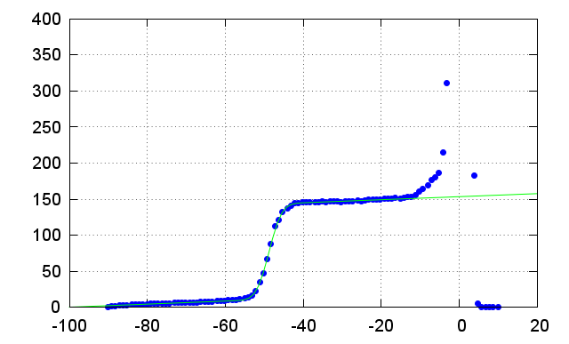
Results of Beam Test
Lower-energy threshold scan at 30keV
  S-curve at -49.5mV ⇒30keV
  The slop at 30keV corresponds to Equivalent Noise Charge of 360 e-
30keV
Noise floor
1.7keV=(ENC) 360 e
Beam intensity [k count/s]
Al/CdTe/Pt (-charge)
Gain : Hig Gain
X-ray Energy : 30keV
HV: -300V
Exposure time : 0.1s
←High energy
Lower Energy Threshold [mV]
Notes:
This is the result of Lower threshold scan,
S-curve here corresponds to 30keV
There is signal at higher than 30keV, because of high order of monochrometer,
So we extended scan range to higher energy.

Slide 21
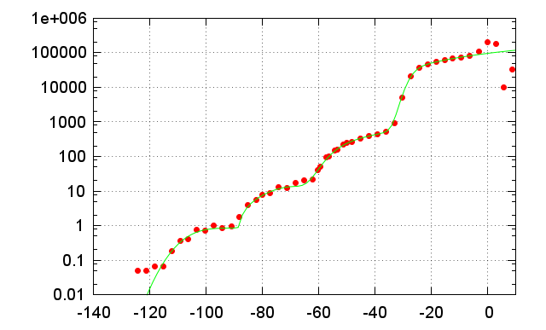
Result of Beam Test
Lower threshold scan
120keV
90keV
60keV
30keV
Noise floor
Al/CdTe/Pt (-charge)
HV : -500V
Gain : Low ,
(-66mV,-66mV)
Exp time: 5, 60sec
→X-ray up to 120keV was detected by SP8-01
Notes:
Low gainThen could see 2nd, 3rd, 4th order of mochromator.
We could know that the 120keV.

Slide 22
Results of Beam Test
Window scan
  Higher/lower energy th. was scan both in same time.
Al-pix/CdTe/Pt (-charge)
Gain : Hig Gain
HV: -300V
Exposure time : 1s
Window width :5mV
(3.2keV)
Intensity was normalized at peak.
⇒Window comparator worked fine.
Notes:
We scand both higher and lower energy at 15keV, to 70keV in high gain.
We could get enegy spectrum of beam.

Slide 23
Results of Beam Test
Energy linearity of readout
High Gain
Low Gain
Lower-energy Thresholds[mV]
Thresholds of window comparator [mV]
X-ray energy [keV]
X-ray energy [keV]
Linearity of high gain in 15-40 keV : 98%
low gain in 30-120keV: 90%

Slide 24
Summary
New pixel detector, SP8-01, was developed for high energy X-ray SR experiment.
  200 x 200 um/pix, 16 x 16 pix/chip of CdTe sensor
  Custom-designed ASIC with window-comparator
SP8-01 was performed as X-ray detector.
  Time constant: 200ns
  ENC : 360 e-, Background noise: 0.6cnt/hr/pix
  SP8-01 detected X-ray
    High Gain : 30keV-120keV
    Low Gain : 15keV-70keV (linearity of 98% in 15-40keV)
⇒Design of SP8-02 (small pixel, multi-chip module) was started.

Slide 26
Design of SP8-01
Simulated ENC
Equivalent Noise Charge
Capacitance of detector

Slide 27
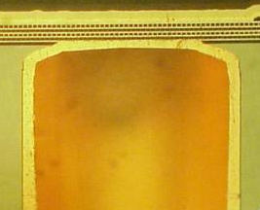

TSV (Through Silicon Via)
TSV technology has been developed for advanced Silicon devices having 3D stacking structure
Outsource
Top-side I/O pad
Pixel electrode
Top-side I/O pad
Insulator
Thickness
250μm
ASIC
Via hole
Conductive
layer
Conductive layer
Back-side I/O pad
Via hole
Φ80μm
The fabrication of the ASIC was depended on
the Silicon industries.

Slide 28
Introduction (Large area Flat Panel Detector)
By eliminating the dead space ・・・
CdTe
ASIC
Interface board
No wire bonding and no dead space
Bump bonding
The development of 4-sides buttable hybrid module is a key for a large area FPD.

Slide 29
Results of Beam Test
CdTe stability

Slide 30
Analog

Slide 31
Design of ASIC --Comparator --
V_{bias}
Pre-Amp
Shaper
Photon
(E)
R_{p}
R_{s2}
Lower Threshold
Upper Threshold
Detector
Offset
Q(E)
C_{p}
C_{s1}
C_{s2}
V_{aout1}
V_{aout2}
V_{dout3}
C_{cal}
Offset-adjustable window-type comparator
  Global lower/higher threshold are set to whole 256 pixels
  Each pixel can be adjusted the “offset” of thresholds
TP
Highter energy th.
>
Comparator input
FF
Lower energy th.
>
delay
FF
counter input
Offset trim

Slide 32
Design of ASIC --Analog--
V_{bias}
Pre-Amp
Shaper
R_{p}
R_{s2}
Lower Threshold
Photon
(E)
Upper Threshold
Detector
Offset
C_{p}
C_{s1}
C_{s2}
Q(E)
V_{aout1}
V_{aout2}
V_{dout3}
C_{cal}
Result of simulation of analog outputs
TP
Input charge -1.1fC
(correspond to 30keV X-ray photon )
Time [us]
Parameters (C,R,,,) of the analog circuit , which match the specification, were fixed using T-SPICE simulation
Notes:
First, we fixed the parameter of
This is a result of simulation that 30keV X-ray was goes in to Detector
Pre-amp and Shaper will outputs pulse like this

Slide 33
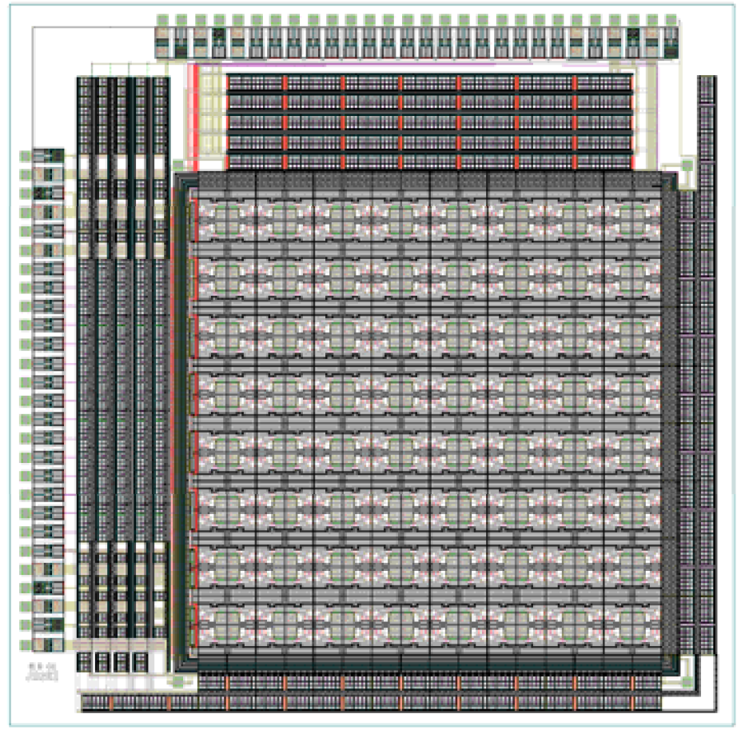
Fabrication of Detector
Layout of a chip
5mm
5mm
16pixel
16pixel
Notes:
いらない

Slide 34
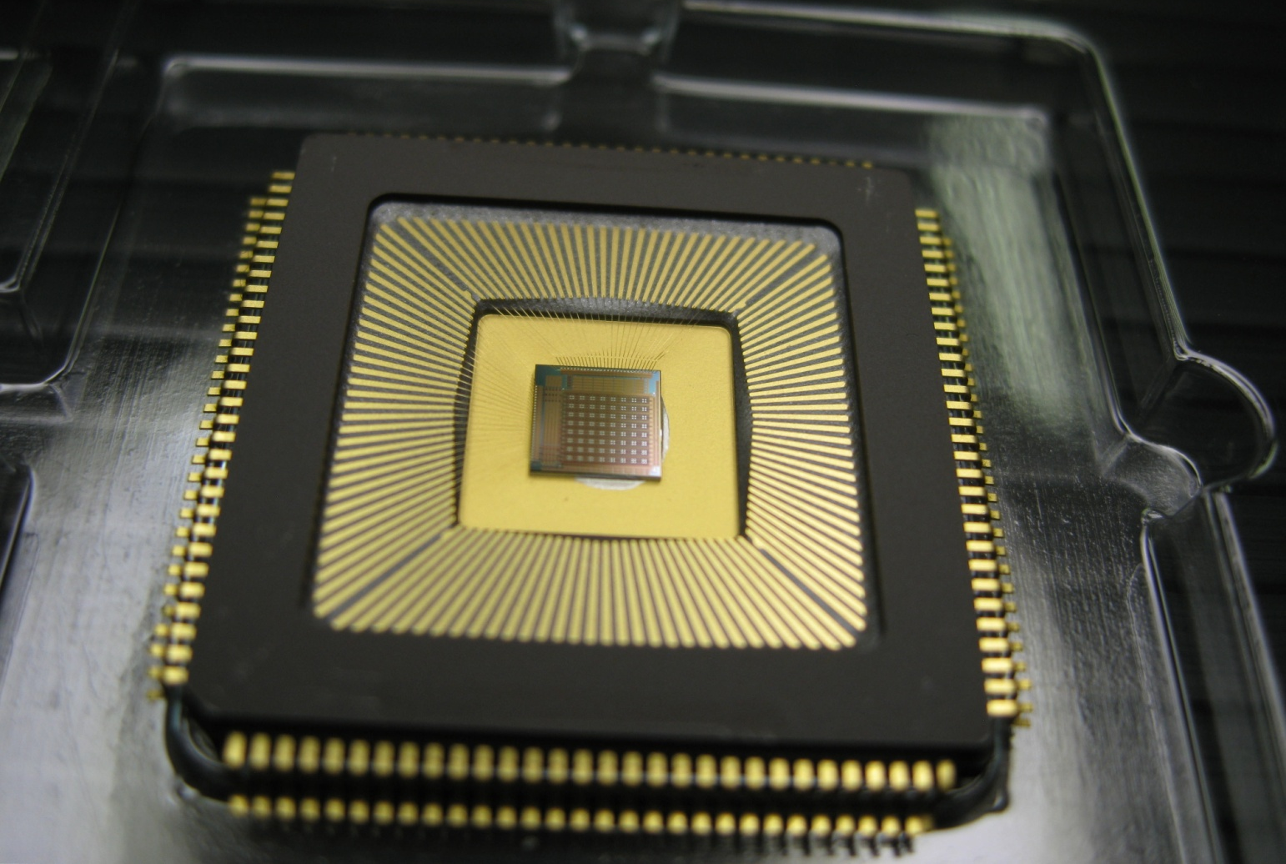
Fabrication of Detector
ASIC
  40 Chips was fabricated by TMC 0.25um
Notes:
なし

Slide 35
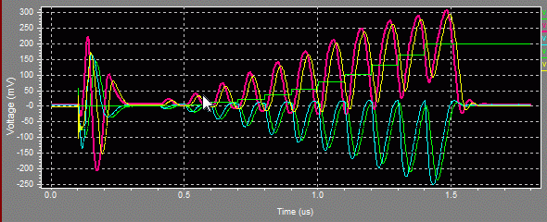
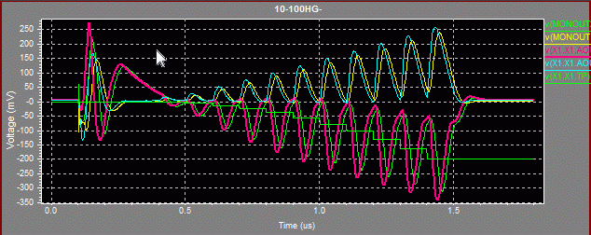
Design of Readout (ASIC) --Analog--
High Gain(10-40keV)
60
Pre-amp output
50
30
40
Shaper output
10
20
+charge
10
-charge
20
30
40
50
60
Notes:
And High Gain, up to 60 keV
1つでよいかも これは省略

Slide 36
Concepts
Gold-stud bonding
Bump bonding
  Wafer level process
  High temperature and high pressure
  ◎ Si
  △ CdTe
In/Au stud bonding (Developed by JAXA)
  Chip level process
  low temperature and soft process
  ◎ CdTe

Slide 37

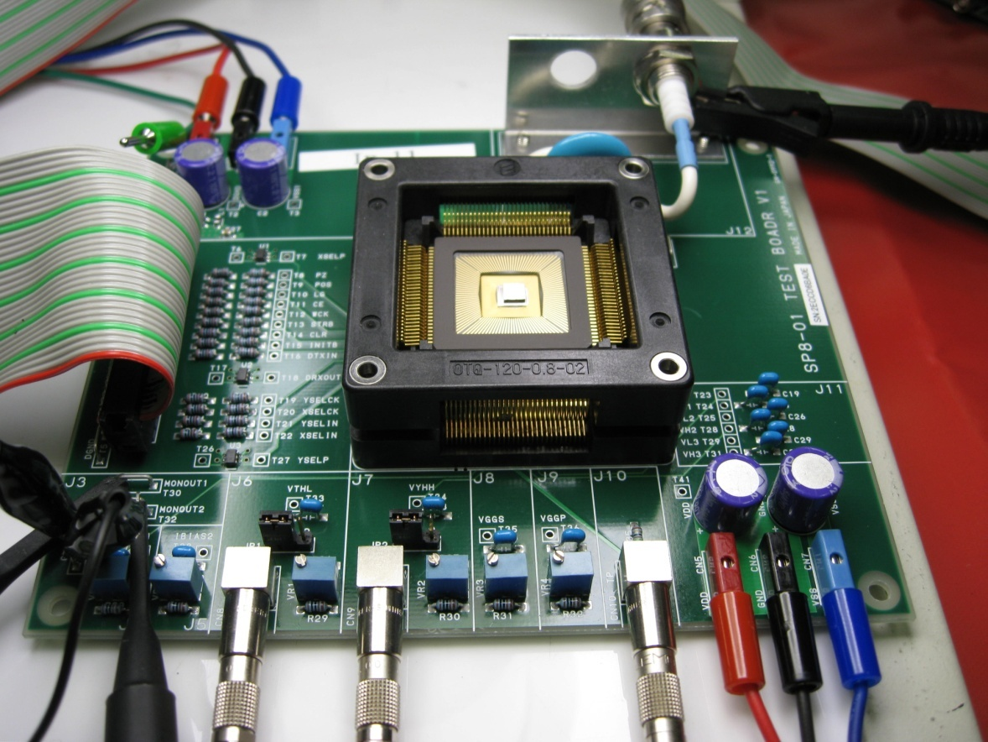
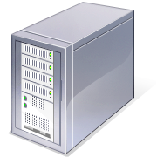
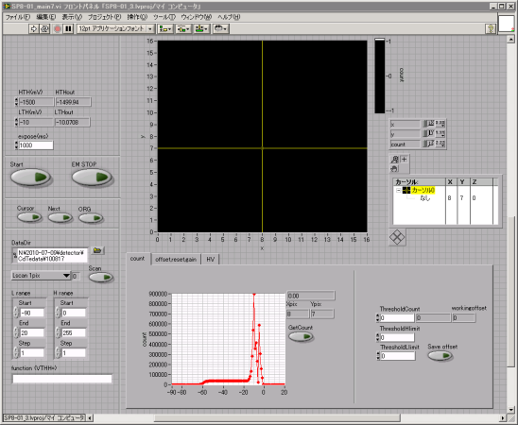
Fabrication of Detector
Test board and control system
  All the operation can be done by GUI on PC
Data
Readout board: NI- PCI 7831
(DIO, AD/DA with FPGA)
+
L
LabVIEW software
Notes:
Put detector to test board and connected to PC
最初の5分でこのへんまで
なし

Slide 38
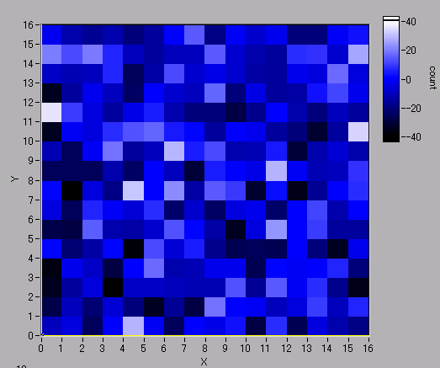
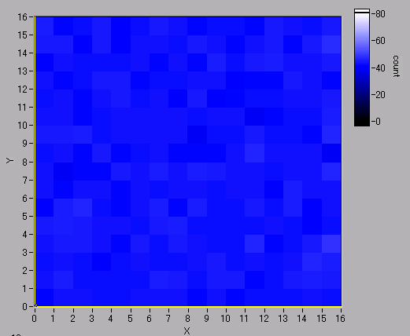
Performance of ASIC
Uniformity of 0-level (offset of amp.) and pulse height (gain of amp.) in a chip
Shaper output of -1.06fC (10keV)
0-level
STD=15mV
Max-Min = 76mV
0-level
Pulse height
Pulse height
adjusting “offset of window ” for each pixel was reasonable.
Ave. =43.2mV
STD =1.4mV
Max-Min = 9.1mV
Notes:
Offset調整したら。。をしめす。
なしにしても

Slide 39
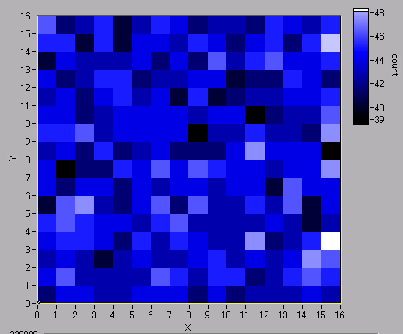
Performances of ASIC
Uniformity of 0-level (offset of amp.) and pulse height (gain of amp.) in a chip
Shaper output of -1.06fC (10keV)
0 level
STD=15mV
Max-Min = 76mV
0-level
Pulse height
Pulse height
“offset” adjuster in window-comparator for each pixel was reasonable
Ave. =43.2mV
STD =1.4mV
Max-Min = 9.1mV
Notes:
なしに

Slide 40
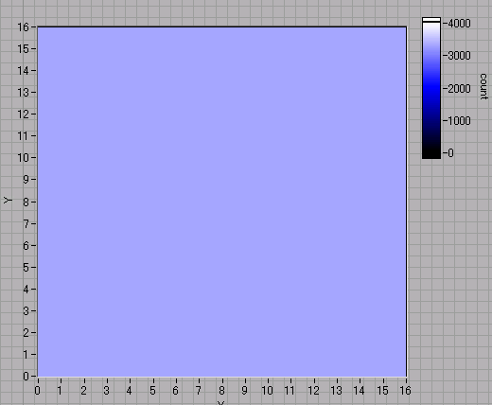
Performances of ASIC
Test Pulse : charge : -6.4fC
frequency : 3.4kHz
Exposure time : 0.1sec
Higher Energy threshold : ∞
Window-comparator, counter,
and other digital functions
(offset adjuster, switches …)
was tested with test pulse.
⇒ALL the pixels in the ALL
11 tested chips
( 5 ASIC-only + 6 ASIC+ CdTe)
worked as expected
Background noise was 0.6 count/hr/pixel
with window-comparator of 25-30keV
Notes:
全面にX線を当てたときの絵。 Amかビームラインの絵 等高線の絵

Slide 41
Design of ASIC -- Comparator --
V_{bias}
Pre-Amp
Shaper
Photon
(E)
R_{p}
R_{s2}
Lower Threshold
Upper Threshold
Detector
C_{p}
C_{s1}
C_{s2}
Offset
Q(E)
V_{aout1}
V_{aout2}
V_{dout3}
C_{cal}
Offset-adjustable window-type comparator
  Global lower/higher threshold are set to whole 256 pixels
  Each pixel can be adjusted the “offset of window”
TP
Undetectable
Detectable
Undetectable
Detectable
Output of Shaper
Low energy threshold
High energy threshold
offset
(adjustable for each pixel)
Input of Counter
Notes:
いらない

Slide 42
Design of ASIC --Comparator--
V_{bias}
Pre-Amp
Shaper
Photon
(E)
R_{p}
R_{s2}
Lower Threshold
Upper Threshold
Detector
Offset
Q(E)
C_{p}
C_{s1}
C_{s2}
V_{aout1}
V_{aout2}
V_{dout3}
C_{cal}
Offset-adjustable window-type comparator
  Global lower/higher-energy threshold are set to all 256 pixels
TP
Shaper output
Low energy thr.
High energy thr.
Notes:
ここは省略ぎみに いらない

Slide 43
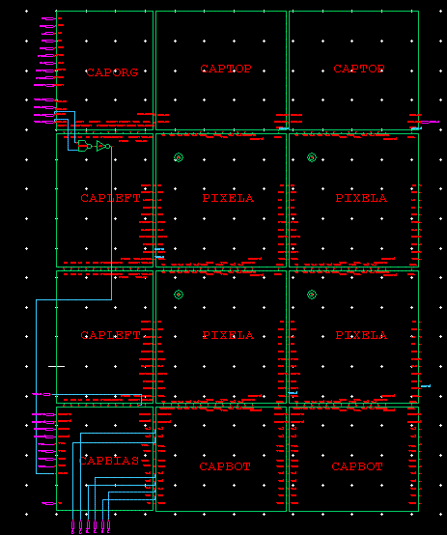
Design of Readout (ASIC) –Counter--
V_{bias}
Pre-Amp
Shaper
Photon
(E)
R_{p}
R_{s2}
Lower Threshold
Upper Threshold
Detector
Offset
Q(E)
C_{p}
C_{s1}
C_{s2}
V_{aout1}
V_{aout2}
V_{dout3}
Counter readout
C_{cal}
counter
TP
Counter and counter-readout circuit was simulated with ASIC of 2x2 pixels
Base clock was 250MHz (84nsec/pixel=53usec/frame) in the simulation
PIXCEL
Notes:
いらない

Slide 44
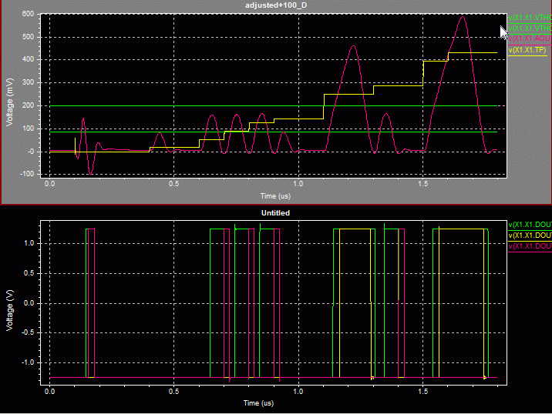
Design of Readout (ASIC) --Comparator--
Shaper output
(Comparator input)
Comparator output
(Counter input)
The behavior of the comparator was confirmed using SPICE simulation
Notes:
Comfirmed the いらない

Slide 45
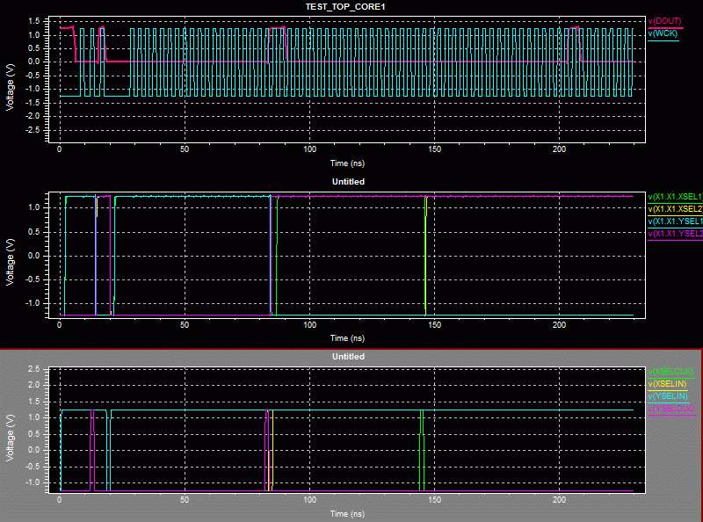
Design of Readout (ASIC)
Input clock and Counter Ontput
Output of pixel-selected signal
Input of pixel selector
Notes:
See the behavior of simulatied ASIC
いらない

Slide 46
Design Concepts
Detector that is suite for SPring-8….
High sensitivity in high energy X-ray region
(up to 100keV)
  ⇒CdTe sensor
Ability to apply to many kinds of SR experiments
  ⇒Hybrid pixel detector: single photon counting, 2D, high frame rate detector
Function to cutoff high-order X-ray
  ⇒Readouts with a window-type comparator
This type of detector(PILATUS) already applied to many kinds of SR experiment.
(time-resolved diffraction, XAFS,,,,)
Notes:
And , The detector should be Multi purpose single photon counting….
So we adopted e which is
ここはコンパクトに

Slide 47
Design of Readout (ASIC)
All parts of the digital circuit was preformed as designed
Notes:
いらない

Slide 48
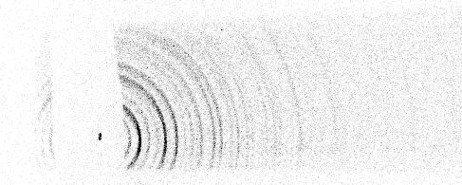
Design Concepts
Diffraction Pattern of Si with lower comparator only
Lower comparator at 30.8keV
Without upper comparator, high order X-ray from monochromator was mixed with the target energy X-ray in the detected image.
Cutting higher energy is as important as cutting lower energy to detect image of the target X-ray energy
113keV
37.8keV
Lower comparator at 40keV
226keV
113keV

Slide 49
Results of Beam Test
Window threshold scan
  Lower and Higher energy threshold was both scanned in same time
X-ray of target energy
Low energy X-ray
(background)
Lower energy thr.
Higher energy thr.
Higher order X-ray
Input of Counter

Slide 50
Results of Beam Test
Low-energy threshold scan
  Count is 0 when lower-energy threshold eq. to highter-energy threshold.
  Counting is start when the shaper output exceeds the lower-energy threshold
Low energy X-ray
(background)
X-ray of taget energy
Higher order X-ray
Lower energy th.
Higher energy th.
Offset=0
Input of Counter
Notes:
なし

Slide 51
Result of Beam Test
Low-energy threshold scan
  Count increases when lower-energy threshold cross pulse height of the target energy
Low energy X-ray
(background)
Lower energy threshold
X-ray of target energy
Higher order X-ray
Offset=0
Higher energy threshold
Input of Counter

Slide 52
Results of Beam Test
Low-energy threshold scan
  Count continually increase because of low-energy background
Lower threshold
Offset=0
Higher threshold
Input of Counter
Notes:
なし

Slide 53
Result of Beam Test
Lower-energy scan
  When the lower energy threshold cross 0-level of shaper output, the count rapidly increase
Lower threshold
Offset=0
Higher threshold
Input of Counter
Notes:
なし

Slide 54
Beam test
Lower-energy scan
  Count is 0 when the lower-energy threshold over the 0-level noise region
Lower energy threshold
Higher energy threshold
Counter

