Slide 1
The Pixel Luminosity Telescope: a Dedicated Luminosity Monitor for CMS
Pixel 2010
Matt Hollingsworth on behalf of the CMS PLT Group

Slide 2
CMS-Pixel Luminosity Telescope (PLT) Collaboration
Canterbury University
Anthony Butler, Phil Butler, Nuno Rodrigues, Stuart Lansley
CERN
  Jean-Paul Chatelain, Cathy Farrow, Richard Hall-Wilton, Rob Loos, Vladimir Ryjov, Pier Trapani, Carl Ayres
HEPHY Vienna
  Manfred Pernicka, Siegfried Schmid, Helmut Steininger
Princeton University
Valerie Halyo, Bert Harrop, Adam Hunt, Dan Marlow, Bill Sands, David Stickland, Phil Hebda
Rutgers University
  Oleksiy Atramentov, Anthony Barker, A.J.Richards, Ed Bartz, John Doroshenko, Yuri Gershtein,
  Dmitry Hits, Rishi Patel, Steve Schnetzer, Bob Stone
Vanderbilt University
  Bill Gabela, Will Johns
University of California, Davis
  Richard Lander
University of Tennessee
  William Bugg, Stefan Spanier, Matt Hollingsworth, Zong Chang Yang
Past Contributors
  Gary Grim (LANL), Richard Lander (UC, Davis), Alick Macpherson (CERN), Lalith Perera (Mississippi)

Slide 3
Importance of Luminosity Monitoring in CMS
Limiting systematic in many Tevatron measurements
Production cross section -> Absolute mass of new particles
Bunch-by-bunch uniformity
  Trigger biases
Instant feedback to accelerator control
  Instantaneous luminosity
  Beam quality
Want to measure luminosity as well as possible ➔PLT

Slide 4
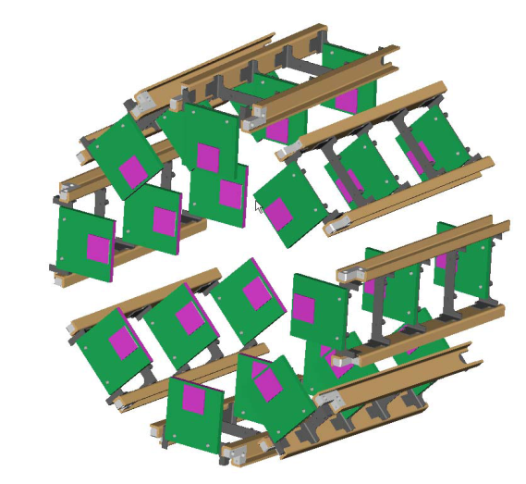
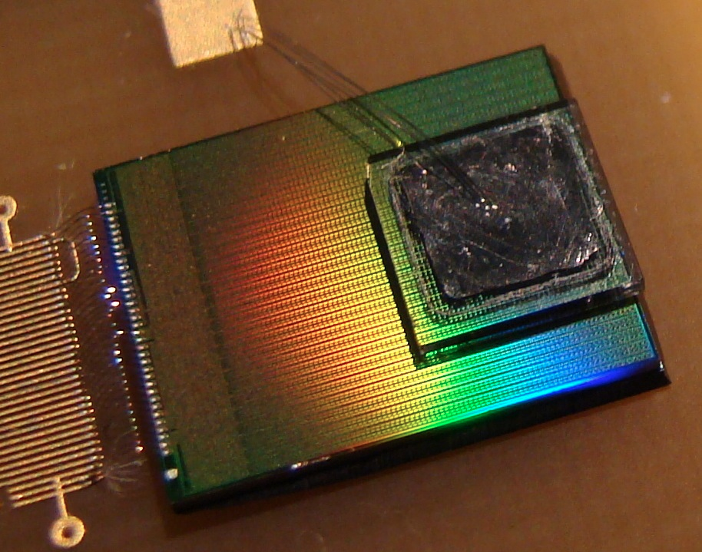
The Pixel Luminosity Telescope (PLT)
Relative bunch-by-bunch luminosity measurement
Independent of CMS (self-triggered)
Precision at 1% level (stat, syst)
3 layer particle tracking
Self monitoring/calibrating
7.5cm
4mm
4mm
Beam Halo
4.45 cm
IP
P
P
175 cm
sCVD Diamond Pixel Detector
  Fast OR readout (3-layer coincidence): online luminosity information
  Full pixel readout (1-10 kHz): alignment, luminous region, background studies, etc.
Notes:
We have infrastructure for measuring the flux… but we don’t normalize the flux to luminosity.
E Bartz et al 2009 JINST 4 P04015
doi: 10.1088/1748-0221/4/04/P04015
http://iopscience.iop.org/1748-0221/4/04/P04015

Slide 5
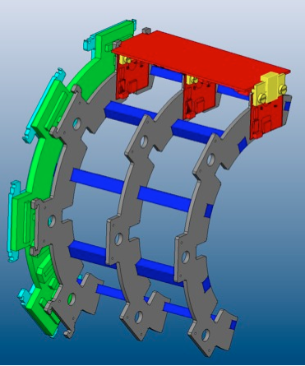
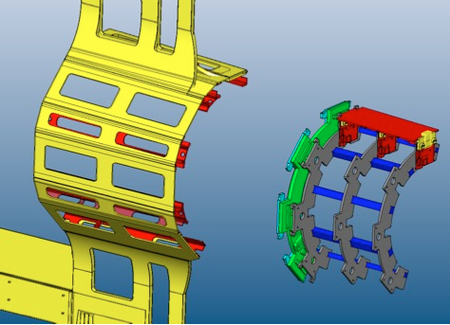
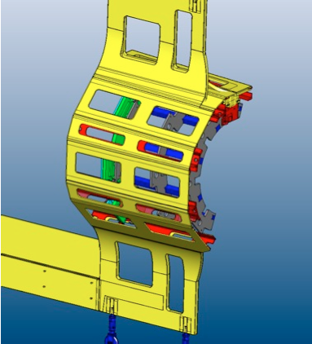
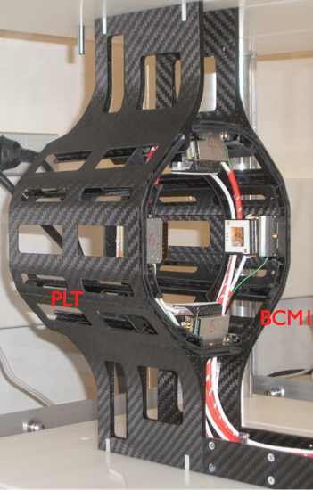
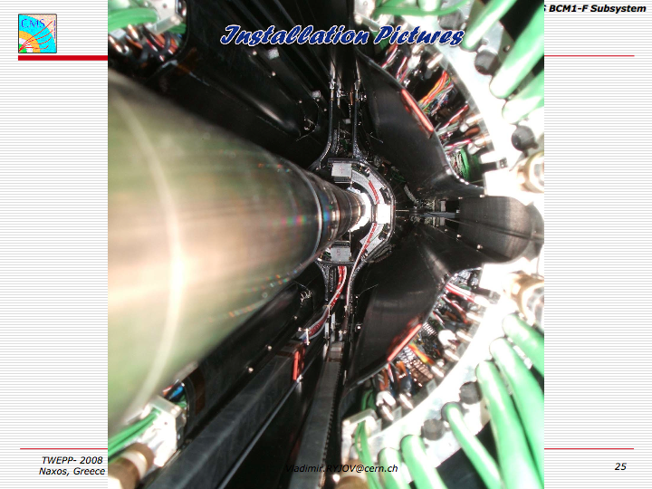
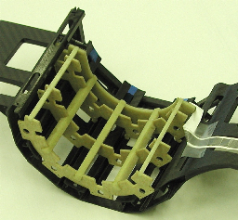
PLT Mechanics
The design ...
HDI
Port Card
Hybrid
Optoboard
installs into existing beam conditions monitor carriage
The reality ...
prototype

Slide 6
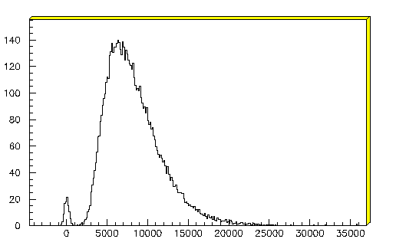
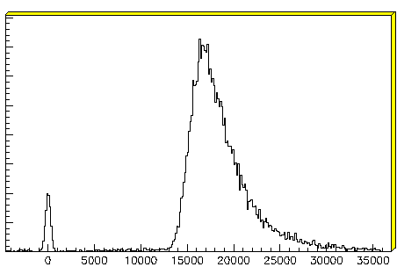
Single-Crystal Diamond Detector (sCVD)
Radiation hard (survives > 2 x 10¹⁵ p/cm²)
No need for cooling
Full charge collection at E-field < 0.2V/um
Fast signal collection (~1ns from 500 um)
Pulse height well separated from pedestal
BCM1F is currently the largest implementation of sCVD diamond
  W. Lohmann et al., “Fast Beam Conditions Monitor BCM1F for the CMS Experiment”, NIM A614 (2010) 433
⁹⁰Sr
Poly crystal
Single crystal
entries
# e-
# e-

Slide 7
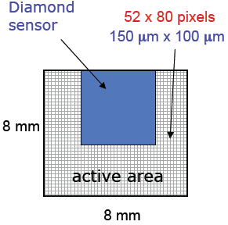
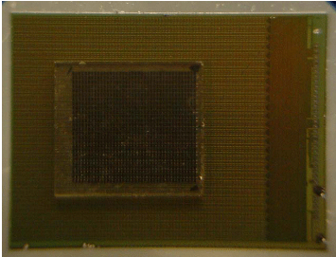
Readout
CMS Pixel chip (PSI46) bump-bonded to sCVD
Has fast cluster counting in double-columns built in
Individual pixel thresholds adjustable
Individual pixels can be masked
Self-triggered by Fast Or readout
Full analog readout of
  Hit address
  Charge deposit
Standard pixel readout (FEC, FED [ADC])
FED has custom firmware for Fast Or
Bump bonded at Princeton micro-fab lab

Slide 8
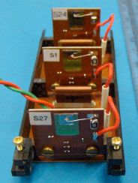
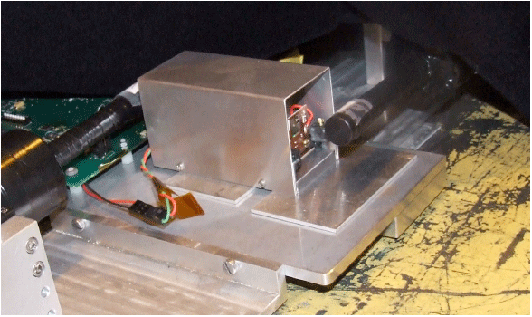
CERN SPS – May 2009
150 GeV/c π+
2 days of beam time
Used electrical FED and FEC
Small (6x6 mm) Scintillators
(used as triggers)
3
2
1
Diamond

Slide 9
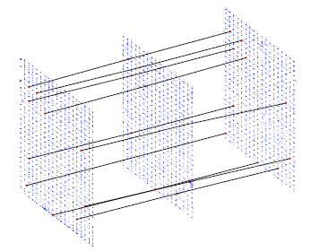
Efficiencies
Fiducial area
  Masked border rows/columns
  Removed columns in the shadow of the entrance counter
Dead pixels
  Plane 1: 1.8%
  Plane 2: 2.2%
  Plane 3: 0.1%
Bump bonding efficiency
Fast Or Efficiency:
Plane1
AND
?
Plane2
AND
True
Plane3
Plane 1 Plane 2 Plane 3
Measured Efficiencies 99.3% 99.6% 99.9%

Slide 10
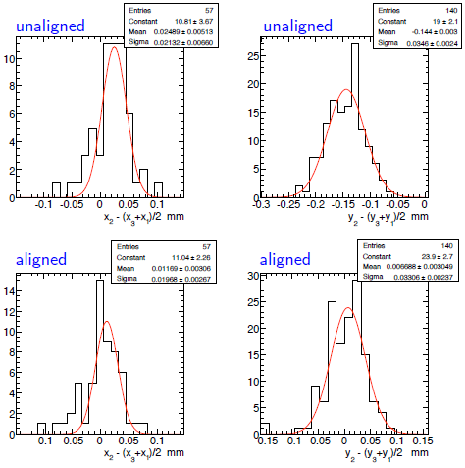
Alignment
ΔX
ΔY
Successfully reconstructed tracks
  Hit position defined as the “center of charge” (charge sharing)
Define residual: x₂ – (x₃-x₁)/2
Alignment
  X offset: 25 ± 5 um
  Y offset: 144 ± 3 um
Even with only a few tracks, a successful alignment was achieved
  X alignment: 57 tracks
  Y alignment: 140 tracks
ΔX
ΔY

Slide 11
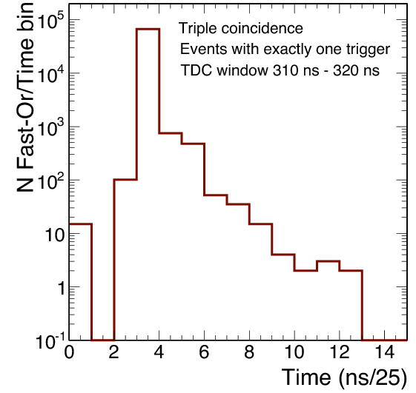
Fast Or
FNAL Mtest – March 2010, 80 GeV pions
Full optical readout used (including Fast Or)
Studied timing of Fast Or with a Multi-Hit TDC
Triggered on scintillator coincidence
Particle Arrival
Delay
Δt
25ns
Classification:
Early
In-Time
Late
FED ADC
Bins

Slide 12
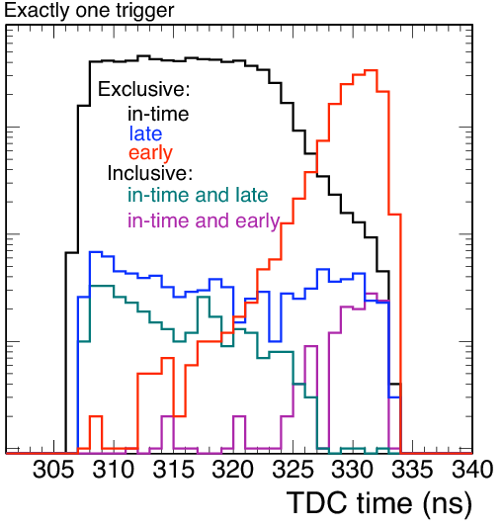
Fast Or Timing Studies
Beam out of sync with the system clock -> time walk effects exaggerated
Select out in-time particle arrivals with TDC -> measure early, late, and on-time Fast Ors in LHC operating conditions
Exclusive: only one Fast Or
Inclusive: in-time + early or late
 | Exclusive | Inclusive
Early | 0.13% | 0.01%
Late | 0.84% | 0.38%
Exclusive events -> errors in relative bunch-by-bunch luminosity measurement
Inclusive events-> errors in overall luminosity measurement (overcount)
Meets goal of 1% systematic error
Notes:
Summary: We can subtract the late events, and the early events will be highly suppressed when we are in time
with the beam

Slide 13
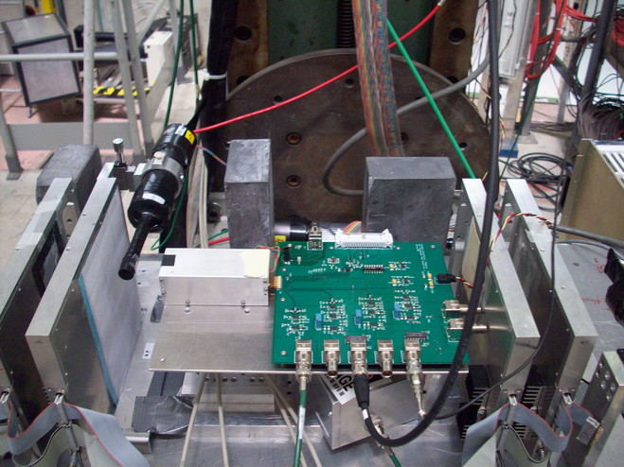
CERN PS Т9 – May 2010
Beam composition
  60% protons
  35% pions
  10 GeV
3 weeks of beam
  90% time running
Included Si Strip tracker, provided by the University of Zurich
  Intrinsic resolution of 2 um per plane
  Resolution limited by multiple scattering

Slide 14
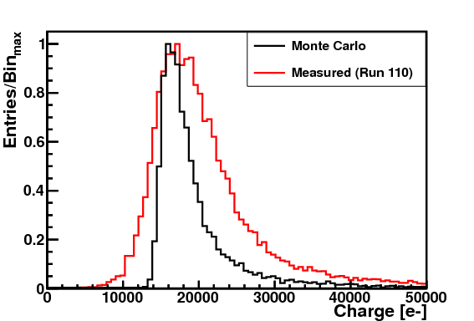
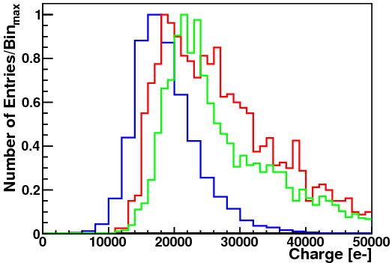
Charge Deposit
Signal/Threshold = ~16000/3000 =5.3
Broadening effects
  Calibration Error
  Beam out of time with system clock
  Broken clusters
1-Hit
2-Hit in X
2-Hit in Y
Charge deposit for all 1-cluster events (all cluster topologies included)
Normalized to the maximum point
Charge deposit by cluster topology
Notes:
Beam out of sync with internal clock
Calibration error (at least 10%)
Thresholds

Slide 15
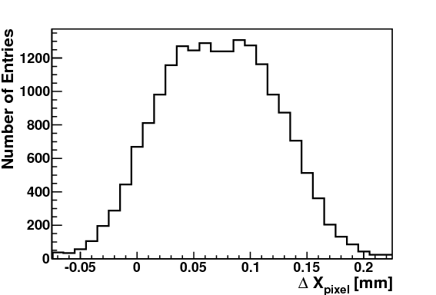
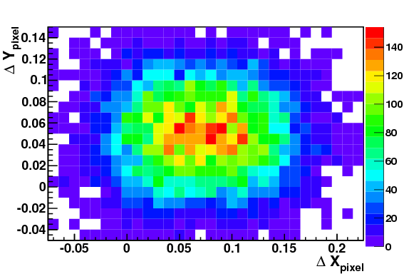
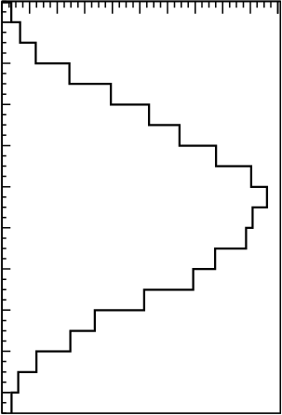
In-Pixel Occupancy: 1 Hit Events
Position in the pixel is calculated with respect to the lower left corner
Δx_{pixel} = x_{track} – col*(150 [μm]), Δy_{pixel} = y_{track} – row*(100 [μm])
[mm]
The red box corresponds to the pixel area
  150 μm x 100 μm
[mm]

Slide 16
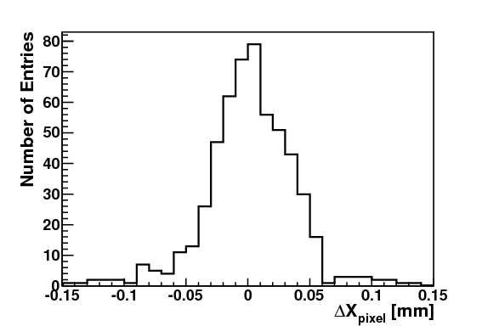
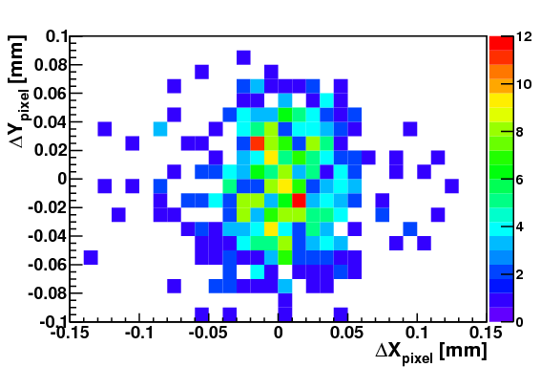
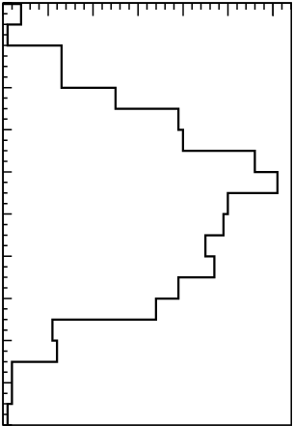
In Pixel Occupancy: 2 Hit “XX” Clusters
ΔX_{border} = (x_{track} % d_{x} - δ)
  δ is a phase factor used to adjust border position to 0
0 corresponds to the border between the pixels
Cluster configuration
1
2
The red boxes represent the area of the component pixels

Slide 17
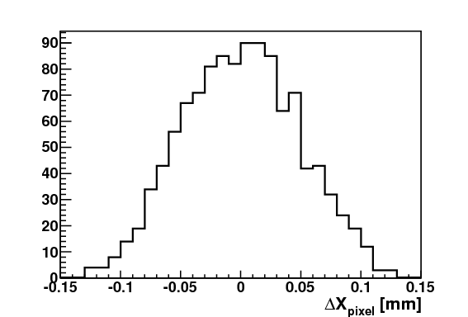
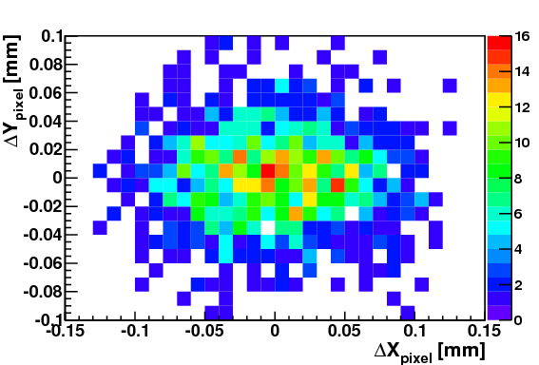
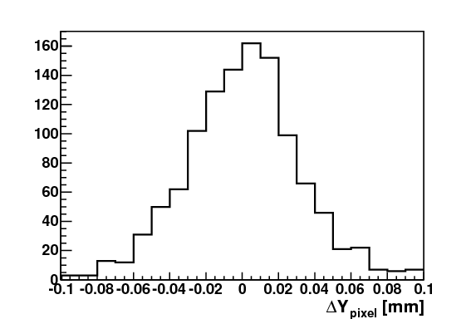
In Pixel Occupancy: 2 Hit “YY” Clusters
ΔY_{border} = (y_{track} % d_{x} - δ)
  δ is a phase factor used to adjust border position to 0
0 corresponds to the border between the pixels
Cluster configuration
1
2
The red boxes represent the area of the component pixels

Slide 18
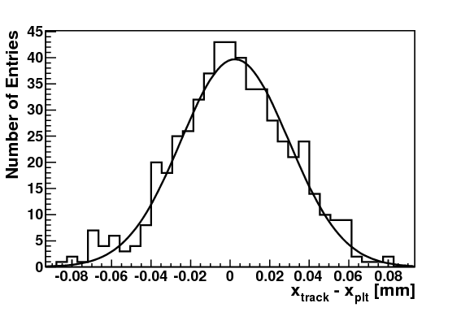
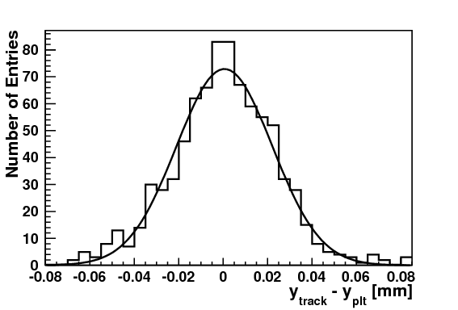
2-Hit residuals with η-based correction
Residuals: Δ_{x} = x_{track} – x_{plt} , Δ_{y} = y_{track} – y_{plt}
Required that there is exactly 1 hit in the PLT
Includes η = Q_{r}/(Q_{r}+Q_{l}) correction
Perpendicular Tracks
Entries: 588
σ: 27.33 μm (+- 1μm)
μ: 2.4 μm (+- 1.2 μm)
Entries: 823
σ: 21.6 μm (+- 0.6 μm)
μ: 0.6 μm (+- 0.8 μm)
Charge sharing improves the resolution beyond digital resolution
Efficiency goes down significantly (90% drop for perpendicular tracks) when requiring 2-hit clusters
Digital Resolution
X : 43. 3 μm
Y : 28.9 μm

Slide 19
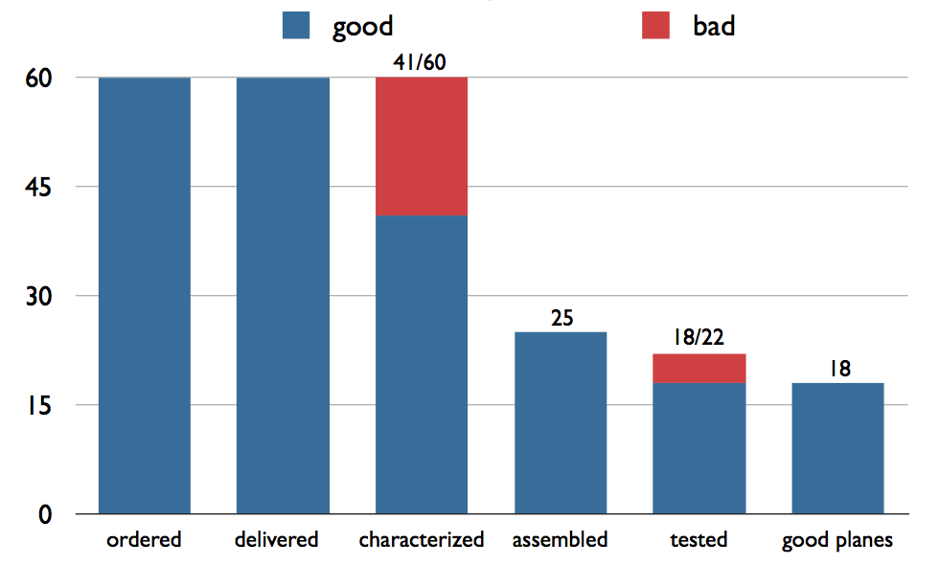
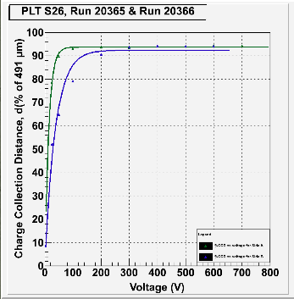
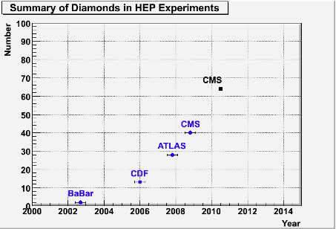
Production
sCVD diamonds from Diamond Detectors
Diamond Characterization done at Rutgers
Bump bonding at PRISM
side A
side B
PLT is the largest implementation of diamonds in HEP so far
Using this sample to understand further properties of diamond as detector material
PLT
QA done on every diamond to ensure almost complete charge collection
BCM
Charge collection distance required to saturate at <200V

Slide 20
Conclusions
PLT is a dedicated luminosity monitor for CMS based on sCVD diamond detectors
  1% statistical precision on bunch-by-bunch luminosity in ~1s
  Precision realtime monitoring of IP centroid
  Monitoring of beam halo and beam abort gap
Will provide information on operation of diamond detectors
  Diamond tracking performance and efficiency
  Long-term high radiation environment
  E. Bartz et al., “Results from a beam test of a prototype PLT diamond pixel telescope”, NIM A (2010)

Slide 21
Backup

Slide 22
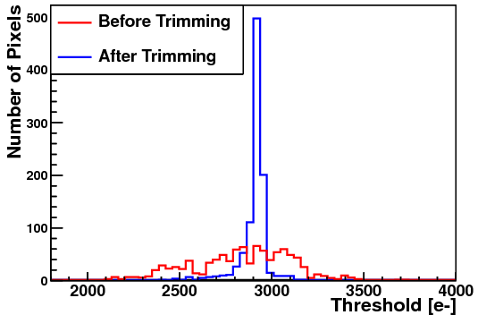
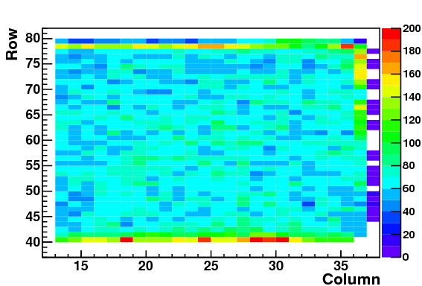
Event Selection/Characterization
Trimmed per-pixel thresholds to 3000 e-
ADC -> Charge conversion done using PSI46 charge injection facility
The border region was excluded
Pixel thresholds before and after trimming
Exactly one cluster, defined as a collection of adjacent hits, also required
Red box indicates analyzed region

Slide 23
PLT Performance – Test Beams
Test beams
  2009 : CERN SPS
    Efficiency
  2010 : FNAL Mtest
    Optical Readout Characterization
    Fast Or signal timing studies with TDC
  2010 : CERN PS
    Long-running systematics
    In-pixel occupancy
    Spatial Resolution

Slide 24
Setup
Configuration 1
4
3
2
1
Beam
USC
DSC
PLT
Trigger for most of the runs: Fastout of Plane 2 + DSC
Configuration 2
7 deg
4
3
2
1
Beam
USC
PLT
DSC

Slide 25
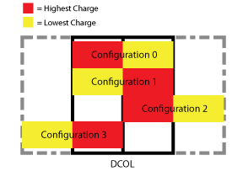
DCOL Configurations
Divided clusters with a length of 1 in X and 0 in Y into 4 separate types (“XX” clusters)
Configuration 0 and 1 are referred to as “inside DCOL” clusters while 2 and 3 are referred to as “mixed DCOL” clusters

Slide 26
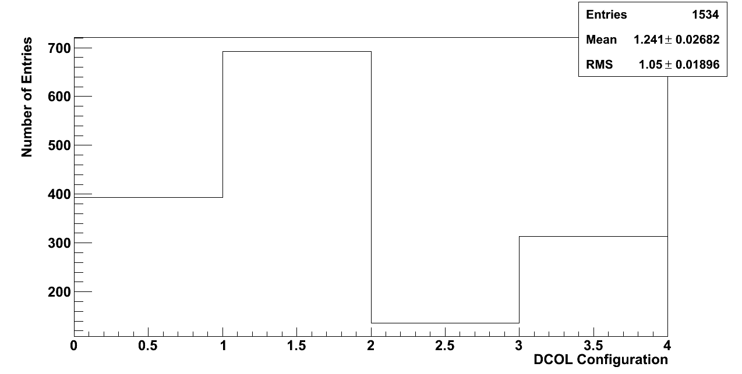
DCOL Asymmetries
More asymmetries can be found if I divide the sample into the 4 configurations described earlier
DCOL Configurations for XX clusters. A preference is seen for the charge to be higher in the right pixel (configuration 1 and 3) than the left pixel (0 and 2).

Slide 27
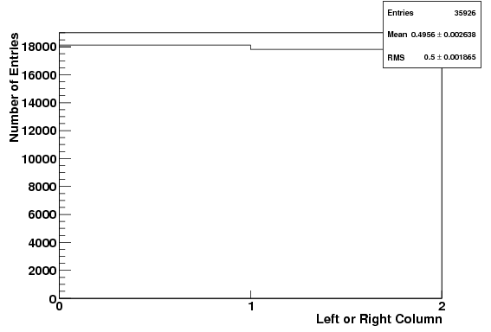
Left/Right Column Occupancy for Single-Hit Events
Same plot as on previous slide, except for 1-hit events: asymmetry much less significant
Column % 2. 0 corresponds to a hit in the left column of a DCOL, while 1 corresponds to a hit in the right

Slide 28
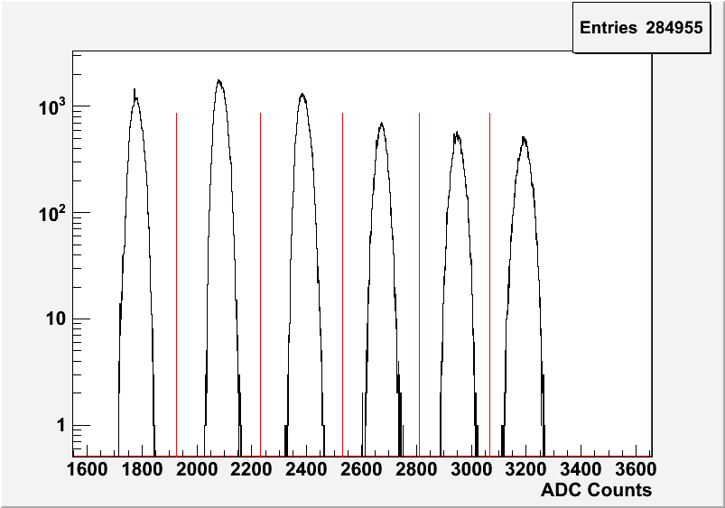
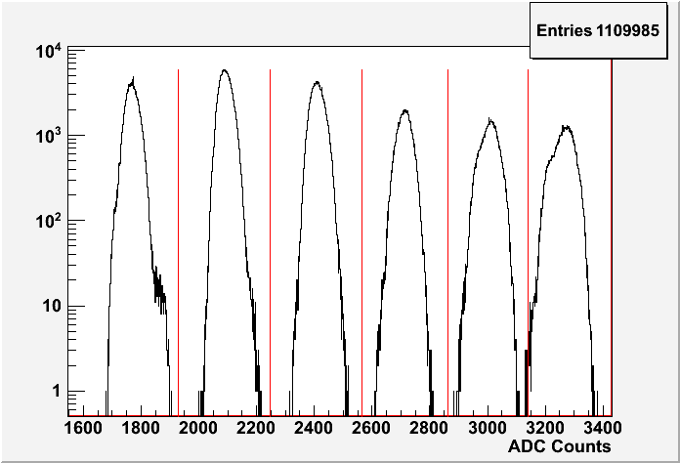
Address Levels
Run 115
Have an algorithm for automatically detecting address levels
Peak detection -> Defines address levels as the center of each peak pair
Results in plots like that ->
Would probably be worthwhile to make this an online calibration that sweeps over all pixel to get the ringing that comes from larger level drops
Levels are not necessarily stable!
Nothing was touched from run 115 (top) to run 116 (bottom), but at some point the address levels started fluctuating
Could have been from a brownout or some sort of electrical failure… run 116 was the only time that the bt/plt scalers lost sync also
Run 116

Slide 29
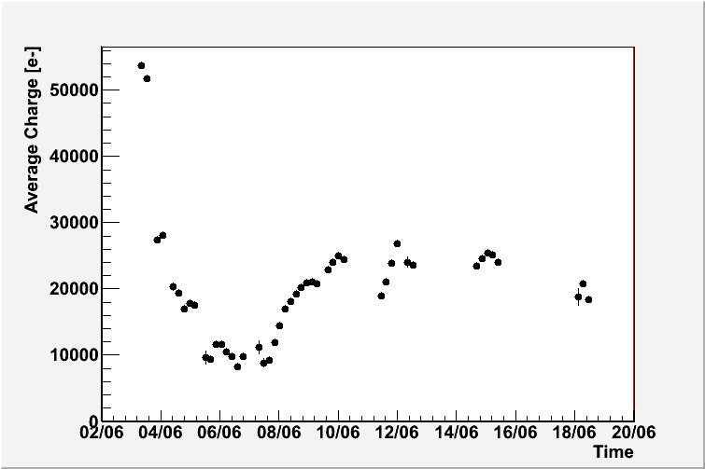
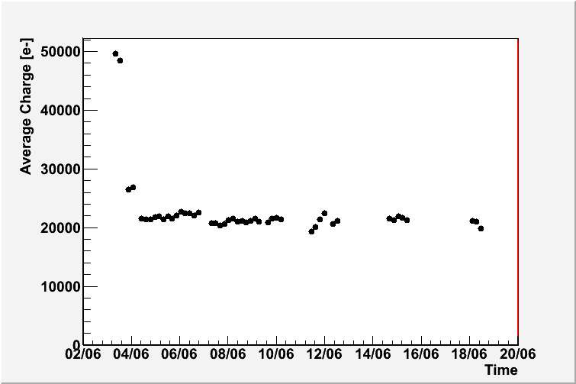
Pulse Height Stability
300 V
350 V
Plane 1
Area marked in red is untrustworthy (gain calibration isn’t appropriate)
Plane 1’s pulse heights stabilized after enclosure was made to be light-tight
Plane 2’s pulse heights were stable during the entire run
Covered front hole with tape
Plane 2
Trimming, 7th @ 8:00 am

Slide 30
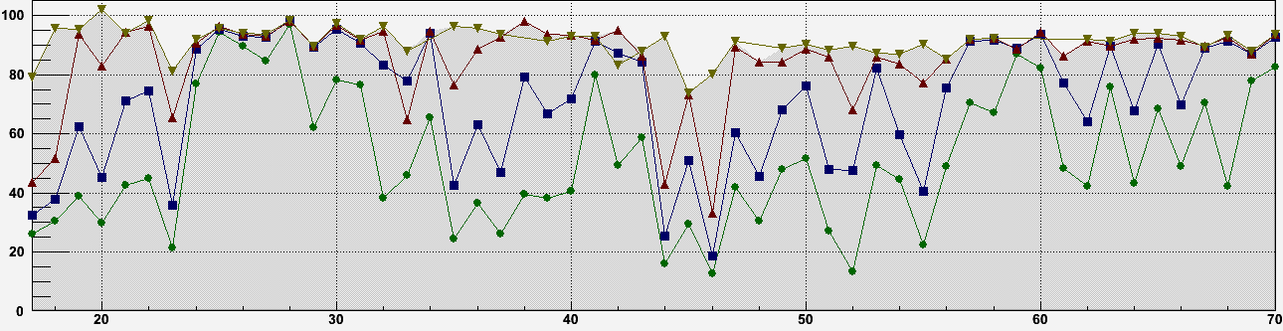
PLT Diamond CCD Summary
50 V
100 V
200 V
500 V
Charge Collection Distance (%)
Diamond Number

Slide 31
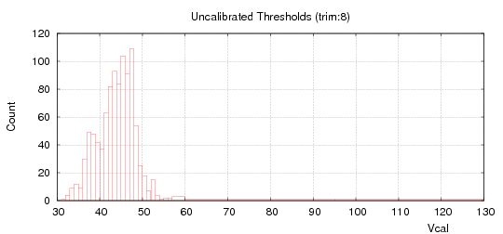
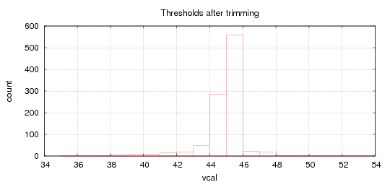
Trimming
ROCs were individually trimmed
Took 15 minutes/ROC
First 2 ROCs were trimmed, never trimmed the last one
In electrons: ~3000 e-
Expected Charge Deposit
  Perpendicular tracks: 36*513*1.05=19391
  Grazing angle tracks: 36*100*1.05=3780

Slide 32
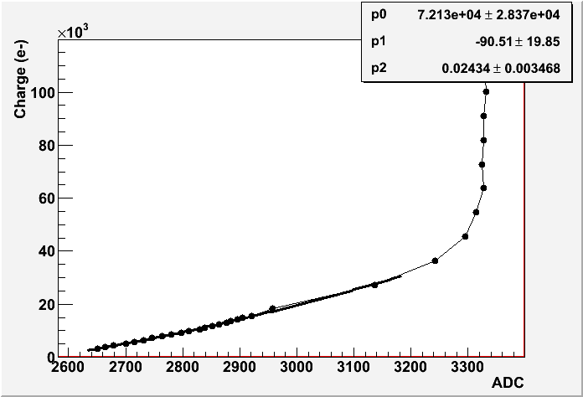
Gain Calibration
Took 4 different gain calibration runs, ~6 days apart (run 101,102,103,104)
First run seems to be unusable for plane
Run | Time
101 | Jun 4 13:13
102 | Jun 7 09:08
103 | Jun 12 17:40
104 | Jun 18 16:12
(id=1,col=20,row=56)

Slide 33
