Slide 1


Towards minimum material trackers for HEP experiments at upgraded luminosities
L. Gonella, F. Hügging, N. Wermes - Physikalisches Institut Uni Bonn
Pixel 2010, Grindelwald, 09/09/2010

Slide 2
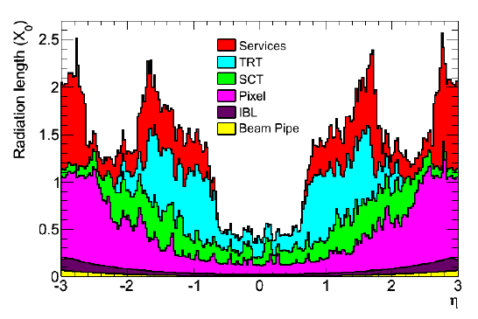
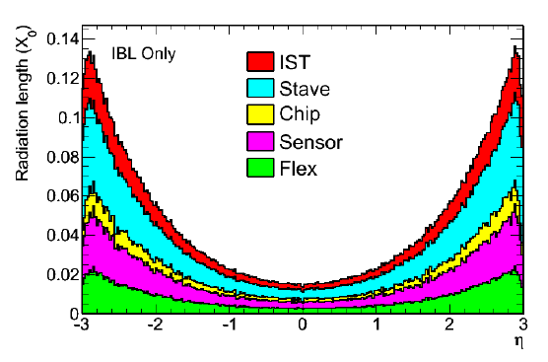
Low material @ (S)LHC: a challenge for trackers
ATLAS pixel detector @LHC: 3.5% X0 per layer^{(*)}
  Stave structure: 1.47% X0
  Services: 0.92% X0
    Services also dominate the material budget @ large η
    Main contribution comes from power cables
Insertable B-Layer (IBL): current estimate 1.5% X0
ATLAS pixels @ Super LHC (SLHC): ≤2% X0
IBL only
ATLAS inner det. material distribution (incl. IBL)
Current IBL material distribution estimation
(*) all x/X0% numbers in the talk are given per pixel layer

Slide 3
Material reduction strategy
Address known sources of material
  Reduction of stave structure material
    CC foam
  Less massive (and more efficient) powering scheme
    Serial powering
    DC-DC conversion
  Light services, especially in active area
    Al flex cables
    Through Silicon Via (TSV)
Prevent new significant contributions to the material budget
  Electronics
    Thin FE chip
Work ongoing in Bonn

Slide 4
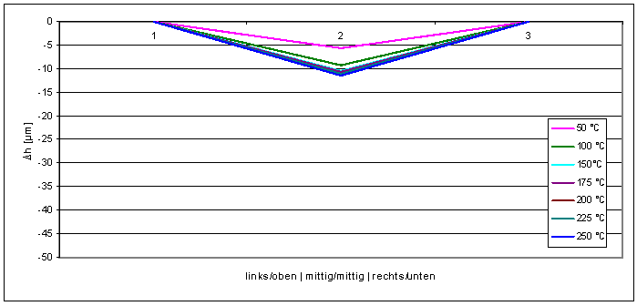
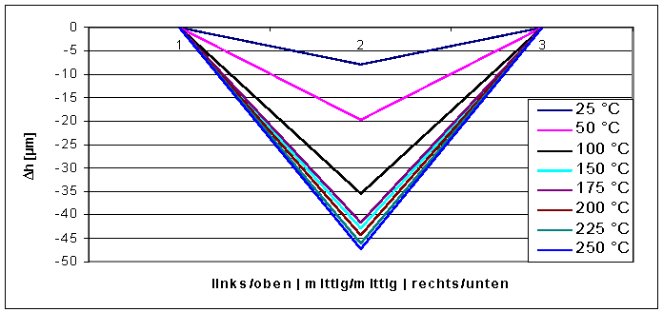
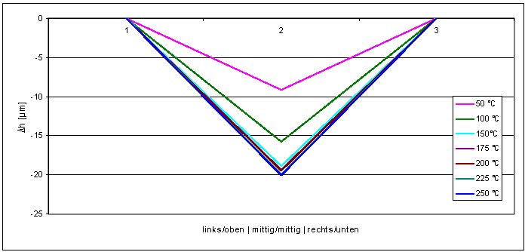
Thin FE chip
Bow profile along a diagonal
16.8 mm
11.1 mm
FE-I4
15µm
FE-I3
FE-I3
1x1 FE-I3, 190µm
ok
FE-I3
7.4mm
FE-I3
FE-I3
20.2mm
190µm thick → 0.26% X0
2x3 FE-I3 (FE-I4 size), 190µm
not ok
FE-I3
FE-I3
350 - 400µm thick → ~0.5% X0
  Current flip chip technique: IZM solder SnAg
Chip bow during flip chip
  Due to CTE mismatch between Si bulk and metals
  ~ 1/d³, d = chip diagonal
New techniques using handle-wafers during flip chip and lift-off after flip chipping are needed
  3 methods studied so far with IZM Berlin
~ peak temp. of reflow process
2x3 FE-I3 (FE-I4 size), 300µm
not sufficient

Slide 5
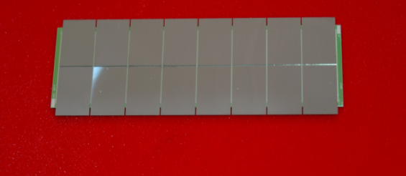
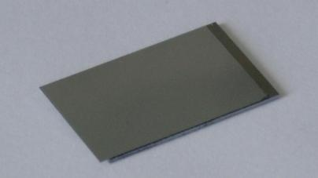
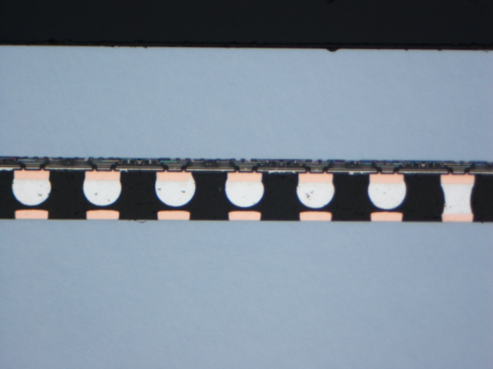
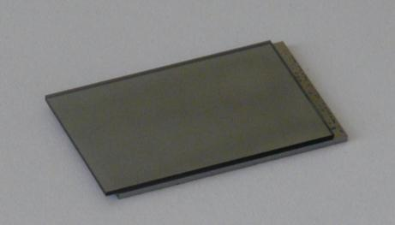
First investigations and problems
First two methods used resp. a wax and a Brewer glue for carrier bonding
Not successful
  thinning ok, but chips bent up at the corners, opposite to the End Of Column region
  Bump bonds do not connect in this area
1st method: wax
ATLAS pixel module with 90 µm thick FE-I2
2nd method: Brewer glue
2x2 FE-I3 array = 66% FE-I4, 90 µm, on dummy sensor
w/o carrier chip
w/ carrier chip
open bumps at the corner of the FE

Slide 6
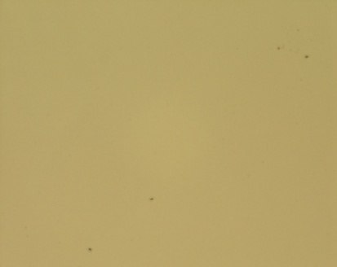
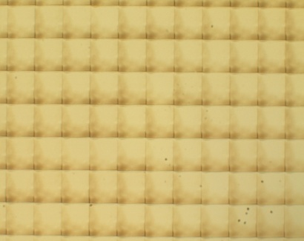
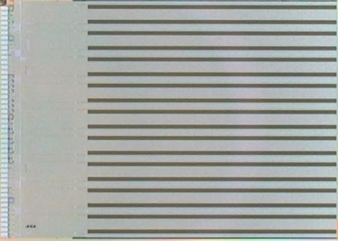
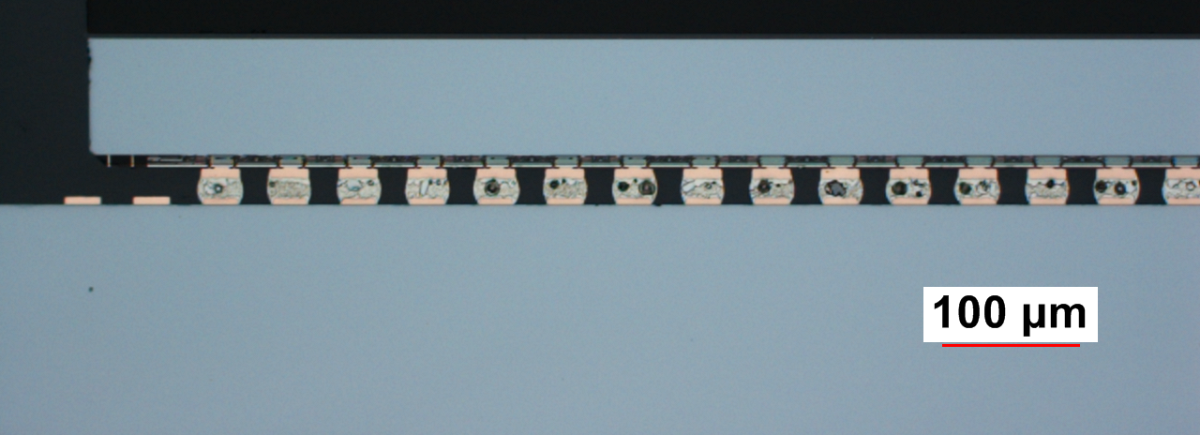
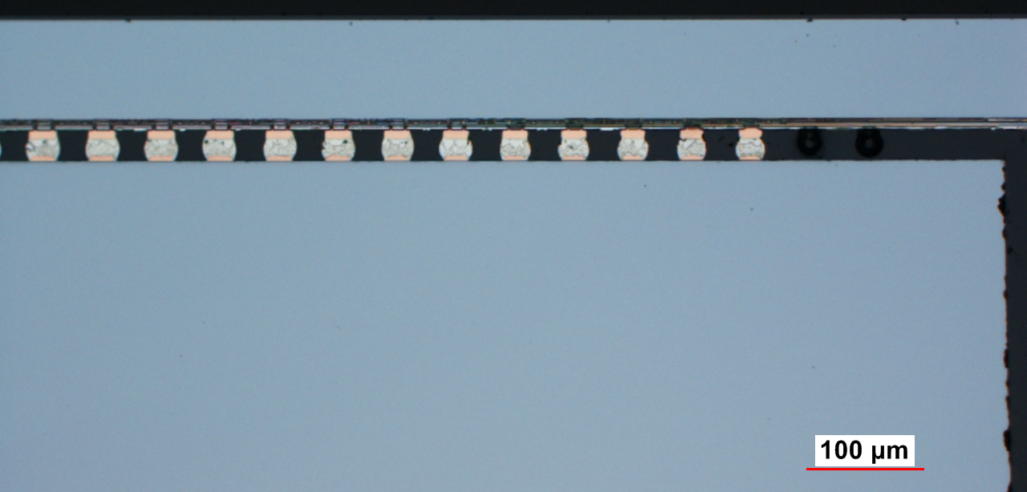
Polyimide method
Process steps:
thinning of FE wafer
Mounting on glass carrier wafer using polyimide glue
Bumping process on FE frontside
Glass carrier on Si testchip before laser exposure_25x
Glass carrier on Si testchip after laser exposure_25x
Dicing of FE wafer and carrier wafer package
FE flip chip bonding to sensor tile
2x2 FE-I2 array, 90um, on dummy sensor
Cross section cut of first column →
all bumps are connected!!!
Laser exposure of chip backside
Carrier chip detach
90 µm
90 µm

Slide 7
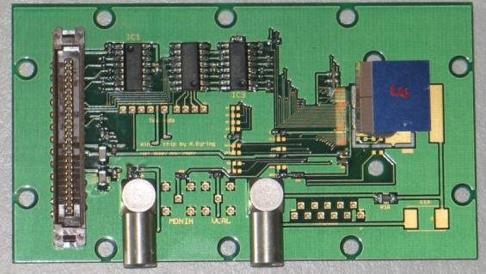
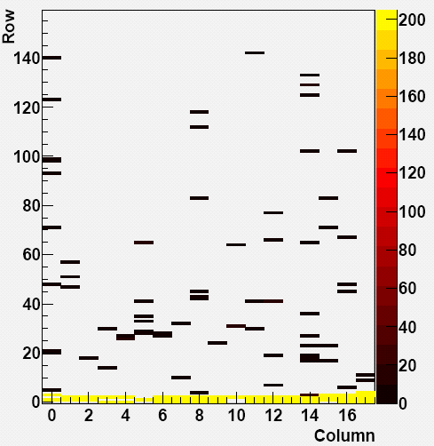
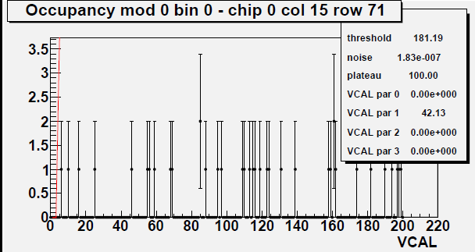
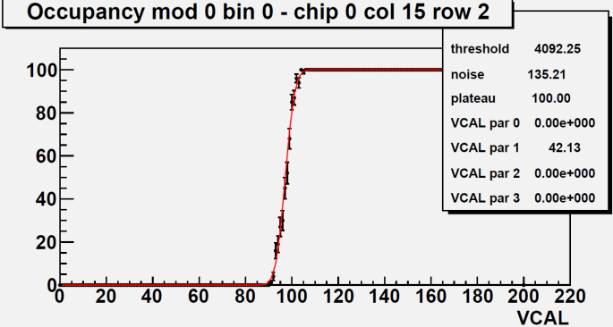
Results of electrical tests
Normal threshold behavior = unconnected bumps
All bumps connected in “critical” area…
..and across the chip
Some disconnected bumps close to the End of Column region → Handling problems during wire bonding
Polyimide method works. Chosen thinning method for the FE-I4 thin chip modules prototyping program →
FE-I4 will be 16.8 x 20.2mm², 90µm thick

Slide 8
Serial powering
Allows transmitting power at low currents and high voltages
  A chain of n modules is powered in series by a constant current I
  Current to voltage conversion is performed locally (on chip/module) by regulators
Key facts
  I scales of a factor n, wrt parallel powering
  V_{drop} is limited only by the power density and the current source output voltage capability
Low I + high V_{drop} tolerance =
reduced power cable cross section
serial powering
parallel powering

Slide 9
LV cables x/X0%: SP vs. DC-DC
Direct powering with DC-DC conv → fixed V_{drop} between V source and converter
@SLHC: 0.2V on stave, 0.8V on Type 1 services
Active area
DC-DC conv: Vdrop = 0.2V
  P_{cable} = 5.56% P_{tot}
  LV cables: 0.1% X0
SP @ P_{cable} = 5.88% P_{tot}
→ LV cables = 0.014% X0
→ ~85% less material
x/X0% SP
(%)
x/X0% DC-DC
Large η
DC-DC conv: V_{drop} = 0.8V → LV cables: 2827.2mm² x-section
SP @ V_{drop} = 0.8V → LV cables = 684mm² x-section
x/X0% SP = 0.25 x/X0% DC-DC

Slide 10
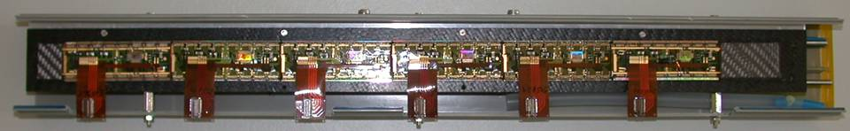
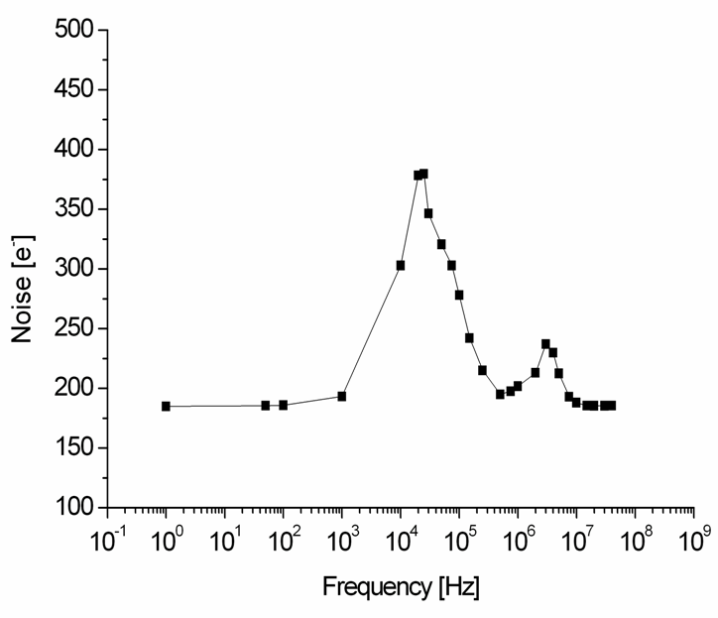
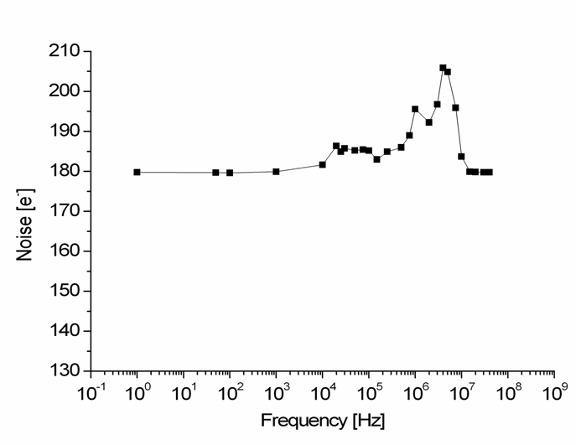
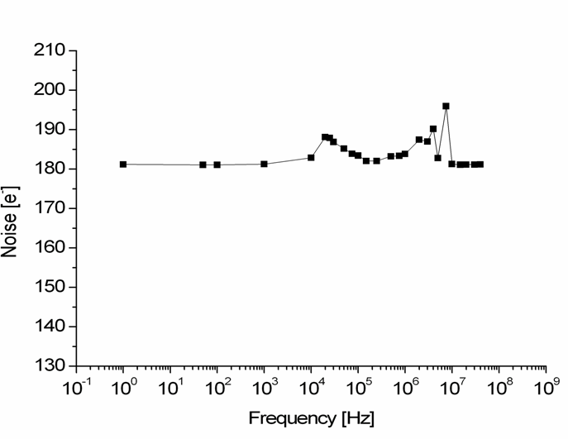
Serial powering proof of principle (2005)
(D.B.Ta et al, NIM A 557 (2006) 445-459)
mod6
mod5
Half stave of the current ATLAS pixel detector powered in series
  No performance degradation due to powering scheme, in particular wrt noise pickup
Switchable load to induce noise
mod4
mod4
max:
400e⁻
mod3
mod3
max:
205e⁻
mod5
max:
195e⁻
mod2
mod1

Slide 11
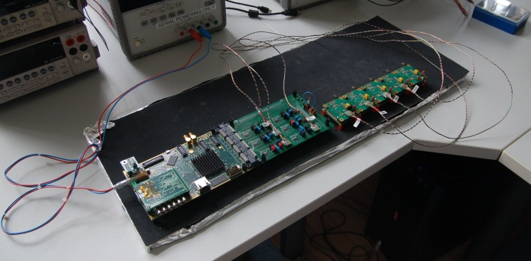
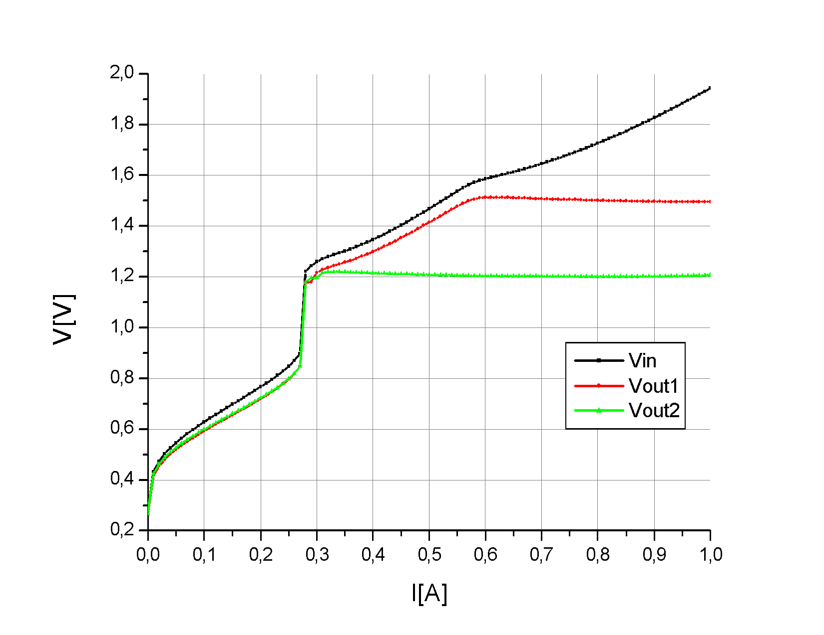
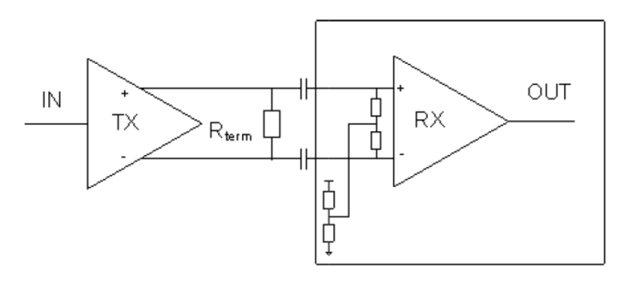
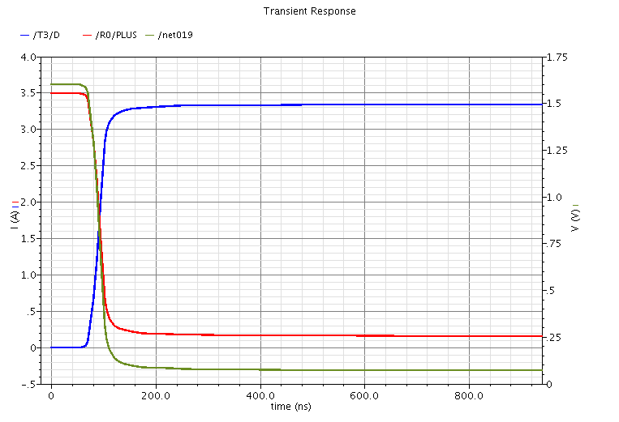
… cont’d work… serial powering for SLHC
New regulator concept targeting serial powering application developed: Shunt-LDO
  2 prototypes confirmed working principle and good performance
    Tested as a single chip and in a serial powering chain with the pixel stave emulator
  2 Shunt-LDOs integrated in FE-I4
V-I characteristic of 2 Shunt-LDO in parallel w/ different Vout
MEASUREMENT RESULTS
FE-I4 LVDS receiver design w/ self biased inputs for AC-coupling
MPC slow ctrl simulation
Protection scheme is proposed
  Main element: Module Protection Chip
    Features slow control and fast response
  Simulations have started
Prototyping of an SLHC pixel outer stave with serial powering is starting
  Work on stave cable and module flex
V_{mod}
I_{MPC}
Proof of principle demonstrated feasibility and reliability.
Development of serial powering for SLHC is entering system prototyping phase.
I_{mod}

Slide 12
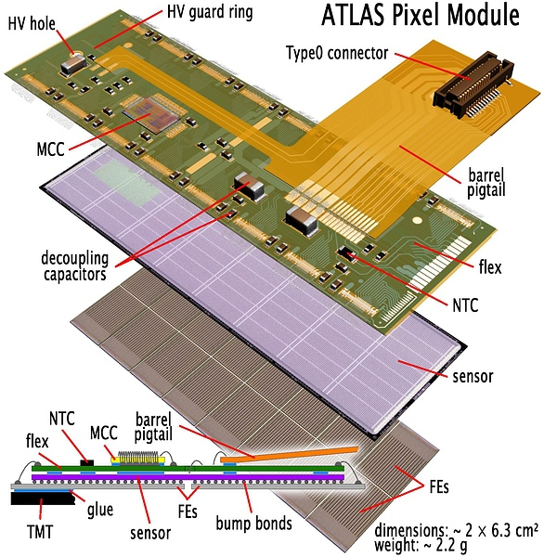
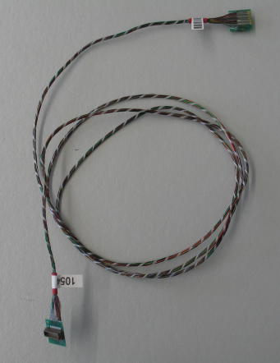
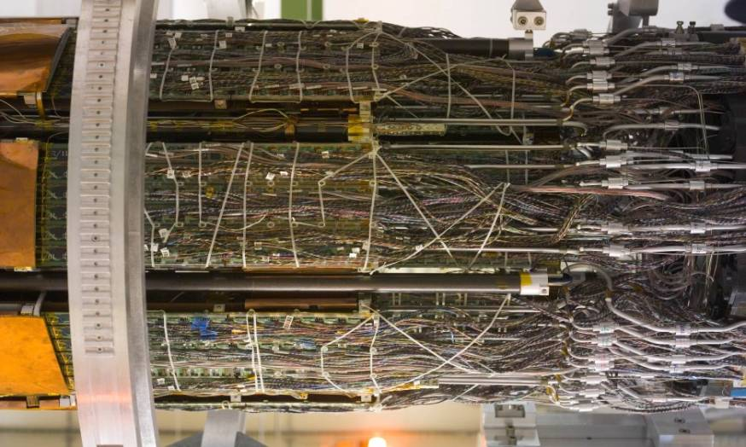
Light Al flex cables
ATLAS pixels stave services are composed of
  Module flex (Cu lines) + passive comp → 0.38% X0
  Pigtail → 0.05% X0
  Connector + PCB → 0.16% X0
  Type0 cables (Cu lines) → 0.28% X0
Type 0 cable
ATLAS pixel detector stave services
Lighter alternative for services in active area: flex cables with Al traces
  X0(Al) factor 6 smaller than X0(Cu)
  Connection can be done via wire bonds or tab bonding, no need for connectors
For IBL → stave services with Al flex

Slide 13
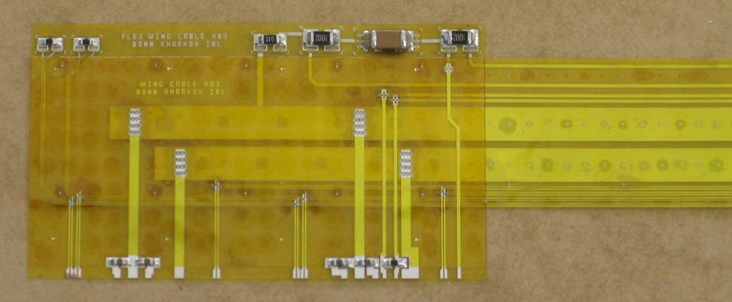
Al flex for IBL
A stack of single sided Al flex running on the back of the stave
Connection to the modules is done via wings, tab bonded to the flex
TAB bonds between wing and flex
Flex
Flex
FE
sensor
wing
module flex
Wing w/ passive components
Thickness = 70µm
Width = 16mm
wire bonds
Module flex + pass. comp → stay 0.38% X0 → 0.27% X0
Connector + PCB → wire bonds 0.16% X0 → negligible
Pigtail → wing 0.05% X0 → 0.01% X0
Type 0 cables → Al Flex 0.33% X0 → 0.12% X0 0.92% X0 → ~0.40% X0

Slide 14
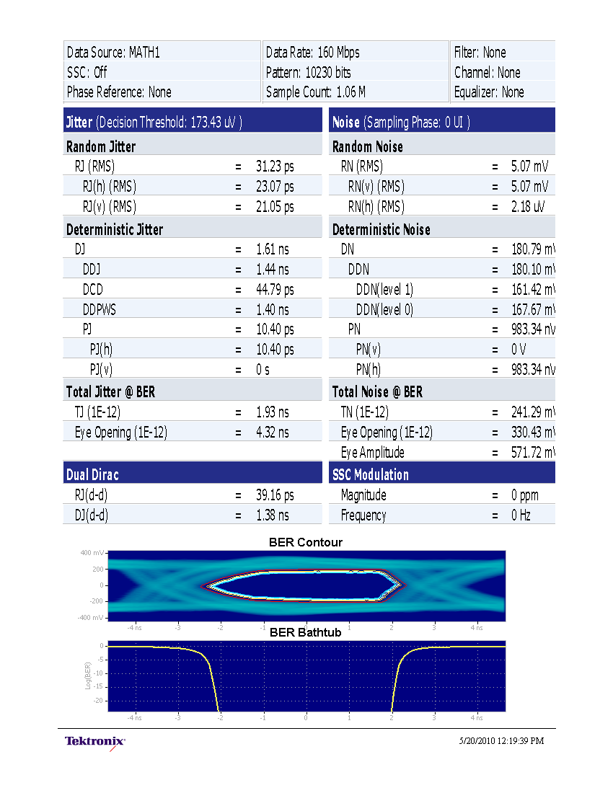
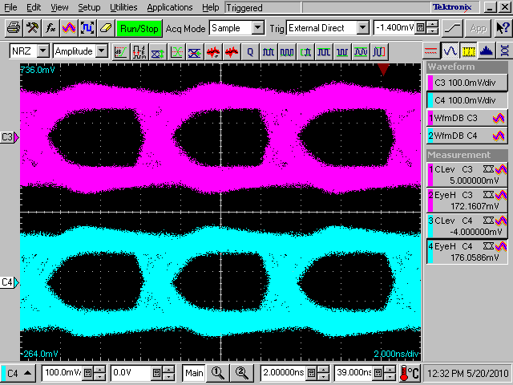
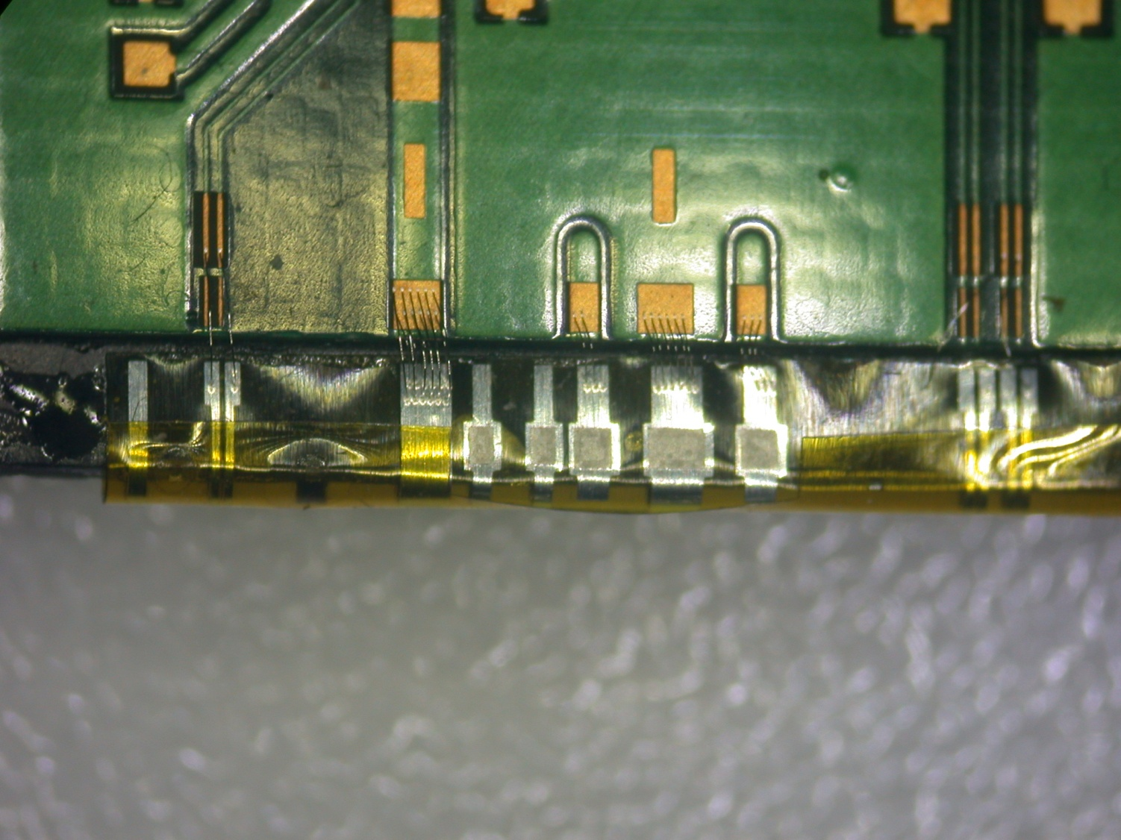
Electrical and mechanical tests
Eye diagram for signal on flex and 6m Type1 cables:
160Mbps, 8b10b encoded prbs
Eye amplitude ~570mV → OK
Total jitter 4.32ns → OK
Bending tests (preliminary)
Bending radius 0.5mm
No cracks visible → OK
PCB
0,5mm
CC structure
1mm
Electrical and mechanical tests on first Al flex prototypes for IBL show good performance.
Final prototype design targeting IBL stave services specs is being designed.

Slide 15
Module concepts with TSV
TSV is a 3D interconnection technique that allows routing of signals on the FE backside → direct connection of service flex on FE backside (via wire bonding for instance)
  Less material: no need for wings, module flex, connectors
    Using the IBL as an example (note: TSV will not be used for the IBL!): Al flex + wire bonds + pass. comp.: ~0.13%X0
  Easy interconnection scheme
2 processes studied so far with IZM Berlin: Straight Side Walls and Tapered Side Walls TSVs
  Both working, tapered side walls TSVs faster process → preferred method for prototyping program
  An ATLAS pixel module with 90µm thick FE-I2 and tapered TSVs with simple backside metallization is being build at IZM Berlin
TSVs
pass. comp.
backside metal lines on FE
flex
bonding area
FE-Chip
Sensor
FE backside
View from top
pads
bonding area actually connected
flex
Stave top view
Single chip modules
(… from End of Stave …)
(cont…)

Slide 16
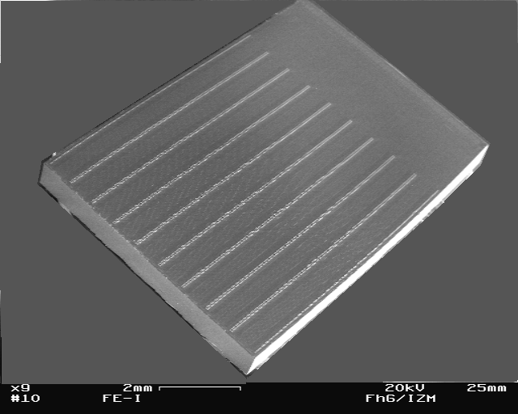
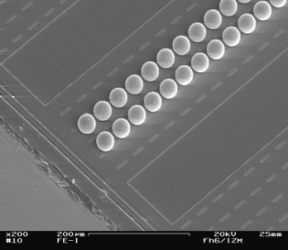
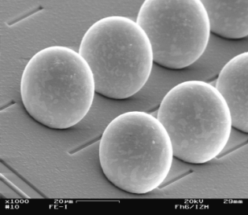
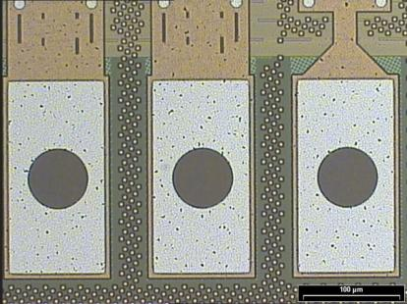
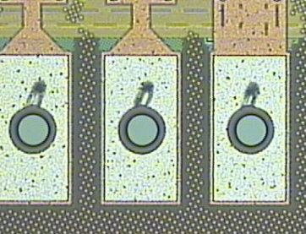
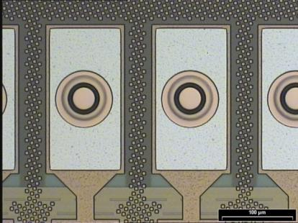
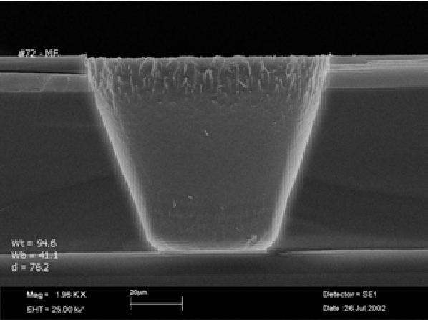
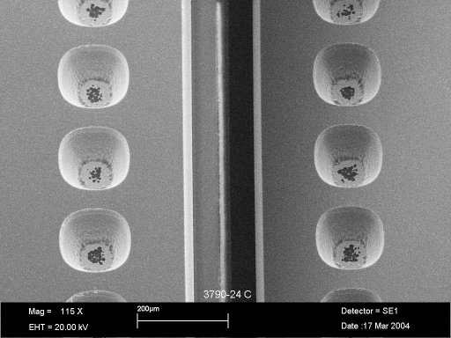
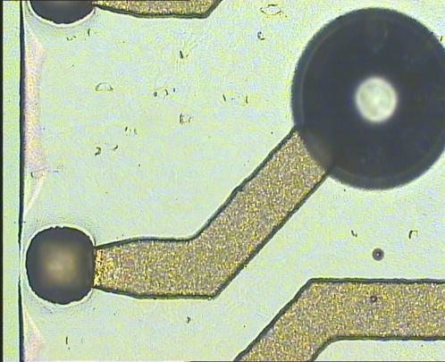
Tapered TSVs processing on ATLAS FE-I2
Front side processing
Bump deposition and dicing
Al pad opening by wet etching
BEOL SiO2 stack etching
Cu electroplating – interconnection plug to Al pad
Final step
Done
Back side processing
Thin chip!
90µm
Tapered side walls TSV
Backside redistribution
Ongoing
Process demonstrated on Monitor- and ATLAS FE-I Wafer → Prototyping of an ATLAS pixel module with 90µm thin FE-I2, Tapered TSVs, and simple backside metallization is ongoing with IZM Berlin. First samples expected in 04/2011

Slide 17
Conclusions and Next Steps
Possible ways of reducing material budget in trackers for HEP experiments at high luminosity are studied in Bonn, namely
  Thin chips
  Serial powering
  Al flex cables & TSV
The feasibility of all methods has been demonstrated and they are now entering the final prototyping phase
Case study: upgrades of the ATLAS pixel detector
  Thin chips: FE x/X0% = 0.54% X0 (400µm) → 0.12% X0 (90µm)
  Serial powering:
    on stave: LV cables x/X0% SP ≤ 15% LV cables x/X0% DC-DC
    Type1 services: LV cables x/X0% SP ≤ 25% LV cables x/X0% DC-DC
  Al flex (+TSV): stave services @LHC = 0.92% X0 → @IBL = ~0.40% X0 (~0.13% X0)

