Slide 1
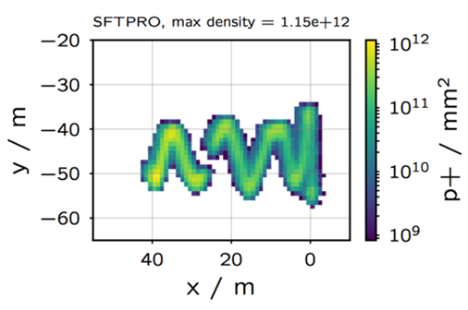
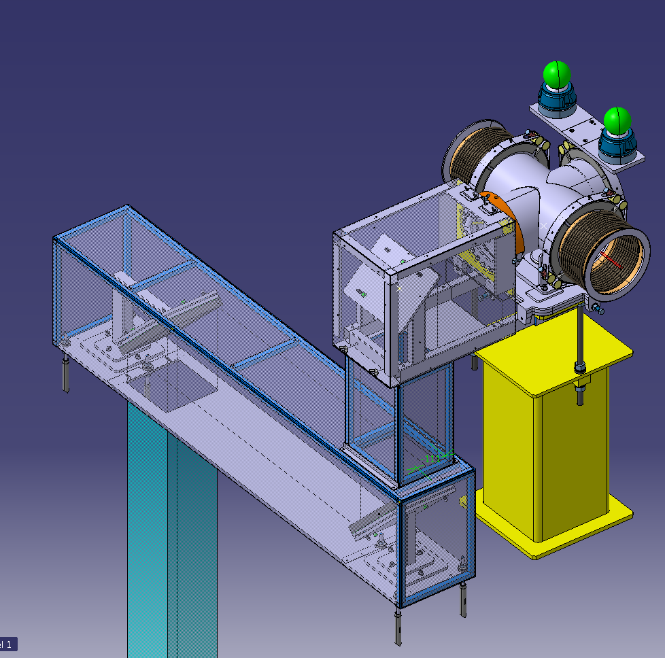
SBDS – BTV readiness
2020_02_17 S. Burger BI-PM
Example of an image of a beam dilution as expected to be captured by the BTV system
Content
Vacuum parts
Optical line
Detector shielding
Electronics
Software
Layout of the SBDS BTV system

Slide 2
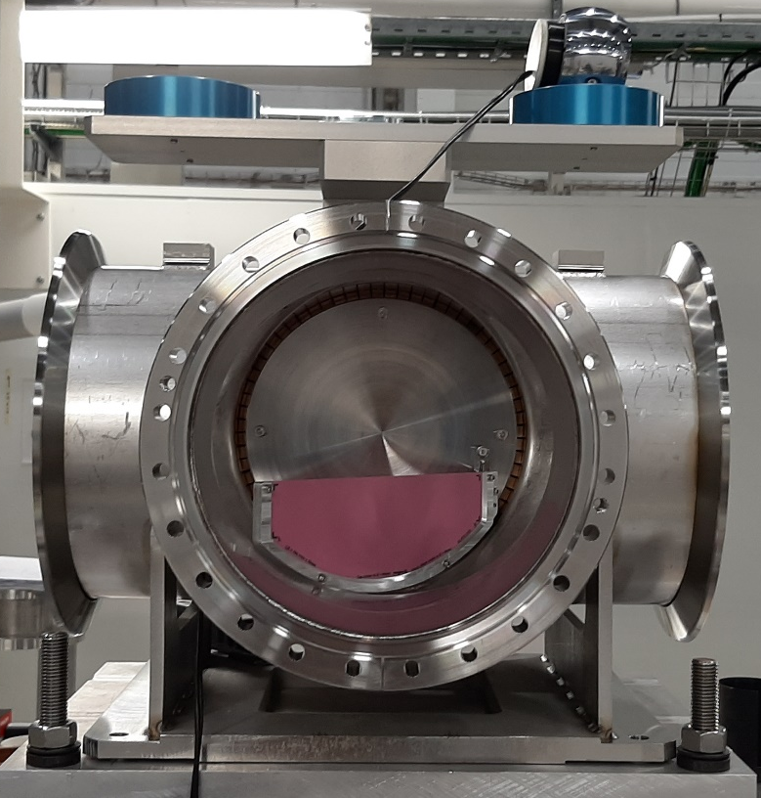
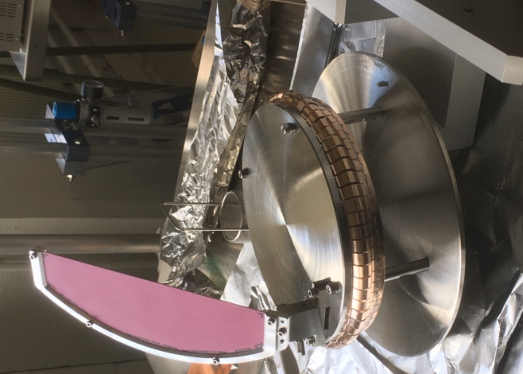
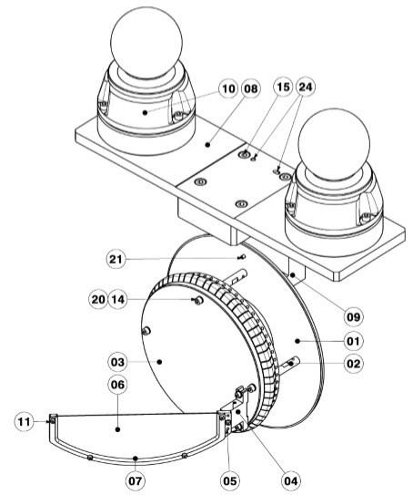
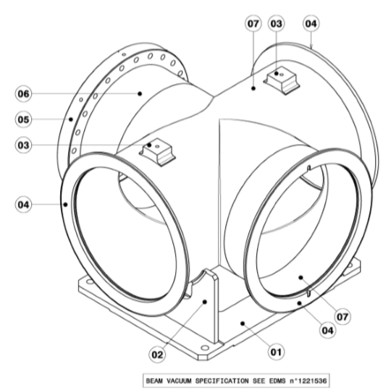
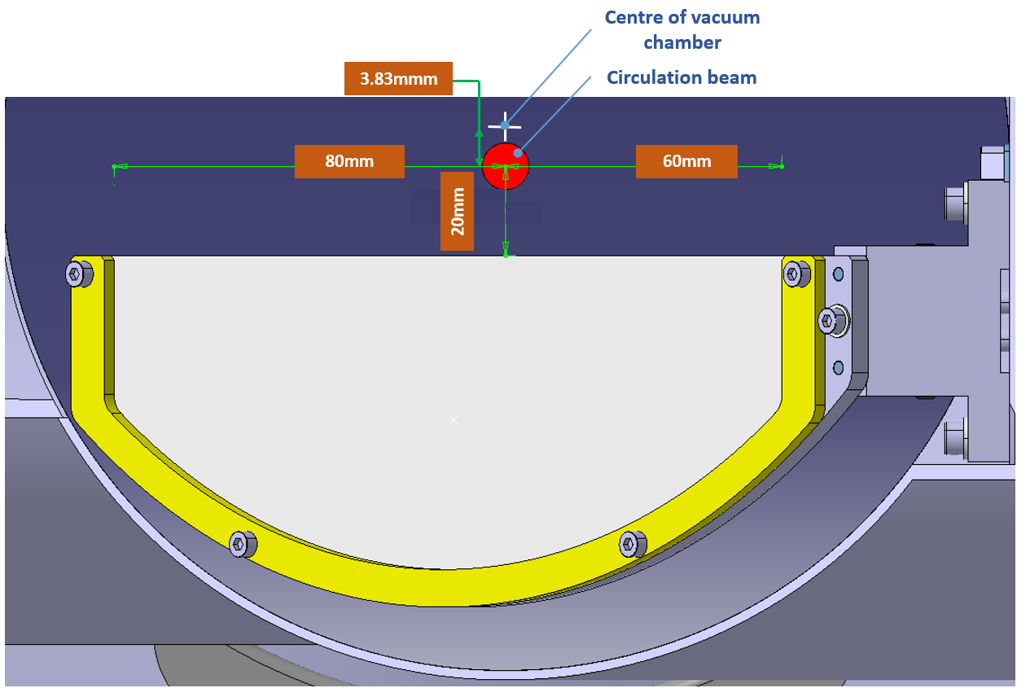
Vacuum parts
2x Instrumentation Ready – 1 aligned
1x vacuum chamber Ready for Impedance then vacuum acceptance test
2x viewport DN250 Received and VAC test OK
Screens Received, calibration marks done
Initial planning OK
Vacuum acceptance test foreseen in March 2020
Installation ~June 2020
3D design of the SBDS BTV vacuum chamber
Screen alignment phase of the SBDS BTV
3D drawings of the SBDS vacuum chamber and BTV isntrument

Slide 3
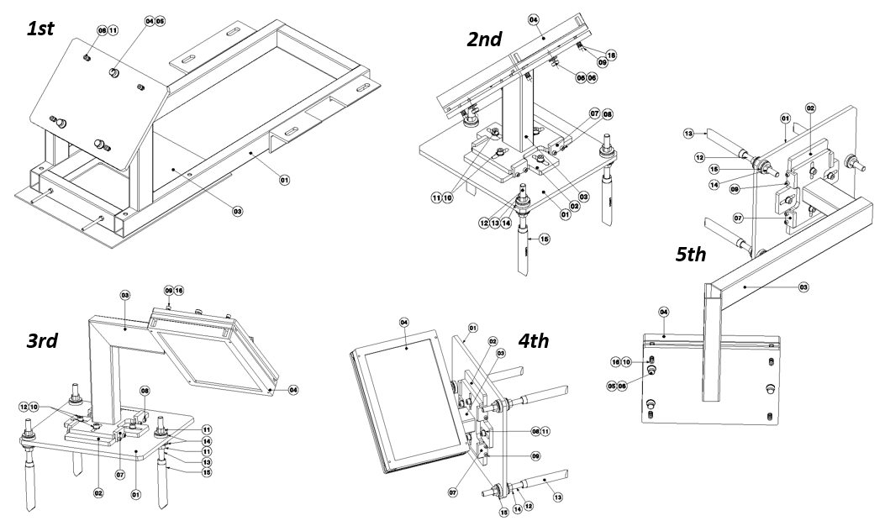
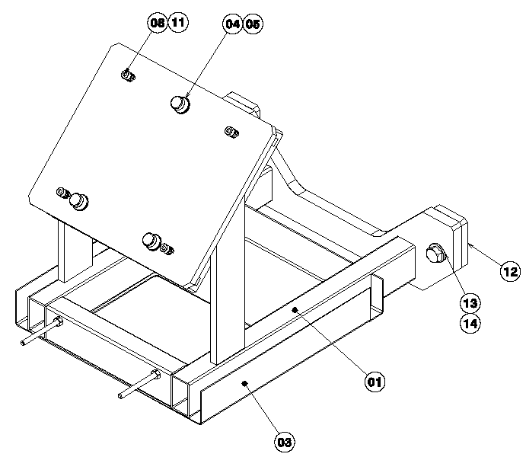
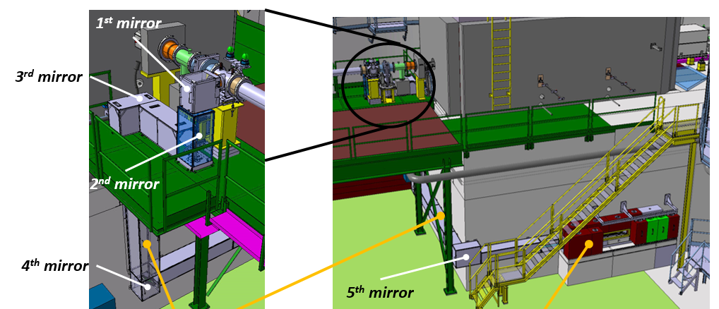
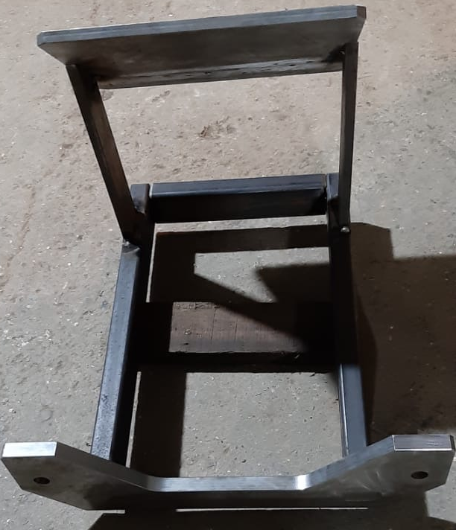
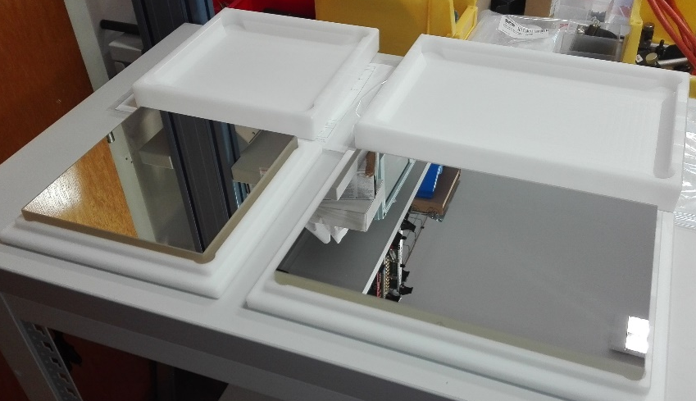
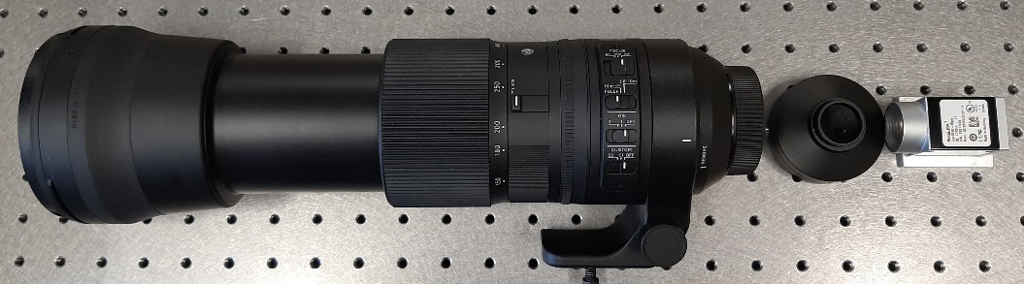
Optical line
1st
3D models of the SBDS BTV optical lines
5x High quality mirrors are already at CERN
Mirror supports and covers at CERN by March 20
Camera and F600mm camera lens ready
Initial planning OK
Installation ~June 2020
3D modeles of the mirrors + supports
F600mm camera lens with the BASLER camera to be used on the BTVD
Mirror supports fabrication ongoing in India
High quality (lambda/5) mirrors

Slide 4
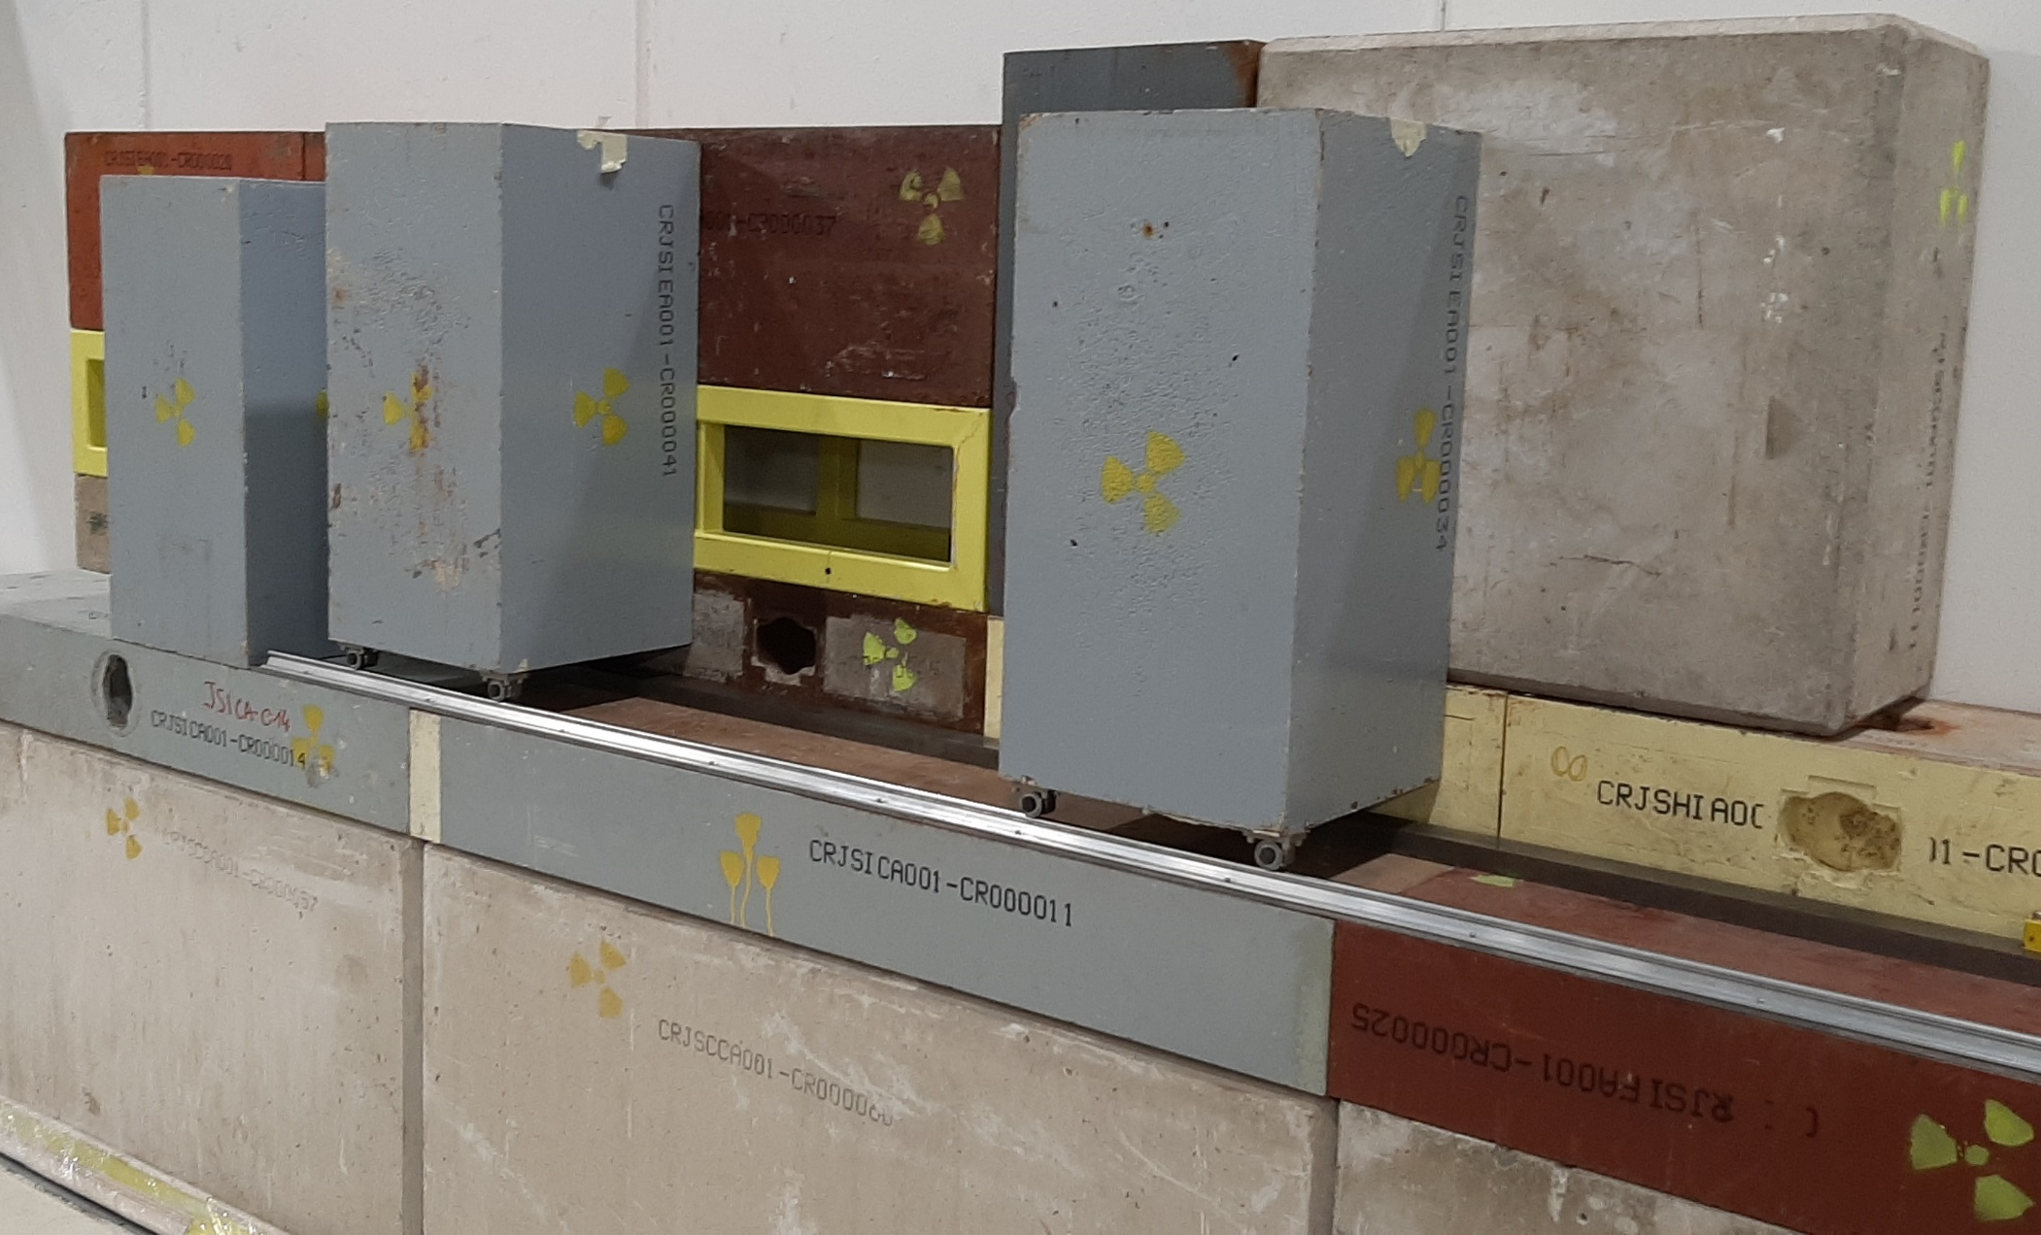
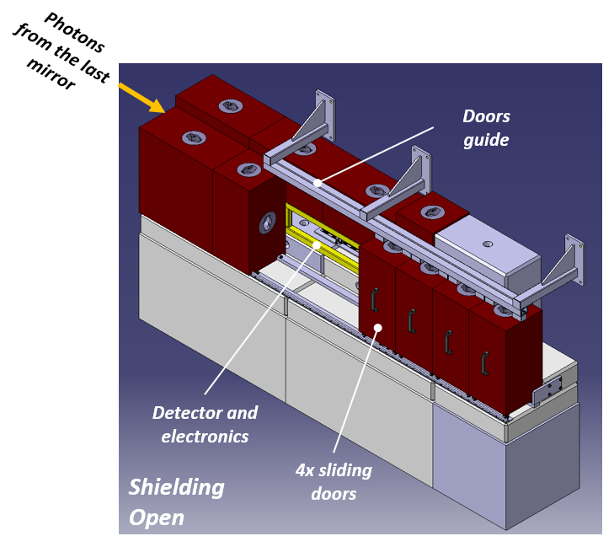
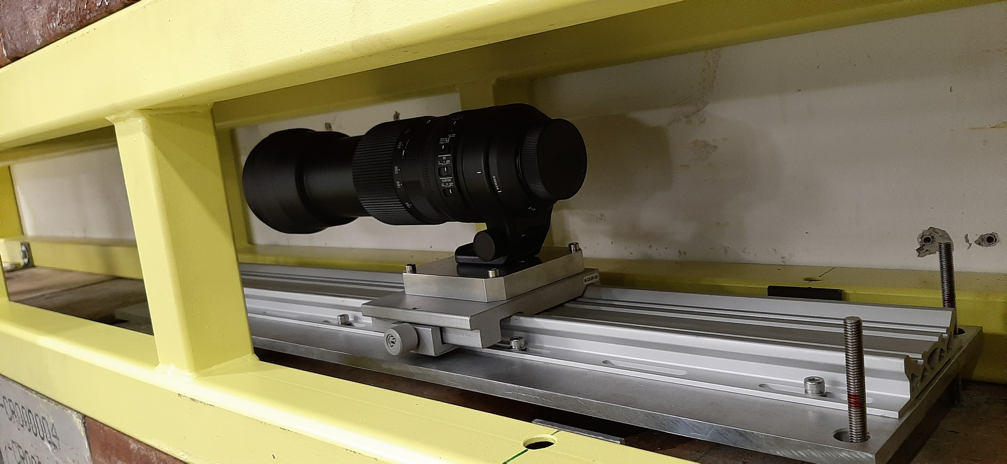
Detector Shielding
Mockup actually finalized in 867.
Available very soon for delivery @ BA5
Installation foreseen in June 20 but could probably be anticipated if needed
SBDS BTV detector shielding mockup installation in B867
SBDS BTV detector shielding 3D design
F600mm camera lens with the BASLER camera installed inside its shielding

Slide 5
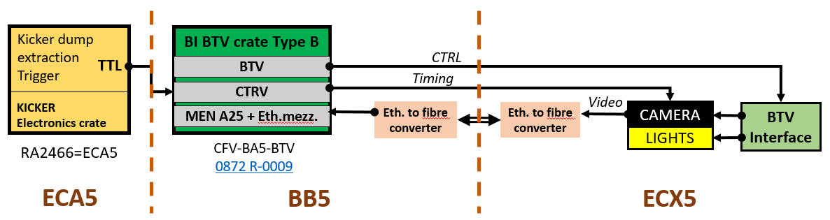
ELECTRONICS
SBDS BTV detector shielding 3D design
Hardware in available.

Slide 6
SOFTWARE request
SPS BTVD
------------
Camera acquisition in free running mode, exposure 20ms -> rate 50Hz.
Timing trigger should freeze N images before the trigger event and M after (pre and post triggering).
Algorithm should scan the images and publish the best one (based on max signal amplitude just below saturation), the index of the published image should be published together with the image.
All N + M images should be available (GET with the index) until the next acquisition (then overwrite).
To be defined what to store in the PM, where to store it and by whom. (from ABT?) Detection of camera failure, interlock? (ABT).
For debug/test purposes it would be nice to have the possibility to dump all the acquired images on a disk on request. Also there should be some mechanism of freezing all the images and interlock the SPS injection in a PM like fashion, but this should be specified by the relevant groups.

Slide 7
IST / HWC
IST / HWC foreseen in July (following installation)
→ Need to test trigger from kicker as well
Reminder: beam time needed to setup the instrument parameters
Nominal setup: high intensity beam (critical)
MD setup for low intensity beam

