Slide 1
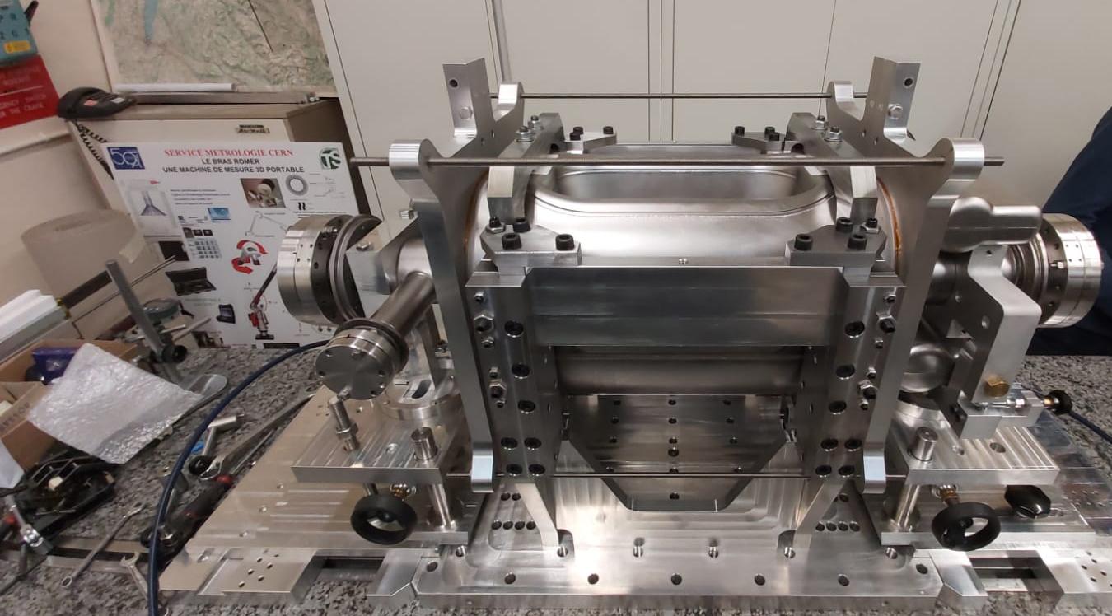
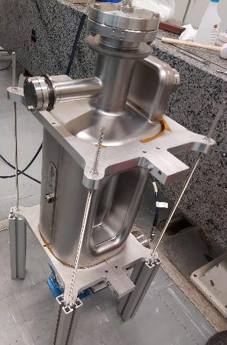
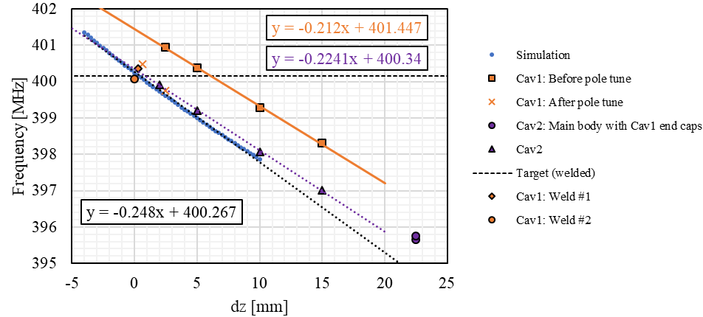

Fundamental Mode
Vertical setup
Horizontal setup
Welded freq = 400.052 MHz (-108 kHz from predicted). Welding caused frequency decrease
RFD1
RFD2
Vertical setup was easier and gave better $Q_{L}$ values

Slide 2
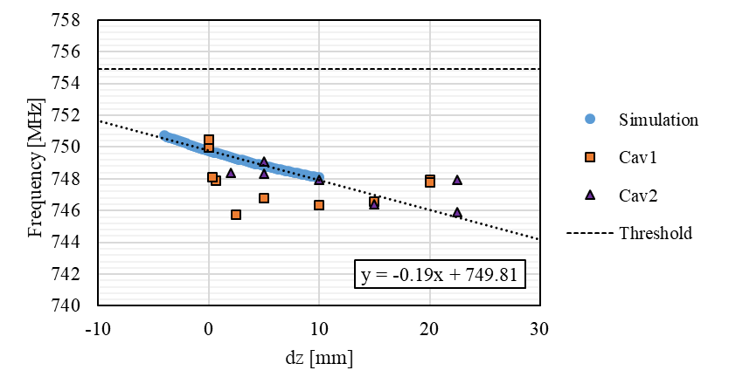
HOMs
Monitored 5 high order modes
QL of 760 MHz mode very low during trim tuning. Recovered after welding
Welded

Slide 3
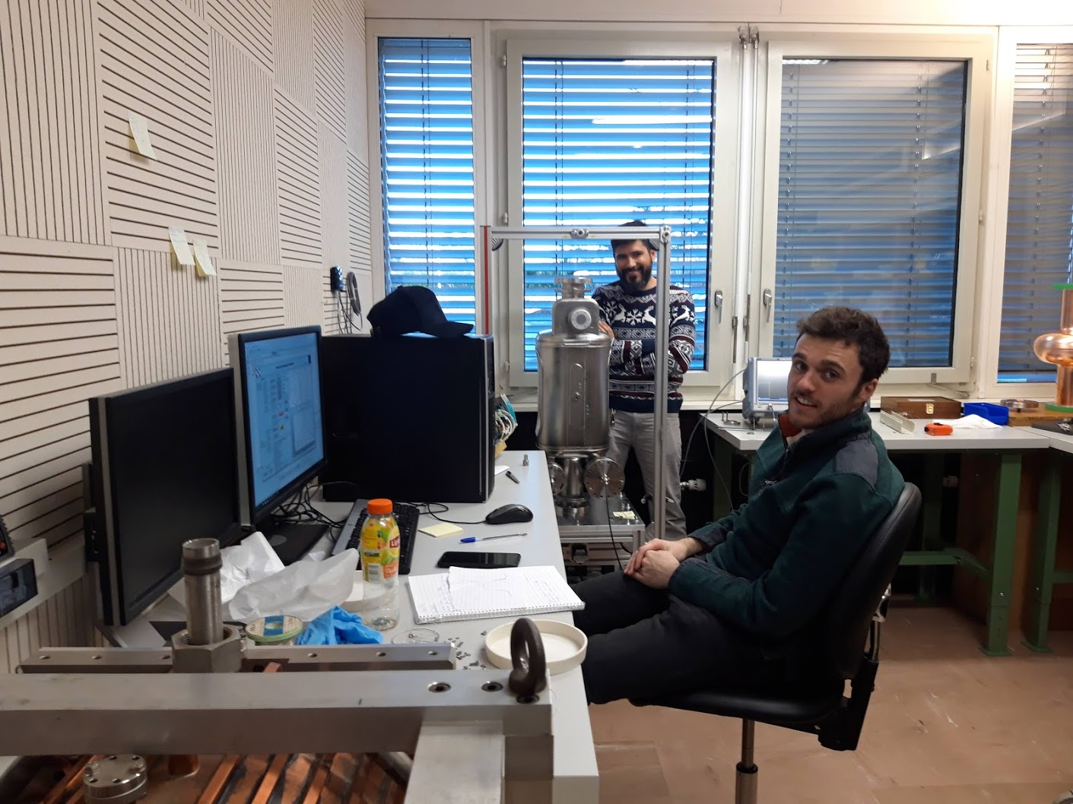
Beadpull RFD1
Performed grid & polar scans with metallic needle and metallic sphere. Dielectric needle grid scan but with noisy data (analysis ongoing)

